Slide 1
Reproductive & Developmental Science Module 2 Reprogramming of somatic cells to pluripotency
Wei Cui
Stem Cells Differentiation Laboratory
IRDB, Faculty of Medicine

Slide 2
Topics
Concept of reprogramming.
Current somatic cell reprogramming technologies.
Reprogramming and regenerative medicine.

Slide 3
Topics
Concept of reprogramming.
Current technologies used for somatic cell reprogramming.
Reprogramming and regenerative medicine.

Slide 4
Development
Cell differentiation during development gradually limits their developmental potency.
Zygote
trophectoderm
Blastocyst
ICM
Ectoderm
Mesoderm
Endoderm
Germ cell

Slide 5
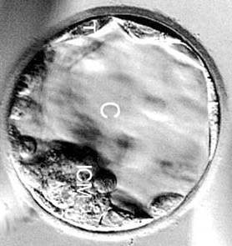
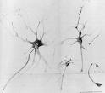
Gene Expression
Oct4, Nanog, Sox2, (+)
NeuroD, AFP, mActin (-)
Neural Ectoderm
Mesoderm
Endoderm
MAP2, NeuroD,
Oct4, Albumin, MHC
MHC, Troponin I,
Oct4, NeuroD, Albumin
Albumin, ApoF
Oct4, NeuroD, MHC
Epigenetic Regulation

Slide 6
Epigenetic Regulation
Chromatin and DNA modifications, no changes in DNA sequence.
Regulate gene expression pattern without changes in DNA sequence.
Play a role in the process of cellular differentiation and responsible for cells to maintain different characteristics.
Notes:
chromatin and DNA modifications that are stable over rounds of cell division but do not involve changes in the underlying DNA sequence of the organism. These epigenetic changes play a role in the process of cellular differentiation, allowing cells to stably maintain different characteristics despite containing the same genomic material.

Slide 7
Reprogramming
Epigenetic changes are potentially reversible.

Slide 8
Epigenetic Memory during Development
Embryonic
Gene
Expression
Differentiated
Gene
Expression
Development
Pluripotent
Multipotent
or unipotent

Slide 9
Reprogramming: Erasure of Epigenetic Marks
Embryonic
Gene
Expression
Differentiated
Gene
Expression
Reprogramming
Pluripotent
Multipotent
Reversal of a differentiated cell to one with characteristic of an undifferentiated embryonic state.
Modified from http://www.anatomy.uiowa.edu/PAGES/directory/faculty/leno.htm

Slide 10
Topics
Concept of reprogramming.
Current somatic cell reprogramming technologies.
Reprogramming and regenerative medicine.

Slide 11
Current Technologies
Somatic Cell Nuclear Transfer (SCNT)
Fusion with embryonic stem cells.
Reprogramming with defined factors.

Slide 12
Current Technologies
Somatic Cell Nuclear Transfer (SCNT)
Fusion with embryonic stem cells.
Reprogramming with defined factors.

Slide 13
Somatic Cell Nuclear Transfer (Cloning)
Animals
Donor cell
Reproductive cloning
Injection
Surrogate mother
Activation
Culture
Oocyte
Enucleation
Therapeutic cloning
Isolation of ES cells
Differentiating to somatic cells

Slide 14
First Cloned Animal
The first cloned animal was tiny tadpoles. Robert Briggs and Thomas King used cells from a tadpole embryo to create identical ones.
Briggs, R. & King, T. J. (1952) Proc. Natl. Acad. Sci. USA 38, 455-463.

Slide 15
First NT and First SCNT
First NT is carried out in 1958.
Fishberg, M., Gurdon, J. B., & Elsdale, T. R. (1958) Nature 181, 424.
First SCNT animal was produced by John Gurdon at Oxford University in 1962 from Xenopus Laevis.
Gurdon, JB (1962) J Embryol Exp Morphol 10: 622.
Notes:
Briggs and King failed to produce clones from aged cells.
It’s impossible to produce a clone from the nucleus of an adult cell.

Slide 16
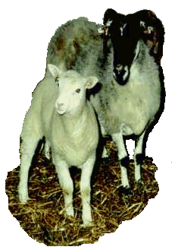
First SCNT Mammals
Dolly, the sheep is the 1st cloned mammal from somatic cells in 1996.
Wilmut et al. (1997) Nature 385:810-3

Slide 17
Implication of Cloning Dolly
Provide evidence of reversible epigenetic changes in mammals.
A new avenue of production of ES cells having identical genetic information as a somatic cell.
http://www.roslin.ac.uk/imagelibrary

Slide 18
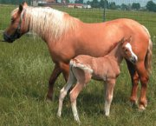
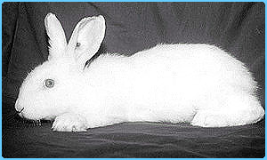
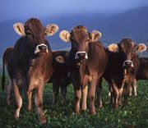
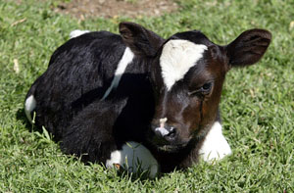
Cloned Animals

Slide 19
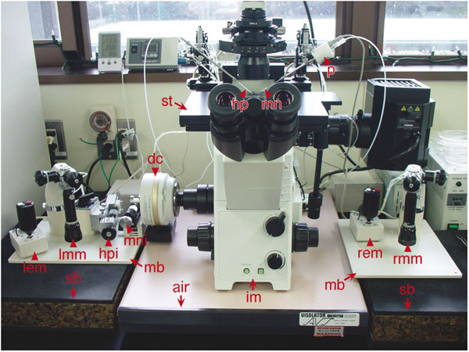
Manipulators

Slide 20
Mechanic Factors
Extensive micromanipulations of oocyte and somatic cells.
Exposure to noxious chemicals.
Loss of 10-15% of ooplasm during enucleation.
Confirmation of enucleation-expose to UV.
Activation of the cloned embryos.

Slide 21
Epigenetic Factors
Type, age of nuclear donor cells.
Degree of epigenetic reprogramming achieved.
Degree of demethylation achieved.
Chromatin remodeling

Slide 22
Dolly’s Death…..
Loss of Dolly attributed to a
progressive lung disease, usually
found in older sheep(13-14
years). She was 6 years old. So
was it premature aging?
Some facts:
Dolly's DNA from an ewe of 6 years.
Was born 6 year sheep?
http://www.roslin.ac.uk/imagelibrary

Slide 23
Current Technologies
Somatic Cell Nuclear Transfer (SCNT)
Fusion with embryonic stem cells.
Reprogramming with defined factors.

Slide 24
Reprogramming by Fusion with Embryonic Stem Cells
Transduction with Puror virus
Chemical cell fusion
Co-select for cell-hybrid
2n
2n
Pluripotent
Transfection with GFP Hygror construct
4n
2n
2n
Cowan et al, Science 2005, 309:1369-1373

Slide 25
ESC-Fused Hybrid
Able to proliferate and form colonies.
Express Oct4.
Differentiate into three germ layers in vitro.
Expression profile similar to ESCs.
Tetratploid.
Don’t know full differentiation potential.
Tumorigenesis?

Slide 26
Current Technologies
Somatic Cell Nuclear Transfer (SCNT)
Fusion with embryonic stem cells.
Reprogramming with defined factors.

Slide 27
Reprogramming by Defined Factors
Hypothesis: Certain factors capable of maintaining ESCs pluripotency can also reprogramme differentiated cells.
Questions:
What are they?
How to prove them?

Slide 28
Reprogramming by Defined Factors

Slide 29
Generating Reporter Cells
Pluripotent gene
Pluripotent gene
X
βgeo
βgeo
MEF
Retroviral infection
&
G418 selection
ψ
5’ LTR
cDNA
3’ LTR

Slide 30
Defined Factors for iPS Cells
Induced Pluripotent Stem Cells
Oct4: Transcription factor, pluripotent marker.
Sox2: Transcription factor Sox B family member.
C-myc: Pro-oncogene.
Klf4: Transcription factor, associated with cancer.

Slide 31
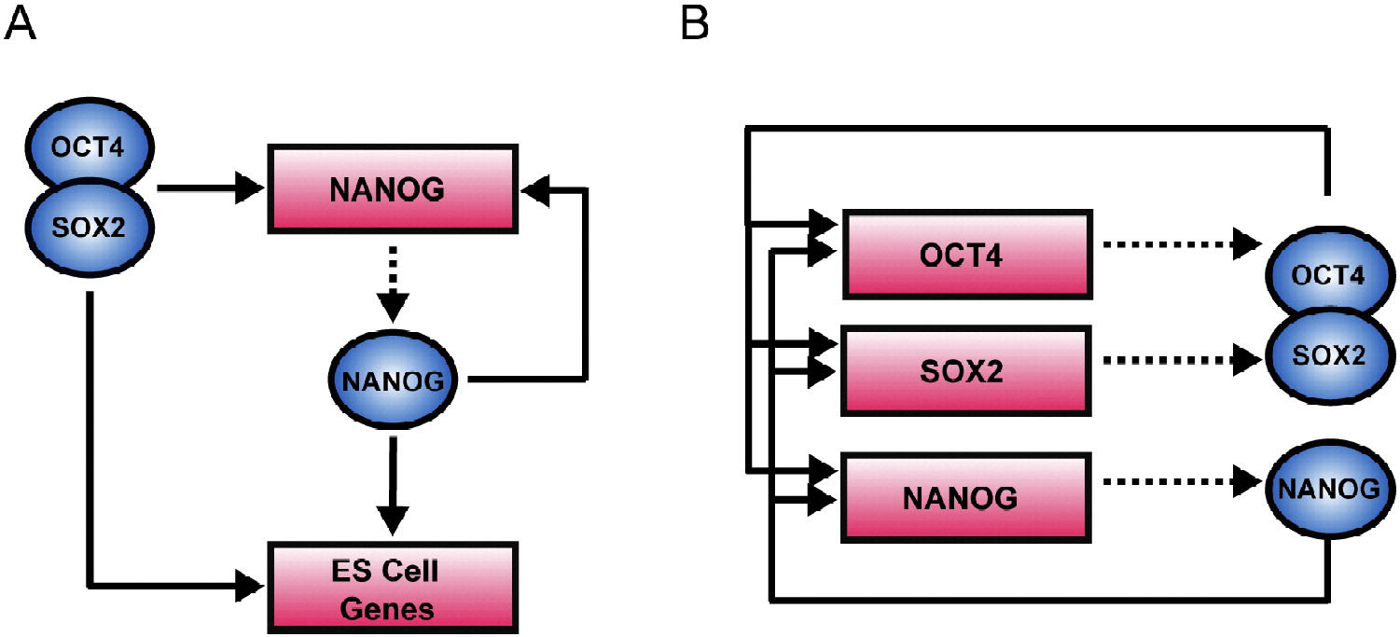
Core Transcriptional Regulatory Circuitry
Lineage
TF
Boyer et al (2005) Cell 122:947

Slide 32
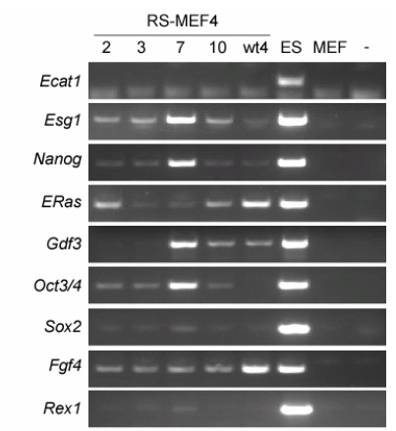
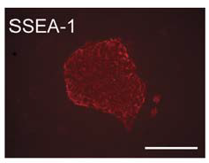
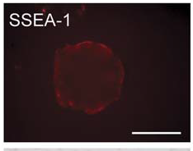
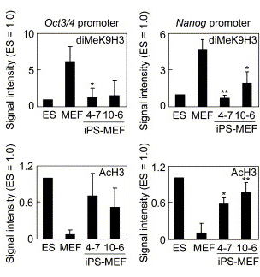
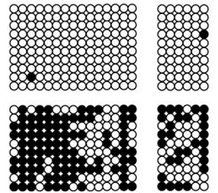
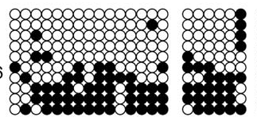
Characterisation of iPS Cells
ESC
iPSC
MEF
Oct4
Nanog
ESC
Oct4
Nanog
MEF
iPSC

Slide 33
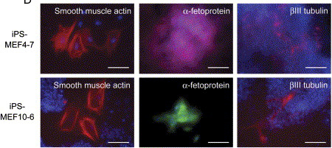
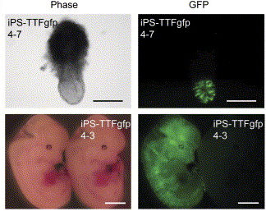
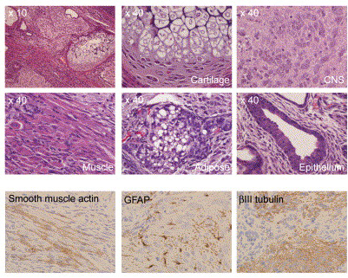
Characterisation of iPS Cells

Slide 34
Characteristics of mouse iPS Cells
Morphology: ESC-like colonies.
Express ES cell markers.
Similar epigenetic signatures as ES Cells.
Differentiate to all three germ layers in vitro.
Form chimeras when inject into blastocyst.
Some iPS cells are able to produce animals when injected into tetraploid blastocysts

Slide 35
Reprogramming Human Fibroblast Cells to iPS Cells
Oct4, Sox2,
C-myc, Klf4
Takahashi et al, Cell 2007 131:867-872
Oct4, Sox2
Nanog, Lin28
Yu et al, Science 318:1917-1920

Slide 36
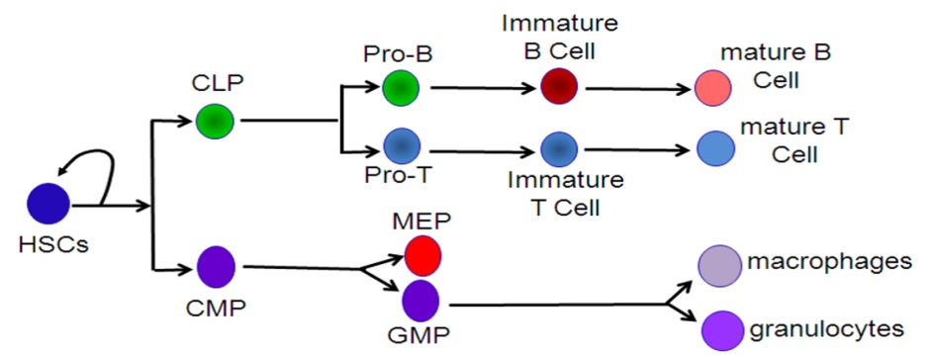
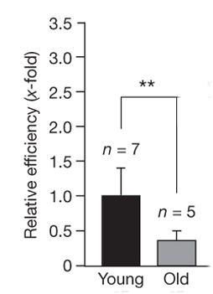
Epigenetic Memory & iPSCs (cell status)
Differentiation
Age
(2 mth)
(2 yrs)

Slide 37
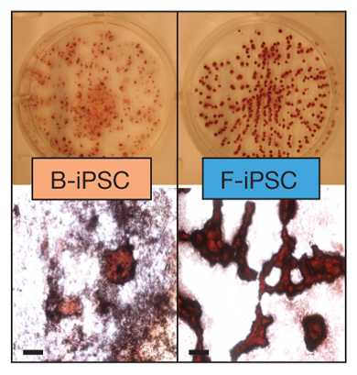
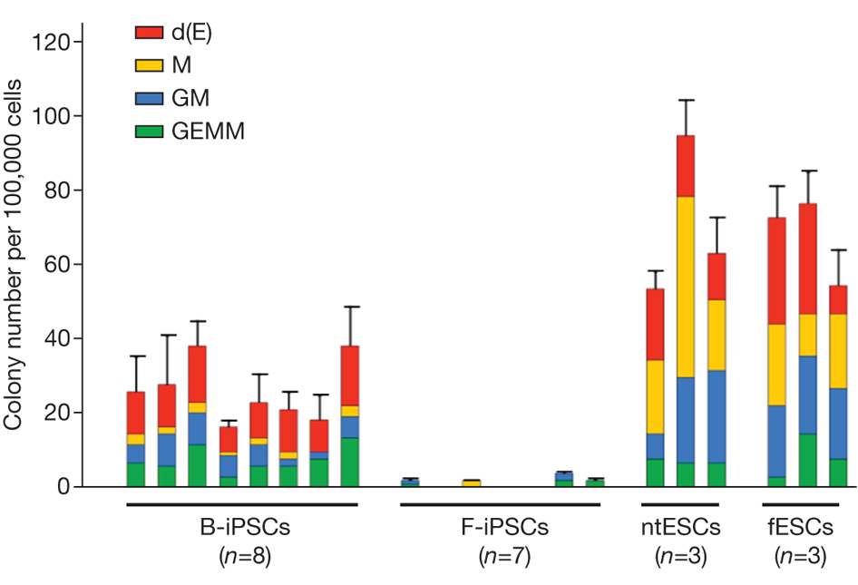
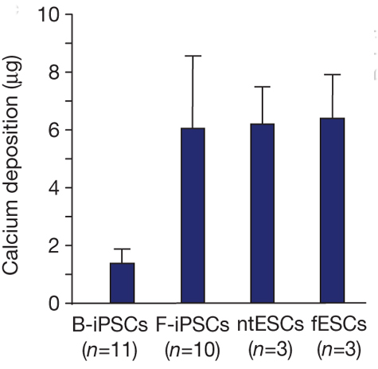
Epigenetic Memory & iPSCs (cell type)
Haematopoietic differentiation
Bone differentiation
Kim et al (2010) Nature 467:285

Slide 38
Topics
Concept of reprogramming.
Current technologies used for somatic cell reprogramming.
Reprogramming and regenerative medicine.

Slide 39
SCNT and Regenerative Medicine
Overcome immune rejection.
Able to produce all cell types required.
Ethical issue.
Low efficiency.
Mitochondrial DNA

Slide 40
iPS and Regenerative Medicine
No ethical issue.
No immune rejection.
Able to differentiate into all cell types.
Low efficiency (particularly with older cells).
May have differentiation preference.
Viral transduction (in progress to overcome).
Oncogene.

Slide 41
Future Prospects
Understand basic biology underlie reprogramming.
Non-‘genetic’ method to reprogramme epigenetic status.
No exogenous DNA integration into the genome (mRNA, protein).

Slide 42
Learning Objectives
Understand implication of reprogramming in basic biology and regenerative medicine.
Able to describe how to identify successful generation of iPSCs.
Able to identify factors that affect somatic cell reprogramming.

Slide 43
References
Jaenisch & Young Stem cells, the molecular circuitry of pluripotency and nuclear reprogramming. Cell 2008 132:567-582.
Takahashi et al. Induction of pluripotent stem cells from mouse embryonic and adult fibroblast culture by defined factors. Cell 2006 126:663-678.
Yu et al. Induced pluripotent stem cell lines derived from human somatic lines. Science 2007 318:1917-1920.
Stadtfeld & Hochedlinger Induced pluripotency: history, mechanisms, and applications. Gene & Dev 2010 24:2239-2263.
Hanna et al., Pluripotency and cellular reprogramming: facts, hypotheses, unresolved issues. Cell 2010 143:508-525

