Slide 1
Human pregnancy overview (lectures 1 & 2)
Mark Sullivan

Slide 2
Sources
Langmans Medical Embryology: TW Sadler (Lippincott).
The Developing Human: Moore and Persaud (Elsevier).
Essential Reproduction: Johnson & Everitt (Blackwell Scientific Pubs).

Slide 3
Human pregnancy
Mother
Baby (infant, embryo, fetus, conceptus)
Placenta

Slide 4
Human pregnancy
0
13
26
39
Maternal changes - throughout
Embryo Fetus Viability Term
Placental changes – complex, mostly first half
There are 3 trimesters of pregnancy
They were not defined by science, but are based on experience

Slide 5
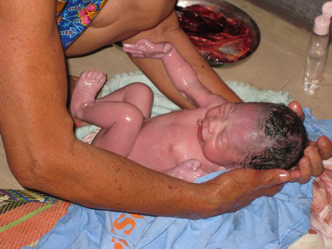
http://article.wn.com/view/2009/05/16/Natural_childbirth_tip_have_a_birth_plan/

Slide 6
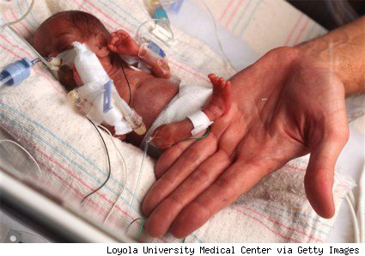
http://www.politicsdaily.com/2010/01/02/preemies-health-care-reform-and-the-cost-benefit-conundrum/

Slide 7
Human pregnancy
What happens in the mother?

Slide 8
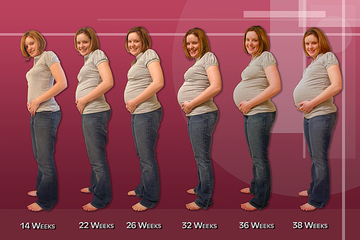
Mother (summary)
http://miracleinthewomb.com/wp-content/uploads/2011/09/First-Trimester-Of-Pregnancy-mom
http://www.sharedpregnancy.com/pregnancy-symptoms/staying-fit-during-pregnancy-tips-for-each-trimester/

Slide 9
Human pregnancy
Maternal changes
Increased weight
Increased blood clotting tendency
Decreased blood pressure
Decreased brain size (very slight!!)
Altered hormones
Altered appetite
Altered fluid balance
Altered emotional state
Altered joints
Altered immune system

Slide 10
Human pregnancy
What happens in the baby?

Slide 11
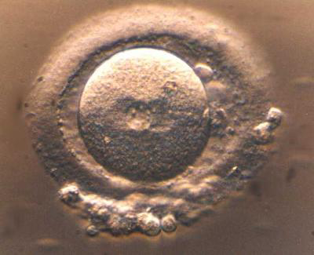
Baby (summary)
http://www.eurekalert.org/multimedia/pub/web/19315_web.jpg

Slide 12
http://www.graphicshunt.com/search/11/baby.htm

Slide 13
Human pregnancy
What happens in the placenta?
What IS the placenta??

Slide 14
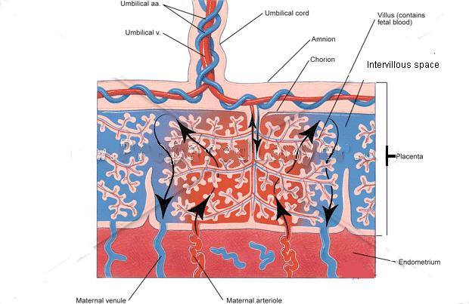

Slide 15
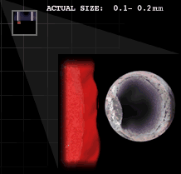

Slide 16
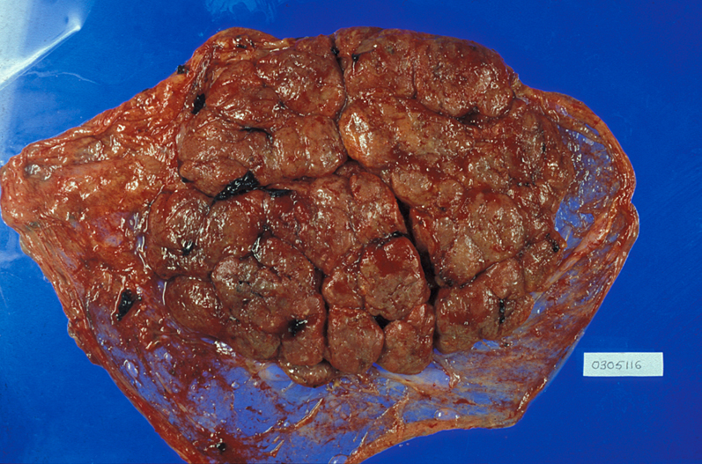

Slide 17
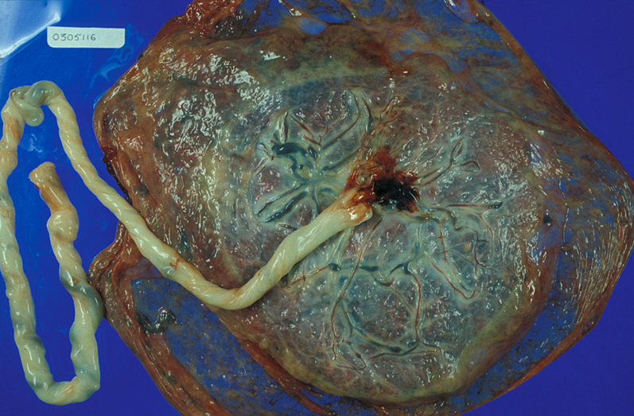

Slide 18
The perspective of the baby (a child-centered approach!)

Slide 19
Technical terms
Conceptus – everything resulting from the fertilised egg
Embryo – the baby up to week 8 (week 10)
Fetus – the baby for the rest of pregnancy
Infant – less precise, normally applied after delivery

Slide 20
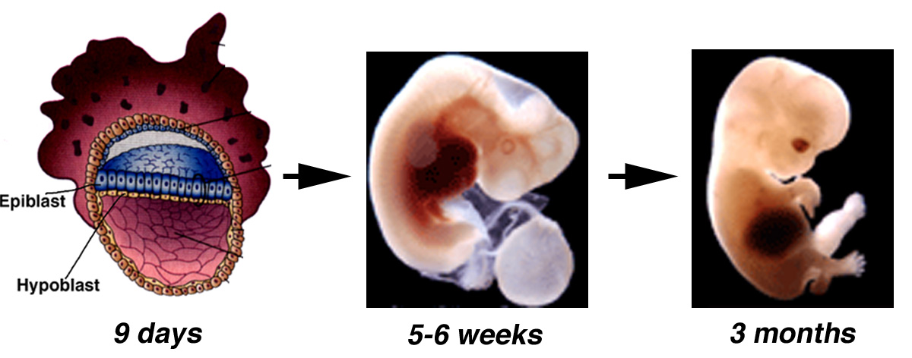
Blastocyst
Embryo
Fetus

Slide 21
http://www.graphicshunt.com/search/11/baby.htm

Slide 22
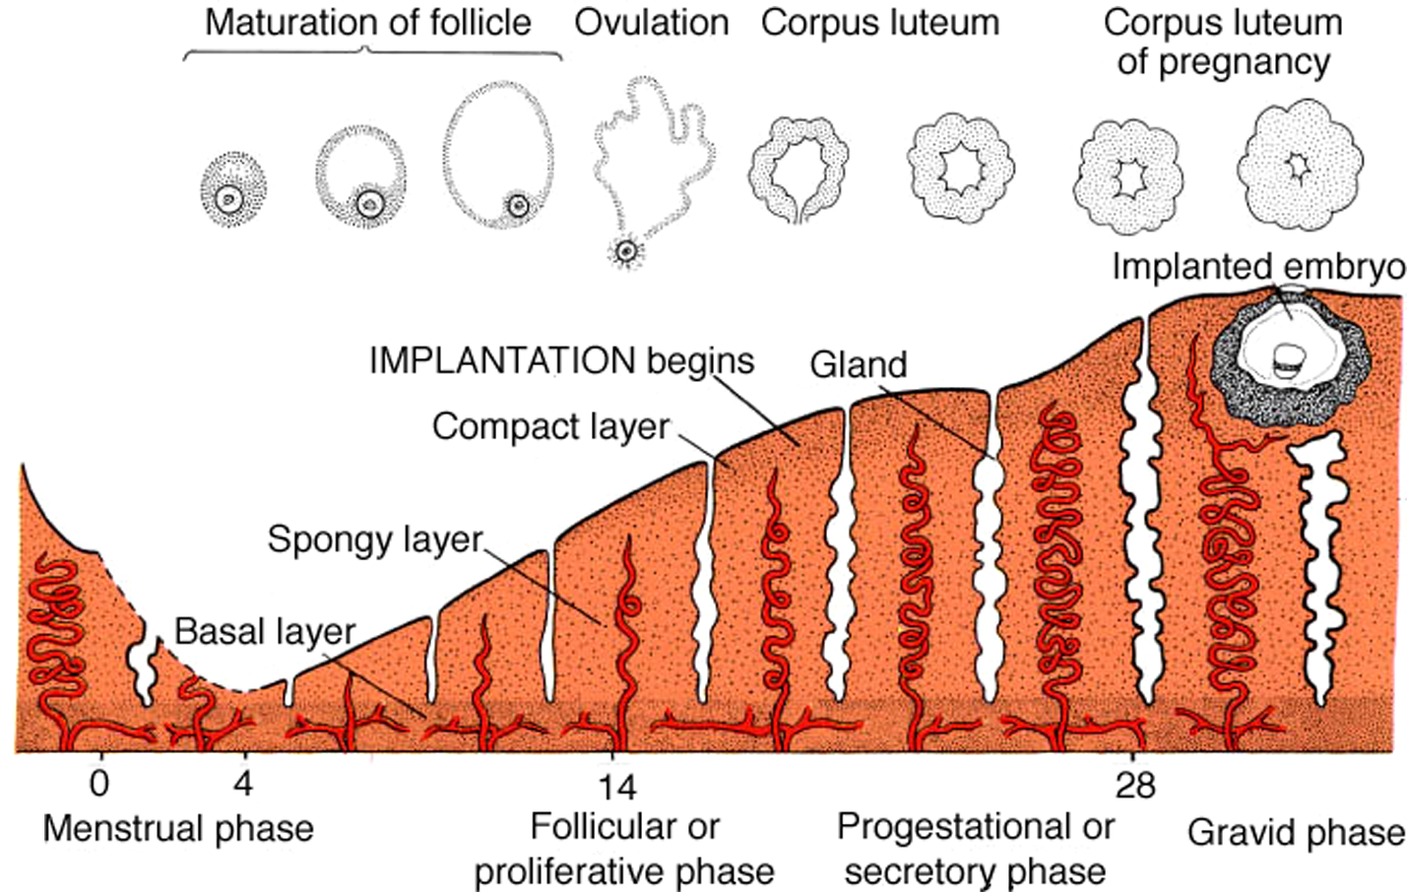
Uterine changes following fertilisation
LMP

Slide 23
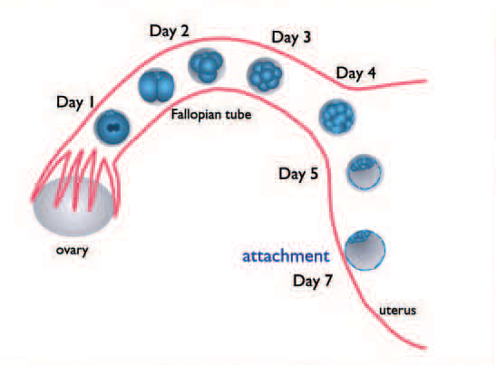
Preimplantation development

Slide 24
Early in development embryos of different species look very similar.
Fish, chick, mouse used as model genetic systems to study human diseases – as gene families used for development are similar

Slide 25
Growth
Fetal phase of development.
Weeks Length Weight
9-12 5-8cm 10-45g
50g
13-16 9-14cm 60-200g
17-20 15-19cm 250-450g
21-24 20-23cm 500-820g viability limit
25-28 24-27cm 900-1300g 1050g
29-32 28-30cm 1400-2100g
33-36 31-34cm 2200-2900g
37-40 35-36cm 3000-3400g 2100g

Slide 26
FEED ME! (Trimesters 2 and 3)

Slide 27
Blastocyst
Embryo
Fetus

Slide 28
Embryonic development
This is not a mystery, it is very simple!
Proliferation
Movement
Differentiation
Loss (apoptosis)

Slide 29
Embryonic development
This is not a mystery, it is very simple!
Proliferation (multiply cells?)
Movement (divide spatially?)
Differentiation (add functions?)
Loss (apoptosis) (subtract?)

Slide 30
Proliferation

Slide 31
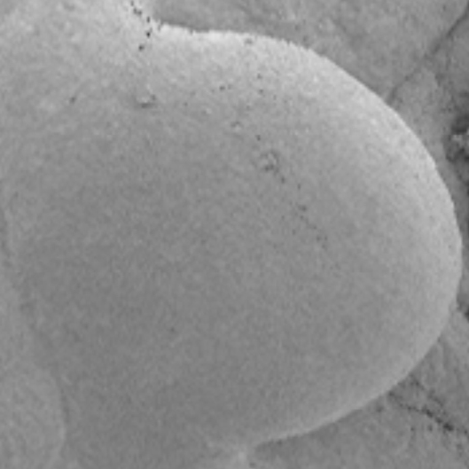
Limb bud
Part of : www.the-scientist.com/ blog/display/55439/

Slide 32
Modified proliferation

Slide 33
Movement
Chemo-attractants
Re-modelling of tissues (proteases)

Slide 34
Differentiation
Paracrine factors
Receptor expression
Loss of proliferation

Slide 35
Cell loss
Apoptosis
Regulated cell death, controlled by paracrine factors mainly.

Slide 36
Learning objectives (i)
Embryonic development.
A complex process
Achieved by the repeated application of 4 ‘simple’ processes
Involves co-ordinated application of these processes

Slide 37
First trimester
‘Week 1 (pregnancy)’
Normal menstrual cycle days 0-7
‘Week 2 (pregnancy)’
Normal menstrual cycle days 8-14
Ends with ovulation & fertilisation

Slide 38
First trimester
‘Week 3 (pregnancy)’
Week 1 of embryonic development
Pre-implantation development of conceptus
Normal menstrual cycle days 15-21
Conceptus = blastocyst
Implantation of conceptus in decidualising endometrium begins (~day 20)

Slide 39
First trimester
‘Week 4 (pregnancy)’
Week 2 of embryonic development
Abnormal menstrual cycle, no endometrial shedding (day 28) – ‘missed period’
Implantation of conceptus in decidualising endometrium MOSTLY complete by day 28
Embryo – consists of 2 layers of cells

Slide 40
First trimester
‘Week 5 (pregnancy)’
Week 3 of embryonic development
Definite ‘missed period’
Embryo – gastrulation: formation of 3 layer disc, initiation of CNS & blood vessels – 3mm
Maternal – increasing levels of progesterone from corpus luteum, increasing hCG from conceptus. Pregnancy test may be positive.

Slide 41
First trimester
‘Week 6 (pregnancy)’
Week 4 of embryonic development
Embryo – Closure of neural tube. Heart, face, arm initiated. 4mm

Slide 42
First trimester
‘Week 7 (pregnancy)’
Week 5 of embryonic development
Embryo - Face & limbs continue. (5-8mm). Isolated from maternal blood supply.

Slide 43
First trimester
‘Week 8 (pregnancy)’
Week 6 of embryonic development
Embryo - Face, ears, hands, feet, liver, bladder, gut, pancreas. (10-14mm)

Slide 44
First trimester
‘Week 9 (pregnancy)’
Week 7 of embryonic development
Embryo - Face, ears, fingers, toes. (17-22mm)

Slide 45
First trimester
‘Week 10 (pregnancy)’
Week 8 of embryonic development
Embryo - Lungs, liver, kidneys, (28-30mm)

Slide 46
First trimester
‘Week 11 (pregnancy)’
Week 9 of embryonic development
Embryonic stage now completed, referred to as fetus.
All the main structures are present; differentiation and elaboration during the next 6 months

Slide 47
First trimester
‘Week 12 (pregnancy)’
Week 10 of embryonic development
Fetus – gradual growth

Slide 48
First trimester
‘Week 13 (pregnancy)’
Week 11 of embryonic development
Fetus – 8cm / 45g

Slide 49
Development
First trimester:
2nd week Development of bilaminar dsic
3rd week Formation of trilaminar disc (mesoderm), CNS & somites.
Blood vessel initiation. Formation of placental villi. (3mm).
4th week Closure of neural tube. Heart, Face, arm initiated.
Umbilical cord. Elaboration of placental villi. (4mm)
5th week Face & limbs continue. (5-8mm).
6th week Face, ears, hands, feet, liver, bladder, gut, pancreas. (10-14mm)
7th week Face, ears, fingers, toes. (17-22mm)
8th week Lungs, liver, kidneys, (28-30mm)
All of this takes place in a low oxygen environment (~3%)
Week 8 of embryonic development = Week 10 of gestation

Slide 50
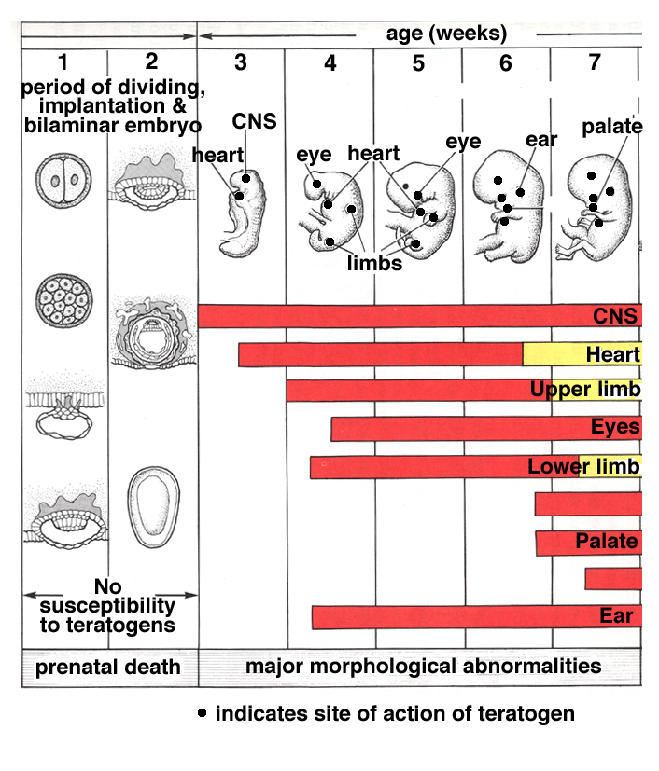
Sites and
timing of
action
of teratogens
in early
development

Slide 51
The first trimester
Summary
Greatest changes and risks for the fetus
If the fetus survives to week 13 (P), then live birth is ~95%
Limited effect on maternal system, though NB hormones

Slide 52
Second trimester
Overview
Safest time for the baby and the mother
Fetal weight increases from 50g – 1000g
Uterine stretch!!
Not a good time to be born!
Detailed knowledge is limited……..

Slide 53
http://www.politicsdaily.com/2010/01/02/preemies-health-care-reform-and-the-cost-benefit-conundrum/

Slide 54
Third trimester
Weeks 27-39 (term)
Everything grows
Development of key systems
Fetus (infant) ~3.5kg at term
2 kg increase during last trimester
>30cm in length

Slide 55
Third trimester
Maturing of key systems for life:
Brain
Lungs
Digestion
Immune system

Slide 56
Third trimester
Summary
Infant size increases
Organ systems reach in utero maturity
Uterine system prepares for delivery
Risks connected with delivery process, not with pregnancy per se

Slide 57
Risks at delivery
Infant
Must breathe within a very short time of delivery
Must become independent of placenta
Heart circulation must change to lungs
Lungs must work

Slide 58
Placental development
Key points

Slide 59
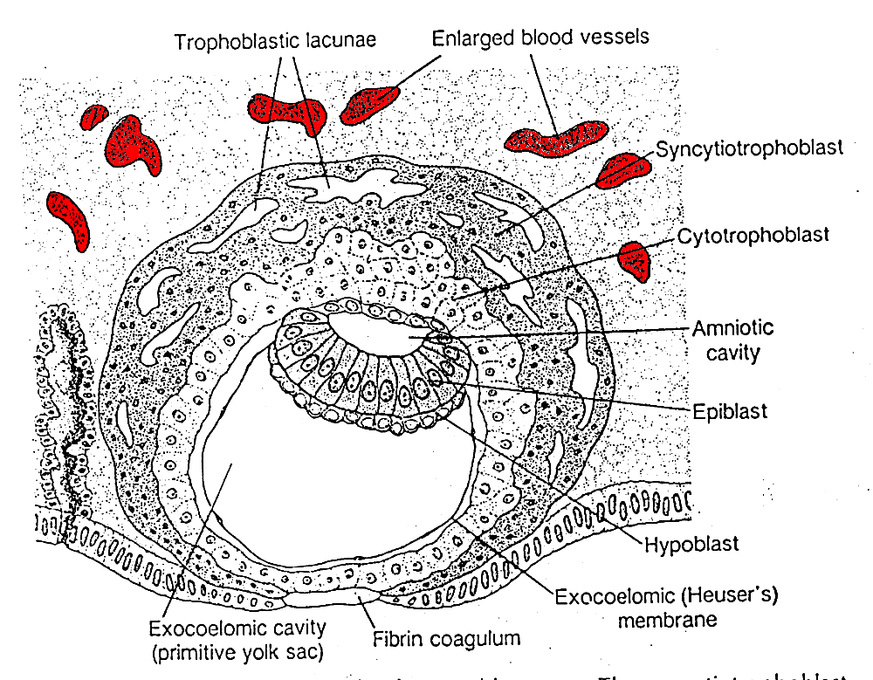
Day 9 - embryonic

Slide 60
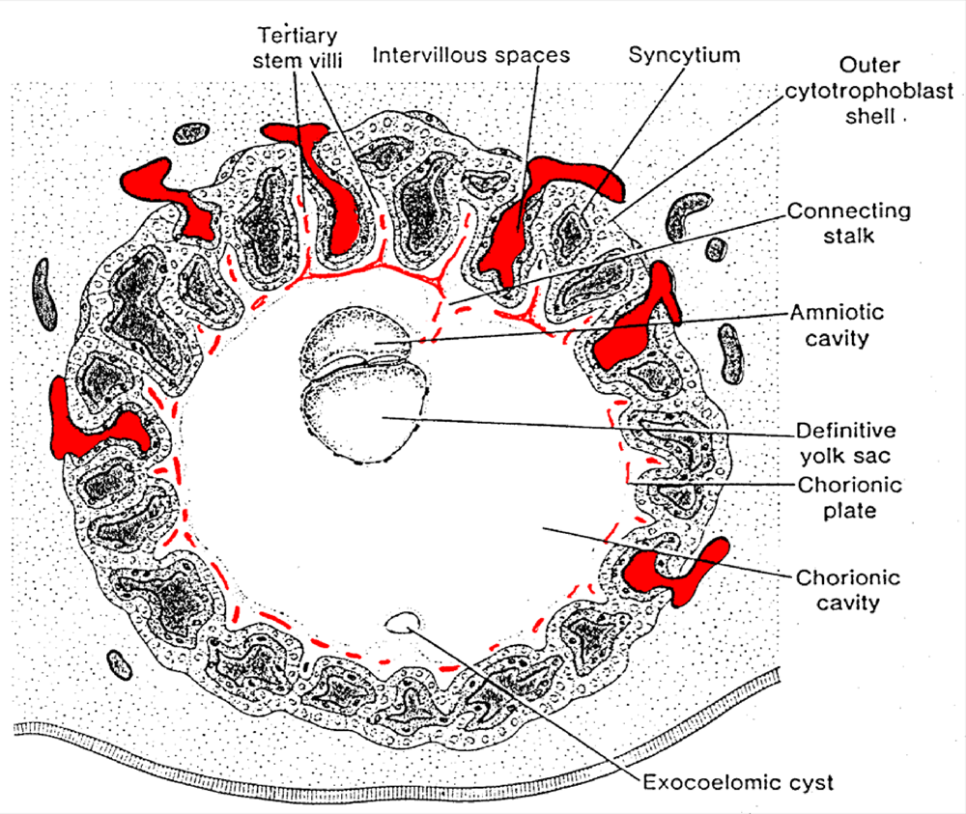
Day 21
Sadler, 2006

Slide 61
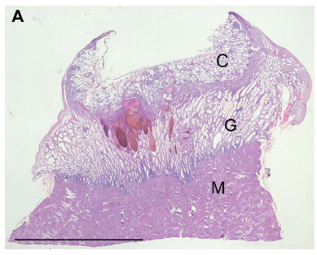
From: Hempstock et al, 2004. Rep.Biol.Endo. Doi:10.1186/1477-7827-2-58

Slide 63
www.arnenixoncenter.org/. ../Willow%20Tree.JPG

Slide 64
www.arnenixoncenter.org/. ../Willow%20Tree.JPG

Slide 65
Essential pregnancy
To focus on the main events in each trimester
Longitudinal information to follow later in the course

Slide 66
Essential pregnancy
0-13 weeks: The first trimester
Precondition 1: fertilisation
How do we count pregnancy?

Slide 67
Uterine changes following fertilisation
LMP

Slide 68
First trimester
‘Week 1 (pregnancy)’
Normal menstrual cycle days 0-7
‘Week 2 (pregnancy)’
Normal menstrual cycle days 8-14
Ends with ovulation & fertilisation

Slide 69
First trimester
‘Week 3 (pregnancy)’
Week 1 of embryonic development
Normal menstrual cycle days 15-21
Implantation of conceptus in decidualising endometrium begins (~day 20)
Pre-implantation development of conceptus

Slide 70
Preimplantation development

Slide 71
First trimester
‘Week 4 (pregnancy)’
Week 2 of embryonic development
Abnormal menstrual cycle, no endometrial shedding (day 28) – ‘missed period’
Implantation of conceptus in decidualising endometrium MOSTLY complete by day 28
Conceptus = blastocyst
Embryo – consists of 2 layers of cells
Placenta – trophoblast differentiation by end of week 2, primary structure developing

Slide 72
Day 9 - embryonic

Slide 73
First trimester
‘Week 5 (pregnancy)’
Week 3 of embryonic development
Maternal – increasing levels of progesterone from corpus luteum, increasing hCG from conceptus. Pregnancy test may be positive.
Definite ‘missed period’
Embryo – gastrulation: formation of 3 layer disc, initiation of CNS & blood vessels – 3mm
Placenta – structure of villi present, contain fetal blood vessels; contact with maternal capillaries

Slide 74
Day 21
Sadler, 2006

Slide 75
First trimester
‘Week 6 (pregnancy)’
Week 4 of embryonic development
Maternal – hormone levels increasing
Embryo – Closure of neural tube. Heart, face, arm initiated. 4mm
Placenta – villi become more elaborate. Cytotrophoblast shell isolates conceptus from maternal blood supply. Umbilical cord forming.

Slide 76
First trimester
‘Week 7 (pregnancy)’
Week 5 of embryonic development
Maternal – hCG levels increasing rapidly
Embryo - Face & limbs continue. (5-8mm). Isolated from maternal blood supply.
Placenta – Histiotrophic nutrition established. Progesterone production increasing

Slide 77
First trimester
‘Week 8 (pregnancy)’
Week 6 of embryonic development
Maternal – hCG levels reaching their peak. Corpus luteum beginning to degenerate.
Embryo - Face, ears, hands, feet, liver, bladder, gut, pancreas. (10-14mm)
Placenta – no major changes in structure, but progesterone production increases further.
Spiral arteries of decidualised endometrium: start of remodelling by placental cells.

Slide 78
First trimester
‘Week 9 (pregnancy)’
Week 7 of embryonic development
Maternal – Second period missed. Corpus luteum regresses; ‘luteo-placental shift’.
Embryo - Face, ears, fingers, toes. (17-22mm)
Placenta – becomes the main source of progesterone to sustain the pregnancy
Spiral artery remodelling continues

Slide 79
First trimester
‘Week 10 (pregnancy)’
Week 8 of embryonic development
Maternal – no major changes
Embryo - Lungs, liver, kidneys, (28-30mm)
Placenta – no major changes

Slide 80
First trimester
‘Week 11 (pregnancy)’
Week 9 of embryonic development
Maternal – no major changes
Embryonic stage now completed, referred to as fetus.
Placenta – interface with decidual spiral arteries changes, placenta begins to receive full maternal blood supply.

Slide 81
Early in development embryos of different species look very similar.

Slide 82
First trimester
‘Week 12 (pregnancy)’
Week 10 of embryonic development
Maternal – no major changes
Fetus – gradual growth
Placenta – completion of exposure to maternal blood supply

Slide 83
First trimester
‘Week 13 (pregnancy)’
Week 11 of embryonic development
Maternal – end of first trimester. 3rd missed period.
Fetus – 8cm / 45g
Placenta – Little change. ~5cm in diameter.

Slide 84
Blastocyst
Embryo
Fetus

Slide 85
The first trimester
Summary
Greatest changes and risks for the fetus
If the fetus survives to week 13 (P), then live birth is ~95%
Limited effect on maternal system, though NB hormones

Slide 86
The second trimester
Weeks 14-27
Maternal changes become obvious
Fetus changes from development to growth
The limit of fetal life (end of trimester)

Slide 87
After 12 weeks of pregnancy

Slide 88
Maternal changes
Increased weight
Increased blood volume
Increased blood clotting tendency
Decreased blood pressure
Altered hormones
Altered appetite (quantity and quality)
Altered fluid balance
Altered emotional state
Altered joints
Altered immune system

Slide 89
Second trimester
Overview
Safest time for the baby and the mother
Fetal weight increases from 50g – 1000g
Placental size increases from 5cm-20cm
Uterine stretch!!
Progesterone levels continue to increase
Estrogens increase
Not a good time to be born!
Detailed knowledge is limited……..

Slide 90
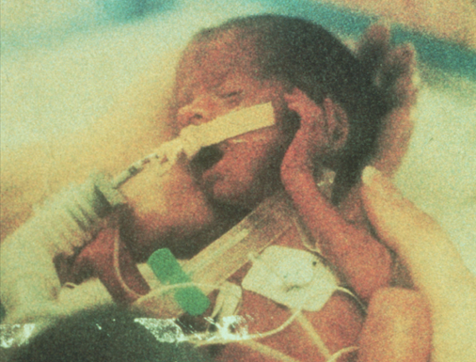

Slide 91
Third trimester
Weeks 27-39 (term)
Everything grows
Fetus (infant) ~3.5kg at term
2 kg increase during last trimester
>30cm in length
Placenta ~0.5 kg, 25cm in diameter
Effectiveness of placenta: 50g – 1000g – 2000g per trimester

Slide 92
Third trimester
Maturing of key systems for life:
Brain
Lungs
Digestion
Immune system

Slide 93
Third trimester
Summary
Infant size increases
Organ systems reach in utero maturity
Uterine system prepares for delivery
Risks connected with delivery process, not with pregnancy per se

Slide 94
Labour stages
Not in labour (~39 weeks)
Latent stage (~8 weeks)
Labour (12-48 hours)
13w 26w 39w
First trimester Second trimester Third trimester
Phase 1 (many hours)
Contractions, cervical changes
Phase 2 (hours)
Baby delivered
Phase 3 (30 min)
Placenta delivered

Slide 95
Risks at delivery
Placenta
Disposable, has done its job
Can be lost without a problem
Placenta & umbilical cord have NO nervous system

Slide 96
Risks at delivery
Infant
Must breathe within a very short time of delivery
Must become independent of placenta
Placenta must be separated (limit blood loss)
Heart circulation must change to lungs
Lungs must work

Slide 97
Risks at delivery
Mother
Blood loss
All placenta MUST leave uterus
Link between these factors
Other factors

Slide 98
Learning objectives
Trimester 1 – slide 85
Trimester 2 – slide 89
Trimester 3 – slide 91 & 92

