Slide 1
Placental development - I
Mark Sullivan

Slide 2
Embryo development

Slide 3
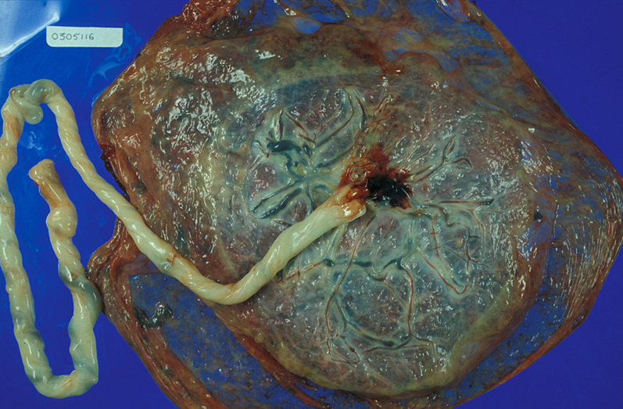
Fetal side of placenta

Slide 4
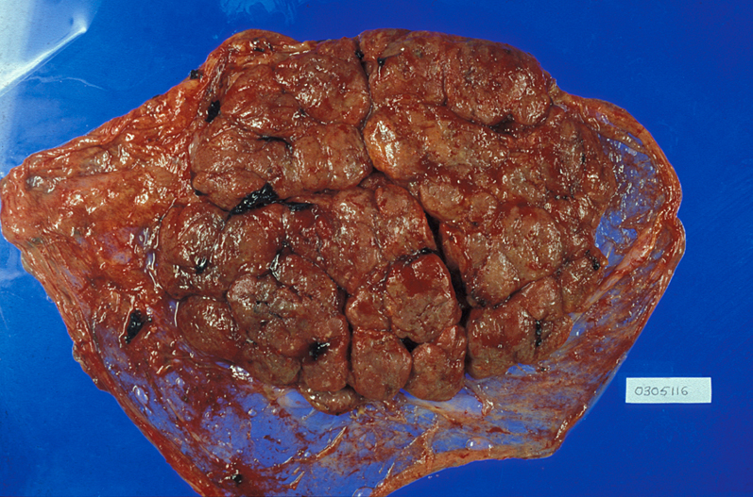
Maternal side of placenta
Cotyledon

Slide 5
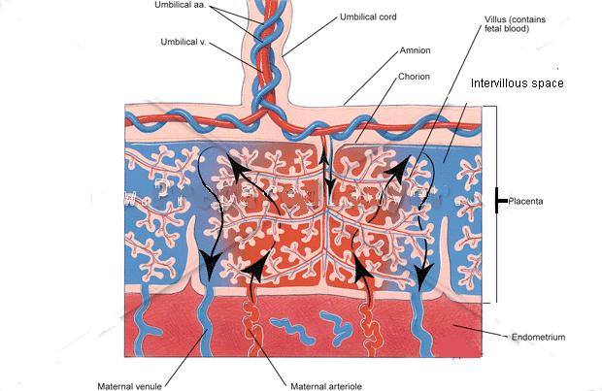
Basic placental structure
Villus – villi – villous

Slide 6
Placental size
Weeks (GA) *(Fert Age) | Placental weight (g) | Diameter (mm)
0-1* |  | 0.1
1-2* |  | ~2
2-3* |  | ~10
4-8 | 15 (5-27) | 20 (15-40)
9-13 | 40 (10-80) | 50 (30-90)
14-17 | 80 (28-134) | 100 (55-185)
18-22 | 130 (58-198) | 130 (68-185)
23-26 | 200 (129-304) | 170 (105-235)
Term | 500 (400-600) | 200 (150-250)

Slide 7
Placental development
1
2
3
4-8
23-26
18-22
9-13
14-17

Slide 8
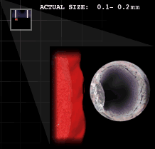
Pre-implantation

Slide 9
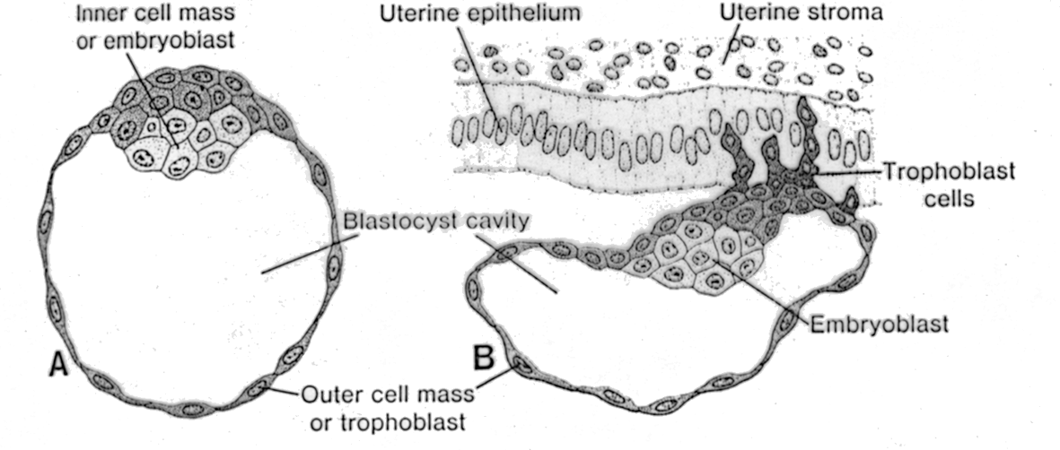
Implantation
Essential Reproduction

Slide 10
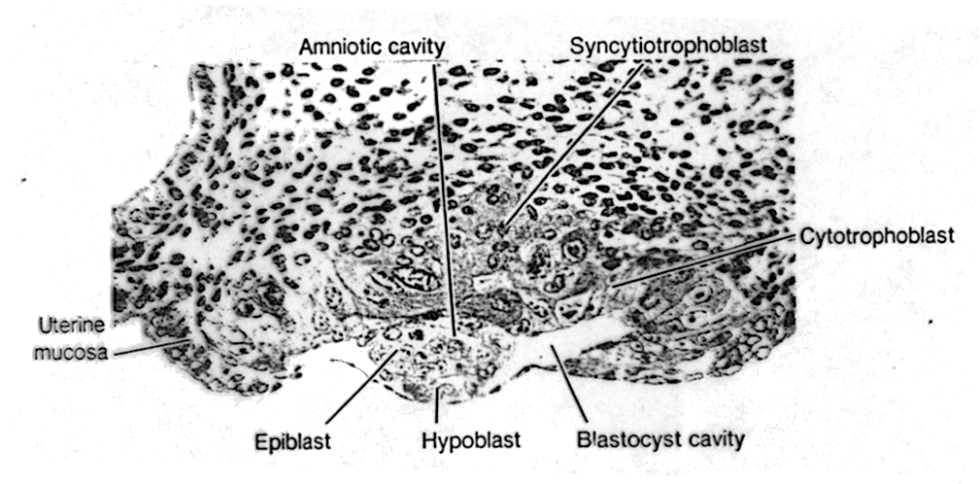
During implantation (Day 7.5)
Placenta
Decidualising endometrium

Slide 11
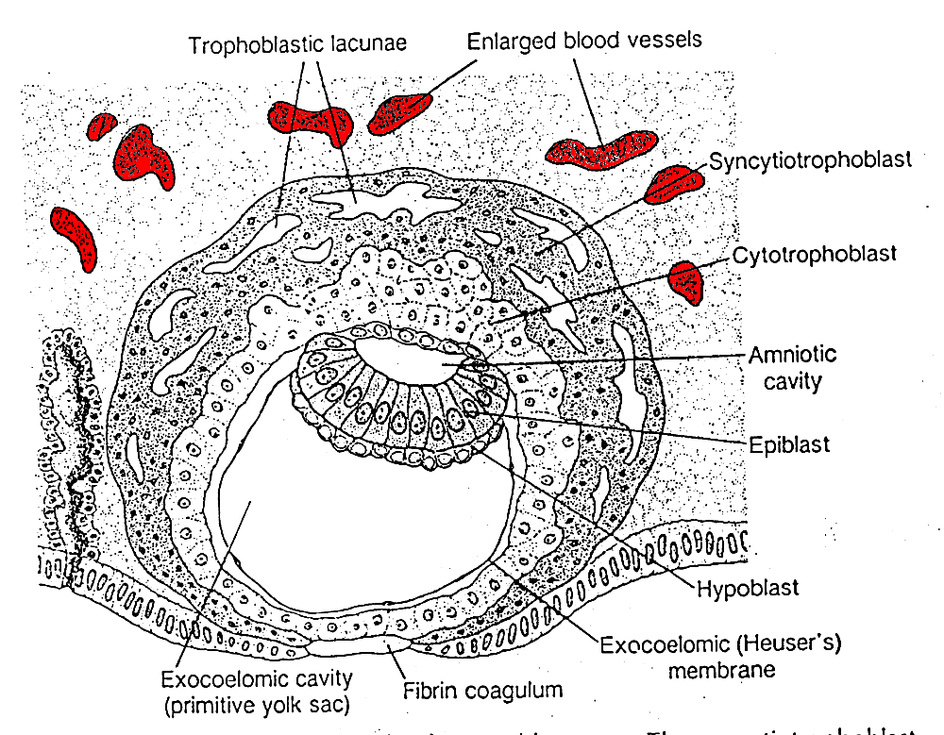
Day 9
CTB proliferation
Sadler, 2006

Slide 12
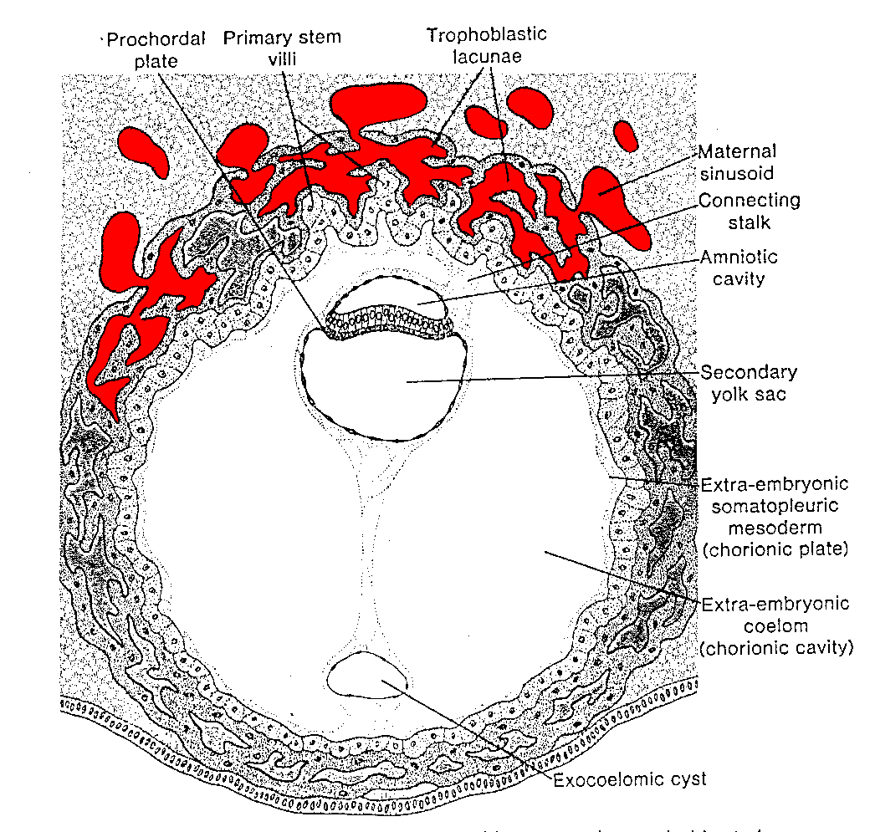
Day 13
Primary villi
Sadler, 2006

Slide 13
Placenta : Feto-maternal interface
Development of placenta
Development of feto-maternal interface

Slide 14
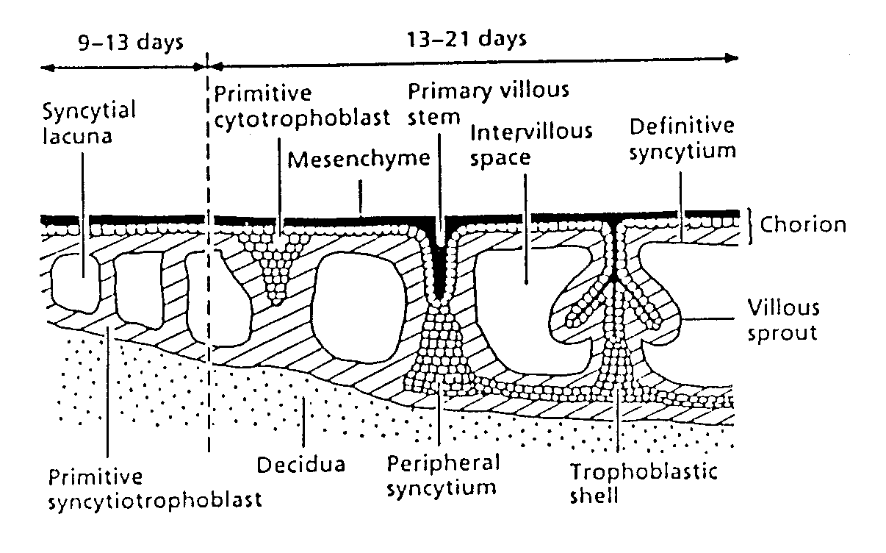
Villous development
Obstetrics, Turnbull & Chamberlain

Slide 15
Cytotrophoblast development

Slide 16
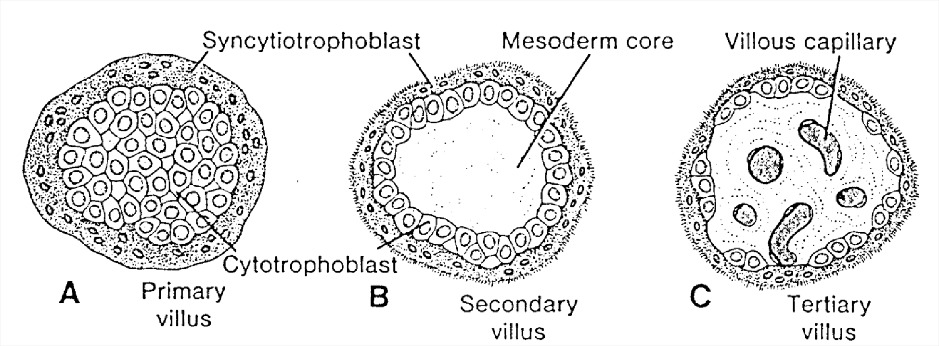
Villous development
Sadler, 2004
NB: Extra-embryonic mesoderm

Slide 17
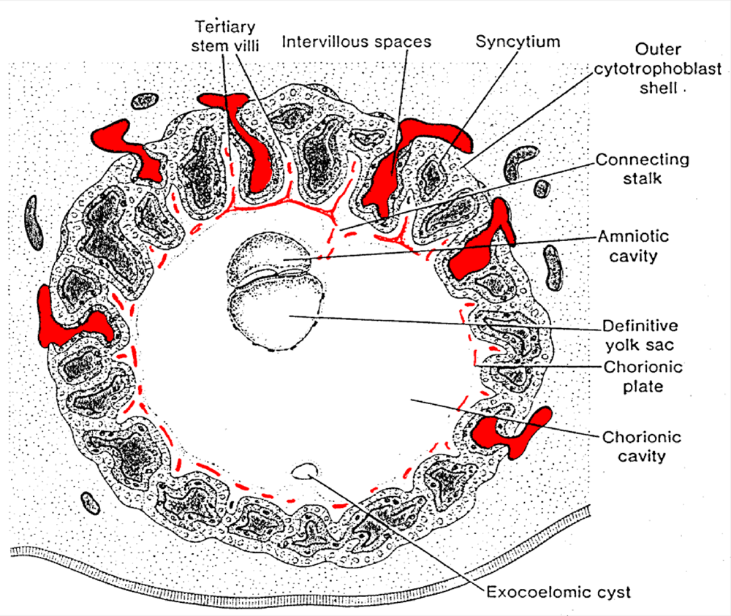
Day 21
Sadler, 2006

Slide 18
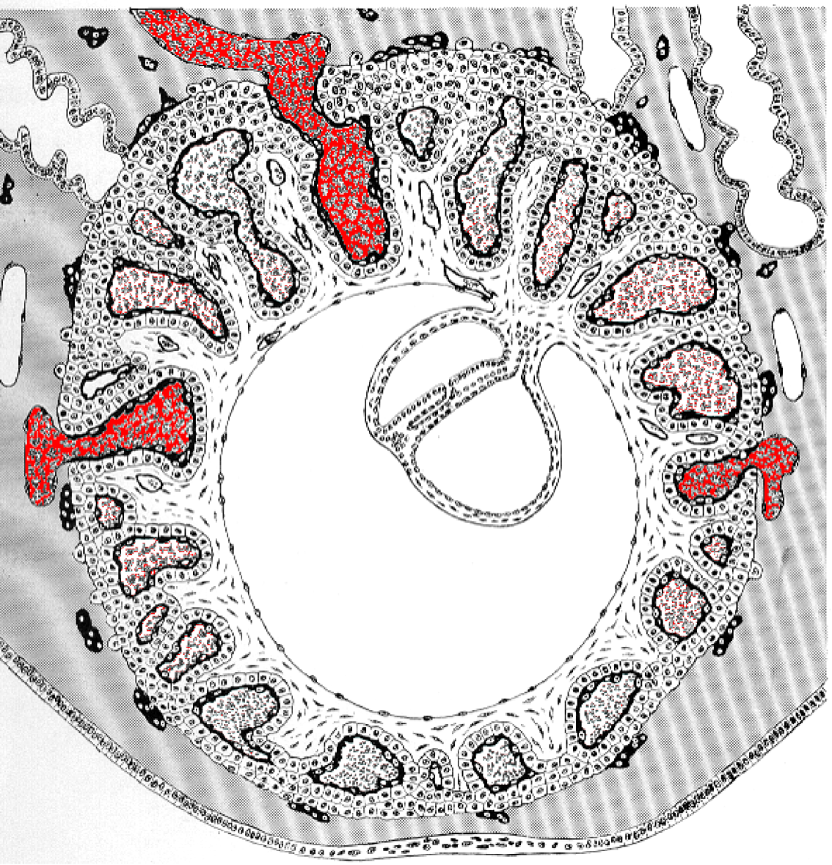
Day 28
Sadler, 2006

Slide 19
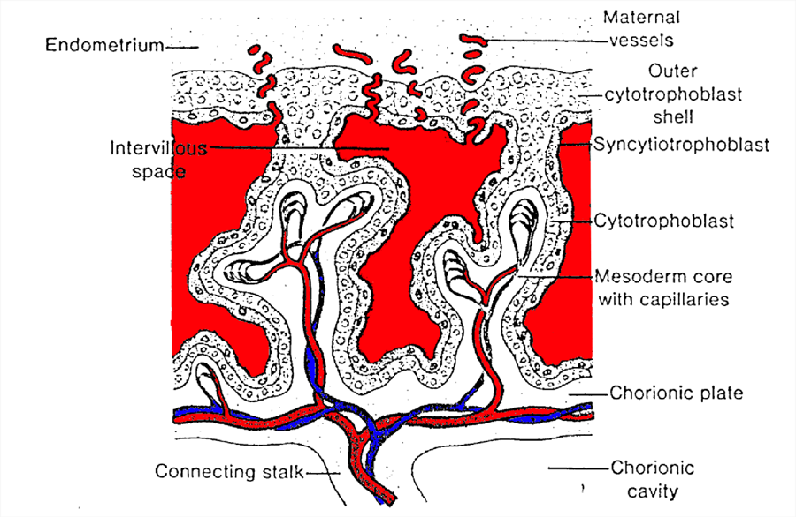
Villous structure

Slide 20
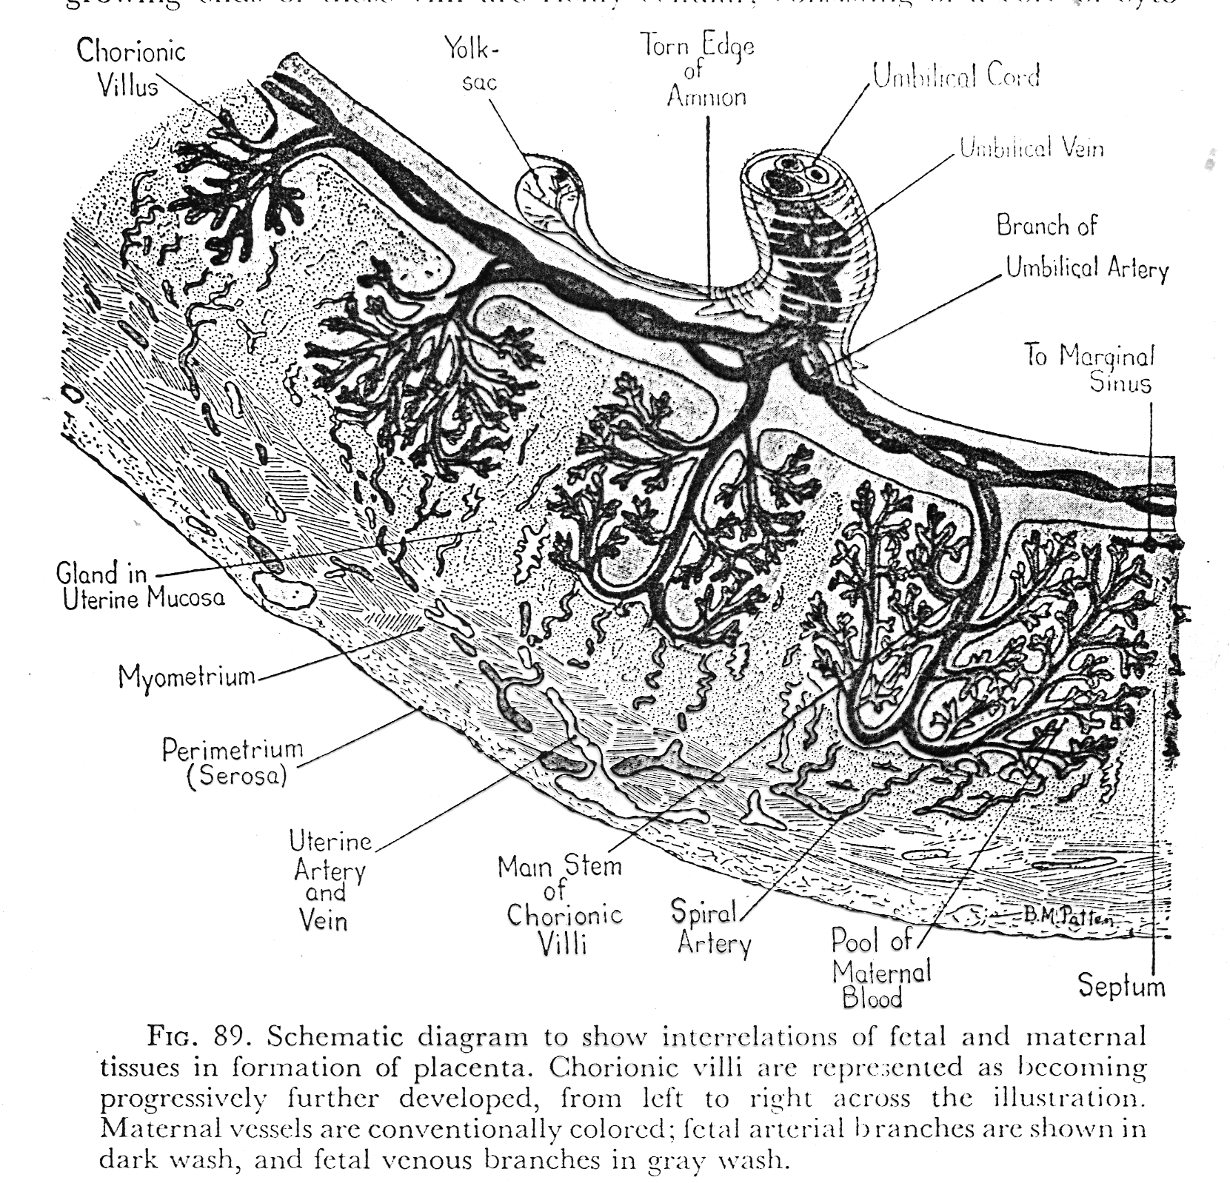
P. Kaufmann

Slide 21
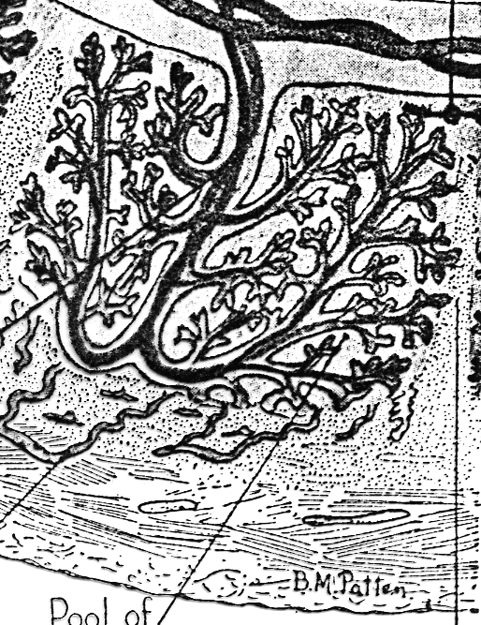
P. Kaufmann

Slide 22
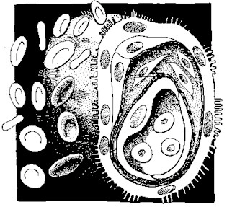

Slide 23
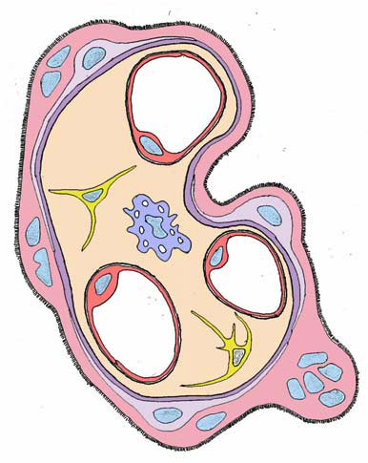
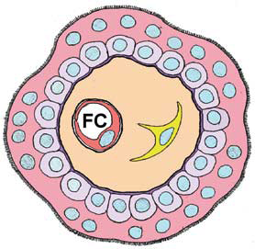
Malassine et al. Retrovirology 2008 5:6. doi:10.1186/1742-4690-5-6

Slide 24
Summary
Formation of villi
Starts shortly after implantation
Simple iterative process of cell replication and movement
Syncytiotrophoblast + cytotrophoblast + mesoderm + blood vessels

Slide 25
Summary
Further development of villi
Maintenance of syncytium
Loss of cytotrophoblast
Decreased distance between fetal & maternal blood supplies
Elaboration of basic structure: main reason for increased size

Slide 26
Placental (or villous) functions
Functions
Separation
Exchange
Biosynthesis
Immunoregulation
Connection

Slide 27
Separation
Maternal blood and fetal blood never mix.
Pregnancy MAY be independent of the uterus - e.g. ectopic pregnancy.

Slide 28
Separation &
exchange
Malassine et al. Retrovirology 2008 5:6. doi:10.1186/1742-4690-5-6

Slide 29
Exchange
Products in:
Glucose, amino acids, lipids, oxygen
Peptides and proteins
Products (waste) out:
Carbon dioxide
metabolites

Slide 30
Exchange processes
Diffusion
Concentration gradient
Additional mechanisms
Facilitated diffusion
Active transport
Receptor-mediated
Aqueous or lipid-specific

Slide 31
Biosynthesis
Extreme placental metabolic capacity Synthesis & metabolism
Hormones
Pregnancy specific or general
Roles?
Growth factors
For placental development
Cytokines
To regulate feto-maternal interface?

Slide 32
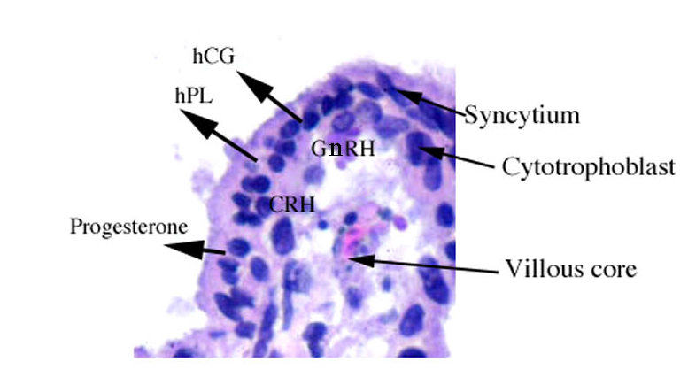
Biosynthetic pathways

Slide 33
Immunoregulation
Normally
Exposure of tissue to foreign antigens activates the immune response, leading to rejection within a few days or weeks.
In pregnancy
There is intimate contact between maternal and fetal tissues, with no evidence of any rejection!!

Slide 34
Placental development (II)
The feto-maternal interface

Slide 35
During implantation (Day 7.5)
Placenta
Decidualising endometrium

Slide 36
Basic placental structure
Spiral (endometrial) arteries

Slide 37
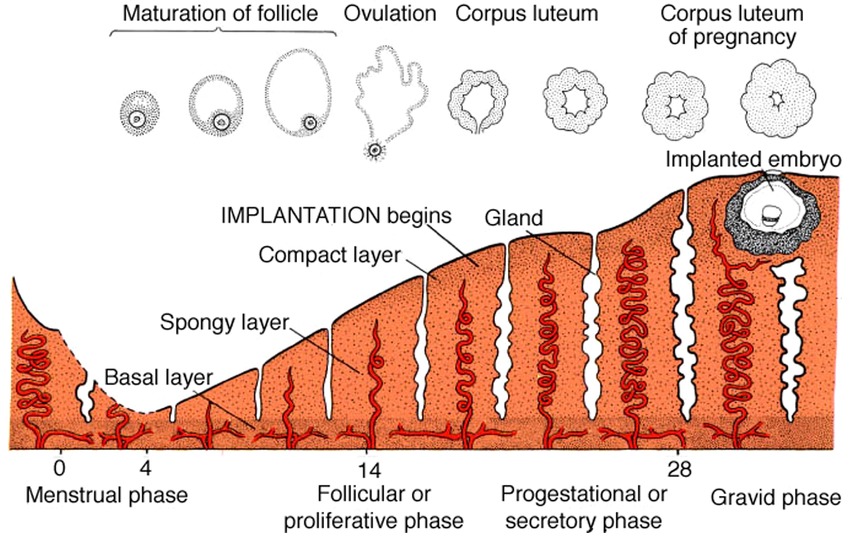
Uterine changes following fertilisation
LMP

Slide 38
Day 9
STB contact
Sadler, 2006

Slide 39
Day 13
Capillary contact
Sadler, 2006

Slide 40
Day 21
Sadler, 2006

Slide 41
Day 28
Sadler, 2006

Slide 42
Villous structure – vessel error!
Day less than 30 – cannot be spiral arteries!

Slide 43
Placental development
1
2
3
4-8
9-13

Slide 44
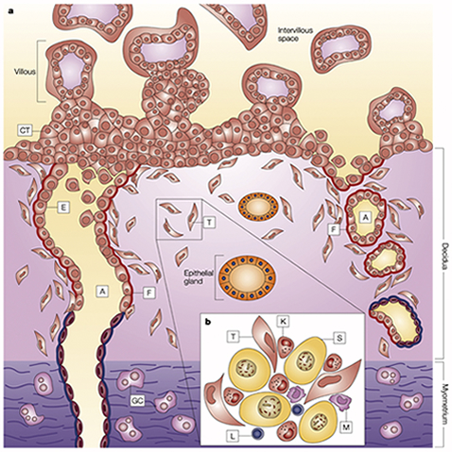
www.path.cam.ac.uk/ pages/moffett/

Slide 45
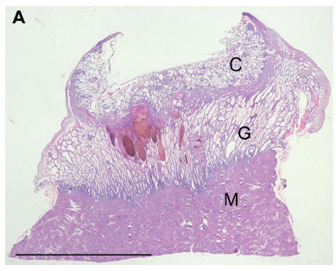
From: Hempstock et al, 2004. Rep.Biol.Endo. Doi:10.1186/1477-7827-2-58
Glandular hypertrophy – histiotrophic nutrition

Slide 46
First trimester
10-12 weeks.
Loss of cytotrophoblast plugs
Exposure of placenta to full maternal blood flow
Reason for pregnancy losses at this time
Oxygen tension increases from ~3% - ~8%.
Need to define ‘normoxia’ with care!!

Slide 47
Information on spiral vessel density & placental size
~10 weeks
One functional spiral artery per cotyledon (approx)

Slide 48
Remodelling of spiral arteries
www.path.cam.ac.uk/ pages/moffett/

Slide 49
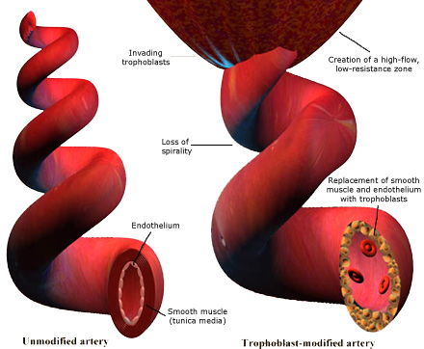
http://www.sgul.ac.uk/depts/immunology/~dash/troph/spiral.jpg

Slide 50
Trophoblast invasion

Slide 51
Trophoblast invasion

Slide 52
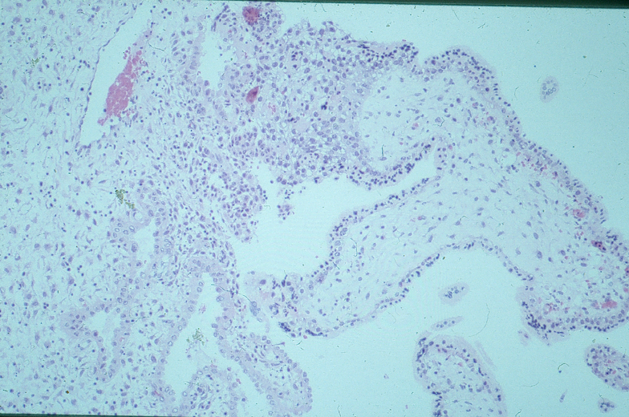
Feto-maternal interface (in vivo)

Slide 53
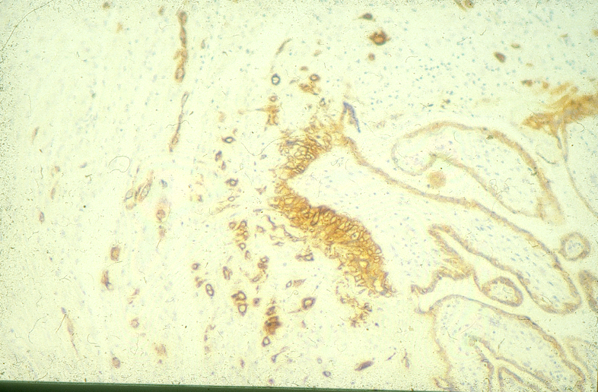
Feto-maternal interface (in vitro)
Cytokeratin staining

Slide 54
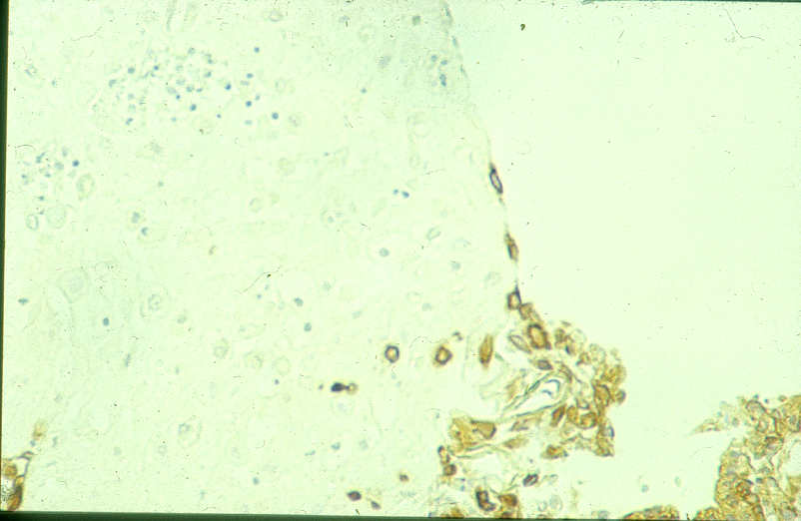
Feto-maternal interface (in vitro)
Cytokeratin staining

Slide 55
Control of invasion
Matrix metalloproteinases (25)
Collagenases, Gelatinases, Matrilysins, Stromelysins, membrane-type (MT-MMPs)
TIMPs (4)
Tissue inhibitors of MMPs
ADAMs (40)
A Disintegrin and Metalloproteinase enzyme family
(NB. FASEB J. 2007 Oct 9; [Epub ahead of print] ADAM-15: a metalloprotease that mediates inflammation. Charrier-Hisamuddin L, Laboisse CL, Merlin D.)

Slide 56
MMPs and TIMPs
MMP-1 (Interstitial) Vettraino, 1996
MMP-2 (Gel A, 72kD)
Yudate, 1996; Librach et al, 1994
MMP-3 (Stromelysin-1) Vettraino, 1996
MMP-7 (PUMP-1, Matrilysin) Vettraino, 1996
MMP-8 (Nφ procollagenase) Kolben, 1996
MMP-9 (Gel B, 92kD)
Vettraino, 1996; Kolben, 1996; Yudate, 1996;
Librach 1994
MMP-10 (Stromelysin-2) Pang 2003
MMP-11 (Stromelysin-3) Popovici 2006
MMP-12 (Mφ metalloelastase) He 2006
MMP-13 (Procollagenase-3) Vegh, 1999
MMP-14 (MT-MMP-1) Nawrocki, 1996
MMP-15 (MT-MMP-2) Takino, 1995
MMP-16 (MT-MMP-3) Shimada 1999
MMP-17 (MT-MMP-4)
MMP-18 Cossins, 1996
MMP-19 Pendas, 1997
MMP-20 (Enamelysin)
MMP-21 (XMMP) Ahokas 2002
MMP-22
MMP-23 Velasco et al, 1999
MMP-24 (MT5-MMP) LaMarca 2005
MMP-25 (MT6-MMP)
MMP-26 (endometase) Park et al, 2000
MMP-27
MMP-28 (epilysin) Li 2003
TIMP-1 Hurskainen, 1996; Kolben, 1996
TIMP-2 Hurskainen, 1996; Ruck, 1996
TIMP-3 Hurskainen, 1996
TIMP-4 Greene, 1996
MMP-4, -5, -6 are not real entities!

Slide 57
Tissue reorganisation
TIMP
Pro-MMP
MMP
TIMP
+
Pro- MMP

Slide 58
Complex pairs
MMP-2 + TIMP-2 + MT1-MMP
MMP-9 + TIMP-1 + uPA/PAI-2/uPAR
Cell surface degradation of ECM

Slide 59
Learning objectives
Invasion of syncytiotrophoblast
Change to cytotrophoblast invasion
Importance of cytotrophoblast invasion
Vascular remodelling and the fetomaternal interface
Regulatory processes

