Slide 1
Fundamentals of assisted reproduction BSc Imperial 2012
Lisa Webber BA BMBCh PhD MRCOG
Consultant Gynaecologist
Specialist in Reproductive Medicine

Slide 2
Learning objectives
Basic principles of ART
Overview of IVF
Overview of IUI

Slide 3
CORPUS LUTEUM
PROGESTERONE
OESTRADIOL
FSH
LH
1 7 14 21 28
FOLLICULAR PHASE
LUTEAL PHASE

Slide 4
Dominant follicle in a natural cycle

Slide 5
CORPUS LUTEUM
PROGESTERONE
OESTRADIOL
FSH
LH
1 7 14 21 28
PROLIFERATIVE PHASE
SECRETORY PHASE

Slide 6
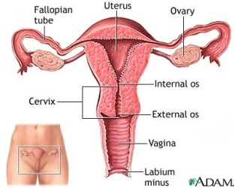

Slide 7
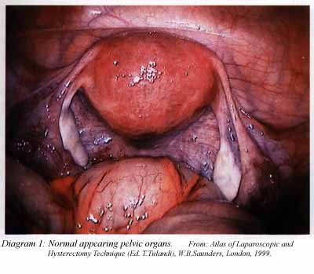
Laparoscopy

Slide 8
In Vitro Fertilization (IVF)

Slide 9
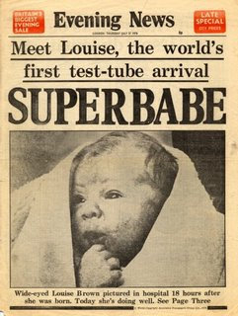
1st IVF baby born 1978
Louise Brown 26/07/1978
Oldham Hospital, Manchester
Patrick Steptoe (RIP 1988) &
Robert Edwards
Nobel Prize 2010
Developed to help couples with tubal disease

Slide 10
Early IVF – the difficulties
Natural cycle – 1 egg
Timing of egg collection – urinary LH
Immature egg
Missed ovulation
Laparoscopic egg collection
Pelvic adhesions

Slide 11
1st IVF baby after ovarian stimulation 1981
Elizabeth Carr 28/12/1981
Drs Georgeanna & Howard Jones, Norfolk, Virginia USA
hMG injections to increase number of eggs collected

Slide 12
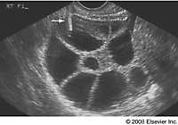
Controlled ovarian hyperstimulation

Slide 13
Live births/cycle
1985 - 8.5% UK
transvaginal ultrasound & egg collection
stimulation protocols/ovulation prevention
embryology
2010 - 52% CRGH

Slide 14
Stimulation protocols for IVF
Aim: to produce a cohort of growing follicles that reach maturity at the same time
Mechanism: to override ovarian-pituitary negative feedback mechanism
FSH – urinary, synthetic

Slide 15
Prevention of ovulation
Aim: to control timing of ovulation in order to collect eggs
Mechanism: to block ovarian-pituitary positive feedback mechanism
Gonadotrophin releasing hormone agonist or gonadotrophin releasing hormone antagonist

Slide 16
Triggering of oocyte maturation
LH surge triggers resumption of meiosis
hCG used instead of LH
egg collection timed for 36 hours later

Slide 17
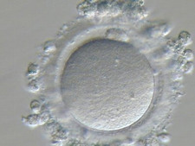
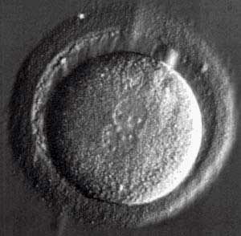
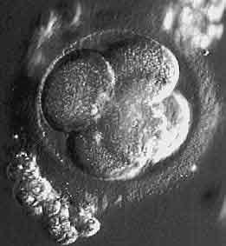
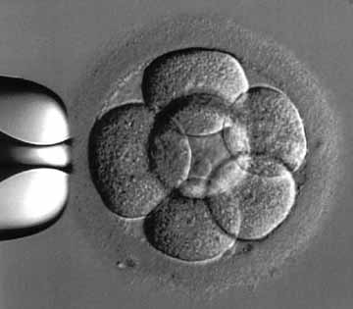
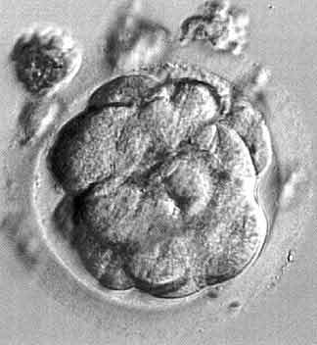
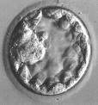
Embryo development
Mature Day 1 Day 2 Day 3 Day 4 Day 5
egg fertilised 2-4 cells 6-8 cells morula blastocyst

Slide 18
Luteal phase support
Progesterone
hCG – increased risk OHSS
Oestrogen?

Slide 19
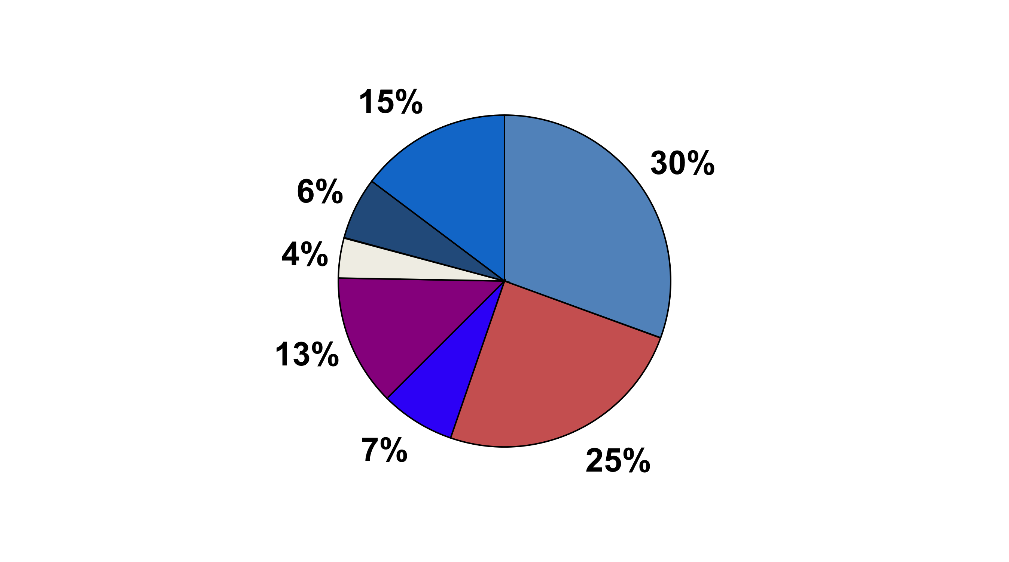
Causes of infertility in those having IVF
female factors
multiple factors
male factor
other
endometriosis
tubal disease
ovulation disorders
unexplained
HFEA 2008

Slide 20
Intrauterine insemination

Slide 22
Intrauterine insemination
IUI
natural cycle
with clomid
with gonadotrophins (superovulation/IUI)

Slide 23
Stimulated intrauterine insemination
2 or 3 eggs
timing
sperm higher up genital tract
fertilisation in vivo

Slide 24
In vitro fertilitsation
multiple eggs
eggs fertilised in vitro
selection process
embryo transfer

Slide 25
Which treatment for unexplained infertility??
Keep trying
clomid
IUI
natural cycle
with clomid
with gonadotrophins
IVF
BUT risks and costs must be considered
multiple pregnancies
risks of egg collection (IVF)
OHSS

Slide 26
Principles of ART
Sperm closer to egg(s)
+/- increasing number of eggs

