Slide 1
Injury of the immature brain
Mechanisms and prospects for neuroprotection
Dr Denis Azzopardi, ICM, London

Slide 2
Brain Injury in the Preterm and Full-term Infant
Thought primarily due to the interplay of hypoxia-ischaemia and infection / inflammation
Pattern of injury varies with development- periventricular white matter injury predominates in the preterm infant
Impaired growth/nutrition may also contribute to poor brain growth and development

Slide 3
Main types of brain injury in preterm infant
Germinal layer/intraventricular haemorrhage
  Clin Perinatol. 2008 Dec;35(4):777-92, vii. Review
Periventricular white matter injury
  Clin Perinatol. 2002 Dec;29(4):745-63. Review
White matter atrophy
  Obstet Gynecol. 2006 Mar;107(3):546-8.
.

Slide 4
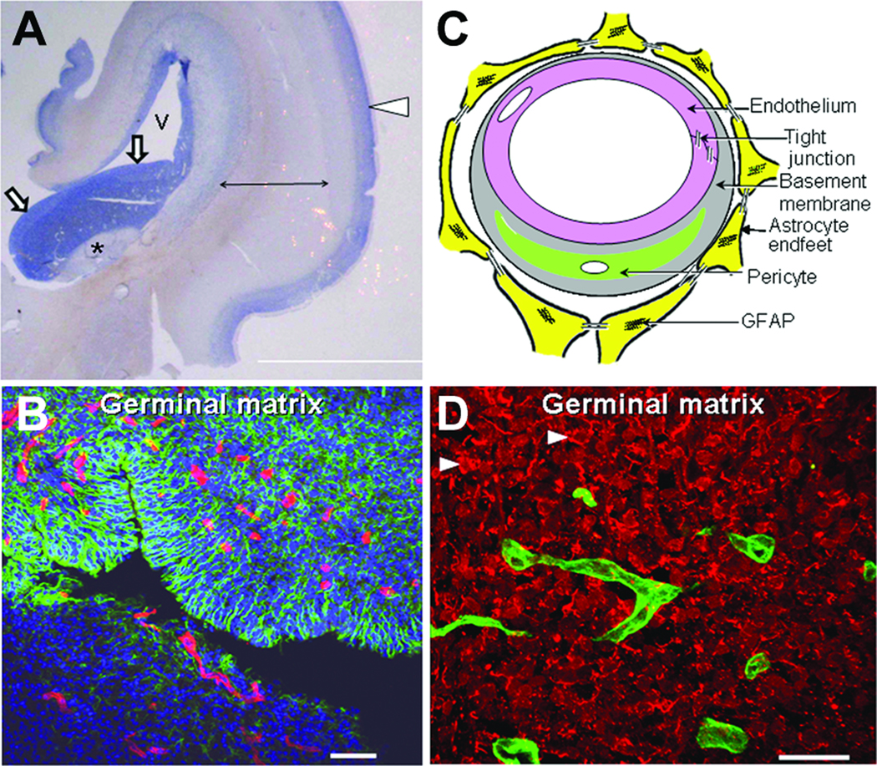
Pediatric Research (2010) 67, 1–8;

Slide 5
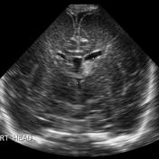
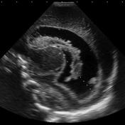
Classification of intraventriclar haemorrhage
Grade 1: restricted to germinal matrix region
Grade 2: extension into ventricle filling less than 50% of ventricle
Grade 3: extension into ventricle with dilatation of ventricle
Grade 4: Accompanied by infarction of periventricular area

Slide 6
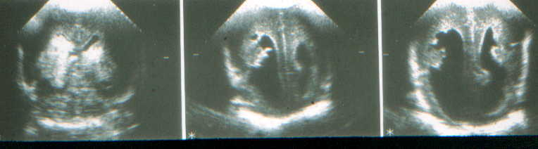
Germinal Matrix-Intraventricular Haemorrhage in the Preterm
Fluctuating cerebral blood flow
Increase in cerebral blood flow
Increase in cerebral venous pressure
Platelet and coagulation disturbance
Neurology of the Newborn (Volpe) 4th edition 2000

Slide 7
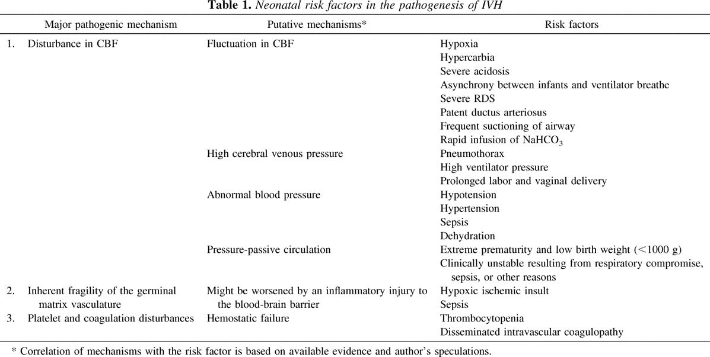
Pediatric Research (2010) 67, 1–8;

Slide 8
Prevention of intraventriular haemorrhage
Optimal prenatal care
Optimal intensive care techniques
  Avoiding excessive handling
  Maintenance of homeostasis
Antenatal corticosteroids
Postnatal surfactant replacement therapy

Slide 9
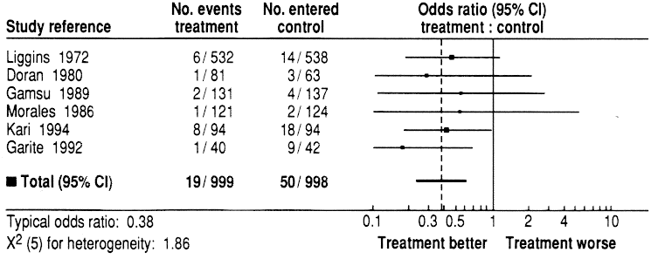
Antenatal Steroids and the Occurrence of IVH
Crowley: Am J Obstet Gynecol, Volume 173(1).July 1995.322-334

Slide 10
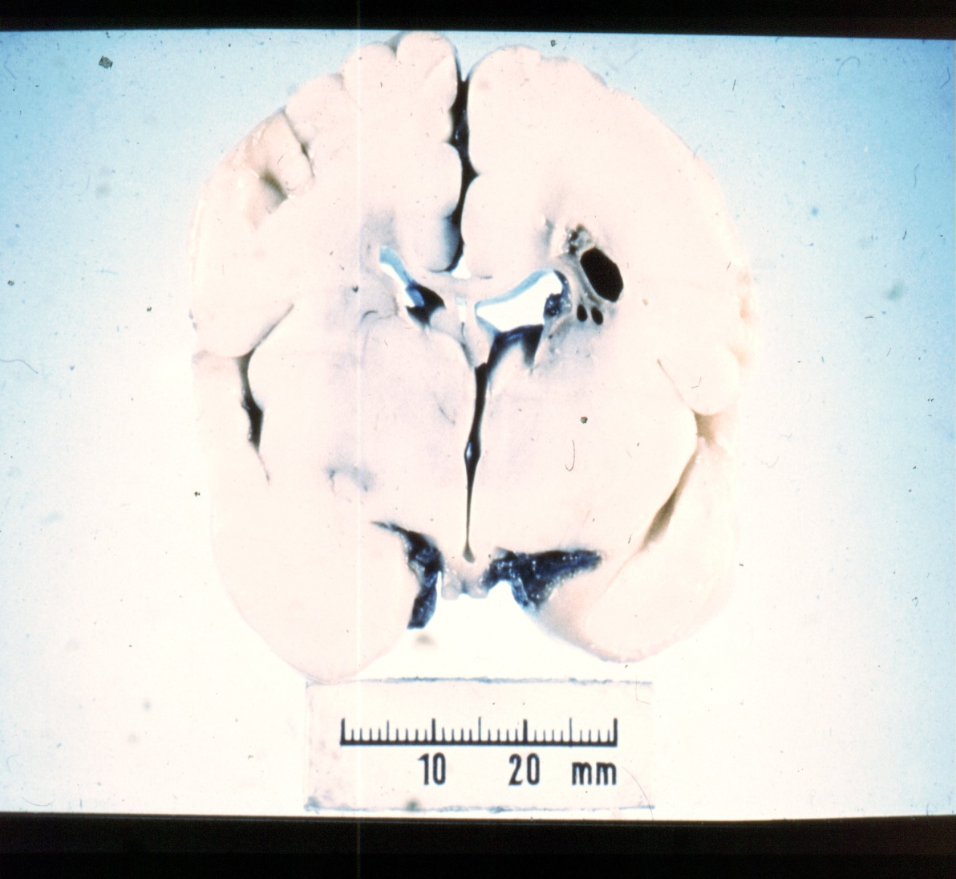
White Matter Injury in the Preterm: Pathogenesis
Ischaemia
  Arterial end zones and border zones
  Systemic hypotension
  Hypocarbia
Intrinsic vulnerability
Infection-Inflammation
Glutamate toxicity
Neurology of the Newborn (Volpe) 4th edition 2000

Slide 11
Infection, Inflammation and Immunology
Intrauterine infection is a major association of preterm delivery
Does intrauterine infection damage the brain?

Slide 12
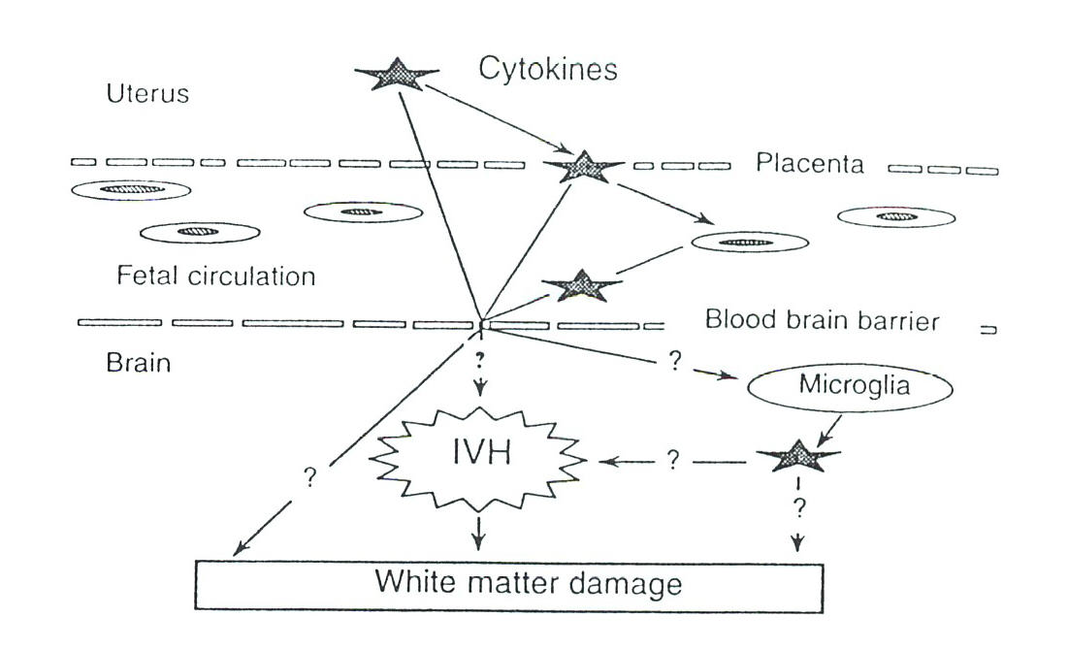
  Dev Med Child Neurol Suppl. 2001 Mar;86:18-20.
  Clin Perinatol. 2002 Dec;29(4):745-63.

Slide 13
White Matter Injury in Preterm Infants
Chorioamnionitis | PVL (RR; 95% CI) | CP (RR; 95% CI)
Clinical | 3.0; 2.2-4.0 | 1.9; 1.4-2.5
Histologic | 2.1; 1.5-2.9 | 1.6; 0.9-2.7
Chorioamnionitis as a Risk Factor for Cerebral Palsy: A Meta-analysis JAMA Vol. 284 No. 11, September 20, 2000

Slide 14
Abnormal MRI soon after birth is associated with a fetal immune activation and inflammation
(Duggan et al Lancet 2001

Slide 15
The T_{H}1 and T_{H}2 response and MR images
40
Normal MRI
Abnormal MRI
30
%CD4+ cells
20
10
0
Intracellular IL-4 (T_{H}2)
Intracellular IFN-γ (T_{H}1)

Slide 16
Synergy between inflammation and hypoxia-ischaemia
Hypoxia-ischaemia induces longstanding inflammatory changes in brain
  (Bona et al Pediatr Res 1999; 45:500-9)
Pretreatment with IL-1,6,9 or TNFα was not directly toxic but exacerbated excitotoxic brain injury
  (Dommergues et al Ann Neurol 2000;47:64-53)
Lipopolysaccharide causes mitochondrial impairment in astrocytes (Clark et al J Neurochem 2000)
Sub-lethal ischaemia + sub-lethal infection = massive damage
  (Hagberg et al Eur J Neurosci. 2001 Mar;13(6):1101-6.)

Slide 17
White Matter Injury in Preterm
Difficult to image and may be underestimated

Slide 18
High Incidence Of White Matter Abnormality on MRI in Preterms
MRI at median 2 days after delivery
  68% abnormal
17% white matter lesions
12% basal ganglia lesions
35% ventricular dilatation
20% intraventricular and/or germinal matrix bleeds
MRI at term in 73% (13% died, 7% refused, 7% studied later)
  100% abnormal
50% ventricular distortion and dilatation
50% diffuse high signal in white matter
2% intraventricular and germinal matrix bleed
J Pediatr 1999;135:351

Slide 19
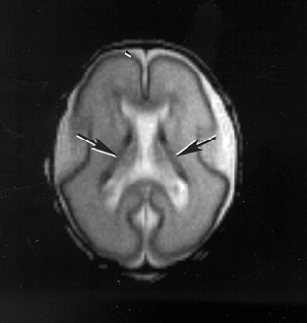
MRI in a Consecutive Cohort of Infants Born at 23-29 Weeks Gestational Age

Slide 20
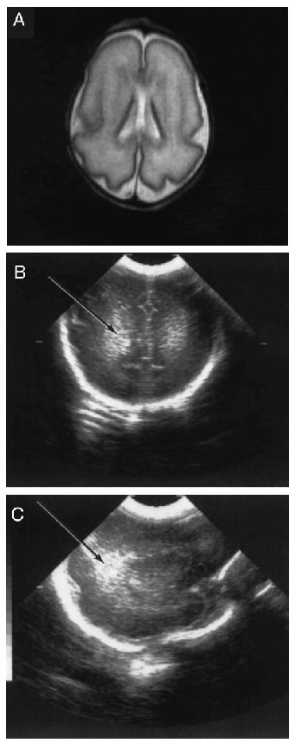
White Matter Abnormality in Preterms
Example of normal MRI and increased periventricular echodensity in preterm infant.
Maalouf: Pediatrics, Volume 107(4) Part 1 of 2.April 2001.719-727

Slide 21
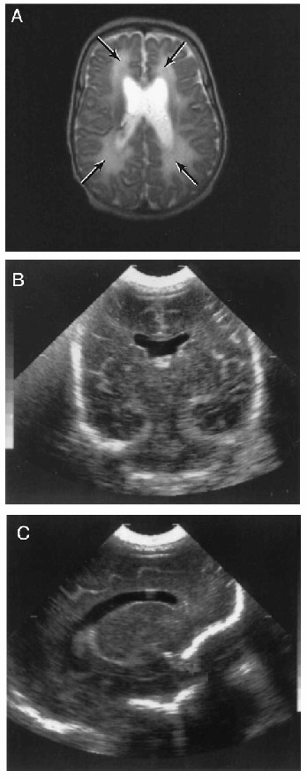
White Matter Abnormality in Preterms
Example of abnormal MRI showing diffuse enhanced signal intensity (DEHSI) in white matter but normal ultrasound appearances in preterm infant.
Maalouf: Pediatrics, Volume 107(4) Part 1 of 2.April 2001.719-727

Slide 22
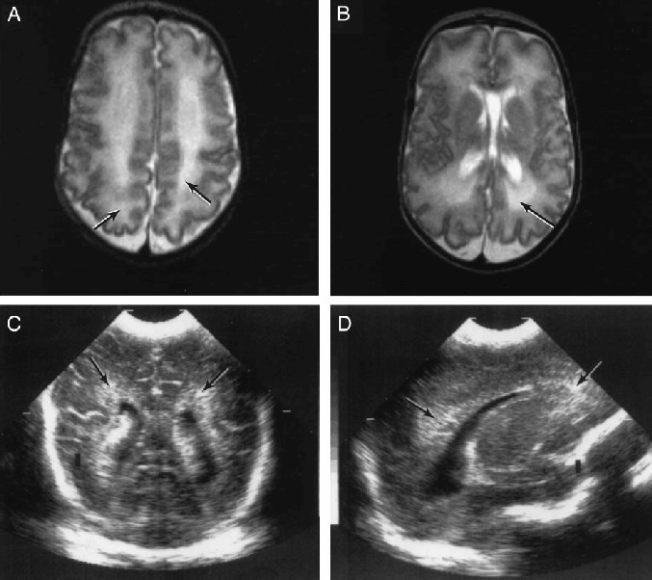
White Matter Abnormality in Preterms
Example of abnormal MRI (DEHSI) and abnormal ultrasound appearances in preterm infant.
Maalouf: Pediatrics, Volume 107(4) Part 1 of 2.April 2001.719-727

Slide 23
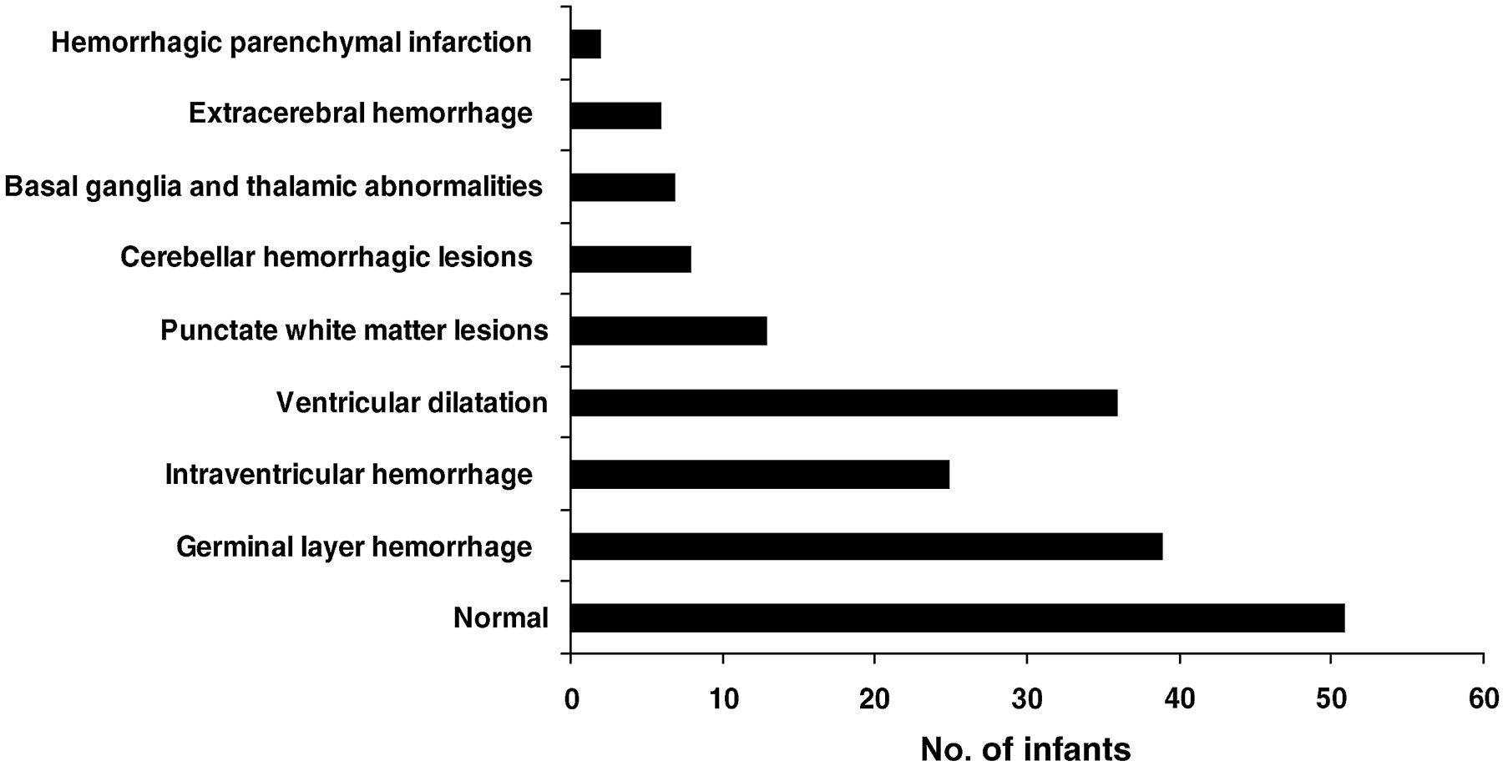

Findings on the first MRI brain scans after birth (n = 119).
Dyet L E et al. Pediatrics 2006;118:536-548
©2006 by American Academy of Pediatrics
Notes:
Findings on the first MRI brain scans after birth (n = 119).

Slide 24
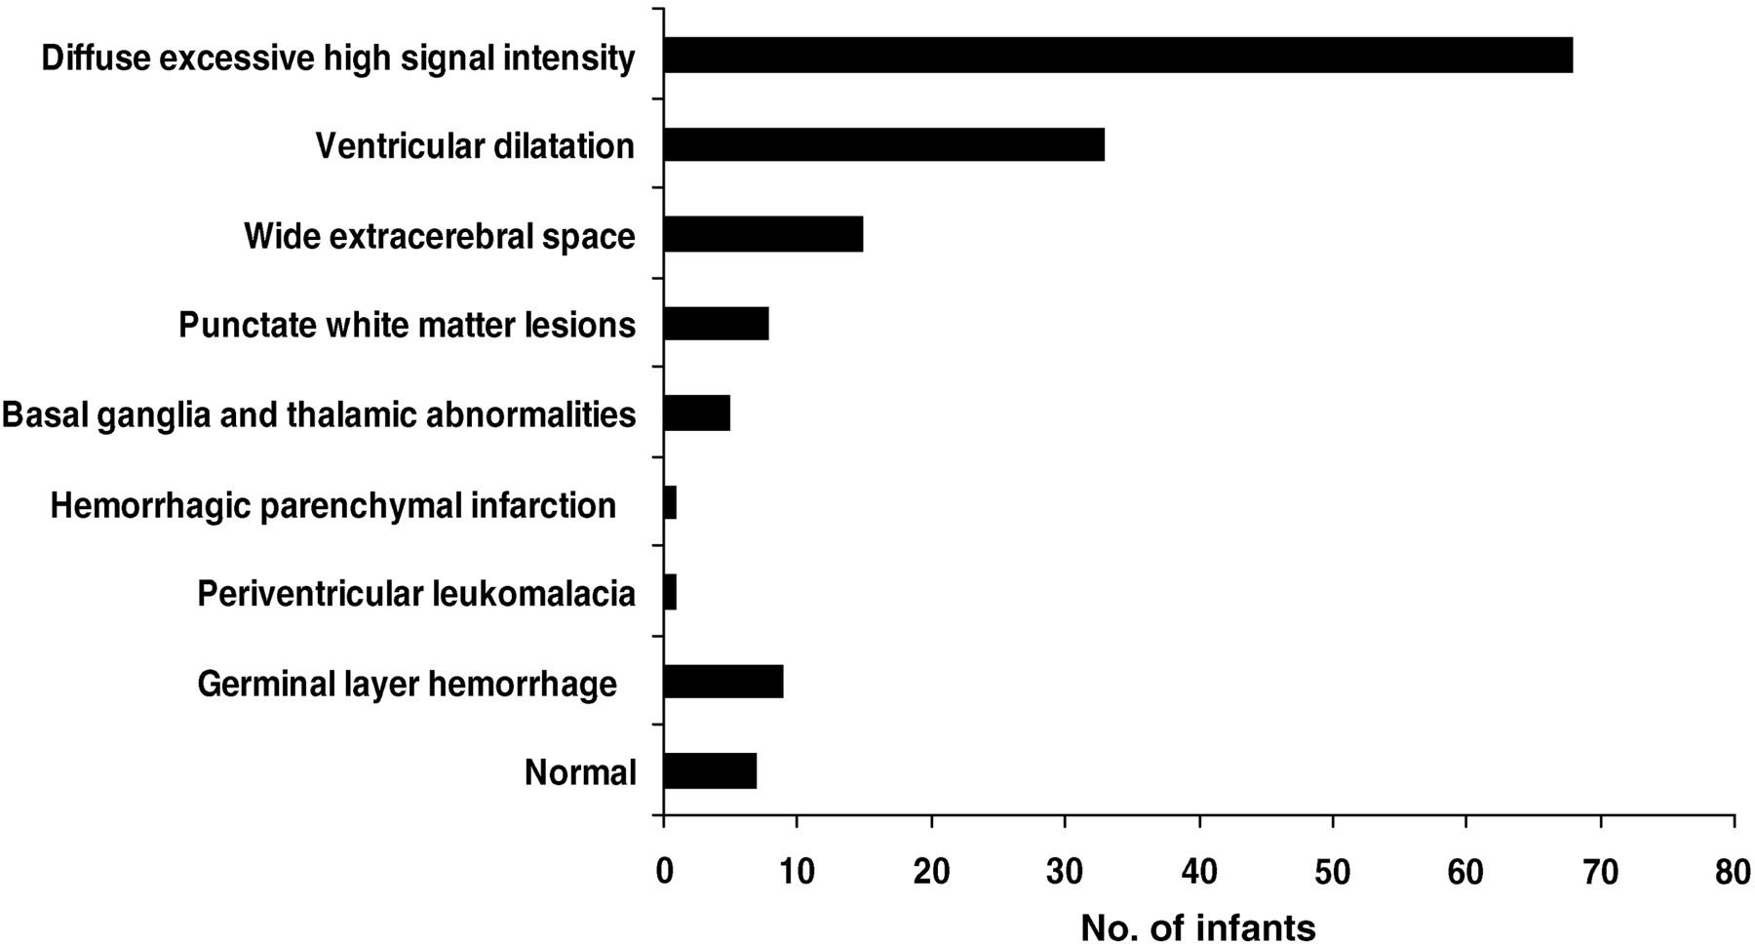
Findings on the term MRI brain scans (n = 87).
Dyet L E et al. Pediatrics 2006;118:536-548
©2006 by American Academy of Pediatrics
Notes:
Findings on the term MRI brain scans (n = 87).

Slide 25
Cerebral cortical folding is reduced in preterm infants
Term
Preterm
(Ajaye-Obe et al Lancet 2000)

Slide 26
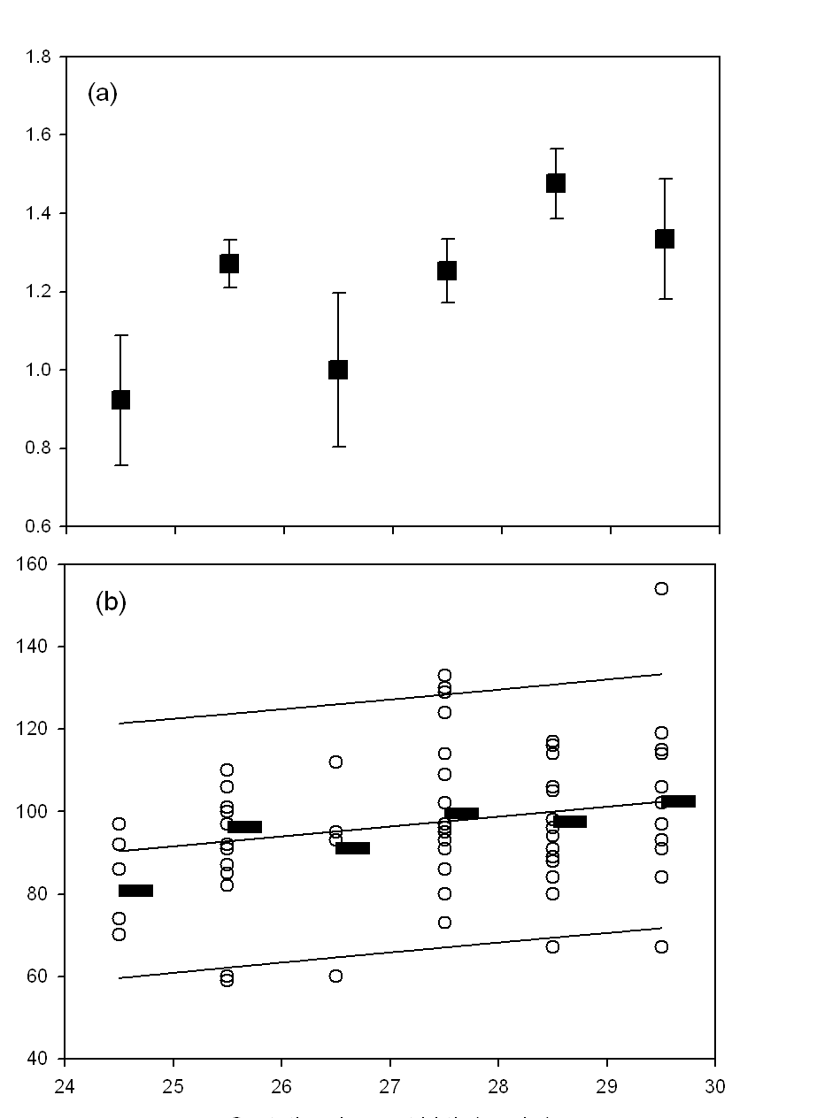
Prematurity is related to reduced cortical growth before term and associated adverse outcome at 2 years
Growth of cerebral cortex per unit brain volume
Griffiths quotient at 2 years
Kapellou et al. PLoS Medicine 2006 Aug;3(8):e265.
Gestational age at birth
Page 26
© Imperial College London

Slide 27
Association of NEC and neurological impairment
Arch Dis Child Fetal Neonatal Ed 2012;97:F318-F322

Slide 28
Strategies for Improving Neurological Outcome in the Preterm
Therapeutic intervention
  Protectors (hormones, growth factors)
  Modifying inflammatory response (anti inflammatory cytokines, cytokine receptor blockers)
Better perinatal care (eg avoidance of hypocarbia, infection, hypoglycaemia)
Social intervention

Slide 29
Neuroprotective therapeutic interventions in the preterm
Prevention of IVH
  Ethamyslate: Cochrane Database Syst Rev. 2010 Jan 20;(1):CD004343
  Indomethacin:Cochrane Database Syst Rev. 2010 Jul 7;(7):CD000174. Review.
Prevention of white matter injury
  Melatonin: Ann Neurol. 2002 Jan;51(1):82-92. PLoS One. 2009 Sep 22;4(9):e7128.
  Erythropoietin: Ann Neurol. 2010 May;67(5):657-66. Nature Reviews Neurology 6, 301-302

Slide 30
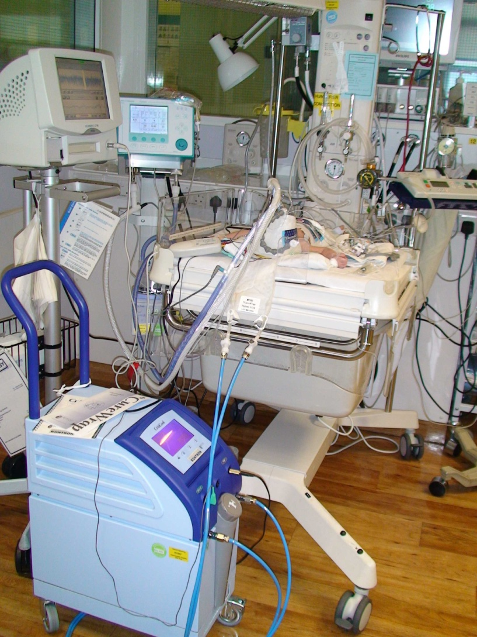
Neonatal encephalopathy
Neonatal encephalopathy accounts for 1 million deaths worldwide and even greater numbers of disabled survivors
In countries with excellent maternity services NE occurs in 2-3/1000 births with 1-2/1000 developing moderate/severe NE
Mortality is about 30% and disabilities occur in about 50% of survivors following moderate/severe NE
Cognitive function may be impaired even in mild/moderate cases

Slide 31
Overview of hypoxic ischaemic encephalopathy
Early Hum Dev. 2010 Jun;86(6): Pages 327-377
Best Practice Guidelines
Hypoxic Ischaemic Encephalopathy in Newborn Infants
Guest Editor: Denis Azzopardi

Slide 32
Characteristics of neonatal encephalopathy
Occurring soon after birth in full term or near full term infants
Seizures
Abnormal neurological behaviour
Abnormal posture
Abnormal tone
Abnormal reflexes
Abnormal EEG
Notes:
32

Slide 33
Consider Other Diagnosis
Antenatal events
Metabolic
Neuromuscular
Developmental abnormalities
Infections
Cerebral infarction
Postnatal asphyxia

Slide 34
Diagnosis of birth asphyxia
American College of Obstetrics and Gynaecology
One or more of the following
  Apgar < 3 at 5 minutes
  Metabolic acidosis (serum bicarbonate <12 mmol/L)
  Delayed onset of respirations (> 5 minutes)
Mechanical ventilation at birth
Evidence of encephalopathy
Evidence of multisystem involvement
Notes:
34

Slide 35
Case definition
Any baby with estimated gestational age 37 weeks or more (or weight = or > 2500 g if gestation unknown) who has neonatal encephalopathy, defined as an illness occurring at any time in the first 4 days (96 hours) of life and
consisting of one or more of:
· Definite or probable fits (whatever the clinical manifestation) and including apnoeic attacks and cyanotic spells.
· Increased muscle tone
· Decreased muscle tone
· Abnormal neurological behaviour such as reduced responsiveness, coma, hyper-alertness, jitteriness.
· Unable to feed orally for a period of at least 24 hours (unless caused by respiratory problems, structural lesions, e.g. cleft palate or oesophageal atresia, or by the need for neonatal surgery).
The relationships between neonatal encephalopathy and cerebral palsy: a cohort study
J.Obst Gynae (2001) 21 114-120

Slide 36
Neonatal encephalopathy
Incidence in UK ~ 2.6/1000 births
Incidence of neonatal encephalopathy with fits: 1.6/1000 births
Rate of death / cerebral palsy related to asphyxia: 0.58/1000 births
57159 enrolled in the study
150 cases with NE
(92 with fits)
143 cases for study
NO FITS
N=56
Disabled/impaired n=3
Died n=0
FITS
N=87
Disabled/impaired n=31
Died n=15
J.Obst Gynae (2001) 21 114-120
Notes:
36

Slide 37
Other diagnosis
150 cases with NE
7 with other diagnosis
Group B strep
Inherited metabolic disease
Pyridoxine dependency
Nesidioblastosis
Narcotic withdrawal
13-q syndrome
143 cases for study
Notes:
37

Slide 38
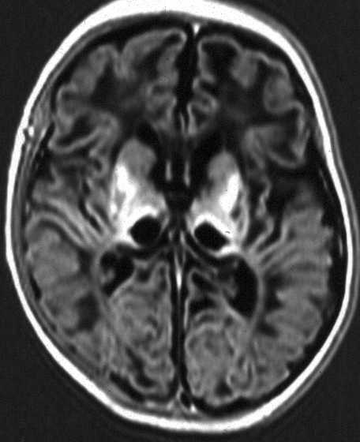
Intrapartum asphyxia is likeliest cause of neonatal encephalopathy occurring immediately after birth
57159 enrolled in the study
150 cases with NE
(92 with fits)
143 cases for study
NO FITS
N=56
Disabled/impaired n=3
Died n=0
FITS
N=87
Disabled/impaired n=31
Died n=15
143/150 in a cohort study of 57159 newborns Reference: The relationship between neonatal encephalopathy and cerebral palsy. J.Obst Gynae (2001) 21 114-120
197/245 encephalopathic newborns studied by MRI Reference: Origin and timing of brain lesions in term infants with neonatal encephalopathy. Lancet (2003) 361 736-742
Notes:
38

Slide 39
Assessment by condition at birth
Apgar score
  At 5 or 10 minutes
Blood gas analysis
  pH, base deficit or serum bicarbonate
Need for resuscitation
  Delayed onset of respiration
Notes:
39

Slide 40
Apgar score: subsequent death and cerebral palsy
Apgar score 0-3 at 5 minutes results in :
  386-fold increase in neonatal death
  81-fold increase in cerebral palsy
 | Apgar 0-3 (N) | Apgar >3 (N) | Positive predictive value (%) | Negative predictive value (%)
Neonatal death | 48 | 160 | 23 | 99
Cerebral Palsy | 16 | 136 | 11 | 95
Total No. of children | 208 | 234237
J.Pediatr (2001) 138 798-803
Notes:
40

Slide 41
condition at birth
< or > 2 SD from reference values | Positive Predictive Value % | Negative Predictive Value %
Umbilical arterial pH | 8 | 96
Lactate concentration | 5 | 96
Apgar score at 5 minutes | 19 | 96
Apgar score and pH | 27 | 96
BMJ (1988) 297 24-27
Notes:
41

Slide 42
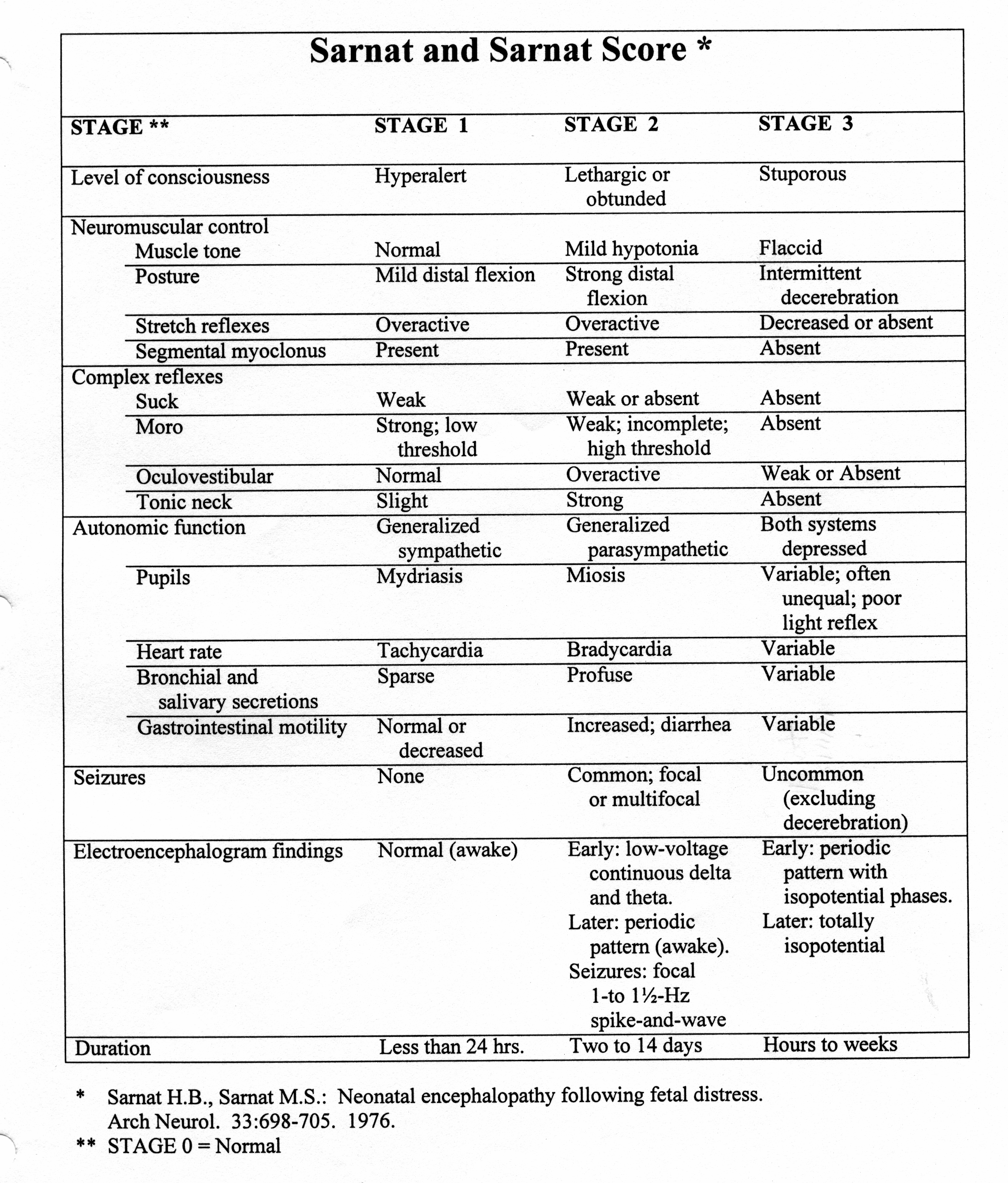
Grading of severity
Sarnat score based on a group of 21 infants
Score included the EEG
Rarely performed in full
Notes:
42

Slide 43
Clinical Assessment of HIE
Severity | Features | Deaths (%) | Neurological Abnormalities (%) | Normal (%)
Mild | Irritability, normal tone | 0 | 0 | 100
Moderate | Hypotonia, seizures | 5 | 24 | 71
Severe | Stupor, flaccid | 80 | 20 | 0
Levene Early Hum Dev. 1985 May;11(1):21-6

Slide 44
Assessment by neuroimaging
Cranial ultrasound
Magnetic resonance imaging

Slide 45
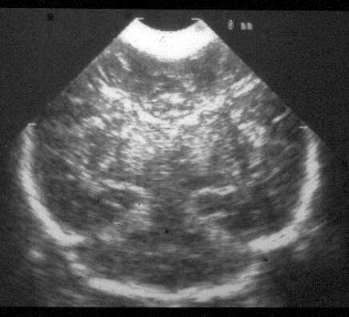
Cranial ultrasound
General increase in echodensity
Slit like ventricles
Echodense thalamus / basal ganglia
J Paediatr Child Health (2000) 36: 363 -369
Notes:
45

Slide 46
Role of MRI
Helps confirm diagnosis
Helps with ‘timing’ of injury
Objective guide to prognosis
Notes:
46

Slide 47
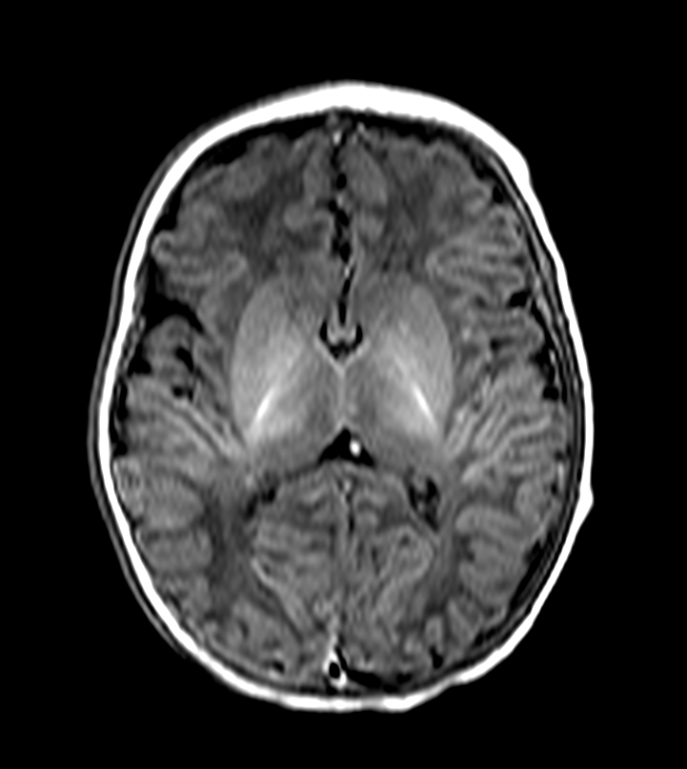
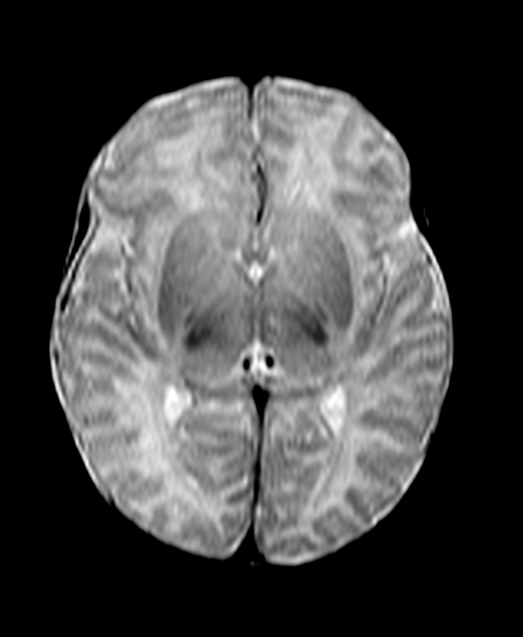
Normal MR appearances at term
T1 weighted
T2 weighted
Myelin visible in PLIC from 37 weeks
Notes:
47

Slide 48
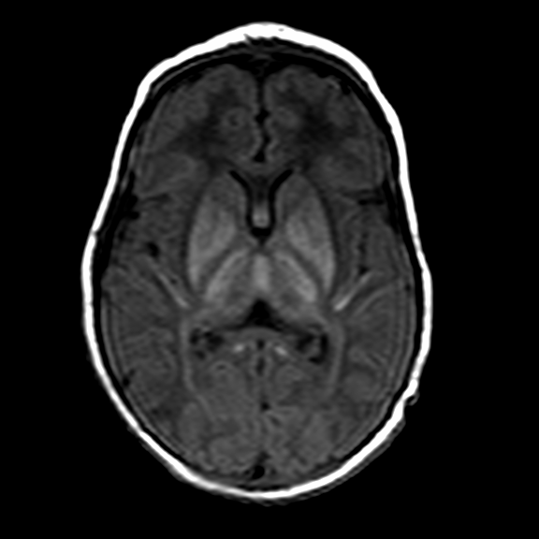
Signal Intensity in PLIC
Normal at term
Complete loss of
signal intensity
Notes:
48

Slide 49
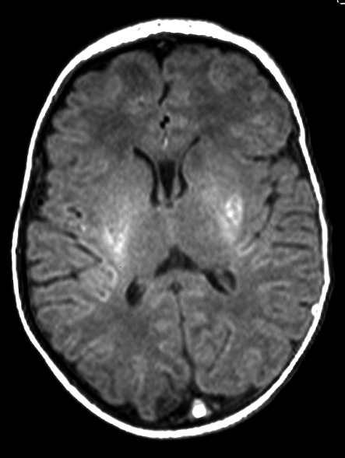
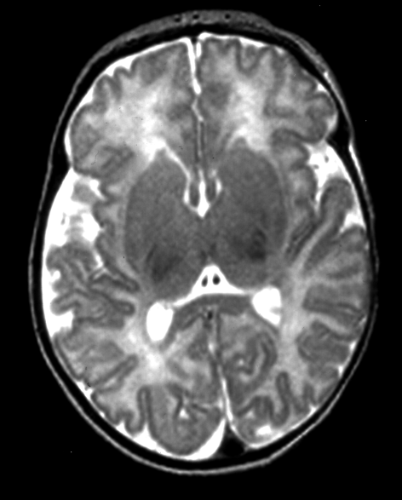
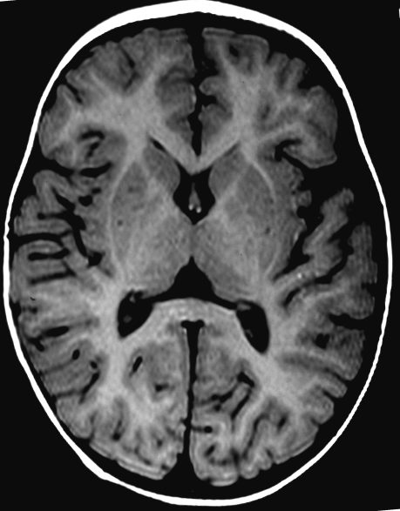
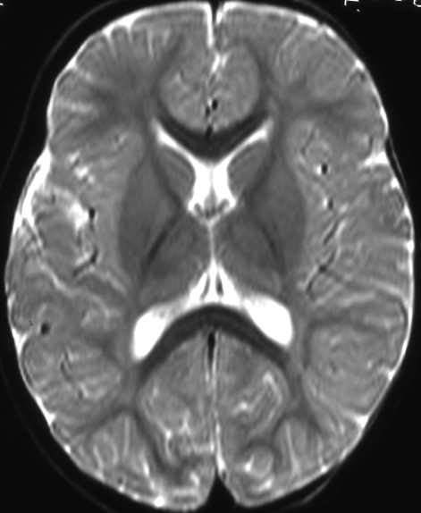
Mild basal ganglia and thalamic lesions
Delay in motor milestones
Late tremor
Notes:
49

Slide 50
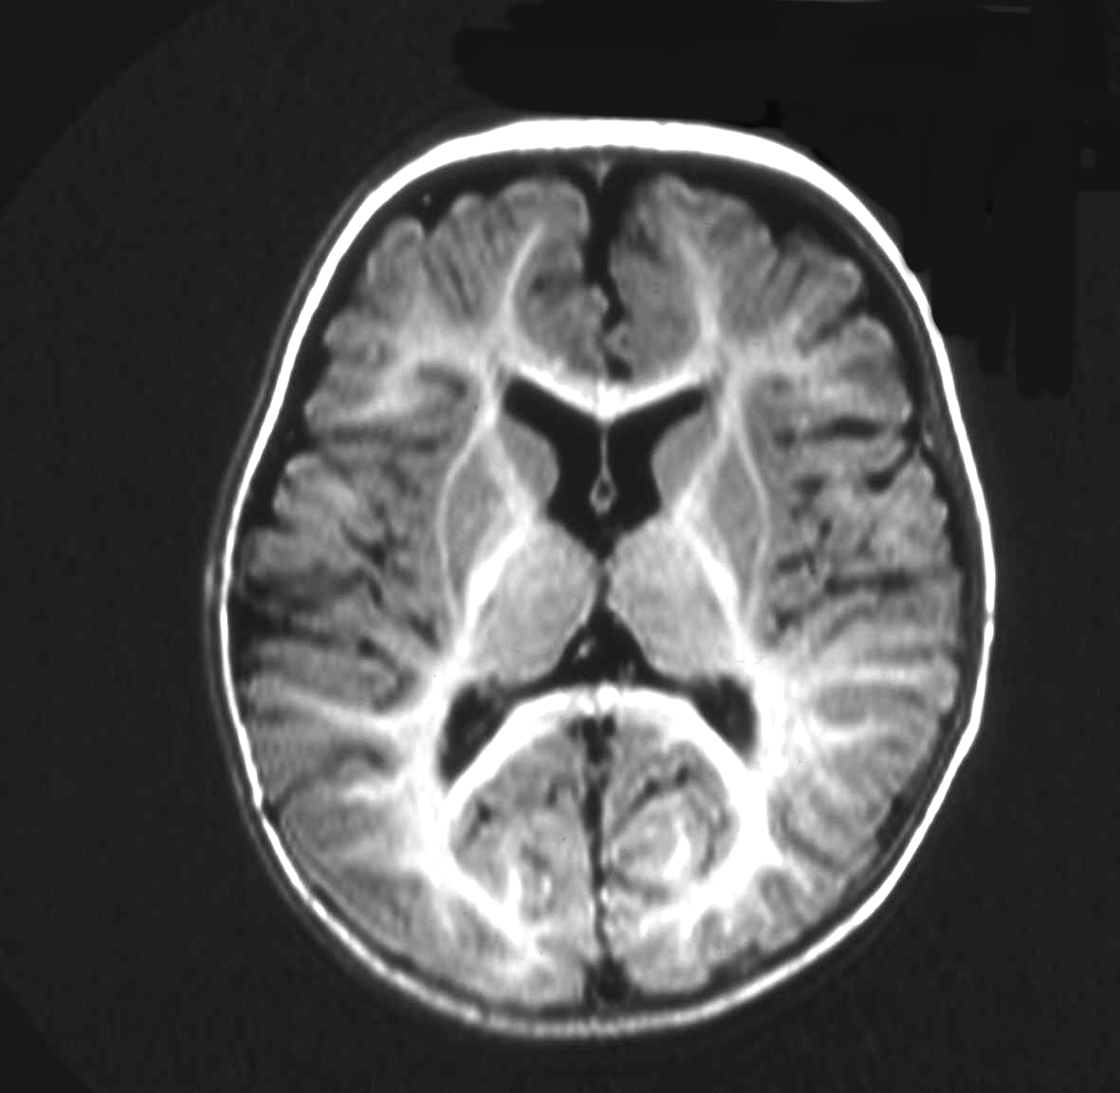
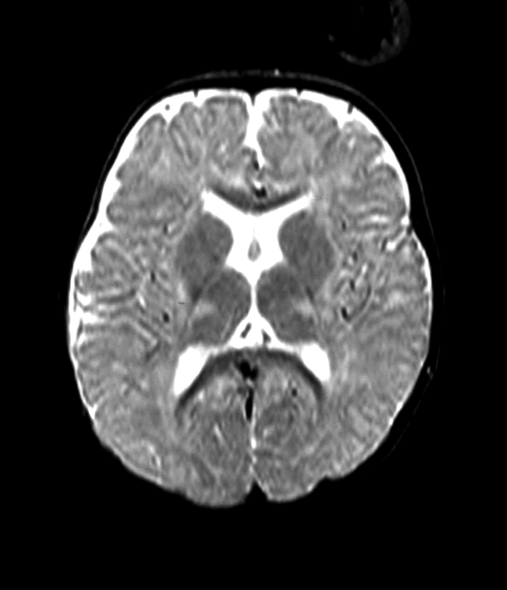
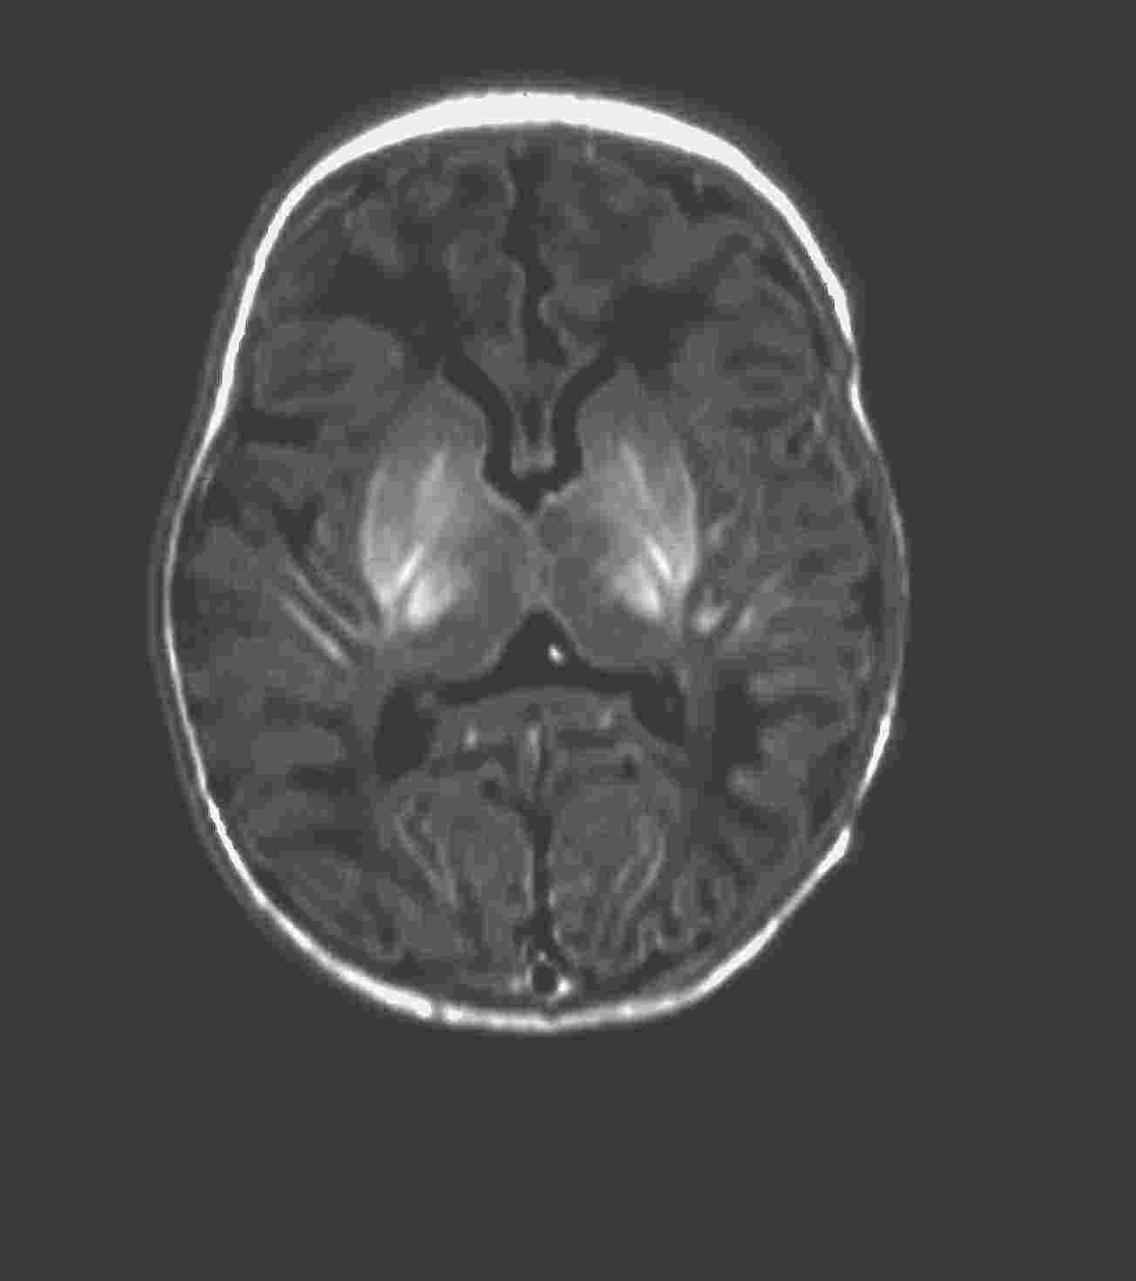
Moderate basal ganglia and thalamic lesions
5 days
12 months, athetoid
cerebral palsy
Notes:
50

Slide 51
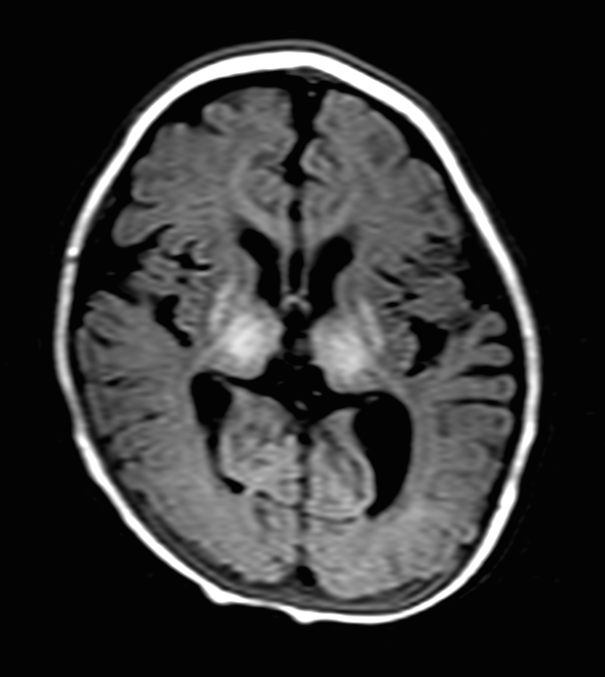
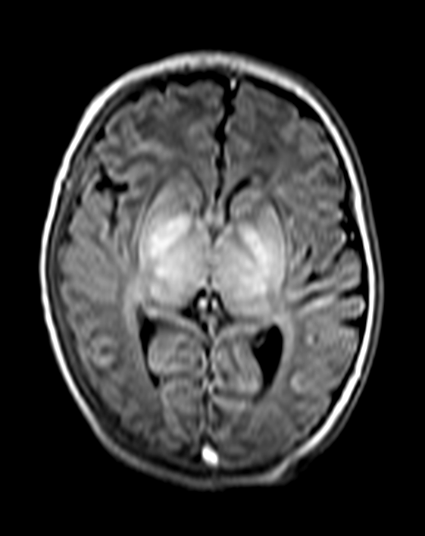
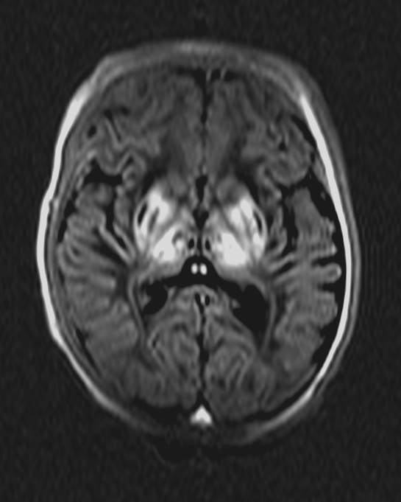
Severe basal ganglia and thalamic lesions
5 days
18 days
7 months
severe spastic CP
BGT and WM atrophy
Notes:
51

Slide 52
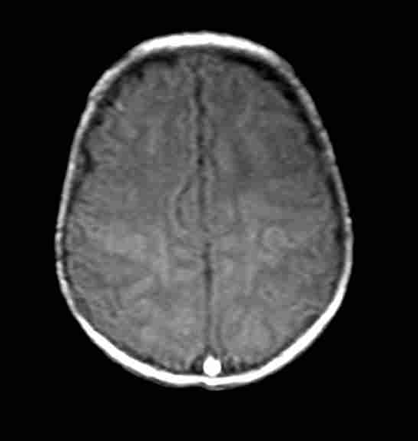
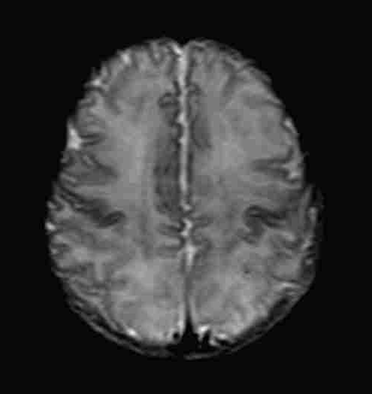
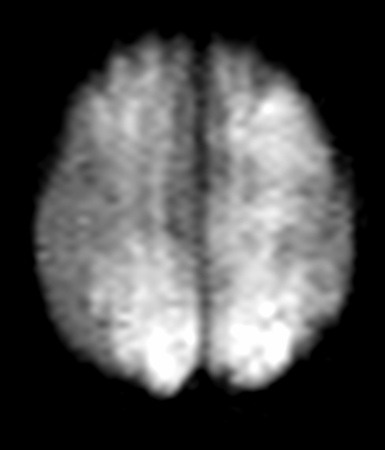
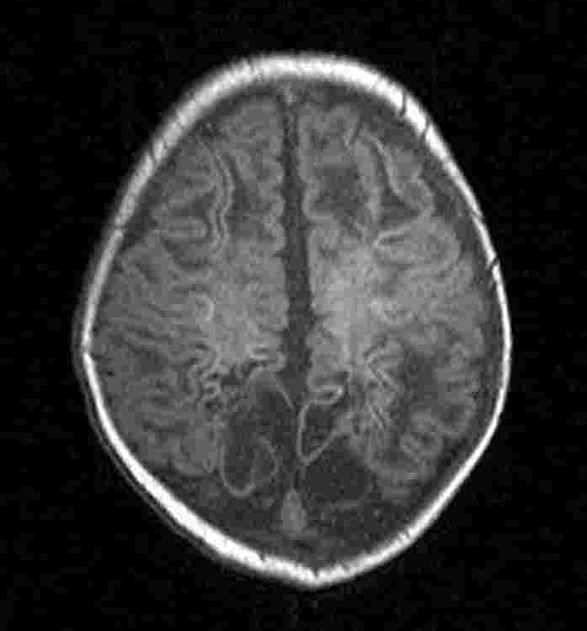
White matter infarction
T1
T2
DWI
T1 3 weeks
Notes:
52

Slide 53
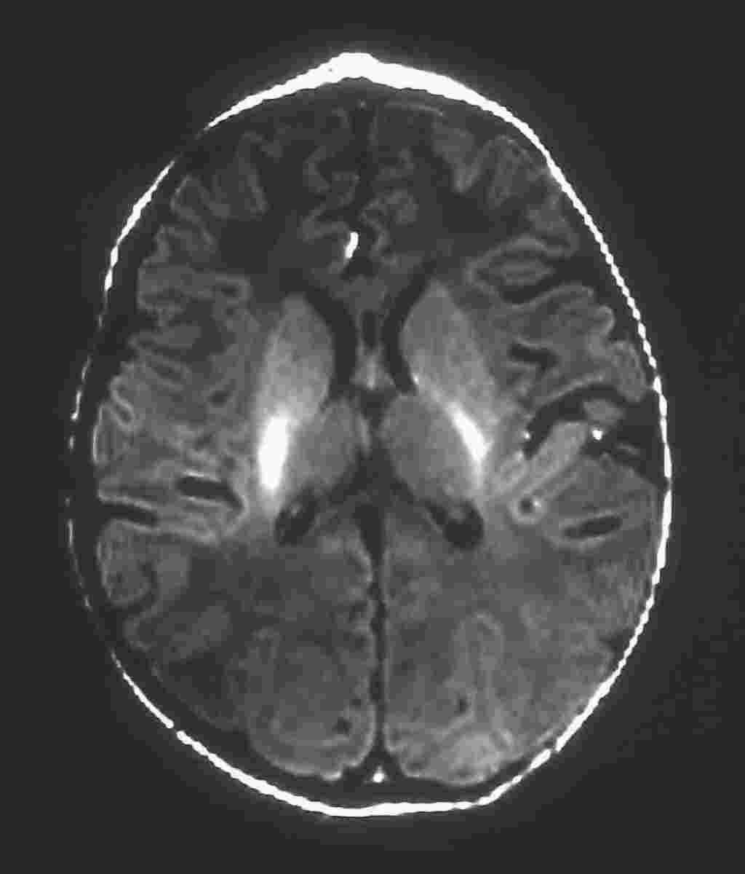
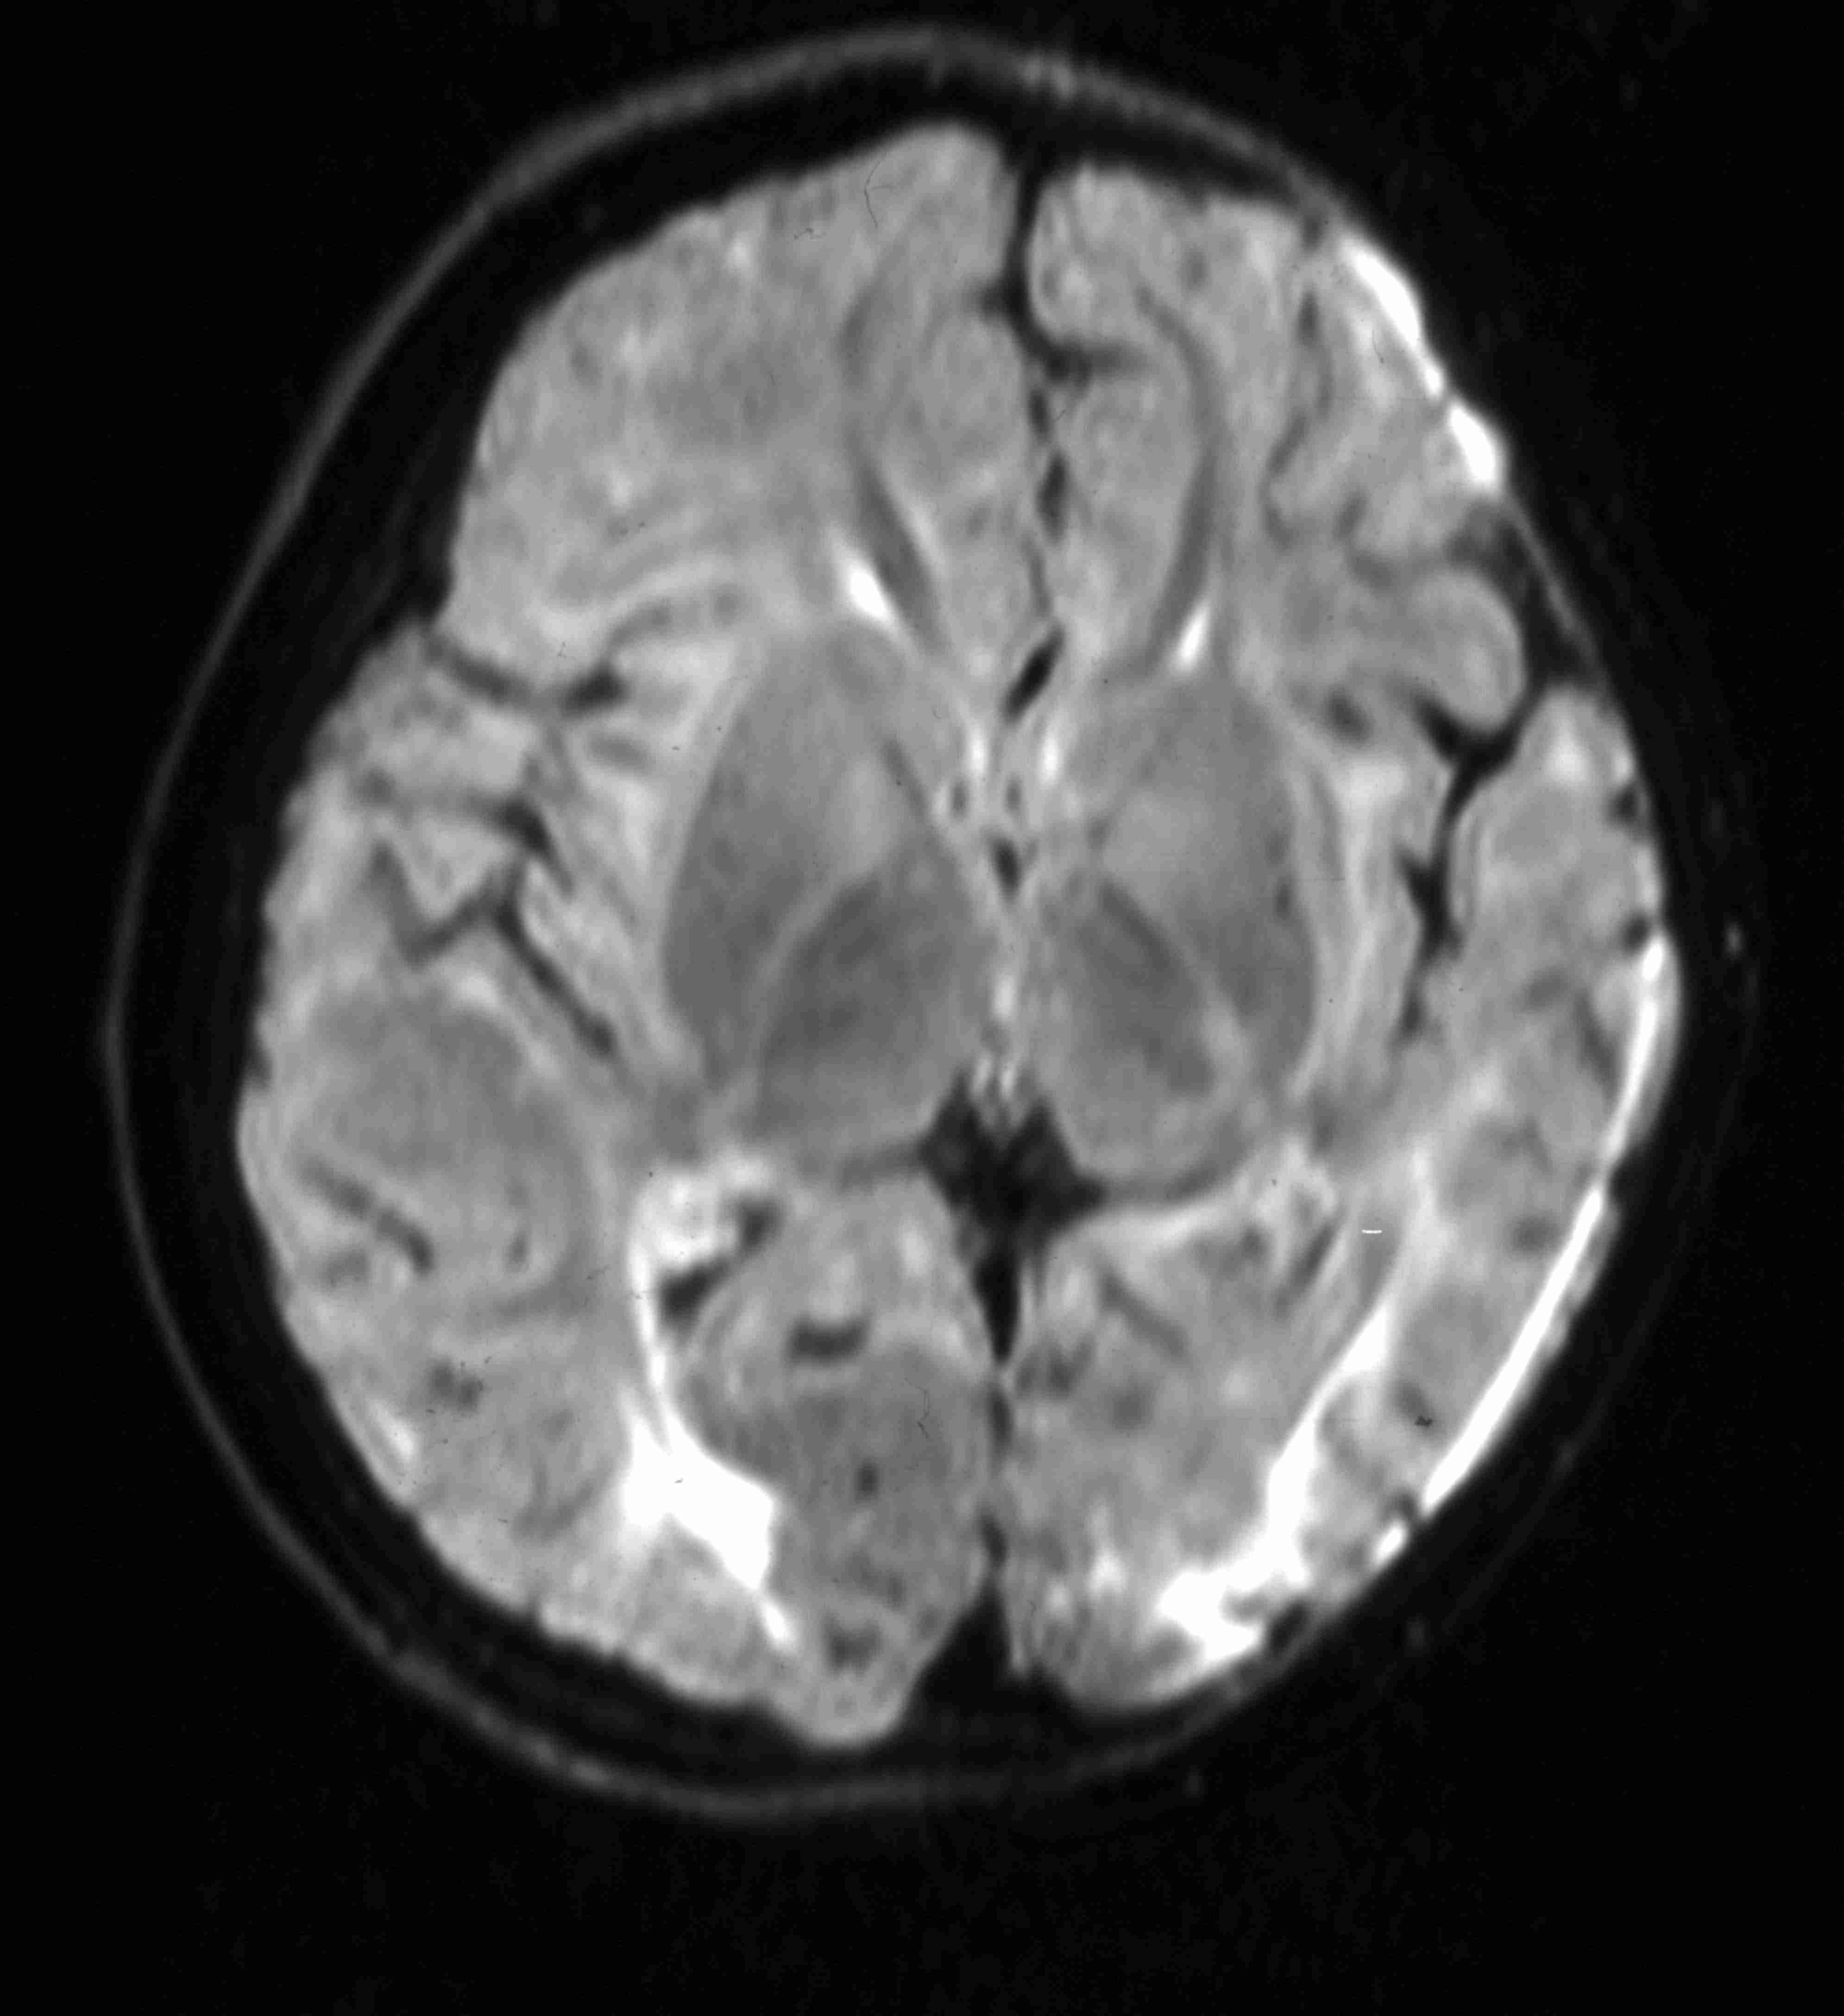
Normal PLIC – abnormal outcome
Normal basal ganglia
Parasagittal WM
infarction
Late FLAIR imaging
No motor impairment
Microcephaly, decreased IQ
Notes:
53

Slide 54
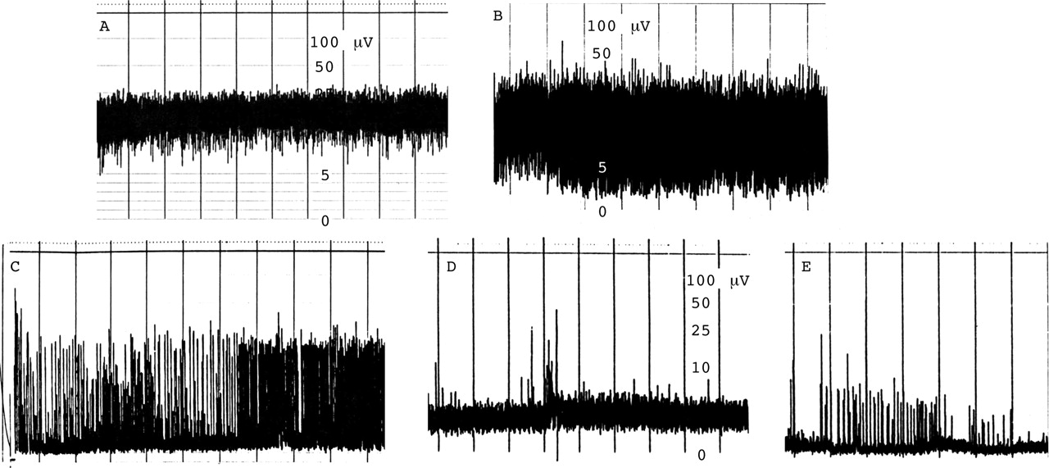
Classification of aEEG in neonatal encephalopathy
Continuous normal voltage
Discontinuous normal voltage
Burst suppression
Continuous low voltage
Flat trace
de Vries, L S et al. Arch. Dis. Child. Fetal Neonatal Ed. 2005;90:F201-F207

Slide 55
Predictive values for neurological examination and aEEG
 | Positive Predictive Value (%) | Negative Predictive Value (%) | Likelihood ratio
Abnormal examination | 58 | 90 | 3.5
Abnormal aEEG | 73 | 91 | 7
Combination of abnormalities | 85 | 92 | 13
Pediatrics (2003) 111 351-357
Notes:
55

Slide 56
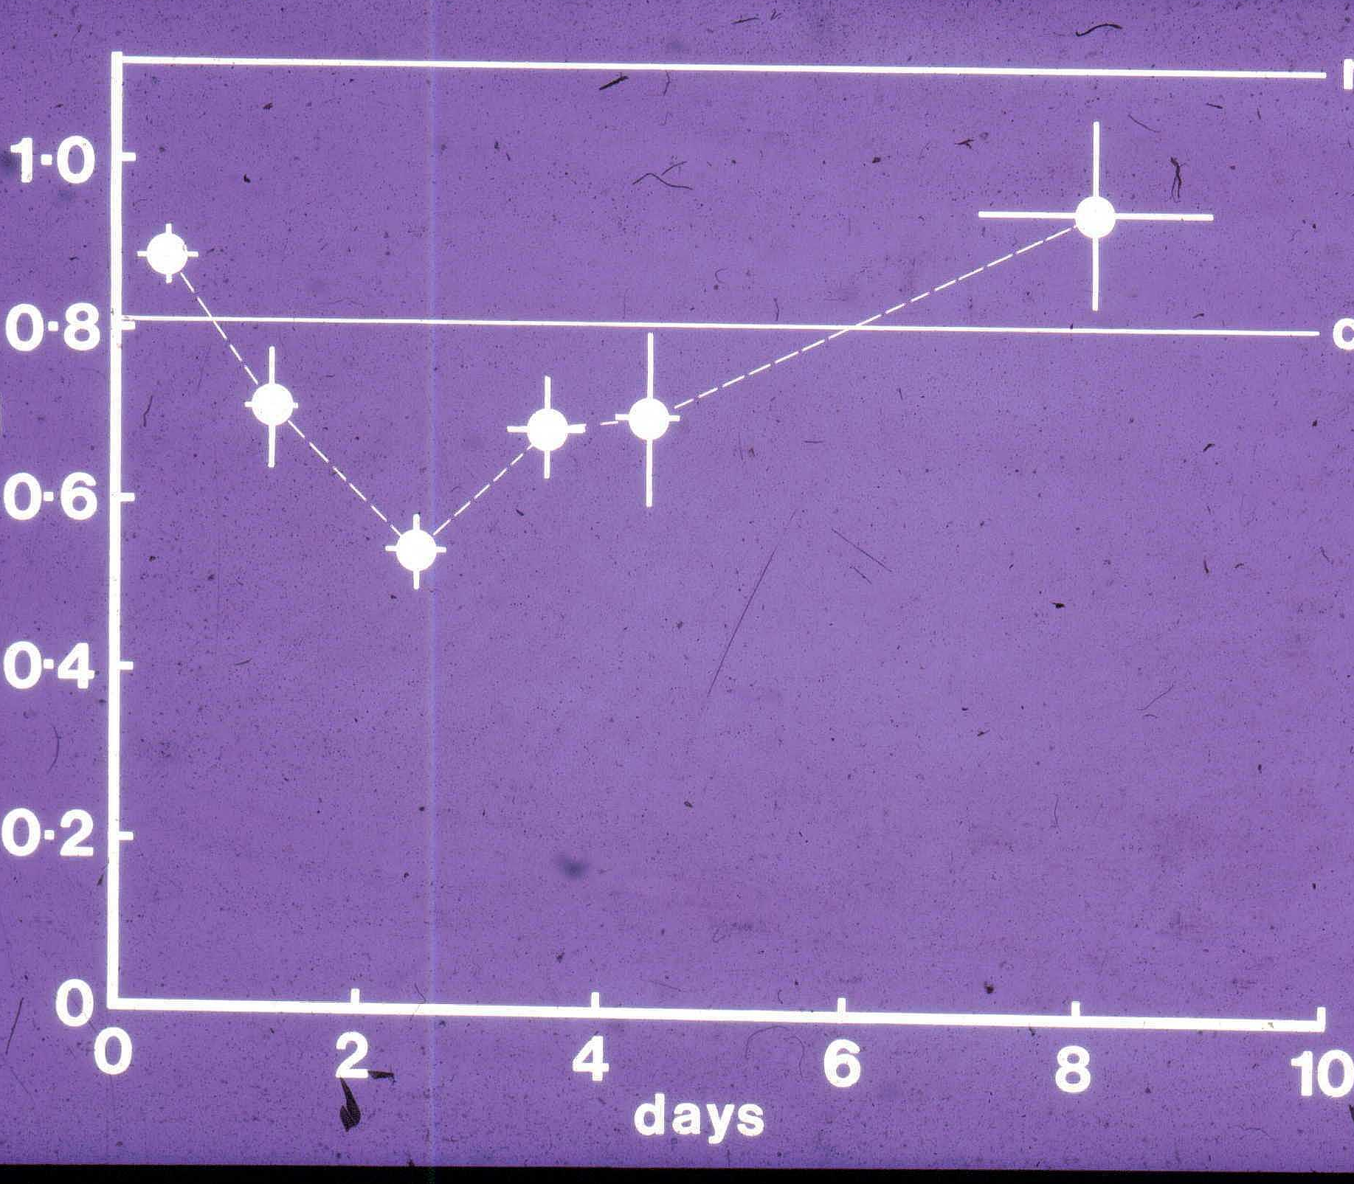
The hypothesis of secondary energy failure
Asphyxia
Latent period
Delayed cell death
Notes:
56

Slide 57
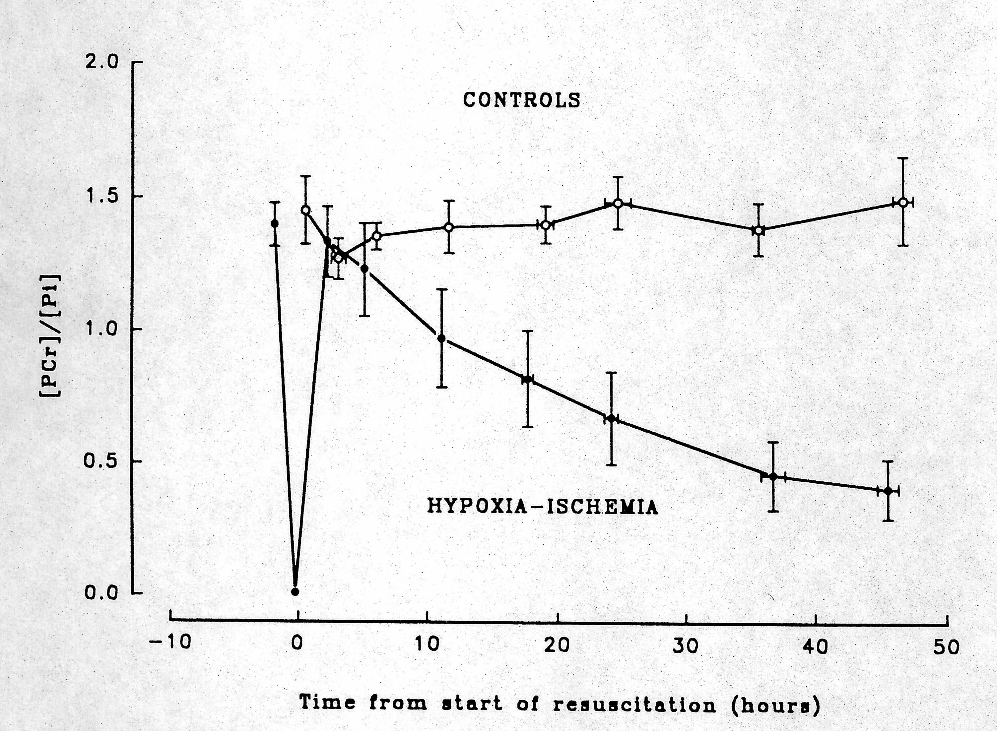
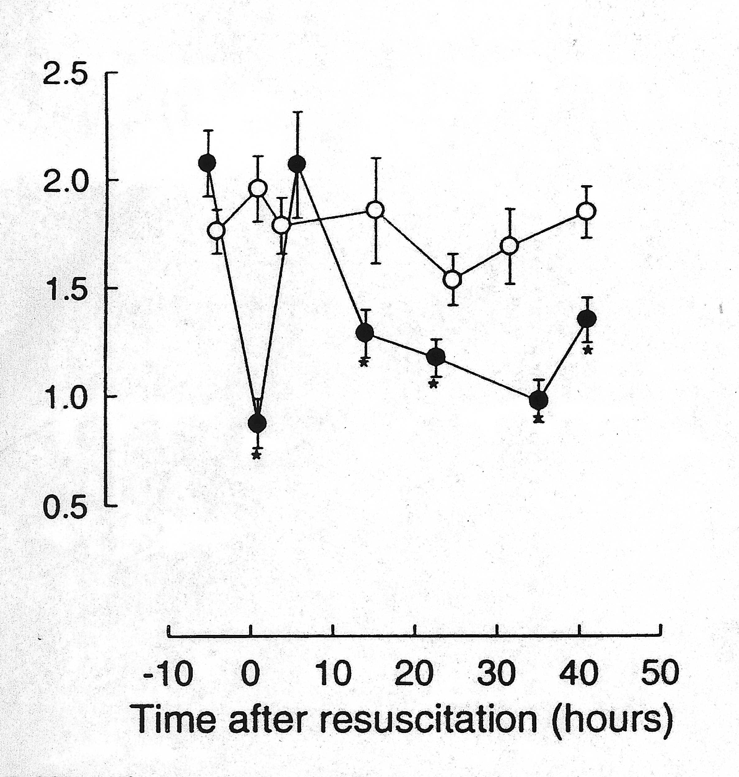
Testing the hypothesis: delayed energy failure after hypoxia-ischaemia in immature animals
Focal stroke (rat)
Global hypoxia-ischaemia (piglet)
Phosphocreatine/Pi
Phosphocreatine/Pi
(Blumberg et al Exp Brain Research 1997;113:130-137)
(Lorek et al Pediatr Res
1994;36:699-706)
Notes:
57

Slide 58
The pathways leading to brain injury following neonatal encephalopathy have been extensively studied
Impaired cerebral energetics
Cell membrane dysfunction
Excitotoxicity
Free radical production
Immune activation
Gene expression
Apoptosis/necrosis
Notes:
58

Slide 59
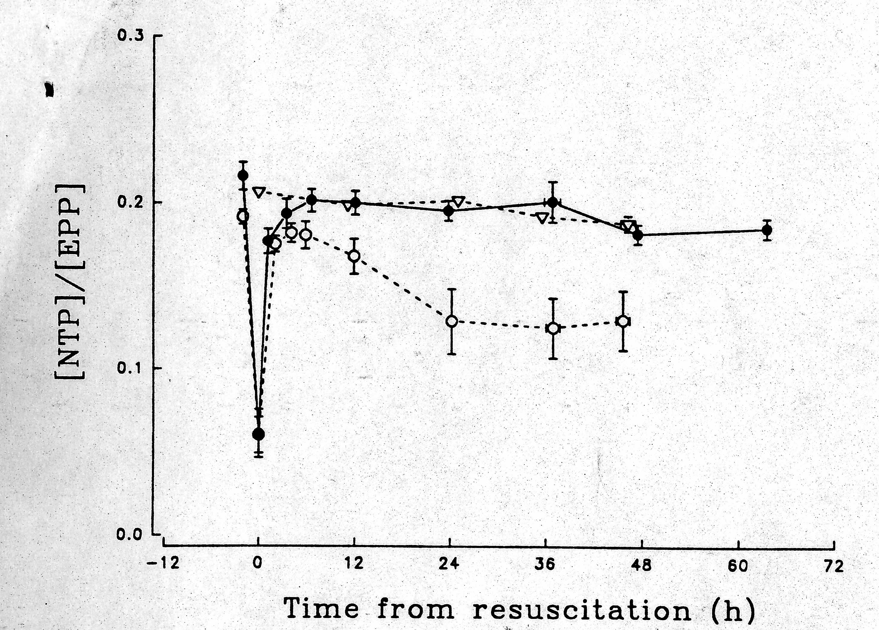
Experimental evidence of hypothermic neuroprotective therapy
Cooling 0-12 hours after hypoxia ischaemia prevents secondary energy failure
Control
Hypothermia
Normothermia
cooling
(Thoresen et al Pediatr Res 1995;37:667-670)

Slide 60
Study | Cooled : Controls | Cooling method | Temp ºC (core) | Duration Cooling (hours) | Primary outcome | Follow-up period
Akisu | 11:10 | Selective | 36.5 | 72 | Platelet activating factor levels in CSF | 4-10 days
Shankaran, 2002 | 9:10 | Systemic | 34.5 | 72 | Hospital course | To hospital discharge
Lin | 32:30 | Selective | 34-35 | 72 | CT scan appearances, neurological assessment | 7-10 days
Eicher | 32:33 | Systemic | 33 | 48 | Rate of death + severe disabilities | 12 months
Robertson | 21:15 | Systemic | 33-34 | 72 | Mortality, neurological assessment, seizures | 17 days
Gluckman (CoolCap trial ) | 116:118 | Selective | 34-35 | 72 | Rate of death + severe disabilities | 18 months
Shankaran, (NICHD trial) | 102:106 | Systemic | 33.5 | 72 | Rate of death + moderate + severe disabilities | 18 months
Azzopardi (TOBY trial) | 163:162 | Systemic | 33-34 | 72 | Rate of death + severe disabilities | 18 months
Jacobs (ICE trial) | 110:111 | Systemic | 33-34 | 72 | Rate of death + severe disabilities | 24 months
Simbruner (neo.nNeuro.network trial) | 64:65 | Systemic | 33-34 | 72 | Rate of death + severe disabilities | 18 months
Zhou 2010 | 119:116 | Selective | 34-35 | 72 | Rate of death + severe disabilities | 18 months

Slide 61
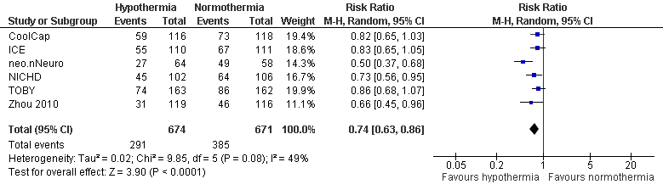
Death or severe disability to 18 months of age

Slide 62
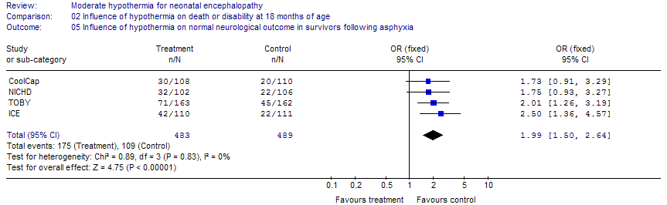
Effect of therapeutic hypothermia on
rate of intact survival at
18 months

Slide 63
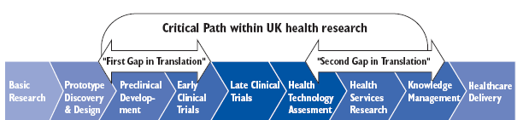
Path for healthcare research
Academic research.
Cooksey: A Review of UK Health Funding. 2006 Chart 7.1
Implementation
Surveillance
Audit

Slide 64
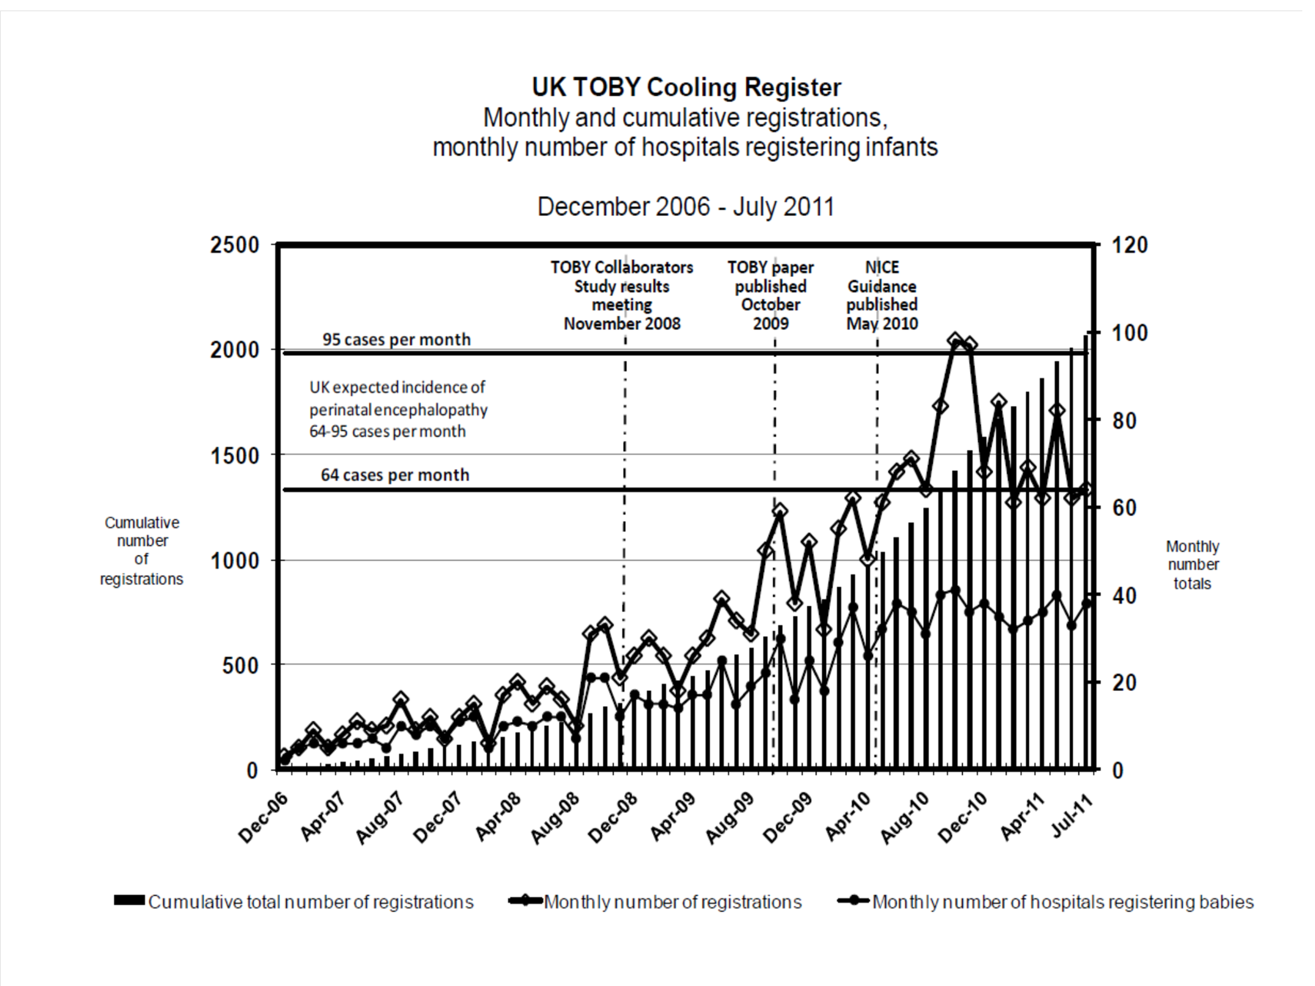

Slide 65
Clinical effectiveness
For every 7-10 infants treated one less infant has an unfavourable outcome
But the rate of severe adverse outcome was 43% in cooled infants (down from 55%) in controls

Slide 66
Failed neonatal neuroprotective therapies
Calcium channel blockers
  Insufficient experimental data
  Insufficient pharmacokinetic data
Phenobarbitone
  Insufficient experimental data
  Small clinical trials with inappropriate end points
Magnesium sulphate
  Small clinical trials
  Logistical/technical problems with large trial
Allopurinol
  Logistical problems

Slide 67
Ongoing studies of therapies additional to hypothermia
Erythropoetin
Topiramate
Melatonin
Allopurinol
Xenon
………………

Slide 68
Injury of the Immature Brain
Mechanisms and Prospects for Neuroprotection
Dr Denis Azzopardi, ICM, London

