Slide 1
Success and failure of ART BSc Imperial 2012
Lisa Webber BA BMBCh PhD MRCOG
Consultant Gynaecologist
Specialist in Reproductive Medicine

Slide 2
Learning objectives
Limitations of ART

Slide 3
IUI live birth rates donor sperm
Female natural cycle stimulated cycle
age
under 35 13.2% 20.2%
35–37 9.7% 16.5%
38-39 7.7% 10.6%
40-42 6.2% 8.4%
43-44 0
HFEA 2010

Slide 4
IUI clinical pregnancy rates partner sperm
Female natural cycle stimulated cycle
age
under 35 13.2% 14.4%
35–37 8.4% 14%
38-39 6.3% 12%
40-42 1.1% 9.3%
43-44 5% 5.2%
over 44 1.7%
HFEA 2011

Slide 5
IVF & ICSI live birth rates
Female age
under 35 32.4%
35–37 28%
38-39 20.2%
40-42 12.9%
43-44 5.7%
over 44 2.3%
HFEA 2010

Slide 6
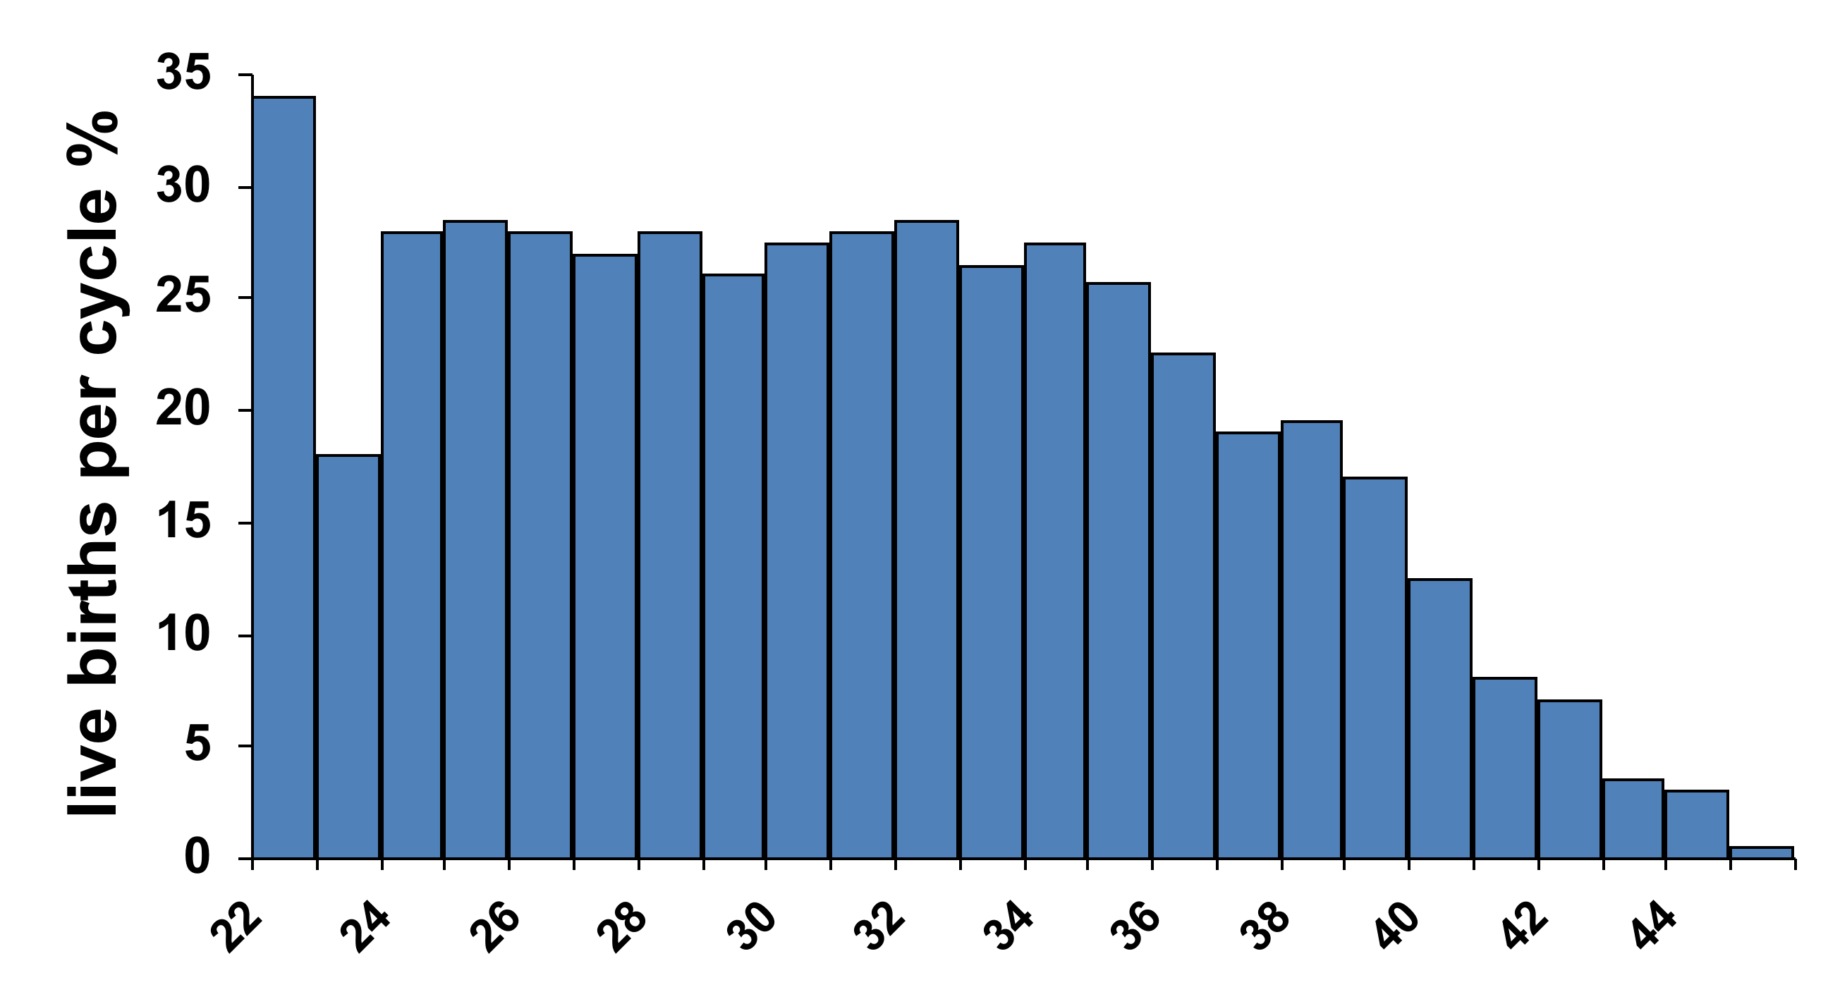
IVF births by maternal age
Age (years)
HFEA

Slide 7
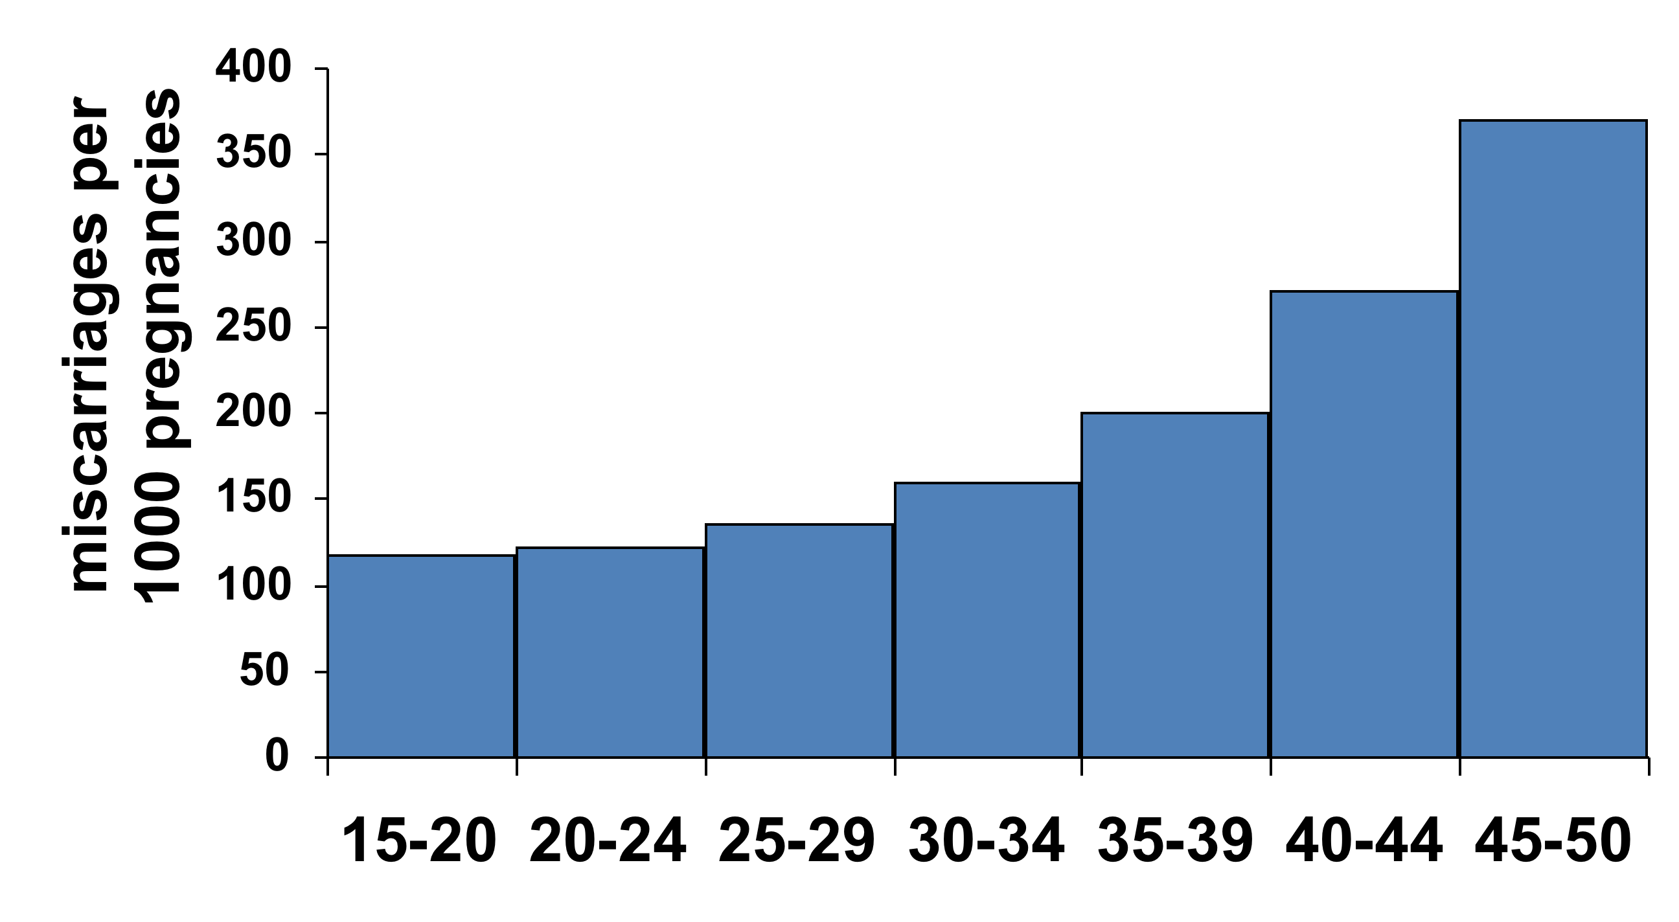
Rate of miscarriage by age
Leridon et al 2005

Slide 8
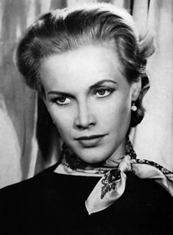
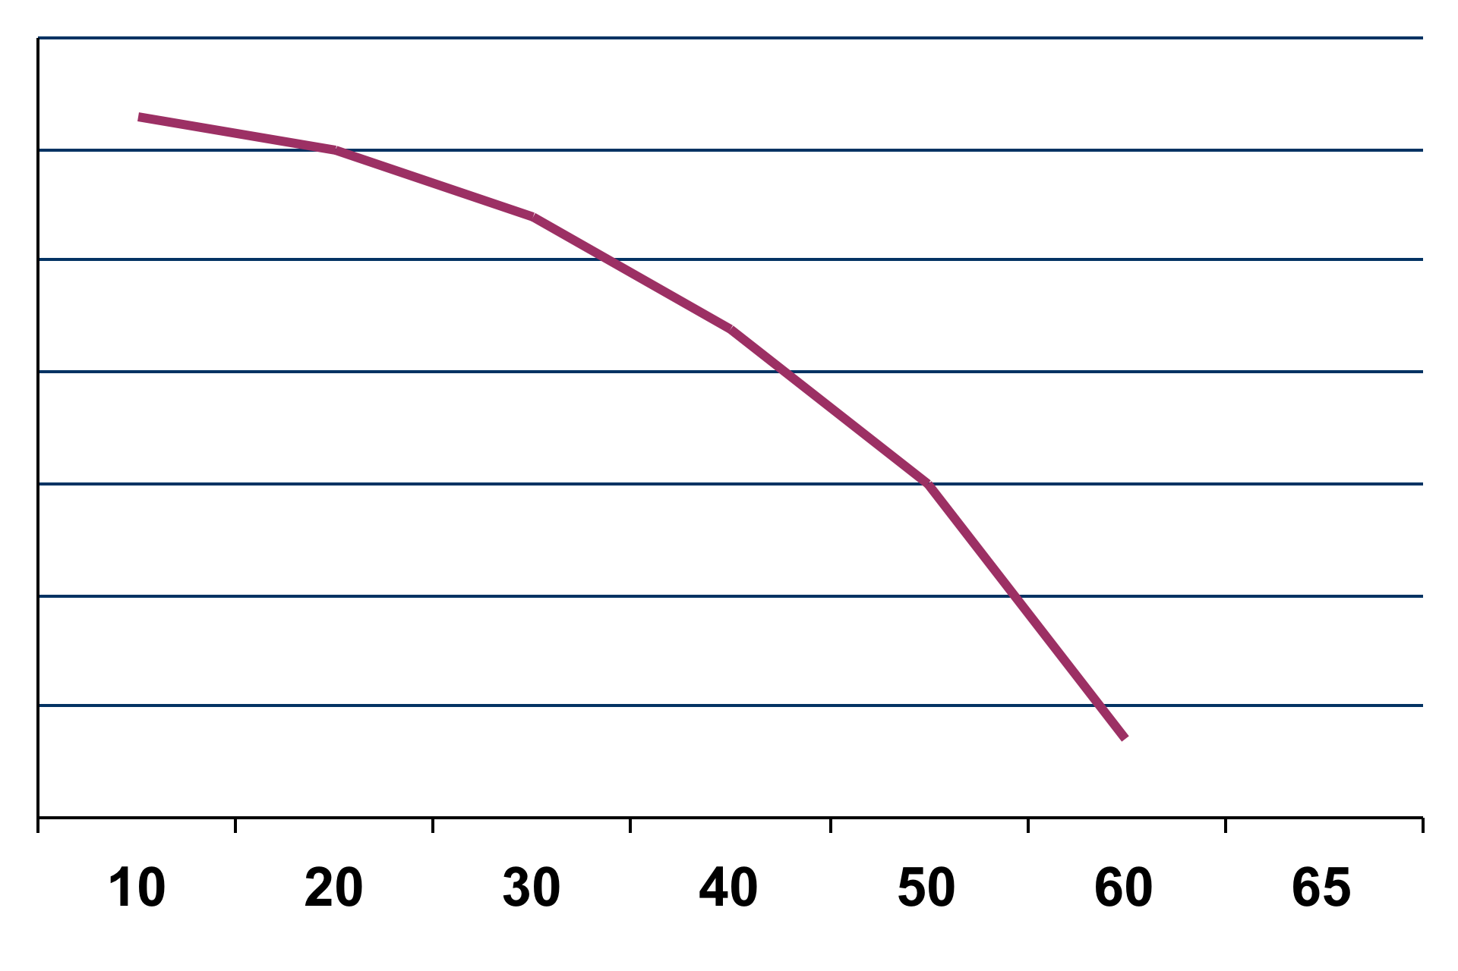
hypothesised age-dependent loss of preantral follicles
10⁶
10¹
follicle count
age (years)
Faddy et al 1992

Slide 9
Fecundability in Hutterites
declines almost linearly from 20 to 40 years
fecundability at 35 years half that at 25 years
Larsen et al 2003

Slide 10
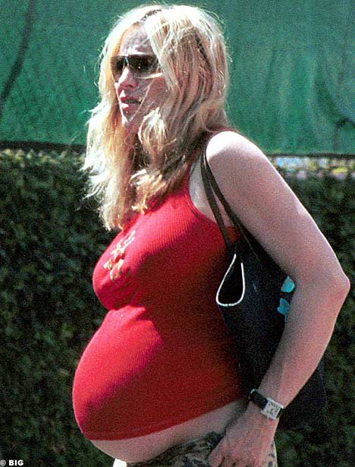
age makes it harder to become and stay pregnant

Slide 11
Endometrial/implantation issues
Abnormal endometrium eg chronic endometritis
Irregular endometrial cavity: polyps, fibroids, septum, adhesions
Implantation window unsynchronized
? benefit of endometrial trauma

Slide 12
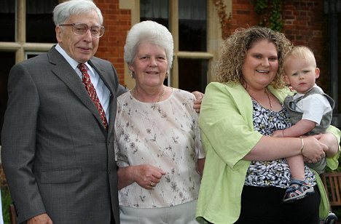
Bob Edwards with Louise Brown,
her mother Lesley and son Cameron

