Slide 1
An introduction to spermatogenesis
Sheba Jarvis
30 Oct 2012

Slide 2
Learning objectives
Understand basic testicular development and anatomy
To recognise the importance of the testicular cell types
To understand the development of primitive male germ cells into mature spermatozoa

Slide 3
Germ cell specification
Notes:
In normal mouse embryos, the germ cell precursors migrate from the extraembryonic mesoderm back into the embryo, by way of the allantois. The route of mammalian PGC migration from the allantois (Figure 19.6) resembles that of anuran PGC migration. After collecting at the allantois (by day 7.5 in the mouse: Chiquoine 1954; Mintz 1957), the PGCs migrate to the adjacent yolk sac (Figure 19.6A,Figure 19.6C). By this time, they have already split into two populations that will migrate to either the right or the left genital ridge. The PGCs then move caudally from the yolk sac through the newly formed hindgut and up the dorsal mesentery into the genital ridge (Figure 19.6B,Figure 19.6D). Most of the PGCs have reached the developing mouse gonad by the eleventh day after fertilization. During this trek, they have proliferated from an initial population of 10–100 cells to the 2500–5000 PGCs present in the gonads by day 12.

Slide 4
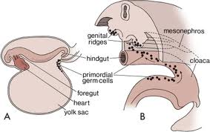
The site of the primordial germ cell origin in the wall of the yolk sac in a 3-week-old embryo. B, Migratory path of the primordial germ cells along the wall of the yolk sac and dorsal mesentery into the developing genital ridges.

Slide 5
Sex determining region (Y chromosome)
The genetic determinant of sex is on the Y chromosome
Y chromosome possesses the sex determining region (SRY) which controls male determination
The SRY encodes a ‘protein switch’ which acts on other specific male genes found elsewhere in the genome
SRY found on the short arm of the Y chromosome

Slide 6
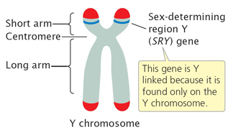
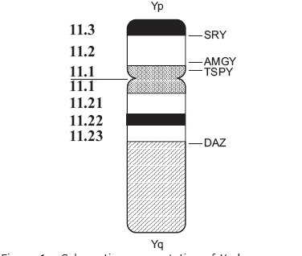
Sex determining region (Y chromosome)
From: Hake, L. & O'Connor, C. (2008) Genetic mechanisms of sex determination. Nature Education 1(1)

Slide 7
Endocrine effects of SRY
The SRY gene encodes a unique transcription factor that activates a testis-forming pathway at about week seven of development.
Before this time, the embryonic gonad is "indifferent,"
The early embryo has two systems of ducts:
Wolffian (Male)
Müllerian ducts (female)
The SRY gene product stimulates the indifferent gonad to develop into a testis and produces testosterone and anti-Müllerian hormone (AMH)
Testosterone and dihydrotestosterone, induce formation of other organs in the male reproductive system, while AMH causes the degeneration of the Müllerian duct.

Slide 8
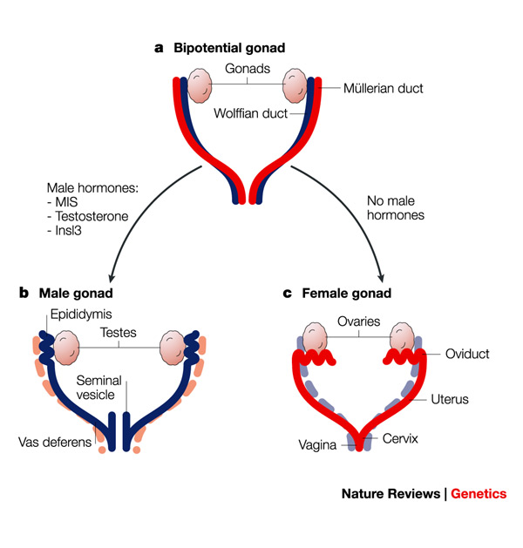
Endocrine effects of SRY

Slide 9
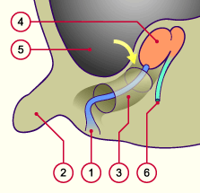
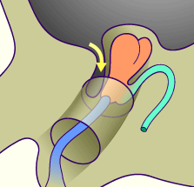
Testicular descent
Fig 1 Protrusion of the peritoneum and the beginning of the testicular descent into the inguinal canal.
Fig. 2
Formation of the vaginal process is visible. It enters with the testis into the inguinal canal. Shown in blue is the gubernaculum that becomes increasingly shorter.
Taken from http://www.embryology.ch/anglais/ugenital/diffmorpho04.html

Slide 10
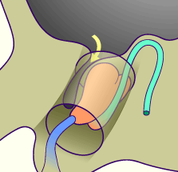
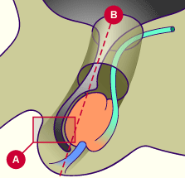
Testicular descent
Fig. 3 Between the 3rd and 7th month of pregnancy the testes remain near the inguinal canal in order to pass through it. The vaginal process lengthens while the gubernaculum shortens, thereby drawing the testis, the deferent duct and its vessels on both sides downwards. Fig. 4 In the 9th month of pregnancy (but also sometimes only after birth) the testes reach the scrotum. The vaginal process forms now a serous bilaminar structure on the front side of the testis.

Slide 11
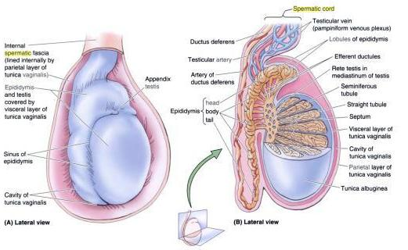
Testicular anatomy
From: anatomytopics.wordpress.com

Slide 12
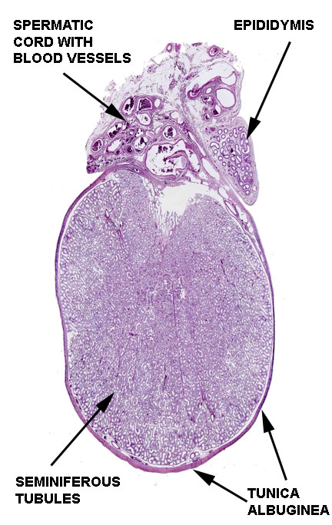
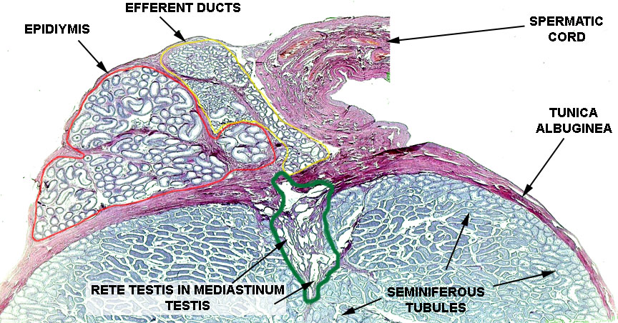
Testicular compartments

Slide 13
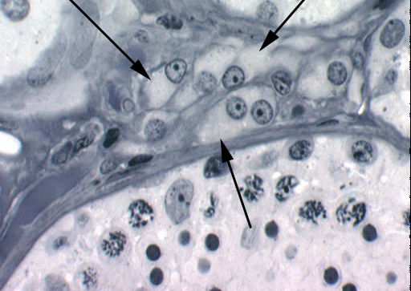
Testicular growth
At 16/40 of gestation, the testis is enclosed by the outer tunica albuginea testicular tissue, stromal tissue containing Leydig cells, Sertoli Cells and Germ cells
Leydig cells are interstitial cells that secrete testosterone from 8/40 of gestation with a prenatal peak at 13/40 and agin at 3 months post partum which declines until a further peak at puberty

Slide 14
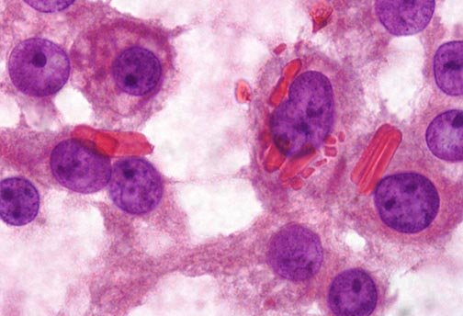
Leydig cells
Leydig cells have 5 main morphological features
Vesicular nucleus
ovoid, elongated mitochondria with tubular cristae
Smooth ER
Lipid droplets (cytoplasmic)
Lipofuscin pigment and rod shaped crystals (Reinke’s)

Slide 15
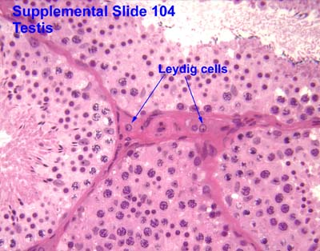
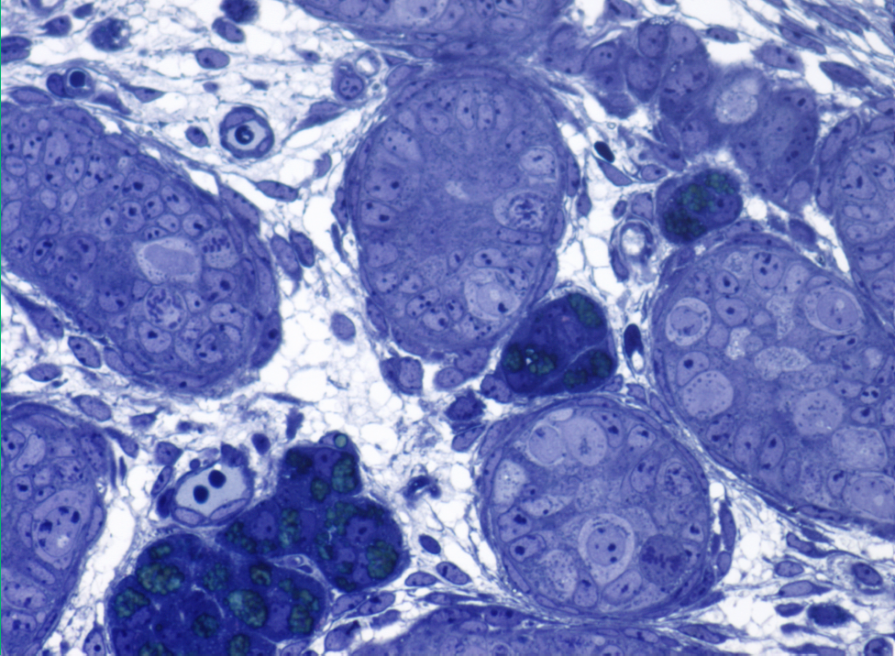
Testicular cells types: Leydig cells

Slide 16
Leydig cells
Possess luteinizing hormone receptor (LH).
As a results they secret testosterone, androstendione and dihydroepiandrosterone
LH also increases the cholesterol desmolase activity (converts cholesterol to pregnenolone) leading to testosterone synthesis.
In the developing testis ‘fetal’ Leydig cells are present between the 8th and 20th week of gestation to produce enough testosterone to masculine the male fetus
Adult leydig cells differentiate in the postnatal testis

Slide 17
Testicular growth and puberty
Sertoli cells are somatic cells found within the seminiferous tubules and are ‘nurse’ cells.
They produce anti-Mullerian hormone until puberty
At puberty, the testicular size increases due to growth of all components of the testis: germ cells, Sertoli and Leydig cells.
Seminiferous tubules canalise from cords to tubules and spermatogenesis ensues

Slide 18
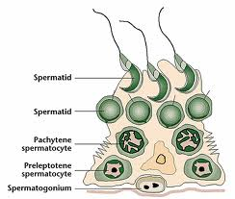
Testicular cells types: Sertoli cells

Slide 19
Sertoli cells
Sertoli cells have an intimate physical relationship with the germ cells during the process of spermatogenesis
The cytoplasmic extensions that pass between the germ cell populations surrounding the Sertoli cell provides structural support
A microfilament and microtubular network present in the cytoplasm of the Sertoli cell
Dynamic architecture within the tubule depending on the stage of the spermatogenic process.
Sertoli cells have a role in regulating the internal environment of the seminiferous tubule.

Slide 20
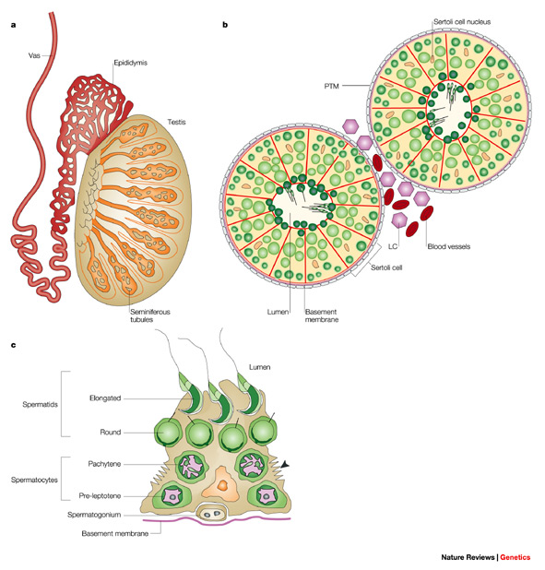
Seminiferous tubules

Slide 21
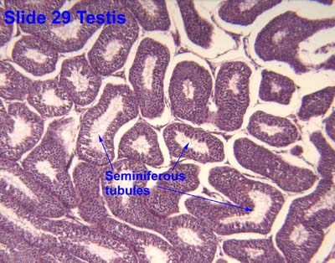
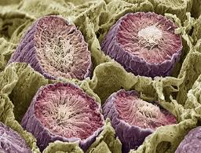
Seminiferous tubules

Slide 22
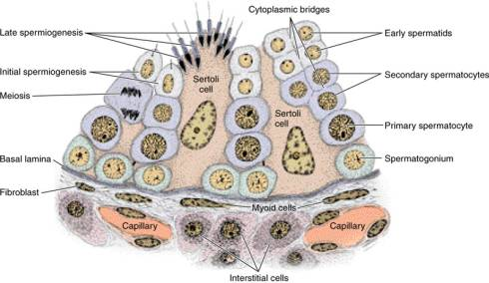
Seminiferous tubules

Slide 23
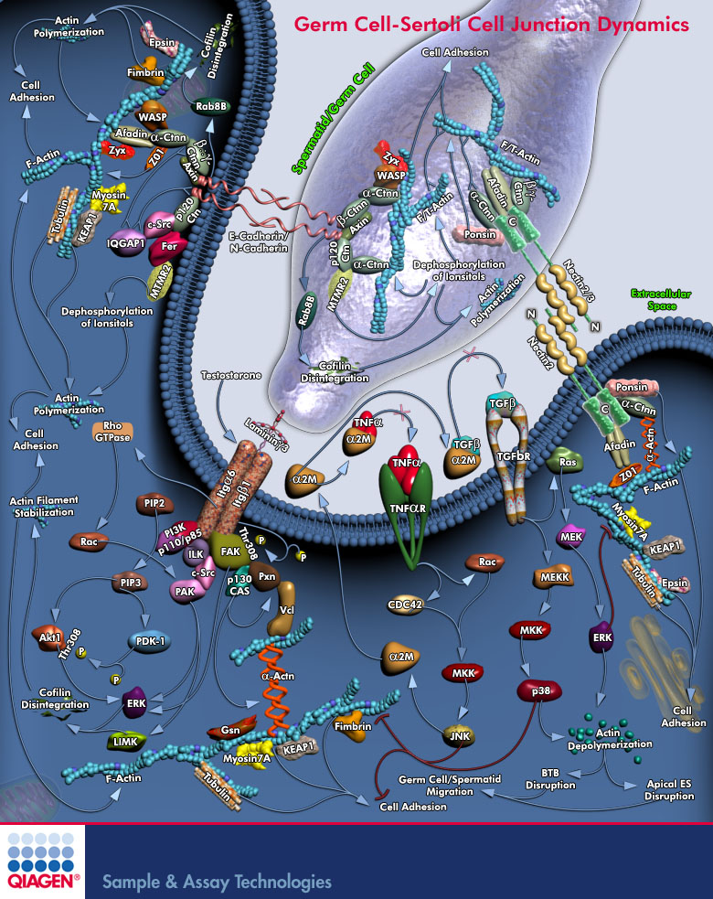
Intimate somatic and germ cell relationship

Slide 24
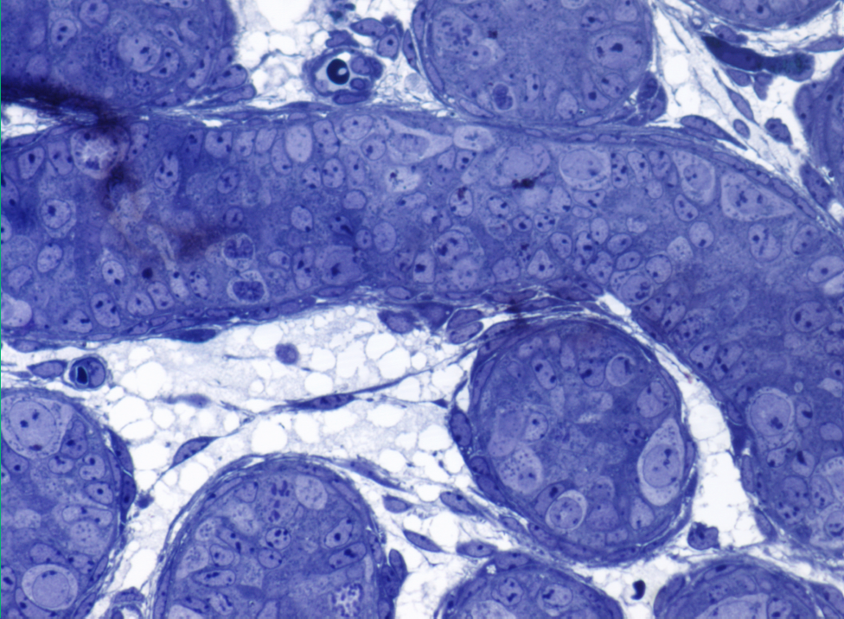
Prespermatogenesis
Gonocyte
Sertoli cells
Gonocyte

Slide 25
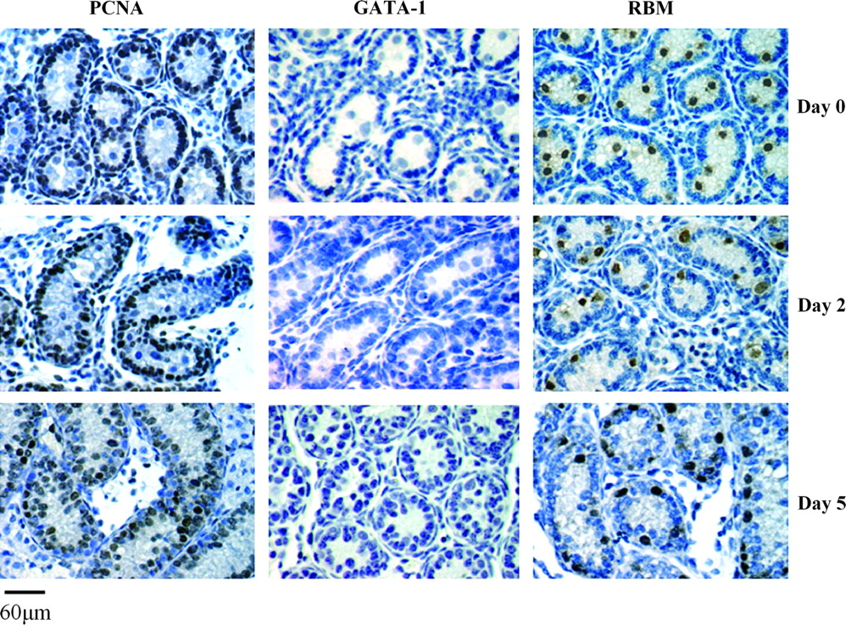
The immature testis - prespermatogenesis
Immunolocalization of PCNA, GATA-1 and RBM in germ cells and Sertoli cells
during early postnatal development (days P0, P2 and P5).

Slide 26
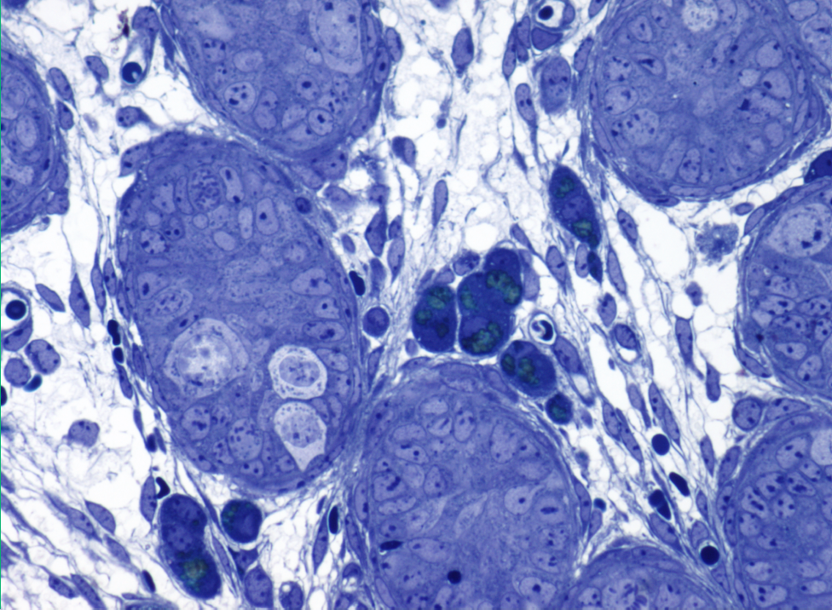
Gonocytes are present until puberty

Slide 27
Pre-pubertal testicular development
Immunolocalization of PCNA, GATA-1 and RBM in germ cells and Sertoli cells
during early pubertal development (days P8 and P14)

Slide 28
Adult testis (mouse)

Slide 29
Stages of spermatogenesis
Spermatogenesis- the development of mature spermatozoa from diploid spermatogonial stem cells — takes 75 days in man and 35 days in mice
The adult testis carries out two essential functions:
To produces mature, haploid spermatozoa
To secrete steroid hormones, the most important of which is the androgen testosterone.
Normal spermatogenesis depends on interactions between the somatic (Sertoli, Leydig and peritubular) cells and the germ cells

Slide 30
Stages of spermatogenesis
Spermatogenesis has three phases:
Mitotic proliferation
Meiotic division
Cytodifferentiation

Slide 31
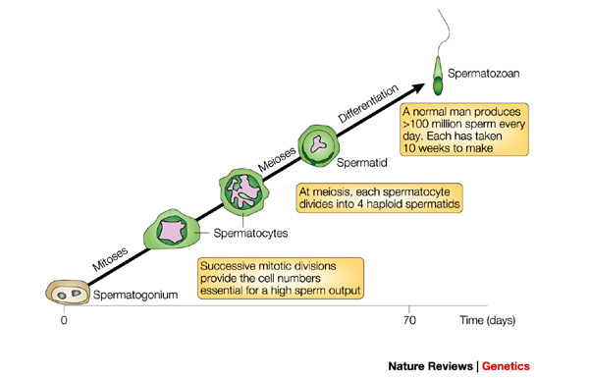
3- steps of spermatogenesis
During the process of spermatogenesis, the mammalian germ cell undergoes mitosis, meiosis and structural remodelling into the mature spermatozoa

Slide 32
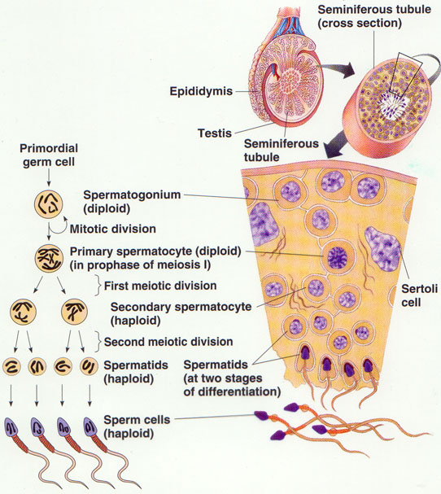
Spermatogenesis
From: iceteazegeg.wordpress.com

Slide 33
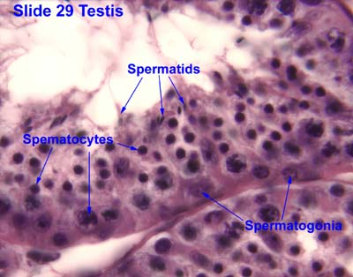
Histological findings

Slide 34
Spermatogonial subtypes
Cell population that divide by mitosis providing both a renewing stem cell population and spermatogonia committed to entering meiosis.
The identification of different types of spermatogonia is complex due to a lack of definitive markers
Classification of these cells has depended on the features of their nuclei and their chromatin
Two main classes of spermatogonia can be identified in all mammals: Type A exhibiting fine pale staining nuclear chromatin and Type B with coarse chromatin collections found close to the nuclear membrane.
Type A spermatogonia are divided into several subtypes that may represent different phases of proliferation and progression towards Type B spermatogonia.

Slide 35
Type A spermatogonia
The prevailing model of spermatogonial proliferation and differentiation in primates is the ‘reserve stem cell model’ (Clermont, 1969)
A dark (reserve cells)
A pale (renewing stem cells)
-A pale are the renewing stem cells that undergo regular divisions to maintain a pool of undifferentiated germ cells and support spermatogenesis under normal circumstances.
- A dark are reserve stem cells that, in the adult, rarely divide and are activated when spermatogenesis is destroyed by radiation

Slide 36
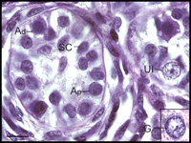
Type A spermatogonia

Slide 37
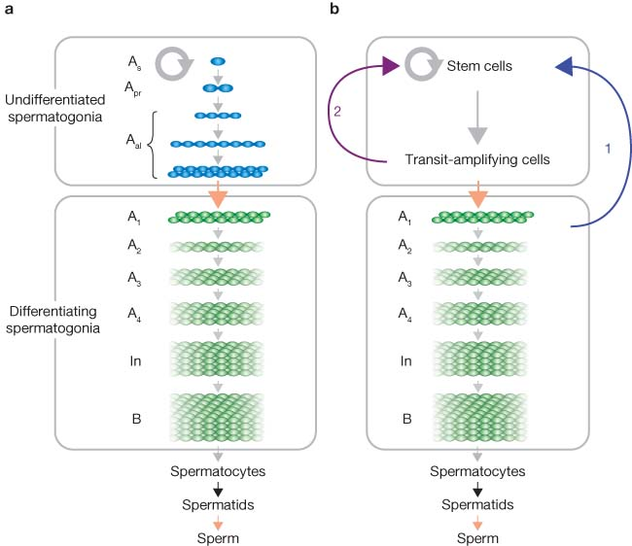
Spermatogonial activity
Notes:
(a) As or Asingle spermatogonia represent the most primitive germ cells in the testis. As a result of incomplete cell division, their daughter cells remain interconnected to form syncytia of 2n cells. As, Apr (two interconnected cells) and Aal (chains of 4, 8 and generally up to 16) spermatogonia are the so-called 'undifferentiated spermatogonia'. Aal transform into A1 cells, the youngest 'differentiating spermatogonia'. A1 cells subsequently undergo a series of mitoses that result in A2, A3, A4, In and B spermatogonia accompanying elongation of syncytial chains. According to the 'As model', only As cells act as self-renewing stem cells, whereas Apr and longer chains are all devoid of self-renewal activity, as indicated by the arrows (grey and black arrows indicate mitotic and meiotic divisions; orange arrows are transforming steps without cell division). (b) Schematic representation ofproposed 'de-differentiation' pathways. Arrows 1 and 2 indicate the model proposed by Barroca et al.8 and by Nakagawa et al.9, respectively. 'Undifferentiated spermatogonia' include stem and transit-amplifying cells, whereas stem cells may or may not be As.

Slide 38
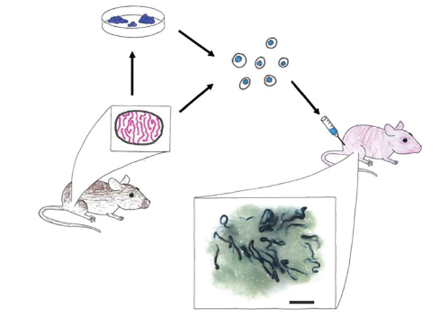
Classifying spermatogonia functionally
Can differentiate the mechanisms and markers that represent the most ‘stem-like’ spermatogonia using a spermatogonial transplantation assay devised by (Brinster et al, 1994)

Slide 39
Functional studies
FACS sorted cells
Separate fractions of most ‘stem-like’ cells injected into mouse testis (recipient)
Busulphan treated mice or
Mutant transgenic mice
Donor mouse
Testis removed and made into suspension

Slide 40
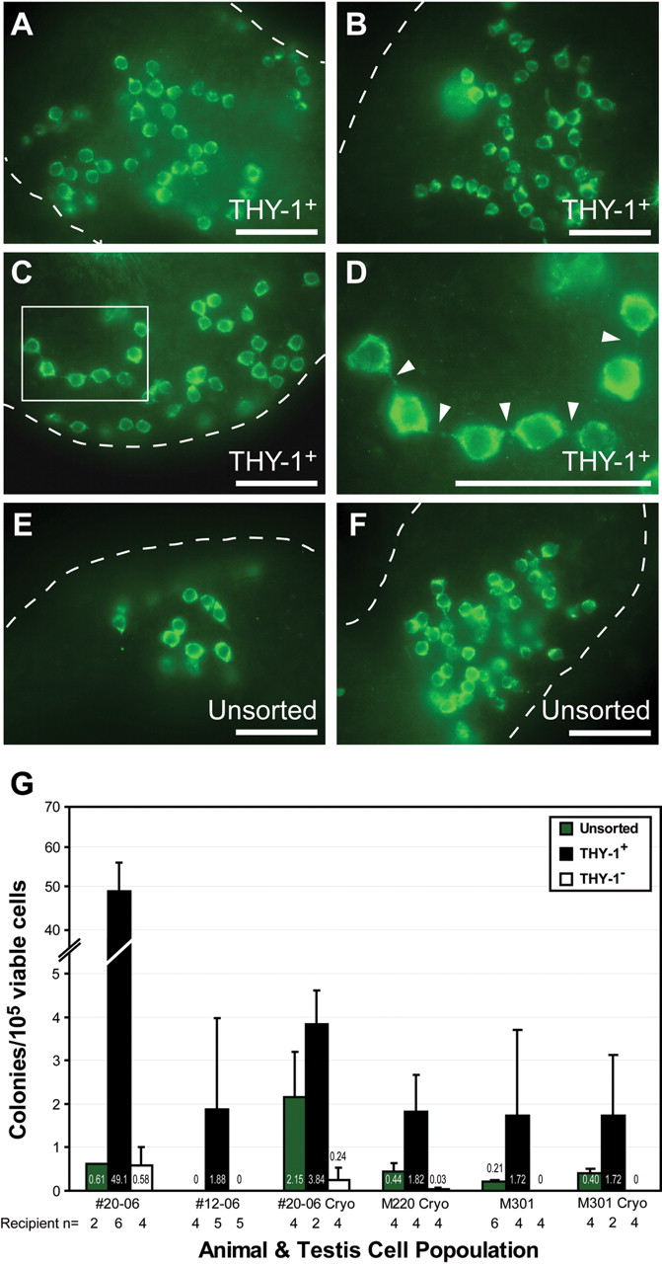
FACS sorting: xenotransplantation
Hermann B P et al. Hum. Reprod. 2009;humrep.dep073
Notes:
FACS sorted testis cells have xenotransplant colonizing activity.

Slide 41
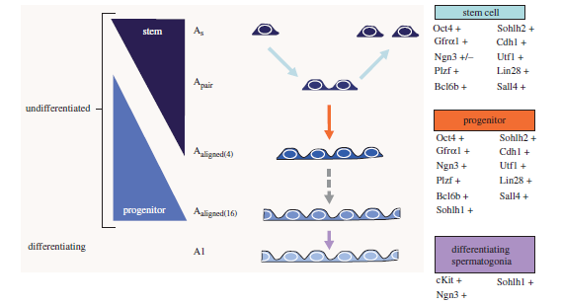
Molecular spermatogonia markers
Ordered gene expression controls spermatogenesis in different cell types
From : Phillips et al (2010)

Slide 42
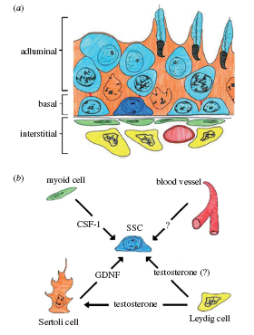
The spermatogonial stem cell niche

Slide 43
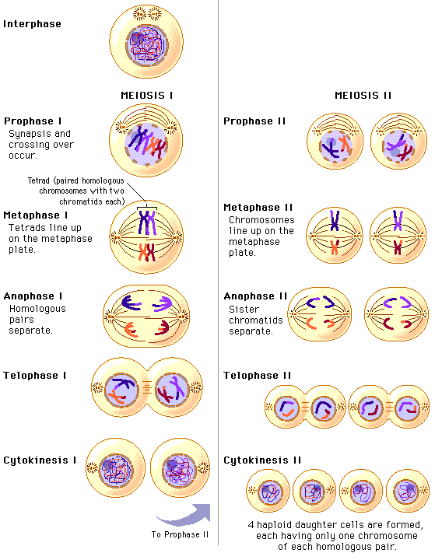
Meiosis

Slide 44
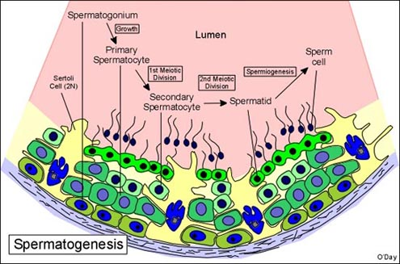
Meiosis

Slide 45
Spermiogenesis
The transformation of a round spermatid into a spermatozoon is complex
Round cells becomes converted into a spermatozoon with the capacity for motility.
The basic steps in this process are consistent between all species and consists of
the formation of the acrosome
nuclear changes
the development of the flagellum or sperm tail
the reorganisation of the cytoplasm and cell organelles
the process of release from the Sertoli cell termed spermiation
Notes:
The formation of the acrosome commences by the coalescence of a series of granules from the Golgi complex which migrates to come into contact with the nuclear membrane where it becomes applied as a cap-like structure over approximately 30-50% of the nuclear surface
The nuclear changes involve a reorganisation of the nucleus and cytoplasm such that the nucleus comes into close apposition with the cell membrane in a region where it is covered by the acrosomal cap. Subsequently, there is a progressive condensation of chromatin to form progressively larger and more electron dense granules together with a change in the shape of the condensed nucleus. This change in shape varies significantly between species. The condensation of chromatin represents the morphological appearances of significant biochemical changes which result in the stabilization of DNA. These changes include the replacement of lysine-rich histones with transitional proteins which in turn are subsequently replaced by arginine-rich protamines (24,25). The resultant DNA becomes resistant to digestion by the enzyme DNase. Associated with these changes there is a marked decrease in nuclear volume and a cessation of gene transcription

Slide 46
Spermiogenesis

Slide 47
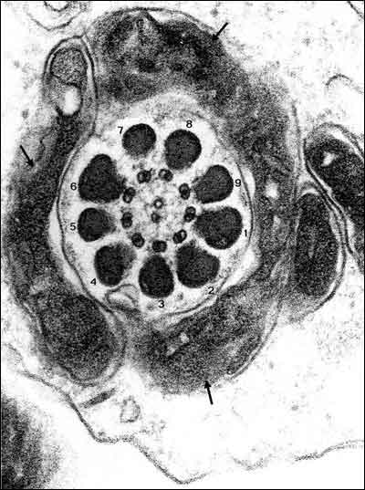
Spermatozoa
A cross-section through the developing mid-piece of the sperm tail shows the aggregation of mitochondria (arrows) surrounding the outer dense fibres which in turn surround the axoneme composed of 9 doublet microtubules surrounding two central microtubules.

Slide 48
Summary
Spermatogenesis is complex and the formation of mature spermatozoa is an essential function
Concerted sequence of events to proliferate, maintain and mature germ cells starting with spermatogonial stem cells and culminating in mature gametes
Testis is organised tissue and spermatogenesis regulated by
Hormonal
Differential gene expression
Cell to cell communication
Similar principles of spermatogenesis are found in mammalian testes in a much conserved pattern
The fate and physiology of spermatogonia can be studied using spermatogonial transplantation to further understanding of testis biology

