Slide 1
Principles and applications of radiotherapy
Dr Park
Consultant Clinical Oncology

Slide 2
Radiation
Emission and propagation of energy through space or a material medium
Waves sometimes behave like particles
Particles sometimes behave like waves

Slide 3
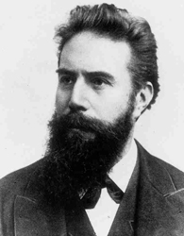
History
X-rays discovered by Wilhelm Roentgen 1895.
Nobel prize for physics 1901.

Slide 4
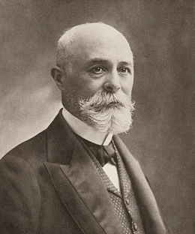
History
Radioactivity discovered by Henri Becqueral 1896
Left a rock in a draw with a photographic plate.
1903 shared Nobel prize for physics with the Curies.

Slide 5
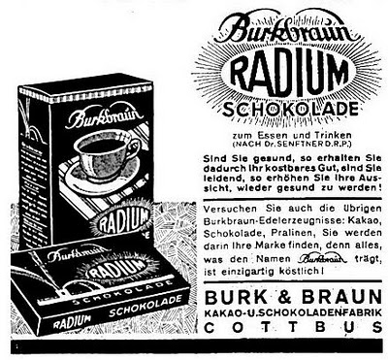
History – Bizarre uses of radium 1900s
Luminescent dials on clocks
Health goods
tonics, toothpaste, ointments

Slide 6
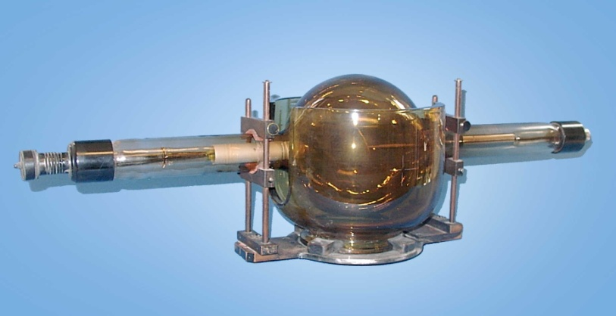
History
1901 Intracavitary radium for uterine tumours – Cleaves, Abbe
1912 Coolidge 200kv “deep X-ray hot tube”

Slide 7
What is radiotherapy used for?
Radical treatment of malignancy
Neoadjuvant/Adjuvant therapy
Treatment of oligometastatic disease
Palliation

Slide 8
What is Radiotherapy?
High energy ionising radiation
X-rays
Gamma rays
Electrons
Protons

Slide 9
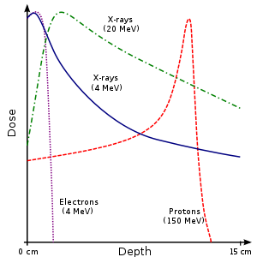
Which type should we use?

Slide 10
Mechanism of Cell Death
Direct and indirect damage of DNA leading to mitotic crisis.
Apoptosis
Senesence

Slide 11
Radiotherapy Principles
Relationship between dose and tumour control
Dose limited by risk of toxicity
Exploiting difference in tumour and normal tissue response to radiotherapy.
Tumour Control
Incidence
Complications
Dose

Slide 12
Target Volume Definitions ICRU 50 and ICRU 62
GTV Macroscopic disease
CTV Microscopic disease
PTV Margin added
IM internal organ motion SM daily set-up error
OAR Organs at risk

Slide 13
Target Volume Definitions ICRU 50 and ICRU 62
GTV – macroscopic disease
Notes:
13

Slide 14
Gross tumour volume (GTV)
Macroscopic disease = Volume to receive a high dose
If geographical miss will inevitably fail
Localisation
CT - intravenous contrast
MRI
CT-PET
Clinical examination
Notes:
CT has significant limitations for defining tumour. Even with contrast, it can be difficult to differentiate tumour from uterine body, bladder, bowel and to determine appropriate length of vagina to treat.
MRI provides superior soft tissue resolution and is the best imaging technique for staging gynae tumours. Defines tumour size, and extent into surrounding tissues.
In cervical cancer, detecting tumour invasion into parametrium, vagina and uterine body and surrounding structures.
PET is useful for detecting pelvic, para-aortic and distant metastases. Only useful for planning if can detect site – needs to be CT PET. For local disease and defining target volume accurately – controversial as lacks adequate resolution. Needs to be in conjunction.
14

Slide 15
Target Volume Definitions ICRU 50 and ICRU 62
GTV – macroscopic disease
CTV – microscopic disease
Notes:
15

Slide 16
CTV (Clinical target volume)
What should be included in the CTV?
Direct spread
Lymphatic drainage
Metastatic spread

Slide 17
CTV
Clinical target volume determined by:
Recurrence data
Pathological series

Slide 18
Target Volume Definitions ICRU 50 and ICRU 62
GTV – macroscopic disease
CTV – microscopic disease
OAR – organs at risk
Notes:
18

Slide 19
Target Volume Definitions ICRU 50 and ICRU 62
GTV – macroscopic disease
CTV – microscopic disease
PTV – planning target volume
- set up error
-internal motion
OAR – organs at risk
Notes:
19

Slide 20
Why do we fractionate?
Late toxicity in normal tissues more likely with larger dose per fraction.
More accurate delivery allows hypofractionation.

Slide 21
Which type should we use?

Slide 22
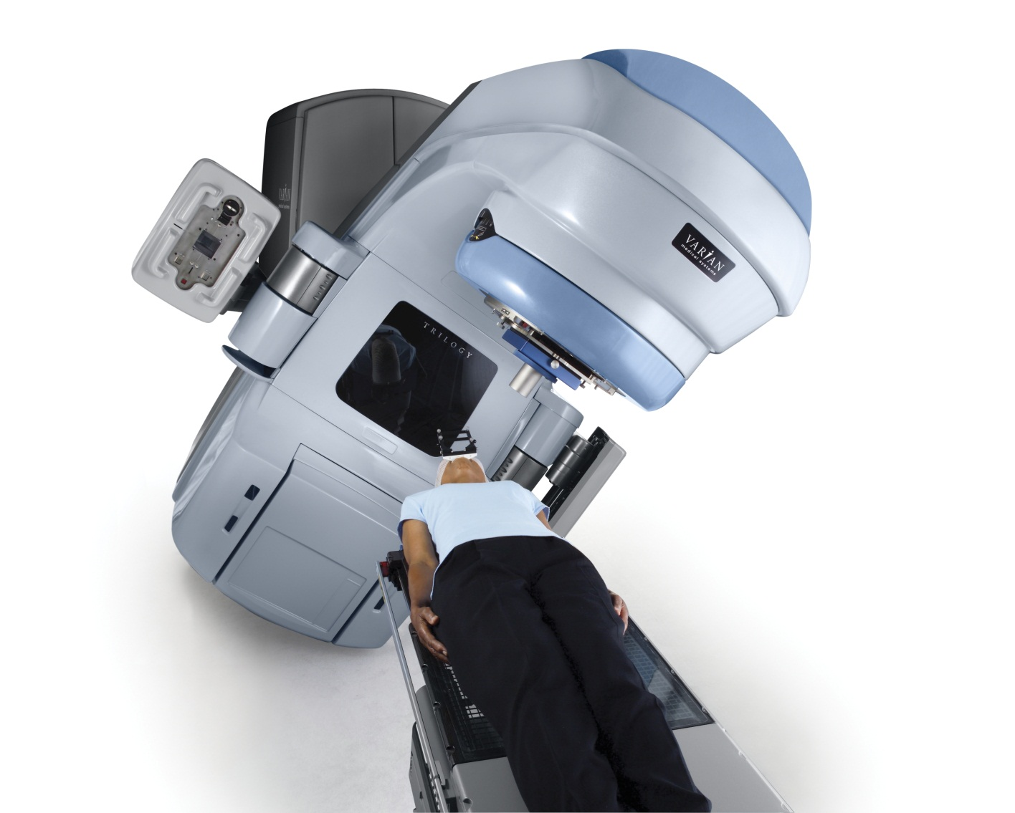
Linear Accelerator
Picture courtesy of Varian Medical Systems

Slide 23
Conventional Radiotherapy – 2 Fields
Example:
Pelvic Radiotherapy for Gynaecological Cancer

Slide 24
Conventional Radiotherapy – 4 Fields
Example:
Pelvic Radiotherapy for Gynaecological Cancer

Slide 25
IMRT – 7 Fields
Example:
Pelvic Radiotherapy for Gynaecological Cancer

Slide 26
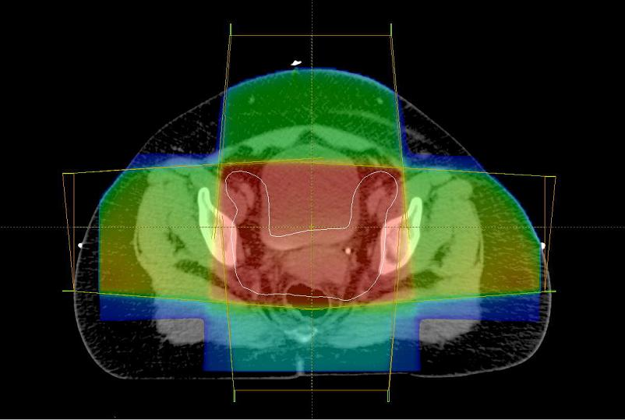
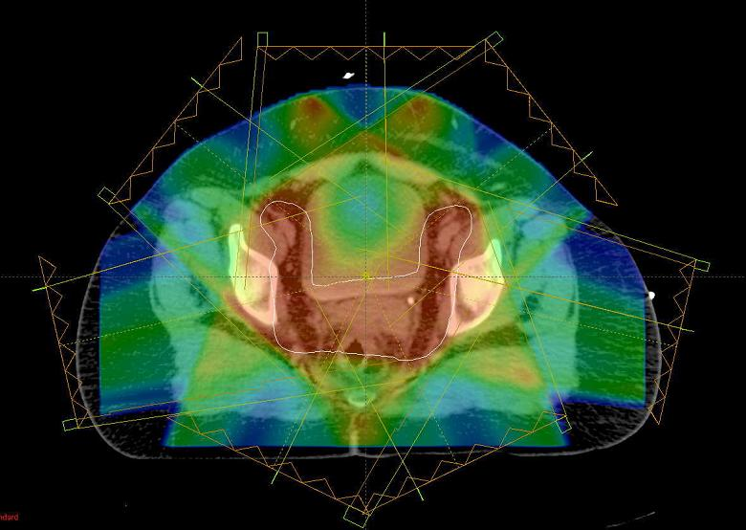
Conformal RT
IMRT

Slide 27
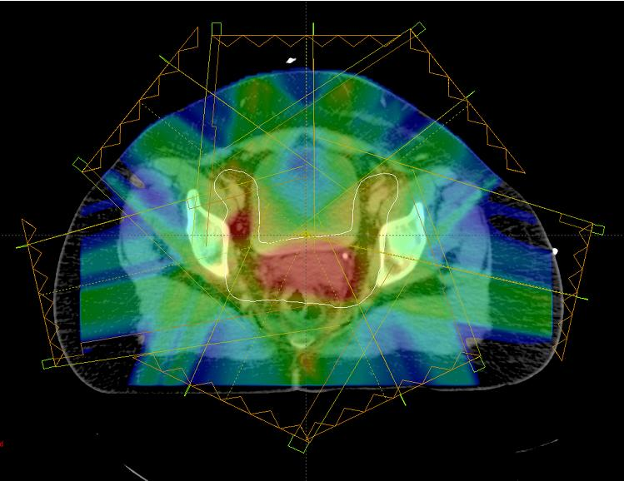
Simultaneous integrated boost IMRT (dose painting)

Slide 28
Practical Aspects
Planning CT scan +/- contrast
Immobilisation + marking with tattoos
Bladder/Bowel filling instructions

Slide 29
Bladder Filling
Week 1
Week 3

Slide 30
Brachytherapy
Application of radioactive source next to or in target.
PTV not an issue
High dose close to source with rapid drop off in dose.
Commonly used in:
Cervix cancer
Prostate cancer
Endometrial cancer

Slide 31
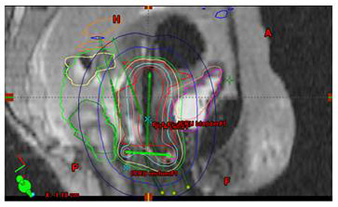
Cervix Brachytherapy Dosimetry
Image courtesy of Varian Medical Systems

Slide 32
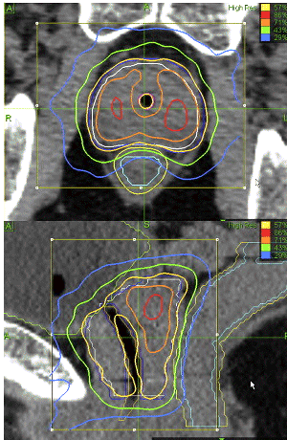
Prostate Brachytherapy
Donald B. Fuller IJROBP 2007:70:1588

Slide 33
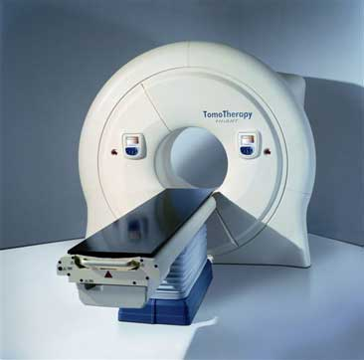
Image-guided radiotherapy
Cone beam CT
Tomotherapy

Slide 34
Potential use of cone beam CT
Register daily CT to planning CT
Check target volume is covered daily
Determine if reproducible pattern of movement
Select from several library plans depending on daily position
Detect changes in target volume
Notes:
34

Slide 35
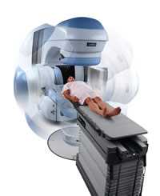
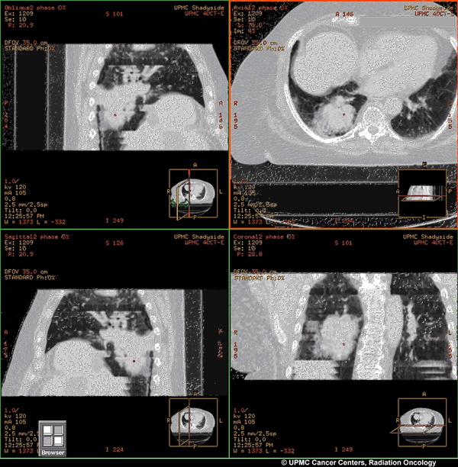
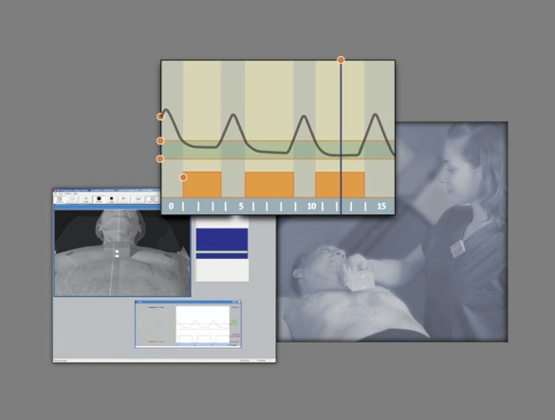
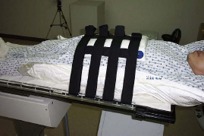
Linac based stereotactic therapy
4D CT
Varian trilogy
Respiratory gating
Notes:
35

Slide 36
Cyberknife therapy
Produces 6MV X-rays
Robotic movement
X-Ray detectors at 90⁰
Multiple fields
Takes 30 – 150 minutes per fraction
Small number of fractions
Tracks fiducial markers or bony landmarks
- Can move with respiration
- Can move with bowel gas
Notes:
36

Slide 37
Target Volume Definitions ICRU 50 and ICRU 62
PTV – planning target volume
OAR – organs at risk
Notes:
37

Slide 38
Target Volume Definitions ICRU 50 and ICRU 62
PTV – planning target volume
OAR – organs at risk
Notes:
38

Slide 39
Toxicity
Short and long term toxicity.
Depends on structures being irradiated.

Slide 40
Gynae slides courtesy of Dr A. Taylor

