Slide 1
Control of peptide hormone production
Gonadotrophins: physiological and pathophysiological aspects
Ilpo Huhtaniemi, MD, PhD
Institute of Reproductive and Developmental Biology, Imperial College London,
Hammersmith campus
Du Cane Road, London W12 0NN, UK

Slide 2
PHENOTYPES OF
MUTATIONS IN
THE HUMAN
H-P-G AXIS
HYPOTHALAMUS
GnRH
Hypogonadotrophic
hypogonadism (no anosmia)
STEROIDS
PEPTIDES
GnRHR
PITUITARY
GLAND
F: Arrested follicular
maturation
M: Azoospermia
F: Anovulatory infertility
M: Absent postnatal
sexual maturation
LH
FSH
Inactivating:
F: Arrested follicular maturation
M: Poor spermatogenesis
Activating:
F: ??
M: Gonadotrophin independent
spermatogenesis? (n=1)
Inactivating:
F: Anovulatory infertility
M: Male pseudohermaphroditism
Activating:
F: No phenotype
M: Testotoxicosis
LHR
FSHR
GONADS

Slide 3
Inactivating Mutations of the GnRH Receptor

Slide 4
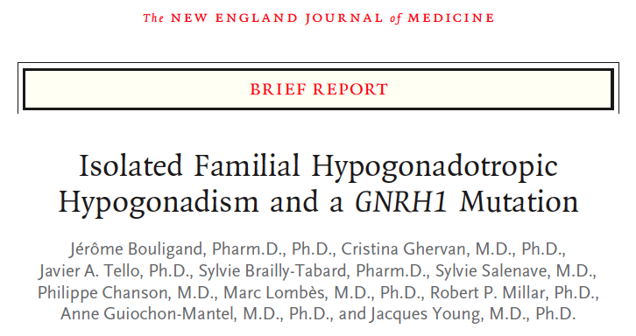


Slide 5
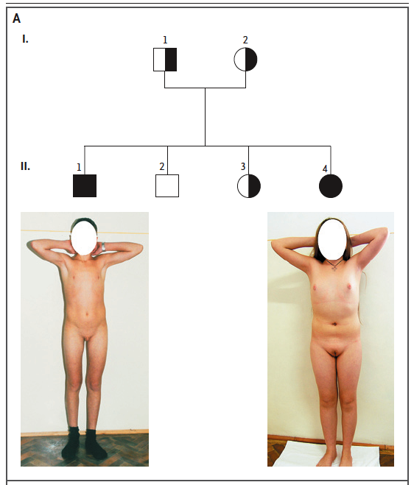
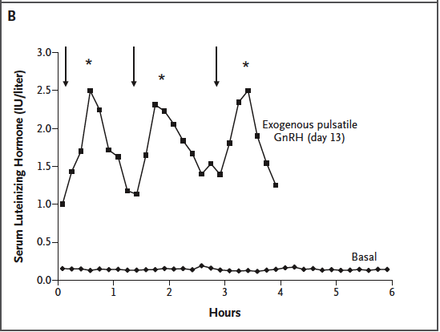

Slide 6
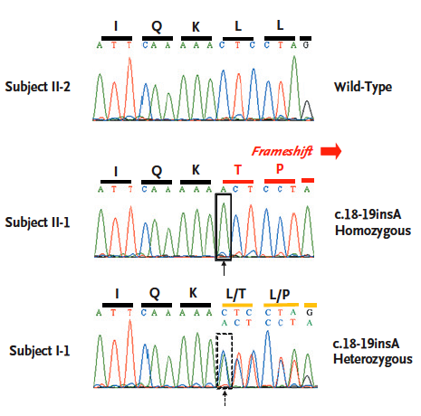

Slide 7
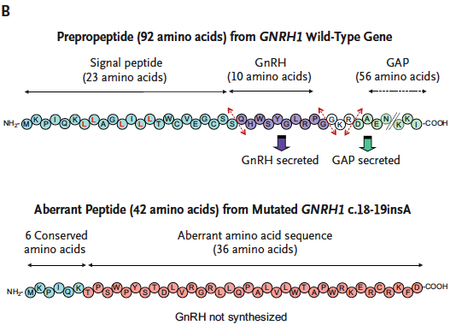

Slide 8
Idiopathic Hypogonadotropic Hypogonadism (IHH) and Kallmann Syndrome
• Closely related, both sharing disturbed hypothalamic GnRH secretion
• Kallmann syndrome
- HH + anosmia (+ synkinesis, middle facial defects, unilat. renal agenesis, hearing loss, skeletal anomalies)
- Deficient GnRH/LH/FSH secretion
- X-linked (anosmin mut.) and autosomal dominant (FGFR1 mut.) and recessive forms
- male:female = 5:1

Slide 9
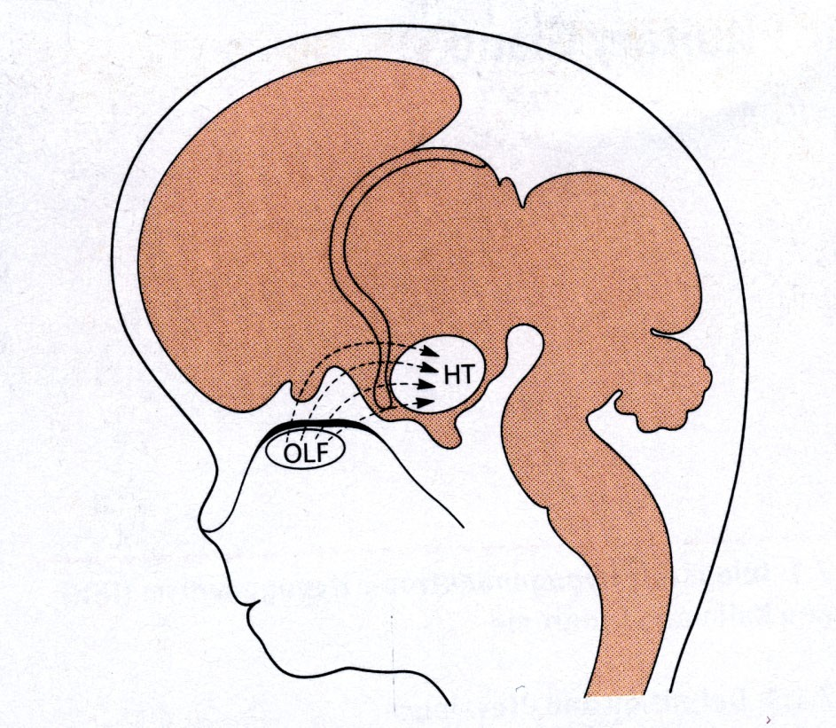
Migration of GnRH neurons

Slide 10
HH due to Inactivating GnRH Receptor Mutations
• About 20 GnRH receptor mutations known
• Phenotype complete or incomplete HH without anosmia
• Contributes to 10-15% of IHH
Other known mutations causing HH (30% currently known)
KAL1, FGFR1, FGF8, PROK2, PROKR2, NELF, CHD7,
GNRH1, GNRHR, KISSR, TAC3, TAC3R

Slide 11
+
-
HYPOTHALAMUS
GnRH
+
Inactivating:
Hypogonadotrophic
hypogonadism (no anosmia)
GnRHR
+
PITUITARY
GLAND
STEROIDS
PEPTIDES
-
F: Arrested follicular
maturation
M: Azoospermia
F: Anovulatory infertility
M: Absent postnatal
sexual maturation
LH
FSH
+
+
LHR
FSHR
GONADS

Slide 12
INACTIVATING MUTATIONS AND POLYMORPHISMS OF GLYCOPROTEIN HORMONE SUBUNITS
Y
Y
C
α
52
78
1
92
(Glu56Ala)
Y
IVS2+1G->C
LH
β
30
1
121
Ala-3Thr
Trp8Arg
Ile15Thr
Glu54Arg
Ser102Gly
Y
Y
Gly36Asp
FSH
β
7 24
1
Cys82Arg
110
Cys51Gly
Val61Δ2bp
->Stop87
Tyr76X
Y
Y
O
O
O
O
hCG
β
13
30
122 132
127 137
1
145
(Val79Met)

Slide 13
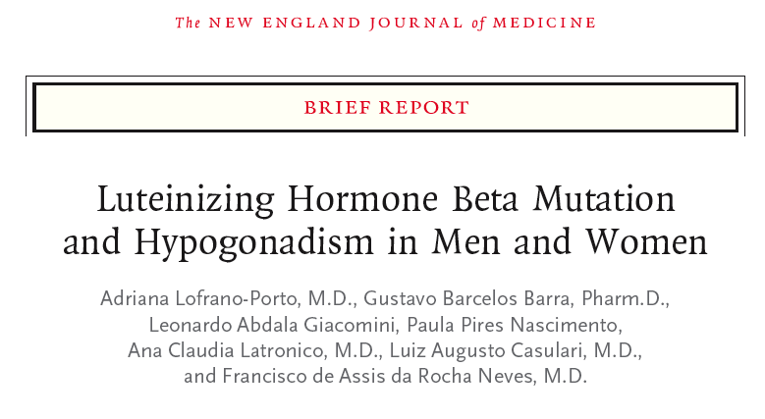

Slide 14
+
-
HYPOTHALAMUS
GnRH
+
Inactivating:
Hypogonadotrophic
hypogonadism (no anosmia)
GnRHR
+
PITUITARY
GLAND
STEROIDS
PEPTIDES
-
F: Arrested follicular
maturation
M: Azoospermia
F: Anovulatory infertility
M: Absent postnatal
sexual maturation
LH
FSH
+
+
Inactivating:
F: Arrested follicular maturation
M: Poor spermatogenesis
Activating:
F: ??
M: Gonadotrophin independent
spermatogenesis? (n=1)
Inactivating:
F: Anovulatory infertility
M: Male pseudohermaphroditism
Activating:
F: No phenotype
M: Testotoxicosis
LHR
FSHR
GONADS

Slide 15
Insert LLKLLLLLQ->
**
- NH
2
HUMAN
LH RECEPTOR
MUTATIONS
LeuGlu
Cys133Arg
Phe194Val
Deletion of:
Activating
Asn291Ser
Asn312Ser
Exon 8 ->
*
*
Exon 10 ->
Glu354Lys
Cys343Ser
Inactivating
Leu368Pro
Trp491Stp
*
Polymorphism
Ala593Pro
Ala373Val
Ile542Leu
Δ
Leu608/Val609
Cys581Arg
Ser616Tyr
Asp578Tyr
/Glu/Gly/His
Met398Thr
Ile625Lys
Ile374Thr
Thr577Ile
Thr392Ile
Leu457Arg
Ile575Leu
Cys545Stp
Asp564Gly
Ala572Val
Met571Ile
Arg554Stp
Cys543Arg
Ala568Val
- COOH

Slide 16
HUMAN FSH RECEPTOR MUTATIONS
- NH
2
Ile160Thr
Ala189Val
(Asn191Ile)
Asp224Val
*
*
Thr307Ala
Pro346Arg
Val341Ala
Thr499Ile
Leu 601Val
Arg573Cys
Ala419Thr
*
Asp567Gly/Asn
Asn680Ser
- COOH

Slide 17
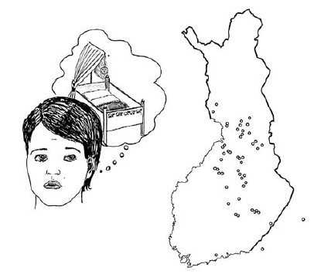
FSH Receptor Inactivation
WOMEN:
• primary hypergonadotrophic
amenorrhoea
• infertility
• arrested follicular maturation
MEN:
• normal puberty
• subfertility with poor semen quality
(Picture: Norio 2003)
Aittomäki et al: Cell 1995; 82: 959-968.
Tapanainen et al: Nature Genetics 1997; 15:205-206.

Slide 18
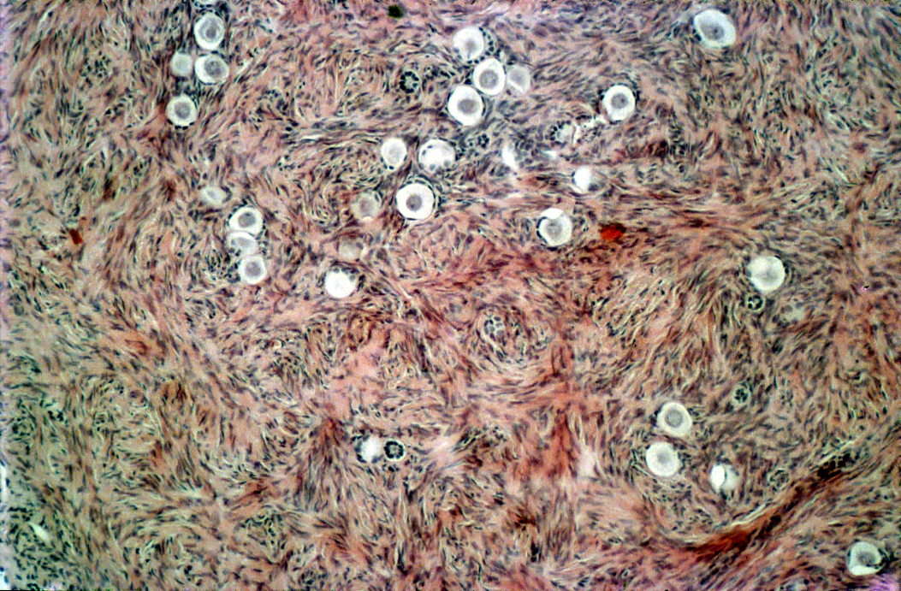
Ovarian histology of a woman homozygous for the Ala189Val FSHR Mutation
Aittomäki et al. 1996

Slide 19
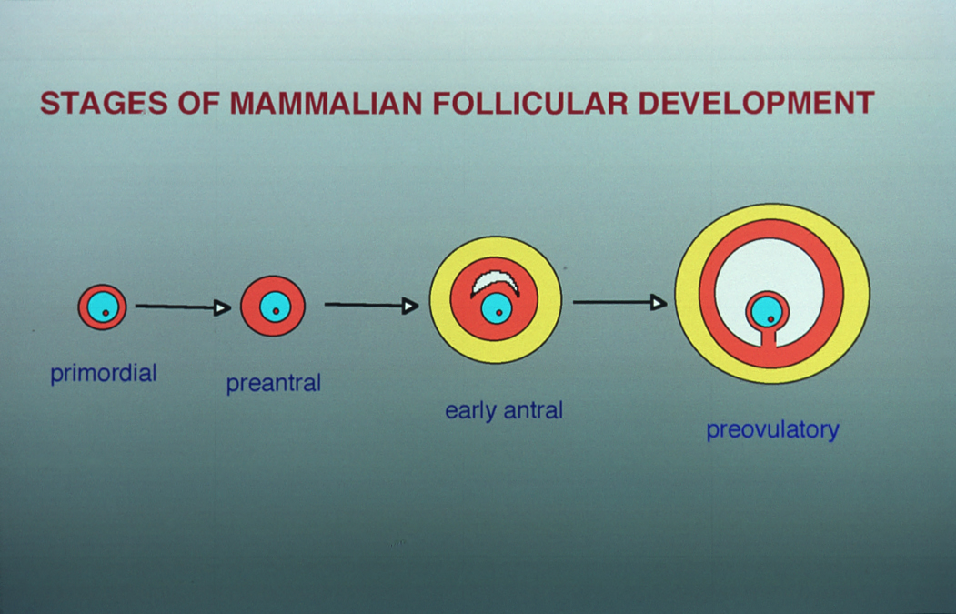
FSH
LH

Slide 20
MEN HOMOZYGOUS FOR THE C566T FSHR MUTATION
Subject
Age
Fertility Testis size Sperm count Ejac. vol. ( at age)
(yrs) (ml; dex/sin) (millions/ml) (ml)
1 47 2 children 16.5/16.5 5.0 3.0 (47)
2 55 2 children 13.5/15.8 < 0.1
3.3 (55)
3 45 infertile 4.0/4.0 < 0.3 4.8 (30)
4 29 unknown 8.6/6.0 42 1.5 (29)
5 42 unknown 8.0/8.0 < 1.0 2.5 (42)
Tapanainen et al.: Nature Genet 1997

Slide 21
Why do we study transgenic and knockout mice
They reconfirm the phenotypes of human mutations
They allow studies on molecular pathogenesis, and provide clues for novel diagnostic and therapeutic strategies for genetic diseases
They provide clues about phenotypes of mutations not yet discovered in humans
The are great hypothesis-generating tools for basic and clinical studies

Slide 22
The HPG Axis: Existing Transgenic Mouse Models
+
-
HYPOTHALAMUS
GnRH
+
GnRHR
+
PITUITARY
GLAND
STEROIDS
PEPTIDES
-
LHβ-CTP-TG
FSHβ-TG
LH
FSH
+
+
Cα-TG
hCGβ-TG
Const. FSHR act.
LHR
FSHR
(Const. LHR act.)
GONADS

Slide 23
The HPG Axis: Existing Knockout Mouse Models
HYPOTHALAMUS
GnRH
Hpg mouse
GnRHR-KO
GnRHR
PITUITARY
GLAND
STEROIDS
PEPTIDES
Common-α-KO
LH
FSH
FSHβ-KO
LHβ-KO
FSHR-KO
LHR
FSHR
LHR-KO
GONADS

Slide 24
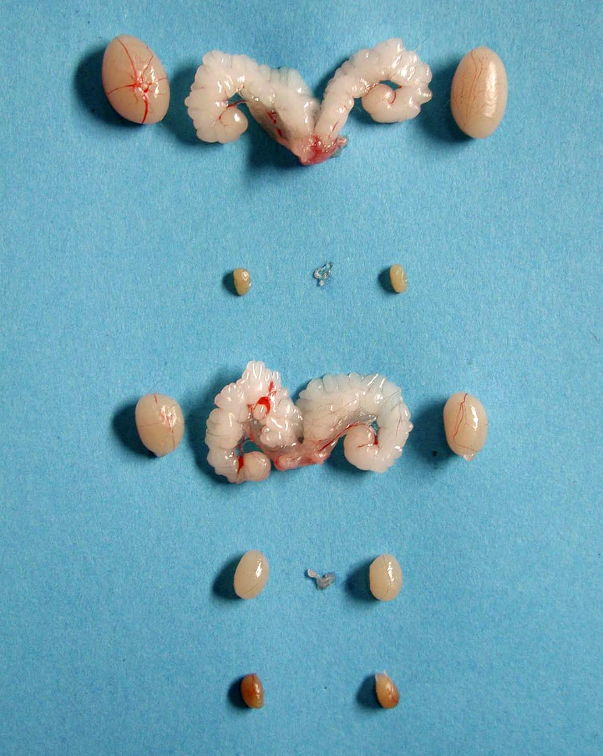
Normal
hpg
FSHR KO
LuRKO
Tfm
From H. Charlton

Slide 25
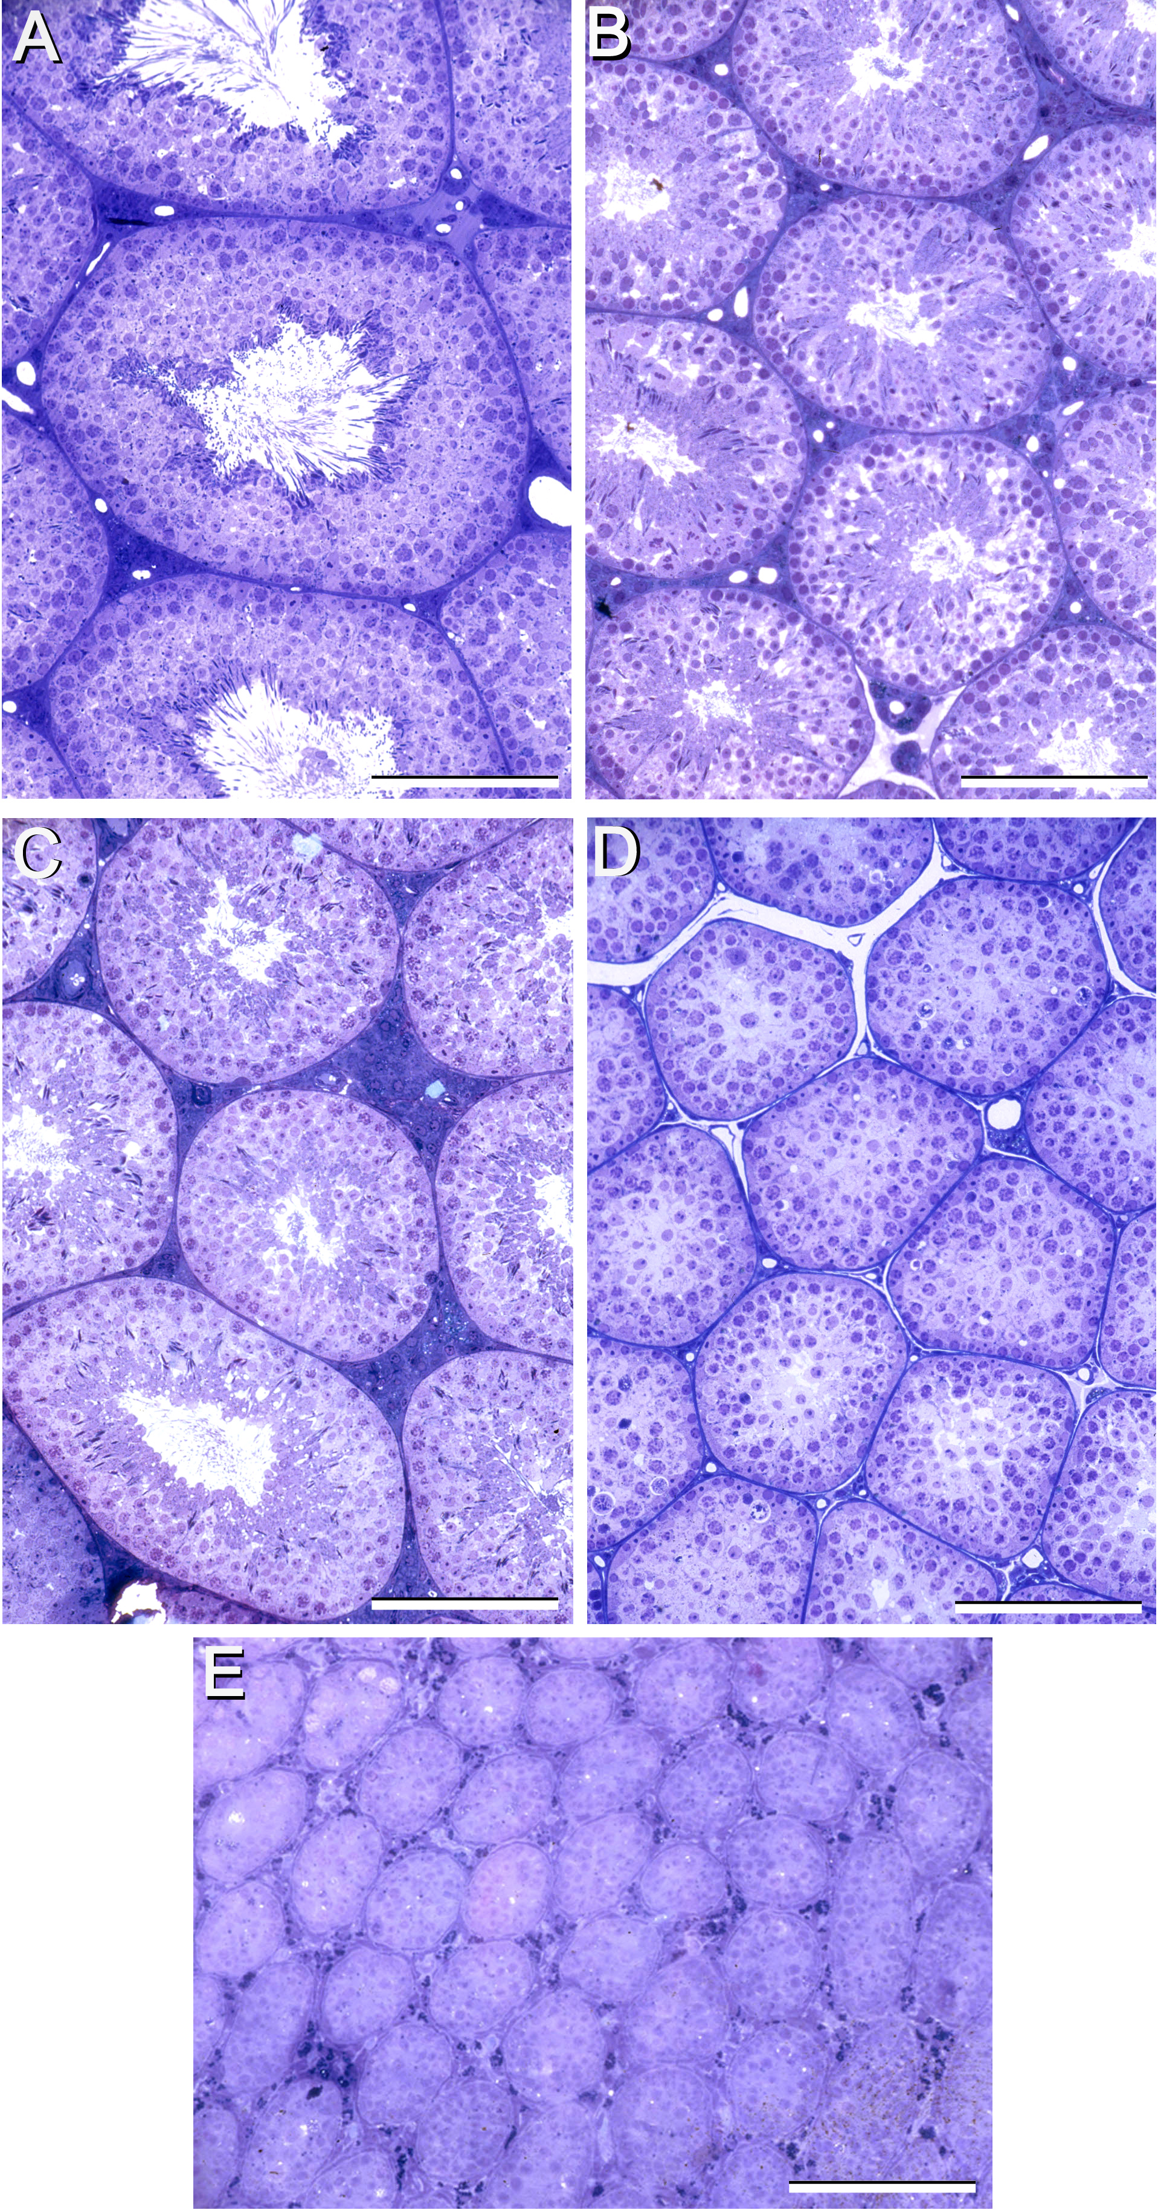
NORMAL
FSHR-KO
FSHβ−KO
LuRKO
Hpg
from H. Charlton

Slide 26
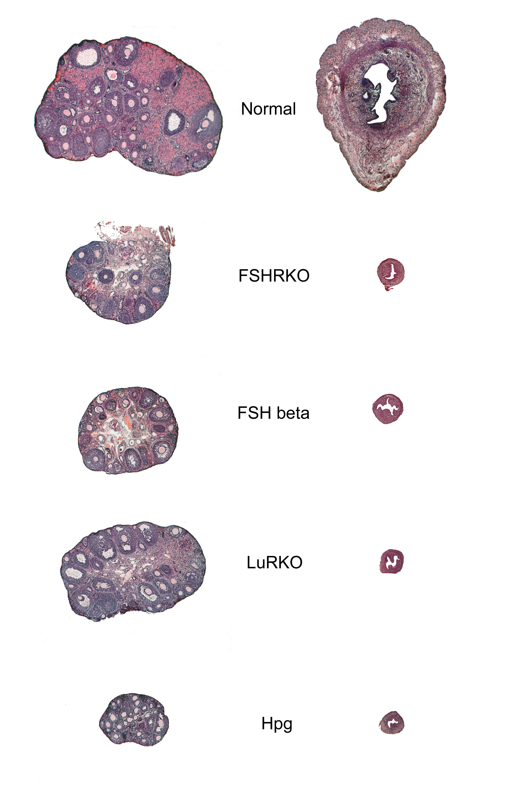

Slide 27
The Mouse LH Receptor
- NH
2
Extra-
cellular
Trans-
membrane
Intra-
cellular
- COOH

Slide 28
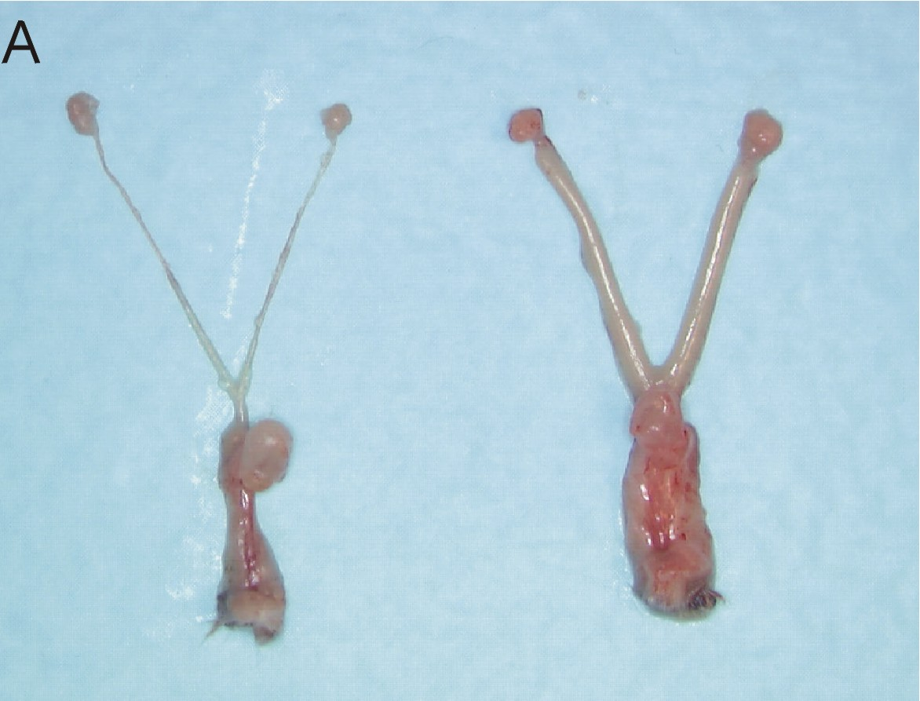
GONADS AND ACCESSORY SEX ORGANS OF WILD-TYPE (+/+)
AND LuRKO (-/-) FEMALE MICE
Ovary
Uterus
-/-
+/+
Vagina
Zhang et al.
Mol Endo 2001

Slide 29
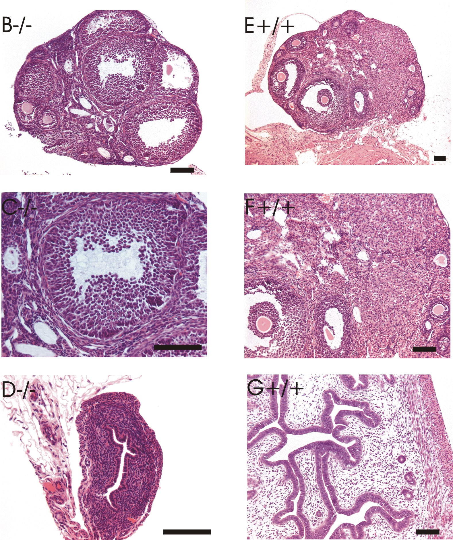
OVARIAN AND UTERINE HISTOLOGY OF
WILD-TYPE (+/+) AND LuRKO (-/-) MICE
-/-
+/+
Ovary
Uterus
Bar = 100 μm
Zhang et al. Mol Endo 2001

Slide 30
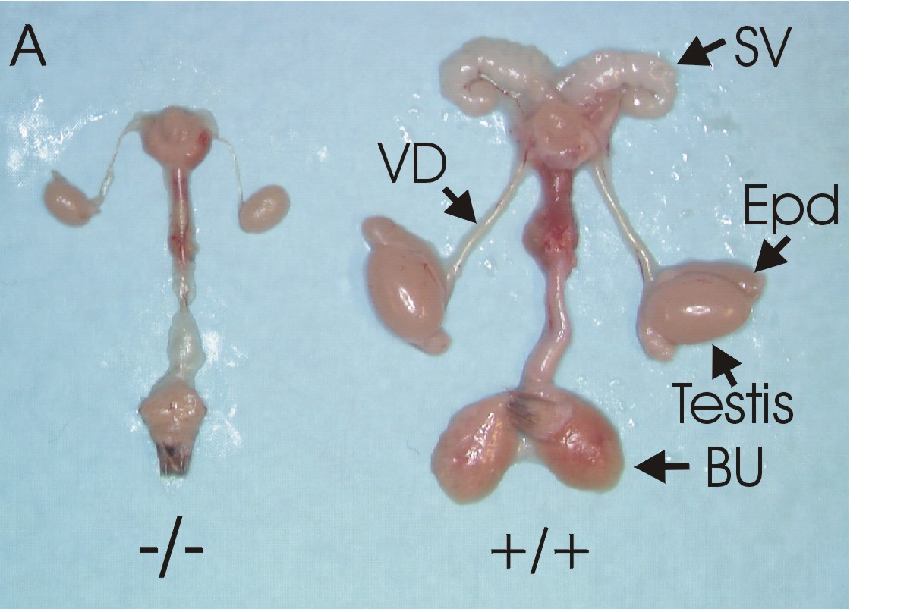
GONADS AND ACCESSORY SEX ORGANS OF WILD-TYPE (+/+)
AND LuRKO (-/-) MALE MICE
Zhang et al. Mol Endo 2001

Slide 31
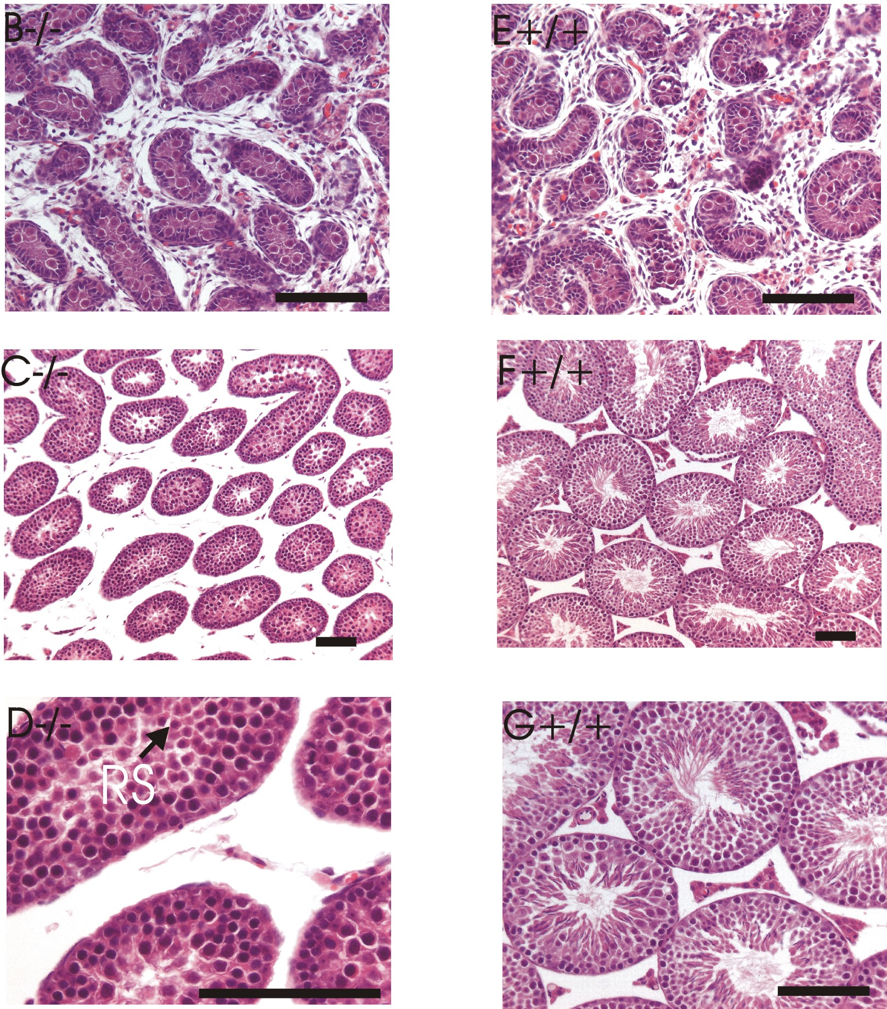
TESTICULAR HISTOLOGY OF
WILD-TYPE (+/+) AND LuRKO (-/-) MICE
-/-
+/+
Neo-
natal
Adult
Bar = 100 μm
Zhang et al. Mol Endo 2001

Slide 32
FSHβ/FSHR Inactivation
HUMAN
MOUSE
Male
• normal sexual differentiation and
maturation
• reduces testis size and qualtity
of sperm (FSHR)
• fertility possible (FSHR)
• azoospermia (FSHβ)
Male
• normal sexual differentiation
and maturation
• reduced testis size
• normal fertility
Female
• normal sexual differentiation
• sexual infantilism + infertility
• primary/early 2nd amenorrhoea
• ovaries full of immature follicles
• lack of follicular maturation
Female
• normal sexual differentiation
• delayed vaginal opening
• no estrous cycle
• ovaries full of immature follicles
• lack of follicular maturation

Slide 33
LH/LHR Inactivation
HUMAN
MOUSE
Male
• pseudohermaphroditism (LHR)
• normal sexual differentiation (LHβ)
• Leydig cell hypoplasia
• lack of pubertal maturation
Male
• normal sexual differentiation
• Leydig cell hypoplasia
• lack of pubertal maturation
• infertility
Female
• normal sexual differentiation
• delayed pubertal maturation
• olgomenorrhea/amenorrhea
• anovulatory infertility
Female
• normal sexual differentiation
• delayed vaginal opening
• no estrous cycle
• anovulatory infertility

Slide 34
DIFFERENT BACKUP MECHANISMS OF MALE FETAL MASCULINIZATION IN MEN AND MICE
X
Pit. LH
Fetal testis
HUMAN
Male
differentiation
T
hCG
LHR
Pit. LH
Fetal testis
Male
differentiation
T
MOUSE
LHR
Paracrine
factors

Slide 35
DIFFERENT BACKUP MECHANISMS OF MALE FETAL MASCULINIZATION IN MEN AND MICE
Pit. LH
Fetal testis
X
Male
differentiation
HUMAN
X
T
X
hCG
LHR
pseudohermaphroditism
Pit. LH
Fetal testis
Male
differentiation
T
MOUSE
LHR
Paracrine
factors

Slide 36
DIFFERENT BACKUP MECHANISMS OF MALE FETAL MASCULINIZATION IN MEN AND MICE
Pit. LH
Fetal testis
HUMAN
Male
differentiation
T
hCG
LHR
X
Pit. LH
Fetal testis
X
Male
differentiation
T
MOUSE
LHR
Paracrine
factors

