Slide 1
Ovarian cancer
Jane Borley
j.borley10@imperial.ac.uk
Clinical Research Fellow
2 November 2012

Slide 2
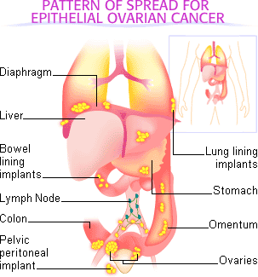
Ovarian Cancer
6,500 cases diagnosed annually
Over 4,000 deaths per year
40% 5 year overall survival rate
2/3rds have advanced disease
Majority succumb to chemotherapy resistant disease

Slide 3
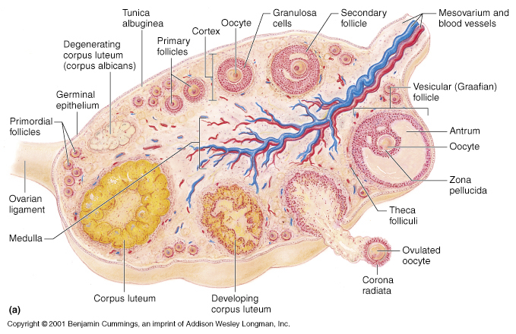
Histological subtypes
Epithelial
Germ-cell
Sex cord-stromal

Slide 4
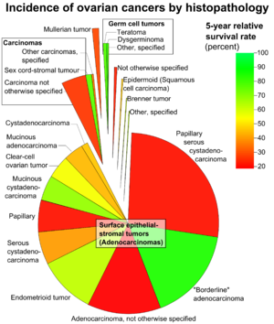
Histological subtypes
Majority are epithelial cell in origin
Serous papillary
Endometrioid
Mucinous
Clear cell
All subtypes can also be benign and borderline type

Slide 5
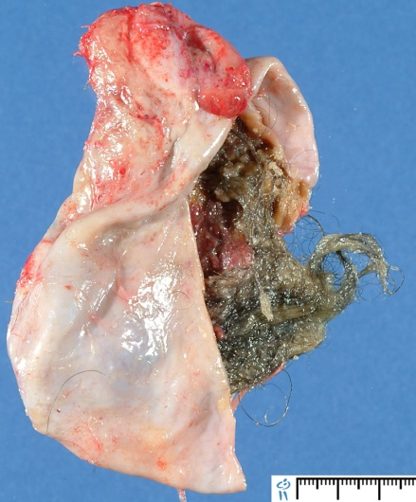
Histological subtypes
Germ-cell and sex-cord-stromal tumours are much rarer and present at an earlier age
Germ-cell
Teratoma
Dysgerminoma
Chemosensitive
Sex cord-stromal
Granulosa-cell tumour
Often secrete oestrogen
Precocious puberty
PMB
Sertoli-cell tumour

Slide 6
Genetic abnormalities in epithelial ovarian cancer
E Despierre et al. Gynecologic Oncology March 2010

Slide 7
Epidemiology
Cancer Research UK (2011) CancerStats: Ovarian Cancer

Slide 8
Epidemiology
Can you explain these differences?
Cancer Research UK (2011) CancerStats: Ovarian Cancer

Slide 9
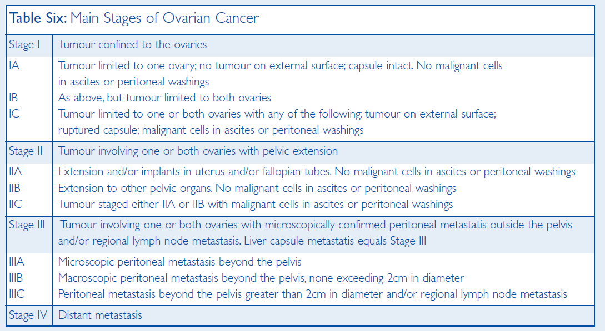
Stage
Cancer Research UK (2011) CancerStats: Ovarian Cancer

Slide 10
Survival by stage
Cancer Research UK (2011) CancerStats: Ovarian Cancer

Slide 11
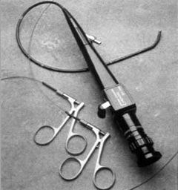
Symptoms
Abdominal bloating
Abdominal discomfort / pain
Bowel disturbance
Abdominal swelling
Back pain
Difficulty eating / feeling full quickly
Urinary frequency

Slide 12
Risk Factors
Familial (10%)
3-4 fold increase in risk if 1st degree relative diagnosed
BRCA1 mutation (40-50% lifetime risk)
BRCA2 mutation (20-30% lifetime risk)
Reproductive factors
Increased risk associated with
Early menarche
Late menopause
Nulliparity
Infertility
HRT
Decreased risk
Pregnancy
Oral contraceptive use
?breastfeeding

Slide 13
Risk factors
Environmental
Increase risk in
Smoking
Obesity
Asbestos
Talc

Slide 14
Screening
No recommended screening programme in the UK... yet!
? Pelvic USS
?CA125
? Both
? Age screened

Slide 15
Diagnosis
CA125
Non-specific
Also raised in pregnancy, endometriosis, pelvic infection
Normal CA125
20% of advanced disease
50% of stage 1 cancers
HE4
FDA approved use for monitoring of patients with previously diagnosed EOC

Slide 16
Diagnosis
NICE guideline no. 122

Slide 17
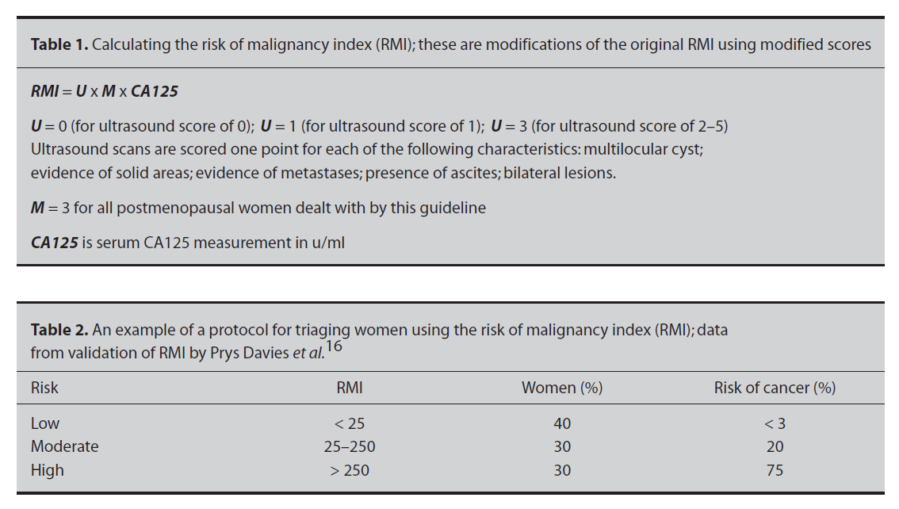
Imaging
Risk of malignancy index
Royal College of Obstetricians & Gynaecologists Greentop guideline no. 34 & 62

Slide 18
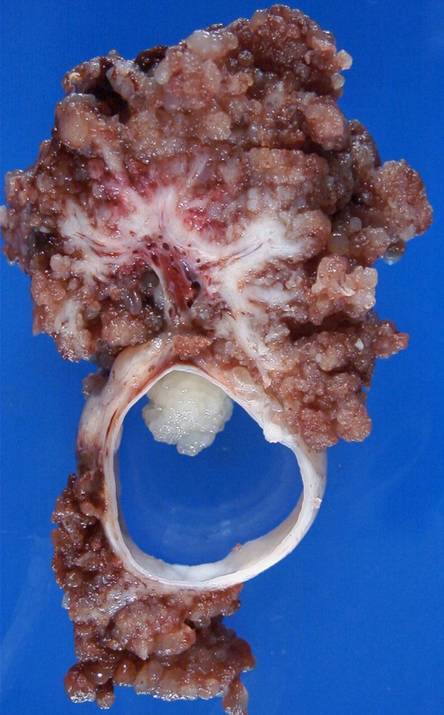
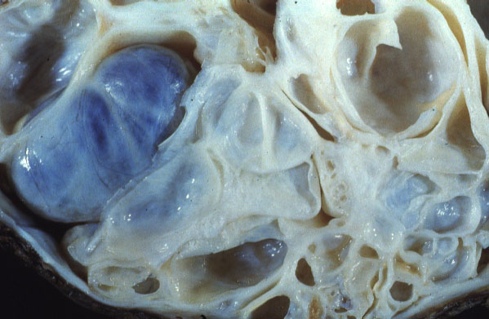

Slide 19
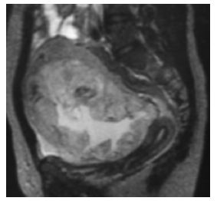
Diagnosis
Staging CT
MRI pelvis
Biopsy if uncertain nature or origin
CT guided / laparoscopic
MDT discussion

Slide 20
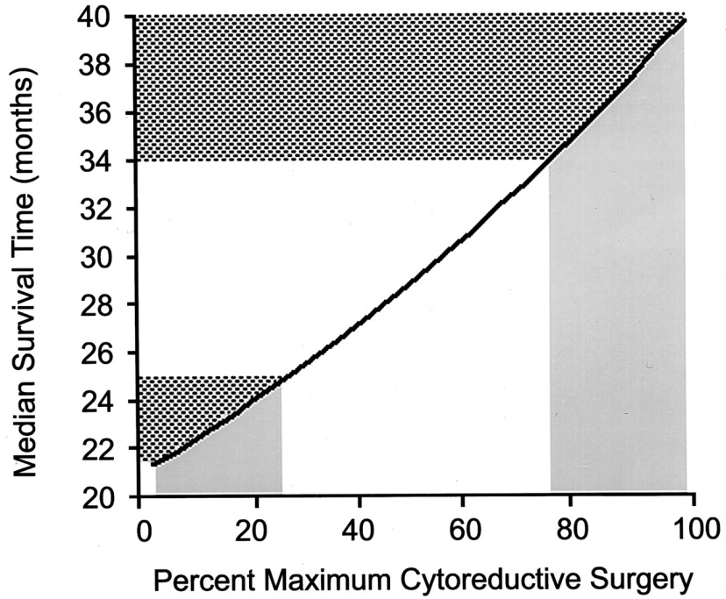
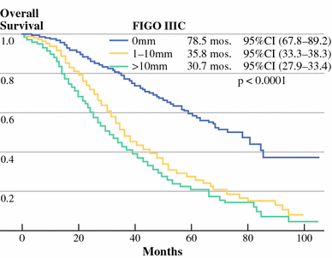
Treatment - Surgery
Total abdominal hysterectomy, bilateral salpingoophrectomy, omentectomy, lymphadenectomy
Aim to adequately stage disease and remove all visible disease possible
Primary
Interval
Secondary
Prophylactic oophrectomy (BRCA mutation carriers)
Aim to remove all disease, directly related to survival
Optimal
Suboptimal
P. Wimberger et al. Ann Surg Oncol. 2010
RE. Bristow et al. JCO 2002

Slide 21
Chemotherapy
Adjuvant
Neoadjuvant
1st line
Platinum based compound
Carboplatin
Cisplatin
With or without paclitaxel (Taxol)
The majority will respond initially to chemotherapy
Monitoring – CA125
2nd line
Repeated platinum drug treatment with paclitaxel
Paclitaxel
Liposomal doxorubicin (Caelyx or Doxil)
Topotecan (Hycamtin)
Etoposide
Gemcitabine

Slide 22
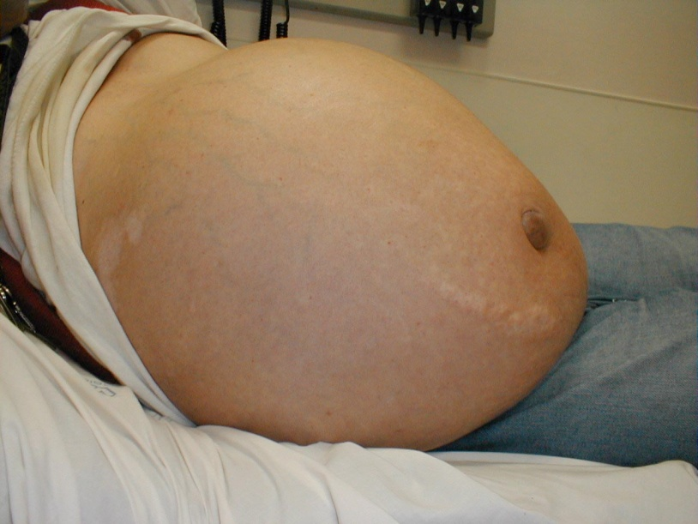
Palliative care
Ascitic drains and shunts
Pain control
Nausea & vomiting
Bowel obstruction & fistula
Renal obstruction
Psychological care

Slide 23
Clinical challenges
Screening and early diagnosis
Treatment stratification
Tumour heterogeneity
Chemotherapy resistance
SEER survival monograph: Ovarian Cancer
Cancer Research UK (2011) CancerStats: Ovarian Cancer

Slide 24
Screening
UKCTOCS
2001-2005
202,638 postmenopusal women, aged 50-74yrs
Randomised
No screening
Annual CA125 and TVUSS (if CA125 raised) (MMS group)
Annual TVUSS (USS group)
Of those screen positive
43% had ovarian malignancy in MSS group and 8% in USS group
a large proportion of women had surgery for benign disease (47% in MMS group, 92% in USS group)
A larger proportion of early stage ovarian cancer found
Results on effects on mortality awaited

Slide 25
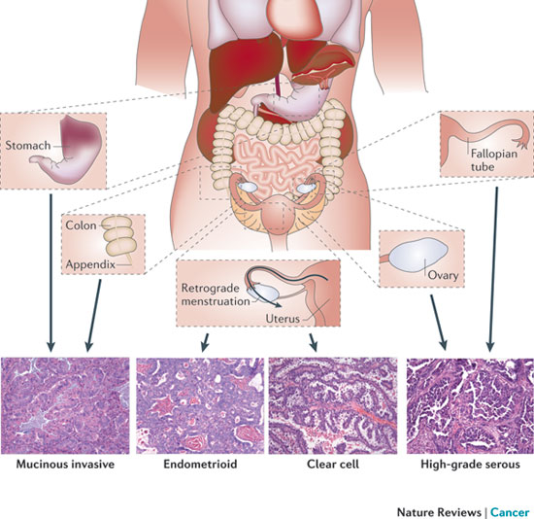
Tumour heterogeneity
“Molecular and aetiological distinct diseases that share an anatomical location”
Driver mutations differ
Could this explain why the ovarian cancer field lags behind other cancer research fields?
S Vaughan et al. Nature Reviews: Cancer. Oct 2011

Slide 26
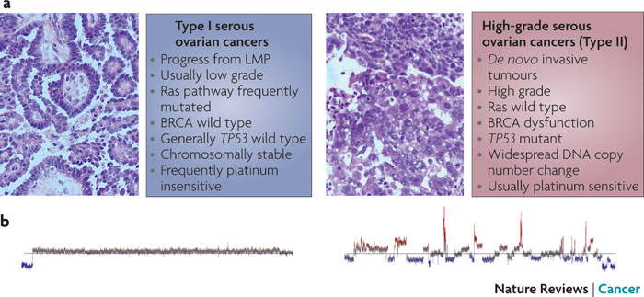
Type 1 and Type 2 tumours
D Bowtell. Nature Reviews: Cancer. November 2010

Slide 27
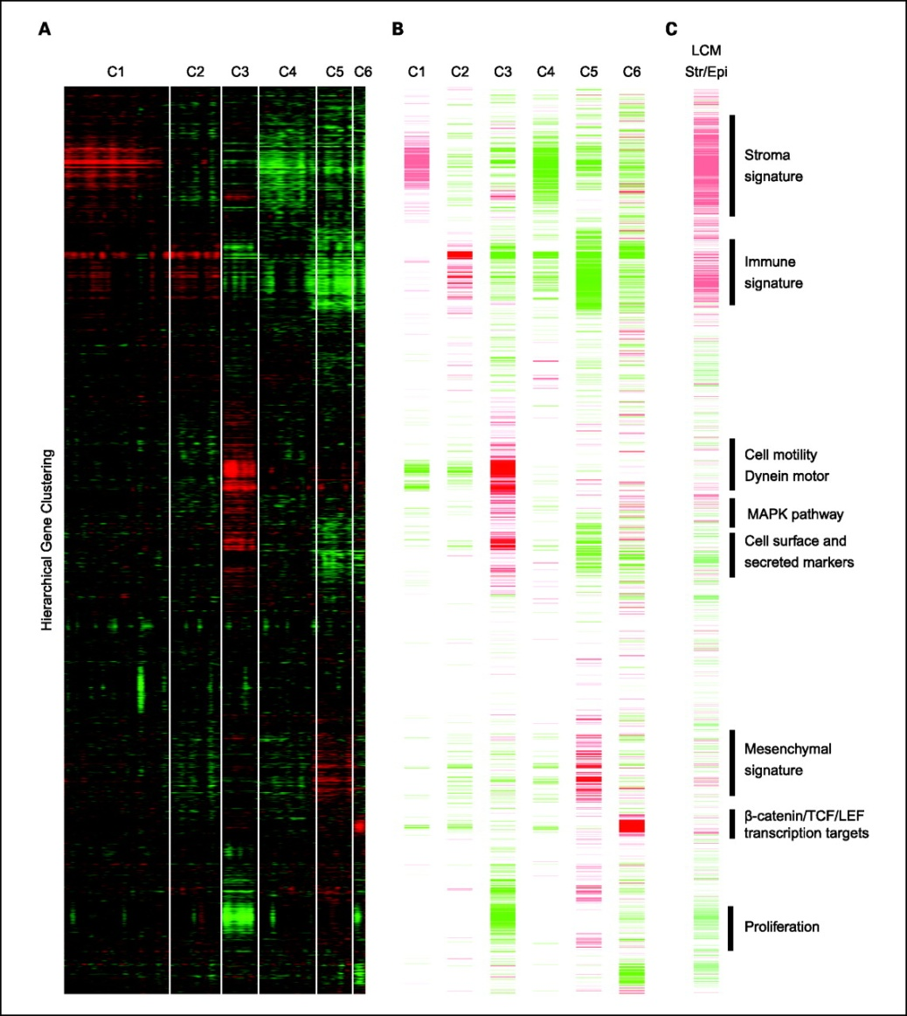
Different molecular subgroups
Clustering of expression data derived from serous and endometrioid tumours originating from the ovary, peritoneum, and fallopian tube.
Tothill R W et al. Clin Cancer Res 2008;14:5198-5208

Slide 28
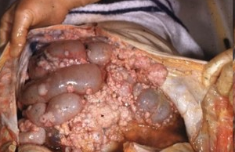
Treatment stratification
Can we predict patients who will have a good surgical outcome?
Should chemotherapy be before of after surgery?
Can we predict chemotherapy resistance or prognosis?

Slide 29
Prediction of surgical debulking
Success of debulking depends on
Surgical expertise
Tumour burden, site of disease & stage
CA125
300 to 912 IU/ml, sensitivity of 49-80%, specificity of 54-89.6%
CT & MRI
Variable prediction

Slide 30
Neoadjuvant chemotherapy vs primary debulking
I Vergote et al. NEJM. Sept 2010

Slide 31
Further advances
Intraperitoneal chemotherapy
Dose-dense regimens
Increase dose frequency while maintaining the same dose per cycle
Targeted therapy
Anti-angiogenic therapy
Bevacizumab (avastin)
Monoclonal antibody that inhibits VEGF-A
Tyrosine kinase inhibitors
IGF-1R inhibitors

Slide 32
The future?
Mrs KM, 58 year old, mother of 2
Presents to GP with persistent abdominal bloating and pain for past 3 months
Previously missed her annual screening test due to concerns over TV scan
GP orders test X which is abnormally raised and thus undergoes USS which demonstrates a malignant ovarian cyst

Slide 33
The future?
Urgent referral to the gynaecology oncologist
They order the FutureYSurgical biomarker blood test which indicates that her tumour is amenable to surgery and is the optimal treatment regimen is surgery followed by adjuvant chemotherapy
Undergoes optimal debulking, TAH, BSO, omentectomy, stage 2A serous adenocarcinoma confirmed on histology
Molecular profile of tumour is performed
Undergoes individualised chemotherapy for 6 months using drugs Z, G & H which specifically target the tumour mutations.

Slide 34
The future?
Molecular profile of tumour indicates patient is resistant to drug C which is known to be effective in 80% of cases but causes severe side-effects. Mrs KM not given drug C
Maintenance drug K given for following 18 months
6mthly monitoring performed with highly specific test W
5 years later attends sons BSc graduation with no sign of recurrence

Slide 35
?

