Slide 1
Learning outcomes
Describe the structure of the nucleosome
List the major epigenetic modifications to chromatin
Describe the biological consequences of DNA methylation in the human genome
Explain how chromatin modifications influence gene expression through the development of regulatory complexes at specific genomic loci
List the transcription factors that can reprogram somatic cells to iPS cells
Explain how somatic cells can be reprogrammed to iPS cells

Slide 2
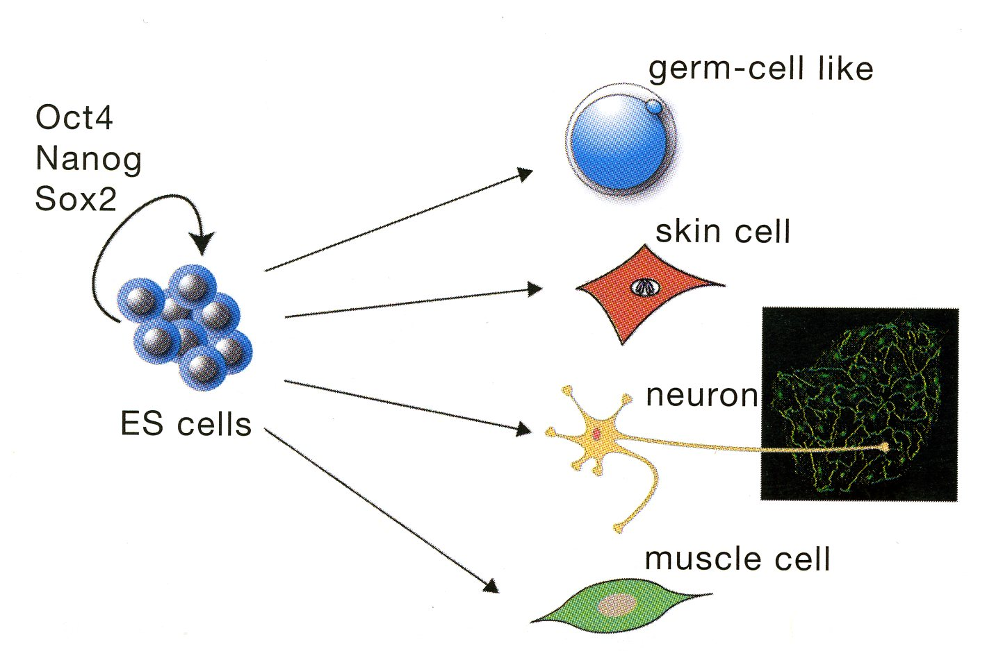
Differentiation of ES cells into Different Cell Types

Slide 3
How do Cells Know What to Do?
Cells differentiate in response to external signals: position, developmental & hormonal cues
Cells/tissues exhibit specific physiological responses to environmental cues
30,000 genes in the human genome: alternately spliced mRNA variants
> 200 cell types in mammalian organisms, each expressing specific sets of genes
Guesstimates
approx 10,000 genes selectively expressed in each type of cell, determined during development; cell/tissue functions determined by 100-1000s genes in response to physiological and environmental changes
gene transcription is controlled by transcription factors in response to signalling pathways, which reorganise genes by epigenetic mechanisms
approx 20,000 genes are silent, their expression could disrupt cell differentiation & cause chaos

Slide 4
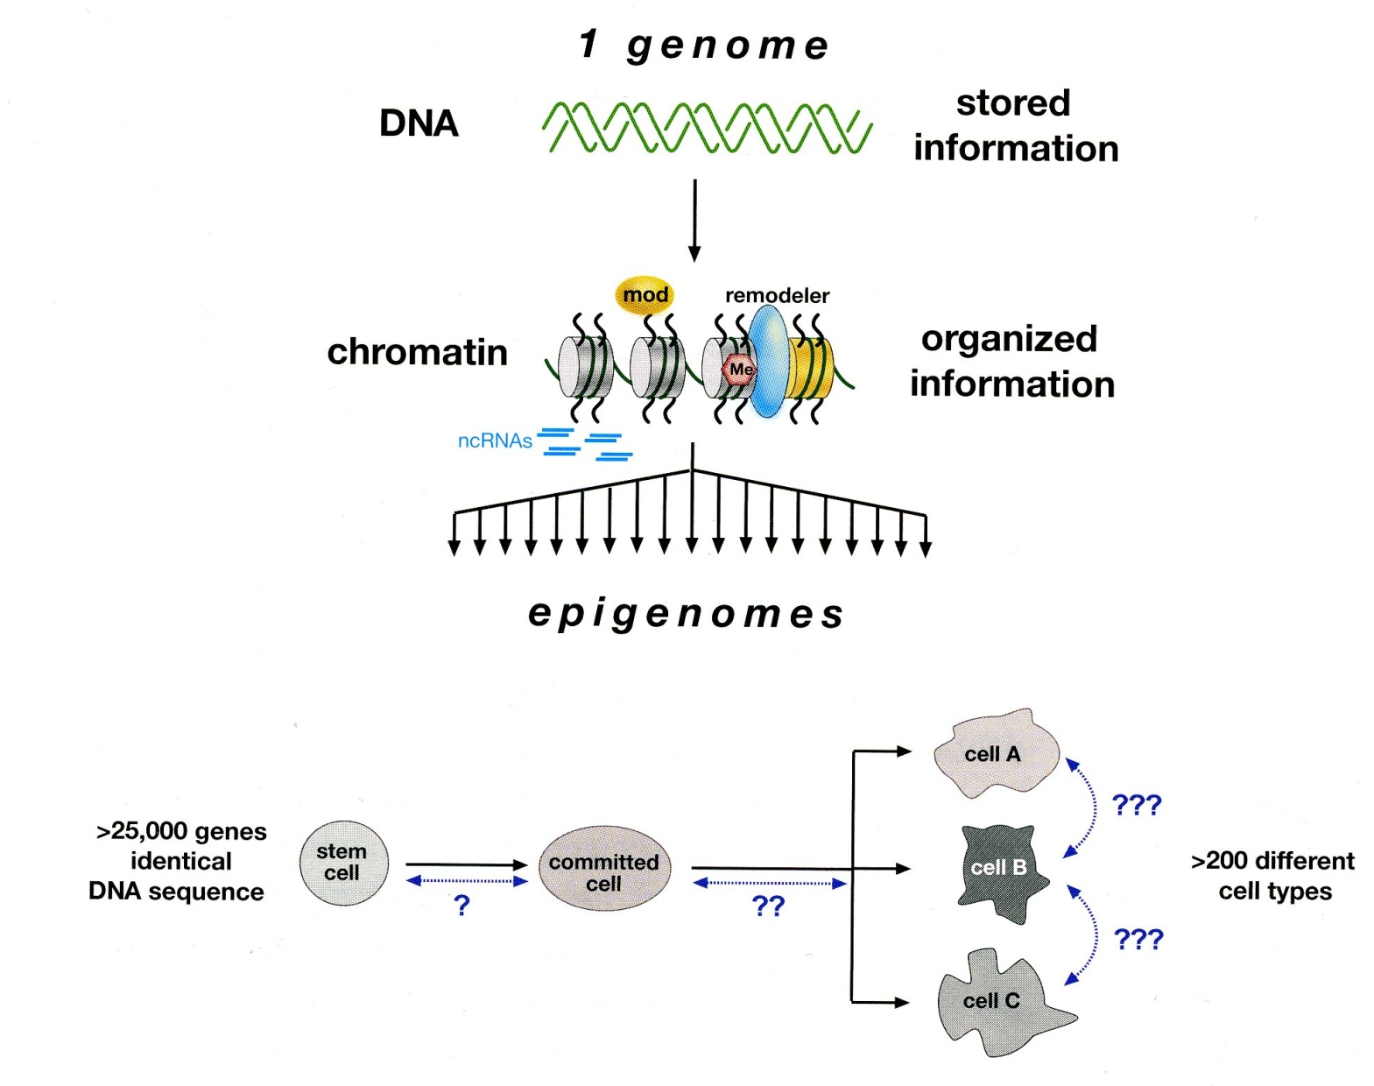
DNA and Genetics versus Chromatin and Epigenetics
mutations
translocations
Stability?
inheritance
imprinting
Induced pluripotency

Slide 5
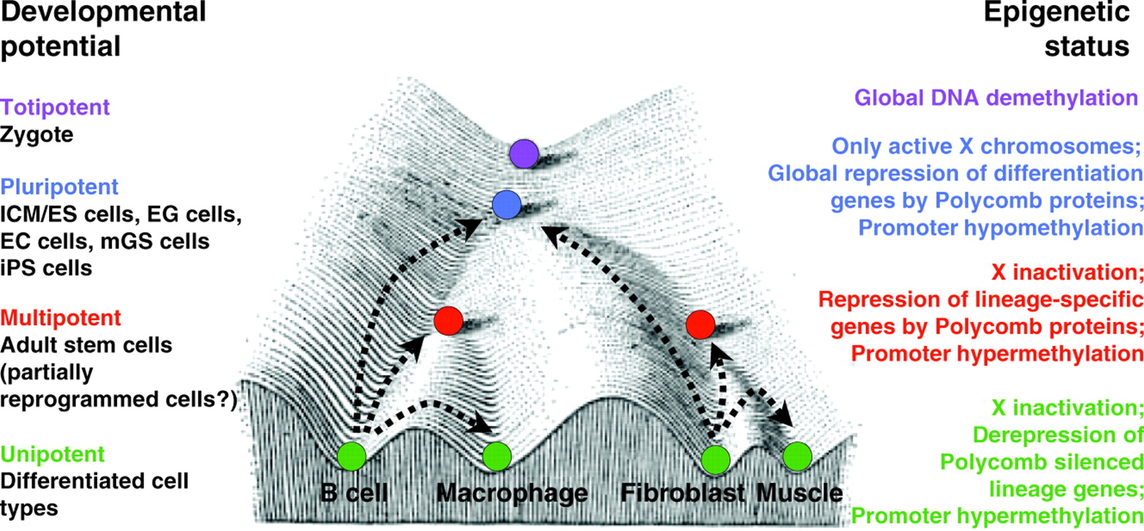
The developmental potential and epigenetic states of cells at different stages of development
A modification of C. H. Waddington's epigenetic landscape model, showing cell populations with different developmental potentials (left) and their respective epigenetic states (right). Developmental restrictions can be illustrated as marbles rolling down a landscape into one of several valleys (cell fates). Colored marbles correspond to different differentiation states (purple, totipotent; blue, pluripotent; red, multipotent; green, unipotent). Examples of reprogramming processes are shown by dashed arrows.
Hochedlinger K , Plath K Development 2009;136:509-523

Slide 6
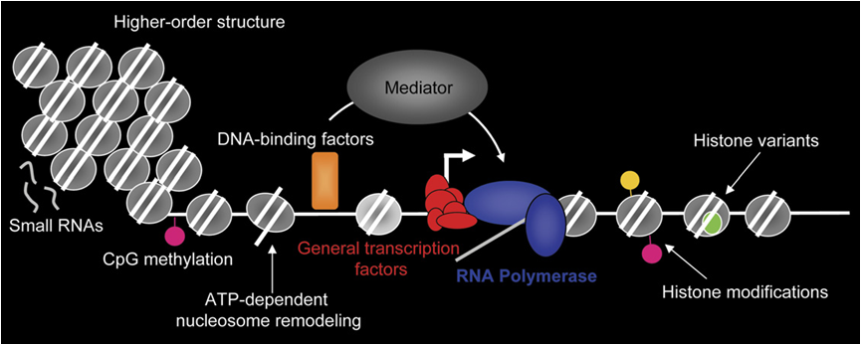
Molecular Epigenetics
Dunn & Kingston, 2007
One way or another, there is an effect on gene expression, which means one way or another, there is an effect on the binding or activity of RNA polymerase II, or on post-transcriptional processes such as splicing.

Slide 7
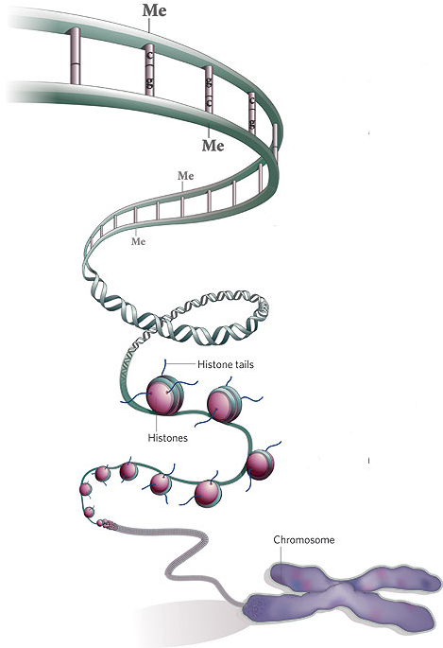
The Two Main Components of the Epigenetic Code
DNA methylation
Methyl marks added to certain DNA bases repress gene activity
Histone modification
A combination of different molecules can attach to the ‘tails’ of proteins called histones. These alter the activity of the DNA wrapped around them.
Notes:
7

Slide 8
Higher-Order Structuring of Chromatin
DNA wrapped around nucleosomes.
Compacted structure involving linker histone H1.
Dynamic higher-order looping that occurs in both interphase and metaphase chromatin.
Most compacted form of chromatin that occurs only during cell division (mitosis or meiosis).

Slide 9
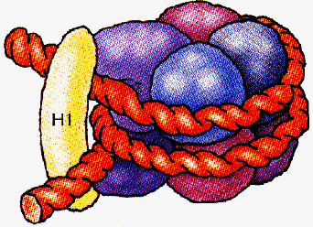
Chromatosome Structure
2 molecules each of
H2A, H2B, H3 and H4
DNA
11 nM
Core histone octamer + 1 Linker Histone + 2 full turns of DNA (168 bp).
Linker histone H1 binds the nucleosome and the entry and exit sites of the DNA, thus locking the DNA into place and allowing the formation of higher order structure.
Zhou, Gerchman, Ramakrishnan, Travers,
Muyldermans Nature 395, 402 (1998)
An, Leuba, van Holde, Zlatanova
PNAS 95, 3396 (1998)

Slide 10
Epigenetic Regulation of Gene Expression
Heterochromatin
Euchromatin
Methylated
DNA
Histone

Slide 11
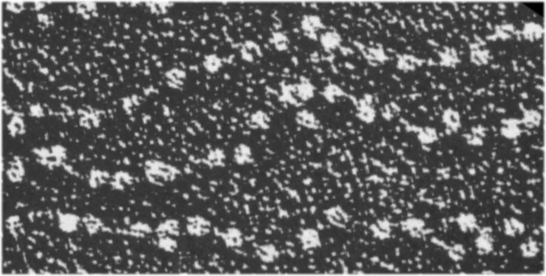
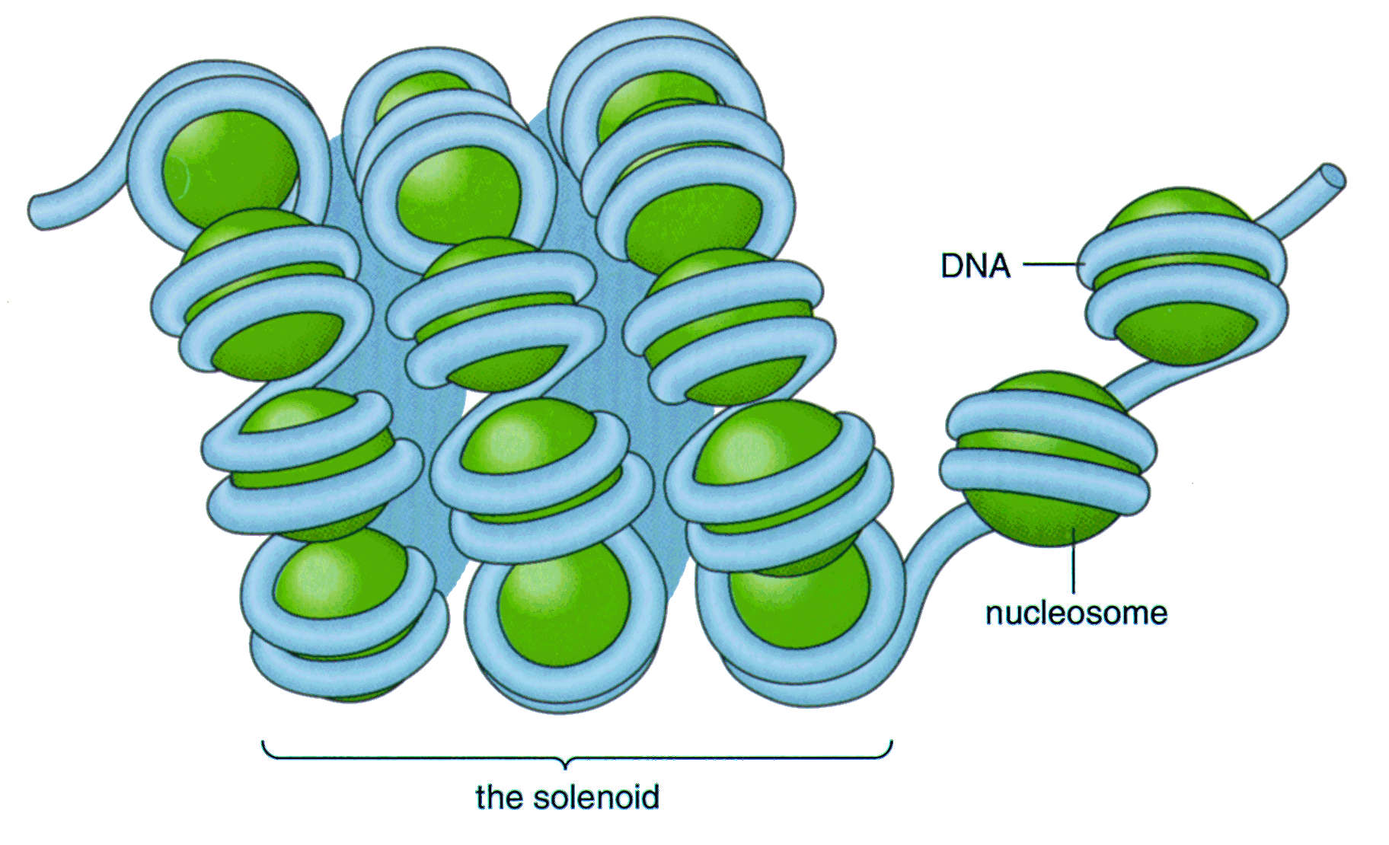
Chromatin fibers
30 nm
chromatin fiber
11 nm
(beads)
+ charged N termini
(bind DNA on neigbouring
nucleosomes)
highly acetylated
core histones
(especially H3 and H4)
HIGH level of histone H1
NO gene transcription
Reduced level of histone H1
Gene transcription possible

Slide 12
What Controls Gene Transcription?
Gene transcription patterns are determined by epigenetic regulation ie chromatin structure
DNA methylation
Histone modifications
Nucleosome positions
Stable inherited patterns versus regulated patterns determined by intrinsic or extrinsic signals
Epigenetic signatures are determined by the recruitment of chromatin remodelling enzymes to
transcription factors
Activity of transcription factors is regulated by signalling pathways that respond to
developmental and physiological cues

Slide 13
Classes of Epigenetic Modifications
DNA
Histone proteins

Slide 14
DNA Methylation
DNA methylation occurs at position C5 within CpG dinucleotides. 5meC constitutes <1% of nucleotides.
CpG frequency ~5x less than expected, thought to be due to increased mutation at CpGs.
Transitions (C-T) occur at 10-40 fold higher than other dinucleotides.
As many as 50% of point mutations in p53 gene in human tumors occur at CpG.
CpGs are not randomly distributed in the genome.
CpGs are methylated in repeats and 3’ regions of genes, but not in CpG islands.
There are estimated to be about 26,000-45,000 CpG islands, many which tend to be located in the promoter regions of housekeeping genes and some tissue specific genes. 60% of human genes have CpG islands.
Notes:
14

Slide 15
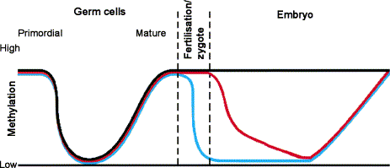
DNA Methylation Patterns are Established During Development
Imprinted
Maternal
Paternal
Mammalian development is accompanied by two major waves of genome-wide demethylation and remethylation: one during germ-cell development and the other after fertilisation.
Dean, Santos and Reik. Seminars in Cell & Developmental Biology 2003 14: 93-100

Slide 16
Roles of DNA Methylation
Transcriptional silencing
Protecting the genome from transposition
Genomic imprinting
X inactivation
Tissue specific gene expression

Slide 17
Final Outcome of Cytosine Methylation
5-methylcytosine
Chemically unstable
Prone to deamination
Resulting in thymine
Inefficient recognition of mismatch by DNA repair mechanisms
Cytosine (unmethylated)
Cytosine deamination gives uracil, which is recognized by DNA repair systems
Evolutionary outcome
Gradual decrease in CpG
Replaced by TpG (CpA)

Slide 18
Biological Roles of Cytosine Methylation
No role in some species: it does not occur at all in
S. cerevisiae and C. elegans
In Bacteria
Host defence mechanism, restriction enzymes in host
cell recognize and cleave unmethylated DNA of invading phages
In vertebrates / human
Important role in gene expression
An epigenetic mechanism: transmission of gene expression pattern to daughter cells
A form of host defence against transposons

Slide 19
Cytosine Methylation by DNMTs
Methyl Group
Addition of the methyl group at the 5 position of the cytosine pyrimidine ring does not sterically interfere with GC base-pairing.
Unmethylated DNA is methylated de novo by Dnmt3a and Dnmt3b.
Dnmt1 is the maintenance DNA methyltransferase for hemi-methylated sites.

Slide 20
CpG Islands
Regions of high CpG density that lack CpG methylation found at promoters of most genes.
Long-term silencing of the gene can be ensured by methylation of the CpG island region (e.g. inactive X chromosome and imprinted genes).
In cancer cells, genes aberrantly silenced by CpG island methylation.

Slide 21
DNA Methylation and Gene Expression
Unmethylated CpG islands are correlated with active
genes (e.g., housekeeping genes)
Suppressed genes contain methylated CpG islands
Mechanism of transcription suppression:
Methylation may prevent the binding of transcription
factors to the promoter region
Methylation may promote the recruitment of factors that prevent gene expression
Methylation inhibits transcription by converting
chromatin from an open to a closed conformation
(through methyl-CpG-binding proteins, and histone
modification by recruiting HDAC activity)

Slide 22
Mammalian DNA Methyltransferases
Conserved catalytic domain.
Divergent N-terminal regulator domain:
PCNA = PCNA-interacting domain
NLS = Nuclear localisation signal
RFT = replication foci-targeting domain
CXXC = cysteine-rich domain (for CpG binding)
BAH = bromo-adjacent homology domain
PWWP = proline-tryptophan-tryptophan-proline motif
ATRX = cysteine-rich region with C2-C2 zinc finger

Slide 23
Proteins That Bind Methyl-CpG
5 members of the MBD proteins aligned by MDB domains.
TRD – Transcriptional repression domains
T:G mismatch glycosylase domain repairs 5-methylcytosine deamination
Kaiso lacks MBD domain but binds DNA via zinc fingers

Slide 24
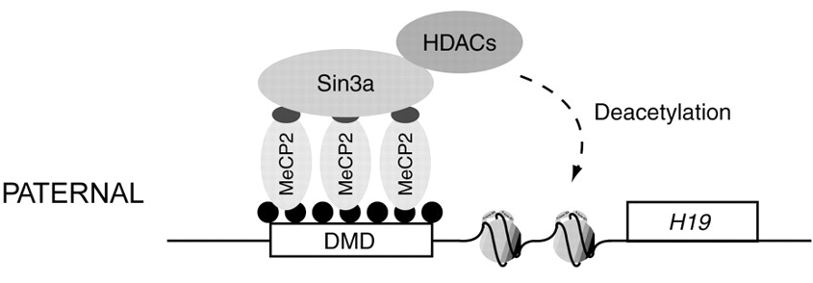
DNA Methylation and the Chromatin Landscape
Methylated-DNA binding proteins (MECP2, methyl CpG binding protein 2) bind to DNA
this recruits a complex of histone deacetylases and SIN3A
induces a closed chromatin structure → gene silencing
in contrast to usual deacetylation-related silencing, when methylation is involved, it is considerably more stable

Slide 25
Classes of Epigenetic Modifications
DNA
Histone proteins
Diverse range of modifications
Large number of enzymes that establish and remove marks
>70 different sites
Methylation
Acetylation
Phosphorylation
Ubiquitinylation
SUMOylation
NEDDYlation

Slide 26
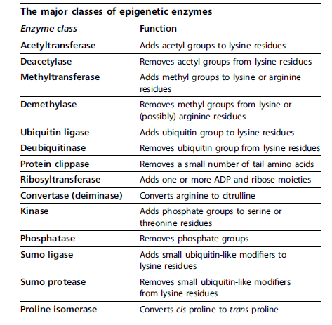
Histone Modifications

Slide 27
Histone Modifying Enzymes
Histone acetyltransferase
Protein arginine methyltransferase
Histone lysine methyltransferase
Histone deacetylase
Protein Phosphatase

Slide 28
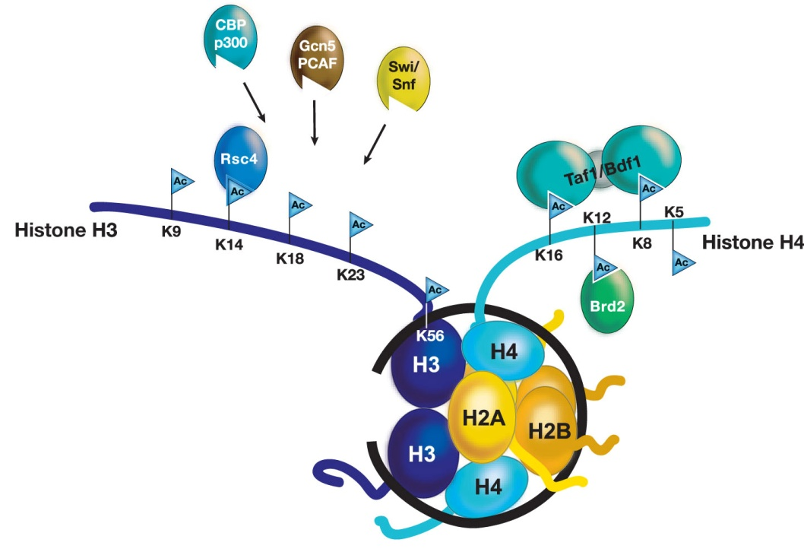
Characterised Sites of Histone Acetylation
Histones are mostly acetylated at lysine residues located in the amino termini of H3 and H4.
The proteins that express binding specificity to acetylated histones are shown.

Slide 29
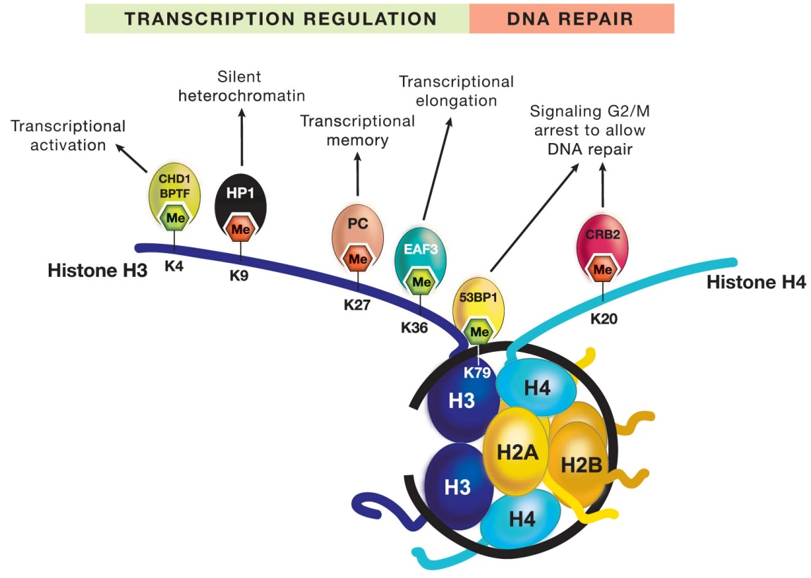
Characterised Sites of Histone Methylation
Green = activation
Red = repression
Methylation of histones occurs at lysine residues in histones H3 and H4.
Certain methylated residues are associated with transcriptional activation (green), whereas others are involved in repression (red).
Notes:
G9a
Suv39h1 and Suv39h2

Slide 30
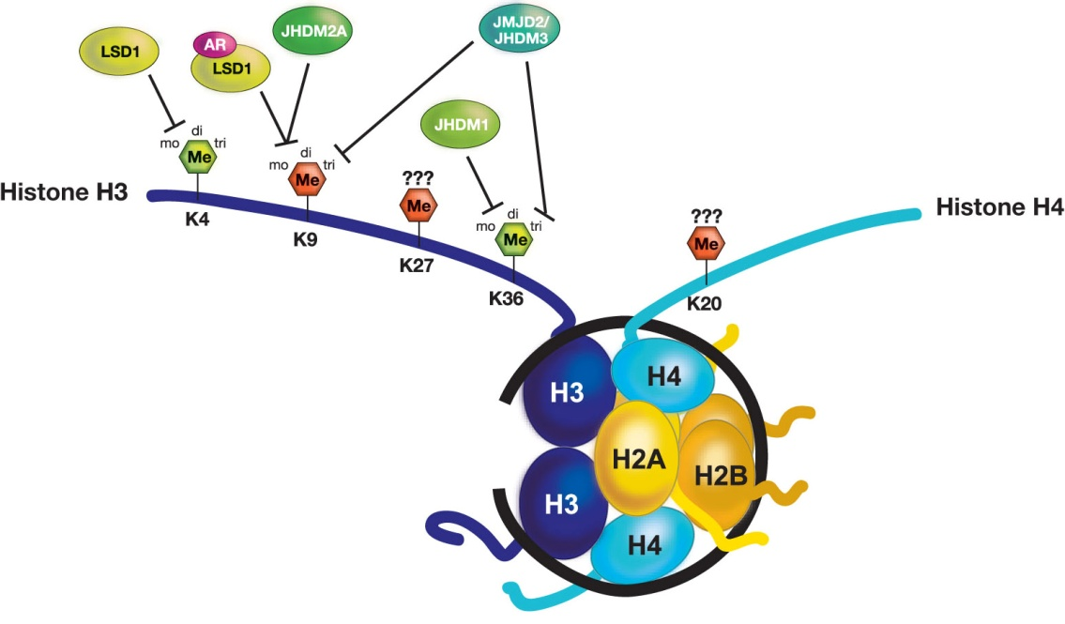
Histone Lysine Demethylases and Their Sites of Demethylation on Histone H3
Sites of histone lysine methylation may be mono-, di-, or tri-methylated.
Known histone lysine demethylaes show different specificities in demethylating histone residues or methylated states.

Slide 31
Sites of Histone Ubiquitination and Consequences for Transcriptional Regulation

Slide 32
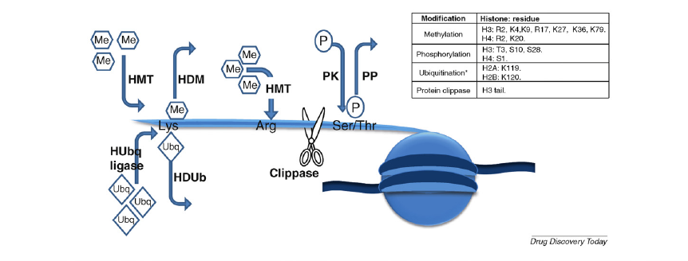
Histone Modifications

Slide 33
Use of Embryonic, Fetal and Adult Stem Cells
for Regenerative Medicine
Developmental potential: ES > fMSC > AdSC
Applications: bone marrow and skin transplantation
pancreatic, cardiac, dopaminergic neurones
brown adipocytes?
Sources of stem cells:
embryonic: embryos
fetal: blood, liver
adult: reprogrammed somatic cells?

Slide 34
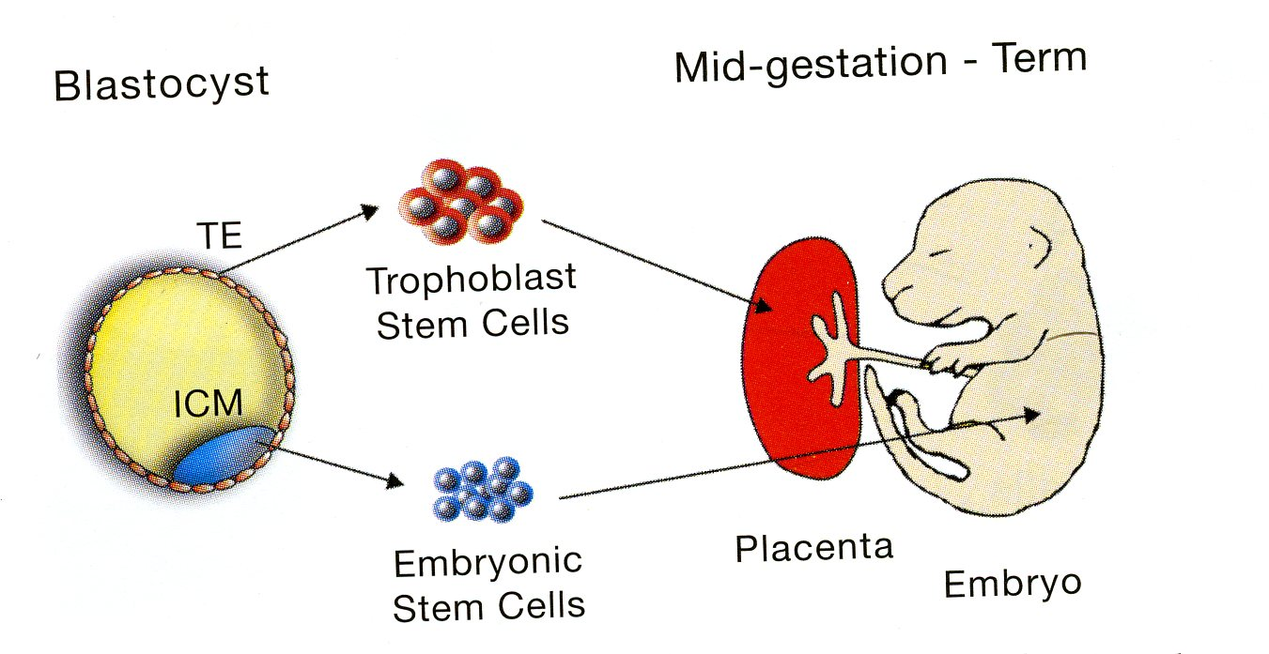
Derivation of ES and TS Cells from the Blastocyst

Slide 35
Use of Mesenchymal Stem Cells in Regenerative Medicine
http://www.biomedcentral.com/1741-7015/9/52

Slide 36
Epigenetic Landscape and Pluripotency
Given that ES and somatic cells contain almost identical DNA, epigenetic regulation is one of the major influences on their pluripotency and differentiation potential.
The epigenetic status of a somatic cell is different to that to that of a pluripotent stem cell.
Dedifferentiation requires global epigenetic reprogramming.
Pluripotent stem cells contain bivalent domains that are characteristic chromatin signatures:
Enriched for: repressive e.g. H3K27me3
and active e.g. H3K4me3 marks.
DNA methylation – in differentiated cells Oct4, Nanog, and Sox2 promoter regions are highly methylated and in an inactive state. During reprogramming these promoters become demethylated.

Slide 37
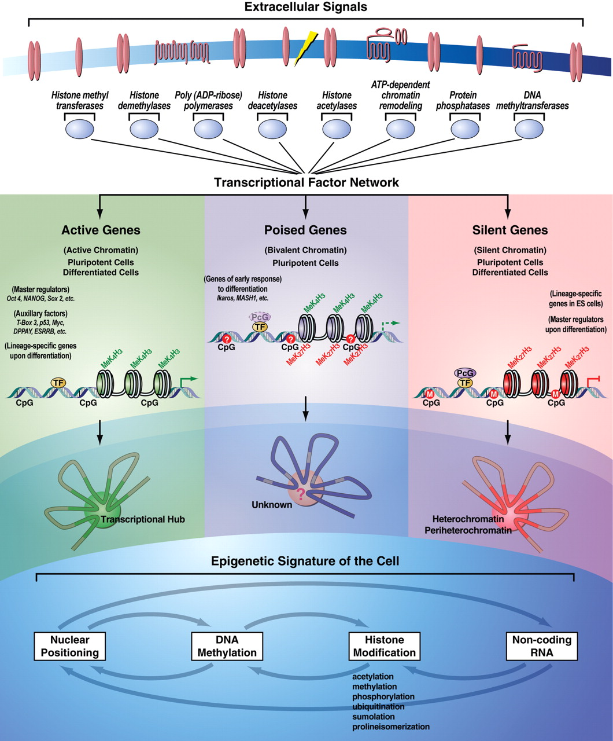
Epigenetic response to extrinsic signals occurs through the transcriptional factors network.
MeK4H3 - Active
MeK27H3 - Repressive
Lunyak V V , Rosenfeld M G Hum. Mol. Genet. 2008;17:R28-R36

Slide 38
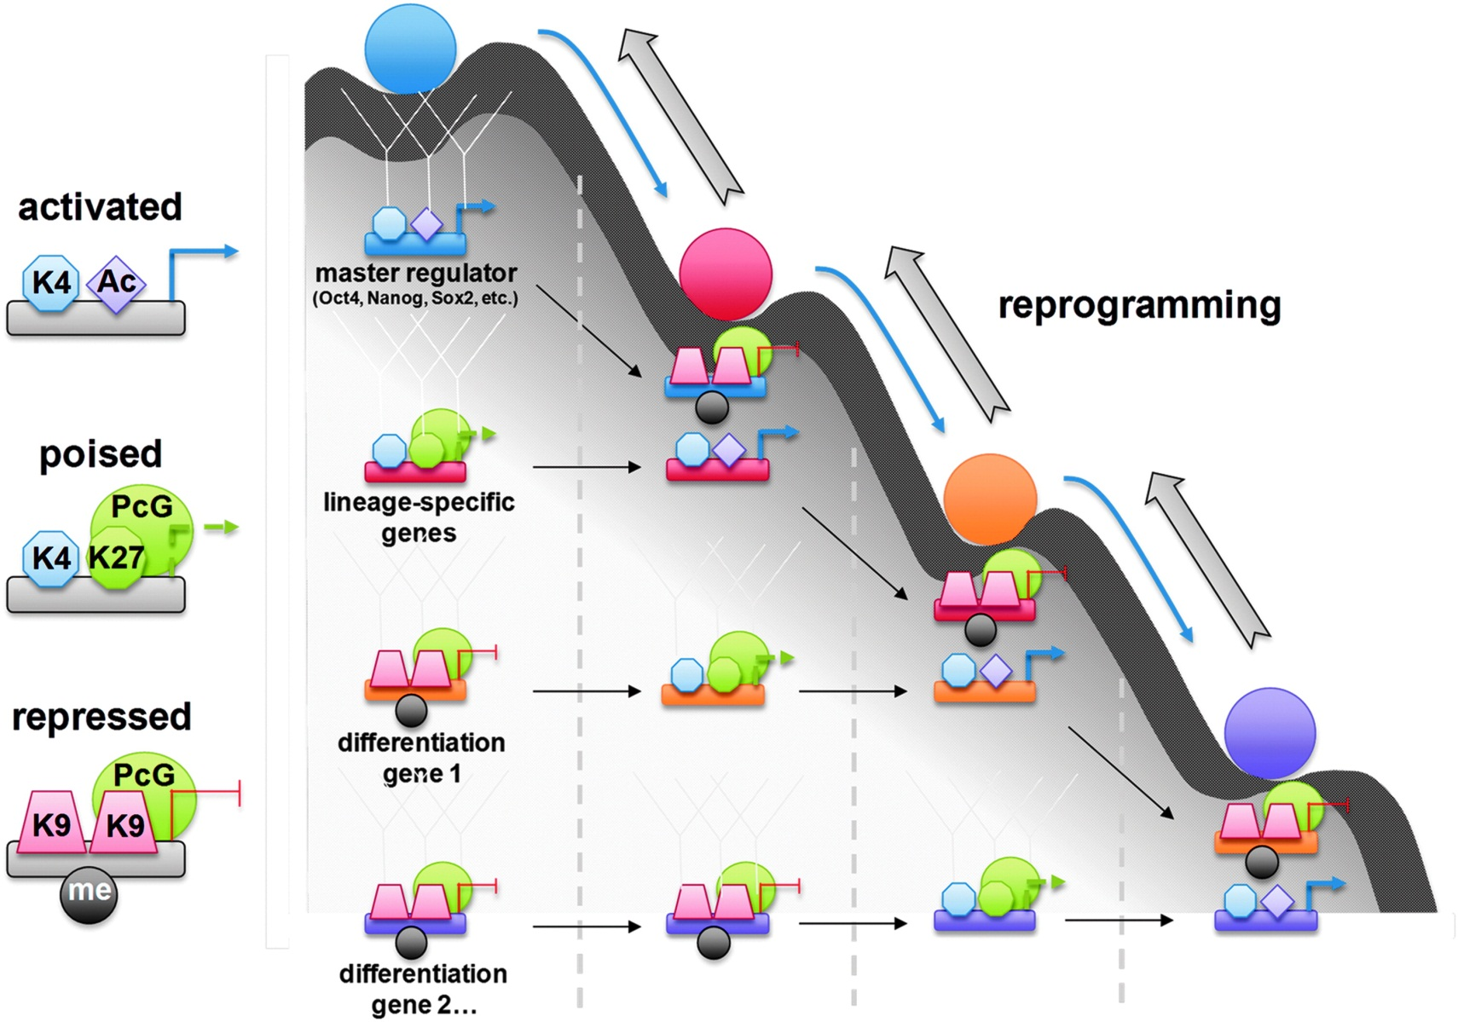
ES Cell to Somatic Cell Differentiation

Slide 39
Epigenetic Landscape and Pluripotency
To maintain pluripotency in ES cells, differentiation-triggering genes should be inactive.
Polycomb group proteins (PcGs) play important roles in silencing these developmental regulators.
The polycomb repressive complexes (PRCs) are conserved from Drosophila to humans. There are two distinct complexes: PRC1 and PRC2.
Transcriptionally silent developmental regulators targeted by Oct4, Sox2 and Nanog are also occupied by PcGs.
PRC2 catalyses H3K27 methylation.
H3K27 methylation provides a binding surface for PRC1.
PRC1 facilitates condensation of chromatin structure, inhibition of chromatin remodelling to maintain silencing.

Slide 40
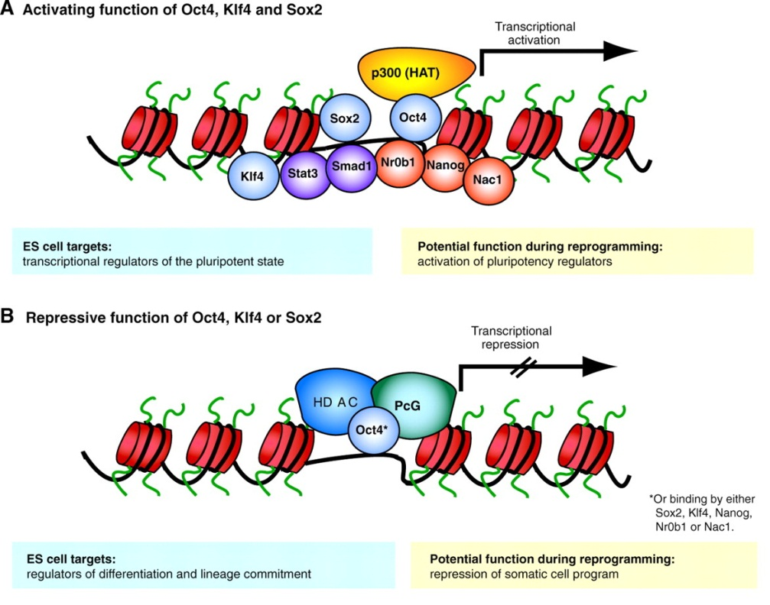
ES cell transcription factor network and implications for reprogramming
Hochedlinger K , Plath K Development 2009;136:509-523

Slide 41
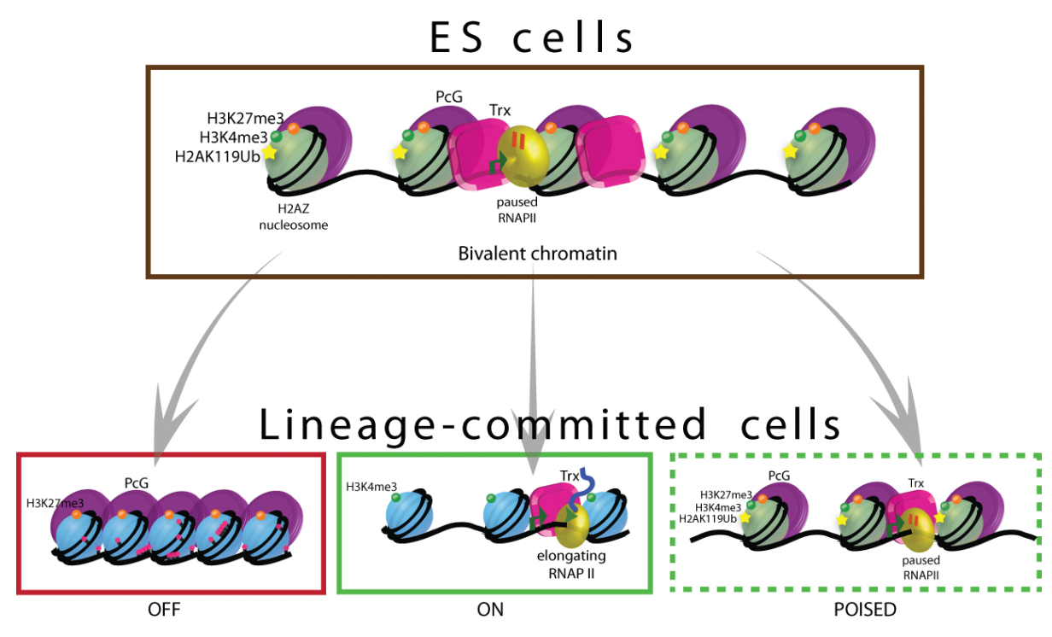
Genes Expressed Early in Differentiation are Bivalent, Poised in ES Cells

Slide 42
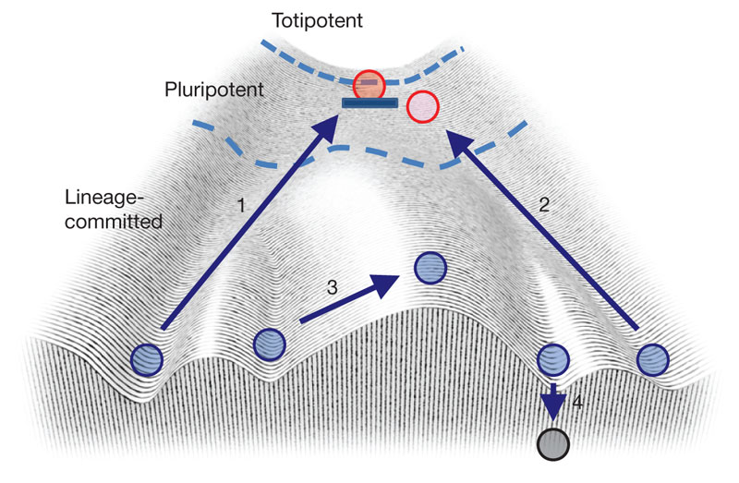
Reprogramming Somatic Cells to iPS

Slide 43
Approaches to Reprogramming Somatic Cells
Fusion of somatic cells with embryonic stem cells
Somatic cell nuclear transfer (SCNT)
Reprogramming with defined factors
Oct4, Sox2, myc, Klf4.

Slide 44
Somatic Cell to iPS Cell - Reprogramming

Slide 45
Transcription Factor-induced Pluripotency
Nanog

Slide 46
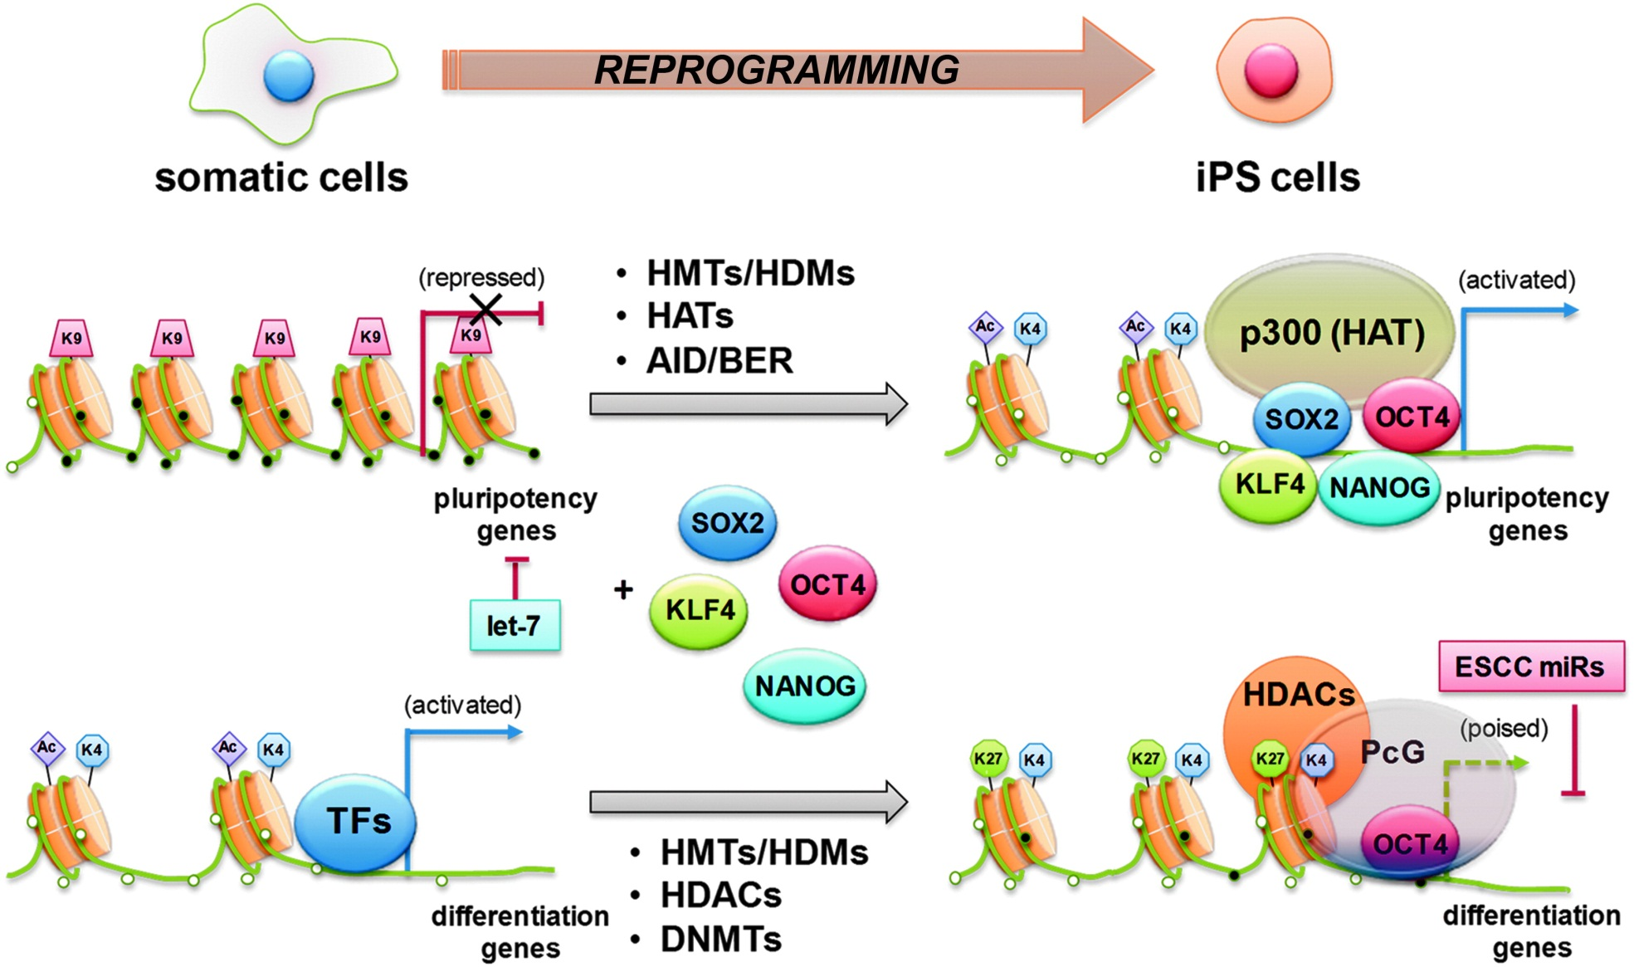
Transcription Factor-induced Pluripotency

Slide 47
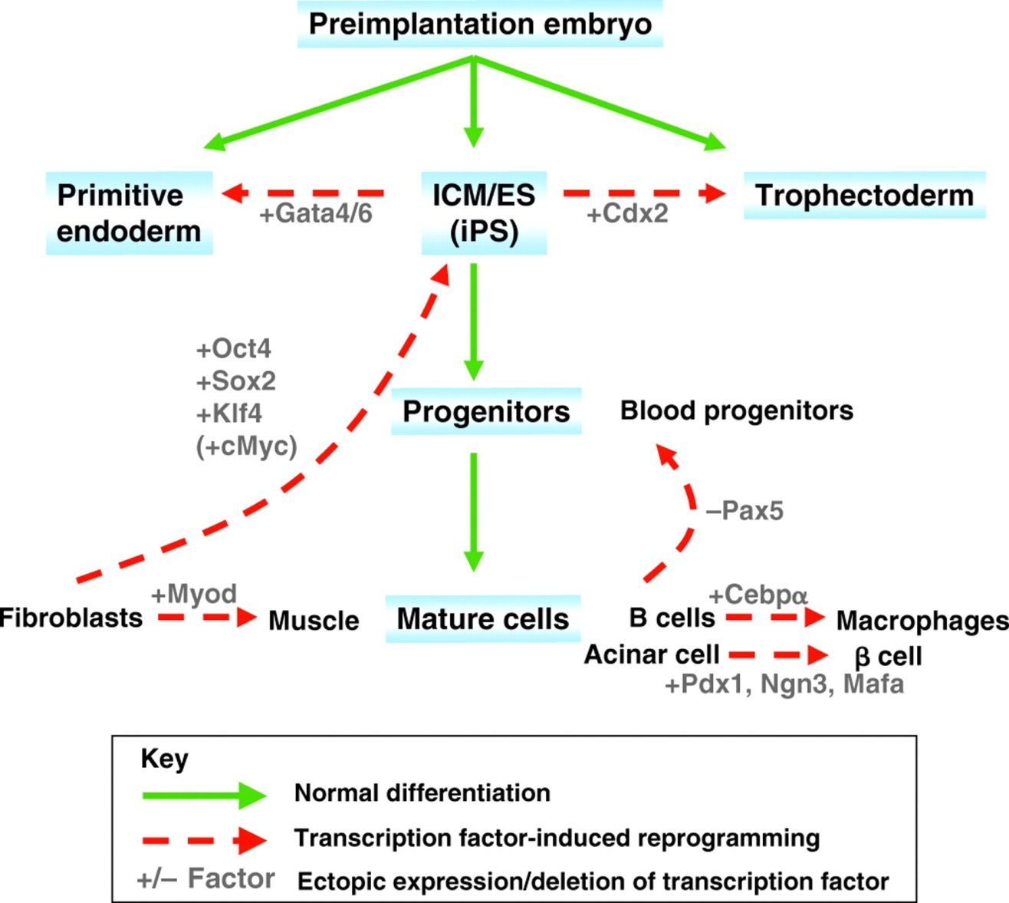
Examples of transcription factor-mediated reprogramming.
Hochedlinger K , Plath K Development 2009;136:509-523

Slide 48
Limitations of Different Approaches
Human embryos: limited supply; potential ethical considerations
Somatic cell nuclear transfer (SCNT) and reprogramming are very inefficient processes that are capable of generating pluripotent stem cells. Similar but not identical to embryonic stem cells - distinct epigenetic signatures
Reprogramming with myc, an oncogene, could increase the risk of tumours the integration of vectors to express the programming factors will need to be controlled.

Slide 49
Summary
Epigenetic status controls gene expression
DNA methylation – important for silencing
Histone modifications – Acetylation – Methylation
Epigenetic Landscape of Stem Cells and how it changes during lineage commitment
Reprogramming of somatic cells – key transcription factor

Slide 50
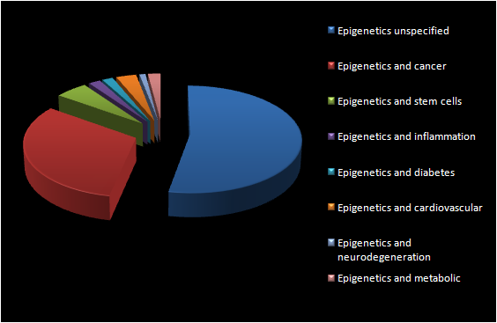
So Much Still to Understand
What first attracts a nucleosome or a modifying enzyme to a specific chromosomal locus?
What are the roles of non-coding RNAs?
What are the roles of histone variants?
How are histone marks transmitted from mother to daughter cell?
How will we overcome epigenetic barriers to reprogramming?
How will we identify the most appropriate intervention points in diseases?
What’s the relative importance of histone and non-histone targets?

Slide 51
Further Reading
Epigenetic Landscape of Stem Cells
http://www.frontiersin.org/Epigenomics/10.3389/fgene.2012.00081/full
http://hmg.oxfordjournals.org/content/17/R1/R28.full
http://onlinelibrary.wiley.com/doi/10.1002/med.21265/full
http://www.nature.com/nrm/journal/v13/n8/full/nrm3393.html
http://dev.biologists.org/content/136/4/509.full

