Slide 1
Primary Care Small Group Exercises

Slide 2
Learning objectives
To consider the advantages and disadvantages of the Brazilian primary care model.
To consider what attributes of the Brazilian healthcare system could be adopted by other healthcare system, and what barriers to adoption might be.
To consider the implications of the NHS reforms to primary care

Slide 3
Exercise one: The Brazilian Primary Care system
Read the paper: Harris M. Integrating Primary Care and Public Health- Learning from the Brazilian way.
Questions for discussion in small groups.
Describe the Brazilian Primary Care system.
Do you think this is article a fair and representative view of the Brazilian primary care model?
What lessons for primary care in the UK (or other developed countries) can be learned from the Brazilian model?
What would happen if you tried to introduce this sort of model in the UK? What barriers do you think you would encounter?

Slide 4
Exercise 2: Designing a primary care system
Read the Chapter on Primary Care from the Global Health Watch Document
Questions for discussion in small groups.
Look at the example of Rwanda (beginning at the bottom of page 52), and how it developed its primary care system.
The current healthcare minister in Rwanda is Dr Anges Binagwaho- until recently a practicing clinician. When she took office, first as permanent secretary for health, then as health minter, she faced a massive challenge, with a damaged health system, small budget, multiple external stakeholders’ trying to run external programmes and a significant shortage of skilled clinical staff. Imagine you were in her position.
Imagine you were in her role in 2000, having recently taken control of the Department of Health.
How would you go about planning a national primary care system?
What would be your priorities in terms of clinical services?
What structural design would you use (how would you balance vertical and horizontal programmes)?

Slide 5
For reference: Facts about Rwanda
There is a population of 9.7 million. GDP per capita is $1500. The population is young: an estimated 42.7% are under the age of 15, and 97.5% are under 65. The annual birth rate is estimated at 40.2 births per 1,000 inhabitants, and the death rate at 14.9. The life expectancy is 56.8 years. An estimated 7.3% of urban dwellers and 2.2% of rural dwellers, aged between 15 and 49, are HIV positive. The country's literacy rate, defined as those aged 15 or over who can read and write, was 71% in 2009. There are chronic issues of retention of health care workers. As an example of the skills shortage, at present you have one neurosurgeon and three cardiologists registered nationally.

Slide 6
Discussion: NHS primary care reforms
Devolution of power: Clinical commissioning groups to assume some 60% of NHS purchasing from 2013
CCGs will account to a new NHS Commissioning Board, which will authorise them as ‘fit and ready’ to commission
NHSCB will operate out of regional offices & local area teams (LATs)
PCTs & SHAs abolished
Commissioning Board will also commission services directly – primary care, specialised services
Commissioning will take place within (and be measured against) a new NHS Outcomes Framework

Slide 7
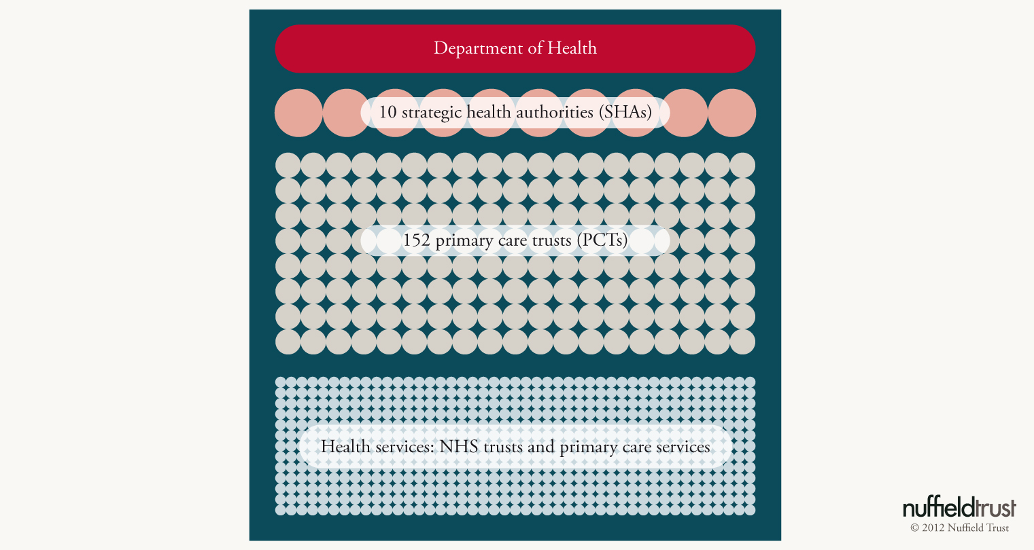
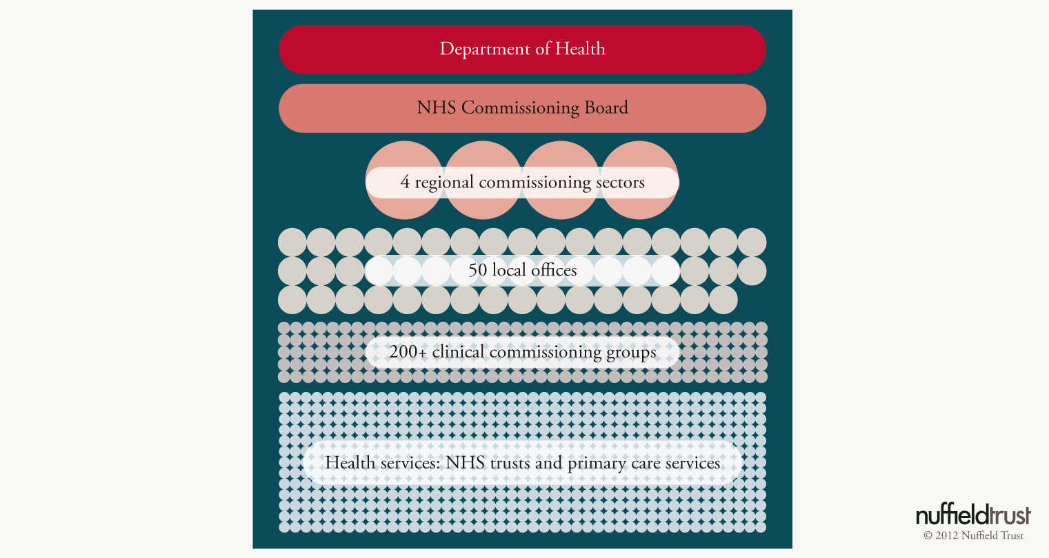
New institutions
Cost of reorganisation: £1.3 billion?

Slide 8
Clinical Commissioning Groups
The main commissioning unit in the NHS, replace PCTs (NHSCB to commission specialist services)
All GPs must be members of a CCG
Premise: clinicians will be driving decision making in the NHS
GPs will need to make rationing decisions
Must ‘have regard to’ HWBs
Able to buy in support from Commissioning Support Services
Have a duty to enable integration but must avoid anti-competitive behaviour
Notes:
Variable sizes
Key change = it will be your GP across the table making difficult funding decisions
Will they have the skills in house
Have regard to HWBs? What does that mean? HWB can veto service reconfiguration

Slide 9
Main challenges facing new CCGs
Organisational development
Identifying skills gaps & buying in support to fill them
Managing tight budgets & rationing care
Coping with the workload
Influencing powerful providers where previous commissioners have failed
Navigating integration/competition policy appropriately
Keeping GP members on board
Coping with wider system flux (new structures & regulatory frameworks): will the NHSCB ‘let go’?

Slide 10
Opportunities for the next phase
For CCGs to use their combination of clinical expertise and real financial control to design and enact new forms of care
For CCGs to have standing and influence that eluded PCTs
For CCGs to use their clinical leadership to influence a range of local providers to develop integrated care
For CCGs to be much stronger and more visible local commissioners
For the NHS Outcomes Framework to act as an important benchmark of commissioning performance

