Slide 1

Health Systems
- policy, politics and practice
Dr Julie Balen
Centre for Health Policy
Institute of Global Health Innovation
Imperial College London
2013

Slide 2
Contents
- quick re-cap from last lecture
- intro to policy & health policy
- policy actors
- form/typology of health policy
- policy making process/cycle
- evaluating policy
- examples from the field

Slide 3
Health systems are dynamic & interconnected systems at whose heart are people
‘It is the multiple relationships and interactions among the six ‘building blocks’ ... that convert these blocks into a system’
People & relationships
governance
Information
service delivery
human resources
medicines & technology
financing
De Savigny & Adams, 2009
Others have described these as “hardware” and “software”.
Notes:
When we talk about the structure of a health system – we are referring to the key components – people, equipment, money, information, but these components are interrelated and interdependent, and hence we are also talking about the patterns and relationships between them. These relationships depend on the institutions → the formal and informal rules of the game that shape human behaviour! Power dynamics, issues of trust, communication, partnerships, collaborations, ownership – some are intangible, meaning, hard to measure, hard to describe, or to predict, or to control! Hence also hard to study!
They are political and social institutions! Institutions → Norms, rules of conduct, established procedures

Slide 4
Schematic illustrating health system structure/components
Global & National forces
Health Systems:
Hardware: Organization; Financing; Equipment; Information/data
Software: Actors & Relationships; Norms & Values; Institutions (“rules of the game”)
Health Policy:
Content & Instruments
Actors, Power & Politics
Institutions, Interests & Ideas
Policy Change
&
Health System Development
The hardware and software are often tied together to create a sum that is greater than its parts – ie the health system itself, with emergent properties – intended or unintended .
Notes:
Health systems are diverse & complex. Structure & organisation – includes size and scope, is it top-down, centralised, bottom-up, de-centralised, partially centralised, are services provided vertically, horizontally, or are they integrated, partially-integrated…
Actors – national,, sub-national, supra-national, global, governmental, non-governmental, inter-governmental, donors, policy makers, health-care providers, patients, relatives, society…. What is the composition and how much say/action does each actor have
They contain more actors than just the policy makers and practitioners – including private companies, different types of social entrepreneurs, civil society organizations, faith based organizations.
Formal rules such as constitutions, laws, regulations, contracts
Also
Informal rules of the game based on ethics, norms, traditions, culture, values, religious thought; VALUES RELATED TO HEALTH MAY BE HEALTH EQUITY, FAIRNESS, INCLUSIVENES, COMPREHENSIVENESS, COVERAGE, EFFICIENCY, QUALITY – SOME VALUES MAY BE IN CONTENTION WITH OTHERS, DOES THIS CREATE ANY ISSUES? ANY EXPLICIT ISSUES? HIDDEN ONES?
Ultimately – health care is a relationship between the patient and the provider – a micro-political interaction!

Slide 5
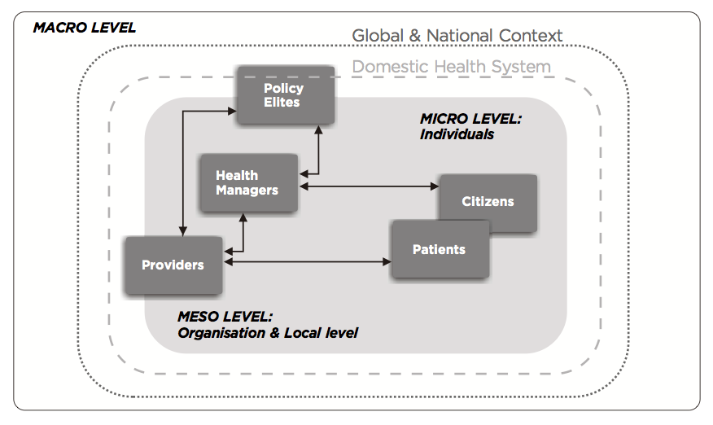
Health systems operate at multiple levels
statements of intent but also as the informal, unwritten practise.

Slide 6
Health policy is inherently political
Involves health care decisions related to the allocation of scarce resources
  The very definition of politics
National health care systems are reflective of a country’s political traditions and norms
In everyday life, distinction between policy & decision is often blurred (Walt 1994)
  terms decision making & policy making often used synonymously

Slide 7
Health policy defined
Public Policies: authoritative decisions made in legislative, executive or judicial branches of government
  intended to direct or influence the actions, behaviors, or decisions of others
Health Policies: aggregate principles, stated/unstated that characterize distribution of resources, services, and political influences
  that impact on the health of the population
Health policies are public policies or authoritative decisions pertaining to health or influencing pursuit of health
Health policies affect or influence groups or classes of individuals or organizations
Notes:
Health policies are
a by-product of public social policies
pertain to health care at all levels,

Slide 8
Health policy defined…
Actions taken by government, the prime intention of which is to promote health or reduce health inequalities.
Four examples of objective:
  Efficiency
    Better outcomes
    Lower costs
  Equity
  Macroeconomics
  Politics
Notes:
including policies affecting the production, provision, and financing of health care services.

Slide 9
Health policy mixes multiple objectives
Objectives about “Health Insurance”
  Protection against the unpredictability of health care expenses
Objectives about “Health Care”
  Delivers only “costworthy” (efficient) health care
  Equity and fairness in access to health care
  Making health services more respectful, kind, friendly…
Objectives about “Health”
  A special concern for the health of disadvantaged groups
  A special concern for the health of workers (human capital)
  Financing public goods that affect health
Social objectives
  Redistribution of income between rich and poor, healthy and sick, powerful and weak

Slide 10
Who sets health policy?
Governments, in the light of
  History
  Institutional arrangements
  National wealth
  Political pressures and constraints
  International pressures
But a government is an (often shaky) alliance of different interests!

Slide 11
Who are the major actors?
Citizens
  Taxpayers
  Patients
Health care professionals
Provider organizations
Pharmaceutical and health technology companies
Local purchasers (PCTs or local insurers)
National and local governments
Industries such as food, environment, tobacco, pharma
Regulators
Researchers
NGOs and international agencies
  multilateral & bilateral organisations
  global public-private initiatives (eg Gates Foundation)
  transnational civil society movements (People’s Health Movement)
Notes:
Health policy can be seen as formal written documents, rules and guidelines that present policy makers decisions about what actions are deemed legitimate and necessary.
However, these formal documents are translated – operationalized-- through decision making of policy actors, such as middle-managers, health providers, health workers, patients, citizens, and their daily practices.
THESE DAILY PRACTICES BECOME HEALTH POLICY AS IT IS EXPERIENCED AND EMOBIDED, WHICH MAY DIFFER FROM THE INTENTION ON THE FORMAL DOCUMENTS.

Slide 12
Public vs. private policy
Health policies can be made through the public sector (by government) or the private sector
Public Policy
  Policy that is established by the federal, state, and local levels of government
Private Policy
  Policy that is established by private organizations

Slide 13
Forms & categories of health policies
There are 5 main forms of health policies
  Laws
  Rules/Regulations
  Operational Decisions
  Judicial Decisions
  Macro Policies
Public health policies grouped into 2 categories
  Used as allocative tools
  Used as regulatory tools

Slide 14
1. Laws
A rule of conduct or action prescribed or formally recognized as binding or enforced by a controlling authority
Enacted by any level of government
Can also be referred to as a program
  For example, the Medicare program in USA

Slide 15
2. Rules/Regulations
Designed to guide the implementation of laws
Can be made in the executive branch by the organizations and agencies responsible for implementing laws

Slide 16
3. Operational Decisions
Operational decisions are made by the executive branch of the government as a part of the implementation of a law
Normally these decisions consist of protocols and procedures that follow the implementation of a new law
These decisions tend to be less permanent than rules or regulations

Slide 17
4. Judicial Decisions
These are policies that are created as a result of a decision made in the court system
For example, an opinion listed in 1992 by a DHHS administrative law judge stated that a hospital was in violation of the Rehabilitation Act Amendments of 1974

Slide 18
5. Macro Policies
Macro policies are broad and expansive and help shape a society’s pursuit of health in fundamental ways
Example
  FDA regulation of pharmaceuticals

Slide 19
1. Allocative tools
Designed to provide net benefits to some distinct group or class of individuals/organizations, often at expense of others, to ensure that public objectives are met
  come in the form of subsidies
  Involve direct provision of income, services, or goods to certain groups of individuals or institutions
Distributive policies include:
  funding of medical research through the National Institute of Health
  the development of medical personnel
  the construction of facilities
  initiation of new institutions
Redistributive policies include:
  creating visible beneficiaries and payers
  taking money or power from one group and giving it to another

Slide 20
2. Regulatory tools
Policies designed to influence actions, behaviors, & decisions of others to ensure public objectives are met
Call on government to prescribe & control behavior of a particular target group by
  monitoring the group and imposing sanctions if it fails to comply
Five main categories of regulatory policies
  Social regulations
  Quality controls on the provision of health services
  Market-entry decisions
  Rate or price-setting controls on health service providers
  Market-preserving controls
Notes:
Health policies may be used as regulatory tools

Slide 21
Social Regulations
These regulations are established in order to achieve socially desirable outcomes and to reduce socially undesirable outcomes
Examples
  Environmental protection
  Childhood immunization requirements
  Ban on smoking

Slide 22
Quality Controls
These regulations are intended to ensure that health services providers adhere to acceptable levels of quality in the services they provide and that producers of health-related products meet safety and efficacy standards
Example
  FDA regulation of pharmaceuticals
  New Pay for Performance (P4P) regulations

Slide 23
Market-entry Restrictions
These regulations focus on licensing of practitioners and organizations
Example
  Certificate of Need programs
  Physician credentialing (Hospital privileges)

Slide 24
Rate or Price-setting Controls
These regulations are designed to control the growth of prices

Slide 25
Market-preserving Controls
These regulations establish and enforce rules of conduct for market participant

Slide 26
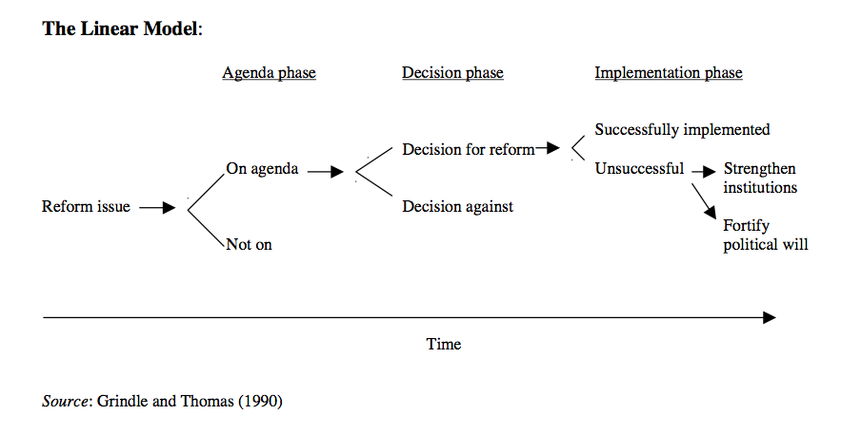
The old model of the policy process
Policy is now thought of more as a ‘chaos of purposes and accidents’
Notes:
This model assumes that policy makers approach the issues rationally, going through each logical stage of the process, and carefully considering all relevant information. If policies do not achieve what they are intended to achieve, blame is often not laid on the policy itself, but rather on political or managerial failure in implementing it (Juma and Clarke 1995). Failure can be blamed on a lack of political will, poor management or shortage of resources, for example.
There is much evidence to suggest that this model is far from reality. In reality, political science, sociology, anthropology, international relations and business management all involved in policy-making, and attempt to build a broader picture of the process.

Slide 27
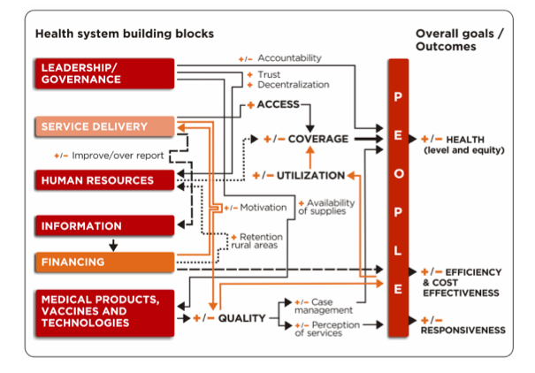
Notes:
Policy-making must be understood as a political process as much as an analytical or problem solving one.
The policy-making process is by no means the rational activity…
Indeed, the metaphors that have guided policy research over recent years suggest that it is actually rather messy, with outcomes occurring as a result of complicated political, social and institutional processes which are best described as ‘evolutionary’’, (Juma and Clarke 1995).
This is summarised by Clay and Schaffer (1984), ‘The whole life of policy is a chaos of purposes and accidents. It is not at all a matter of the rational implementation of the so-called decisions through selected strategies.’

Slide 28
In a context where there exists considerable uncertainty, policy overload and major organisational turbulence, the processes for implementing policy and reaching sustainable decisions are likely to become more difficult to put into place successfully

Slide 29
Main stages of policy cycle
The formation and implementation of health policy occurs in a policy cycle comprising five components:
  1.) issue raising
  2.) policy design
3.) public support building
4.) legislative decision making and policy support building
5.) legislative decision making and policy implementation

Slide 30
Main stages of policy cycle…
Getting item on national political agenda
      National Health Insurance (NHI)
        First appeared on agenda due to the efforts of early (private) reformers
          Returned to agenda as part of FDR’s New Deal
Formulating political solutions to given problem
      Could be “re-heated” policies hatched previously
        Garbage can theory of policy making
Making a political decision
      National health insurance never enacted
        Medicare and Medicaid passed by Congress
          Signed into law 1965
Implementing the political decision (law)
Administration of a given program
      Relates to the day-to-day functioning of government program
Evaluation of a given program (this step often not realised)
Notes:
Policies become effective
if there is enough political support
Important to understand the politics of influencing policy agendas

Slide 31
Examples of health policies
Public Health policies include:
  Reforms in medical education
  1965 enactment of Medicare and Medicaid
  Federal funding for family planning clinics
  A merger of two hospitals violates antitrust laws
  Procedures for licensing physicians
  Monitoring sanitation standards in restaurants
  Banning smoking in public places

Slide 32
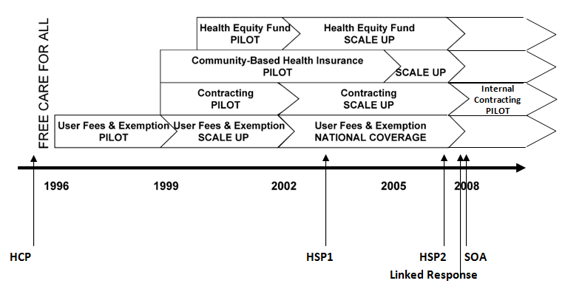
Key health reforms in Cambodia, 1996-2010
D
S
D = demand side; S = supply side
Notes:
S = supply side
D = demand side
The ones that were of real interest were the integration reforms LR and SOA

Slide 33
Integration & harmonisation policy
Mounier-Jack 2008
&
Coker et al., 2010
Notes:
Still very much debated

Slide 34
Where there is a degree of international consensus
A health system should be based on universal coverage, with a broad funding base, and individual financial contributions unrelated to levels of sickness
The central importance of performance information as a core resource for improving health system performance
The desirability of assessing health technologies according to some measure of cost-effectiveness
The important role of some element of competition amongst providers in offering challenge and incentives for improved quality and efficiency
The use of small but symbolically important user charges to signal preferred behaviour on the part of patients

Slide 35
General consensus but less evidence
The need to design provider payment mechanisms that are aligned with system objectives
The need to put in place a strategic purchasing function that constrains expenditure, maximizes health gain & reduces health inequalities
The need to target preventive efforts on interventions that deliver manifest improvements in future health outcomes and expenditure reductions
The need to harness the potential of information and communication technology to improve he quality of care
The need to assure high quality governance of health service organizations

Slide 36
Less consensus
The role of gatekeepers and the ‘medical home’
Workforce policy
Institutional design to secure integrated, patient-centred care
Tackling the social determinants of health
Long term care and the ageing population
The role of disease management

Slide 37
Fundamental policy questions remain
How much should society spend on health care?
How should health services be financed?
Where should those resources be focused?
What are the best approaches to tackling the determinants of ill-health?
What is the best way to organize and compensate health care providers?

Slide 38
Evaluating policy
Outcomes in
  Health
  Responsiveness
  Equity
  Cost-effectiveness
Other criteria
  Side-effects
  Macroeconomic consequences (e.g. productivity)
  Sustainability (e.g. labour supply)
  Political economy
Technical challenges
  Rarely controlled experimentation
  Data limitations
  Short time horizon
  Econometric challenges
  Political resistance to evaluation

Slide 39
Research & Policy Development
The research community influences policymaking through:
  Documentation
    Gathering, cataloging, correlating
  Analysis
    Feasibility, efficacy, practicality of an intervention
  Prescription
    Research that shows a course of action
Use of technical evidence during policy formulation – evidence-based policy making vs evidence-informed policy making

Slide 40
Use of evidence
  Eg. Thailand:
  Designing, adopting & implementing policy of universal health insurance coverage relied on national capacity for health policy analysis and research on health systems, to guide and support the political decisions that were involved
  Policy change was brought about after commissioning policy studies and publicly disseminating results regarding the feasibility of universal coverage. Also influential were social and political advocates who worked closely with policy researchers to ensure that the policy changes were guided by evidence.

Slide 41
the complex forces of power and process that underpin change.
a number of key factors are identified as having helped maternal mortality emerge on the political agenda:
• International agency priorities, resources and medical technologies are critical but advances in maternal mortality is a national political challenge.
• Local context matters and generating will is not a formulaic process.
• Advocates are more likely to be effective in moving political elites to action if they:
a) Coalesce and form a cohesive policy community;
b) Bring into their community well connected and influential political
entrepreneurs (individuals have been critical in mobilising government
policy action in Indonesia and Honduras);
c) Develop credible indicators to show policy-makers the extent of the problem;
d) Organise large scale focusing events to galvanise support for the issue; and
e) Present clear policy alternatives to show the problem can be dealt with
Notes:
Power, a concept at the heart of the health policy process,

Slide 42
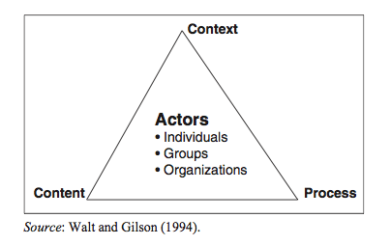
Notes:
Adoptation system!!!
Policy making not just about particular decision made at certain point in time, but more often understood as ongoing interaction among institutions, interests (groups and ppl who stand to gain or loose from change) and ideas (arguments, evidence)
Therefore need to take into account factors such as role of the state, the interests of various actors and the manner in which they wield power, the nature of political systems and their mechanisms for participation, also role of culture and value systems and how they are expressed as beliefs, ideas, arguments,
Also international factors which increase the inter-dependence between states – and affect state sovereignty over policy processes.

Slide 43
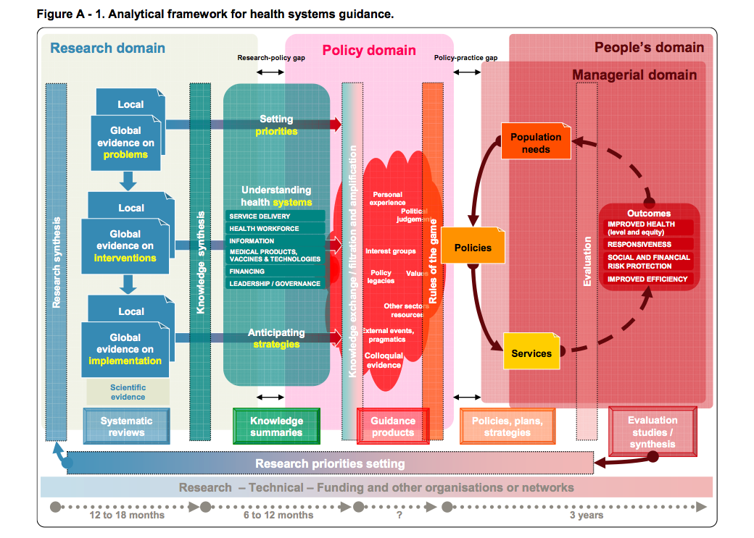

Slide 44
Health policy covers wide domain, but the most important levers will be in the following areas
Institutional design: choices about the types of entities that comprise the health system, including purchasers (such as local governments, social insurers), providers, markets, competition, and ownership.
Finance sources: including user charges, national and local taxes, and voluntary insurance markets.
Payment mechanisms: including specification of the ‘health basket’ funded from statutory sources, mechanisms for allocating funds to local purchasers, and reimbursement rules for providers.
Regulation: including setting standards and rules, inspecting and accrediting providers, and assessing the efficacy and cost-effectiveness of treatments.
Public goods: assuring the proper quality and pricing of natural public goods, such as water sanitation, research and development policy, information technology infrastructure and control of infectious disease.
Information: ensuring all parties are provided with appropriate level of reliable information, including data specification, advertising policy, public reporting requirements, monitoring public health, and facilitating patient choice.
Workforce: planning, training and regulation.
Advocacy and coordination: ensuring health is embedded in all government policy, and is fully reflected in public debate.

Slide 45
Health policy - summary
Not just an output of decision making but rather the entire process of decision-making
Encompasses the
  formal documents, guidelines and rules
  the decision-making practices of the full range of policy actors
    that translate the documents into policy-as-experienced
Analysis focuses on people, processes, power

Slide 46
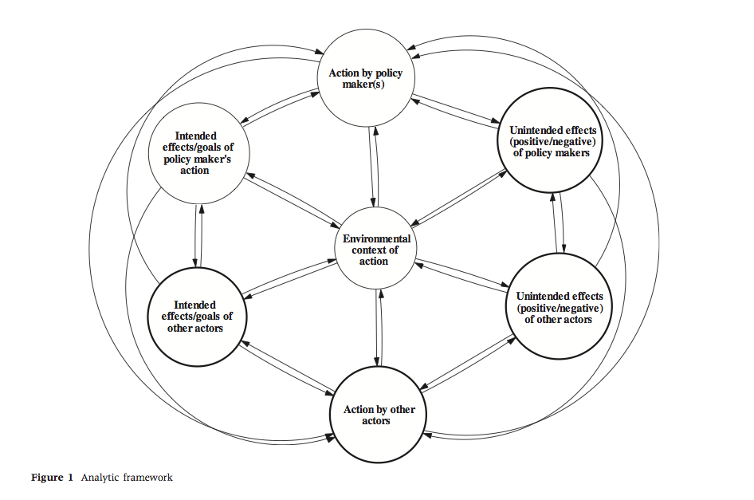

Slide 47
Seminar
Seminar questions for fish-bowl discussion/debate:
You are the Chilean Minister for Women’s Health Services. You’ve expressed concerns over rising national rates of caesarean section delivery (37% of births in the mid-1990s), and a preliminary analysis of health fund statistics revealed that caesarean section rates were twice as high in women who had private health insurance plans than in women who were receiving delivery care financed through the National Health Fund. Discuss your options

Slide 48
Seminar
Seminar questions for fish-bowl discussion/debate:
You are Director of Tertiary Hospital in LMIC, you’ve noticed a general trend that many of your staff don’t seem to be motivated. They leave early, and you know most work privately as a 2nd job. Pay is low in public sector, so you understand, however also want to do something to improve the situation.

Slide 49
Seminar
Seminar questions for fish-bowl discussion/debate:
You are based at the Outbreak Alert and Response unit of WHO, you’ve just had news of the first case fatality report from a new emerging influenza, unknown strain. Cases seem to have originated in Laos/Cambodia border area, but have also been found in Canada & Germany so far. Seems virulent. What will your next 72 hours entail? And the following 7 days?

