Slide 1
Causal pathways to sexual health in orphans: a worked example of the use of theoretical frameworks in social epidemiology
Laura Robertson

Slide 2
Lecture plan
Theoretical frameworks & hypothesis testing:
Introduction
Examples of theoretical frameworks in HIV research
Worked example: orphanhood & HIV risk
Theoretical framework
Hypothesis development
Analysis & findings
Summary

Slide 3
Theoretical frameworks: introduction & examples

Slide 4
Theoretical frameworks & hypothesis testing
A hypothesis is a proposed explanation for an observed phenomenon.
In epidemiology, we are interested in the causal pathway between various risk factors & health outcomes.
Theoretical frameworks provide a visual representation of our assumptions regarding the causal structures underlying disease risk.
They help facilitate the development of explicit hypotheses regarding the causal pathways between risk factors & disease.
We can then use epidemiological data & statistical methods to test these hypotheses.

Slide 5
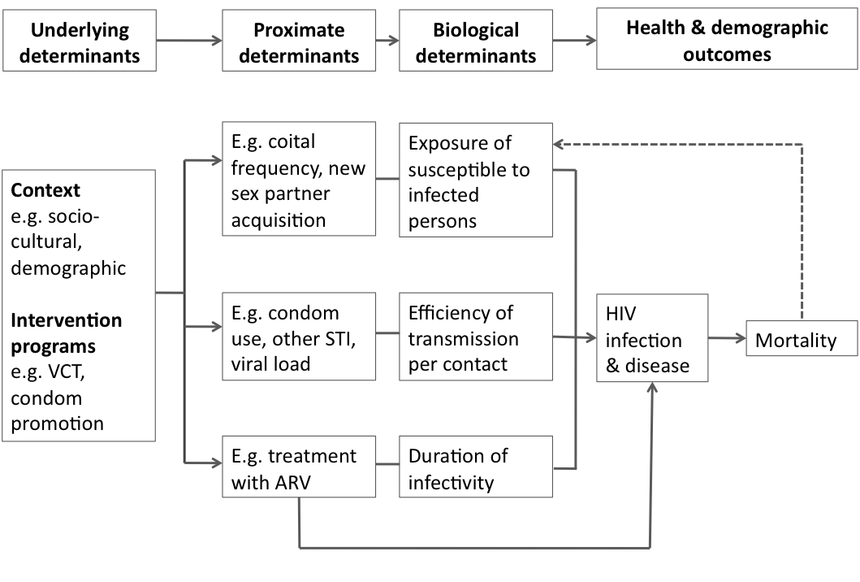
Proximate determinants framework Boerma & Weir (2005)
Proximate determinants provide a link between underlying social/environmental determinants & biological determinants of risk of HIV infection

Slide 6
Social epidemiology framework Poundstone et al (2004)
“Factors at multiple levels – from the microscopic to the societal” contribute to the distribution of HIV

Slide 7
Example: orphanhood & HIV risk in adolescents

Slide 8
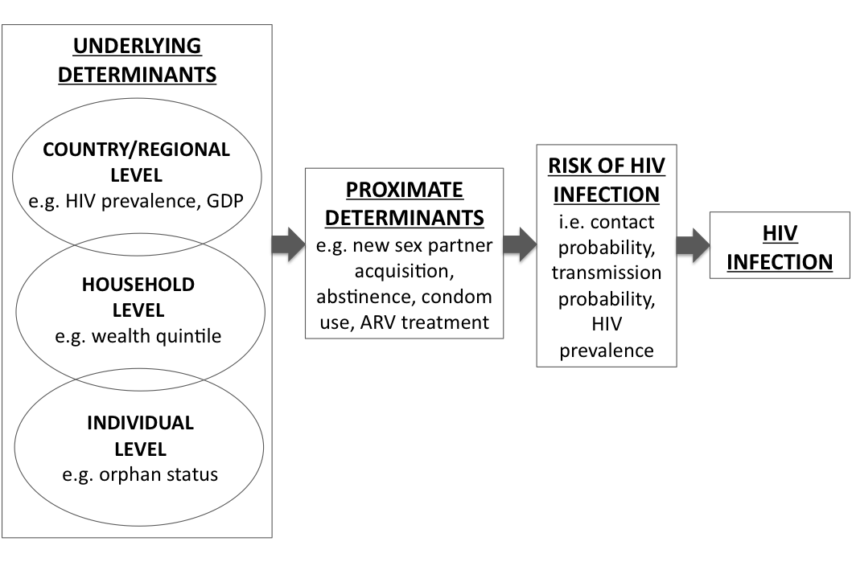
Theoretical framework*
*see handout for full version of the framework
We expanded the proximate determinants framework to make more explicit the country/regional, household and individual level, underlying determinants of HIV

Slide 9
Literature review & hypothesis
Literature review
A study of data from across sub-Saharan Africa has shown that in some countries female, orphaned adolescents are at increased risk of starting sex compared to non-orphans. In other countries this was not the case.
Adult mortality & orphan prevalence are higher in countries with higher HIV prevalence, which puts stress on the extended family that traditionally cares for orphaned children.
Orphans in South Africa (high HIV prevalence) experience stigma & psychosocial distress. Psychosocial distress has been shown to explain some of the increased sexual risk amongst female orphans in Zimbabwe (high HIV prevalence).
Hypothesis
In countries with high HIV prevalence, female, orphaned adolescents will experience increased risk, compared to non-orphans, of starting sex. This increased risk will be reduced in countries with low HIV prevalence.
Palermo & Peterman (2009); Bicego et al (2003); Hosegood et al (2007); Monasch & Boerma (2004); Cluver et al (2006, 2008); Nyamukapa et al (2008)

Slide 10
Analysis & findings
Odds ratios for starting sex comparing orphaned and non-orphaned female adolescents aged 15-17 years stratified by country-level HIV prevalence
Data on female adolescents aged 15-17 years collected in nationally representative, cross-sectional demographic surveys from 9 countries in sub-Saharan Africa.
Country-level data were stratified by HIV prevalence & the pooled data were analysed using hierarchical statistical modeling techniques.
In countries with high HIV prevalence, maternal & double orphans are at significantly increased risk of starting sex but in countries with low HIV prevalence, orphans are not at increased risk.

Slide 11
Summary
Theoretical frameworks provide a visual representation of our assumptions regarding the causal structures underlying disease risk.
They help facilitate the development of explicit hypotheses, which can be tested using epidemiological data and statistical methods.

