Slide 1
Financing health systems
Peter C Smith
Imperial College Business School and Centre for Health Policy

Slide 2
Session objectives
To explain the flows of finance in the health system
To describe the major methods of paying health service providers, and the incentives they give rise to
To discuss the ways in which health systems can protect individuals from the financial consequences of illness.

Slide 3
Structure
Introduction – sources of finance
Flows of finance in the health system
Paying providers
Financial protection
‘Universal health coverage’
Development assistance for health
Concluding comments

Slide 4
Categories of health service funding
User charges
Voluntary health insurance
  Payments according to actuarial risk
  Reduces insurance risk only
Social health insurance
  Payment according to ability to pay
  Reduces insurance and actuarial risk
External funding

Slide 5
Some basic financing data 2010
Source: World Bank HNP data 2012

Slide 6
Total health care expenditure as % of national income, 1960 - 2007
Source: OECD Health Data 2010

Slide 7
Proportion of publicly financed health care expenditure, 1960-2007
Source: OECD Health Data 2010

Slide 8
Private household expenditure as a % of total health expenditure 2006
Source: OECD Health Data 2009

Slide 9
Out-of-pocket payments as a % of total health expenditure 1980-2007
Source: OECD Health Data 2009

Slide 10
Private health insurance as a % of total health expenditure 1980-2007
Source: OECD Health Data 2009

Slide 11

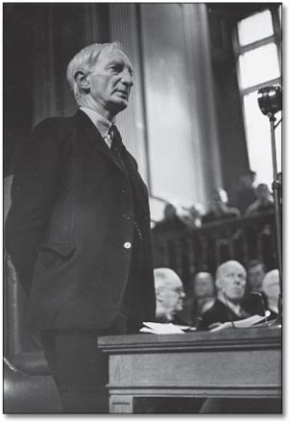
The Beveridge Report: 1942

Slide 12
Some landmarks in
European health insurance
Year | Country | Innovation
1883 | Germany | Benefits for low-income workers
1889 | Austria | Benefits for low-income workers
1909 | Norway | Benefits for low-income workers
1911 | Germany | Income ceiling raised
1911 | UK | Benefits for low-income workers
1930 | France | Benefits for low-income workers
1933 | Denmark | Compulsory private insurance
1935 | Portugal | Limited benefits for low income
1941 | Netherlands | Benefits for low-income workers

Slide 13
Some landmarks in
European health insurance (contd)
Year | Country | Innovation
1942 | Spain | All salaried employees covered
1943 | Italy | All salaried employees covered
1944 | Belgium | All salaried employees covered
1947 | Sweden | Universal system, tax financed
1948 | UK | National Health Service
1962 | Finland | Universal system, tax financed
Source: David Cutler, Harvard University.

Slide 14
Categories of European health system
Social insurance: competitive | Social insurance: non-competitive | Tax funded: decentralized | Tax funded: centralized
Belgium The Netherlands Germany Switzerland | Austria France | Denmark Finland Italy Spain Sweden | Norway Portugal UK

Slide 15
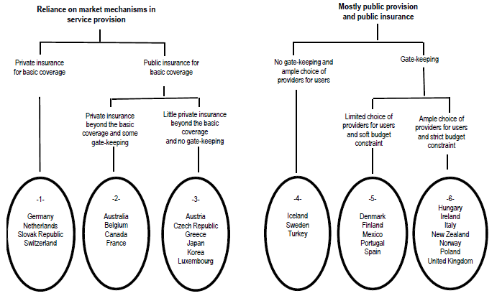
Joumard, I., C. André and C. Nicq (2010), “Health Care Systems: Efficiency and Institutions”, OECD Economics Department Working Papers, No. 769, OECD Publishing.

Slide 16
Structure
Introduction – sources of finance
Flows of finance in the health system
Paying providers
Financial protection
‘Universal health coverage’
Development assistance for health
Concluding comments

Slide 17
Direct patient financing
Citizen/
patient
User charge
Provider/physician

Slide 18
Social insurance (stand-alone)
Social insurer
Prepayment/
premium
Fee for service/
capitation
Citizen/
patient
User charge
Provider/physician

Slide 19
Integrated social insurance
Government
Social insurer
Redistribution
Prepayment/
premium
Fee for service/
Capitation
Citizen/
patient
User charge
Provider/physician

Slide 20
Tax funded
Capitation/
bargaining
Government
Local government/
local administration
Local
taxes
Fee for service/
Capitation/
Salary
Citizen/
patient
User charge
Provider/physician

Slide 21
Further elaborations
Overseas Aid
Government
Local government/
local administration
Citizen/
patient
Provider/physician
Voluntary
Insurance

Slide 22
The major financing functions
Revenue collection
  Taxation
  Social health insurance
  Voluntary health insurance
  User charges
Revenue pooling
  Setting budgets
  Risk adjustment transfers
Paying providers
  Global budget (block contract)
  According to costs incurred
  According to activity
  Pay for performance

Slide 23
Structure
Introduction – sources of finance
Flows of finance in the health system
Paying providers
Financial protection
‘Universal health coverage’
Development assistance for health
Concluding comments

Slide 24
Paying providers
Global budget (block contract)
  Fixed (block) contract independent of services provided
According to costs incurred
  Fee for service
According to activity
  Diagnosis-related groups (DRGs)
Pay for performance
  Augmenting conventional payment mechanisms to adjust payments according to measured levels of quality achieved.

Slide 25
Any payment mechanisms generates implicit incentives
Objective | Global budget | According to costs | According to activity
Increase Activity | -- (+?) | ++ | +
Expenditure control | ++ | -- | - (+?)
Improve Quality | - | + | -
Improve equity of access | -- | + | -
Improve efficiency | - | -- | ++

Slide 26
A definition of P4P (forthcoming)
“the deliberate adaptation of provider payment mechanisms explicitly to promote the pursuit of health system quality objectives”.
The key elements of any P4P programme should usually be:
  a statement of the quality objectives it seeks to promote;
  definition of quality metrics that will influence reimbursement;
  formulation of the associated rules for reimbursement that make some element conditional on measured levels of attainment;
  rules for providers regarding provision of information and other standards;
  governance arrangements that ensure that the system is working as intended.

Slide 27
What should be rewarded?
Structure
  Provision of service
  Accreditation
  Information provision
Process
  Adherence to guidelines
Outcomes
  Biomedical status
  Avoidable admissions
  Health status

Slide 28
P4P programs and measures in OECD countries.
Source: Borowitz, Cashin, Chi, Smith, and Thompson (forthcoming) for European Observatory and OECD

Slide 29
Some examples
France Contract for Improved Individual Practice
Germany Disease Management Programme
Australia Practice Incentive Programme
UK Quality and Outcomes Framework

Slide 30
Quality and Outcomes Framework (QOF)
Developed in negotiation between government and providers
Implemented in April 2004
Major emphasis on clinical quality
About 20% of income determined by quality incentives
Major reliance on self-reporting (with external audit).
http://www.qof.ic.nhs.uk/
http://www.nhsemployers.org/pay-conditions/primary-890.cfm

Slide 31
Quality and Outcomes Framework 2004/05:
Indicators and points at risk
Area of practice | PIs | Points
Clinical | 76 | 550
Organizational | 56 | 184
Additional services | 10 | 36
Patient experience | 4 | 100
Holistic care (balanced clinical care) | - | 100
Quality payments (balanced quality) | - | 30
Access bonus | - | 50
Maximum | 146 | 1050

Slide 32
Quality and Outcomes Framework: Clinical indicators
Domain | PIs | Points
CHD including LVD etc | 15 | 121
Stroke or transient ischaemic attack | 10 | 31
Cancer | 2 | 12
Hypothyroidism | 2 | 8
Diabetes | 18 | 99
Hypertension | 5 | 105
Mental health | 5 | 41
Asthma | 7 | 72
COPD | 8 | 45
Epilepsy | 4 | 16
Clinical maximum | 76 | 550

Slide 33
Hypertension: indicators, scale and points at risk
Records | Min | Max | Points
BP 1. The practice can produce a register of patients with established hypertension |  |  | 9
Diagnosis and initial management
BP 2.The percentage of patients with hypertension whose notes record smoking status at least once | 25 | 90 | 10
BP 3.The % of patients with hypertension who smoke, whose notes contain a record that smoking cessation advice has been offered at least once | 25 | 90 | 10
Ongoing Management
BP 4.The % of patients with hypertension in which there is a record of the blood pressure in the past 9 months | 25 | 90 | 20
BP 5. The % of patients with hypertension in whom the last blood pressure (in last 9 months) is 150/90 or less | 25 | 70 | 56

Slide 34
Threshold indicator BP5
Points
earned
56
39.2
20
70
100
55
Achievement %
(55-20)/(70-20) x 56 = 39.2

Slide 35
Achievement in England
 | 2004/05 | 2005/06 | 2006/07 | 2007/08 | 2008/09 | 2009/10 | 2010/11
Average points score (%) | 91.3 | 96.2 | 95.5 | 96.8 | 95.4 | 93.7 | 94.7
Practices achieving full marks (%) | 2.6 | 9.7 | 5.1 | 7.5 | 2.0 | 1.0 | 1.3
Source: NHS Information Centre http://www.qof.ic.nhs.uk/

Slide 36
GP Earnings 1998/99 to 2009/10
(real growth, at 2009/10 prices)
Source: Information Centre for Health and Social Care (2011) GP Earnings and Expenses 2009/10, Leeds.
.

Slide 37
Trends in six QOF indicators 2001-2006
QOF
CHD Coronary heart disease
STROKE Stroke
HBP Hypertension
Copyright © 2007 QRESEARCH (Version 12) and The Information Centre for health and social care.

Slide 38
Summary of findings to date
  Quality was improving rapidly before the QOF was introduced
  The QOF may have led to a further small, but possibly transient, increase in quality
  In general, the targets seem to have been set at too low a level
  The rewards associated with the QOF appear to have been excessive
  Only modest evidence that ‘unmeasured’ quality is suffering relative to measured quality
  Evidence of some small amount of ‘gaming’ to achieve improved scores
  Side-benefits of QOF include:
    computerization;
    better information flow;
    more informed patients;
    better focus for GPs;
    more informed debate on what GPs should do.

Slide 39
Structure
Introduction – sources of finance
Flows of finance in the health system
Paying providers
Financial protection
‘Universal health coverage’
Development assistance for health
Concluding comments

Slide 40
Financial protection
Financial protection (FP): extent to which people are protected from the financial consequences of illness
  Key objective of health care systems, multidimensional
  Financial hardship and lack of access to HC due to costs still widespread (World Health Report 2010)
Notes:
FP is usually understood as the extent… As it’s clear from the latest WHR, it is recognised as a key objective of HC systems, but one that’s still elusive in several countries where fin hardship due to medical bills and cost barriers to access are widespread.
The need for FP arises from 3 main factors: (1) the uncertainty about the need for HC (both timing and severity of health needs), (2) the high costs of HC (both in absolute & relative terms, as even low medical costs can be financially catastrophic for poorer HHs or prevent access to needed services), and (3) the loss of earnings associated with ill health (on top of any actually incurred health costs).

Slide 41

5th July 1948
“...there are no charges, except for a few special items. There are no insurance qualifications. But it is not a ‘charity’. You are all paying for [the NHS], mainly as taxpayers, and it will relieve your money worries in times of illness.”

Slide 42
Serious Problems Paying or Unable to Pay
Medical Bills in the Past Year
42
Percent
Source: 2010 Commonwealth Fund International Health Policy Survey in Eleven Countries.

Slide 43
Serious Problems Paying or Unable to Pay
Medical Bills in the Past Year, by Income
43
(Adjusted) percent
Note: Percentages adjusted based on logistic regression to control for health status, age, and—in the U.S.—insurance status.
* Indicates significant within-country differences with below-average income (p < 0.05).
THE COMMONWEALTH
FUND
THE COMMONWEALTH
FUND
Source: 2010 Commonwealth Fund International Health Policy Survey in Eleven Countries.

Slide 44
Cost-Related Access Problems in the Past Year
44
Percent | AUS | CAN | FR | GER | NETH | NZ | NOR | SWE | SWIZ | UK | US
Did not fill prescription or skipped doses | 12 | 10 | 7 | 6 | 3 | 7 | 6 | 7 | 4 | 2 | 21
Had a medical problem but did not visit doctor | 13 | 4 | 6 | 16 | 2 | 9 | 6 | 5 | 6 | 2 | 22
Skipped test, treatment, or follow-up | 14 | 5 | 6 | 10 | 3 | 8 | 5 | 4 | 4 | 3 | 22
Yes to at least one of the above | 22 | 15 | 13 | 25 | 6 | 14 | 11 | 10 | 10 | 5 | 33
THE COMMONWEALTH
FUND
Source: 2010 Commonwealth Fund International Health Policy Survey in Eleven Countries.

Slide 45
Confident Will Be Able to Afford Needed Care
45
Percent responded, if they became seriously ill, confident/very confident they would be able to afford the care they needed
THE COMMONWEALTH
FUND
THE COMMONWEALTH
FUND
Source: 2010 Commonwealth Fund International Health Policy Survey in Eleven Countries.

Slide 46
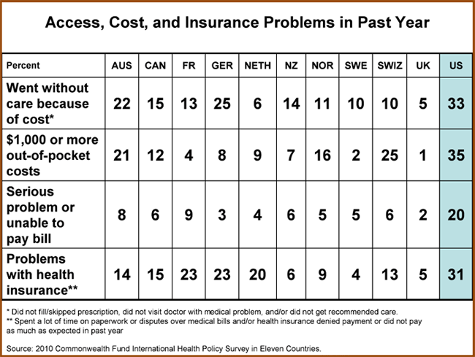
Commonwealth Fund Survey 2010

Slide 47
Overall Views of Health Care System, 2010
47
Percent | AUS | CAN | FR | GER | NETH | NZ | NOR | SWE | SWIZ | UK | US
Only minor changes needed | 24 | 38 | 42 | 38 | 51 | 37 | 40 | 44 | 46 | 62 | 29
Fundamental changes needed | 55 | 51 | 47 | 48 | 41 | 51 | 46 | 45 | 44 | 34 | 41
Rebuild completely | 20 | 10 | 11 | 14 | 7 | 11 | 12 | 8 | 8 | 3 | 27
THE COMMONWEALTH
FUND
Source: 2010 Commonwealth Fund International Health Policy Survey in Eleven Countries.

Slide 48
Strong link between % reporting cost problems and opinions of health system
UK
NL
SWIZ
FR
SWE
NOR
NZ
CAN
GER
USA
AUS
Source: 2010 Commonwealth Fund International Health Policy Survey in Eleven Countries.

Slide 49
Structure
Introduction – sources of finance
Flows of finance in the health system
Paying providers
Financial protection
‘Universal health coverage’
Development assistance for health
Concluding comments

Slide 50
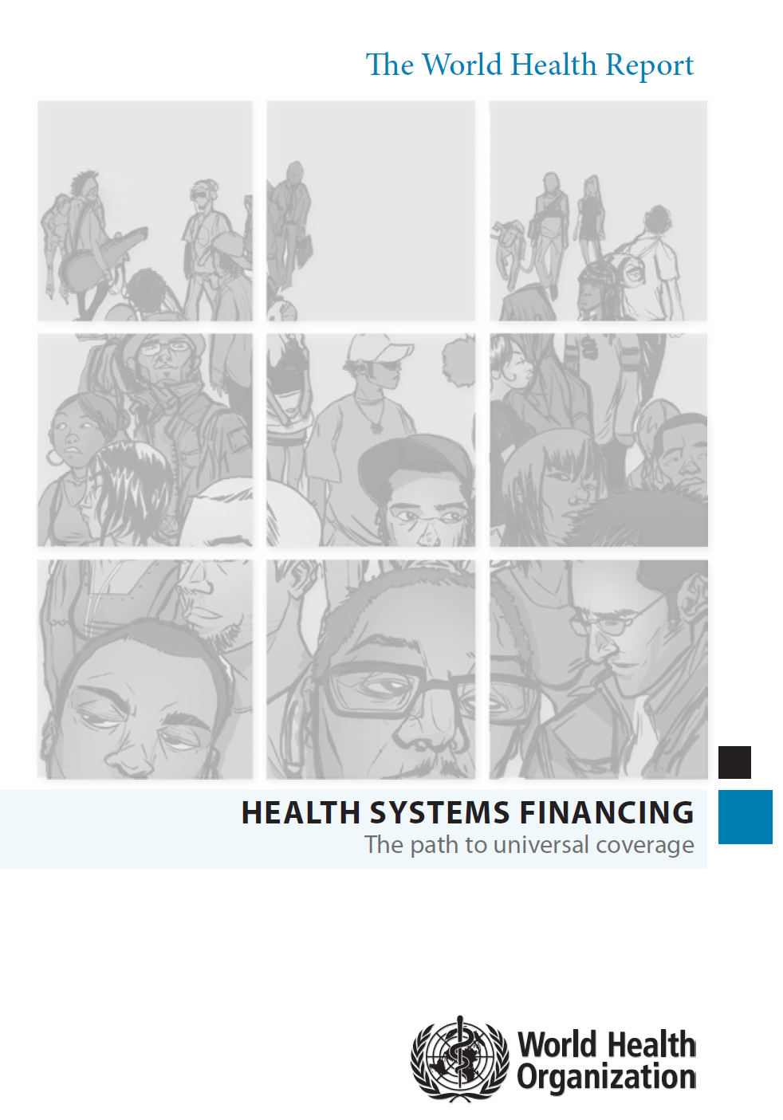
Universal health coverage

Slide 51
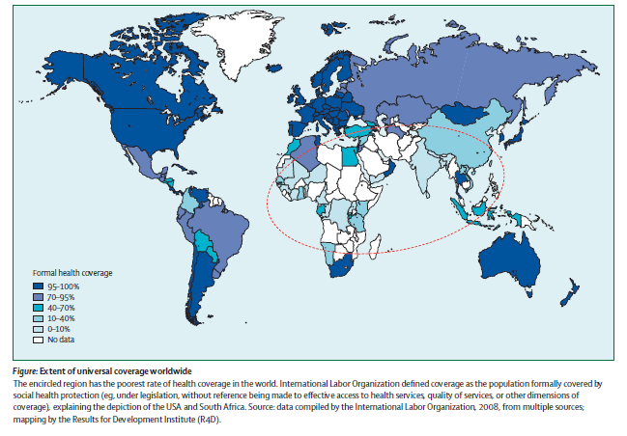
Source: L Garrett,A Mushtaque, R Chowdhury, A Pablos-Méndez (2009), “Viewpoint. All for universal health coverage”, The Lancet, 374, 1294–1299

Slide 52
Catastrophic payments headcounts in Asia
Notes:
1. Van Doorslaer, O’Donnell et al (2007) Catastrophic Payments in Asia. Health Economics.

Slide 53
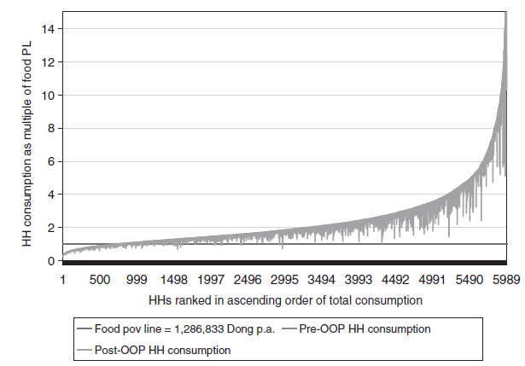
Extreme poverty, pre-payment and post-payment income, Vietnam 1998
Adam Wagstaff and Eddy van Doorslaer (2003), “Catastrophe and impoverishment in paying for health care: with applications to Vietnam 1993–1998”, Health Economics. 12: 921–934

Slide 54
Three dimensions to consider when moving towards universal coverage
(source: World Health Report 2010)

Slide 55
Some indicators of affordability and access difficulties
Access difficulties:
  DTP3 immunization coverage among 1 year-olds (%)
  Measles (MCV) immunization coverage among 1-year-olds (%)
  Births attended by skilled personnel (%)
Payment difficulties:
  Catastrophic payments (% households)
  Impoverishing payments (% driven into poverty)
  OOP payments (% total expenditure)

Slide 56
Structure
Introduction – sources of finance
Flows of finance in the health system
Paying providers
Financial protection
‘Universal health coverage’
Development assistance for health
Concluding comments

Slide 57
Development assistance for health
About 25% of total health expenditure in low income countries
How effective is it?
Is it additional to local sources of expenditure, or is it a substitute?

Slide 58
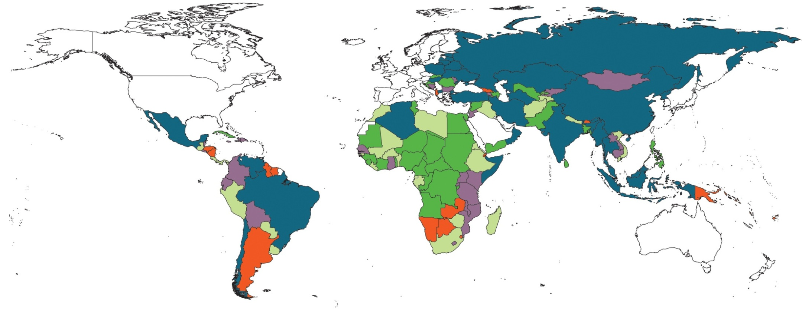
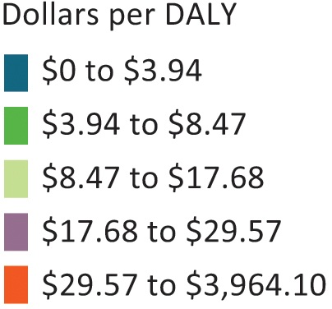
Total DAH per all-cause DALY, 2004 to 2009
Source: Institute for Health Metrics and Evaluation,
Financing Global Health 2011: Continued growth as MDG deadline approaches.

Slide 59
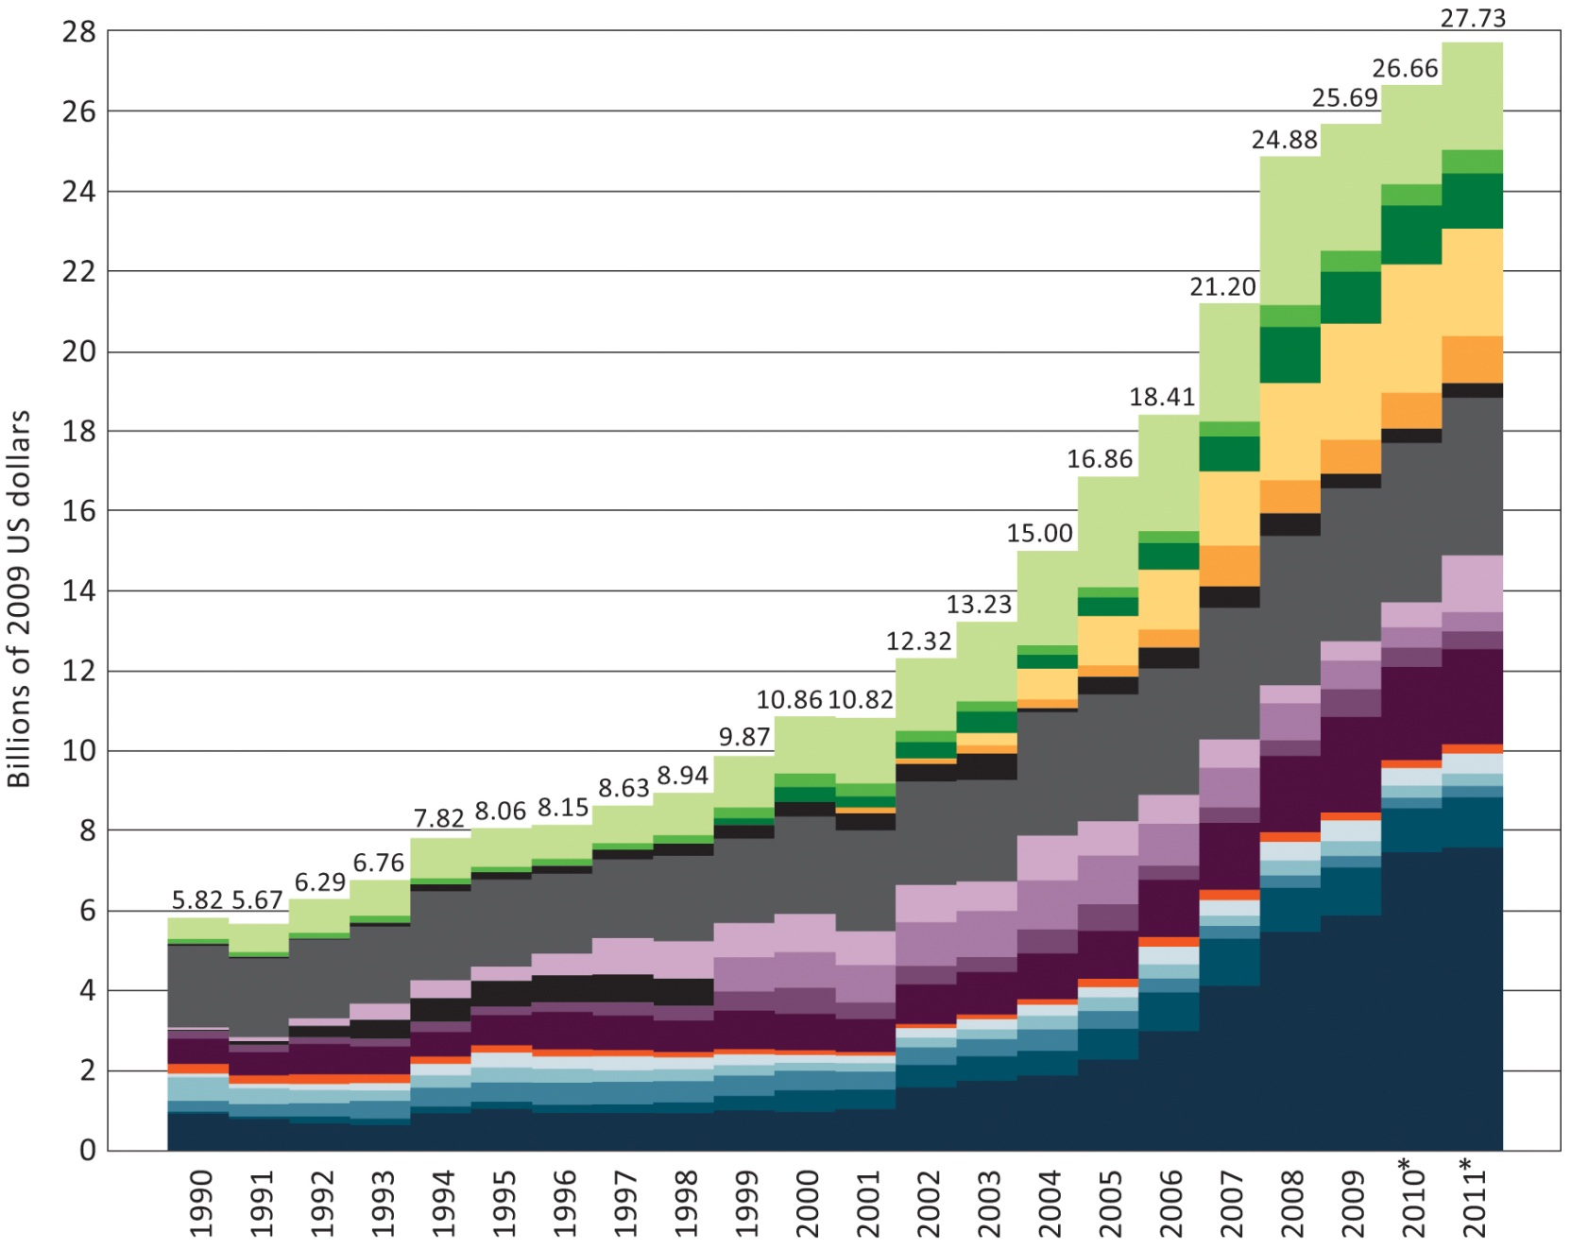
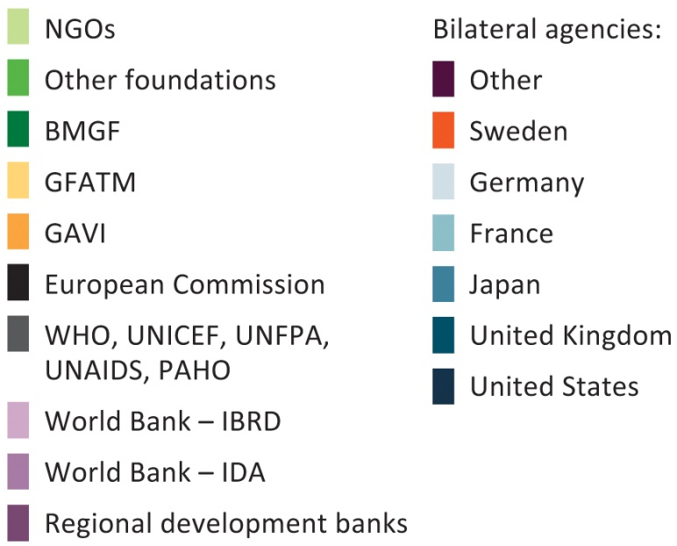
Development Assistance for Health by channel of assistance, 1990 to 2011
Source: Institute for Health Metrics and Evaluation,
Financing Global Health 2011: Continued growth as MDG deadline approaches.
Notes:
BMGF Bill & Melinda Gates Foundation
GFATM Global Fund
GAVI Global Alliance for Vaccines and Immunisation

Slide 60
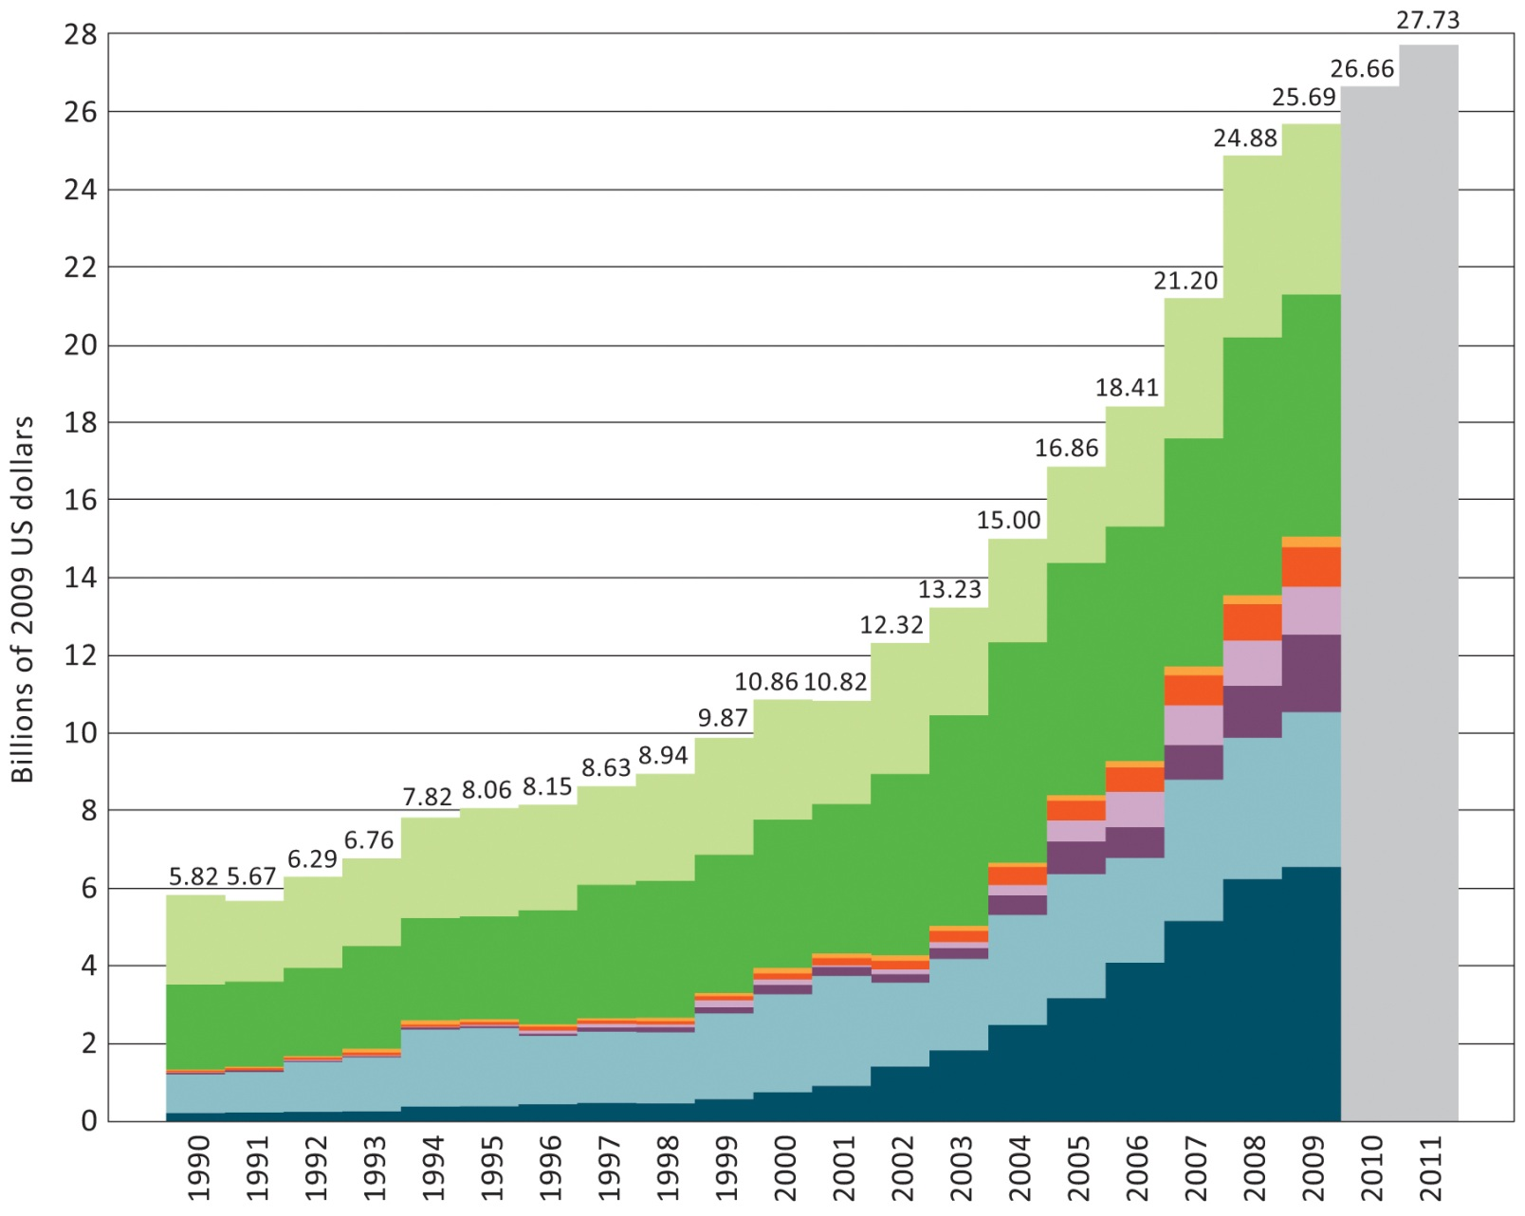
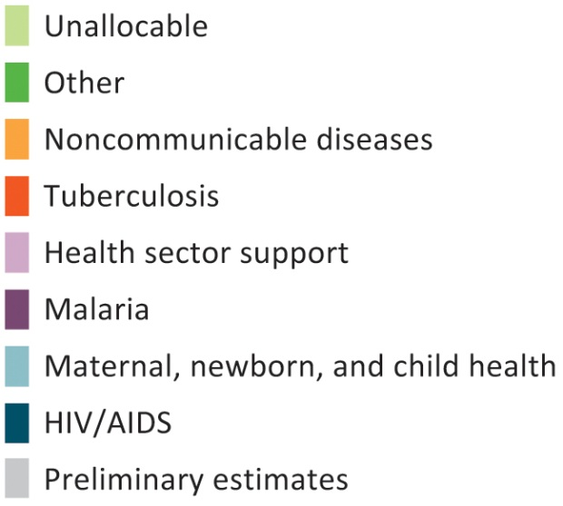
DAH for
HIV-AIDS; maternal, newborn, and child health; malaria; health sector support; TB; and non-communicable disease
Source: Institute for Health Metrics and Evaluation,
Financing Global Health 2011: Continued growth as MDG deadline approaches.

Slide 61
Reading
Conrad, D. (2010), “Incentives for health-care performance improvement”, in Smith, P., Mossialos, M., Papanicolas, I. and Leatherman, S. (eds), Performance measurement for health system improvement: experiences, challenges and prospects, Cambridge: Cambridge University Press.
Smith, P. (2009), “The impact of user charges on health care”, in OECD, Achieving Better Value for Money in Health Care, Paris: OECD, pp 151-163.
World Health Organization (2010), World Health Report 2010: Health systems financing: the path to universal coverage, Geneva: WHO.

