Slide 1
Critical appraisal of systematic reviews
Teresa Norat, PhD
Department of Epidemiology and Public Health

Slide 2
Critical appraisal of systematic reviews
By the end of the session you will be able to:
Use the Critical Appraisal Skill Tool for Systematic Reviews (CASP)
Identify the main potential biases in systematic reviews and meta-analysis
Present critical appraisal findings to lecturers and peers

Slide 3
Critical appraisal of systematic reviews
What is critical appraisal?
Critical appraisal is the process of carefully and systematically examining research to judge its reliability (validity), and its value (results) and relevance in a particular context

Slide 4
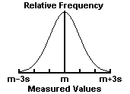
What makes studies unreliable? Bias
is a systematic error, or deviation from the truth, in results or inferences
can lead to underestimation or overestimation of the true intervention effect
can be small or substantial
should not be confused with imprecision (a random error)
Bias (systematic error )
Notes:
Error is defined as the difference between the true value of a measurement and the recorded value of a measurement. There are many sources of error in collecting clinical data. Error can be described as random or systematic. Random error is also known as variability, random variation, or ‘noise in the system’. The heterogeneity in the human population leads to relatively large random variation in clinical trials.
Systematic error or bias refers to deviations that are not due to chance alone. The simplest example occurs with a measuring device that is improperly calibrated so that it consistently overestimates (or underestimates) the measurements by X units.
Random error has no preferred direction, so we expect that averaging over a large number of observations will yield a net effect of zero. The estimate may be imprecise, but not inaccurate. The impact of random error, imprecision, can be minimized with large sample sizes.
Bias, on the other hand, has a net direction and magnitude so that averaging over a large number of observations does not eliminate its effect. In fact, bias can be large enough to invalidate any conclusions. Increasing the sample size is not going to help. In human studies, bias can be subtle and difficult to detect. Even the suspicion of bias can render judgment that a study is invalid. Thus, the design of clinical trials focuses on removing known biases.
Random error corresponds to imprecision, and bias to inaccuracy. Here is a diagram that will attempt to differentiate between imprecision and inaccuracy
“Recording the strengths and weaknesses of included studies provides an indication of whether the results have been unduly influenced by aspects of study design or conduct (essentially the extent to which the study results can be ‘believed’).
Assessment of study quality gives an indication of the strength of evidence provided by the review and can also inform the standards required for future research. Ultimately, quality assessment helps answer the question of whether the studies are robust enough to guide treatment, prevention, diagnostic or policy decisions.”
Biases can vary in magnitude: some are small (and trivial compared with the observed effect) and some are substantial (so that an apparent finding may be entirely due to bias).
Even a particular source of bias may vary in direction: bias due to a particular design flaw (e.g. lack of allocation concealment) may lead to underestimation of an effect in one study but overestimation in another study. It is usually impossible to know to what extent biases have affected the results of a particular study, although there is good empirical evidence that particular flaws in the design, conduct and analysis of randomized clinical trials lead to bias
Bias refers to systematic error, meaning that multiple replications of the same study would reach the wrong answer on average. Imprecision refers to random error, meaning that multiple replications of the same study will produce different effect estimates because of sampling variation even if they would give the right answer on average. The results of smaller studies are subject to greater sampling variation and hence are less precise. Imprecision is reflected in the confidence interval around the intervention effect estimate from each study and in the weight given to the results of each study in a meta-analysis. More precise results are given more weight.

Slide 5
Bias in systematic reviews
Bias within single studies: risk assessment
Bias between studies in systematic reviews
publication bias and related biases
choice of databases
biased inclusion criteria
differentially delayed publication
publication language
selective reporting

Slide 6
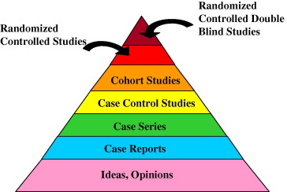
The hierarchy of research evidence

Slide 7
Type of study bias
Type of bias | Description
Selection bias | Differences between baseline characteristics of the groups that are compared
Performance bias | Systematic differences between groups in the care that is provided, or in exposure to factors other than the interventions of interest
Detection bias | Systematic differences between groups in how outcomes are determined
Attrition bias | Systematic differences between groups in withdrawals from a study
Reporting bias | Systematic differences between reported and unreported findings
Notes:
Internal validity—extent to which systematic error (bias) is minimised in clinical trials
Effective blinding can also ensure that the compared groups receive a similar amount of attention, ancillary treatment and diagnostic investigations.
Detection bias refers to systematic differences between groups in how outcomes are determined. Blinding (or masking) of outcome assessors may reduce the risk that knowledge of which intervention was received, rather than the intervention itself, affects outcome measurement. Blinding of outcome assessors can be especially important for assessment of subjective outcomes, such as degree of postoperative pain.
Attrition bias refers to systematic differences between groups in withdrawals from a study. Withdrawals from the study lead to incomplete outcome data. There are two reasons for withdrawals or incomplete outcome data in clinical trials. Exclusions refer to situations in which some participants are omitted from reports of analyses, despite outcome data being available to the trialists. Attrition refers to situations in which outcome data are not available.
In addition there are other sources of bias that are relevant only in certain circumstances. These relate mainly to particular trial designs (e.g. carry-over in cross-over trials and recruitment bias in cluster-randomized trials); some can be found across a broad spectrum of trials, but only for specific circumstances (e.g. contamination, whereby the experimental and control interventions get ‘mixed’, for example if participants pool their drugs); and there may be sources of bias that are only found in a particular clinical setting.

Slide 8
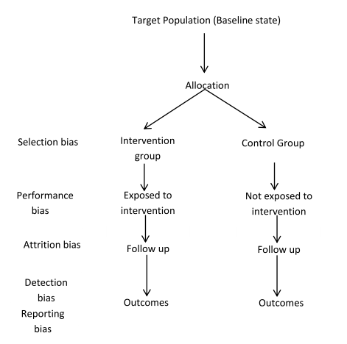
Source of bias in RCTs
Greenhalgh T BMJ 1997;315:305-308

Slide 9
Example of performance bias
Surgery with or without chemotherapy for metastatic colorectal cancer to the liver
J Clin Oncol 2002;20:1499-505
Patients were randomised to surgery with chemotherapy or surgery without chemotherapy
Chemotherapy was applied during operation unless the surgeon found that the prognosis was too poor
Patients who received chemotherapy therefore had a better prognosis
This disrupted the baseline comparability that was established through randomization
Per protocol analyses suggested a significant benefit of adjunctive chemotherapy
Intention-to-treat analyses found no significant effect
Notes:
Is there any suggestion of bias?
The analysis need to include all randomized patients (intention to treat) and not only those that received the treatement (per-protocol)
Empirical evidence from meta-epidemiological studies indicates, for example, that the level of over-estimation associated with attrition bias (lack of intention-to-treat analysis) can reach up to 25% . The lack of adequate randomization (through sequence allocation and allocation concealment) and blinding (thus minimizing Selection- and Performance-/Detection bias, respectively) may reach above 50% (Egger et al Health Technology Assessment 2003,7:1)

Slide 10
Issues in systematic reviews Publication bias: - only a subset of the relevant data is available
Failure to include all relevant data in a review may mean the effect of an intervention/exposure is over (or under) estimated.
Null or non significant findings (esp. in small studies) are less likely to be reported/published than statistically significant findings.

Slide 11
Data sources
PubMed (MEDLINE)
Embase Approximately 85% overlap with MEDLINE with more second tier European and Asian journals.
Cochrane Central Register of Controlled Trials Contains MEDLINE trials plus many trials from other, non-indexed sources; limited to randomized and non-randomized controlled trials.
Web of Science (Science Citation Index) Broad but not deep coverage of all sciences. Will cover some journals missed by PubMed and Embase. Some meeting information.
ClinicalTrials.gov Registers trials that are recruiting and reports which have been completed.
Specialized topic areas
BIOSIS Previews Biologists
CINAHL Nursing and other health related information; patient care
PsycINFO Cognitive and behavioral therapies
POPLINE Reproduction and population issues
LILACS Latin American and Caribbean authors
African Index Medicus African health literature
Sociological Abstracts The primary index for sociological literature. May be useful for community-related studies or interpersonal issues
Meetings and Other Grey Literature
BIOSIS Previews Meetings
NLM Gateway Clinical trials and meeting information. Will identify studies, but the data will have to be pursued by contacting authors.
SIGLE (System for Information on Grey Literature in Europe) is a bibliographic database covering European grey literature in the fields of pure and applied natural sciences and technology, economics, social sciences, and humanities.
GreyNet
Clinical Trial Registries
ClinicalTrials.gov
European Union Clinical Trials Registry
Current Controlled Trials
International Clinical Trials Registry Platform (ICTRP)

Slide 12
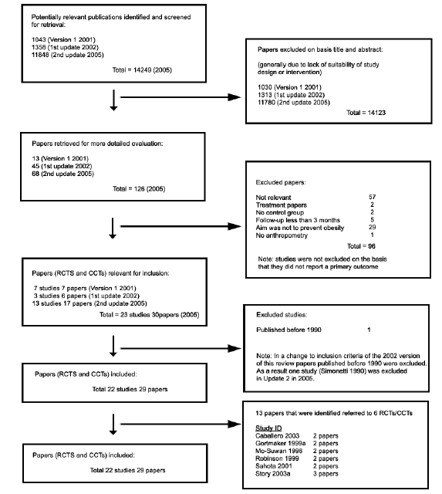
Flow chart. Example

Slide 13
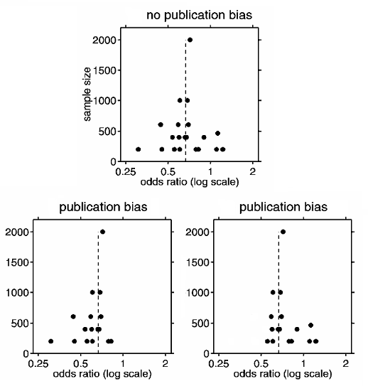
Funnel Plot
A funnel plot which is symmetric about the mean effect and shaped like an upside down funnel indicates no publication bias.
A plot with the lower right or left hand corner of the plot missing indicates that publication bias is present.

Slide 14
Issues in systematic reviews Inconsistency of study results (heterogeneity)
Studies differ with respect to:
Populations
Interventions/exposure
Outcomes
Study design
Clinical differences
Methodological differences
Unknown study characteristics

Slide 15
Assessing heterogeneity
Several methods
One method is to analyze different sub-groups and examine whether results differ (e.g. men and women, groups defined by histology…)[stratified analysis]
Meta-regression analysis

Slide 16
Advantages of meta-analyses
Generate a pooled overall risk estimate
Produce a more reliable and precise estimate of effect
Explore differences (heterogeneity) between published studies.
Identify whether publication bias is occurring.
BUT
If the studies are too heterogeneous, it may be inappropriate, even misleading to statistically pool the results from separate studies!

Slide 17
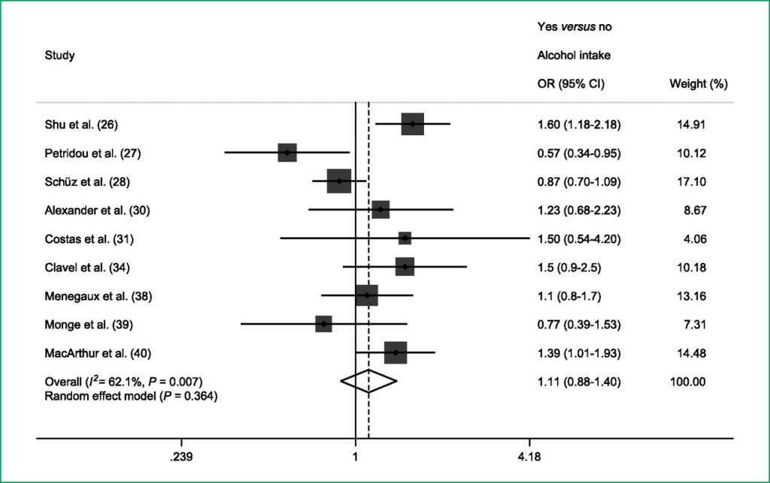
Presentation of results: Forest plots
Example: Maternal alcohol consumption during pregnancy (yes vs no) and risk of childhood leukemia
Latino-Martel P, Chan DS, Druesne-Pecollo N, Barrandon E, Hercberg S, Norat T. Cancer Epidemiol Biomarkers Prev 2010;19:1238-1260
Notes:
Meta-analysis of studies on maternal alcohol consumption during pregnancy (yes versus no) and risk of all childhood leukemia (GL) in children without Down syndrome.

Slide 18
Critical appraisal Skill Program (CASP) Checklist
Are the results valid?
What question did the systematic review address (PICO)?
Population
Intervention/exposure
Outcomes
[Introduction]
2. Did the authors look for the appropriate sort of papers?
Address the review’s question
Have an appropriate study design
[Inclusion, exclusion criteria]

Slide 19
Critical appraisal Skill Program (CASP) Checklist
Are the results valid?
3. Relevant studies missed?
Databases
Reference list
Personal contacts
Unpublished studies
Non-English language
[Flow chart in Results section]
4. Assessment of study quality?
Risk of bias, rigour of individual studies
[Criteria used to assess bias in Methods, Information on study quality on Results]

Slide 20
Critical appraisal Skill Program (CASP) Checklist
Are the results valid?
5. If the results were combined, was it reasonable to do so?
Results of all studies are displayed
Similar results of different studies
Reasons for any variation are discussed

Slide 21
Critical appraisal Skill Program (CASP) Checklist
What are the results?
6. What is the overall result?
Clear about the result. Forest plots, tables
Numerical if appropriate
How are expressed (odds ratio, risk difference, etc)
7. How precise are the results?
Confidence interval

Slide 22
Critical appraisal Skill Program (CASP) Checklist
Relevance
8. Applicability (external validity)
Concern if different population
Different setting
9. Were all important outcomes considered?
10. Are the benefits worth the harms and costs?
Even if not addressed by the review

Slide 23
Reporting systematic reviews standards:
PRISMA, MOOSE
The Preferred Reporting Items for Systematic Reviews and Meta-Analyses (PRISMA) Statement http://www.prisma-statement.org/ 27-item checklist
Focuses on randomized trials but can also be used as a basis for reporting systematic reviews of evaluations of interventions.
PRISMA may also be useful for critical appraisal of published systematic reviews.
Moher et al. Preferred reporting items for systematic reviews and meta-analyses: the PRISMA statement. PLoS Med. 2009 Jul 21;6(7):e1000097.
Liberati et al. The PRISMA statement for reporting systematic reviews and meta-analyses of studies that evaluate health care interventions: explanation and elaboration. PLoS Med. 2009 Jul 21;6(7):e1000100.
Meta-analysis of Observational Studies in Epidemiology (MOOSE) Guidelines http://www.consort-statement.org/mod_product/uploads/MOOSE%20Statement%202000.pdf Observational studies in Epidemiology
Stroup et al. Meta-analysis of observational studies in epidemiology: a proposal for reporting. Meta-analysis Of Observational Studies in Epidemiology (MOOSE) group. JAMA. 2000 Apr 19;283(15):2008-12.

Slide 24
Critical appraisal
Conclusions
Has the research been conducted in such a way as to minimise bias?
If so, what does the study show?
What do the results mean for a particular patient or context in which a decision is being made?
Need to apply knowledge on research methods and on research topic!

Slide 25
Practice: Critical appraisal of systematic reviews
Working in groups (3-4 students) and using the CASP check list for a systematic review, critically appraise the following paper
(30-45 minutes):
Weiss HA, Hamkins CA, Dickson k. Male circumcision and risk of HIV infection in women: a systematic review and meta- analysis. Lancet Infect Dis. 2009. Nov; 9(11): 669-77
Discussion of the appraisals (all students together)

