Slide 1
Do you think your story is: Apocryphal (urban legend)? Direct anecdote (personal experience)? Reportage?
Story Match
All stories are likely to be biased.
Any could be made up.
What if they are true?

Slide 2
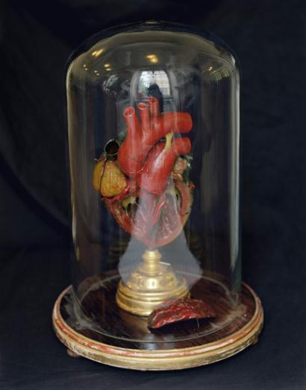
From the Heart:
Cardiovascular disease & metaphor
www.tanyamarcuse.com

Slide 3
The Human Genre Project

Slide 4
www.humangenreproject.com chromosome 11
Jargon
My father’s angina, we learned, was a serious myocardial infarction caused by coronary thrombosis, possibly due to atherosclerosis but more likely unlucky genetic inheritance, potentially preceded by acute depression brought on by Seasonal Affective Disorder, migration north from the Caribbean to cold New England, Vitamin D deficiency, low melatonin levels, low serotonin neurotransmitters; potential feelings of inadequacy, low self-esteem, all leading to ventricular fibrillation, heart attack, death.

Slide 5
Renovation later, mom obliterated the wall where he fell.

Slide 6
The Dream
My friend who has lately died of cancer and I
Fly above a blackened and turbulent ocean
And there is some necessity of leaping from the belly of the plane
There is screaming wind; lashing whitecaps beneath
Someone is urging ‘jump, jump’
I feel a primal fear, hear the words of my father (also dead)
‘I see no point in jumping from a perfectly good airplane’
And I cannot let go
But my friend is already gone.

Slide 7
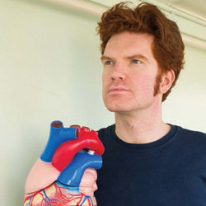
www.richardtyronejones.com http://www.youtube.com/watch?v=1T042EMs_Og&feature=player_embedded

Slide 8
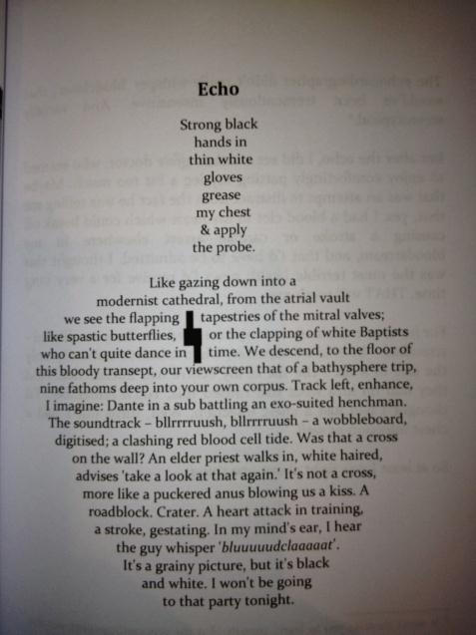

Slide 9
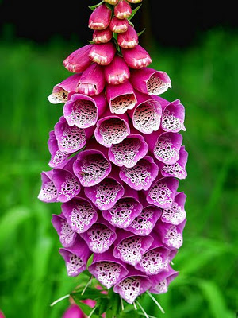
Digitalis – foxglove – has been prescribed since the seventeenth century, perhaps longer, as a diuretic and to slow pulse rate, and is still the drug of choice [to help correct] atrial fibrillation.

Slide 10
Robin Robertson
A SEAGULL MURMUR
is what they called it,
shaking their heads
like trawlermen;
the mewling sound of a leaking heart
the sound
of a gull trapped in his chest.
To let it out
they ran a cut down his belly
like a fish, his open ribs
the ribs of a boat;
and they closed him,
wired him shut.
Caulked and sea-worthy now
with his new valve; its metal
tapping away:
the dull clink
of a signal-buoy
or a beak at the bars of a cage.

Slide 11
Epigenetics http://www.youtube.com/watch?v=kp1bZEUgqVI
How many metaphors can you find in the following video clip?
Jot them down/ make a note.
Be aware of visuals as well as the words he’s saying.

Slide 12
Metaphor Making: Epigenetics

Slide 13
Why so many metaphors?

