Slide 1
Global inequalities: is epigenetics the strongest link?
BSc Global Health: Discussion
Monday 26 November

Slide 2
Learning Outcomes
Understand the concept of epigenetics
Appreciate the role of epigenetics in the future of epidemiology – including possible advantages and disadvantages
Consider the heritability of epigenetic changes
Argue for and against the importance of epigenetics in understanding global inequalities

Slide 3
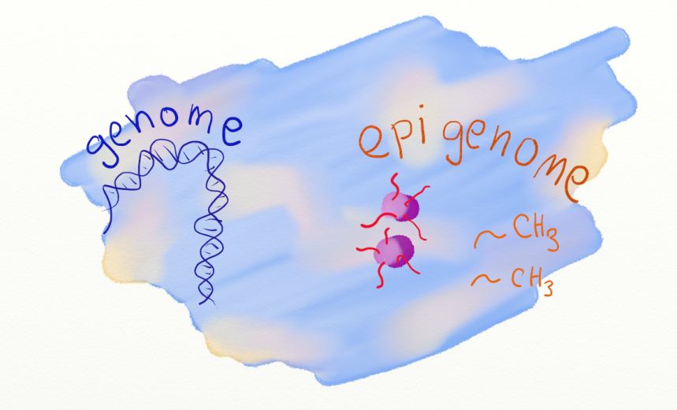
What is epigenetics?
the branch of biology which studies the causal interactions between genes and their products which bring the phenotype into being.
(Conrad Waddington, 1940s)
An epigenetic system should be heritable, self-perpetuating, and reversible
(Bonasio, Science, 2010.)
The study of changes in gene function that are mitotically and/or meiotically heritable and that do not entail a change in DNA sequence
(Wu, Science, 2001)
The study of heritable changes in gene expression or cellular phenotype caused by mechanisms other than changes in the underlying DNA sequence
(wikipedia)
Study of the epigenetic marks on the genome that regulate chromatin structure and accessibility of the DNA to the machinery regulating gene expression
(Heijmans, Epigenetics, 2009)
if the genome is the hardware, then the epigenome is the software
(Joseph Ecker, Salk Institute)

Slide 4
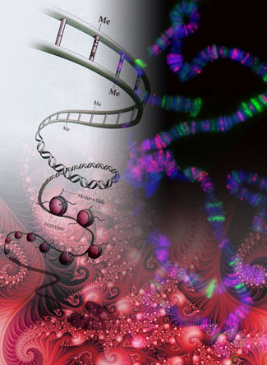
What is the role of epigenetics in the future of epidemiology?
Identification of biomarkers of exposure
Identification of predictive biomarkers
Identification of novel risk factors
Identification of new drug targets - Azacitidine and Myelodysplastic Syndromes
Explain differences in identical twins
Increased understanding of carcinogenesis- silencing of tumour suppressing genes
Increased understanding of gene-environment interactions
Designer babies?!

Slide 5
Advantages and Disadvantages
Advantages
Disadvantages
Lack of agreed precise definition of epigenetics
Difficult to prove role of epigenetic changes in disease if they are highly frequently, largely stochastic and age, tissue or cell specific
Reverse causation (if epigenome due to the disease itself or intermediates of the disease pathway)?
Human epigenome contains as yet unknowable pattern of epigenetic marks
Lack of sufficient computing power
Difficult to compare studies that have used different platforms
Who will own your ‘epigenome’ information?
Biological warfare-destabalising nations?
Future of epigenetics in epidemiology !
Cost of measuring DNA methylation is falling
Development of high throughput sequencing
Targetted help in famine situations and in public health policy – planning for future generations

Slide 6
Discuss the heritability of epigenetic chnages
Historically heritability not a defining feature of epigenetic systems
DNA methylation may be particularly sensitive to environmental factors during the extensive epigenetic reprogramming early after fertilisation – critical window
Epigenetic marks are heritable during cell division
Barker Hypothesis - intra-uterine exposures can result in fetal programming that persists into adulthood and may contribute to the risk for adult-onset
diseases
Epigenetics isn't evolution.- DNA doesn't change!
Represent a biological response to an environmental stressor.-response can be inherited through many generations via epigenetic marks,-but if you remove the environmental pressure, the epigenetic marks will eventually fade
Unknown what the interplay is between inherited genome and that caused by your own environment
.

Slide 7
The Importance of epigenetics in understanding global inequalities
Evidence for an association between epigenetic status and socio-economic status (McGuiness 2012, Borghol 2012)
Importance of prenatal factors
Evidence for an association between global DNA methylation and emerging biomarkers of CVD
Stress has been indicated to affect epigenome
Exposure to toxicants/environmental pollutants associated with a decrease in global methylation
Smoking associated with epigenetic changes
Memory— a wildly complex biological and psychological process — can be improved from one generation to the next via epigenetics (Feig 2009)
If epigenetic marks can accumulate what are the implications for generations of people living in poverty?
Perpetuating cycle – even harder to break out of poverty (on an individual and country-wide level?)
Some of the biggest societal problems in developed society – obesity, stress, CVD, diabetes seems to both be caused by abberant epigenomes and to cause abberant epigenomes themselves
Can we use it to predict waht to do about global inequalities though – targetted?

Slide 8
The Long Term Consequences of Famine in the Netherlands in WWII
Student-led Seminar

Slide 9
Learning Objectives
Understand how prenatal factors can influence the epigenome of adults
Discuss the long term effects of the Dutch famine
Explain how findings from studies of the Dutch famine and other famines can serve as a model to study other prenatal conditions
Consider the global implications of the findings of studies of historical famines

Slide 10
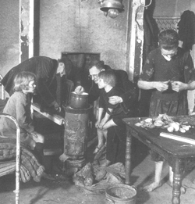
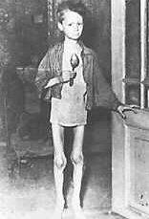
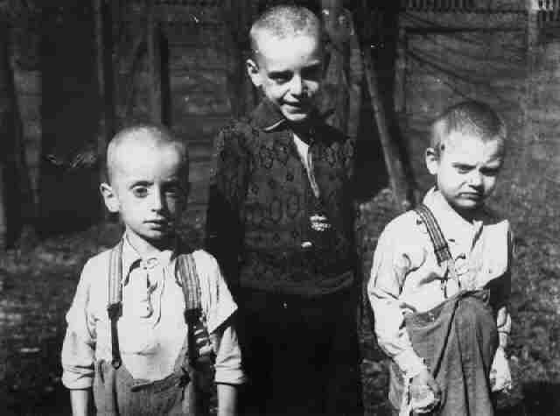
The Dutch Famine: 1944-45
September – November 1944: German administration placed embargo on all food transports to the western Netherlands.
Unusually harsh and early winter froze canals
Much agricultural land became battlefields and was destroyed
People of the Western Netherlands subsisted on <1000 calories/day
Typical daily rations consisted of potatoes, bread, and sugar beets.
More than 4.5 million people affected
Deaths of 18,000 Dutch people were attributed to malnutrition as the primary cause and in many more as a contributing factor.
May 1945: famine ended with the liberation of the country by the Allies. But the famine’s legacy lived on.
.

Slide 11
How Can prenatal factors influence the epigenome of adults?
Diet/Stress/hormones/smoking
Developmental origins hypothesis – agouti gene in mice
Critical window - DNA methylation may be particularly sensitive to environmental factors during the extensive epigenetic reprogramming early after fertilisation
growing list of studies demonstrates meiotic stability in epigenetic markers, which allows epigenetic modifications to be passed on to offspring and even grandoffspring via germline epigenetic inheritance
Barker hypothesis - DNA methylation differences after exposure to prenatal famine may persist during an individuals life course

Slide 12
What were the long term impacts of the Dutch Famine?
Long-lasting effects on infant mortality, infant birth size, mental health, and the development of chronic diseases such as diabetes, obesity, and coronary heart disease and neurological conditions including schizophrenia and depression
Associations dependent on sex of the exposed individual and timing of the exposure during gestation
Grandchildren of women who were pregnant during the famine were also smaller than average
Data suggests that the famine experienced by the mothers caused some kind of epigenetic changes that were passed down to the next generation
Provided mechanistic evidence for the causes of Coeliac disease

Slide 13
How can findings from the Dutch famine serve as a model to study other prenatal conditions?
Provides biological rationale for future studies
Provides candidate loci
Form a catalogue of loci that are vulnerable to prenatal environment
Underlined importance of detailing timing of exposure during gestation and comparing tissues that differentiate during different stages of development
Underlined need for large sample sizes and replication datasets – changes in DNA methylation likely to be small
Suggests birth weight is a poor surrogate for nutritional status during gestation
Selection of appropriate controls - siblings

Slide 14
What are the global implications of the findings from studies of historical famines?
Maternal nutrition, psychosocial stress and environmental toxicant exposure can be reflected in the methylation status of their offspring
These factors tend to mirror social stratification
Famines that may still allow asystematic follow-up include the Soviet (and Ukraine) famine of 1931–1933 as well as severe under nutrition in Greece and the Channel Islands during German Occupation in WWII, in Germany itself at the end of WWII, and in the early postwar period
925 million hungry people in 2010 – 4 million will die of starvation this year
Likely that over nutrition may also cause epigenetic effects
Underlines the importance of living a healthy life – not just for yourself but for generations to come!

