Slide 1
Introduction to Cohort studies: design and key points
BSc Global Health –November, 2012
Rachel Kelly
Department of Epidemiology and Biostatistics

Slide 2
Learning objectives
Understand the design of a cohort study
Critically appraise the use of a cohort study design to answer a specific question
Calculate, understand and interpret two measures of crude RR:
  Cumulative incidence ratio
  Incidence rate ratio

Slide 3
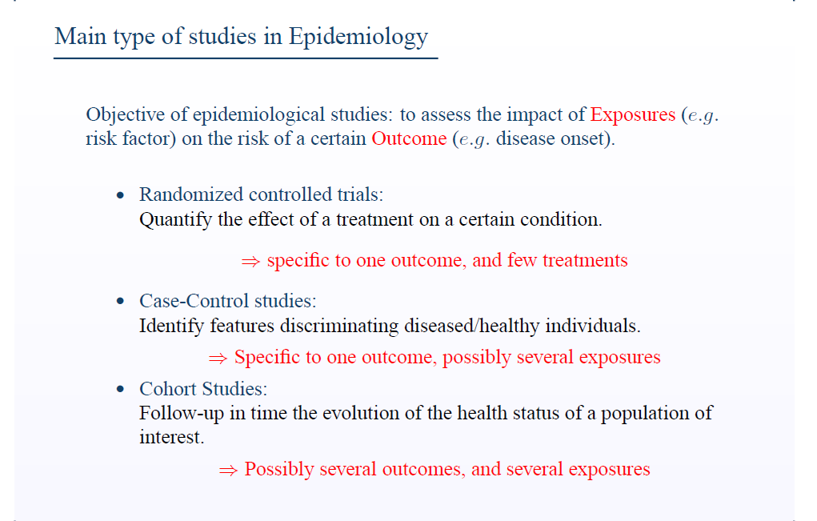

Slide 4
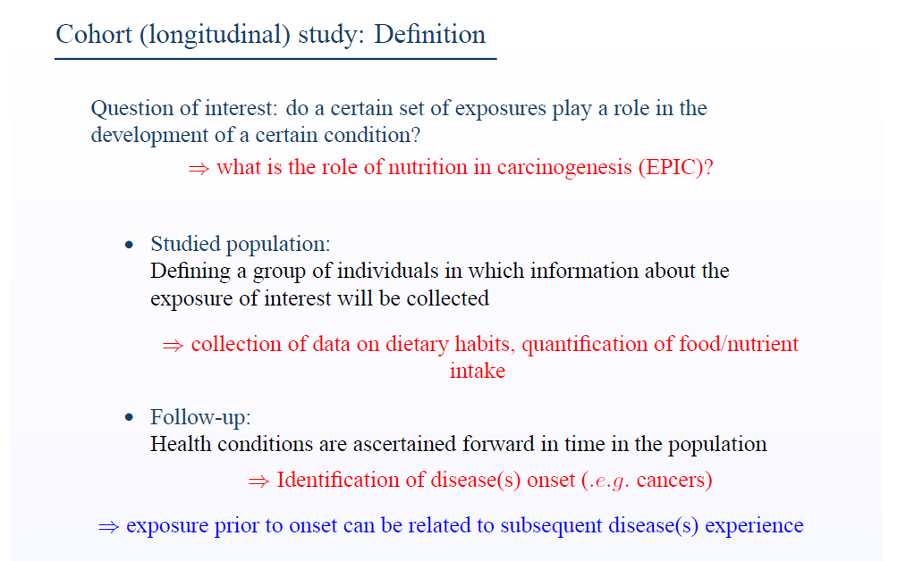

Slide 5
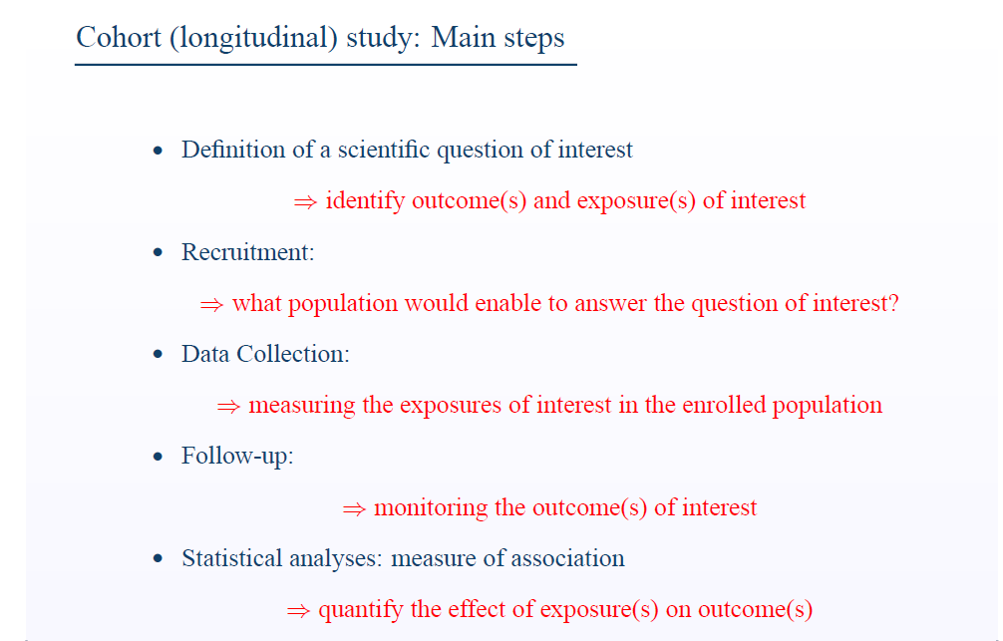

Slide 6
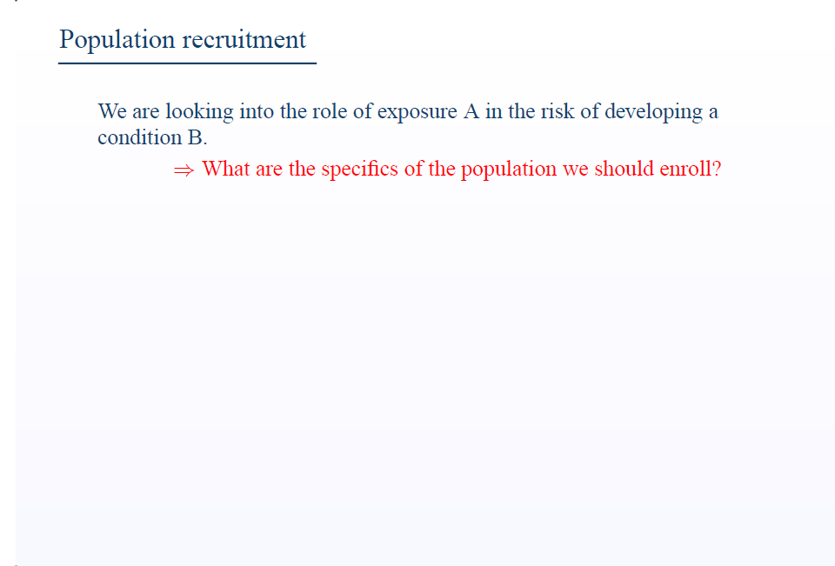

Slide 7
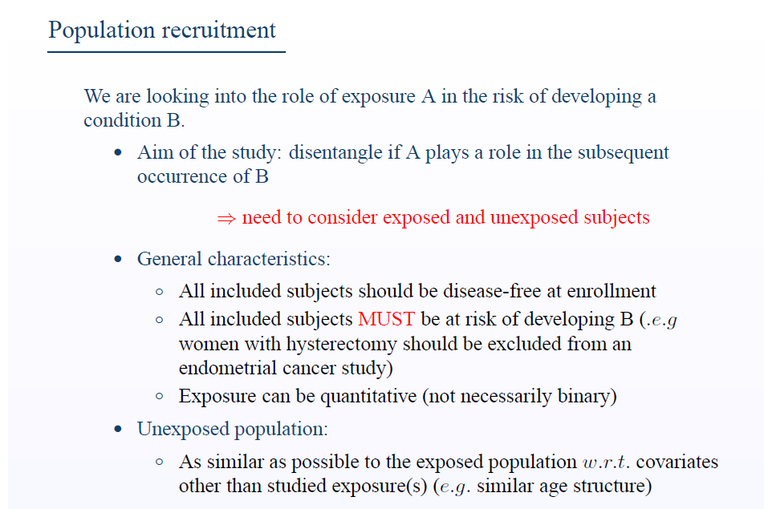

Slide 8
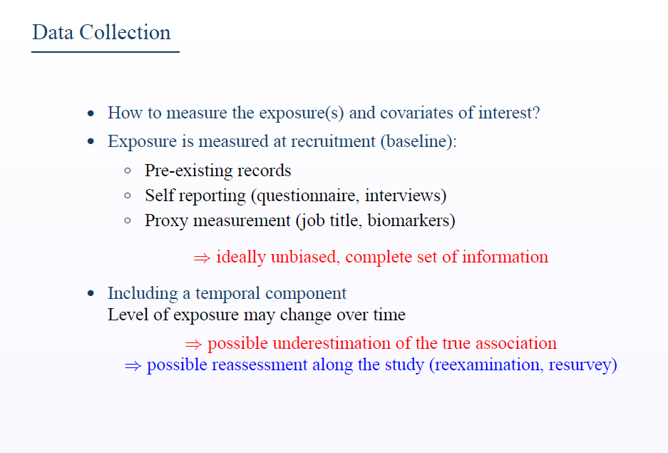

Slide 9
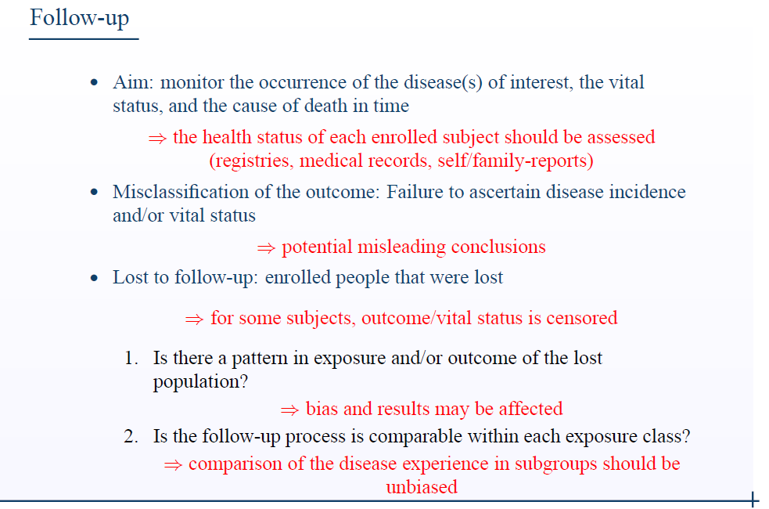

Slide 10
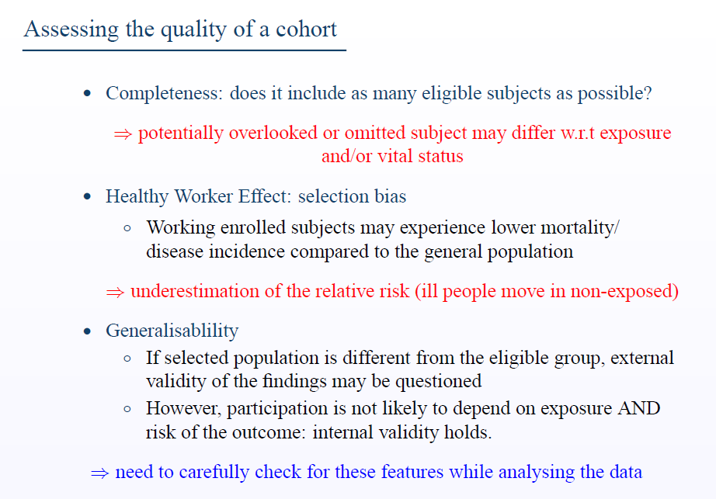

Slide 11
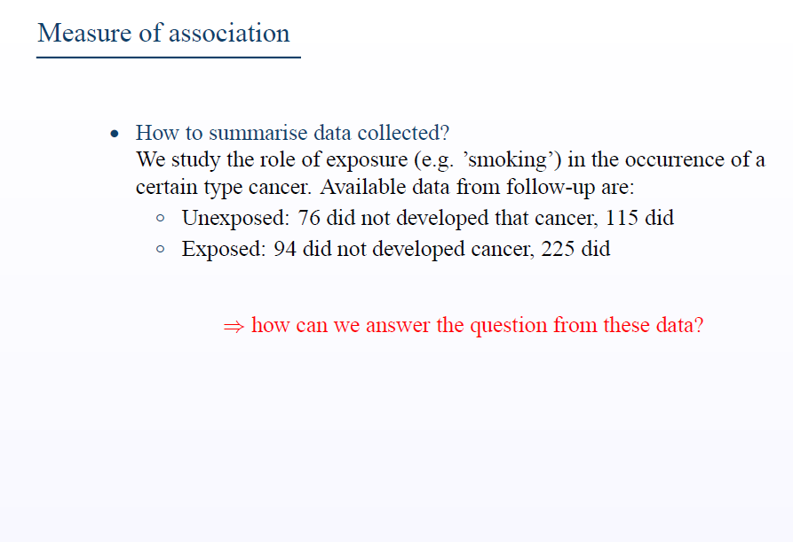

Slide 12
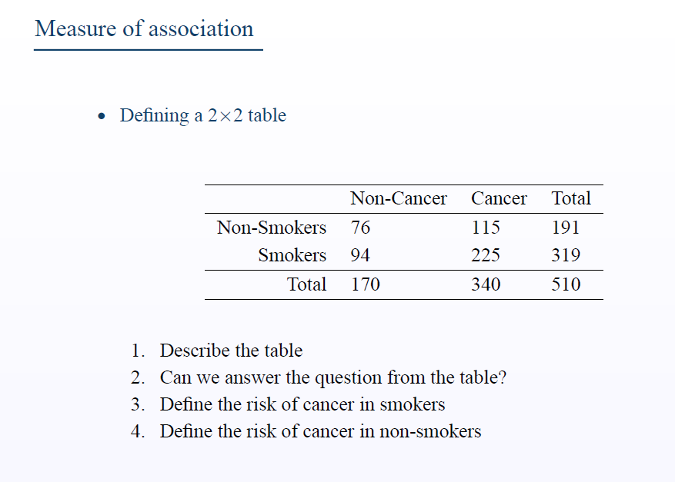

Slide 13
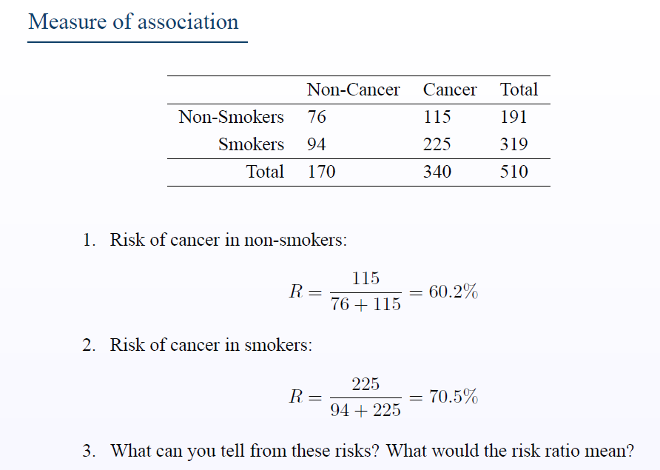
N non smokers at risk at the beginning of FU
N smokers at risk at the beginning of FU
N participants with cancer at the end of FU
N participants at risk at the beginning of FU

Slide 14
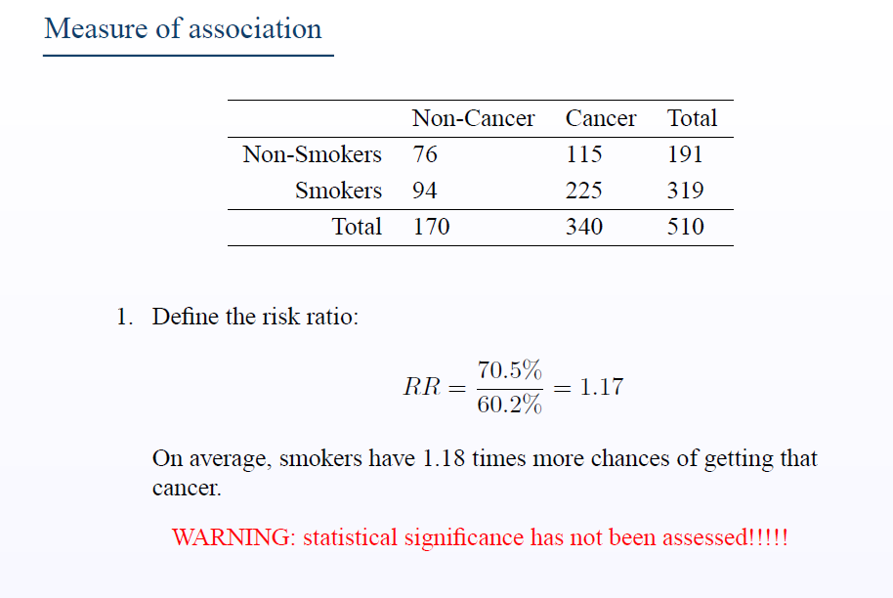

Slide 15
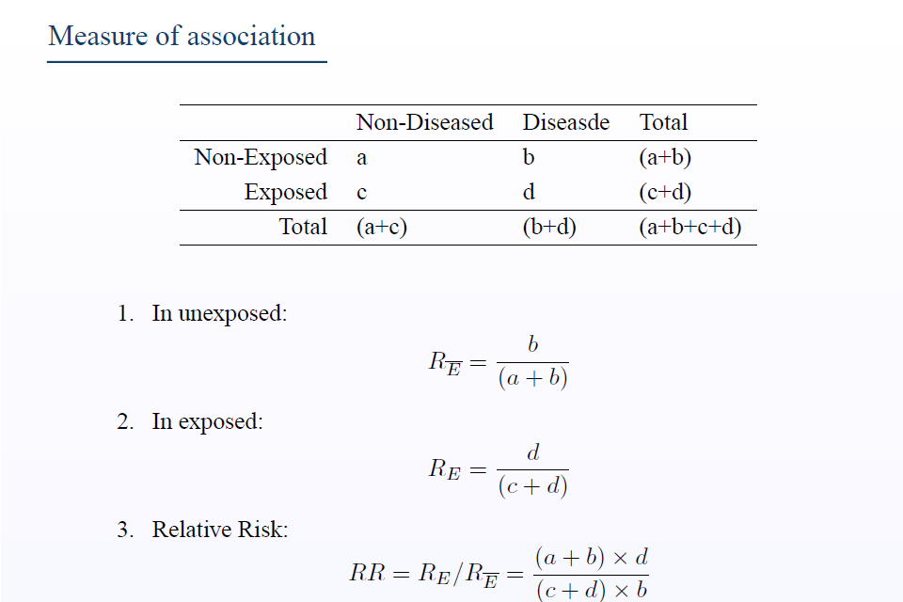

This statistics does not take into account length of follow-up!!!
This statistics is usually called Cumulative Incidence Ratio

Slide 16
Problems with the calculation of the cumulative incidence ratio
Say one wants to calculate the 5-year risk of death in the population but
  only some people are followed for 5-years
  others are followed for less than 5-years because they are lost to follow-up
Loss to follow-up
  Voluntary or involuntary dropping out of the study
The magnitude of the problems increases with length of follow-up period
We need to introduce two new concepts
  Person-time
  Rate

Slide 17
Person-time of observation
Concept of population at risk ie, numerator (cases) must be derived only from that population
Total time included in the follow-up study
  Sum of time spent in the population by all individuals
A person contributes person-time during the time he/she could have developed an event that in the population
  i.e., until diagnosis, death, or loss to follow-up
Units of person-time
  Person-year, person-month, person-day…

Slide 18
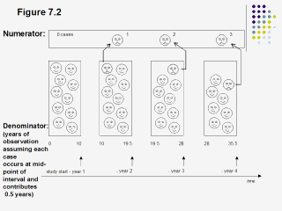
Incidence
From Bhopal

Slide 19
Accrual of person-time
Jan Jan Jan
1980 1989 1999 PY
Subject 1 X 10
Subject 2 X 10
Subject 3 20
40
X = outcome of interest
PY = person years

Slide 20
Incidence rate (IR) ratio
IR in exposed (IRE) = # new cases at end of FU in exposed(A)
person-time in exposed
IR in non exposed (IRNE) = # new cases at end of FU in non exposed(A)
person-time in non exposed
IR ratio: IRE/IRNE
Well defined even if loss to follow-up, open population, and competing risks
*See Rothman and Greenland, Chapter 3

Slide 21
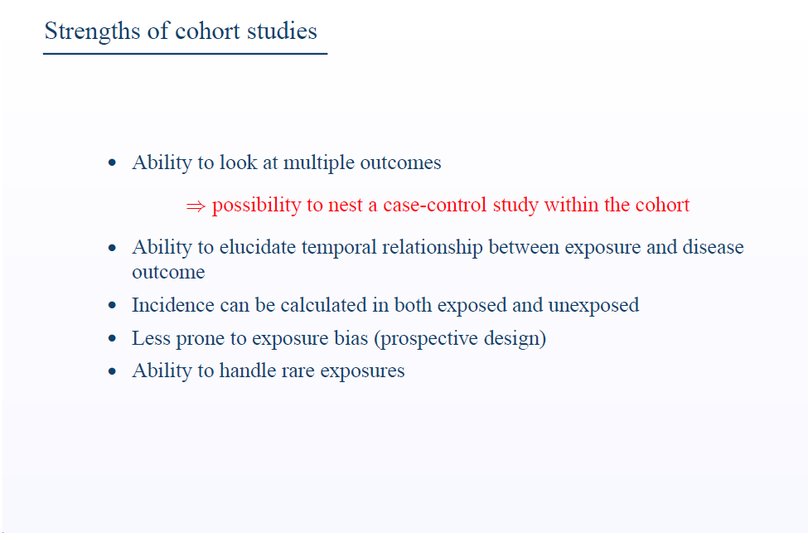

Slide 22
