Slide 1

Climate change – reducing the risks to health
Professor Sir Andy Haines

Slide 2
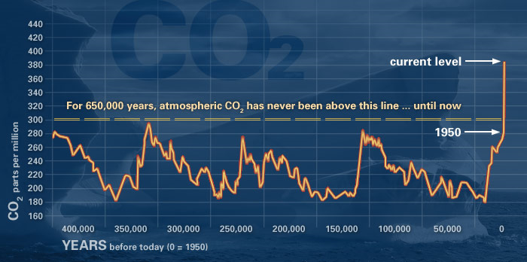
CO 2 over the last 650,000 years

Slide 3
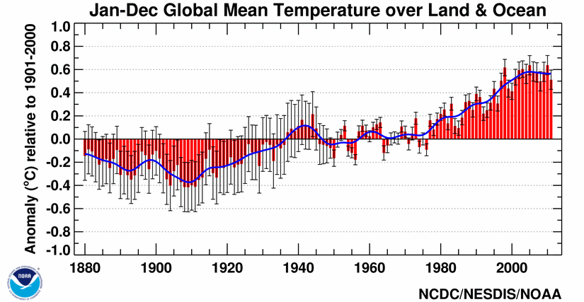
Global temperature trends

Slide 4
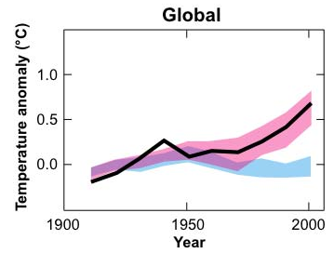
Human activities are very likely the cause of the warming of last 100 years.
Black line: temperature observation from thermometers.
Pink shade: Climate model simulations using all past radiative forcings.
Blue shade: Climate model simulation using only natural forcings
(solar, volcanoes).
IPCC WGI SPM

Slide 5
2.9-6.9°C
Fossil Fuel CO₂ Emissions compared to
IPCC Marker scenarios used for climate projections
1.6-3.4°C
10
CO₂ emissions (Pg C y⁻¹)
Projected growth in
GDP by the IMF,
and -1.0 to -1.7 %/y improvement
in carbon intensity
of the economy
5
1980
2000
2020
Time (y)
Updated from Le Quéré et al (2009) Nature Geoscience, using Marker scenarios
modified from Raupach et al. PNAS (2007)
Notes:
5
2010 projected growth rates.
Based on a 4.8% growth rate of global Gross Domestic Product and the long term 1.7% annual improvement of the carbon intensity of the economy.

Slide 6
Earth’s Temperature Chart, since Dinosaur Extinction 65m yrs ago
Arctic ice sheets
East Antarctic ice sheet
West Antarctic ice sheet
Paleocene
12
8
4
0
?
+5ºC
+3ºC
+1.5ºC
Temp ºC (vs 1961-90 av temp)
last 2m yr = ice-age
60myr 50myr 40myr 30myr 20myr 10myr Now
Millions of Years Before Present
Sea level 25-40 metres higher than today
Tripati et al Science 2009

Slide 7
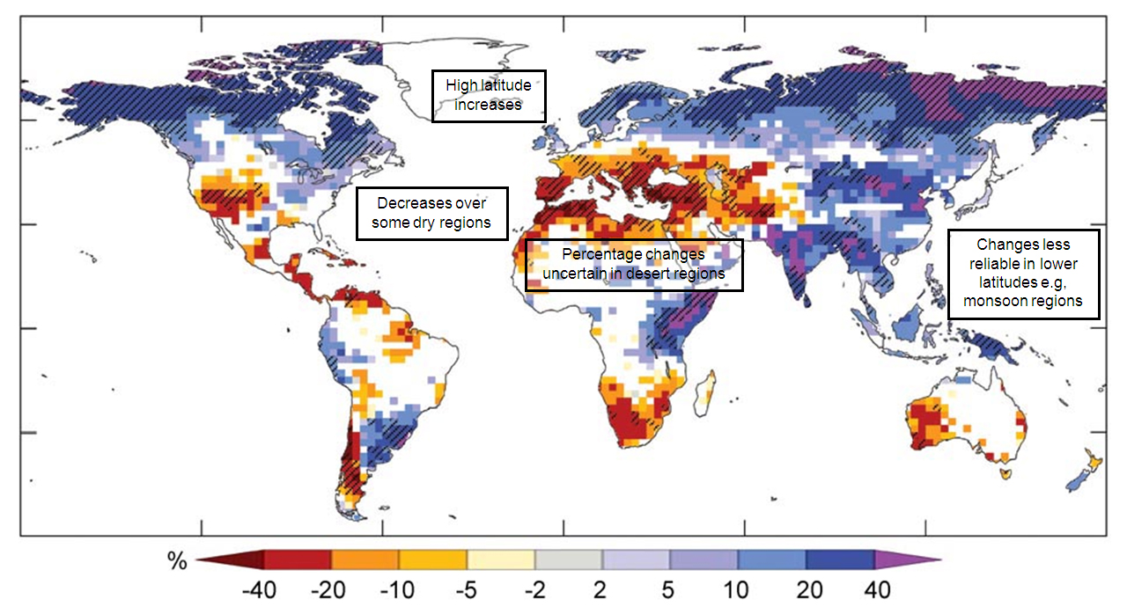
21st Century Water Availability (Runoff) Changes
(Annually averaged)
Drier
Wetter
Very likely runoff will increase in high latitudes.
Likely runoff will decrease over some subtropical and tropical regions.
IPCC AR4 Synthesis

Slide 8
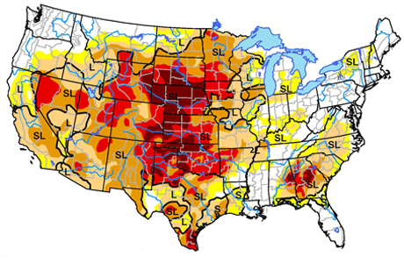
According to the November 27 U.S. Drought Monitor, moderate to exceptional drought covers 62.7% of the contiguous U.S.
S = Short term < 6 months and L = Long term >6 months

Slide 9
Projected Impacts of Global
Temperature Change
0°C
1°C
2°C
3°C
4°C
5°C
Food
Falling crop yields in many areas, particularly developing regions
Possible rising yields in some high latitude regions
Falling yields in many developed regions
450 ppm CO2 eq
Water
Small mountain glaciers disappear – water supplies threatened in several areas
Significant decreases in water availability in many areas, including Mediterranean and Southern Africa
Sea level rise threatens major cities
Ecosystems
Extensive Damage to Coral Reefs
Rising number of species face extinction
650 ppm CO2 eq
Extreme Weather Events
Rising intensity of storms, forest fires, droughts, flooding and heat waves
Risk of Abrupt and Major Irreversible Changes
Increasing risk of dangerous feedbacks and abrupt, large-scale shifts in the climate system
Source: L. Rudolph, 2008
Notes:
The arrows show the approximate temperature at which we might start to see the impacts of “dangerous” climate change, such as significant sea level rise, polar ice sheet disintegration, extinction of animal & plant species, declining food yields, and regional climate change with flooding, drought, and severe weather events, with increasing risk and intensity of impacts as temperatures rise. The “dangerous” level of CO2 is at MOST 450 ppm, probably less. We’re now at 386 ppm. Worldwide CO2 emissions are climbing at a faster rate than even the worst-case IPCC scenario. With business as usual, concentrations would reach 550ppm CO2e by around 2035, with very serious risk of exceeding 5 degrees celsius. To stabilize below 450 ppm CO2 would require that emissions peak by 2010, with a 6 – 10% annual decline thereafter to reduce emissions by 80% by 2050. A 10 year delay in the emissions peak almost doubles the annual rate of decline required to stabilize atmospheric greenhouse gases.Scientists are also now concerned that we may be reaching climate tipping points beyond which we will experience dangerous and irreversible climate changes due to feedback loops such as decreased reflection off of of polar ice or thawing of the arctic tundra – which releases huge quantities of methane, with more than 20 times the greenhouse warming potential of CO2.

Slide 10

Barriers to policy change
Vested interests
Organised denialism
Political short-termism
Divided public opinion
Perception that change is expensive and difficult

Slide 11
Pathways by which climate change may affect health outcomes (Haines and Patz 2003)
Modulating influences
HEALTH EFFECTS
Extreme weather-related health effects
Air (ozone) pollution related
Water-related diseases
Food borne diseases
Vector-borne dis. rodent-borne dis.
Malnutrition
REGIONAL WEATHER CHANGES:
- heatwaves
- extreme
events
- temperature
- precipitation
CLIMATE
CHANGE
Indirect mechanisms
Floods
Droughts
Crop production
Socio economic decline
Adaptation measures

Slide 12
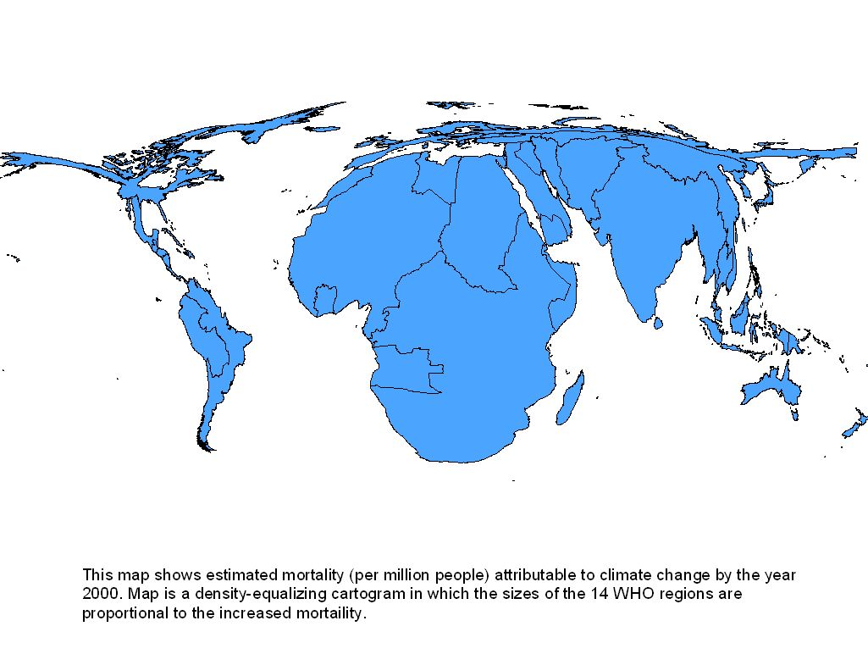

Deaths Attributable to Climate Change in Year 2000
Estimated annual deaths due to climate change from: malnutrition (~80K), diarrhoea (~50K), malaria (~20K), flooding (~3K)
14 WHO statistical regions are, here, scaled by estimated annual mortality (in 2000) due to change in climate since ~1970. Selected causes of death.
(Patz, Gibbs et al, 2007: based on McMichael, Campbell-Lendrum, et al, 2004)

Slide 13
An adaptability limit to climate change due to heat stress
Steven C. Sherwood and Matthew Huber PNAS 2010
Exceeding peak heat stress for extended periods should induce hyperthermia in humans
‘....It would begin to occur with global-mean warming of about on 7 °C, calling the habitability of some regions into question’
D.S.Battisti and R.L. Naylor . Science 2009

Slide 14
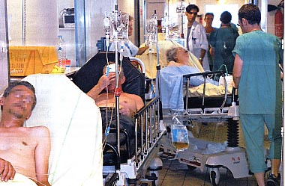
France, August 2003
~15000 deaths (~70,000 in Europe) Robine et al 2007
Temperature distribution across Europe on 10 August 2003 at 1500hrs

Slide 16
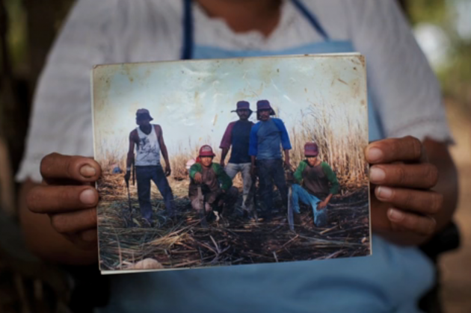
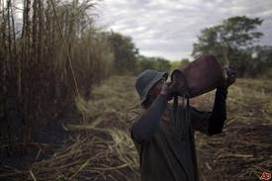
‘Mystery kidney disease decimates Central America sugarcane workers’
NBC News

Slide 17
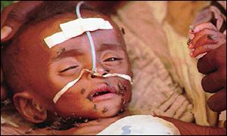
Diarrheal disease and rainfall
Global overview of 36 published reports from LMICs from 1954-2000 (Lloyd, Kovats, Armstrong. Climate Res 2007)
4% (1-7%) increase in diarrhoea incidence in children aged <5 per 10 mm /month decrease in rainfall
Reduced effect of hand washing where rainfall is low?

Slide 18
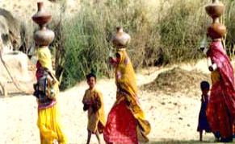
The Global Water Crisis
Water scarcity is growing - by 2025 more than half of the world’s population is projected to live under conditions of severe water stress
Water quality is declining in many parts of the world
70% of all freshwater is used for irrigation
50-60% of wetlands have been lost

Slide 19
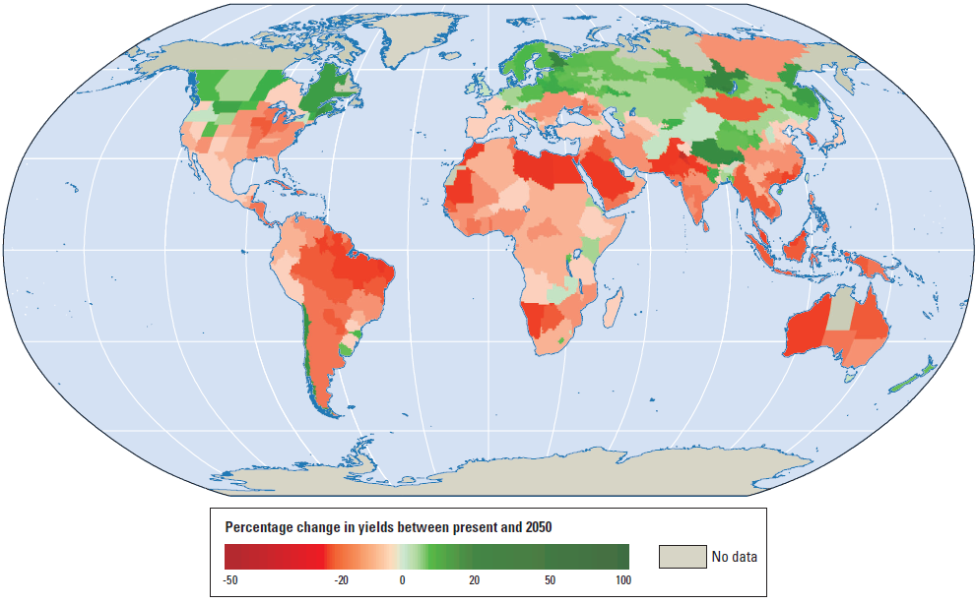
CLIMATE CHANGE: Poor Countries Projected to Fare Worst MODELLED CHANGES IN CEREAL GRAIN YIELDS, TO 2050
20
36
Plus climate-related:
Flood/storm/fire damage
Droughts – range, severity
Pests (climate-sensitive)
Infectious diseases (ditto)
64
80
Percentage change in yields to 2050
-50 -20 0 +20 +50 +100
UN Devt Prog, 2009

Slide 20
Impacts on malnutrition
Increased numbers of stunted children
Lloyd S, Kovats RS, Chalabi Z (2011)
Region | Millions of additional children with stunting in 2050 due to climate change
 | NCAR climate scenario | CSIRO climate scenario
South Asia | 7 | 6
Sub-Saharan Africa | 9 | 9

Slide 21
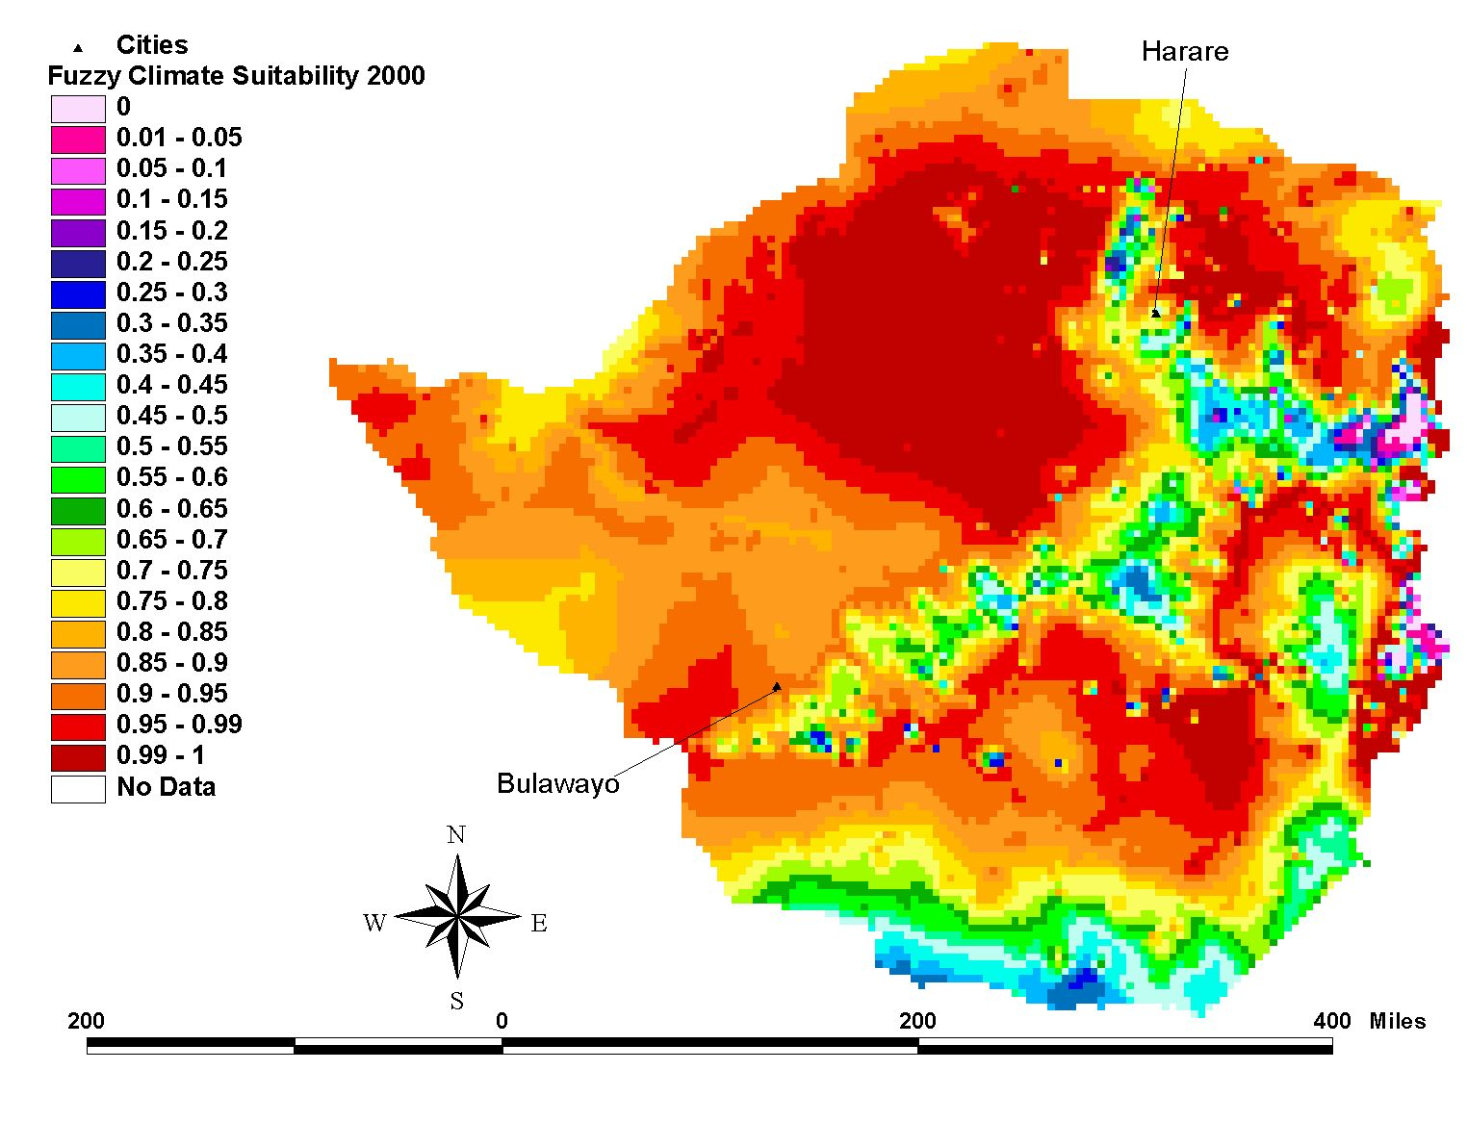
Baseline 2000 2025 2050
Climate Change and Malaria
Potential transmission in Zimbabwe
Climate suitability:
red = high; blue/green = low
Harare
Low probability
Medium probability
Highlands
High probability
Bulawayo
Ebi et al., 2005
Notes:
Down-scaled modelling, at national level, of future zone of potential transmission of malaria in Zimbabwe, under a standard scenario of climate change. Model is hybrid statistical-biological model, applied to probabilistic (‘fuzzy logic’) estimation. Model results do not tell us where the disease WILL be, but where it COULD be – and that has important implications for future data collection, surveillance, and field control programs (and expenses).

Slide 22
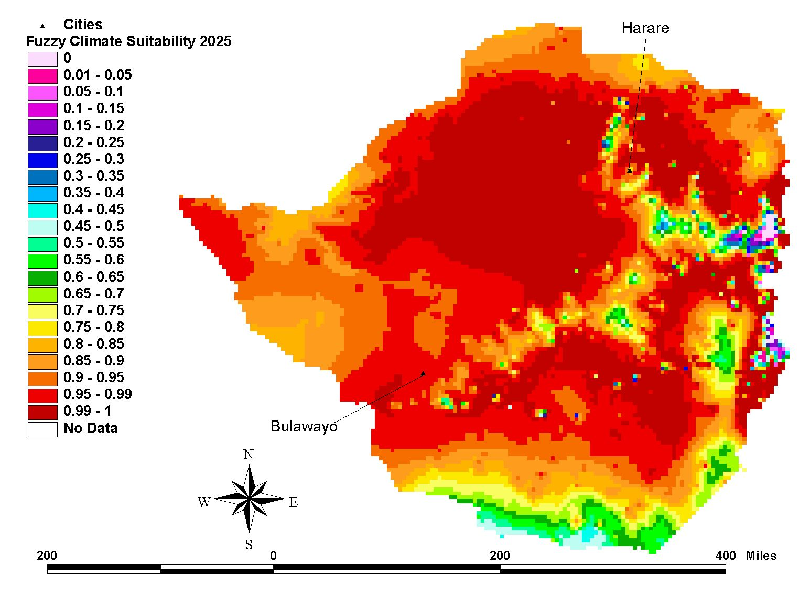
Baseline 2000 2025 2050
Climate Change and Malaria
Potential transmission in Zimbabwe
Climate suitability:
red = high; blue/green = low
Harare
Bulawayo
Ebi et al., 2005

Slide 23
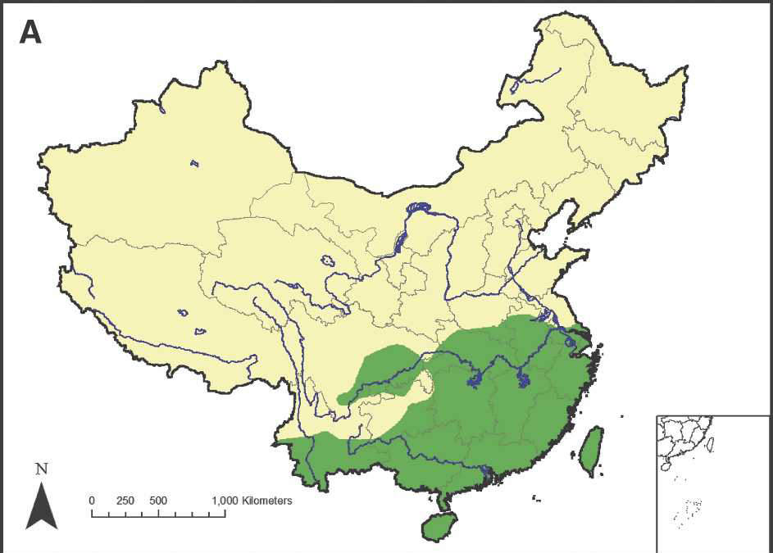
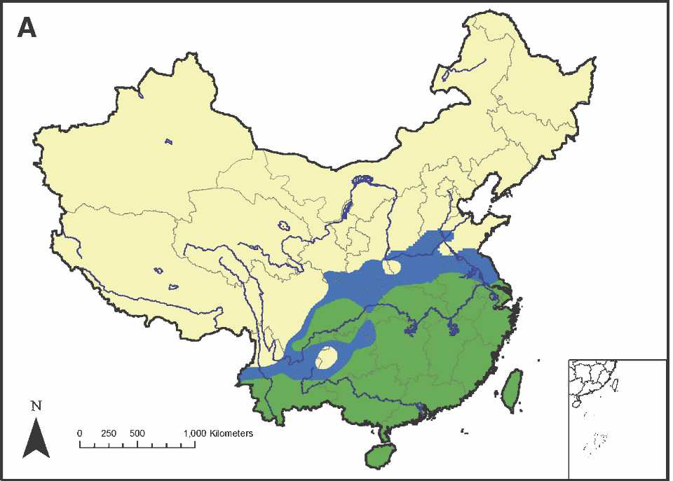
Schistosomiasis transmission, China
Risk map of schistosomiasis transmission in China in 2000 (green colour = potential risk areas for schistosomiasis
transmission)
Predicted risk map of schistosomiasis transmission in China in 2030 (blue colour = predicted additional risk areas)
Xiao-Nong Zhou,Guo-Jing Yang, Kun Yang, Xian-Hong Wang, Qing-Biao Hong, Le-Ping Sun, John B. Malone, Thomas K. Kristensen, N. Robert Bergquist, and Jürg Utzinger. Am. J. Trop. Med. Hyg 2008; 78(2): 188–194.

Slide 24
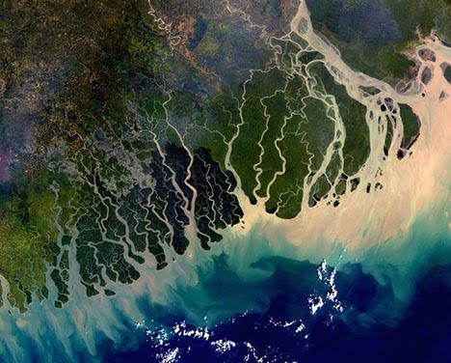
Saltwater intrusion in coastal Bangladesh Khan, Ireson, Vineis 2009
High levels of salinity in drinking water for ~ 20 million people due to river flow changes, sea level rise, irrigation, shrimp farming.
Mean Urinary Sodium ~ x 2 WHO/FAO recommended levels in pregnant women
Prevalence of pre-eclampsia highest in dry season

Slide 25
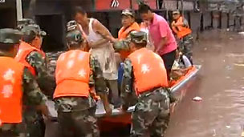
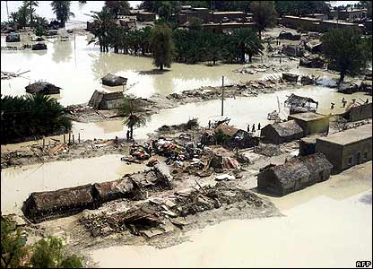
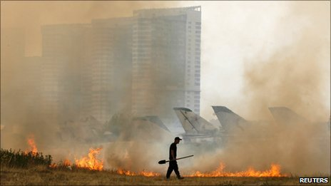
2010 – a harbinger of things to come?
Pakistan floods ~ 20 m affected
Chinese floods ~ 12m displaced
Russian drought and fires –wheat harvest down ~ 30%
56,000 extra deaths in Moscow and Western Russia
(Munich Re estimate)
Record temperatures in 17 countries.

Slide 26
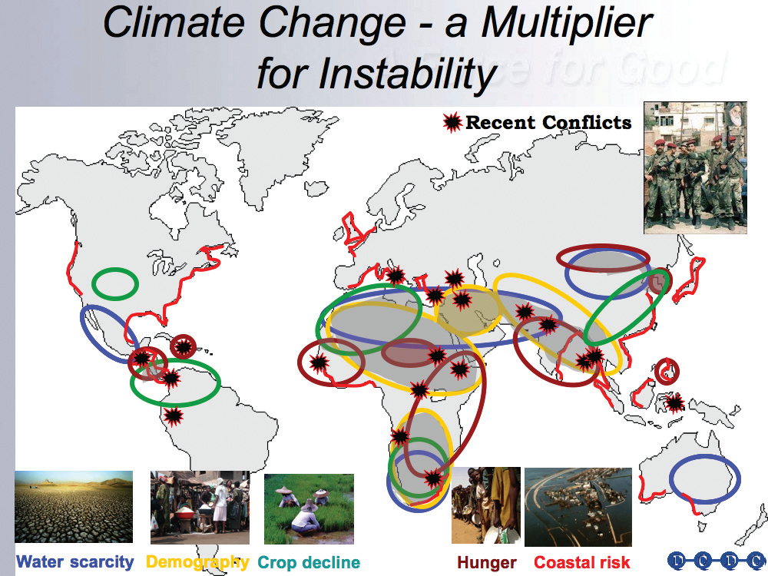
Climate Change: Multiplier of Conflicts and Regional Tensions
Regions afflicted by problems due to environmental stresses:
population pressure
water shortage
climate change affecting crops
sea level rise
pre-existing hunger
armed conflict, current/recent
From UK Ministry of Defence
[May RM, 2007 Lowy Institute Lecture. Sydney]

Slide 27
Possible flooding in the UK by 2080s
Notes:
The Foresight study looked at four possible future scenarios – these model different amounts of climate change, and different socio-economic patterns for the UK.
Although existing policies have served us well simply continuing these into the future is not sustainable in the long term, by 2100 the risks could change as follows:
economic damages could rise by between £0.5 billion and £27 billion per year;
the number of people at high risk could increase by between 1.5 and 2 fold;
the risk of flooding due to more frequent or more intense storms could increase 4 – 6 fold.
However the study showed that:
Risks can be reduced to acceptable levels if we invest an additional £20bn to £80bn over the next 80 years
Increasing investment now makes flood management affordable – in the region of £10m to £30m annual increase – we currently spend in the region of £500m per year in this area
Reference: www.foresight.gov.uk

Slide 28
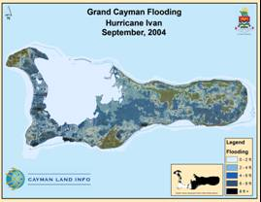
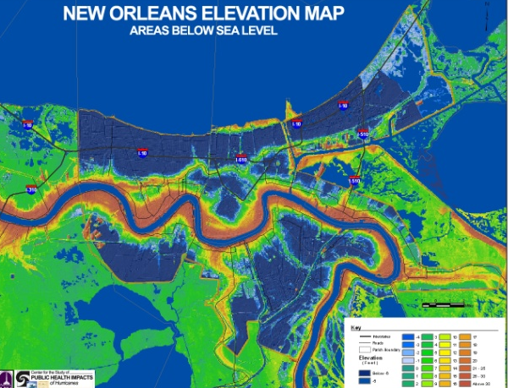
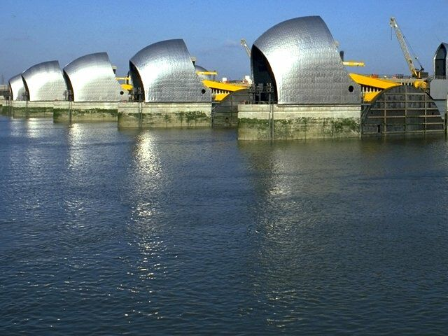
Are there limits to how much we can adapt?…physical, behavioural and technological limits
Physical limits: small low lying islands e.g. Cayman Islands
Behavioural limits: influence where we live and why, e.g. New Orleans
Technological limits: e.g. to the flood defences such as Thames Barrier, London
Notes:
28

Slide 29
Stabilisation scenarios
Global mean temp. increase
(ºC)
Stabilization
level
(ppm CO₂-eq)
Year CO₂ needs to peak
2.0 – 2.4
445 – 490
2000 – 2015
2.4 – 2.8
490 – 535
2000 – 2020
2.8 – 3.2
535 – 590
2010 – 2030
3.2 – 4.0
590 – 710
2020 – 2060
Notes:
Table SPM.6. Characteristics of post-TAR stabilisation scenarios and resulting long-term equilibrium global average temperature and the sea level rise component from thermal expansion only. {Table 5.1}a
Mitigation efforts and investments over the next two to three decades will have a large impact on opportunities to achieve lower stabilisation levels. Delayed emission reductions significantly constrain the opportunities to achieve lower stabilisation levels and increase the risk of more severe climate change impacts.
Sea level rise under warming is inevitable. Thermal expansion would continue for many centuries after GHG
concentrations have stabilised, for any of the stabilisation levels assessed, causing an eventual sea level rise much larger than projected for the 21st century. The eventual contributions from Greenland ice sheet loss could be several metres, and larger than from thermal expansion, should warming in excess of 1.9-4.6°C above preindustrial be sustained over many centuries. The long time scales of thermal expansion and ice sheet response to warming imply that stabilisation of GHG concentrations at or above present levels would not stabilise sea level for many centuries. {5.3, 5.4}
SYR SPM p.21

Slide 30
The scale of the emissions challenge for a high income country (UK)
Source: UK National Atmospheric Emissions Inventory (2008).

Slide 31
Impacts of mitigation on GDP growth
(for stabilisation scenario of 445-535 ppm CO₂-eq)
GDP
GDP without mitigation
Cost of mitigation in 2030: max 3% of global GDP
Mitigation would postpone GDP growth by one year at most over the medium term
GDP with stringent mitigation
Current
Time
2030
Schematic graph

Slide 32
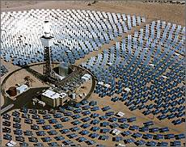

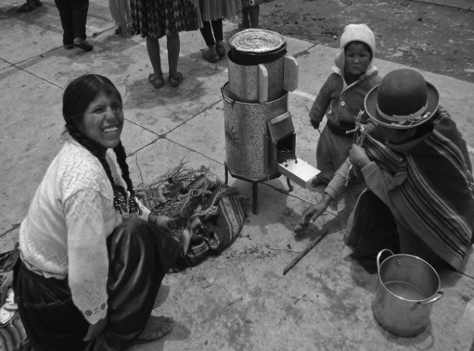
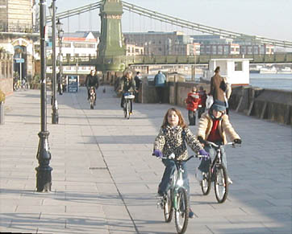
Health co-benefits from the ‘low-carbon’ economy
Through policies in several sectors e.g.
Housing
Transport
Food and agriculture
Electricity generation

Slide 33
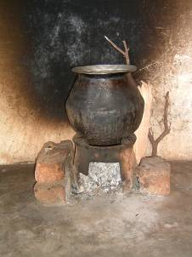
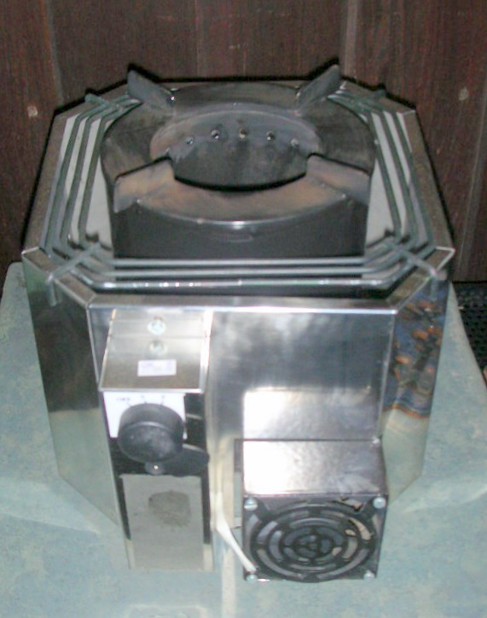
Health and GHG benefits of Indian improved stove programme -150 m over 10 years
Wilkinson P Smith KR et al 2009
2 Million premature deaths averted (mainly women and children)
Reductions in black carbon, methane, ozone precursors ~ 0.5-1.0 billion tonnes of CO₂ eq over the decade
Cost <$50 per household every 5 years

Slide 34
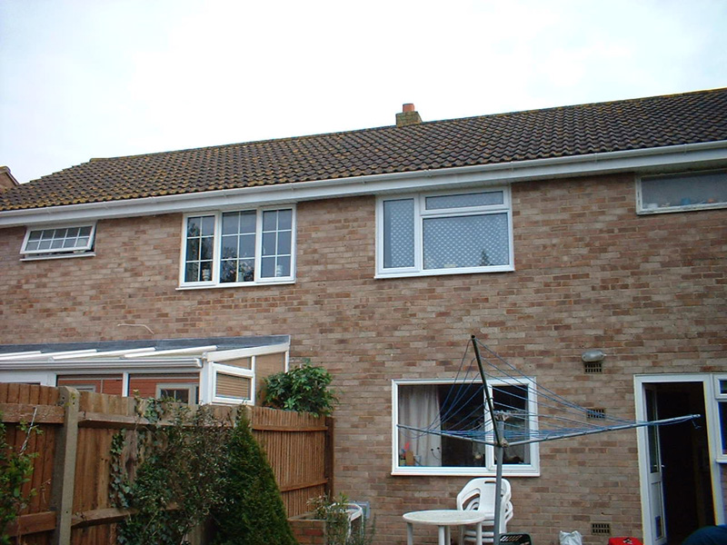
Benefits of household energy efficiency in the UK
(combined insulation and ventilation control improvements)
( Wilkinson et al 2009
Impacts | Reduced exposures e.g. to fine particles, radon, cold, mould, tobacco smoke
Premature deaths averted | ~ 5400/ year
Mt-CO₂ saved (vs 1990) | 55

Slide 35
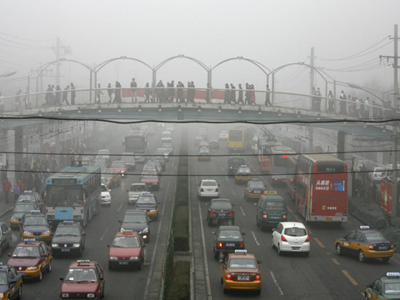
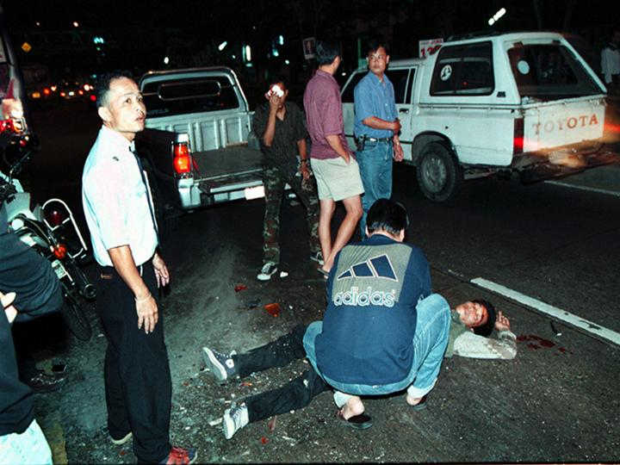
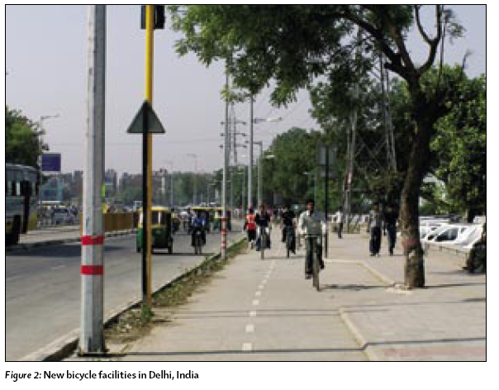
Urban Transport Pathways modelled:
London and Delhi ( Woodcock et al 2009)

Slide 36
Increased active travel in London--- Health effects ( also diabetes, depression , cancer of the breast and bowel)
 | Change in disease burden | Change in premature deaths
Ischaemic heart disease | 10-19% | 1443-2207
Cerebrovascular disease | 10-18% | 866-1271
Dementia | 7-8% | 195-250
Breast cancer | 12-13% | 203-211
Road traffic crashes | 19-39% | 47-86

Slide 37
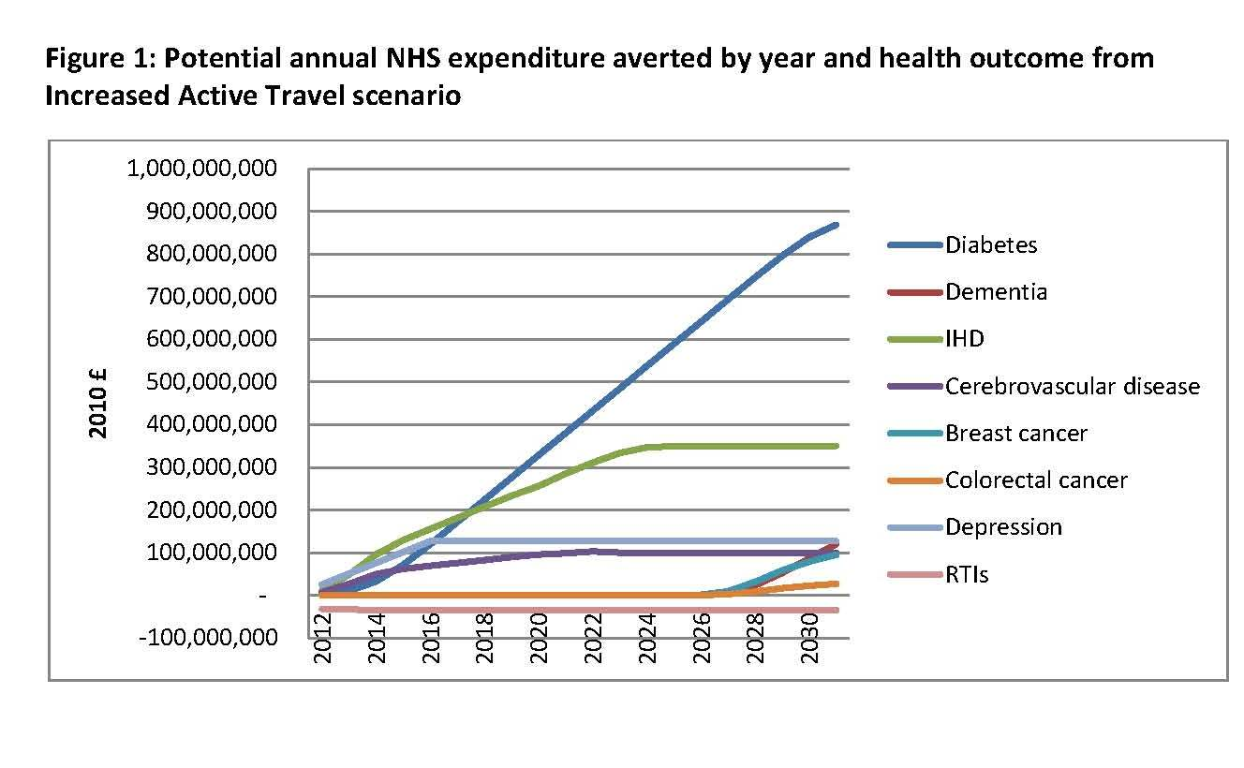
James Jarrett, James Woodcock, Ulla K. Griffiths, Zaid Chalabi, Phil Edwards , Ian Roberts , Andy Haines Lancet 2012

Slide 38
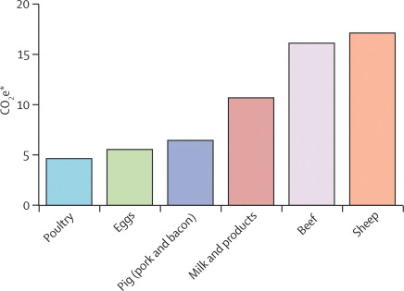
Estimates of total greenhouse-gas emissions for livestock products in the UK
CO₂e=carbon dioxide equivalents
*Tonnes of CO₂e per tonne of carcass mass or equivalent.
Not including emissions resulting from global change in land use

Slide 39
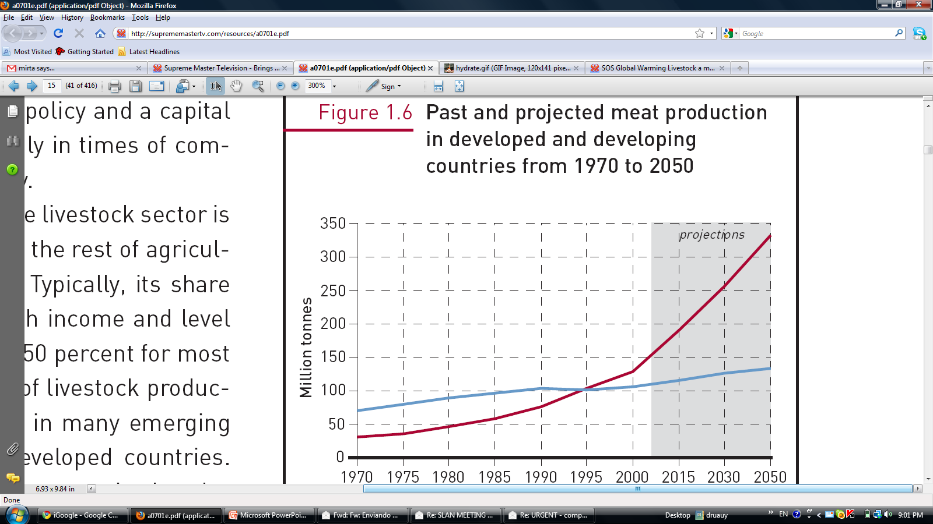
Past and projected meat production
in developed and developing
countries from 1970 to 2050
Source: FAO (2006a) and FAO (2006b).

Slide 40
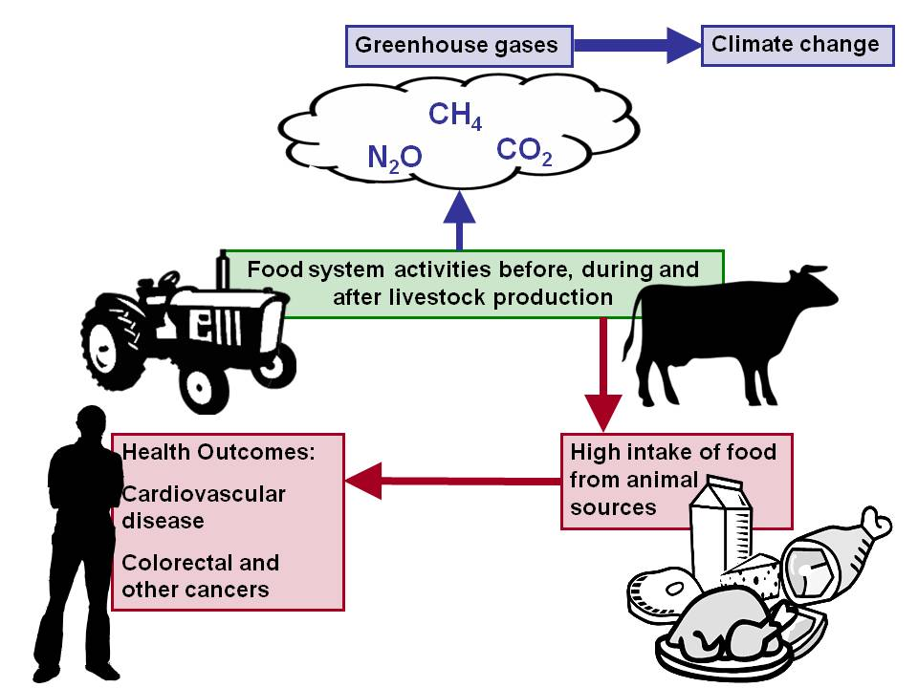
Food and Agriculture Sector
80% of total emissions in sector from livestock production
Reducing animal source saturated fat by 30 % and replacing it with polyunsaturates could reduce heart disease deaths by ~ 15% (~ 18,000 premature deaths) in the UK

Slide 41
Air pollution impacts vs CO₂ emissions
A
B
40
300
lignite
lignite
30
coal
200
Cases of serious illness from air pollution /TWh
Deaths from air pollution and accidents/TWh
coal
20
oil
oil
100
10
biomass
biomass
gas
gas
0
nuclear
0
nuclear
0
500
1000
1500
0
500
1000
1500
Equivalent CO₂ emissions g/kW.hr⁻¹
Source: Markandya A, Wilkinson P. Lancet 2007

Slide 42
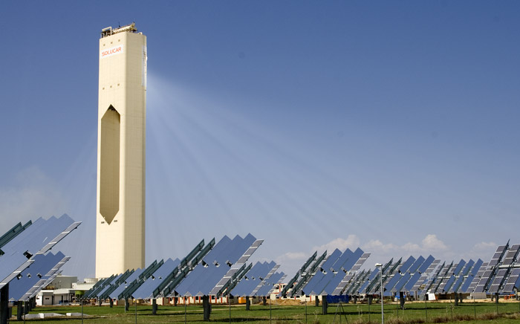
New technologies for clean energy
Notes:
Concentrated Solar Power - Portugal
42

Slide 43
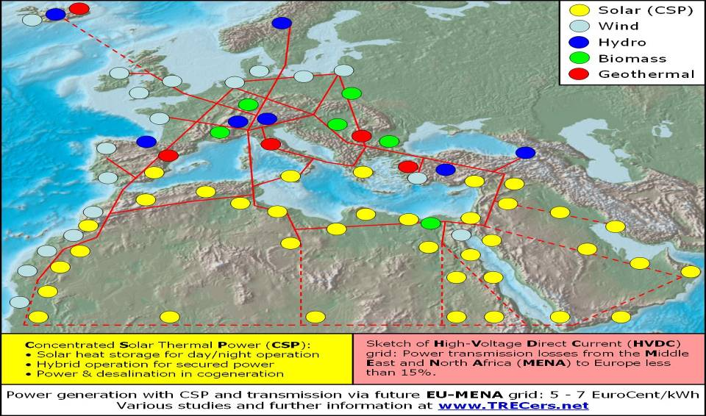
Within 6 hours, deserts receive more energy than the world uses in a year.

Slide 44
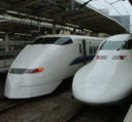
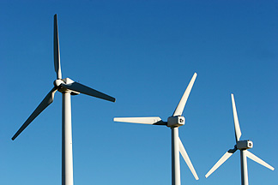


Key mitigation instruments, policies & practices
Research, development and demonstration
Appropriate energy infrastructure investments
Regulations and standards
Taxes and charges
Change in lifestyles & consumption patterns
Effective carbon-price signal
Notes:
A wide variety of policies and instruments are available to governments to create the incentives for mitigation action. Their applicability depends on national circumstances and sectoral context (Table SPM.5). {4.3}
They include integrating climate policies in wider development policies, regulations and standards, taxes and charges, tradable permits, financial incentives, voluntary agreements, information instruments, and research, development and demonstration (RD&D). {4.3}
There is also high agreement and medium evidence that changes in lifestyle, behaviour patterns and management practices can contribute to climate change mitigation across all sectors. {4.3}
Greater cooperative efforts and expansion of market mechanisms will help to reduce global costs for achieving a given level of mitigation, or will improve environmental effectiveness. Efforts can include diverse elements such as emissions targets; sectoral, local, sub-national and regional actions; RD&D programmes; adopting common policies; implementing development oriented actions; or expanding financing instruments. {4.5} SYR SPM p.19
Future energy infrastructure investment decisions, expected to exceed 20 trillion US$16 between 2005 and 2030, will have long-term impacts on GHG emissions, because of the long life-times of energy plants and other infrastructure capital stock. The widespread diffusion of low-carbon technologies may take many decades, even if early investments in these technologies are made attractive. Initial estimates show that returning global energyrelated CO2 emissions to 2005 levels by 2030 would require a large shift in investment patterns, although the net additional investment required ranges from negligible to 5-10%. {4.3} SYR SPM p.18
An effective carbon-price signal could realise significant mitigation potential in all sectors. Modelling studies show global carbon prices rising to 20-80 US$/tCO2-eq by 2030 are consistent with stabilisation at around 550ppm CO2-eq by 2100. For the same stabilisation level, induced technological change may lower these price ranges to 5-65 US$/tCO2-eq in 2030.17 {4.3}

Slide 45
Climate change has far reaching impacts on health but low carbon policies can improve health and the economy.
Co-benefits research was supported by a consortium of funding bodies led by the Wellcome Trust and published in the Lancet 2009
Involving 55 researchers from UK, USA, India, Canada, Australia, Spain, France, New Zealand, WHO Geneva
Economic impacts research commissioned and funded by the Policy Research Programme in the Department of Health. The views expressed are not necessarily those of the Department
Research team: Richard D Smith, Marcus Keogh-Brown, Henning Tarp Jensen, Zaid Chalabi, Alan Dangour, Mike Davies, Phil Edwards, Tara Garnett, Moshe Givoni, Ulla Griffiths, Ian Hamilton, James Jarrett, Ian Roberts, Paul Wilkinson, James Woodcock, Andy Haines (chair),

Slide 46
Man did not weave the web of life,
he is merely a strand in it.
Whatever he does to the web,
he does to himself.
Chief Seattle, 1854

