Slide 1

Global Health
Cardiovascular Disease Epidemiology and biomarkers for CVD
Marjo-Riitta Jarvelin
Professor
School of Public Health
Imperial College London

Slide 2
Outline:
CVD and their intermediate endophenotypes – some definitions and diagnostic points, overall death estimates (by cause)
Main causes of death from CVD perspective – globally and in selected regions
Trends in CVD deaths and disease
Global burden of CVD
Determinants, causes and intermediate endophenotypes of CVD
Life-course perspective in CVD mortality and morbidity
Cardiovascular Disease (CVD) Epidemiology

Slide 3
Global Health & CVD
Types of CVD
General burden and importance relative to other diseases
Gender differences
© Imperial College London

Slide 4
Main types of cardiovascular disease (CVD)
Coronary Heart Disease (CHD) (Coronary Artery Disease)
Cerebrovascular Accident (Stroke) (blockage of flow or leakage)
Myocardial Infarction (Heart Attack)
Angina, Atherosclerosis
Aneurysm
Arrhythmia
High Blood Pressure (Hypertension) (Hypotension)
Venous Thromboembolism
Congestive Heart Failure
Hypertrophic Cardiomyopathy
Congenital Heart Disease

Slide 5
Chronic diseases (CNCDs) - BURDEN: CVD (heart disease/stroke), some Cancers, Respiratory, and T2D
Reaching epidemic proportions worldwide (all ages, nationalities and classes), globally >17 million CVD deaths/y
CNCDs account for ~60% of all deaths worldwide
80% of deaths occur in low- and middle-income countries (CNCDs account 44% of premature deaths worldwide)
The burden is projected to rise particularly fast in the developing world
With “concerted action”, at least 36 million premature deaths can be averted by 2015
  ~17 million of these prevented deaths would be among people under the age of 70
Daar et al, Nature 2007

Slide 6
Worldwide leading mortality rates for the year 2002
Rank | Causes/per 100,000 | Rates | %
1 | Cardiovascular diseases | 268.8 | 29.34
1.1 | Ischemic heart disease | 115.8 | 12.64
1.2 | Stroke | 88.5 | 9.66
2 | Infectious and Parasitic diseases | 211.3 | 23.04
2.1 | Respiratory infections | 63.7 | 6.95
2.2 | Lower respiratory tract infections | 62.4 | 6.81
2.3 | Diarrheal diseases | 28.9 | 3.15
2.4 | HIV/AIDS | 44.6 | 4.87
2.5 | Tuberculosis | 25.2 | 2.75
2.6 | Malaria | 20.4 | 2.23
3 | Malignant neoplasms (cancers) | 114.4 | 12.49
3.1 | Lung cancers | 20 | 2.18
4 | Respiratory diseases | 59.5 | 6.49
4.1 | Chronic obstructive pulmonary disease | 44.1 | 4.82
5 | Unintentional injuries | 57 | 6.23
5.1 | Road traffic accidents | 19.1 | 2.09
6 | Perinatal conditions | 39.6 | 4.32
7 | Digestive diseases | 31.6 | 3.45
8 | Intentional injuries (Suicide, Violence, War, etc.) | 26 | 2.84
9 | Neuropsychiatric disorders | 17.9 | 1.95
10 | Diabetes mellitus | 15.9 | 1.73

Slide 7
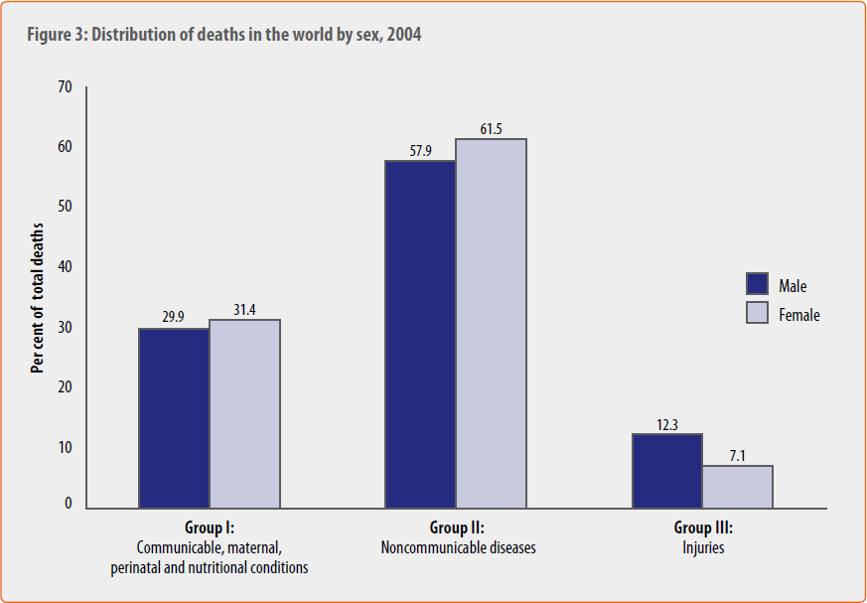

© Imperial College London
WHO report, Causes of death 2004

Slide 8
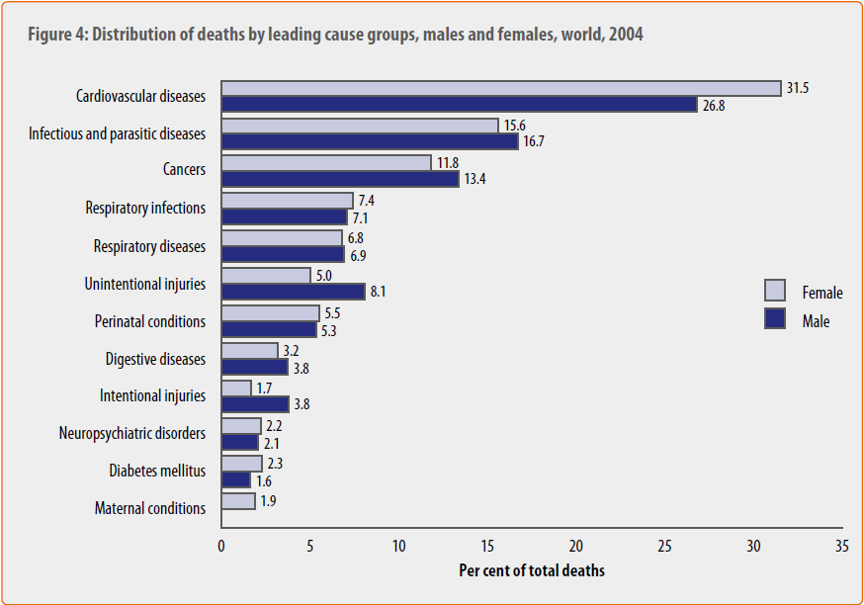
WHO report, Causes of death 2004

Slide 9
Global Health & CVD
Time trends
© Imperial College London

Slide 10
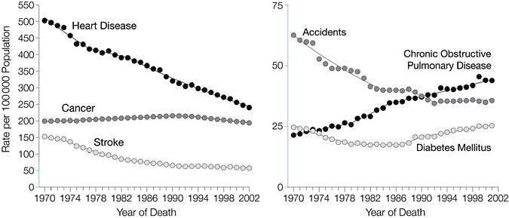
Trends in Age-Standardized Death Rates for the 6 Leading Causes of Death in the United States, 1970-2002
Jemal, A. et al. JAMA 2005;294:1255-1259
© Imperial College London

Slide 11
Trends of Age-Standardized Death Rates in the United States between 1970-2002
Stroke deaths: 63%
Heart disease deaths: 52%
Cancer deaths: 2.7%
Diabetes deaths: 45%
COPD deaths: 102%
© Imperial College London

Slide 12
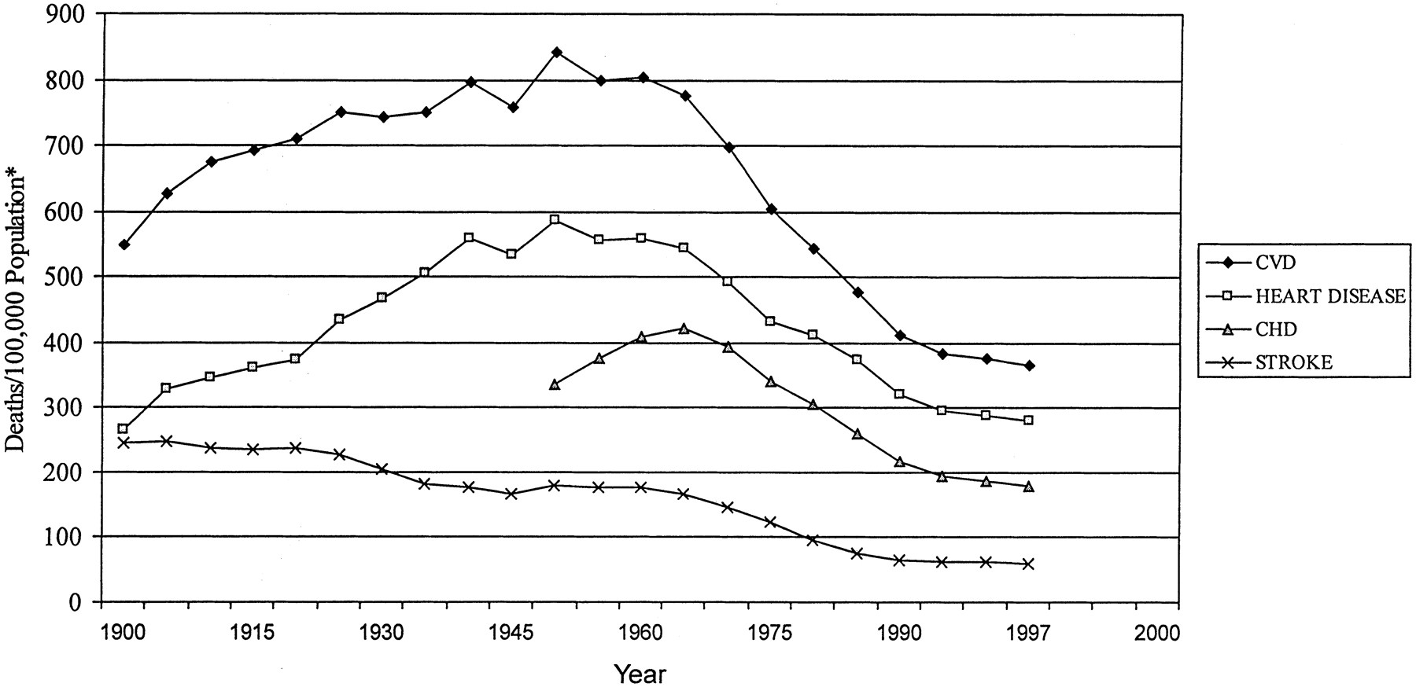


Death rates for major cardiovascular diseases in the United States from 1900 to 1997
© Imperial College London
Cooper, R. et al. Circulation 2000;102:3137-3147
Copyright ©2000 American Heart Association

Slide 13
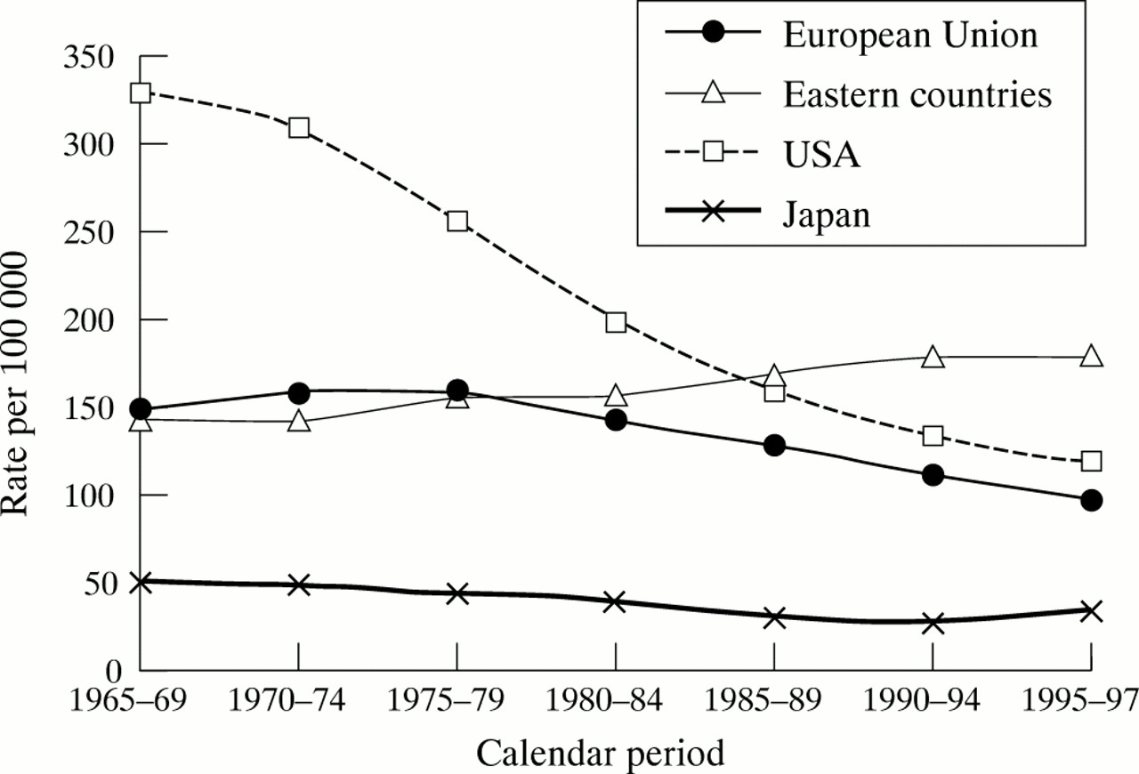

Age standardised death rates from coronary heart diseases (CHD) in men, all ages from the European Union, eastern European countries (Bulgaria, Czech Republic, Hungary, Poland, Romania, and Slovakia), USA, and Japan, 1965-1997
Levi, F et al. Heart 2002;88:119-124
Copyright ©2002 BMJ Publishing Group Ltd.

Slide 14
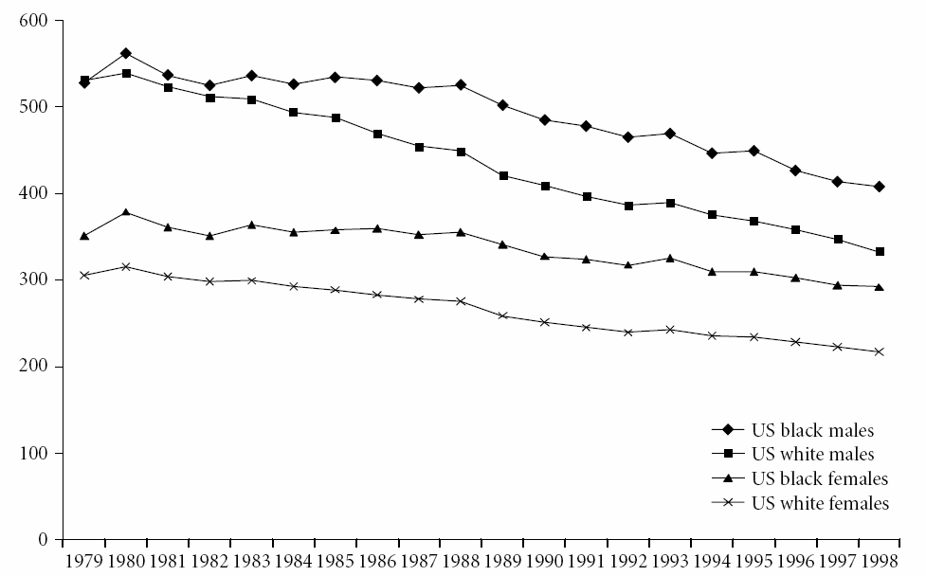
Heart disease mortality by race and gender, US, 1979-98 (per 100 000)
Data from CDC Wonder 2003
© Imperial College London
Cooper RS. Coronary heart disease among persons of African origin. In: M Marmot & P Elliott (eds). Coronary Heart Disease Epidemiology. From Aetiology to Public Health, 2005, Oxford University Press, Oxford, UK, pp73-82.

Slide 15
Global Health & CVD
Time
trends
Place
© Imperial College London

Slide 16
Age-standardized mortality from CHD per 100 000 in European countries in 2000 or the latest available year
Data from the WHO Health for All database
Bobak M, Marmot M. Central and Eastern Europe and the Former Soviet Union. In: M Marmot & P Elliott (eds). Coronary Heart Disease Epidemiology. From Aetiology to Public Health, 2005, Oxford University Press, Oxford, UK, pp 83-101.
© Imperial College London

Slide 17
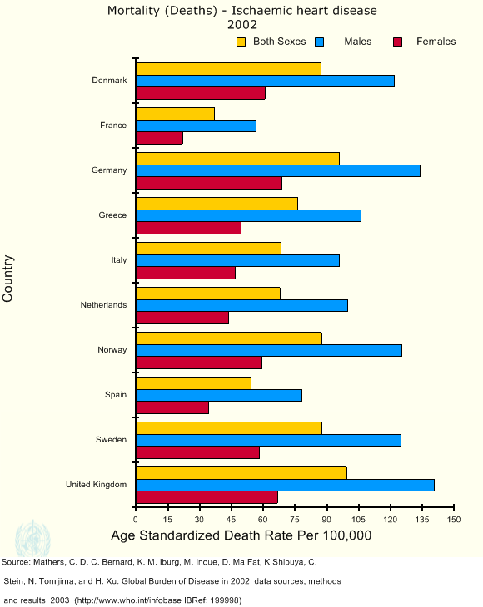
© Imperial College London

Slide 18
Age-adjusted prevalence rates of definite + possible CHD identified for 11,900 men by ECG
Age-adjusted prevalence rates/1000
Country of residence of men of Japanese ancestry aged 45-69 yrs
Marmot MG et al. Am J Epidemiol 1975; 102: 514-25
© Imperial College London

Slide 19
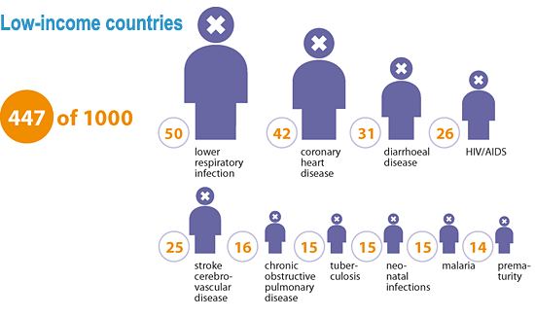
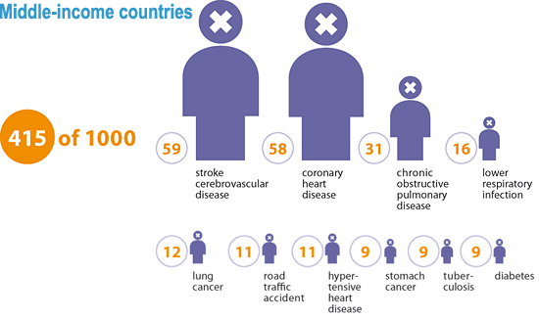
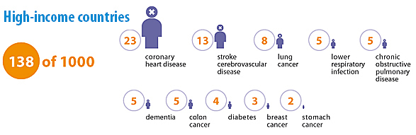
Deaths across the globe: an overview
Imagine a diverse international group of 1000 individuals representative of the women, men and children from all over the globe who died in 2004. Of those 1000 people, 138 would have come from high-income countries, 415 from middle-income countries and 447 from low-income countries.
What would be the top 10 causes of their deaths?
Source: WHO, http://www.who.int/mediacentre/factsheets/fs310/en/index.html
Note: In this fact sheet, we use low-, middle- and high-income categories as defined by the World Bank. Countries are grouped based on their 2004 gross national income. See The global burden of disease 2004 update for more information.

Slide 20
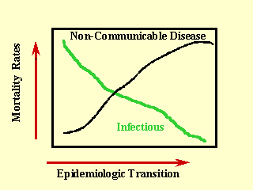
Epidemiologic transition and the Global Burden of Disease
During the epidemiologic transition, a long-term shift occurs in mortality and disease patterns whereby pandemics of infection are replaced by degenerative and man-made diseases….
Notes:
20

Slide 21
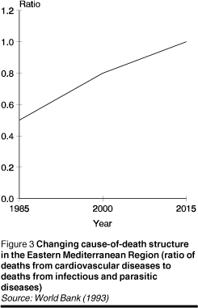
Notes:
21

Slide 22
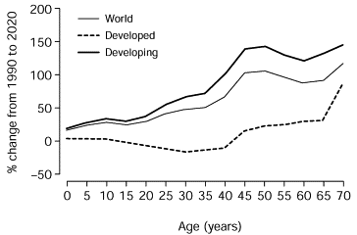
% Living in urban settings:
1970, 1994, & 2025 (projected)
Projected change in global population 1990 to 2020
Source: Yusuf S, Circulation 2001;104:2746-2753
Murray CJL, Lopez AD Lancet 1997;349:1498-1504
Notes:
22

Slide 23
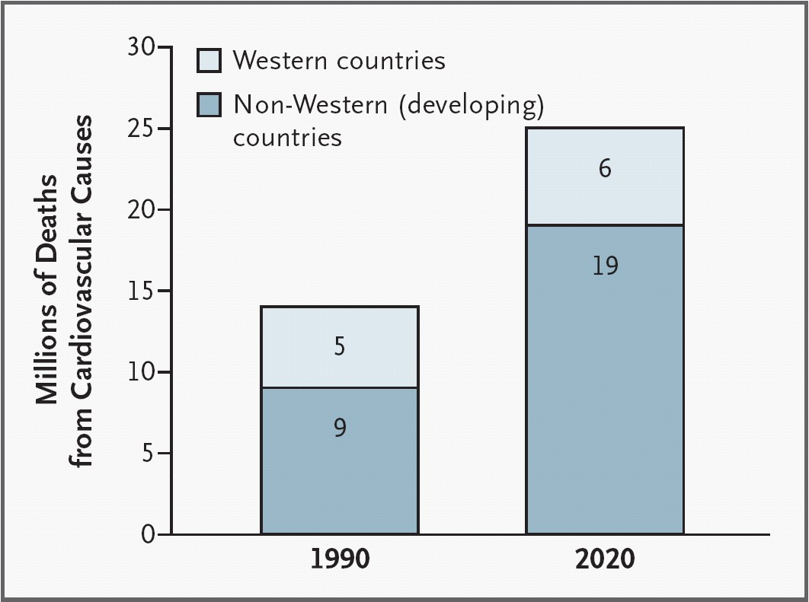
Deaths from cardiovascular causes, worldwide, in 1990 and estimated for 2020. Data from Global Burden of Disease study
Source: Reddy KS, NEJM 2004;350:2438-2440
Notes:
23

Slide 24
Global Health & CVD
Time
Place
Person, Risk Factors for CVD
BP, smoking, chol, sex, ethnic group, obesity
© Imperial College London

Slide 25
Major Risk Factors for Death Worldwide
Raised Blood Pressure
7 million
Tobacco
Developed region
High cholesterol
Developing region
Underweight
Unsafe sex
0
1
2
3
4
5
6
7
Millions of Attributable Deaths
62% of all Strokes and 49% of all Heart Disease attributable to raised BP (ignored often!!)
Lancet 2002; 360: 1347-60
Ezzati et al. Lancet 2002:360:1347-60.

Slide 26
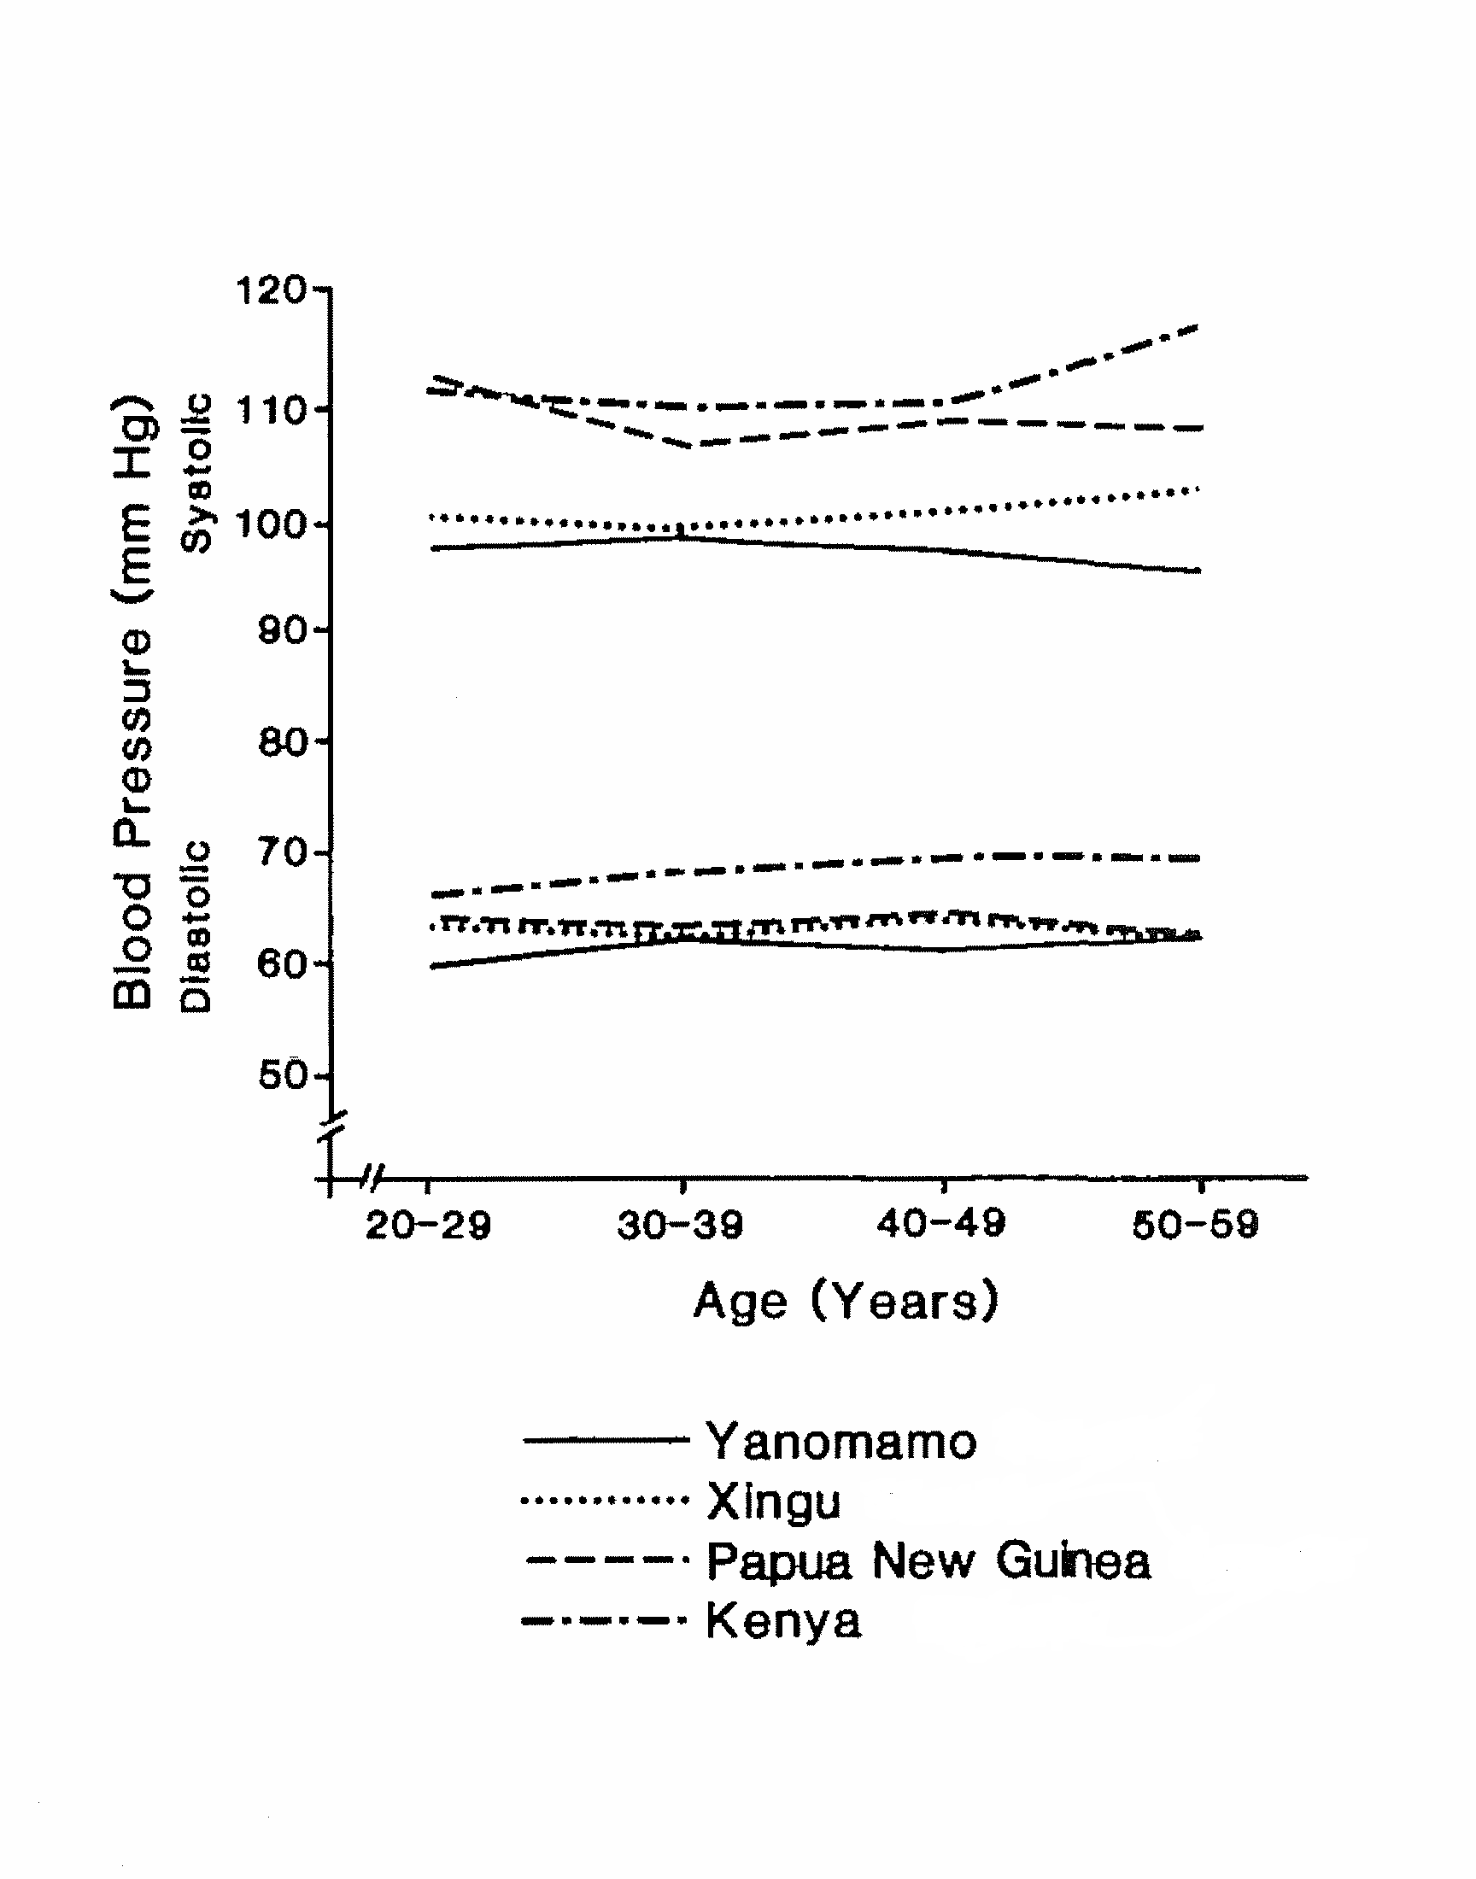
INTERSALT: Four low BP populations
Slide 26
© Imperial College London
Slide 26
© Imperial College London
Notes:
Jennifer is making a new one using mean BP from book chapter?

Slide 27
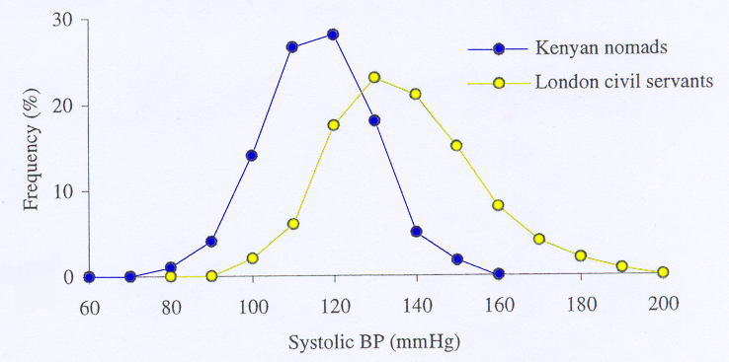
BP Distributions in Different Populations
Lifestyle factors – especially diet – are key in explaining
differences between populations in the rise in BP with age
and the consequent prevalence of high BP at older ages
Adapted from Rose Int J Epidemiol 1985; 14: 32-38
Slide 27
© Imperial College London

Slide 28
CHD mortality
“Hypertension”
“Normotension”
_
347,978 men ages 35-57 at baseline
Adapted from Elliott & Stamler 2005
Multiple Risk Factor Intervention Trial

Slide 29
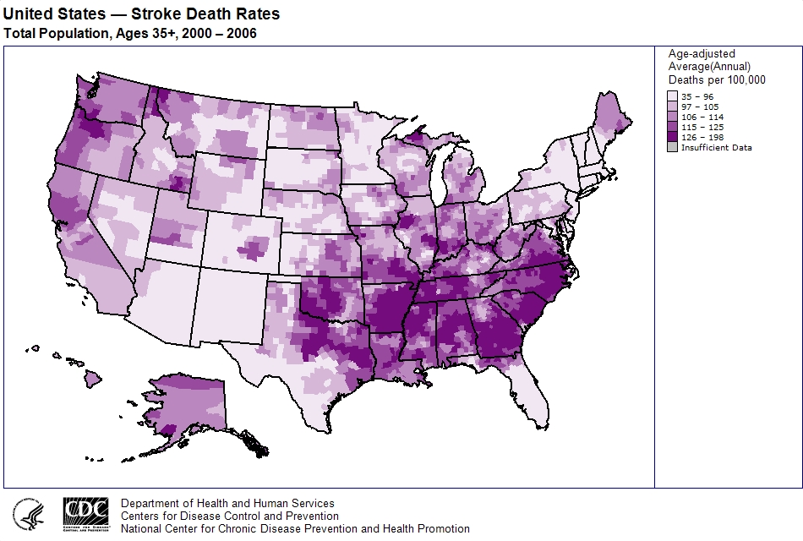
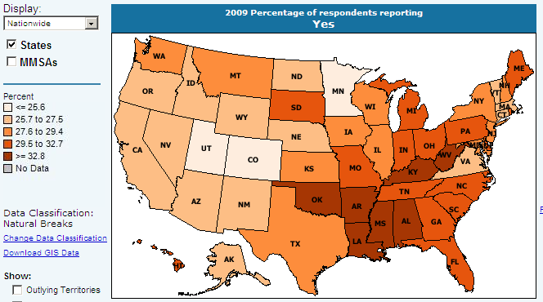
Percent reporting hypertension

Slide 30
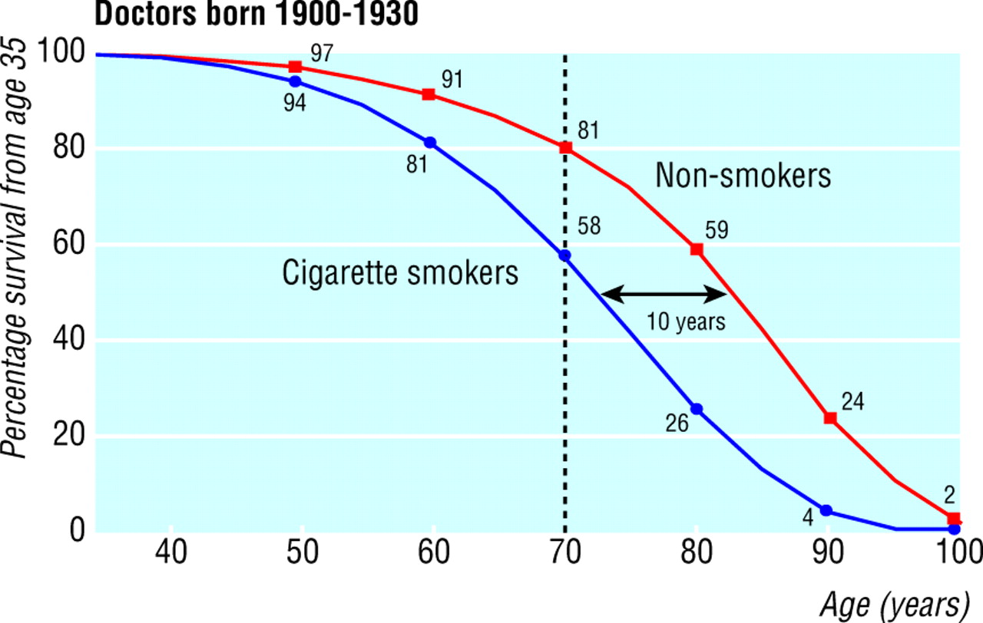

Survival from age 35 for continuing cigarette smokers and lifelong non-smokers among UK male doctors born 1900-1930
Doll, R. et al. BMJ 2004;328:1519
Copyright ©2004 BMJ Publishing Group Ltd.

Slide 31
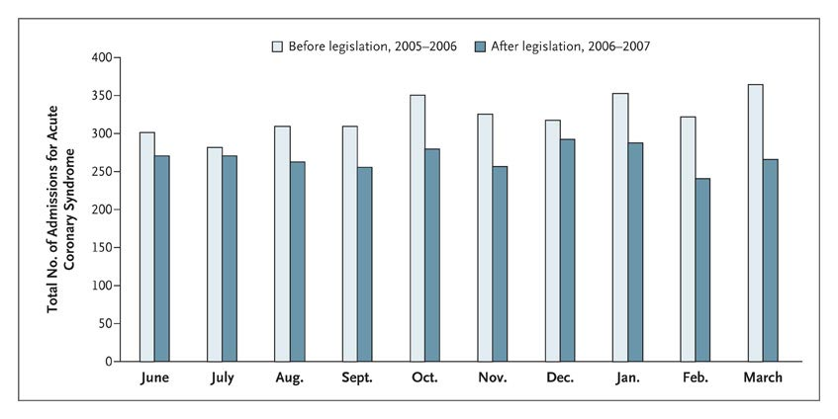
Smoking ban in Scotland
Admissions for Acute Coronary Syndrome According to Month before and after Smoke-free Legislation
Pell J et al. NEJM 2008; 359:482-491

Slide 32
Age-adjusted CHD death rates per 10 000 person-years by level of serum cholesterol and SBP for cigarette smokers screened in MRFIT Study
Neaton JD et al. Arch Intern Med 1992; 152: 56-64

Slide 33
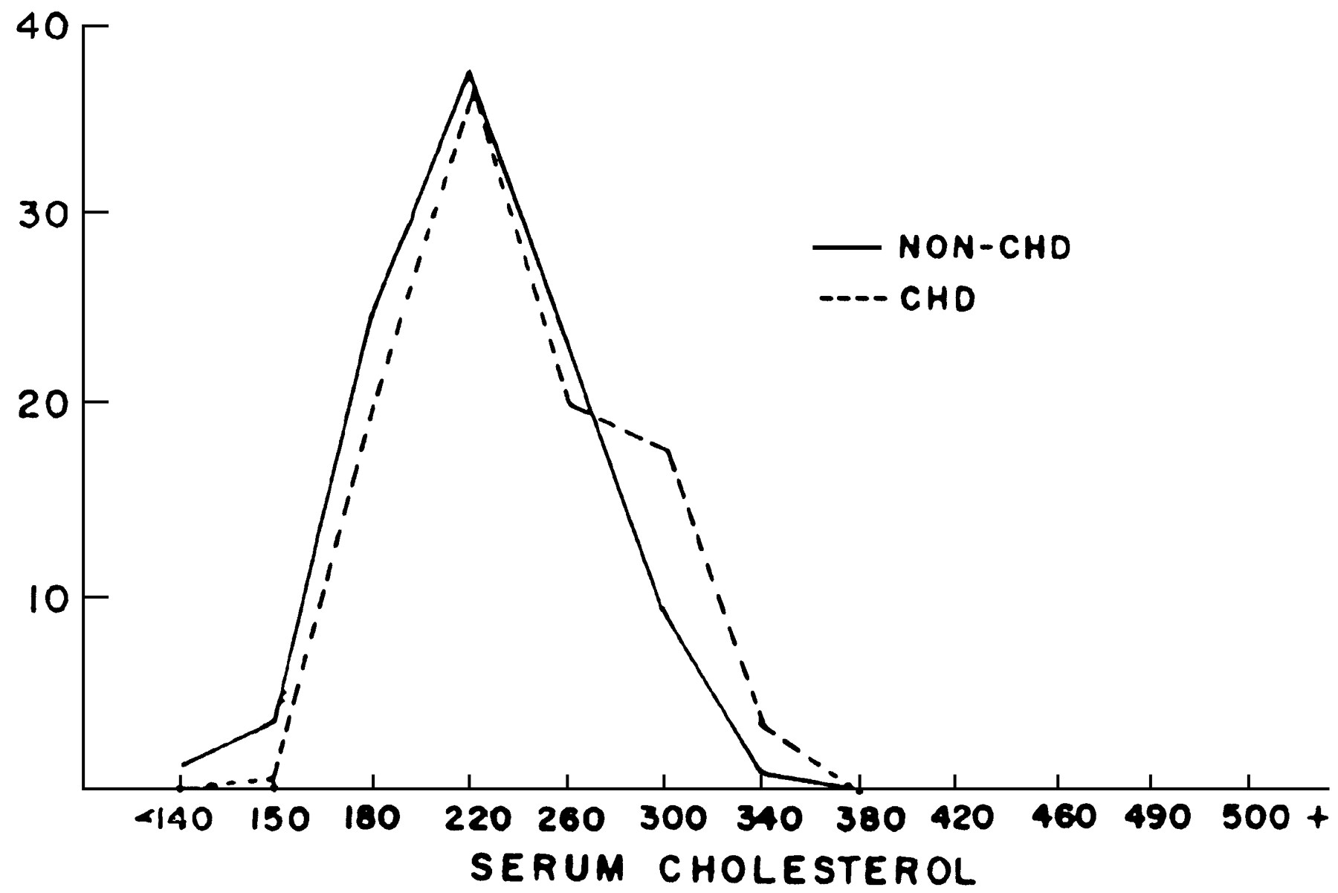

Percentage distribution of serum cholesterol levels (mg/dl) in men aged 50-62 who did or did not subsequently develop coronary heart disease (Framingham Study)
Rose, G. Int. J. Epidemiol. 1985 Sick individuals and sick populations

Slide 34
Serum Cholesterol
Cholesterol is a good predictive marker
Well–measured, so that a single measure characterises the population reasonably well
Longitudinal studies show prognostic validity
However poor ability to discriminate between cases and non-cases of heart disease

Slide 35
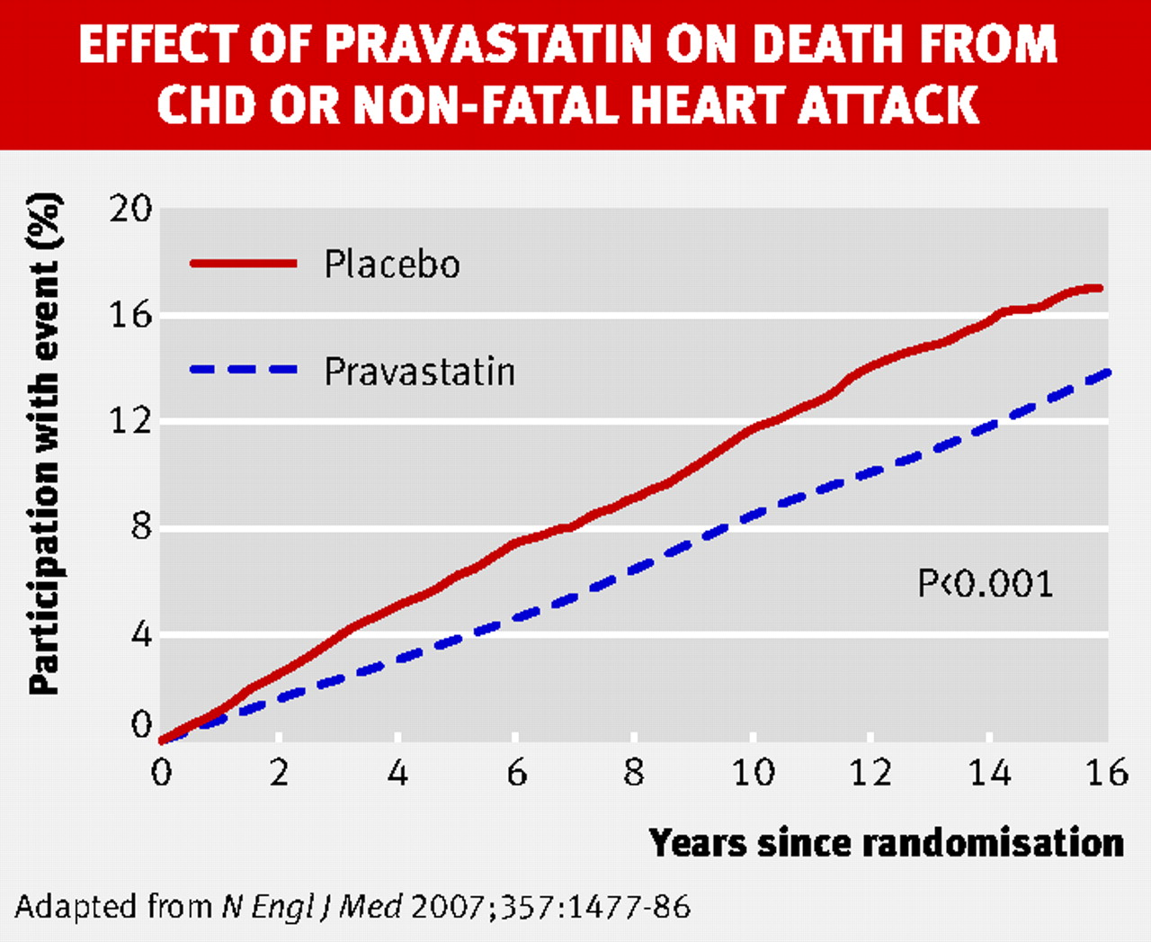
Copyright ©2007 BMJ Publishing Group Ltd.

Slide 36
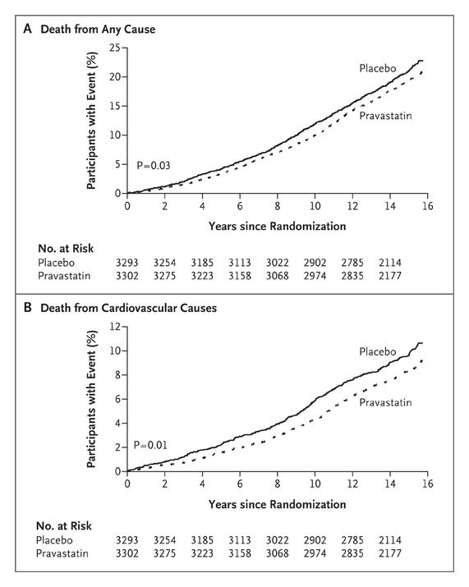

Cholesterol
Kaplan-Meier estimate for Deaths
Hypercholesterolemic men (LDL > 4 mmol) with no history of myocardial infarction
Statin treatment for an average of 5 years provided an ongoing reduction in the risk of coronary events for an additional period of up to 10 years
© Imperial College London
Ford I et al. N Engl J Med 2007;357:1477-1486

Slide 37
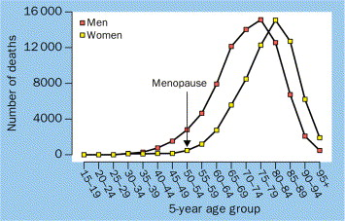

Number of deaths from CHD by age and sex in England & Wales, 1989-93
© Imperial College London
Tunstall Pedoe H. Lancet 1998

Slide 38
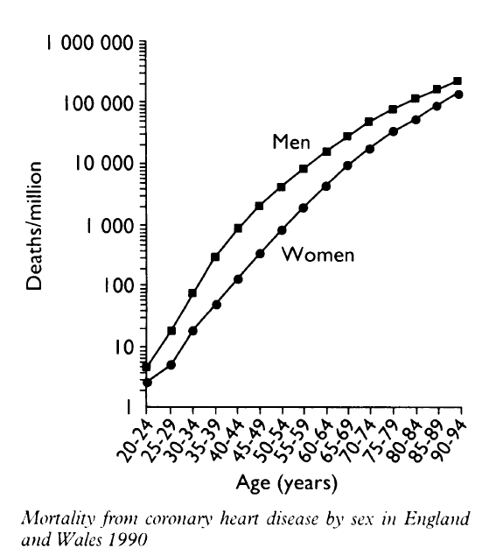

© Imperial College London
Tunstall-Pedoe h, Br Med J. 1992

Slide 39
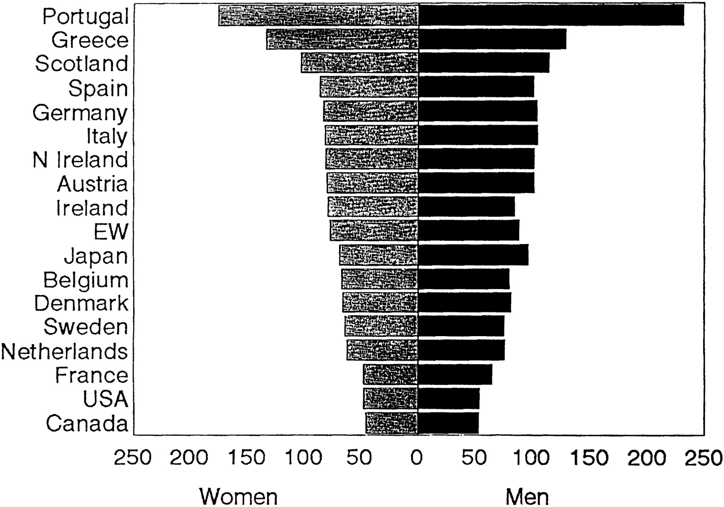
International age-standardized stroke rates by sex [note:males at higher risk, review by Appelros et al 2009]
© Imperial College London
Barrett-Connor, E. Circulation 1997;95:252-264
Copyright ©1997 American Heart Association

Slide 40
Sex difference
Unhealthy Behaviors (cigarette smoking, heavy alcohol use, eating more red meat and fewer fruits and vegetables, and exposure to physical hazards, etc.)
Recent studies adjusting for unhealthy behaviors show that they contribute to but do not fully explain the increased risk of CHD in men
HDL/other lipid levels
Role of hormones, estrogen
© Imperial College London

Slide 41
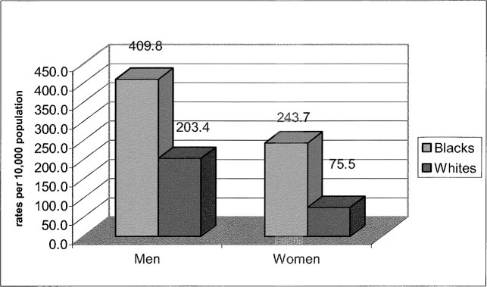
© Imperial College London
Race: CVD mortality rates for men and women, 45-64 years of age
Jones-Webb et al, J. Ethnicity & Disease 2004

Slide 42
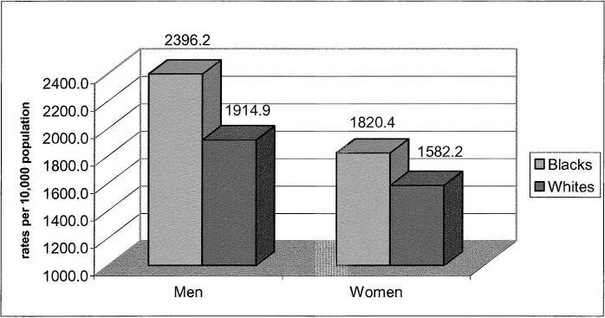
© Imperial College London
Race: CVD mortality rates for men and women, 65+ years of age
Jones-Webb et al, J. Ethnicity & Disease 2004

Slide 43
Obesity Trends* Among U.S. Adults
BRFSS (Behavioral Risk Factor Surveillance System), , 1985
Source: Mokdad A H, et al. J Am Med Assoc 1999;282:16, 2001;286:10.

Slide 44
Obesity Trends* Among U.S. Adults
BRFSS, 2000
Source: Mokdad A H, et al. J Am Med Assoc 1999;282:16, 2001;286:10.

Slide 45
Obesity Trends* Among U.S. Adults
BRFSS, 2006
No Data <10% 10%–14% 15%–19% 20%–24% 25%–29% ≥30%
Source: CDC Behavioral Risk Factor Surveillance System

Slide 46
Lifecourse analyses of FTO – effect on body mass
Early life and CVD

Slide 47
Gene and BMI- ”Spider diagram”
challenge - life-course analyses!
Physical Activity at Age 14 Years
Family SES at Age 14 Years
Physical Activity at Age 31 Years
Maternal Pre-Pregnancy BMI
FTO-rs9939609
Maternal Age
SES at Age 31 Years
Diet at Age 31 Years
Family SES at Birth
BMI at Birth
BMI at Age 14 Years
BMI at Age 31 Years
Parity
Maternal Smoking at the 2nd Month of Pregnancy
Alcohol Use at Age 31 Years
Smoking at Age 31 Years
Gender
Maternal Blood Pressure During Pregnancy
Smoking at Age 14 Years
Alcohol Use at Age 14 Years
Gestational Age
Prenatal
Birth
Childhood
Adolescence
Adulthood

Slide 48
Direct, Indirect and Total Effects of FTO-rs9939609 on Body Mass Index (BMI) During the Life Course in the Northern Finland Birth Cohort 1966 (adjusting for all other factors). Note – SES, physical activity, maternal parity had large effects
Effect of FTO-rs99309609 | P value | Change in the mean level of BMI (g/m²), per A-allele change | 95% CI
Total | 5.0x10⁻⁵ | 371 | 185, 570
Total indirect (via …) | 0.02 | 121 | 19.6, 227
Direct | 0.001 | 239 | 89.6, 396
Abbreviations: BMI, body mass index; CI, confidence interval., BMI log transformed

Slide 49
Key findings :
No mediating effects of the FTO variant through behavioural factors
- reflects the difficulties in measurement of behavioural factors (importance of high quality phenotype data)
BUT STILL..
Many life-course factors such as physical activity (!), diet, SES in spite of not showing mediation, had a strong independent effect on BMI
Mediation through earlier BMI development (1/3 of the total effect) was observed which highlights the importance of EARLY PREVENTION
HOWEVER effect was not fully mediated via earlier BMI development (a direct effect persisted), indicating that the variant continues to function actively over the LATER LIFE course as well
Kaakinen et al, AJE, 2010

Slide 50
Interaction of FTO with physical activity on the Z-score of BMI at 16 years of age (P = 0.008) (Cauchi et al 2008).
Physical activity: 1: inactive (less than 1 hour a week); 2: somewhat active (1-3 hours a week); 3: active (4 or more hours per week).
Inactive
Somewhat active
Active
tt at aa
HoTZ
protective allele
HeTZ
HoTZ
risk allele
FTO (rs1421085)

Slide 51
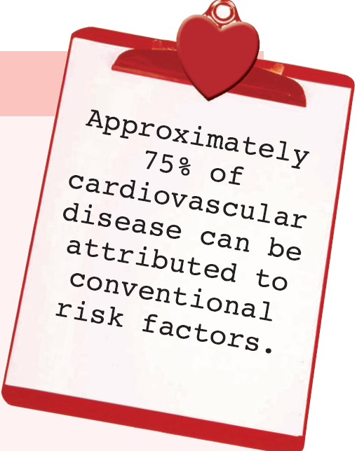
To summarise – risk factors - generally
© Imperial College London

Slide 52

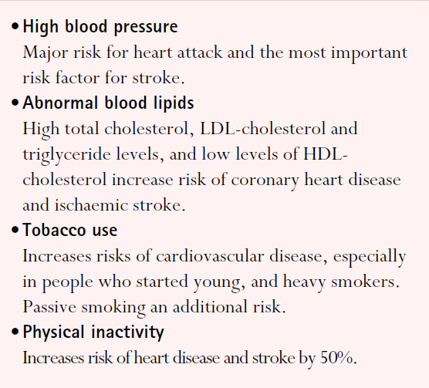
© Imperial College London

Slide 53

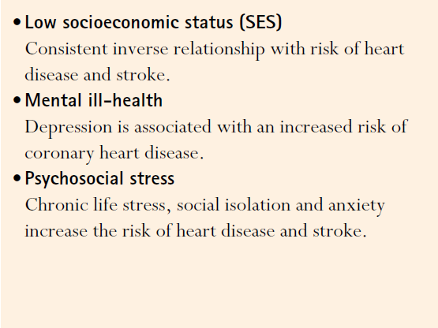
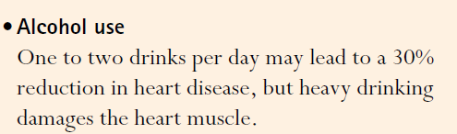

© Imperial College London

Slide 54
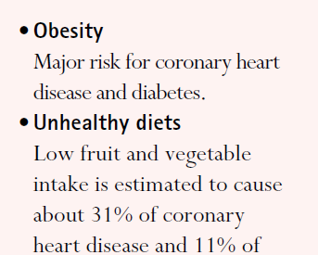



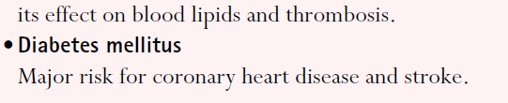
© Imperial College London

Slide 55
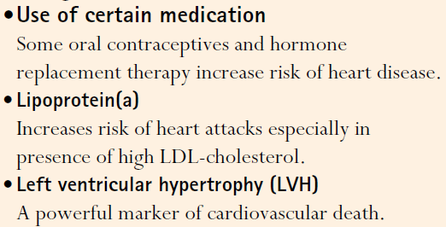
© Imperial College London

Slide 56
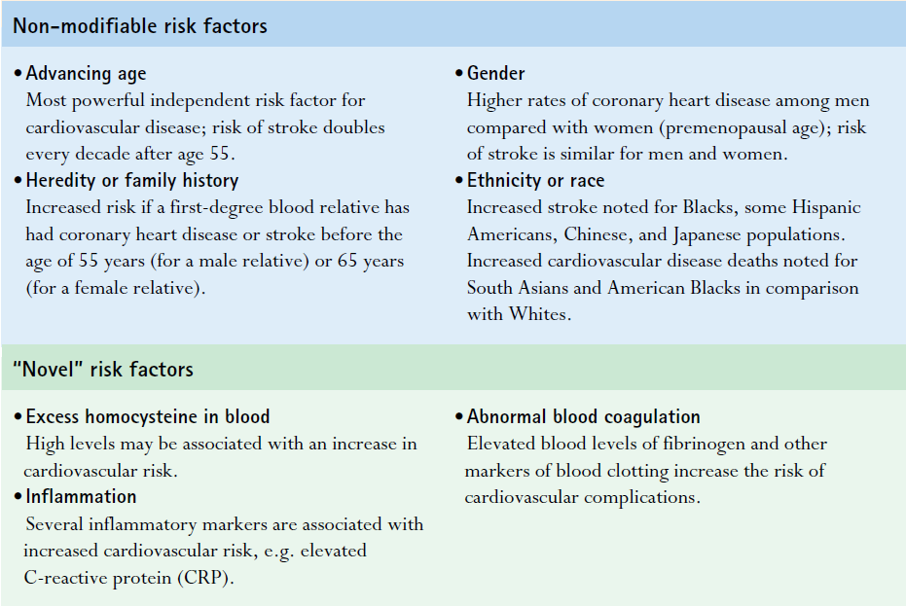
© Imperial College London

Slide 57

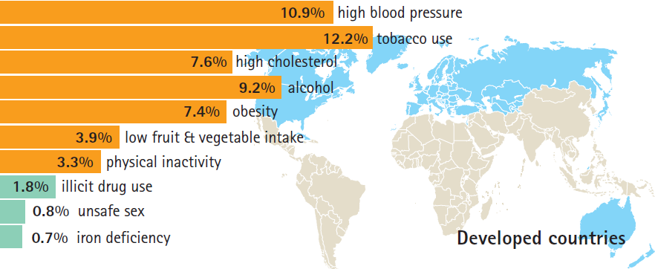
© Imperial College London
Leading risk factors As percentage burden of all diseases
WHO report, 2002

Slide 58
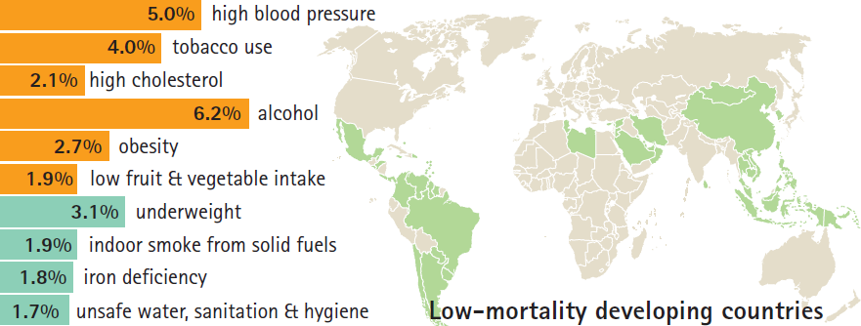
© Imperial College London
Leading risk factors As percentage burden of all diseases
WHO report, 2002

Slide 59
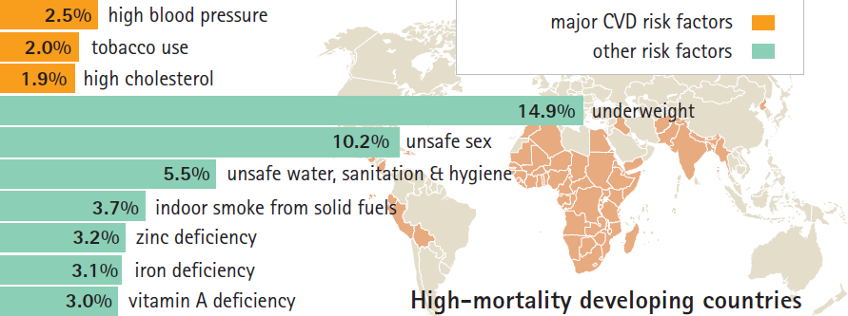
© Imperial College London
Leading risk factors As percentage burden of all diseases
WHO report, 2002

Slide 60
Global projections for selected causes,
2004 to 2030
Cancers
Ischaemic HD
Stroke
Acute respiratory
infections
© Imperial College London
Road traffic
accidents
Perinatal
HIV/AIDS
TB
Malaria
Updated from Mathers and Loncar, PLoS Medicine, 2006
WHO report, Causes of death 2004

Slide 61
Global Health & CVD
Time
Person
Place
Why Prevention Strategies
-Major course of premature death
-Atherosclerosis develops slowly
- Many preventable risk factors/risk factor modification -> mortality decreases
Epidemiologic Transition
Risk Factor
© Imperial College London

Slide 62
Systematic COronary Risk Evaluation
(SCORE)
Helps CVD risk management based on individual's total burden of risk
Estimates the total risk of fatal atherosclerotic event (i.e. heart attack, stroke, aneurysm of the aorta, etc.) over period of 10 years for individuals aged between 45-64
Data from 12 EU cohorts
© Imperial College London

Slide 63
Low CVD risk regions, risk based on total cholesterol
© Imperial College London
Baseline risk calculated based on Belgian, Italian and Spanish cohorts
Notes:
Total cardiovascular risk in the context of these guidelines means the likelihood of a person developing an atherosclerotic cardiovascular event over a defined period of time

Slide 64
High CVD risk regions, risk based on total cholesterol
© Imperial College London
Baseline risk calculated based on Danish, Finnish, and Norwegian cohorts

Slide 65
SCORE is based on overall effects of risk factors
© Imperial College London

Slide 66
Deaths averted – contribution of different factors
Risk factors worse +13%
Obesity +3.5%
Diabetes +4.8%
Less physical activity +4.4%
0
Risk factors better -71%
Smoking -41%
Cholesterol -9%
Popul’n BP fall -9%
Deprivation -3%
Other factors -8%
-20,000
-40,000
Treatments -42%
AMI treatments -8%
Secondary prevention -11%
Heart failure -12%
Angina: CABG/PCI -4%
Angina: drugs -5%
BP treatment -3%
-60,000
68,230 fewer
deaths in 2000
-80,000
1980
2000
Redrawn from Capewell and colleagues

