Slide 1

What causes asthma?
Neil Pearce
Faculty of Epidemiology and Population Health
London School of Hygiene and Tropical Medicine

Slide 2
What causes asthma?
  What is asthma?
  Population patterns and time trends
  The old dogma
  The new dogma
  Models of asthma causation
  Where to from here?
Notes:
In this lecture I first consider evidence for increases in asthma prevalence in various countries.
I then examine international patterns of asthma prevalence.
Finally, I consider possible explanations for these patterns

Slide 3
What is asthma?
  What is asthma?
    variable airways obstruction
  What are the causes of asthma?
  What is the etiologic mechanism(s)
Notes:
In this lecture I first consider evidence for increases in asthma prevalence in various countries.
I then examine international patterns of asthma prevalence.
Finally, I consider possible explanations for these patterns

Slide 4
“Established” asthma risk factors
House dust mite allergen
Other indoor allergens
“Colds”
Parental smoking
Diet
Air pollution
Stress
Occupational exposures
Notes:
These findings do not appear to be explained by “established” asthma risk factors such as allergen exposure or air pollution
These factors are important exacerbators of pre-existing asthma, but do not appear to be major primary causes of asthma

Slide 5
What causes asthma?
  What is asthma?
  Population patterns and time trends
  The old dogma
  The new dogma
  Models of asthma causation
  Where to from here?
Notes:
In this lecture I first consider evidence for increases in asthma prevalence in various countries.
I then examine international patterns of asthma prevalence.
Finally, I consider possible explanations for these patterns

Slide 6
Examples of the Population-based Approach
Cancer Incidence in Five Continents
Global comparisons of CHD
Global comparisons of asthma prevalence
  The European Community Respiratory Health Study (ECRHS)
  The International Study of Asthma and Allergies in Childhood (ISAAC)

Slide 7
I
nternational
S
tudy of
A
sthma and
A
llergies in
C
hildhood
Notes:
1

Slide 8
The three phases of ISAAC (so far!)
I International survey of the prevalence and severity of asthma, rhinitis, and eczema in childhood
II Studies of aetiologic factors, including skin tests for atopy, lung function and bronchial reactivity, serum IgE levels, physical examination, genetic markers, aeroallergens at home, and clinical management
III Repetition of Phase I after at least 5 years to determine trends in these diseases
ISAAC
Tonga
2004
1998

Slide 9
Phase One methods
Design: Multicentre prevalence studies
Identical methods (but translated questions)
Study areas: Largely recruited by personal contacts but differing in lifestyle and environment
Population: 13-14 year old school children (core)
6-7 year olds (strongly recommended)
Sample size: 3,000 children ideally (minimum 1,000)
Study period: July 1992 - December 1995
ISAAC
Tonga
2004
1998

Slide 10
Phase One “core” instruments
written questionnaires on the prevalence and severity of asthma, rhinitis, and eczema for self-completion in 13 - 14 yr olds (compulsory)
video questionnaire on the prevalence and severity of asthma for self-completion by 13 - 14 yr olds (recommended)
written questionnaires on the prevalence and severity of asthma, rhinitis, and eczema for completion by parents of 6 - 7 yr olds (recommended)
ISAAC
Tonga
2004
1998

Slide 11
ISAAC Steering Committee
R Anderson
L Garcia Marcos
U Keil
D Strachan
E von Mutius
S Weiland
H Williams
B Björkstén
(F Martinez)
S Montefort
C Lai
JR Shah
S Foliaki
J Mallol
I Asher (chair)
R Beasley
J Crane
E Mitchell
N Pearce
C Robertson
N Aït-Khaled
G Anabwani
ISAAC
1998

Slide 12
Study Centres and Participants: Phase I
13-14 Year Age Group
ISAAC
gm/08/96: stock_2.ppt
Notes:
19
13

Slide 14
Key Findings From ISAAC Phase I
English-speaking countries have the highest asthma prevalence in the world
There is little variation within the English-speaking countries
Other countries in Latin America are also high
There is a Northwest-Southeast gradient within Europe

Slide 15
Key Findings From ISAAC Phase I
There is an inconsistent correlation of asthma prevalence with affluence (as measured by GNP)
There are some areas (West/East Germany, Hong Kong/Guangzhou) with major prevalence differences within the same ethnic group
There is a weak and inconsistent association between asthma prevalence and that of other “atopic” conditions such as rhinitis and eczema

Slide 16
Key Findings From ISAAC Phase I
Although there are large international differences in prevalence, these do not, in general, correlate strongly with recognised “risk factors” for asthma symptoms
Negative associations (or no association) with air pollution, smoking, pollens, antibiotics, immunization
Positive associations with GNP, tuberculosis, trans fatty acids, (lack of) vegetables, paracetamol, indoor humidity

Slide 17
Phase Three methods
Design: 3A Repeat prevalence studies after 5+ years
3B First prevalence studies in new centres
Study areas: From phase 1 (3A), or volunteers (3B)
Population: 13-14 year old school children
6-7 year olds (strongly recommended)
Sample size: 3,000 children ideally (minimum 1,000)
Study period: 1999 to 2003 (phase 3A)
1998 (“late phase 1”) to 2003 (phase 3B)
ISAAC
Tonga
2004
1998

Slide 18
Phase Three “core” instruments
written symptom questionnaires for self-completion in 13 - 14 yr olds (compulsory)
video questionnaire for self-completion by 13 - 14 yr olds (recommended)
written symptom questionnaires for completion by parents of 6 - 7 yr olds (recommended)
written risk factor questionnaires for completion by parents of 6 - 7 yr olds, and self-completion by 13 - 14 year olds (recommended)
ISAAC
Tonga
2004
1998

Slide 19
Study Centres and Participants: Phase III
13-14 Year Age Group
ISAAC
gm/08/96: stock_2.ppt
Notes:
19
13

Slide 20
CENTRES REGISTERED FOR ISAAC PHASE THREE
Phase 3A centres
Phase 3B centres
Phase 1 centres not participating in Phase 3

Slide 23
Key Findings From ISAAC Phase III
Little change in overall prevalence
International differences in asthma symptom prevalence have reduced
Decreases in English-speaking countries
Increases in some (but not all) regions where prevalence was previously low
Increases in diagnosed asthma in most regions
Particular increases in Africa, Latin America and parts of Asia – asthma is no longer an “english speaking” disease

Slide 24
What causes asthma?
  What is asthma?
  Population patterns and time trends
  The old dogma
  The new dogma
  Models of asthma causation
  Where to from here?
Notes:
In this lecture I first consider evidence for increases in asthma prevalence in various countries.
I then examine international patterns of asthma prevalence.
Finally, I consider possible explanations for these patterns

Slide 25
“Asthma Is an Allergic Disease”
Allergen exposure, particularly in infancy produces atopic sensitization
Continued exposure results in asthma through the development of bronchial hyperresponsiveness, airway inflammation and reversible airways obstruction
Notes:
The global patterns of asthma prevalence therefore call into question the dominant paradigm that asthma is an atopic disease caused by allergen exposure

Slide 26
Models of asthma causation
Allergen exposure
Atopy
Asthma
Rhinitis
Eczema

Slide 27
“Asthma Is an Allergic Disease”
Is BHR a valid measure of asthma prevalence?
How much asthma is really attributable to atopy?
Is allergen exposure a primary cause of asthma?

Slide 28
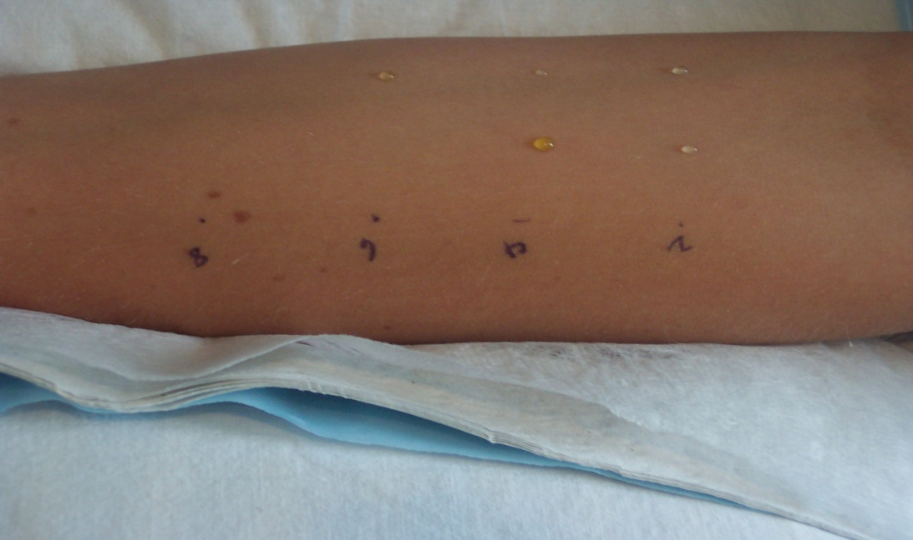
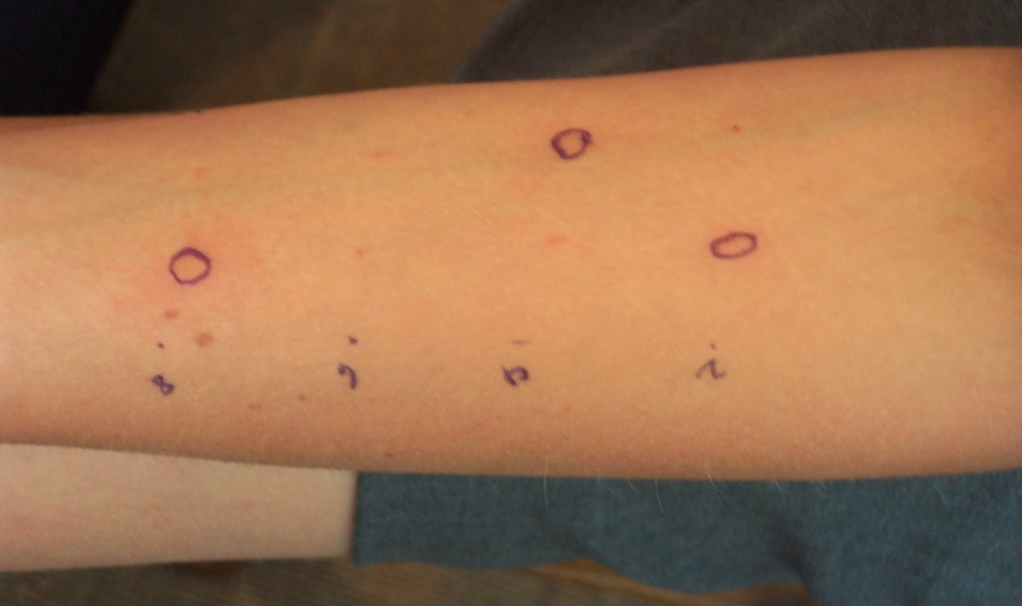
Skin Testing
Allergens used;
Negative control Tree mix
Positive control Mould
Grass mix Dog
House dustmite Cat

Slide 29
Example: Sears et al (1989)
Age = 13
Asthmatics: N = 315, % atopic = 57%
Non-cases: N = 399, % atopic = 35%
Odds ratio = 2.5
Proportion of atopic cases due to atopy = 1.5/2.5 = 0.6
PAR = 57 * 0.6 = 34%

Slide 30
How much asthma is attributable to atopy in children of the general population? (Pearce et al., Thorax 1999)
PAR due to atopy
PAR due to non-atopic mechanism

Slide 31
How much asthma is attributable to atopy in adults of the general population? (Pearce et al., Thorax 1999)
PAR
PAR due to atopy
PAR due to non-atopic mechanism

Slide 32
Association of Atopy With Asthma
Most asthmatics are atopic (58% in children and 54% in adults)
Many non-asthmatics are atopic also (29% in children and 24% in adults)
The proportion of cases attributable to atopy is less than 40% in both children and adults

Slide 33
Current wheeze v skin prick test for atopy
Odds ratio with 95% confidence interval
* not considered in combine estimate due to heterogenity

Slide 34
Non-eosinophilic asthma: importance and possible mechanisms.
Douwes J, Gibson P, Pekkanen J, Pearce N. Thorax 2002; 57: 643-8.
Notes:
In a recent systematic review, we assessed the evidence that asthma is an atopic disease

Slide 35
How much asthma is “attributable” to eosinophilia in adults of the general population (Douwes et al., Thorax 2002)
%

Slide 36
Non-eosinophilic asthma
At most 50% of asthma cases are attributable to eosinophilic airway inflammation
The remainder may be due to neutrophilic airway inflammation triggered by environmental exposure to bacterial endotoxin, air pollution, ozone, viral infections, etc

Slide 37
Is Allergen Exposure a Major Primary Risk Factor for Asthma?
Only five cohort studies have been conducted (all in selected populations) of allergen exposure in infancy and asthma risk after age six years
One study (Sporik et al) was positive, but not statistically significantly; the others found no association between allergen exposure and subsequent asthma risk

Slide 38
Problems with the “allergen hypothesis”
Little evidence that allergen exposure is a major primary cause of asthma
Little evidence that allergen exposure has increased over time
Some preliminary evidence that high exposure early in life (e.g. from cats) may actually be protective
Limited evidence that secondary prevention is effective
Difficulties of allergen avoidance

Slide 39
Mean Der P 1 Levels, and Prevalence of HDM Atopy and Total Atopy in Six Australian Centres
Notes:
The available evidence shows that exposure to specific allergens (e.g. house dust mite) is associated with specific sensitization, but not with overall levels of sensitization or asthma.
It thus appears that in susceptible individuals, the local exposures determine what we become sensitized to, but have little effect on our risk of sensitization in general, or of asthma

Slide 40
What causes asthma?
  What is asthma?
  Population patterns and time trends
  The old dogma
  The new dogma
  Models of asthma causation
  Where to from here?
Notes:
In this lecture I first consider evidence for increases in asthma prevalence in various countries.
I then examine international patterns of asthma prevalence.
Finally, I consider possible explanations for these patterns

Slide 41
What is “Western lifestyle”?
Greater allergen exposure – No
“Cleaner” environment
ISAAC
Tonga
2004
1998

Slide 42
The Hygiene Hypothesis
The increases could be due to increased susceptibility to the development of sensitization and/or asthma due to other exposures (or absence of exposures) in utero and in infancy
In particular, the increases could be occurring because our cleaner environment means that we have lost the previous protective effect of infant infections
  Decreased family size increases risk of atopy and asthma
  Some evidence that infections in infancy reduce the risk of asthma and atopy
Notes:
This evidence has given rise to the “hygiene hypothesis” which argues that increases in asthma prevalence are due to changes in immune function, because our cleaner environment means that we have lost the previous protective effect of infant infections.

Slide 43
TH1 and TH2 Subsets
BACTERIA
VIRUSES
TH0
ALLERGY
HELMINTH


TH1
TH2
⬇
⬇
IFN gamma
IL-2
IL-4, IL-5
⬇
⬇
Induces B cell
IgE Production
Cytolytic
Notes:
One possible explanation for this is that infant infections stimulate the TH1 pathway, whereas without early infections the infant’s immune system continues down the TH2 pathway that results in asthma and allergy

Slide 44
Problems with the hygiene hypothesis
We may be replacing one dogma with another
It is not clear that the “new” risk factors are strong enough to account for the prevalence increases (although “the package” could be)
Asthma prevalence is higher in Latin American countries with (presumably) higher infection rates than in Spain or Portugal
Notes:
As usual there are problems!

Slide 45
Problems with the hygiene hypothesis
The hygiene hypothesis is conceptualised within the “allergen-TH1/TH2” paradigm which appears to account for at most about one-half of asthma cases
Non-eosinophilic (non-atopic/non-allergic) mechanisms may account for the rest of the cases

Slide 46
What is “Western lifestyle”?
Greater allergen exposure – No
“Cleaner” environment - Maybe
Move from rural to urban living
ISAAC
Tonga
2004
1998

Slide 47

Hay-fever an aristocratic disease?
Blackley CH. Experimental researches on the causes and nature of Catarrhus aestivus.Ballière-Tindall & Cox, London, 1873.
“One very curious circumstance in connection with hay-fever is that the persons who are most subjected to the action of pollen belong to a class which furnishes the fewest cases of the disorder, namely, the farming class”
“As civilisation and education advance, the disorder will become more common than it is at the present time”

Slide 48
Atopy, hay fever and asthma in farmers’ children
Study | N farm/non-farm | Atopy OR, 95% CI | Hay fever OR, 95% CI | Asthma OR, 95% CI
Braun-Fahrlander et al, 1999 | 307/1313 (Switzerland) | 0.31 (0.13-0.73) | 0.34 (0.12-0.89) | 0.77 (0.38-1.58)
Riedler et al, 2000 | 282/1710 (Austria) | 0.48 (0.30-0.75)^{C} | 0.51 (0.25-0.98)^{C} | 0.60 (0.32-1.11)^{C}
Von Ehrenstein et al, 2000 | 450/8466 (Germany) | - | 0.70 (0.31-1.58) | 0.66 (0.36-1.23)
Kilpelainen et al, 2000 * | 1098/1248 (Finland) | - | 0.63 (0.5-0.79) | 0.70 (0.46-1.06)
Ernst et al, 2000 ** | 802/397 (Canada) | 0.58 (0.46-0.75) | - | 0.70 (0.52-0.95)
Downs et al, 2001 | 139/334 Moree 145/818 Wagga (Australia) | 0.97 (0.62-1.53) 0.47 (0.32-0.72) | 1.34 (0.88-2.05)^{C} 0.64 (0.44-0.94)^{C} | 1.12 (0.75-1.66)^{C} 0.65 (0.45-0.93)^{C}
Portengen et al, 2002 * | 499/407 (Denmark) | 0.54 (0.40-0.74) | - | -

Slide 49
Urbanisation and childhood asthma* in Africa
Reference | Country | Group | N | Prevalence (%)
Niekerk et al., 1979 | S Africa | Urban Rural | 695 671 | 3.17 0.14
Keeley et al., 1991 | Zimbabwe | Urban high SES Urban low SES Rural | 726 642 687 | 5.8 3.1 0.1
Addo Yobo et al., 1997 | Ghana | Urban rich Urban poor Rural | 599 220 270 | 4.7 2.2 2.7
Ng’ang’a et al., 1998 | Kenya | Urban middle class Urban poor Rural plantation Rural peasant | 331 242 140 339 | 10.3 9.1 12.9 3.2
Weinberg, 2000; * Exercise induced bronchospasm

Slide 50
Asthma and animal contact in New Zealand farming and rural control children II
Adjusted for sex, age, ethnicity, education, smoking in the house, and farm type (* p<0.05)

Slide 51
What causes asthma?
  What is asthma?
  Population patterns and time trends
  The old dogma
  The new dogma
  Models of asthma causation
  Where to from here?
Notes:
In this lecture I first consider evidence for increases in asthma prevalence in various countries.
I then examine international patterns of asthma prevalence.
Finally, I consider possible explanations for these patterns

Slide 52
Models of asthma causation
Allergen exposure
Atopy
Asthma
Rhinitis
Eczema

Slide 53
Models of asthma causation
Allergen exposure
Atopy
Asthma
Rhinitis
Other
exposures
Eczema

Slide 54
Models of asthma causation
Atopy
Allergen exposure
Asthma
Rhinitis
Other
exposures
Eczema

Slide 55
Models of asthma causation
Exposure A
Susceptibility
Atopy
Exposure B
Exposure C
Exposure D
Susceptibility
Asthma

Slide 56
Is “asthma” a collection of different diseases?
It depends on your definition
  “Allergic inflammation of the airways”
  Variable airways obstruction (bronchospasm)
Is there evidence of different phenotypes?
  Unclear currently
Is atopy a risk factor for asthma?
  If it is, it accounts for less than half of all cases
  It may simply be “associated” with asthma (like rhinitis is) rather than a causal factor

Slide 57
Why is it important to differentiate between asthma phenotypes?
Treatment
  Corticosteroids
Disease progress
  Fixed airflow obstruction
Aetiology
  Hygiene hypothesis only applies to atopic asthma
Causes
  Causal exposures

Slide 58
What causes asthma?
  What is asthma?
  Population patterns and time trends
  The old dogma
  The new dogma
  Models of asthma causation
  Where to from here?
Notes:
In this lecture I first consider evidence for increases in asthma prevalence in various countries.
I then examine international patterns of asthma prevalence.
Finally, I consider possible explanations for these patterns

Slide 59
What is the global burden of asthma?
About 15% of children age 13-14 years have had asthma symptoms in the last year
As low as 3% in low-and-middle-income countries (and <1% in rural areas)
As high as 30% in high income countries

Slide 60
What is it going to be in 20 years time?
Up to 30% globally
Increases from 3% up to 30% in low-and-middle income countries
Major costs for health services and patients in LMICs
Major burden of chronic disease

Slide 61
“Established” asthma risk factors do not explain the international patterns or time trends
House dust mite allergen
Other indoor allergens
“Colds”
Passive/active smoking
Diet
Stress
Air pollution
Occupational exposures
There is very little evidence that any of these factors are primary causes of asthma, or that preventive interventions work
Notes:
These findings do not appear to be explained by “established” asthma risk factors such as allergen exposure or air pollution
These factors are important exacerbators of pre-existing asthma, but do not appear to be major primary causes of asthma

Slide 62

Wairarapa Māori Asthma Project
“Before and after” trial of marae-based asthma education
Simple self-management plan
Long term reduction in asthma morbidity and requirement for acute medical services

Slide 63

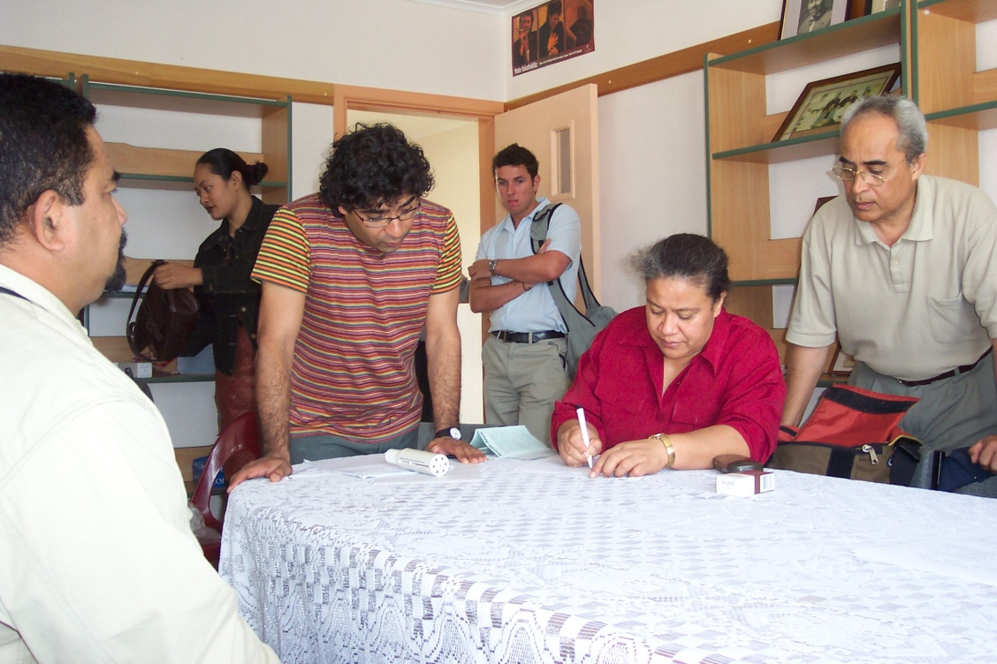
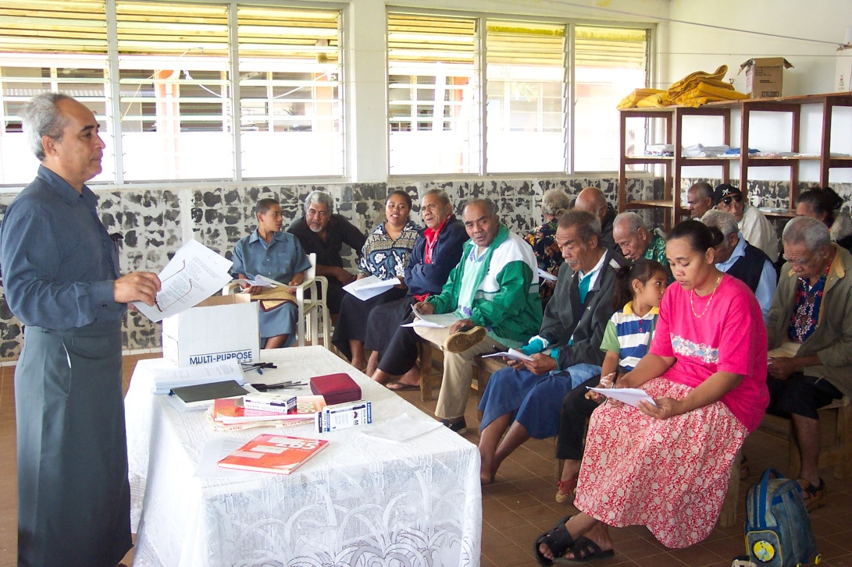
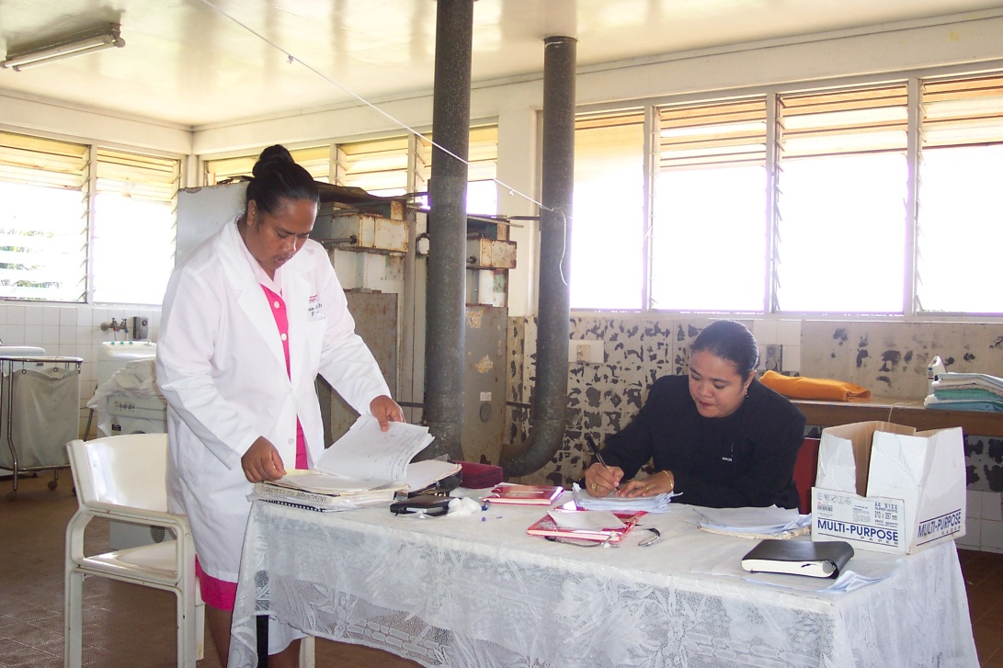

Slide 64
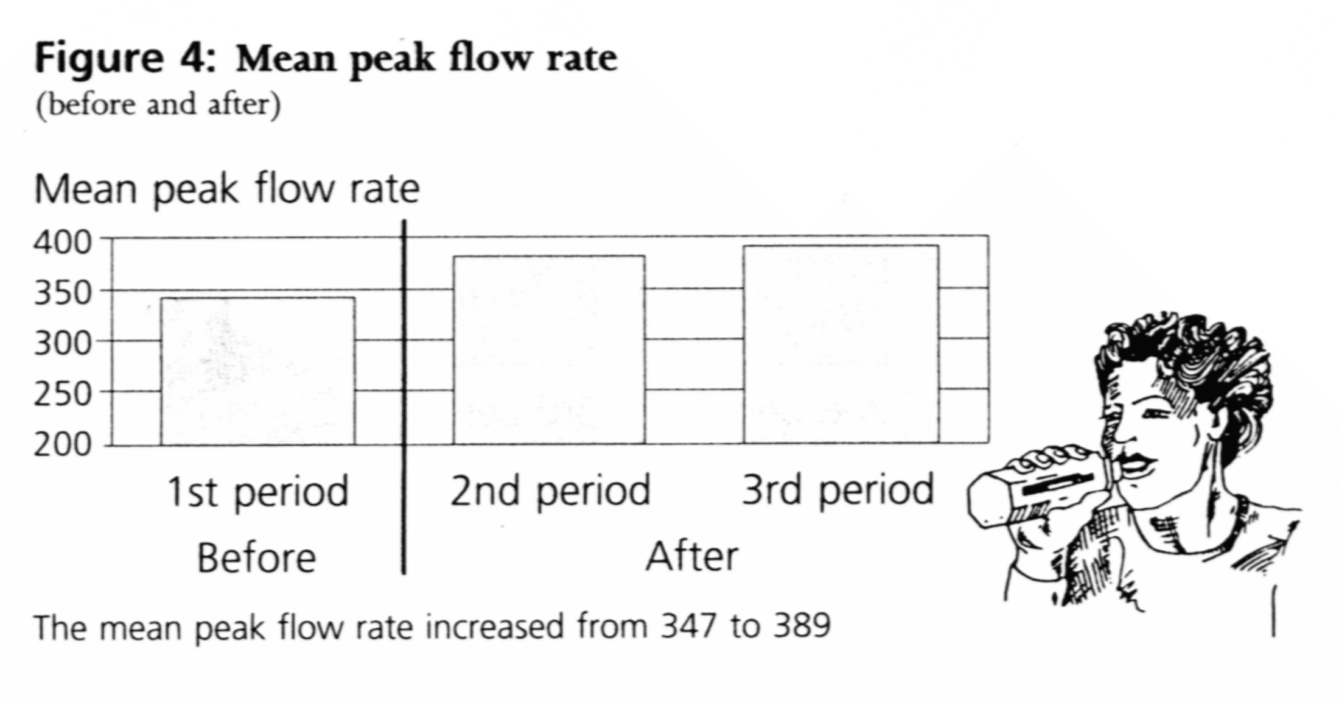

Slide 65
What can we do about asthma?
  Access to inexpensive generic asthma medications
    Asthma Drug Facility
      http://www.globaladf.org/
  Improvements in asthma management
    Global Asthma Network
      http://www.globalasthmareport.org/
Notes:
In this lecture I first consider evidence for increases in asthma prevalence in various countries.
I then examine international patterns of asthma prevalence.
Finally, I consider possible explanations for these patterns

Slide 66
What are the implications for other NCDs?
“One size doesn’t fit all”
While taking action on the things we know about (tobacco, diet, salt, physical activity) we also need to do more research on the diseases that we don’t understand well
In the meantime there is a lot that we can do to improve the management of chronic disease in low-and-middle-income countries
This is, in any case, often a prerequisite to obtaining support for health protection and promotion interventions

Slide 67
Conclusions
Asthma prevalence has been increasing worldwide
The highest prevalences are in English-speaking countries where the epidemic appears to have “levelled off”
“Established” risk factors such as allergen exposure do not explain the international patterns or time trends
The “hygiene hypothesis” suggests that the increases could be occurring because our cleaner environment means that we have lost the previous protective effect of infant infections

Slide 68
Conclusions
It is possible that the “package” of changes involved in increasing affluence and Westernization account for the asthma prevalence increases, but that this does not involve (the lack of) infant infections or classic atopic (TH2) mechanisms
A “broader hygiene hypothesis” suggests that reduced exposure to factors involved in farming may explain the recent rise in asthma in many western countries
Identification of protective factors in farming may be crucial for prevention of asthma in the general population
In the meantime, there is a great deal we can do to improve asthma management and access to asthma medications in low and middle income countries

Slide 69
What causes asthma?
Neil Pearce
Faculty of Epidemiology and Population Health
London School of Hygiene and Tropical Medicine

