Slide 1
Trachoma
Anthony Solomon

Slide 2
Normal conjunctiva (showing area to be examined)

Slide 3
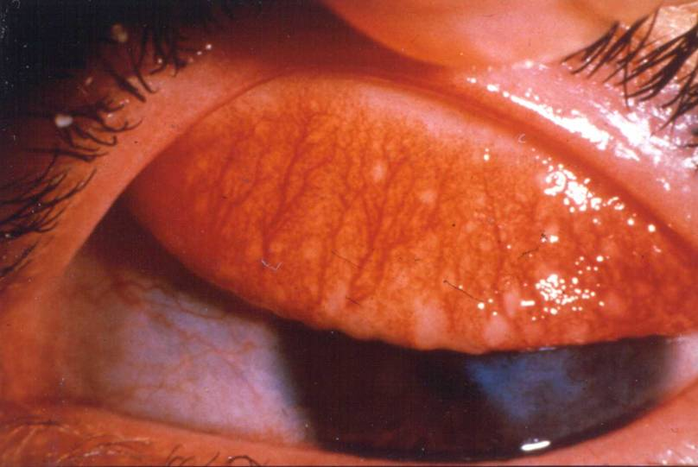
Follicles (TF)

Slide 4
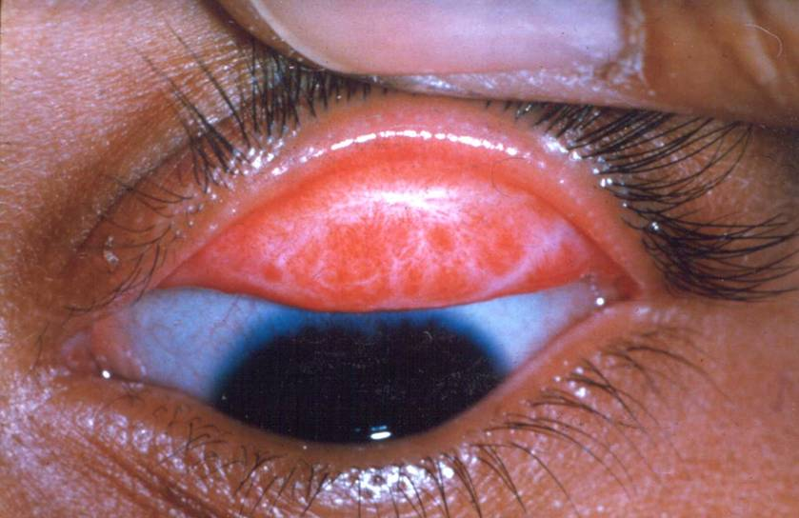
Conjunctival scar

Slide 5
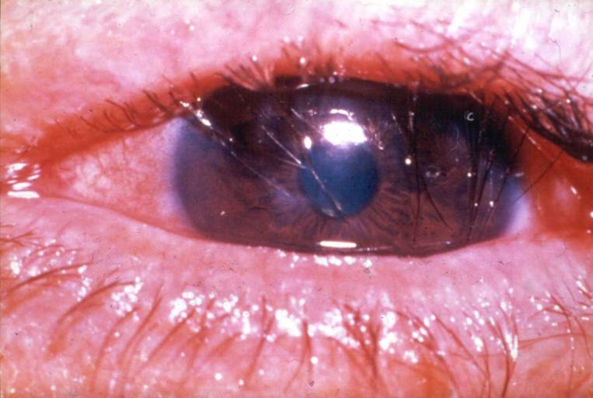
Trichiasis

Slide 6
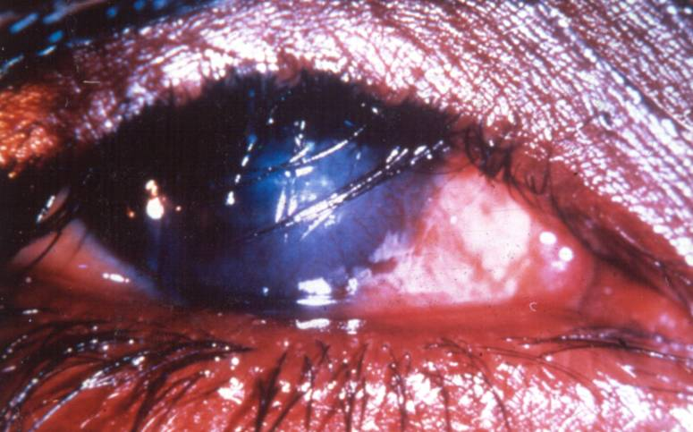
Trichiasis and corneal opacity

Slide 7
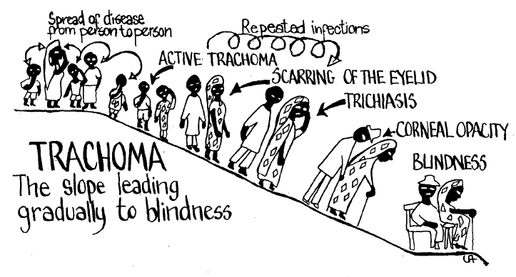
FACIAL CLEANLINESS & ENVIRONMENT
ANTIBIOTICS
SURGERY

