Slide 1
Dengue virus infection and immunopathogenic disease
Abigail Culshaw
a.culshaw@imperial.ac.uk

Slide 2
Dengue virus (DENV)
Dengue virus is a mosquito-borne pathogen endemic to tropical and sub-tropical regions of the world.
2.5 billion people, or 40% of the world’s population, live in areas where there is a risk of dengue transmission.
The World Health Organization (WHO) estimates that 50 to 100 million infections occur yearly.
Around 500,000 of these infections result in the severe form of disease, dengue haemorrhagic fever (DHF) and an estimated 22,000 people, mostly children, die.
Based on a study of eight endemic countries, the estimated total economic burden of dengue is on the order of US$587 million annually. However, known underreporting of dengue infection could increase this estimate to nearly US$1.8 billion.

Slide 3
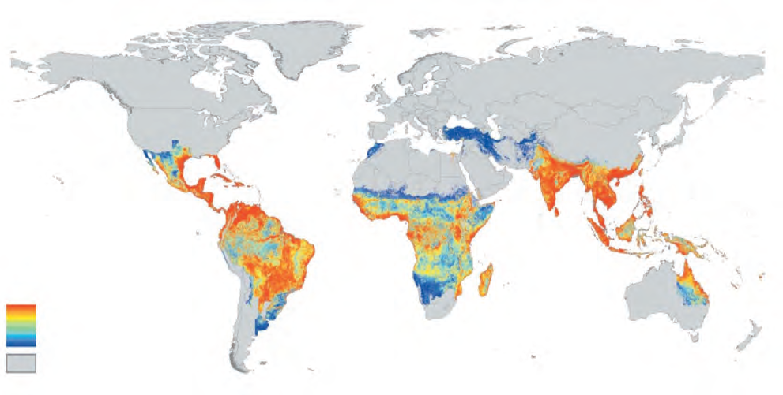
Global prevalence of Dengue virus
High susceptibility
Low susceptibility
Non-endemic region

Slide 4
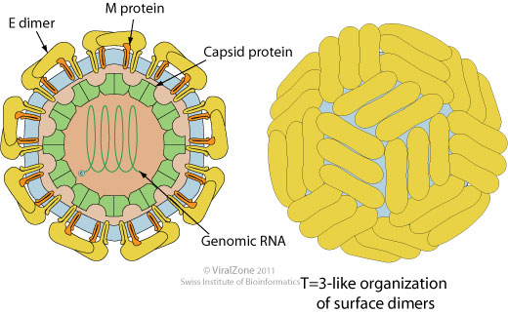
Dengue Virus (DENV)
Flavivirus genus; Flaviviridae family
Other flaviviruses include West Nile, Japanese Encephalitis , Yellow Fever
ssRNA, positive sense genome, 10.8kb
30 nm icosahedral nucleocapsid (NC)
40-50 nm spherical virion (NC + envelope)
Exists as four related serotypes denoted DENV1-4 that share 60-80% genetic homology

Slide 5
Dengue Virus genome
Genome is infectious, mRNA equivalent
Translated into polyprotein
Cleaved by viral and host proteases
3 structural, 7 non-structural proteins

Slide 6
DENV Non-structural Proteins
NS1
  functions as a cofactor for viral RNA replication, co-localising with the double-stranded RNA replicative form.
  It is also found to be expressed on the surface of infected cells and is secreted as multimer – the mechanisms by which soluble and cell surface–associated NS1 contributes to flavivirus pathogenesis remain uncertain
NS3
  protease with NS2B as a cofactor
  helicase and NTPase
NS4B
  interferes with STAT1, blocking IFN-β and IFN-γ
NS5
  RNA polymerase, methyltransferase

Slide 7
DENV Life Cycle
E dimer binds
  Sugars?
  DC-SIGN?
Virus is endocytosed
Acidic environment
Dimer dissociates into monomers
Monomers trimerise irreversibly → fusion

Slide 8
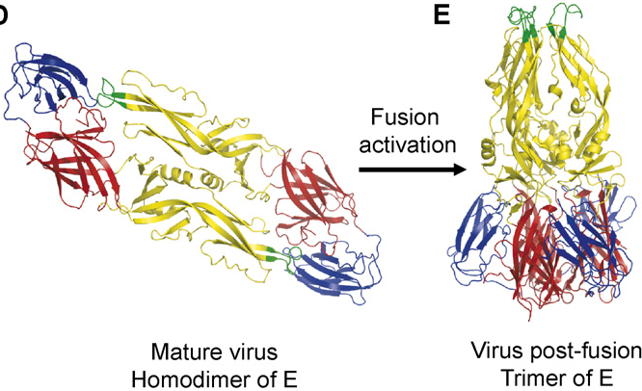
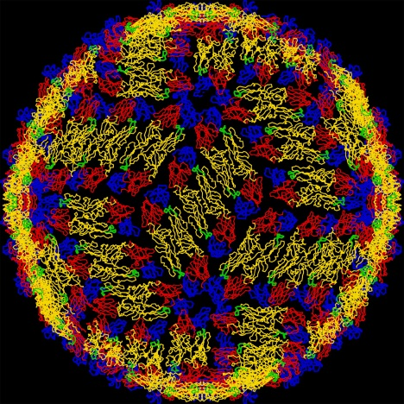
DENV Life Cycle
Whitehead et al., 2007

Slide 9
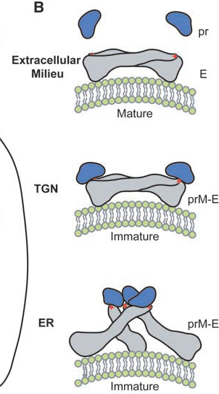
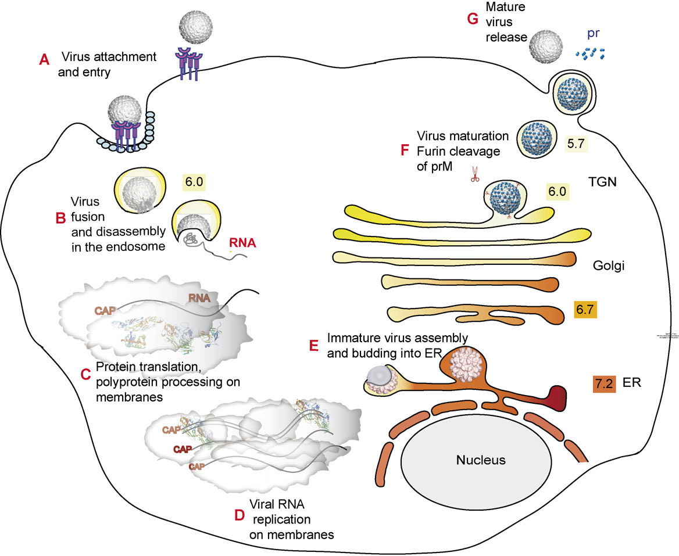
DENV Life Cycle

Slide 10
Target Cells
Not fully elucidated
Dendritic cells are infected – bind DC-SIGN
Monocytes and macrophages may be a major target in vivo
B cells can be infected in vitro
Vascular endothelial cells and hepatocytes contain antigen in vivo but are they infected?
How do viruses spread?
Which organs and cells lead to viraemia?

Slide 11
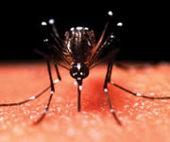
The Spectrum of Dengue Illness
Dengue virus infection
Asymptomatic
Symptomatic
Undifferentiated fever
Dengue fever
Dengue haemorrhagic fever
Without haemorrhage
Unusual haemorrhage
No shock
Shock
DHF grade 1 & 2
DHF grade 3 & 4

Slide 12
Dengue Fever (DF) &
Dengue Haemorrhagic Fever (DHF)
Asymptomatic or undifferentiated fever
Dengue fever (DF)
  Virus incubates for 2-7 days then fever
  headache, muscle & joint pain, self limiting, 1wk
Dengue haemorrhagic fever (DHF)
  4 grades
  capillary leakage, thrombocytopenia, altered haemostasis, liver damage
Dengue shock syndrome (DSS); DHF3,4
  Fluid loss (pleural effusion) can result in shock

Slide 13
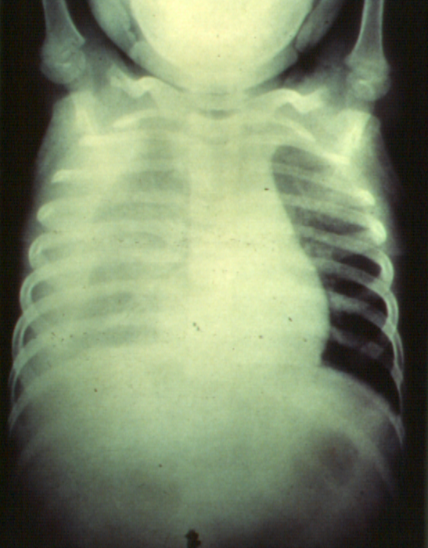
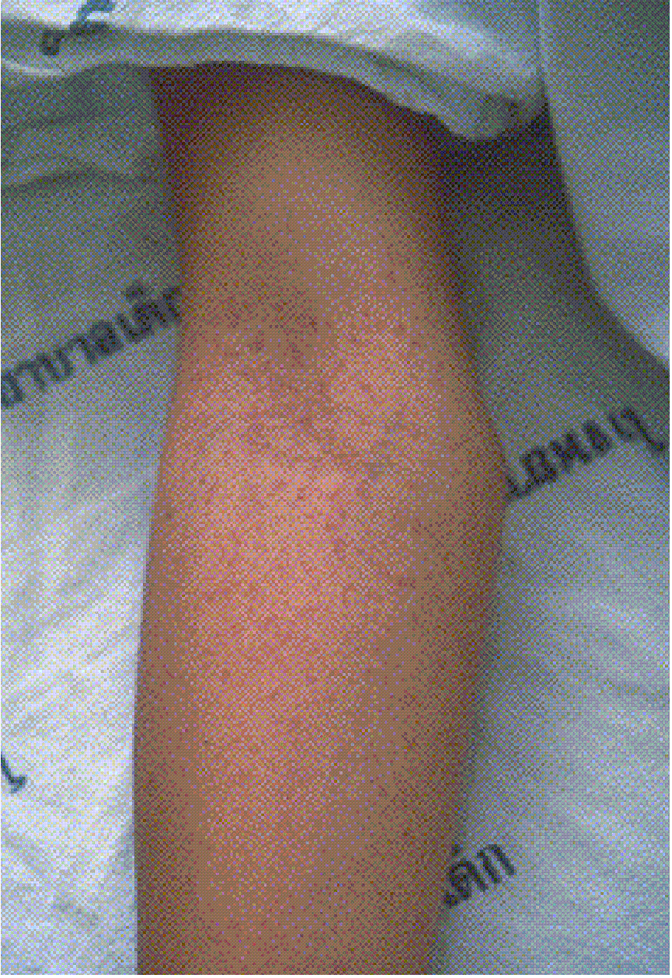
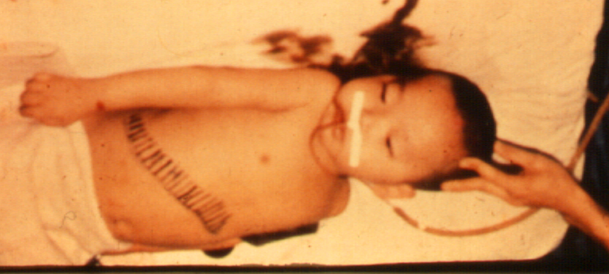
DHF/DSS a unique clinical syndrome
Sudden Onset:
Shock
Pleural Effusion
Ascites
Bleeding
Hepatomegaly

Slide 14
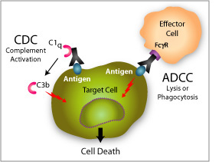
Immune responses to DENV
E is a major target of neutralising and protective Abs
NS1 is a target of protective Abs
NS1-specific Abs lead to antibody-dependant cellular cytotoxicity (ADCC) and complement-mediated cytotoxicity
NS3 is a major target of T cells
  CD4 and CD8

Slide 15
Immune responses to DENV
Neutralising Abs are long-lived
Infection with one DENV serotype can lead to the generation of Abs capable of recognising any or all of the other 3 serotypes – cross-reactive neutralising Abs decline rapidly after infection
Protection is thought to be life-long for homotypic virus but last only a few months for heterotypic virus
Serotype-specific and cross-reactive T cells are detected after infection

Slide 16
DHF Risk Factors
DHF risk factors include:
Pre-existing immunity to heterologous serotypes
Increased time between infections
Age
Ethnicity
Host genetic background
Sequence of infecting serotypes
Viral genotype

Slide 17
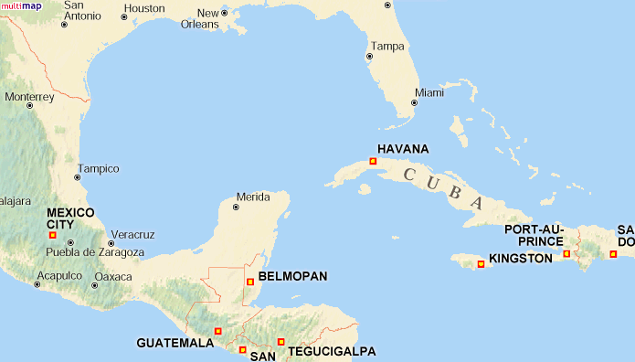
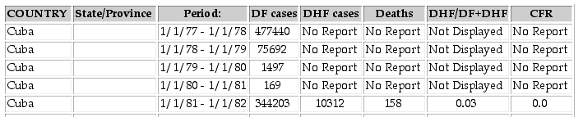
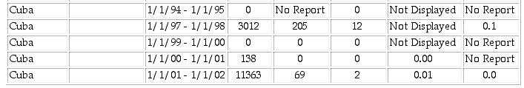
The majority of severe dengue complications occur upon secondary infection
0.007%
1.1%
0.18%
10%
Den 1
Den 1
Den 1
Den 1
Den 2
Den 2

Slide 18
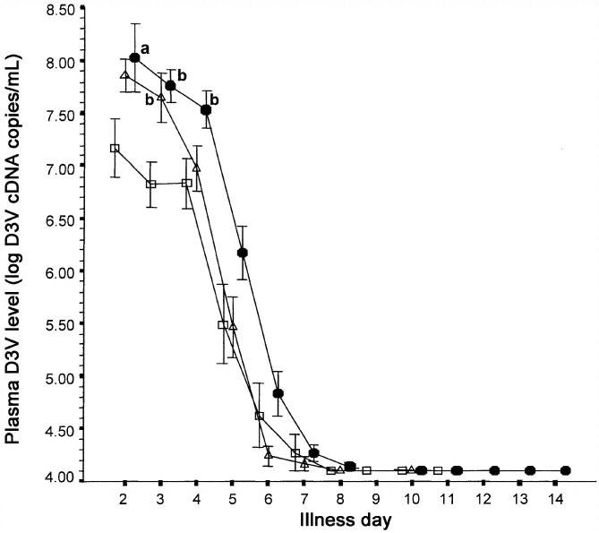
High virus load is associated with severe dengue disease
DHF
DF
Libraty JID 2002

Slide 19
Illness and a cytokine storm coincide with viral clearance
Viral load
Temperature
Platelet
Haematocrit
80000
41
140
50
70000
40.5
120
49
60000
40
100
48
50000
39.5
Cells x 10³/mm³
PFU/ml
39
°C
80
47
40000
38.5
% Hct
60
46
30000
38
45
20000
37.5
40
44
10000
37
20
43
36.5
0
-2
-1
0
1
2
90
36
0
42
Viral load
IFN-γ
TNF-α
IL-6
IL-8
MIP-1β
IL-10
80000
1200
8
140
40
350
250
70000
1000
7
120
35
300
200
60000
6
100
30
250
50000
800
5
25
150
PFU/ml
80
20
200
pg/ml
40000
600
4
60
150
30000
400
3
15
100
20000
2
40
10
100
50
10000
200
1
20
5
50
0
-2
-1
0
1
2
90
0
0
0
0
0
0
day
Illness is worse following secondary infection
High virus loads predict a severe outcome
Severe symptoms occur at point of virus control

Slide 20
Antibody dependent enhancement (ADE)
Leads to increase in viraemia
  DHF and DSS are associated with increased viral load
And/or leads to alternate cytokine cascades
Whitehead et al., 2007

Slide 21
Antibody dependent enhancement (ADE)
First observed in vitro in 1930s, common in vitro to many viruses
During a primary infection with a given serotype, cross-reactive Abs are induced that will be able to bind to the other serotypes
During a secondary infection with another serotype, these cross-reactive Abs will be boosted rapidly and bind
Not neutralising
  Concentration is too low – declined over time
  Enhancing Abs recognise different epitopes to strongly neutralising Abs
Bind to Fc receptors (Fc gamma) on macrophages/DCs and endocytosed

Slide 22
Antibody dependent enhancement (ADE)
Studied ADE in monkeys
Sequential infections of different serotypes compared to primary (DV2)
  Some showed increased (10-fold) viraemia
Animals given dengue-immune serum and then challenged had higher viraemia than those given non-immune serum
Good animal model is lacking

Slide 23
Antibody dependent enhancement (ADE)
In human adults, the presence of pre-existing heterotypic Abs is associated with more severe disease
In infants (6months-1yr), DHF is observed in primary infections
Associated with the presence of maternal Abs (IgG)
  Sub-neutralising concentrations
  Serum enhances in vitro
Up to 6 months, risk of DHF is low – high neutralising Ab titres
After one year, risk of DHF is low – degradation of maternal Abs

Slide 24
Endothelium damage?
Leakage and haemorrhage – increased vascular permeability – How?
Capillaries in skin biopsies are altered but not severely damaged
Endothelial cells seem intact. Tight junctions ok
Some endothelial swelling observed in capillaries in skin
One study identified circulating endothelial cells and increased levels of adhesion molecules (sICAM-1 and sVCAM-1) – indicating damage
In mouse, endothelial cells undergo TNF-induced apoptosis

Slide 25
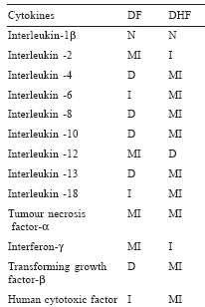
Cytokine production
Massive production of cytokines
  leads to plasma leakage
  Interferes with stability of the vascular endothelial cells
T cells and monocytes
IL-8 and MCP-1 (reduces tight junctions) are also found in pleural effusion
How induced?
How function?

Slide 26
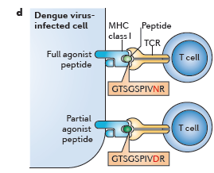
T cells
Secondary infection with heterologous DENV serotype
Sub-neutralising antibodies generated during primary infection opsonise virus - ADE
Increased viral load
Altered CD8+ T cell recognition of virally infected cells – epitope variation
Reduced target cell killing
Increased CD8+ T cell stimulation – memory response
DHF symptoms – vascular leakage
Cytokine Storm

Slide 27
Host susceptibility
No clear, unequivocal associations have been made between a given HLA haplotype and DHF
HLA associated with protection against DHF
  HLA Class I:
    Thai – A*0203, B13, B44, B52, B62, B76, B77
    Cuban – A29, B14
    Vietnamese – A33
  HLA Class II:
    Mexican – DRB1*04

Slide 28
Host susceptibility
HLA associated with susceptibility to DHF
  HLA Class I
    Thai – A2, A*0207, B46, B51
    Cubans – A1
    Vietnamese – A24
  HLA Class II
    Brazilians – DQ1, DR1?
  MICB- recognised by NKG2D-NK cell receptor

Slide 29
Virus virulence
Virulence is associated with high virus load and high transmission rates
Some primary patients do get DHF – more virulent virus?
American DV2 are rarely associated with DHF cases- reduced growth in vitro, mosquitoes
Asian genotypes are associated with DHF
But American DV2 isolated in Pacific Islands and Venezuela was associated with DHF/DSS
Viruses taken from within one population rarely differ between patients of DHF and DF
Good animal model would be very useful

Slide 30
Animal models
Monkeys – viraemia but no disease
Immunocompetent mice
  Different routes of infection
  Different virus strains
  Different doses
STAT1 KO – haemorrhage and leakage
NOD/SCID reconstituted with human cells/tissues – human-like disease
Some promising results coming up

Slide 31
Vaccines
Should be possible to make a vaccine –
acute infection
Viraemia can be controlled after 10 days
Protection conferred against same serotype
Also, passively transferred Abs can protect mice and macaques
Vaccines against other flaviviruses eg YF, JE

Slide 32
Vaccines – goals of immunisation
Protective against all four serotypes
Offer lifelong protection – with antibody levels close to those induced during natural infection and that do no wane over time
Safe and well tolerated
Universal coverage – all endemic areas and age groups
Affordable

Slide 33
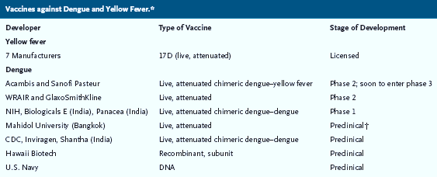
Vaccines

Slide 34
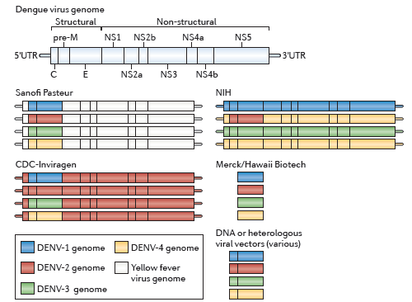
Vaccines
Recombinant Live attenuated viruses
Subunits
Virus-like particles
Whole inactivated virus

Slide 35

Whole inactivated virus – structural proteins only
  No immunity to nonstructural proteins
  Adjuvants and multiple boosters required
  Expensive to produce
Virus-like particles
  Weak to moderate immune response induction
  Adjuvants and boosters also required
Subunits
  Safe
  No advantage over whole inactivated virus or VLP
Recombinant live attenuated virus
  Immunogenic
  Less safe due to possible reversion
  Need to understand the nature of attenuation in order to monitor for reversion

Slide 36
Vaccines
Responses against the live, attenuated vaccines are most promising
Strong and show 80-90% seroconversion against all 4 serotypes
Often immunodominance of one serotype
Unknown attenuation can be a problem
Understanding pathogenesis and immune responses to DENV more clearly should enable more rational vaccine design
  Specific antigens
  Specific epitopes (neutralising vs enhancing)

Slide 37
Vector Control
Control mosquito spread
No stagnant water
Upside down buckets, tyres
Spraying programmes
Wolbachia
Fish/copeopods (small crustacea)

Slide 38
Anti-Dengue drugs
None yet available
Need to be safe and given very early
Promising results with other flaviviruses such as Hep C
Potential targets - NS3 protease, NS5 replicase, Envelope protein

