Slide 1
The big 3: Approaches to control
HIV, TB and Malaria
Dr Paul F McKay
Section of Infectious Diseases
Department of Medicine
St Mary’s campus, Imperial College London
p.mckay@imperial.ac.uk
31 October 2012

Slide 2
The Big 3
The Global relevance of these diseases
Description of each pathogen
A little bit of history
Current control methods
Prospects for a vaccine

Slide 3
Current Global Statistics
World Population 7, 074, 985, 295
People Undernourished: 906, 728, 740
Virus
Living with HIV / AIDS: 34, 832, 214
Died from HIV / AIDS (2011) 1, 700, 000 (4.88 %)
Bacteria
TB Burden (Chronically infected): 12, 000, 000
New TB Infections (2011): 8, 700, 000
Died from TB (2011) 1, 400, 000 (11.67 %)
Parasite
Malaria infections (2010): 216, 000, 000
Died from Malaria (2010) 655, 000 (0.3 %)

Slide 4
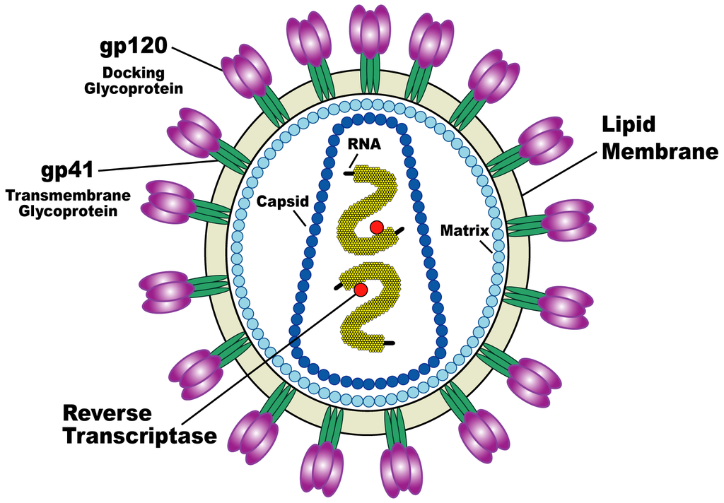
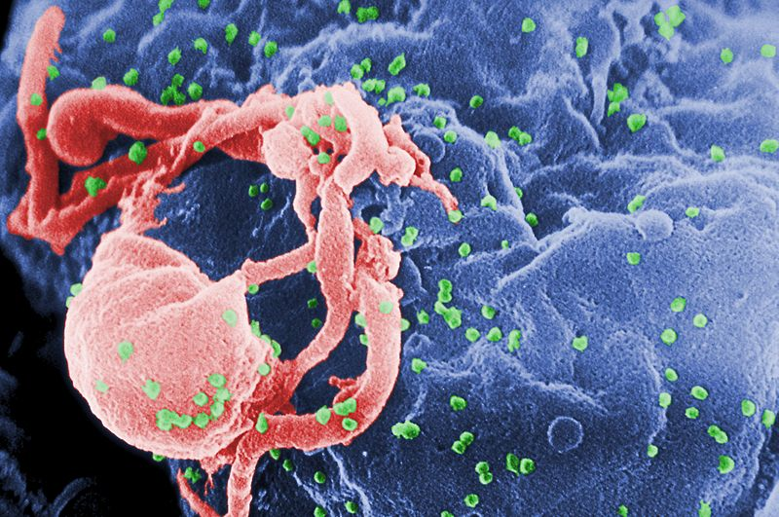
HIV – The causative agent of AIDS
Schematic Virion
Viral budding – Green
Human Immunodeficiency Virus – a lentivirus member of the larger retrovirus family
Lenti = slow, long incubation period
Retrovirus = an RNA virus that uses reverse transcriptase to incorporate into host DNA
http://www.niaid.nih.gov/factsheets/graphics/howhiv.jpg and CDC/ C. Goldsmith, P. Feorino, E. L. Palmer, W. R. McManus

Slide 5
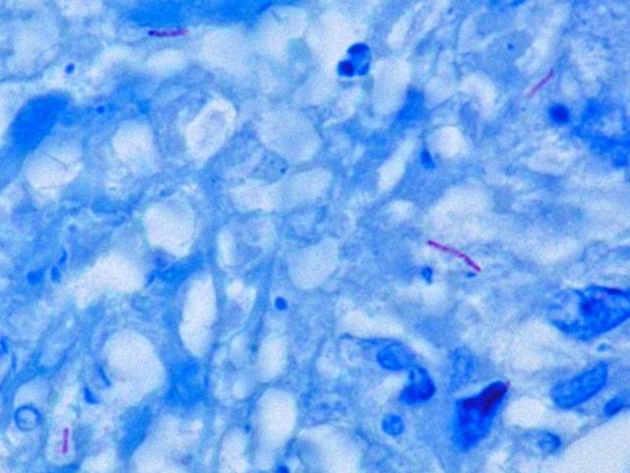
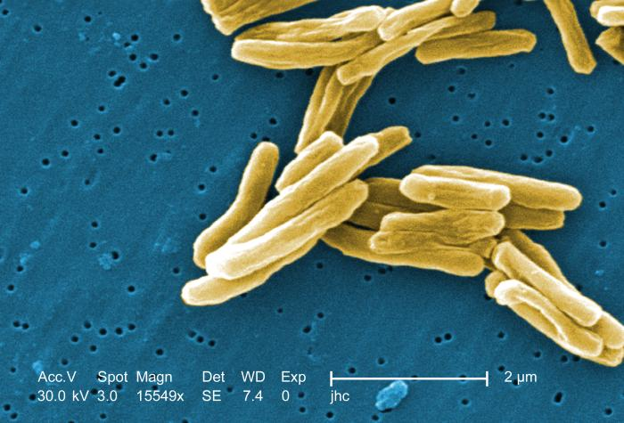
Mycobacteria – The causative agent of Tuberculosis
Scanning Electron Microscopy
Bacteria in Tissue
Slow growing bacteria that can cause Tuberculosis (Mycobacterium tuberculosis) and Leprosy (Mycobacterium leprae)
Part of a very large family of mycobacteria – slow, intermediate and fast-growing members
CDC/Dr. Edwin P. Ewing, Jr. (PHIL #28), 1994.

Slide 6
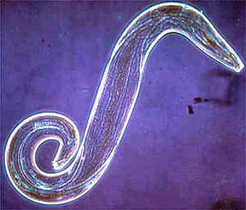
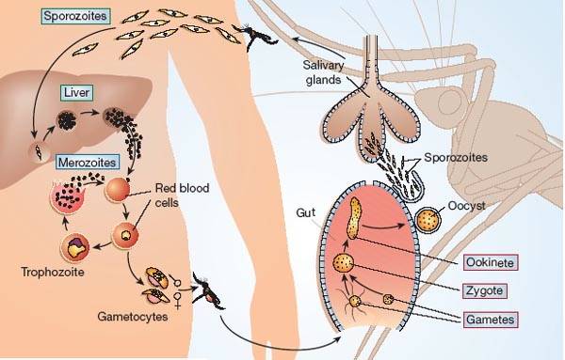
Plasmodium parasites – The causative agent for Malaria
Plasmodium falciparum sporozoite
Plasmodium life cycle
Over 200 known species of Plasmodium – many different animal hosts
P. falciparum and P. malariae most important for humans – cause malaria
Robert Ménard Nature 433, 113-114 doi:10.1038/433113a

Slide 7
HIV
HIV-1 first entered human populations (first common ancestor to divergent Group M HIV viruses) between 1910 and 1930 in or near to Leopoldville (now Kinshasa) in the Democratic Republic of the Congo.
99% of HIV infections are Group M – Contains 9 subtypes (Clades) and 40 distinct circulating recombinant forms (CRFs).
Closely related Simian Immunodeficiency viruses – SIVcpz likely the ancestor of HIV Group M.
Virus spread virtually un-noticed throughout the 1950s – 1980s before finally being recognized as a emerging epidemic in 1981 and pandemic by 1985.

Slide 8
Non-Vaccine Treatments
Nucleoside Reverse Transcriptase Inhibitors (NRTIs)
Non-Nucleoside Reverse Transcriptase Inhibitors (NNRTIs)

Slide 9
Protease Inhibitors
CCR5 and Integrase Inhibitors

Slide 10
New Vaccine Development
Peptide vaccine:
Made of tiny pieces of proteins from the HIV virus
Generally poorly immunogenic – need potent adjuvants
Tolerability
Recombinant subunit protein vaccine:
made of bigger pieces of proteins that are on the surface of the HIV virus
Examples of a recombinant subunit protein are gp120, gp140, or gp160 produced by genetic engineering
More immunogenic but still require an adjuvant

Slide 11
Live vector vaccine:
non-HIV viruses engineered to carry genes encoding HIV proteins
Can be quite immunologically potent – vector carrying the HIV genes can have intrinsic adjuvanticity
The genes are inserted into another vector, which carries them into the body's cells.
The genes in turn produce proteins that are normally found on the surface of the HIV virus. This type of vaccine most resembles the HIV virus but is not harmful. Many vaccines used today, like the smallpox vaccine, use this approach.
DNA vaccine:
Uses copies of a small number of HIV genes which are inserted into pieces of DNA called plasmids. The HIV genes will produce proteins very similar to the ones from real HIV.
Generally poorly immunogenic

Slide 12
Preferred Approaches
Vaccine combinations:
Utilizes any two or three vaccines components – DNA – Adenovirus – MVA, one after another, to create a stronger immune response.
Often referred to as "prime-boost strategy.”
Virus-like particle vaccine (pseudovirion vaccine):
a non-infectious HIV look-alike that has one or more, but not all, HIV proteins.

Slide 13
Challenges to an HIV Vaccine
Diversity of viral envelope sequences
Masking of potential site on the virus – glycosylation
The ability of a damaged immune system to produce
Potently and broadly neutralizing antibodies
Effective cellular responses to clear virus

Slide 14
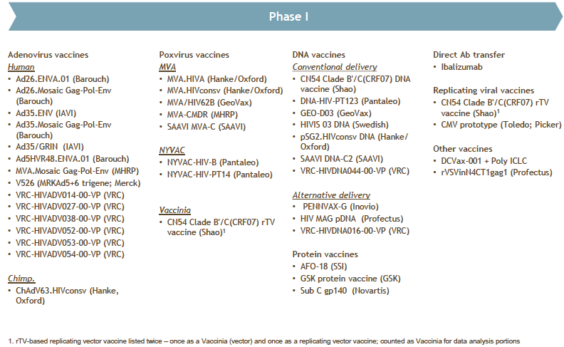
Some Phase 1 Clinical Trials and Vector / Vector Combos

Slide 15
Mycobacterium Tuberculosis
Has existed in humans species for at least half a million years - Homo ergaster / erectus
Robert Koch first describes the ‘tubercule bacillus’ on 24th March 1882 – wins Noble Prize
At this time 1 in 7 of the world’s population died of TB
It is a small and slow growing bacteria that can retain viability after dessication
BCG vaccine first developed in 1908 and used in human in 1921 (Bacille Calmette Guérin)
Still the only vaccine available
At best 80% effective for 5 years – wanes sharply
Some studies have shown much lower efficacy

Slide 16
Non-Vaccine Treatments
1900s – George Bernard Shaw described TB treatments as ‘a huge commercial system of quackery and poison
1920–30s – Discovery of Sulfonamides (1932 - Gerhard Domagk - Noble Prize winner) and Penicillin (1928 -Alexander Fleming – Noble Prize winner) – effective microbial control became a reality
1943 – Selman Waksman identified Streptomycin (SA) – Noble Prize winner
1944 – Para-amino salt of Salicyclic acid (PAS) synthesised - Jörgen Lehman
These two antibiotics became the first line treatment for active TB
(Treatment duration – more than 2 years)
1952 - Isonicotinic acid hydrazide - Isoniazid (INH) – Triple Therapy
SA / PAS / INH
(Treatment duration = 2 years)

Slide 17
Non-Vaccine Treatments
1960s – Ethambutol (EMB) replaces PAS – much better tolerated
(Treatment duration = 18 months)
1970s – Rifampicin (RIF) added to triple combination
(Treatment duration = 9 months)
Also – polling and questionnaires demonstrate that a majority of Western populations believe TB has been erradicated (!!)
1980s – Pyrazinamide (PZA) combined with INH and RIF
(Treatment duration = 6 months)
New analagous drugs continue to be developed
A consistent problem with all treatment regimes has been non-compliance over the extremely long treatment period required to clear the infection.

Slide 18
Research Advances and Challenges
1993 – WHO described TB infection as a ‘Global Health Emergency’
1998 – genetic sequencing of Mycobacterium tuberculosis
2000s – Multi-drug resistant TB (MDR-TB) increases in prevalence
Defined as being resistant to two of the six ‘classes’ of anti-TB drugs
Emerges in individuals due to non-compliance
2004-6 – Extensively drug resistant TB (EDR-TB) reported in all world regions
Defined as being resistant to three of the six ‘classes’ of anti-TB drugs
2007-12 – Totally drug resistant TB (TDR-TB) emerges
Resistant to all classes of TB drugs
Treatment options very limited

Slide 19
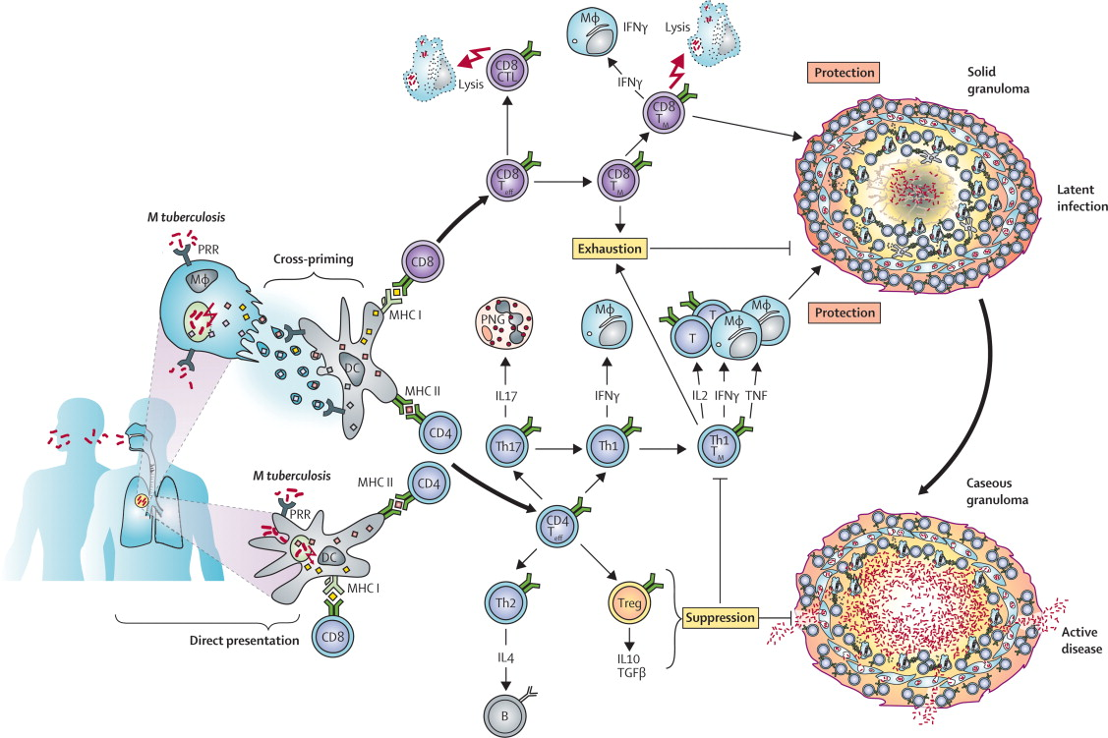
Immune Responses to TB Infection
Kaufmann et al., The Lancet 2010; 375:2110-2119 (DOI:10.1016/S0140-6736(10)60393-5)

Slide 20
Vaccine Strategies and Immune Outcomes
Different vaccination strategies
Present strategy: (A) pre-exposure vaccination with BCG protects against early childhood tuberculosis but does not eradicate Mycobacterium tuberculosis. Future vaccination strategies: (B) pre-exposure boost with subunit vaccine in children primed with BCG to prevent tuberculosis in early childhood and to delay tuberculosis disease outbreak in adults; (C) post-exposure boost with subunit vaccine in adults who had been primed with BCG during early childhood to delay tuberculosis disease outbreak in adults; (D) pre-exposure vaccination with superior BCG replacement to prevent tuberculosis in early childhood and to delay tuberculosis disease outbreak in adults
Kaufmann et al., The Lancet 2010; 375:2110-2119 (DOI:10.1016/S0140-6736(10)60393-5)

Slide 21
Vaccine Strategies and Immune Outcomes
(E) therapeutic vaccination in adjunct to chemotherapy in patients with active tuberculosis; (F) heterologous prime-boost vaccination with superior BCG replacement and subunit vaccine, to achieve sterile eradication; (G) heterologous prime-boost vaccination in individuals with latent infection by prime with superior BCG replacement and subunit vaccine boost to prevent tuberculosis disease outbreak; and (H) pre-exposure vaccination to prevent stable infection with M tuberculosis.
Kaufmann et al., The Lancet 2010; 375:2110-2119 (DOI:10.1016/S0140-6736(10)60393-5)

Slide 22
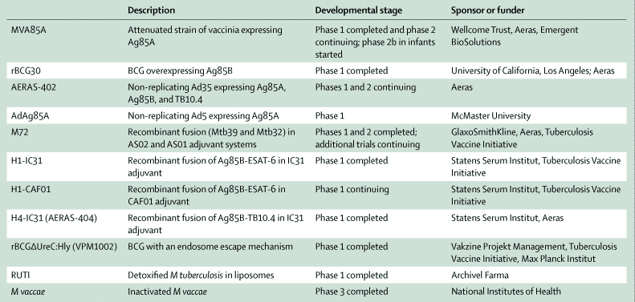
Current Human Clinical Vaccine Trials
Eleven new tuberculosis vaccines that have gone into clinical trials. Two of them, MVA85A and AERAS-402 Mycobacterium vaccae, have gone into phase 2 trials and one, M vaccae, has completed a phase 3 trial.
MVA=modified vaccinia Ankara. Ag=antigen. Ad=adenovirus. AS=adjuvant system. ESAT-6=early secretory antigenic target 6. CAF=cationic adjuvant formulation. Hly=haemolysin.
Mycobacteriophage
Kaufmann et al., The Lancet 2010; 375:2110-2119 (DOI:10.1016/S0140-6736(10)60393-5)

Slide 23
Malaria
1880s – Charles Lousi Alphonse Laveran – identified parasites in the red blood cells of patients suffering from malaria – Noble Prize 1907
1881 – Carlos Finlay – showed the mosquito was the carrier of yellow fever and therefore it may be possible that it could also carry malaria
1898 – Ronald Ross – conclusively demonstrated with an animal experiment that mosquitos transmitted the malaria parasite – Noble Prize 1902
1920s – First effective anti-malarial – Quinine
1940s – Chloroquine became drug of choice – resistance emerged
1970s – Artemisinins in combination with other drugs

Slide 24
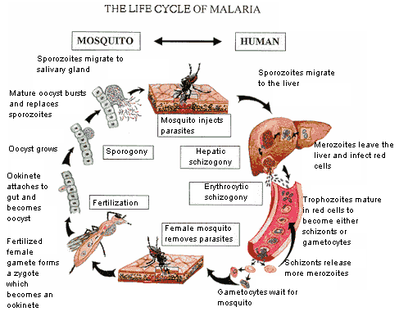

Slide 25
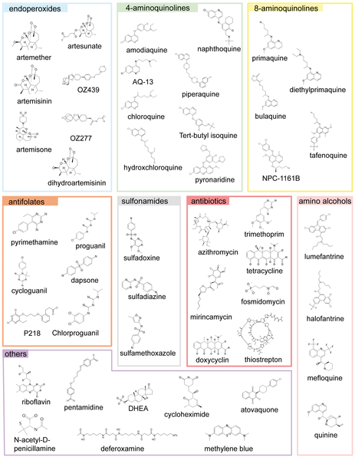
Wide range of drugs from a number of drug classes

Slide 26
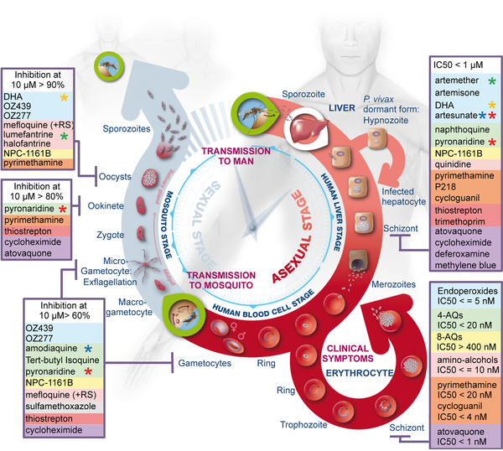

Slide 27
Drug Resistances
Common name | Chemical class | Clinical use | Resistance
Artemisinins (artemether, artesunate, dihydroartemisinin) | Sesquiterpene lactone endoperoxide | In artemisinin-based combination therapies (ACTs) | Possibly emerging
Lumefantrine | Arylamino alcohol | Most common first-line anti-malarial therapy in Africa, in combination with artemether | No evidence of high-level resistance
Amodiaquine | 4-Aminoquinoline | In combination with artesunate in parts of Africa | Limited cross-resistance with chloroquine
Mefloquine | 4-Methanolquinoline | In combination with artesunate in parts of southeast Asia | Prevalent in southeast Asia
Chloroquine | 4-Aminoquinoline | Former first-line treatment for uncomplicated malaria | Widespread
Pyrimethamine | Diaminopyrimidine | For intermittent preventive treatment, combined with sulphadoxine (a sulphonamide) | Widespread
Primaquine | 8-Aminoquinoline | For eliminating liver-stage parasites, including dormant forms of Plasmodium vivax | Unknown
Pyronaridine | Acridine-type Mannich base | Being registered for combined use with artesunate | No cross-resistance with other drugs reported

Slide 28
Although continued efforts to develop a vaccine are on-going, drugs continue to be the only current option
Novel drugs that have higher activity against the parasite while causing lower toxicity to humans are the goal
New chloroquine analogues as well as other drug classes are being developed and tested in clinical trials parallel to vaccine trials

Slide 29
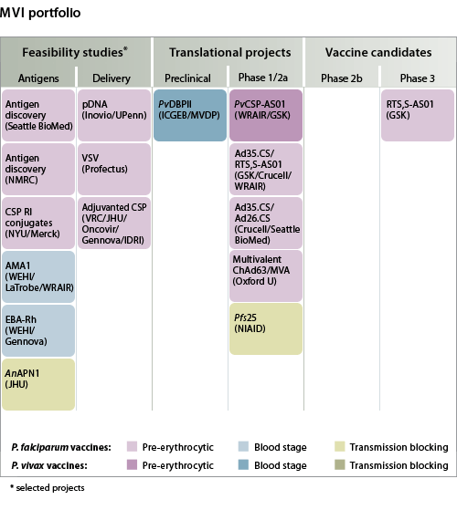
Current Vaccine Candidates and Clinical Trials
The efficacy of the Phase III RTS, S/AS01 has turned out to be quite low – though analysis is on-going and the researchers also found that the immunity waned significantly – they were not able to establish a long-lasting immune response

Slide 30
Summary
Vaccines and new vaccine modalities are being developed for each of these single-vector diseases
HIV – has a good chance of there being a successful vaccine in the next 10 years
The discovery of potent and broadly neutralizing antibodies
Challenge is how to generate these in vivo
TB – has an excellent chance that a vaccine candidate will be successful
BCG provides evidence that TB vaccine can be efficacious
Malaria – Most current efforts are in the development of new drugs and vector (mosquito) control
However, there is no reason to believe that a vaccine cannot be effective

