Slide 1
Global Health BSc projects Q & A
29 October 2012
Dr Mariam Sbaiti
Professor Helen Ward

Slide 2
Key Dates
List of BSc Projects published | Mid-November 2012
Round A of Project choices | Early November 2012
Round B of project choices | Mid November 2012
Agreed project choices and supervisor allocation | By end of November 2012
PART C Projects
Projects and write-up | 3 April – 17 May 2013
2 week Oral presentation (optional) | 11-15 March
Submission of Written project report | 23 May by 2pm
Final Oral Presentation | 24 May
Complete ‘Agreed Project Contribution of Supervisor and Student’ form | By 23 May
Vivas and Sub-Board meetings | 12 June
Project feedback released | 4 July
Notes:
During the project, the students should spend a minimum of four full days per week carrying out scientific experimental work which, dependent on the nature of the project, may involve clinical or laboratory-based activity, data retrieval or data analysis.

Slide 3
Projects should...
(a) be hypothesis-driven or, in the case of clinical projects, be focused on a clear research question
(b) employ clearly defined research methods and
(c) involve critical analysis such as would be required by a high-ranking journal in the field
Notes:
Laboratory-based projects should require the student to test a hypothesis and should normally involve the use of established laboratory/research protocols.
Clinical research projects similarly require a well defined research question or hypothesis to be tested.
Library-based projects should require the student to read and analyse the literature pertaining to a given issue, to seek ways forward by detailed planning of hypothesis-driven research and, in some cases, to make recommendations for change of practice.

Slide 4
2012 Project Titles
Guidelines in the food ration design for Home Grown School Feeding'
Feasibility and acceptability of repeat home-based HIV saliva testing using self sampling oral swabs in men who have sex with men
The NHS Health Check Programme in London: Is it addressing the needs of ethnic minority groups’ (or a variation on this title)
The NHS Health Check Programme in London: Is it addressing the needs of ethnic minority groups’ (or a variation on this title)
A systematic review of the efficacy and protective effects of dihydroartemisinin-piperaquine (DHA-PQP) compared to artemether-lumefantrine (AL) against P. falciparum malaria
Prevention of liver cancer in low income countries?
Kangaroo Mother Care (KMC) – what are its limitations
Terms of reference: Cross country analysis of school feeding coverage
Treatment outcomes of patients co-infected with HIV +HCV
The effect of urbanization on malaria transmission in sub-Saharan Africa (or a variation on this title)
Clofazimine for the treatment of DR-TB
An example of genetic susceptibility in relation to environmental cancer: scientific and ethical issues?
Treatment of Urinary Schistosomiasis in Northern Mozambique
Preventing tuberculosis in patients with HIV: from epidemiology to policy
Emerging Markets and their attitudes to health provision both nationally and internationally?
Why don't we immunise women against childhood infections in pregnancy?
Stress in migrant workers
How is mortality data from the conflict in Afghanistan reported in the media
Approaches to evaluating health links: a case-study of the Imperial-Rwanda link
Arsenic contamination of drinking water, extent of health consequences?
review examining the current published data comparing toxicity vs benefit of initiation of ART at high CD4 counts; the use of ART outside of current treatment recommendations as part of a universal HIV test and treat program.
Strategies for supporting adherence and reducing treatment default in drug resistant TB
The use of mathematical models to inform preparedness and response to pandemic influenza

Slide 5
Marks
Part C counts 40% of total BSc degree mark.
Project mark =
20% Oral presentation (8% of total mark)
10% Performance during Porject (10% of total mark)
70% Project Write-Up (28% of total mark)

Slide 6
Project Assessment guidelines
Penalties for late submission:
5% will be deducted from the awarded mark for assessed work for each day late up to 14 days after the deadline. No mark will be awarded for work submitted after fourteen days.
Penalties for word count:
1% of the mark will be deducted for every 1% over the word limit
Notes:
Normally, the Library will hold an OLIVIA lecture for all BSc students on how to avoid plagiarism during the Introduction to the BSc course. During or after the lecture the students will be required to participate in an online assessment (quiz) on the understanding of plagiarism. Students who do not attend the lecture will be directed to self-learning online and given the opportunity to complete the online assessment (quiz) on plagiarism within a week from the lecture. Students who do not comply will be sent a formal e-mail with a receipt, copied to their Course Director and their file. The e-mail will notify such students that in the occurrence of any plagiarism related offences in the future, their record of not participating in the plagiarism element of the Foundation course will be taken into account. Students who have already taken the online quiz during the BSc Foundation course in Year 3 will be exempt from taking it again during the Introduction to the BSc course in Year 4.

Slide 7
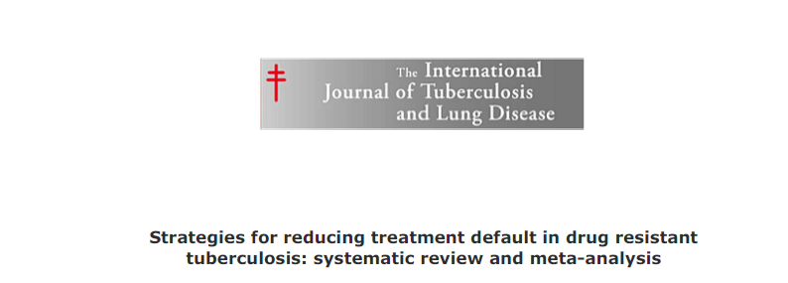

Slide 8
Publications
You may not submit:
a manuscript of a scientific paper for publication to a scientific journal; or
an abstract to a scientific forum, e.g. a conference;
without the prior, explicit, written consent of your supervisor(s)!

Slide 9
Projects 2011
Vaccines in Uganda
Chad IDP camp Crude mortality rate analysis
The role of CD4 counting and viral load for initiation and monitoring of therapy: evidence from operational studies
What are adherence rates to HIV post exposure prophylaxis after sexual violence? Does the mode of provision (use of counsellors, number of follow up visits) of HIV PEP affect adherence
Climate change and salinity in drinking water as a global problem
A review Comparing Fertility Rates in Developing & Developed Countries
What are the chronic consequences of infection with NTDs
A Systematic Review of Current Health Indicators and the Formulation of a New Health Index
Southern Sudan Inpatient mortality analysis
Treatment outcomes for MDR-TB in children
Vacines in Uganda
Availability of diagnostic tests through the internet and implications for regulation using one or more examples (chlamydia, HIV, cholesterol)
Universal coverage: what are the implications (for health, equity and expenditure) of trying to offer free access to health care for all citizens in low income countries
Exposure to pesticides in Bangladesh
Evaluation of the role of effectiveness of border measures for the control of respiratory emerging diseases
What are the chronic consequences of infection with NTDs. Maternal Health-
How mass drug administration for the control of the neglected tropical diseases (NTDs) impact maternal health
Prevalence of neuro-dementia in those suffering from HIV, given inequalities in access to ART
Clinical Research Governance in the UK
Should antibiotics be used in the management of cholera?
The contextualisation of malnutrition in Rwanda, focussing on the definition of malnutrition

