Slide 1
Systematic reviews and meta-analyses
Teresa Norat, PhD
Department of Epidemiology and Biostatistic
Imperial College

Slide 2
Learning outcomes
To understand the need for conducting systematic reviews and meta-analyses.
To understand the definition and uses of meta-analysis
To appreciate the practical problems and limitations of systematic reviews and meta-analyses.
To be able to interpret the findings presented in published systematic reviews and meta-analyses.

Slide 3
Systematic Review
A review of a clearly formulated question that uses systematic and explicit methods to
identify
select
critically appraise relevant research
collect and analyse data from the studies
that are included in the review
Cochrane collection glossary (www.cochrane.org)
Notes:
3
Systematic reviews have become an essential tool of evidence-based practice.
They:
“...differ from traditional narrative reviews by adopting a replicable,
scientific and transparent process, in other words a detailed technology,
that aims to minimize bias through exhaustive literature searches of
published and unpublished studies and by providing an audit trail of the
reviewers’ decisions, procedures and conclusions.” (Tranfield, Denyer, &
Smart, 2003)
The benefits of this approach to reviewing are that it is “systematic and
replicable, giving confidence to the users it informs regarding the status of present
knowledge on a given question” (Rousseau, Manning, & Denyer, 2008, p. 500).

Slide 4
EXAMPLE: SAFETY OF PUBLIC WATER FLUORIDATION
You are a public health professional in a locality that has public water fluoridation.
For many years, your colleagues and you have believed that it improves dental health.
Public health decisions have been based on professional judgment and practical feasibility without explicit consideration of the scientific evidence.
Example cited in: Five steps to conducting a systematic review
Khan et al. J R Soc Med 2003;96:118–121
Notes:
York review^{2,3}

Slide 5
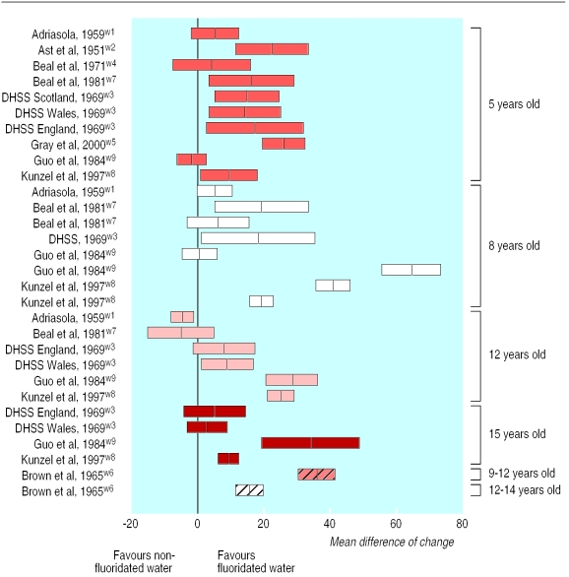
Change in proportion (%) of children without caries in fluoridated compared with non-fluoridated areas (mean difference and 95% confidence interval)
McDonagh ET AL. . Systematic review of water fluoridation. BMJ. 2000 Oct 7;321(7265):855-9
Notes:
214 studies were included. The quality of studies was low to moderate. Water fluoridation was associated with an increased proportion of children without caries and a reduction in the number of teeth affected by caries. The range (median) of mean differences in the proportion of children without caries was -5.0% to 64% (14.6%). The range (median) of mean change in decayed, missing, and filled primary/permanent teeth was 0.5 to 4.4 (2.25) teeth. A dose-dependent increase in dental fluorosis was found. At a fluoride level of 1 ppm an estimated 12.5% (95% confidence interval 7.0% to 21.5%) of exposed people would have fluorosis that they would find aesthetically concerning.
CONCLUSIONS:
The evidence of a beneficial reduction in caries should be considered together with the increased prevalence of dental fluorosis. There was no clear evidence of other potential adverse effects.

Slide 6


The Cochrane Collaboration
Founded in 1993 and named after the British epidemiologist, Archie Cochrane.
“the healthcare resources should be used to provide equitably those interventions that have been shown in well designed studies to be effective”
Cochrane Database of Systematic Reviews (the Cochrane Library)
Mainly controlled clinical trials of healthcare interventions.
www.cochrane.org
Notes:
In his seminal book Effectiveness and Efficiency: Random Reflections on Health Services,published in 1972, Cochrane forcefully argued that the healthcare resources should be used to provide equitably those interventions that have been shown in well designed studies to be effective.
The Cochrane Collaboration produces and disseminates systematic reviews of healthcare interventions.
The collaboration's working groups are addressing many of the currently unresolved issues, including, for example, the approach to observational data and data from evaluations of screening and diagnostic tests. Ways of improving the applicability of reviews, discussed below, and of strengthening the involvement of consumer representatives, are also being studied.

Slide 7


Slide 8
Databases in the Cochrane Library
Database | Total Records
Database of Systematic Reviews (Cochrane Reviews) | 4200
Database of Abstracts of Reviews of Effects (DARE) | 5859
Central Register of Controlled Trials (CENTRAL) | 470139
Database of Methodology Reviews (Methodology Reviews) | 20
Methodology Register (Methodology Register) | 7615
Health Technology Assessment Database (HTA) | 5378
NHS Economic Evaluation Database (NHS EED) | 17015
2011?

Slide 9

WHO Collaborations

Slide 10


Slide 11

Diet and Cancer Report website
http://www.dietandcancerreport.org

Slide 12
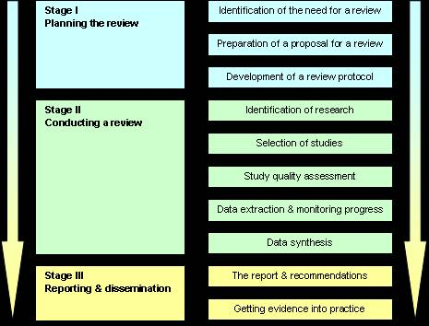
Undertaking Systematic Reviews

Slide 13
Stage I - Planning the review
Need to specify the question to be addressed, usually framed around:
  The population
  The exposure/intervention
  The outcomes
  The study designs
Notes:
The steps in a systematic review
Step 1: Framing questions for a review
The problems to be addressed by the review should be specified in the form of clear, unambiguous and structured questions before beginning the review work. Once the review questions have been set, modifications to the protocol should be allowed only if alternative ways of defining the populations, interventions, outcomes or study designs become apparent

Slide 14

Case study: Efficacy of interventions for preventing obesity in children
Stage I - Planning the review:
The population
  Children under 18 years. Obese children were included.
  Excluded were studies to prevent obesity in pregnant women, studies designed for children with critical illness or severe co-morbidities
The intervention
  Educational, health promotion and/or psychological/family/behavioural therapy/counselling/management interventions
  Interventions which focus on diet, physical activity and/or lifestyle and social support
  -Interventions within the community, school or clinic-based
  Control group with usual care or another active intervention
  Without restriction on who delivered the intervention, for example, researchers, primary care physicians, nutrition/diet professionals, teachers, health promotion agencies, or others
Reviewed by Summerbell CD, Waters E, Edmunds L, Kelly SAM, Brown T, Campbell KJ

Slide 15
Interventions for preventing obesity in children
Stage I - Planning the review:
The population
The exposure/intervention
The outcomes
  Primary outcomes: weight and height, percent fat content, body mass index, ponderal index, skin-fold thickness
  Secondary outcomes: activity levels, dietary intake, measures of self-esteem, quality of life, health status, cost-effectiveness of the intervention
The study designs
  Controlled trials (with or without randomisation) with a minimum duration of twelve weeks. Studies were categorised into long-term (at least one year) and short-term (at least twelve weeks). Study length refers to a combination of the intervention with a follow-up phase.
  Studies both with randomisation of individuals and group randomisation were accepted

Slide 16
Stage II - Identification of relevant work
Clearly defined search criteria
MeSH (Medical Subject headings) and free text words in combination with Boolean operators
Search the published medical literature
Electronic databases such as Cochrane Central Register of Trials, Medline, EMBASE
Search other sources
    Reference lists/citation searches
    Conference proceedings/grey literature
    Contacting established researchers in the field to identify unpublished studies.
Notes:
The steps in a systematic review
Step 2: Identifying relevant work
The search for studies should be extensive. Multiple resources (both computerized and printed) should be searched without language restrictions. The study selection criteria should flow directly from the review questions and be specified a priori. Reasons for inclusion and exclusion should be recorded

Slide 17
Stage II - Identification of research
Search criteria
  1.exp OBESITY
  2. exp Weight Gain/
  3. exp Weight Loss
  4.......................
  8.((bmi or body mass index)adj2(gain or loss or change)).af.
  9. or/1-8
Searched published literature:
- Date from 1990 to March 2005
  Medline
  Embase
  CENTRAL
  the Cochrane Library
  PsycINFO
  CINAHL
Other
  Experts in the field of obesity to seeking additional references
  References lists checked

Slide 18
Stage II - Selection of studies
Eligibility/Inclusion criteria may be based on:
  Study design
    controlled trials, cohort studies, case-control studies etc.
  Year of study
    only studies carried out after a specific date.
  Publication language
    However language shouldn’t be a barrier!
  Sample-size/precision
    Only trials with more than X number of patients.
  Specific exposure/intervention
    E.g. search for a specific diagnosis, but only include studies using a specific diagnostic method.
  Specific outcome
    E.g. search for outcome (e.g. lung cancer), but only include a specific subset (e.g. primary tumours).
  Completeness of information
    Paper must provide details of response rate/take-up rate, loss to follow-up/attrition…
Reasons for inclusion/exclusion should be recorded!
Notes:
The steps in a systematic review
Step 2: Identifying relevant work
The search for studies should be extensive. Multiple resources (both computerized and printed) should be searched without language restrictions. The study selection criteria should flow directly from the review questions and be specified a priori. Reasons for inclusion and exclusion should be recorded

Slide 19
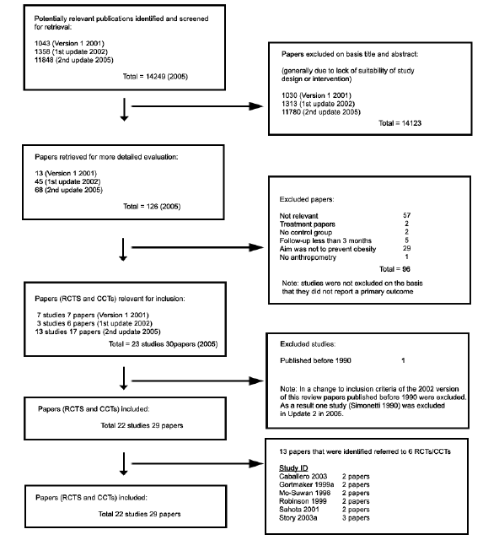
Stage II - Selection of studies (Flow chart)

Slide 20
Stage II - Study quality assessment
Study quality may be assessed according to recognized or user-defined criteria
e.g. Cochrane Handbook for Systematic Reviews of Interventions (http://www.cochrane.dk/cochrane/handbook/hbook.htm)
Quality criteria should assess various biases in study design
              Selection bias
Study design quality should preferably be assessed before study results known, and should ideally be assessed independently by more than one assessor
The use of “scores” is not recommended
Notes:
The steps in a systematic review
Step 2: Identifying relevant work
The search for studies should be extensive. Multiple resources (both computerized and printed) should be searched without language restrictions. The study selection criteria should flow directly from the review questions and be specified a priori. Reasons for inclusion and exclusion should be recorded
Step 3: Assessing the quality of studies
Study quality assessment is relevant to every step of a review. Question formulation (Step 1) and study selection criteria (Step 2) should describe the minimum acceptable level of design. Selected studies should be subjected to a more refined quality assessment by use of general critical appraisal guides and design-based quality checklists (Step 3). These detailed quality assessments will be used for exploring heterogeneity and informing decisions regarding suitability of meta-analysis (Step 4). In addition they help in assessing the strength of inferences and making recommendations for future research (Step 5)
Step 4: Summarizing the evidence

Slide 21
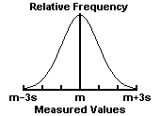
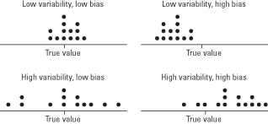
Risk of bias
A bias …..
..is a systematic error, or deviation from the truth, in results or inferences.
…can lead to underestimation or overestimation of the true intervention effect.
…can be small or substantial.
…should not be confused with imprecision (a random error).
Random error (unpredictable)
Notes:
Error is defined as the difference between the true value of a measurement and the recorded value of a measurement. There are many sources of error in collecting clinical data. Error can be described as random or systematic. Random error is also known as variability, random variation, or ‘noise in the system’. The heterogeneity in the human population leads to relatively large random variation in clinical trials.
Systematic error or bias refers to deviations that are not due to chance alone. The simplest example occurs with a measuring device that is improperly calibrated so that it consistently overestimates (or underestimates) the measurements by X units.
Random error has no preferred direction, so we expect that averaging over a large number of observations will yield a net effect of zero. The estimate may be imprecise, but not inaccurate. The impact of random error, imprecision, can be minimized with large sample sizes.
Bias, on the other hand, has a net direction and magnitude so that averaging over a large number of observations does not eliminate its effect. In fact, bias can be large enough to invalidate any conclusions. Increasing the sample size is not going to help. In human studies, bias can be subtle and difficult to detect. Even the suspicion of bias can render judgment that a study is invalid. Thus, the design of clinical trials focuses on removing known biases.
Random error corresponds to imprecision, and bias to inaccuracy. Here is a diagram that will attempt to differentiate between imprecision and inaccuracy
“Recording the strengths and weaknesses of included studies provides an indication of whether the results have been unduly influenced by aspects of study design or conduct (essentially the extent to which the study results can be ‘believed’).
Assessment of study quality gives an indication of the strength of evidence provided by the review and can also inform the standards required for future research. Ultimately, quality assessment helps answer the question of whether the studies are robust enough to guide treatment, prevention, diagnostic or policy decisions.”
Biases can vary in magnitude: some are small (and trivial compared with the observed effect) and some are substantial (so that an apparent finding may be entirely due to bias).
Even a particular source of bias may vary in direction: bias due to a particular design flaw (e.g. lack of allocation concealment) may lead to underestimation of an effect in one study but overestimation in another study. It is usually impossible to know to what extent biases have affected the results of a particular study, although there is good empirical evidence that particular flaws in the design, conduct and analysis of randomized clinical trials lead to bias
Bias refers to systematic error, meaning that multiple replications of the same study would reach the wrong answer on average. Imprecision refers to random error, meaning that multiple replications of the same study will produce different effect estimates because of sampling variation even if they would give the right answer on average. The results of smaller studies are subject to greater sampling variation and hence are less precise. Imprecision is reflected in the confidence interval around the intervention effect estimate from each study and in the weight given to the results of each study in a meta-analysis. More precise results are given more weight.

Slide 22

the quality of a body of evidence is ‘the extent to which one can be confident that an estimate of effect or association is close to the quantity of specific interest’ (GRADE)
A valid study is one which has addressed a clearly focused question, and where the methods used enable the results to be trusted.
If the study is of low validity, the results cannot be trusted.

Slide 23
Assessing of risk of bias of each study is important
The likelihood that the “effect” reported in a systematic review approximates the truth depends on the validity of the included studies, as certain methodological characteristics may be associated with effect sizes
Differences in risks of bias can help explain variation in the results of the studies included in a systematic review (i.e. can explain heterogeneity of results)
Notes:
It is important for authors to describe any methods that they used to gauge the risk of bias in the included studies and how that information was used.
As well as finding all the studies relevant to the review question it is important that a review takes account of the validity of the included studies as this can have an effect on the pooled effect size reported.“ Because the results of a study may in fact be unbiased despite a methodological flaw, it is more appropriate to consider risk of bias. evaluating the validity of included studies is essential, as this informs the analysis, interpretation and conclusions of the review.
More rigorous studies are more likely to yield results that are closer to the truth”.
Meta-analysis of results from studies of variable validity can result in false positive conclusions (erroneously concluding an intervention is effective) if the less rigorous studies are biased toward overestimating an intervention’s effect. They might also come to false negative conclusions (erroneously concluding no effect) if the less rigorous studies are biased towards underestimating an intervention’s effect (Detsky 1992).

Slide 24
Assessing risk of bias:
The Cochrane collaboration tool
Type of bias | Description
Selection bias | Differences between baseline characteristics of the groups that are compared
Performance bias | Systematic differences between groups in the care that is provided, or in exposure to factors other than the interventions of interest
Detection bias | Systematic differences between groups in how outcomes are determined
Attrition bias | Systematic differences between groups in withdrawals from a study
Reporting bias | Systematic differences between reported and unreported findings
Notes:
Internal validity—extent to which systematic error (bias) is minimised in clinical trials
Effective blinding can also ensure that the compared groups receive a similar amount of attention, ancillary treatment and diagnostic investigations.
Detection bias refers to systematic differences between groups in how outcomes are determined. Blinding (or masking) of outcome assessors may reduce the risk that knowledge of which intervention was received, rather than the intervention itself, affects outcome measurement. Blinding of outcome assessors can be especially important for assessment of subjective outcomes, such as degree of postoperative pain.
Attrition bias refers to systematic differences between groups in withdrawals from a study. Withdrawals from the study lead to incomplete outcome data. There are two reasons for withdrawals or incomplete outcome data in clinical trials. Exclusions refer to situations in which some participants are omitted from reports of analyses, despite outcome data being available to the trialists. Attrition refers to situations in which outcome data are not available.
In addition there are other sources of bias that are relevant only in certain circumstances. These relate mainly to particular trial designs (e.g. carry-over in cross-over trials and recruitment bias in cluster-randomized trials); some can be found across a broad spectrum of trials, but only for specific circumstances (e.g. contamination, whereby the experimental and control interventions get ‘mixed’, for example if participants pool their drugs); and there may be sources of bias that are only found in a particular clinical setting.

Slide 25
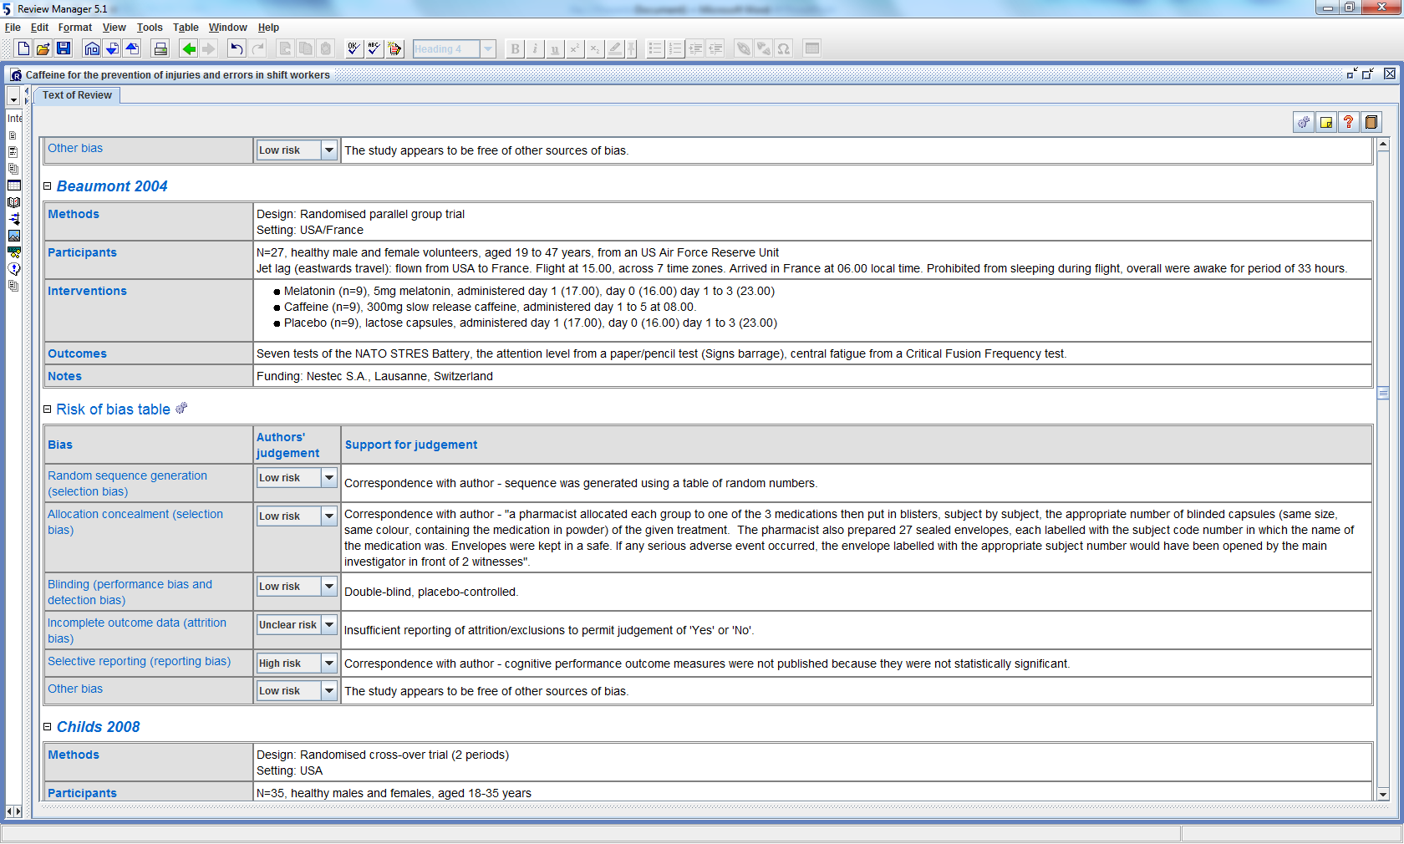
Cochrane collaboration tool : Table for risk of bias assessment (Revman)

Slide 26
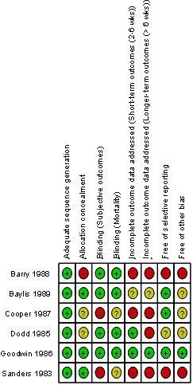
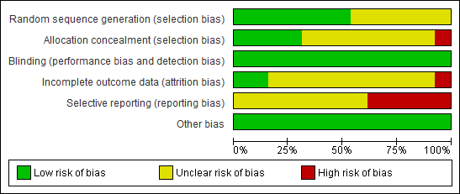
Cochrane collaboration tool: Graphic presentation of risk of bias assessment in clinical trials (Revman)
Proportion of studies with each judgement All judgements in a crosstabulation

Slide 27
Other tools (examples):
Cochrane tools for other study designs:
  The Cochrane Effective Practice and Organisation of Care (EPOC)
  Cochrane Handbook
Non-Cochrane quality assessment tools:
  The Evidence Public Health Practice Project (EPHPP) tool
  Agency for Healthcare Research and Quality (AHRQ)
  Newcastle and Ottawa checklist (cohort studies)
Notes:
“Many tools have been proposed for assessing the quality of studies for use in the context of a systematic review and elsewhere. Most tools are scales, in which various components of quality are scored and combined to give a summary score; or checklists, in which specific questions are asked (Jüni 2001).
In 1995, Moher and colleagues identified 25 scales and 9 checklists that had been used to assess the validity or ‘quality’ of randomized trials (Moher 1995, Moher 1996)… Almost all of the items in the instruments were based on suggested or ‘generally accepted’ criteria that are mentioned in clinical trial textbooks. Many instruments also contained items that were not directly related to internal validity, such as whether a power calculation was done (an item that relates more to the precision of the results) or whether the inclusion and exclusion criteria were clearly described (an item that relates more to applicability than validity). Scales were more likely than checklists to include criteria that do not directly relate to internal validity.
The Collaboration’s recommended tool for assessing risk of bias is neither a scale nor a checklist. It is a domain-based evaluation, in which critical assessments are made separately for different domains. It was developed between 2005 and 2007 by a working group of methodologists, editors and review authors. Because it is impossible to know the extent of bias (or even the true risk of bias) in a given study, the possibility of validating any proposed tool is limited. The most realistic assessment of the validity of a study may involve subjectivity: for example an assessment of whether lack of blinding of patients might plausibly have affected recurrence of a serious condition such as cancer.
The use of scales for assessing quality or risk of bias is explicitly discouraged in Cochrane reviews. While the approach offers appealing simplicity, it is not supported by empirical evidence (Emerson 1990, Schulz 1995b). Calculating a summary score inevitably involves assigning ‘weights’ to different items in the scale, and it is difficult to justify the weights assigned. Furthermore, scales have been shown to be unreliable assessments of validity (Jüni 1999) and they are less likely to be transparent to users of the review. It is preferable to use simple approaches for assessing validity that can be fully reported (i.e. how each trial was rated on each criterion).” Cochrane Handbook

Slide 28
Stage III - Reporting and dissemination
Data synthesis
Study details tabulated in a meaningful way.
Should include details of:
  the populations
  the interventions/exposure
  the outcomes
  the study design
Summary of findings of each study
Study quality assessment
Meta-analysis
Notes:
Data synthesis consists of tabulation of study characteristics, quality and effects as well as use of statistical methods for exploring differences between studies and combining their effects (meta-analysis). Exploration of heterogeneity and its sources should be planned in advance (Step 3). If an overall meta-analysis cannot be done, subgroup meta-analysis may be feasible
Step 5: Interpreting the findings
The issues highlighted in each of the four steps above should be met. The risk of publication bias and related biases should be explored. Exploration for heterogeneity should help determine whether the overall summary can be trusted, and, if not, the effects observed in high-quality studies should be used for generating inferences. Any recommendations should be graded by reference to the strengths and weaknesses of the evidence

Slide 29
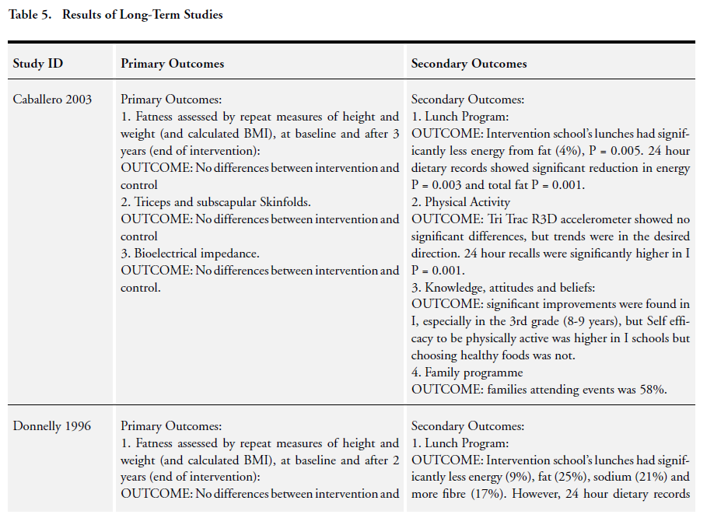

Slide 30
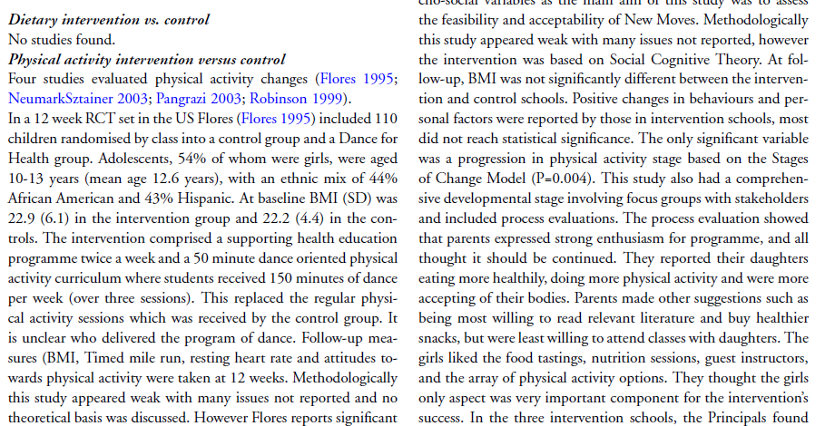
Stage III - Reporting and dissemination: detailed description and critical assessment

Slide 31
Results…
22 studies were included; 10 long term and 12 short term; 19 studies were school/pre-school interventions, 1 community-based targeting low-income families; 2 were family-based targeting non-obese children of obese or overweight parents
Most studies were short-term
Studies that focused on combining dietary and physical activity approaches did not significantly improved body mass index

Slide 32
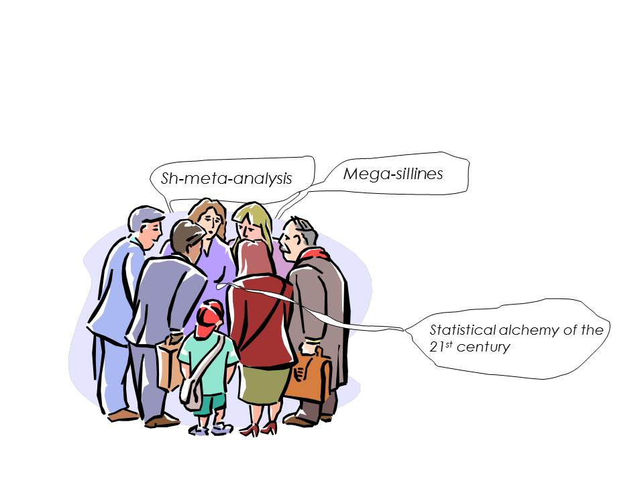
Meta-analysis
Statistical analysis of a collection of studies, especially an analysis in which studies are the primary units of analysis, i.e., methods in which the study is the individual unit of statistical analysis for the purpose of integrating findings

Slide 33

What does a meta-analysis involve?
Rationale for combining studies
Many of the groups …. are far to small to allow any definite opinion being formed at all, having regard to the size of the probable error involved
Karl Pearson, 1904
“Effect” estimates are abstracted (or calculated) from the selected studies
These individual study “effect” estimates are pooled to produce a weighted average effect across all studies. Studies are weighted according to a measure of its importance (often large studies with precise effect estimates)
Notes:
1932. Fisher. Combination of p values
1976. Glass coined the term meta-analysis
1977. Glass&Smith 833 tests of effectiveness of psycotherapy
1978. Rosenthal& Rubin. 345 studies on the effects of interpersonal
expectations on behaviours
1979 GlassSmith. 725 estimates of the relation between class size
and academic achievements
……..
1984 Rosenthal. Compendium of meta-analytical methods
1980’s Health research: cardiovascular disease, oncology, perinatal care.
1990’s Cochrane Collaboration

Slide 34
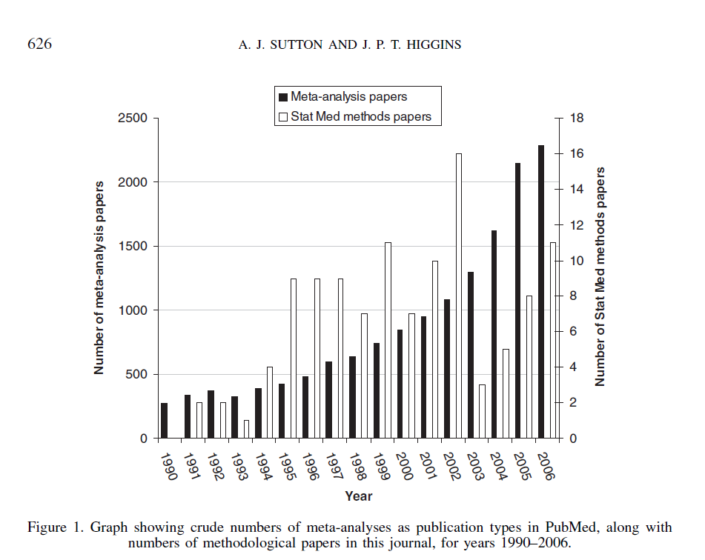
Number of publications as meta-analysis
Sutton and Higgins: Stat Med. 2008 Feb 28;27(5):625-50

Slide 35
What does a meta-analysis involve?
Effect estimates are abstracted (or calculated) from the selected studies
These individual study effect estimates are pooled to produce a weighted average effect across all studies.
Studies are weighted according to a measure of its importance.
  Most weight to informative studies (often large studies with precise effect estimates)
  Least weight to less informative studies (often smaller studies with imprecise effect estimates).

Slide 36
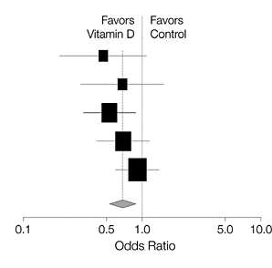
Forest plot
Point estimate treatment
effect of each study
Size of box proportional to the
weight of each study
Meta-analysis
Width of whiskers =
95% confidence interval
Summary estimate
Centre of diamond =
Pooled point estimate
Width of diamond =
95% confidence interval

Slide 37
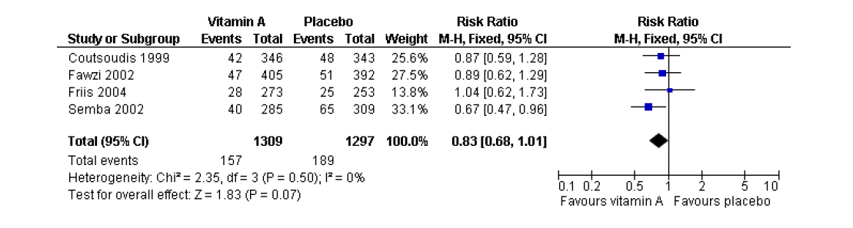
Example: Vitamin A supplementation for reducing the risk of mother-to-child transmission to HIV infection.
Low birth weight (less than 2500 g)
The Cochrane Collaboration 2001
Notes:
A Forest plot is the most common way of presenting the results from a meta-analysis
A Forest plot is a graphical representation of the results from each study included in a meta-analysis, together with the combined meta-analysis result.
The overall estimate from the meta-analysis is usually shown at the bottom, as a diamond.

Slide 38
Advantages of meta-analyses
Combine the estimates of effect from each study to generate a pooled overall risk estimate
Can include more subjects than any single constituent study, and produce a more reliable and precise estimate of effect
Can explore differences (heterogeneity) between published studies
BUT
If the studies are too heterogeneous, it may be inappropriate, even misleading to statistically pool the results from separate studies!
Can identify whether publication bias is occurring.

Slide 39
Publication Bias
Failure to include all relevant data in a meta-analysis may mean the effect of an intervention/exposure is over (or under) estimated
Publication bias is caused when only a subset of the relevant data is available
Null or non significant findings (esp. in small studies) are less likely to be reported/published than statistically significant findings.
Guyatt et al. J Clin Epidemiol. 2011;64(12):1277-82.

Slide 40
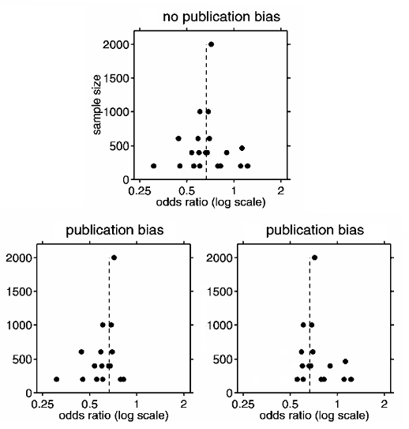
Funnel Plot: exploring publication and related bias
A funnel plot which is symmetric about the mean effect and shaped like an upside down funnel indicates no publication bias.
A plot with the lower right or left hand corner of the plot missing indicates that publication bias is present.

Slide 41
Bias in systematic reviews
publication bias and related biases
choice of databases
biased inclusion criteria
differentially delayed publication
publication language
selective reporting
+ individual study biases

Slide 42
Stage III - Reporting and dissemination
Interpreting the findings
Risk of publication bias and related biases
Exploration for heterogeneity (differences of results across studies) should help to determine if the overall summary can be trusted
Any recommendation should be graded by reference to strengths and weakness of the evidence
Notes:
Data synthesis consists of tabulation of study characteristics, quality and effects as well as use of statistical methods for exploring differences between studies and combining their effects (meta-analysis). Exploration of heterogeneity and its sources should be planned in advance (Step 3). If an overall meta-analysis cannot be done, subgroup meta-analysis may be feasible
Step 5: The issues highlighted in each of the four steps above should be met. The risk of publication bias and related biases should be explored. Exploration for heterogeneity should help determine whether the overall summary can be trusted, and, if not, the effects observed in high-quality studies should be used for generating inferences. Any recommendations should be graded by reference to the strengths and weaknesses of the evidence

Slide 43
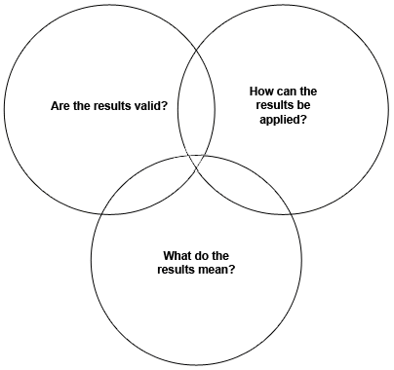
Critical Appraisal Skills Programme (CASP)
How to GRADE the evidence?
Critical appraisal is "the process of carefully and systematically examining research to judge its trustworthiness, and its value and relevance in a particular context”
Burls 2009
10 questions to appraise randomised controlled trials on the following domains:
Notes:
Critical Appraisal Skills Programme
Since its ‘birth’ in 1993, the Critical Appraisal Skills Programme (CASP) has helped to develop an evidence-based approach in health and social care, working with local, national and international groups.
CASP aims to enable individuals to develop the skills to find and make sense of research evidence, helping them to put knowledge into practice.

Slide 44


Slide 45
Internal validity
A valid trial is one which has addressed a clearly focused question, and where the methods used enable the results to be trusted
If the trial is of low validity, the results cannot be trusted
Notes:
If the methods used are not of high scientific quality, then whatever the results reported, they cannot be relied upon
If the trial is of low validity, the results cannot be trusted

Slide 46
External validity
It is the degree to which the results of an observation hold true in other settings
‘If the results are to be translatable into policy and practice decisions, trials must provide evidence about how relevant the interventions might be to other sites and populations’ (Pawson 2005)
Also known as generalisability, applicablity, relevance, transferability

Slide 47
Grading of Recommendations Assessment Development and Evaluation (GRADE) http://www.gradeworkinggroup.org/index.htm
Is used to assess the quality of a body of evidence which is defined as:
‘the extent to which one can be confident that an estimate of effect or association is close to the quantity of specific interest’
Notes:
Chapter 12: Interpreting results and drawing conclusions
Quality of evidence is determined for each outcome

Slide 48
Advantages of systematic review
Explicit methods limit bias in identifying and rejecting studies.
Conclusions are more reliable and accurate because of methods used.
Results of different studies can be formally compared to establish generalisability of findings and consistency of results.
Inconsistencies in results across studies can be identified and new hypotheses generated about particular subgroups.
Quantitative systematic reviews (meta-analyses) increase the precision of the overall result.
Recommendations from reviews based on balanced inferences from the collated research.
Chalmers I, Altman DG, eds. Systematic reviews. London: BMJ Publishing Group, 1995.

Slide 49
Conclusions
Single studies rarely provide a conclusive, universal answer to a question.
Systematic reviews can provide an invaluable overview of evidence on a particular topic.
Meta-analyses can provide:
  A single, more precise, estimate of intervention/exposure effect.
  A greater understanding of similarities/differences among studies.
  An assessment of likely publication bias.
Inconsistencies in results across studies can be identified and new hypotheses generated about particular subgroups.
Systematic reviews/meta-analyses can provide a evidence-base for clinical decisions.

Slide 50
References
The Cochrane Collaboration: http://www.cochrane.org
Egger, M, Davey Smith, G, Altman, eds. DG. Systematic Reviews in Health Care, BMJ Publishing Group, 2001.
Greenhalgh, T. How to read a paper: Papers that summarise other papers (systematic reviews and meta-analyses). BMJ 1997;315:672-675.
Khan, KS, Kunz, R, Kleijnen, J & Antes, G. Systematic Reviews to support Evidence-based Medicine. The Royal Society of Medicine Press Ltd. 2003.
Centre for Reviews and Dissemination. Undertaking Systematic Reviews of Research on Effectiveness. CRD Report Number 4, March 2001 (available from http://www.york.ac.uk/inst/crd/report4.htm)

