Slide 1
Database search skills
27 September 2012
Jackie Cousins
j.cousins@imperial.ac.uk
Notes:
introduction

Slide 2
Training session outline:
Library resources – a brief refresher
Literature searching
  Medical databases
  Building a search strategy
  Introduction to OVIDSP
Manage references using Refworks

Slide 3

Library Services - Review
Full text journal articles
SFX
Virtual Private Network
Document Delivery

Slide 4
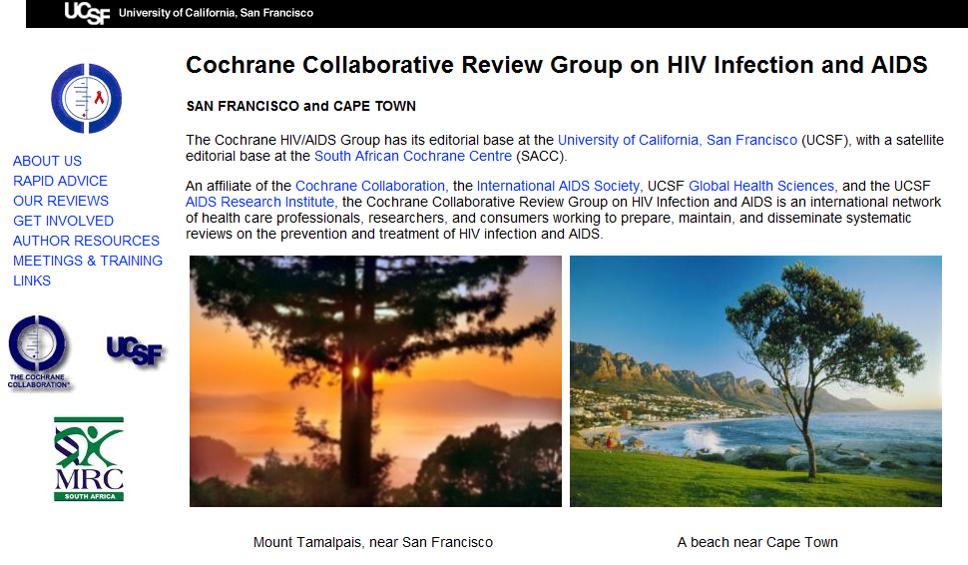
Cochrane Library Review Groups
http://www.igh.org/Cochrane

Slide 5
Learning Outcomes
Know how to construct comprehensive search strategies.
Be familiar with the OvidSP interface for searching databases such as Embase and Medline.
Know how to access full text journal articles.
Know how to access further help.

Slide 6
Databases
Provide a way of searching across a large number of journals to find relevant articles.
Contain a collection of Indexed references to journal articles.
Contain bibliographic information and abstracts of journal articles.

Slide 7




Choosing a database
Core databases
Medline - Accessible via the database hosts - PubMed and OVIDSP
Embase - Accessible via the database host - OVIDSP
Web of Knowledge
Cochrane Library

Slide 8
Planning your search
Before you start Searching…….
Make sure you have:
Asked a focused, answerable question
Broken your search down into its key concepts

Slide 9
Ask a focused, answerable question
Is health promotion a good thing?
How effective is sexual health promotion in HIV prevention.
Is acupuncture an effective treatment
How effective is acupuncture in smoking cessation programs?

Slide 10
Ask a focused, answerable question
What are the treatment outcomes for MDR-TB in children?

Slide 11
Planning your search
Break it down into separate keywords / subjects
Concept 1
Treatment
Outcomes
Concept 2
MDR-TB
Concept 3
Children
What are the treatment outcomes for MDR-TB in children?

Slide 12
Searching OVIDSP - Medline
The Medline database includes over 20 million citations for biomedical articles. It also includes links to many sites providing full-text articles.
Access OVIDSP via the library website:
www.imperial.ac.uk/library

Slide 13
Choosing your search terms
There are 2 ways to go about searching a
Database…..
Using Free text-word terms
Using Subject Headings

Slide 14
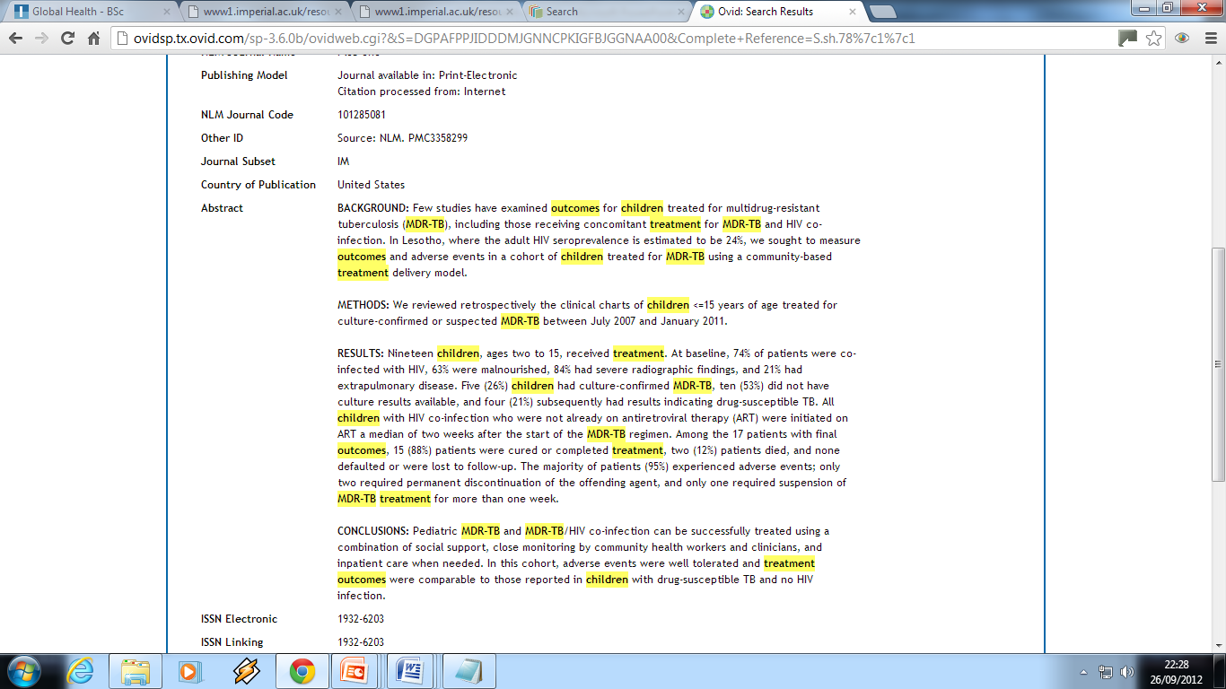
Text word Searching
Searches across the entire article reference

Slide 15
Synonyms and additional terms
Look out for spelling differences (e.g. British / US)
Plurals
  Treatment Outcomes OR Treatment Outcome
  Children OR Child OR Infant
Synonyms / Abbreviations
  MDR-TB Multidrug Resistant Tuberculosis
  Multidrug OR Multi-drug
  Resistant OR Resistance

Slide 16
Search techniques
Truncation symbol (usually $ or *) e.g.
e.g. In OvidSP
  Child$ = Child OR Children
  Outcome$= Outcome OR Outcomes
Wildcard symbol
  P?ediatric$ = Paediatric$ OR Pediatric$

Slide 17
Search techniques – using Boolean
The term ‘OR’ will broaden a search
Concept 1
Treatment
Outcome$
Concept 2
MDR-TB
OR
Multidrug Resistant Tuberculosis
Concept 3
Child$
OR
Infant$
OR
P?ediatric
Items containing either word will now be searched for. Remember to Use all variations or synonyms of a word to be comprehensive.

Slide 18
Search techniques – using Boolean
The term ‘and’ will narrow your search
Concept 1
Treatment
Outcome$
Concept 2
MDR-TB
OR
Multidrug Resistant Tuberculosis
Concept 3
Child$
OR
Infant$
OR
P?ediatric
AND
AND
Items containing all words will now be searched for. Using ‘and’ will usually result in fewer but more relevant hits.

Slide 19
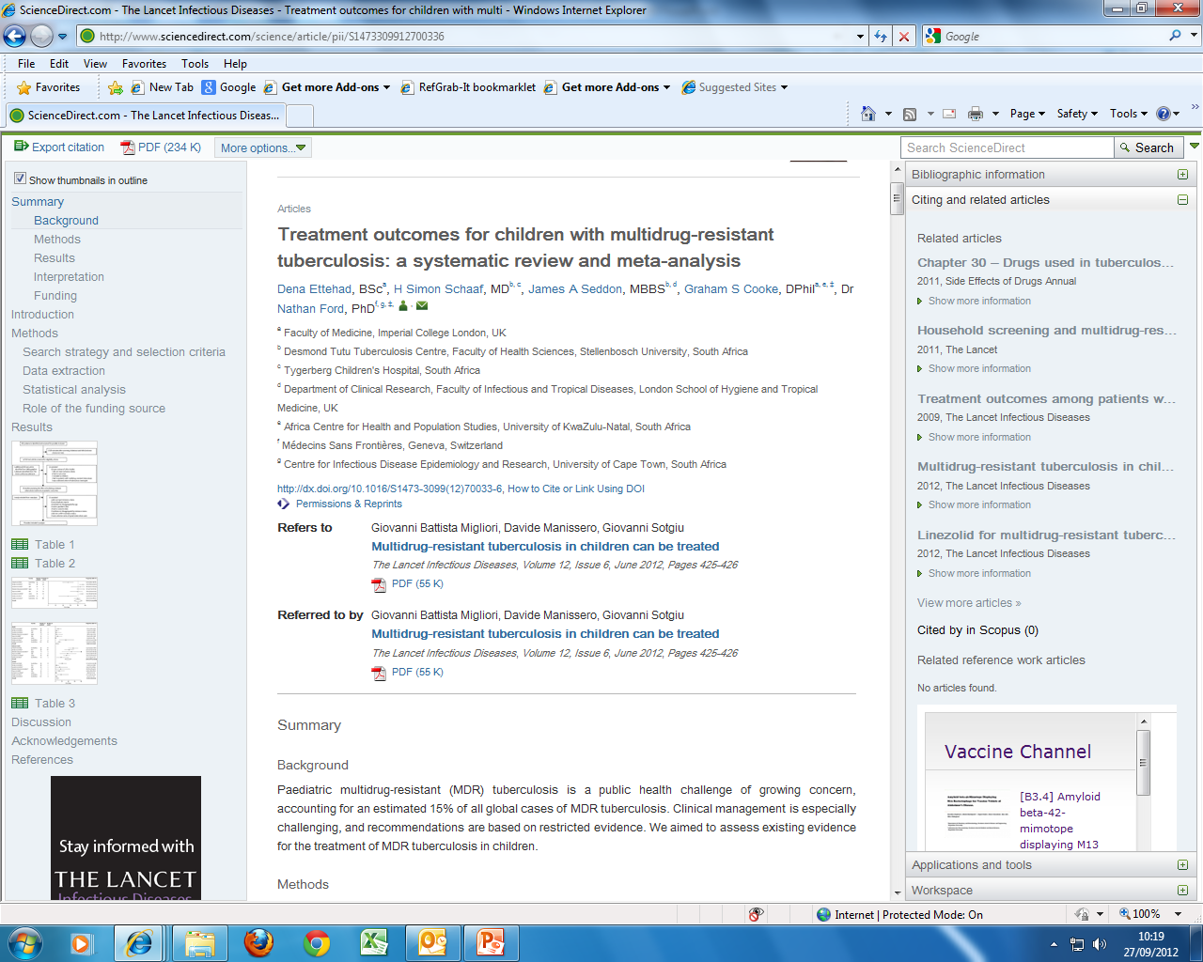
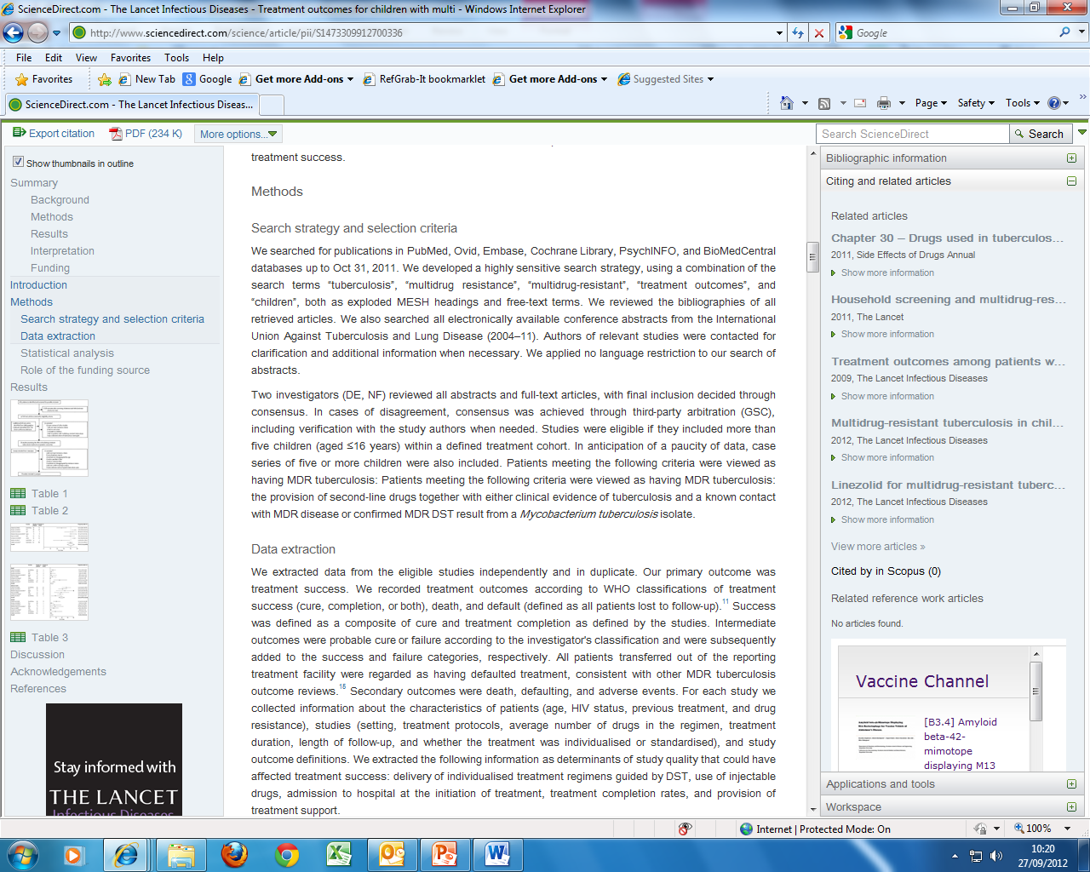
We developed a highly sensitive search strategy, using a combination of the search terms “tuberculosis”, “multidrug resistance”, “multidrug-resistant”, “treatment outcomes”, and “children”, both as exploded MESH headings and free-text terms.

Slide 20

Subject Headings (indexing terms)
Heart Disease
Neoplasms
Diabetes

Slide 21
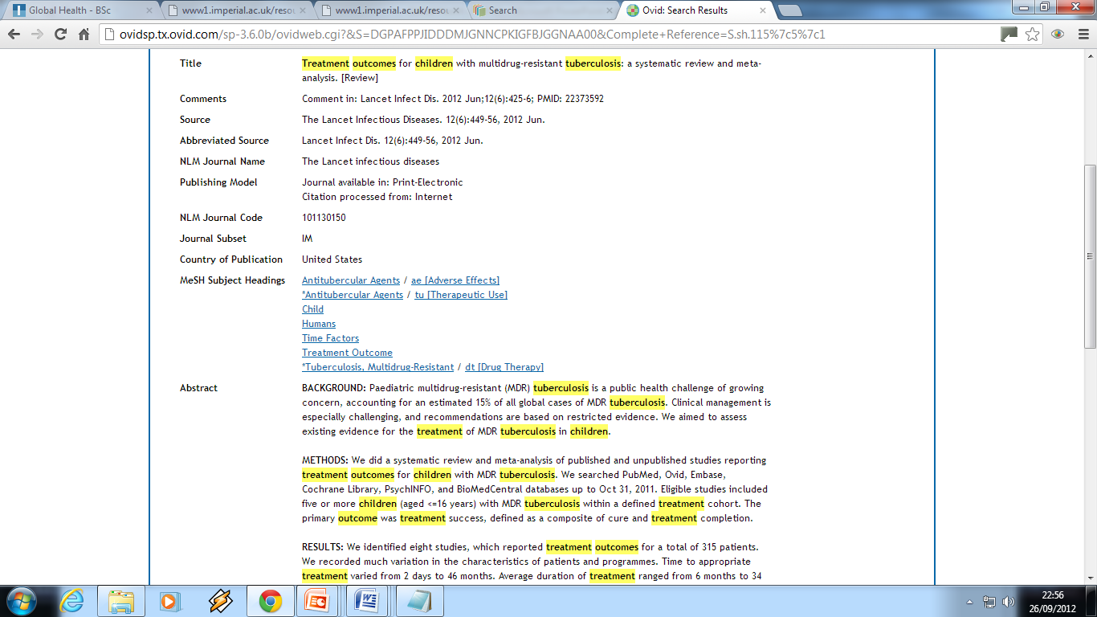

Slide 22
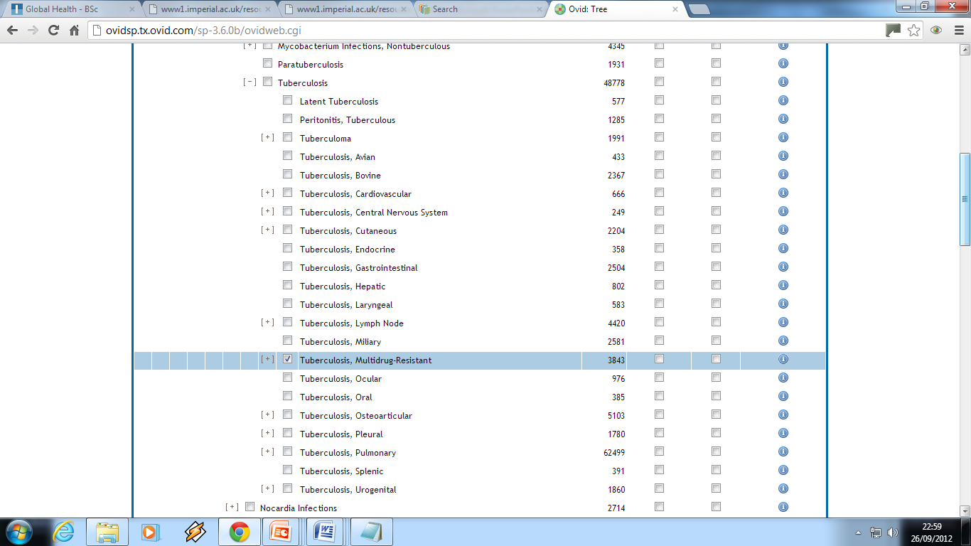
Subject Headings (indexing terms)
Tuberculosis
, Multidrug-Resistant

Slide 23
Subject Headings (indexing terms)
MeSH (Medical Subject Headings) OR Thesaurus
(Name varies across databases)
Controlled vocabulary: Articles indexed regardless of author’s terminology
Time delay while article are indexed

Slide 24
Text word Searching
Use text-words when:
There is no appropriate subject heading
The database does not have a thesaurus
If you are looking for very recent material (it takes time to index new and recently added articles)
Things to remember:
Likely to retrieve irrelevant results
Use all variations or synonyms of a word to be comprehensive

Slide 25

Combine Methods
For a comprehensive search use a combination of both methods
Searching a database is not an exact science.
Try different search combinations to get a good set of results.
Useful search tip
To find relevant subject headings, conduct a basic text-word search first, check records of relevant articles for the subject headings used.

Slide 26
Setting Limits
  Publication year
  Publication / article type
  Age group
  Gender
  Language

Slide 27
Search Questions
Aspirin for the primary prevention of coronary heart disease
Aspirin [MeSH] AND primary prevention [MeSH] AND Coronary Diseas [MeSH]

Slide 28
Search Questions
Effectiveness of Oxygen therapy for lower respiratory tract infections in children
Oxygen Inhalation Therapy[MeSH] AND Respiratory tract infections [MeSH] AND Child [MeSH]

Slide 29
Useful Resources
Greenhalgh, T. How to read a paper : the basics of evidence-based medicine, 4th edition, London, BMJ Books.
Online Library Resource Support Guides: http://www3.imperial.ac.uk/library/subjectsandsupport/medicine/researchsupport/resources
Medicine databases
http://www3.imperial.ac.uk/library/subjectsandsupport/medicine/eresources

Slide 30

Reference management software package
Save and organise your references
Web based – available wherever you are
Create citations and a bibliography from saved references

Slide 31
Accessing RefWorks
#1-Go to the library homepage: http://www3.imperial.ac.uk/library
#2-Select Reference Management under the ‘Find Out About’ column
#3-Once you’re on the Reference Management page, select RefWorks from the column on the right
#4-Select Log in to RefWorks at the bottom of the RefWorks page

Slide 32
Further Support
Charing Cross
Kate Perris
k.perris@imperial.ac.uk
Tele: +44 (0)20 7594 0756
St Mary's
Jackie Cousins
j.cousins@imperial.ac.uk
Tele: +44 (0)20 7594 3691
Hammersmith
Michael Gainsford
m.gainsford@imperial.ac.uk
Tele: +44 (0)20 7594 1740
Contact your Liaison Librarian
Medicine Team:
Royal Brompton
Andrew Regan
a.regan@imperial.ac.uk
Tele: +44 (0)20 7594 8150
Chelsea & Westminster
James Lockley
j.lockley@imperial.ac.uk
Tele: +44 (0)20 3315 8109

