Slide 1
Crash course in methods #4: the politics of evidence
Helen Ward
October 2012

Slide 2
Changes in global health funding*
Big increase in funding for global health
New multi-stakeholder institutions
Global Fund to Fight AIDS, Tuberculosis and Malaria
GAVI Alliance
New governance structures
*Sridhar D (2012) Who Sets the Global Health Research Agenda? The Challenge of Multi-Bi Financing. PLoS Med 9(9): e1001312. doi:10.1371/journal.pmed.1001312

Slide 3
Different structure of governance
WHO/World Bank multilateral institutions
Boards comprise member states
Global Fund / GAVI boards include
civil society representatives
the private sector
the Bill & Melinda Gates Foundation

Slide 4
Different mandates
WHO and World Bank have broad health focus
WHO: “the attainment by all people of the highest possible level of health”
World Bank: “to alleviate poverty and improve quality of life”
GF/GAVI have narrow, problem focused mandate
Global Fund: “to attract and disburse additional resources to prevent and treat HIV/AIDS, TB and malaria”
GAVI: “to save children's lives and protect people's health by increasing access to immunisation in poor countries”

Slide 5
Further differences
Financing
Multi-stakeholder initiatives funded by voluntary contributions
WHO/WB by international agreements
Governance
WHO/WB work through government agencies with offices and personnel in recipient countries
Global Fund & GAVI work with many agencies, not governments

Slide 6
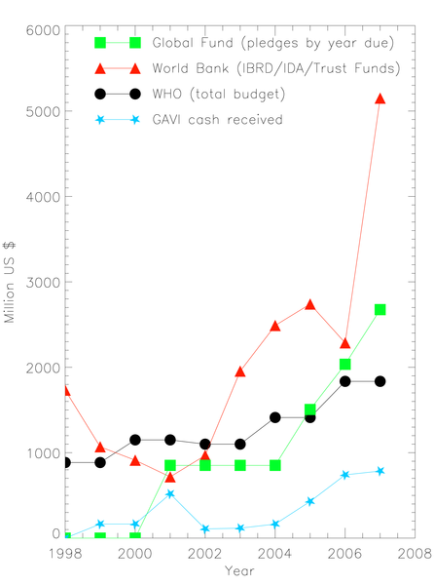
Figure 2. Old and new multilaterals in health [5],[6],[11],[15],[16].
Sridhar D (2012) Who Sets the Global Health Research Agenda? The Challenge of Multi-Bi Financing. PLoS Med 9(9): e1001312. doi:10.1371/journal.pmed.1001312
http://www.plosmedicine.org/article/info:doi/10.1371/journal.pmed.1001312

Slide 7
Content #4: The politics of evidence
Hierarchies of evidence
Control over evidence – gathering, accessing, using
Debates
Is quantitative better than qualitative evidence?
Is empirical better than simulated evidence?
Is evidence neutral?

Slide 8
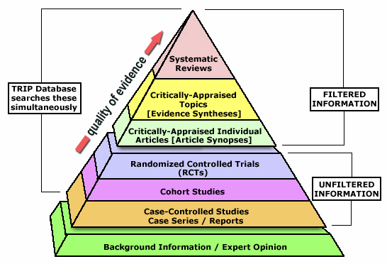
Hierarchies

Slide 9
Research process
Question
Design
Funding
Research team
Process
Analysis
Dissemination
Who is in control of these?

Slide 10
Challenges of participatory research
European sex work network*
Different perspectives (academic, public health, activism)
Debates on research and stigma
Surveillance and research
Use of knowledge
Is evidence neutral?
*Day S; Ward H. Approaching health through the prism of stigma. In Sex work, mobility and health in Europe. 139-160. Day S (ed); Ward H (ed). Kegan Paul, London (2004).

Slide 11
Reading
Crisp, N. Turning the world upside down. The search for global health in the 21st century. RSM Press, London (2010).
Chapter 7: Practical knowledge for the 21st century (1) - people and patients
Chapter 8: Practical knowledge for the 21st century (2) – science and systems
Chapter 9: The paradigm shift to global health
Day S; Ward H. Approaching health through the prism of stigma. In Sex work, mobility and health in Europe. pp139-160. Day S (ed); Ward H (ed). Kegan Paul, London (2004).
Sridhar D Who Sets the Global Health Research Agenda? The Challenge of Multi-Bi Financing. PLoS Med 2012;9(9): e1001312. doi:10.1371/journal.pmed.1001312
Yamey G, Feachem R. Evidence-based policymaking in global health – the payoffs and pitfalls Evidence-Based Medicine 2011; doi:10.1136/ebm.2011.100060

