Slide 1
Crash course in methods #3: types of study
Helen Ward
October 2012

Slide 2
Continued from last session….
Confounding
Standardisation

Slide 3
Confounding
A potential confounder is any factor which is believed to have a real effect on the risk of the disease under investigation and is also related to the risk factor under investigation.
This includes
  factors that have a direct causal link with the disease (e.g. smoking and lung cancer)
  factors that are good proxy measures of more direct unknown causes (e.g. age and social class).

Slide 4
Common confounders
Age
  Elderly people much more likely to be ill
Sex
Socio-economic status
  Poorer people have higher rates of almost all diseases

Slide 5
Confounding - example
Coffee consumption is associated with the risk of cancer of the pancreas.
Disputed because coffee consumption is correlated with cigarette smoking, and cigarette smoking was known to be a risk factor for pancreatic cancer.

Slide 6
Confounding
Confounder
(e.g. smoking)
Outcome
(e.g. ca pancreas)
Risk Factor
(e.g. coffee drinking)
Notes:
Association between smoking and occupation
Independently associated with outcome

Slide 7
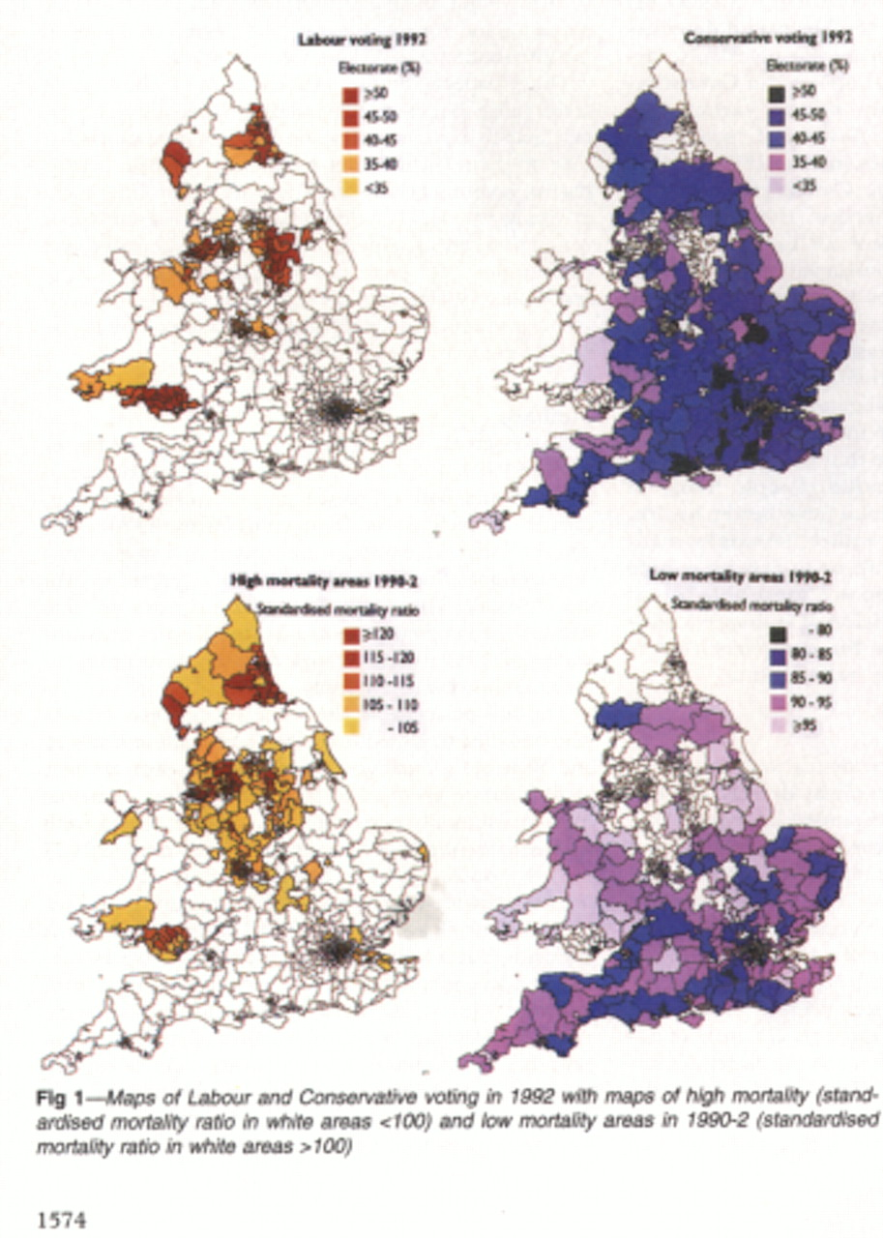

Slide 8
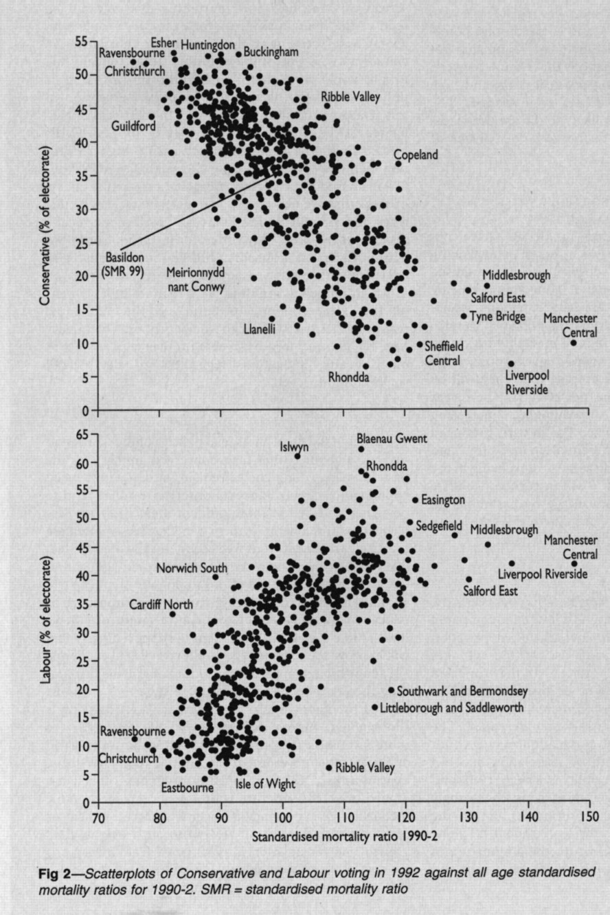

Slide 9
How to deal with confounding
Selection
Stratification
Standardisation
Regression

Slide 10
Standardisation
Two common confounding factors are age and sex.
Crude mortality from all causes in males over a five year period was higher in Bournemouth than in Southampton.
However, this difference disappears when death rates are compared for specific age groups.

Slide 11
Crude and age specific rates
Crude death rates: Bournemouth 1,694 per 100,000
Southampton 1,190 per 100,000

Slide 12
Standardisation
To compare them while controlling for age:
  take the age-specific death rates for Bournemouth
  apply these to Southampton’s population
  produce an expected number of deaths
  Compare the observed deaths with those expected
  Result is an age standardised mortality ratio

Slide 13
Standardised Mortality Ratio
SMR = 111, thus Southampton has a HIGHER death rate than Bournemouth

Slide 14
Session 3: Types of study in global health

Slide 15
Content #3: Types of study in global health
Epidemiological & clinical
  Observational
  Experimental
Simulation
  Mathematical models
  Economic models
Qualitative studies
Systematic reviews

Slide 16
Suggested hierarchy of studies
Systematic reviews/Meta-analyses
Randomised trials (experimental studies)
Cohort studies
Case-control studies
Ecological and time trend studies
Cross sectional studies
Case studies/series
Expert opinion

Slide 17
Descriptive vs. analytical
Descriptive
  Distribution of disease including what population or sub-groups are at risk, what geographical locations, frequency over time
Analytic
  Determinants of disease by testing hypotheses with ultimate goal of judging whether exposure causes or prevents disease

Slide 18
Case studies
Description of one or a few cases
  First few cases of AIDS in San Francisco
  Wakefield et al. Autism and MMR
Useful for generating hypotheses
Unable to establish associations or causal relationship
Unable to determine incidence or prevalence
Take with a pinch of salt

Slide 19
Descriptive studies
Cross sectional
  Surveys
  Census
Vital statistics
Other routine sources of data

Slide 20
Cross-sectional surveys
Describing the distribution of factors or disease in relation to:
  Person (age, sex, race, marital status, occupation, lifestyle)
  Place (variation between and within countries)
  Time (variation over time and season)
Notes:
Cross-sectional studies are typically household interview surveys in which a large number of questions are asked both about illnesses and social circumstances and demographic details. Then some matchings are done between each illness and each factor to try to see if there is a relationship to be found, such that those with the illness have the factor and those without the illness do not. This is sometimes called a “fishing trip” when the study is done without a preconceived idea as to what hypothesis would be generated.

Slide 21
Quickly and easy
Useful for health care providers to allocate resources efficiently and plan effective prevention
Providing clues leading to hypotheses which can be tested in analytical studies
Status of individuals with respect to absence or presence of both exposure and disease assessed at the same point in time
Cannot easily distinguish whether exposure preceded disease

Slide 22
Examples
2001 Census
Health Survey for England
Central overweight and obesity in British youth aged 11-16 years: cross sectional surveys of waist circumference

Slide 23
Ecological studies
Use groups or populations rather than individuals as units of observation.
Include studies of geographical differences and time trends in disease incidence and prevalence.
While ecological studies provide useful information on exposure, disease and modifying factors, they are, in most cases inadequate to establish causal relationships.

Slide 24
Temporal
Increasing incidence of melanoma in Britain has been linked with greater exposure to sunlight (from fashions in dress and holidays abroad)
Successive rises and falls in mortality from cervical cancer have been related to varying levels of sexual promiscuity, evidenced by notification rates for gonorrhoea

Slide 25
Caution with ecological studies
Confounders – age, sex, socio-economic deprivation, others
Bias – collection of data, recording systems.

Slide 26
Case-control studies
A case group with disease compared with control group without disease and the proportion of exposed in each group compared

Slide 27
Odds ratio
A measure of association
used in case control and cross sectional studies
Does not need incidence data
Is generally a good estimate of relative risk

Slide 28
Odds ratio
 | Disease | No disease
exposed | a | b
Not exposed | c | d
Odds ratio = odds of exposure in cases = a / c = ad
odds of exposure in controls b / d bc

Slide 29
Case control studies
Mitchell et al. Cot death supplement. Results from the first year of the New Zealand cot death study. NZ Med J 1991;104:71-76
de Jonge et al. Cot death and prone sleeping position in the Netherlands. BMJ 1989;298:722
Fleming et al. Interaction between bedding and sleeping position in the sudden infant death syndrome: a population-based case control study. BMJ 1990;301;85-9

Slide 30
Fleming et al.
All infants dying suddenly in Avon & Somerset over 18 month period
Contacted GP and health visitor and asked to identify 2 other infants living in same neighbourhood of same age
Parents visited ASAP as part of bereavement service - detailed structured interview

Slide 31
Fleming et al.
67 unexplained deaths (cases)
134 comparison babies (controls)
Detailed structured history
  social factors
  maternal medical history
  pregnancy and perinatal history
  medical history of baby
  details of infants last sleep

Slide 32
Sleeping position

Slide 33
Sleeping position
Odds of lying on front in cases = 62/5 = 12.4
Odds of lying on front in controls = 76/58 = 1.3
OR = 12.4/1.3
= 9.5

Slide 34
Environmental risk factors for SIDs
Sleeping position (9x)
Head covering (20x)
Smoking in pregnancy 20 day (9x)
Thermal insulation/overwrapping

Slide 35
Strength case-control studies
Quick and inexpensive
Well-suited for evaluation of diseases with long latent periods
Optimal for evaluation of rare diseases
Can examine multiple etiologic factors for a single disease

Slide 36
Limitations case-control studies
Inefficient for evaluation of rare exposures
Cannot compute incidence rates in exposed and unexposed individuals
The temporal relationship between exposure and disease may be difficult to establish
Problems with recall and selection bias

Slide 37
Examples
Mothers of children with congenital abnormalities are more likely to remember their exposures
Testis cancer patients more often report a trauma to their testicles

Slide 38
Hierarchy of studies
Systematic reviews/Meta-analyses
Randomised trials (experimental studies)
Cohort or case-control studies
Other comparative studies, including ecological studies
Descriptive studies
Case studies, professional experience, etc.

Slide 39
Cohort studies
Subjects classified according to presence or absence of exposure to factor and followed for a specific time period to determine the development of disease
Follow-up period of several years to allow an adequate number to develop the outcome

Slide 40
Strengths cohort studies
Valuable for rare exposures
Can examine multiple effects of a single exposure
Can elucidate temporal relationship between exposure and disease
Minimise bias in exposure ascertainment
Allows direct incidence calculation

Slide 41
Limitations cohort studies
Inefficient for evaluation of rare diseases
Prospective: expensive and time consuming
Retrospective: availability of adequate records
Losses of follow-up can affect results

Slide 42
Selection of the exposed population
For common exposures a number of populations can be selected
For rare exposures special exposure groups must be selected (special occupations). Advantages: Reduced sample size, accurate exposure ascertainment and follow-up
To ensure good follow-up certain professions, occupations, companies, unions, colleges, communities

Slide 43
Examples
Million Women Study
Members of 4 unions in Denmark were mailed and asked to participate in a study about reproduction and occupation
Framingham heart study followed 5100 members of this Massachusetts community for over 30 years
The Nurse’s health study followed 100,000 American nurses

Slide 44
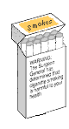
Relative risk
Calculated from cohort studies (or from population surveillance data)
Indicates how much more likely an exposed person is to suffer from the disease
For example,
  smokers are twice as likely to suffer from cardiovascular disease as non-smokers

Slide 45
Relative risk
 | Lung cancer | No lung cancer
Smokers | 40 | 1960
Non-smokers | 2 | 1998
Relative risk = incidence in exposed = 0.02 = 20
incidence in unexposed 0.001

Slide 46
Relative risk
 | Disease | No disease
exposed | a | b
Not exposed | c | d
Relative risk = incidence in exposed = a/(a+b)
incidence in unexposed c/(c+d)

Slide 47
Hierarchy of studies
Systematic reviews/Meta-analyses
Randomised trials (experimental studies)
Cohort or case-control studies
Other comparative studies, including ecological studies
Descriptive studies
Case studies, professional experience, etc.

Slide 48
Randomised Controlled Trial
A planned experiment
Designed to assess the efficacy of treatment or intervention
Comparison of outcomes in a group of patients treated with new therapy and those in a comparable group of patients with a control therapy
Patients in both groups enrolled, treated, and followed over the same time period

Slide 49
Randomisation
Method of assigning patients to treatment group
Avoid bias on the part of the investigator or patient
Tends to create comparison groups that are similar

Slide 50
Problems and issues
Non compliance
Loss to follow up
Validity of the results
Ethical issues
Numbers needed to treat (NNT)

