Slide 1
Crash course in methods #2: Interpreting evidence in global health
Helen Ward
September 2012

Slide 2
Content #2: Interpreting evidence in global health
What is the source of the evidence? (yesterday’s session)
Critical appraisal (methods, results, claims)
Design, analysis, interpretation
Commonly used statistics

Slide 3
What is critical appraisal?
Definitions…
You will cover this with practice in your modules

Slide 4
Global Facts
there were 139,300 measles deaths globally
nearly 380 deaths every day = 15 deaths every hour
2010 data
But how do we know? How was this figure arrived at

Slide 5
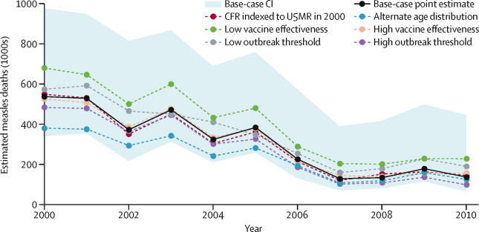
Global measles mortality, 2000 -2010
Figure 3 Global measles mortality re-estimated with alternative variable assumptions The <ce:cross-ref refid="sec1"> appendix</ce:cross-ref> provides details on assumptions. CFR=case-fatality ratio. U5MR=under-five mortality rate.
Simons E et al. The Lancet 2012;379:2173-2178. http://dx.doi.org/10.1016/S0140-6736(12)60522-4

Slide 6
Measuring health
Always consider the source of data
Was it whole population or sample?
What was the coverage?
Was it representative?
Could there be bias?
What definitions were used?
How comparable are data?

Slide 7
Interpreting associations
what are the possible explanations?
Chance
Bias
Confounding
Cause
There are methods for assessing each of these

Slide 8
Men who pay for sex
National survey (Natsal)
~6000 men in 1990, 2000
Asked about having paid a woman for sex
What are the possible explanations for this increase?
 | 1990 | 2000
Ever | 5.6% | 8.8%
Last 5 years | 2.0% | 4.2%

Slide 9
Has there been an increase in the proportion of men who pay for sex?
Chance?
Bias?
Confounding?
Cause?

Slide 10
Has there been an increase in the proportion of men who pay for sex?
Chance?
Look at confidence intervals
If the CI do not overlap then there is a statistically significant difference (at the 5% level)
Could use p value, but that includes less information
 | 1990 | 2000
Ever | 5.6% (4.9, 6.3) | 8.8% (7.9, 9.7)
Last 5 years | 2.0% (1.6, 2.5) | 4.2%(3.6, 4.9)

Slide 11
Chance
Most studies use samples of the population
Each time the population is sampled a slightly different group will be drawn
This produces variation in observed results

Slide 12
Bias
Types of bias
Information/measurement bias – did the method of collecting information change between the two rounds?
Selection bias: systematic differences in recruitment related to exposure or outcome
Recall bias; systematic different in recall of exposure
Observer bias: researcher measures differently
Can’t control for bias in analysis, have to reduce the possibility through design

Slide 13
Confounding
A false association between an exposure and an outcome due to a third factor that is associated with both
In this example, if there was a change in the sample (e.g. more men living in London) then this might confound the association

Slide 14
Cause
A true association may still not be a cause – more of this next time!

