Slide 1
Crash course in methods
Helen Ward
September 2012

Slide 2
Sessions
Measuring and comparing global health
Interpreting evidence in global health
Types of study in global health
The politics of evidence

Slide 3
Content #1: Measuring and comparing global health
Basic tools for describing health
Sources of information
Quality of data
Comparing populations

Slide 4
Content #2: Interpreting evidence in global health
What is the source of the evidence?
Critical appraisal (methods, results, claims)
Design, analysis, interpretation
Commonly used statistics

Slide 5
Content #3: Types of study in global health
Epidemiological & clinical
  Observational
  Experimental
Simulation
  Mathematical models
  Economic models
Qualitative studies
Systematic reviews

Slide 6
Content #4: The politics of evidence
Hierarchies of evidence
Control over evidence – gathering, accessing, using
Debates
  Is quantitative better than qualitative evidence?
  Is empirical better than simulated evidence?
Is evidence neutral?

Slide 7
Session 1: Measuring and comparing global health

Slide 8

Exercise 1: Rank in order of importance in global health
Cardiovascular disease
Neglected tropical diseases
Neuropsychiatric disorders
All infectious diseases
HIV/AIDS
Cancers

Slide 10
Exercise 1: Rank in order of importance in global health
Cardiovascular disease
Neglected tropical diseases
Neuropsychiatric disorders
All infectious diseases
HIV/AIDS
Cancers

Slide 11
Mortality: % of all global deaths
 | Mortality
Cardiovascular disease | 29.1
Neglected Tropical diseases | 0.2
Neuropsychiatric | 2.1
HIV/AIDS | 3.5
Cancers | 12.6
All infections | 16.2
Global Burden Disease 2004 Update, 2008

Slide 12
What is a DALY* (disability-adjusted life year)?
A composite measure of morbidity and mortality
DALY = YLL + YLD
  YLL = years of life lost
  YLD = years lived with disability
One DALY is a year of perfect health lost
*Developed for the World Bank to compare the health burdens of different diseases across the world

Slide 13
Burden: % of global DALYs
 | DALYs
Cardiovascular disease | 9.9
Neglected Tropical diseases | 1.3
Neuropsychiatric | 13.1
HIV/AIDS | 3.8
Cancers | 5.1
All infections | 19.8
Global Burden Disease 2004 Update, 2008

Slide 14
In rank order of global burden
 | Mortality | DALYs
Cardiovascular disease | 1 | 3
Neglected Tropical diseases | 6 | 6
Neuropsychiatric | 5 | 2
HIV/AIDS | 4 | 5
Cancers | 3 | 4
All infections | 2 | 1
Global Burden Disease 2004 Update, 2008

Slide 15
Many different things to measure
Health (“a state of complete physical, mental, and social well-being and not merely the absence of disease or infirmity”)
Morbidity, disability – specific, all cause
Death – specific, all cause

Slide 16
Many different parameters
Count
Incidence
Prevalence
Mortality

Slide 17
Prevalence
Definition: the proportion of people with a disease at any point (point prevalence) or period (period prevalence) in time
Measures the burden of disease in a population, can compare disease burden between populations.
Obtained from cross sectional studies and health service activity data

Slide 18
Incidence
Definition: the number of new cases of the disease in a defined population over a defined period of time.
Incidence measures events (a change from a healthy state to a diseased state)
Also referred to as risk, i.e. indicates the probability of acquisition of a disease over a period of time
Derived from routine data of mortality, cancer registries, population surveys or research studies

Slide 19
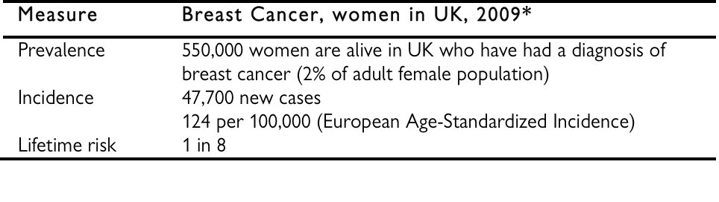
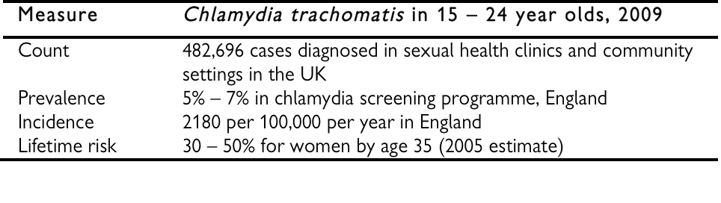
Examples: incidence and prevalence
Source: Ward et al, Ox Handbook Epi for Clin 2012

Slide 20
Mortality – several different measures
Crude mortality rate: numbers per 1000 population per year
Age specific death rates
Case fatality rate: proportion of cases of a disease that die
Infant mortality rate: the number of deaths of infants under age 1 per 1000 live births in a given year
Neonatal mortality rate: number of deaths of infants under 28 days per 1000 live births in a given year
The under-5 mortality rate: probability that a newborn baby will die before reaching age 5, given as a number per 1000 live births

Slide 21
Ten leading causes of death: high income countries

Slide 22
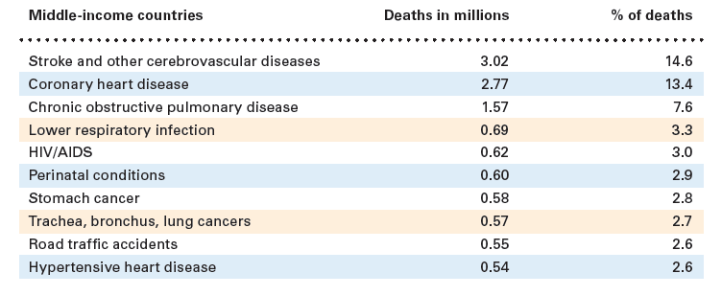
Ten leading causes of death: middle income countries

Slide 23
Ten leading causes of death: low income countries

Slide 24
What changes from high to low income countries?
Addition of “preventable” causes
HIV/AIDS – 7.5% of deaths (LIC)
Perinatal conditions – 6.4%
Road traffic accidents – 1.9%
Diarrhoeal disease – 5.4%
Malaria – 4.4%
TB – 3.8%
This is reflected in the age at death..

Slide 26
Exercise 2: Examples of data - discuss

Slide 27
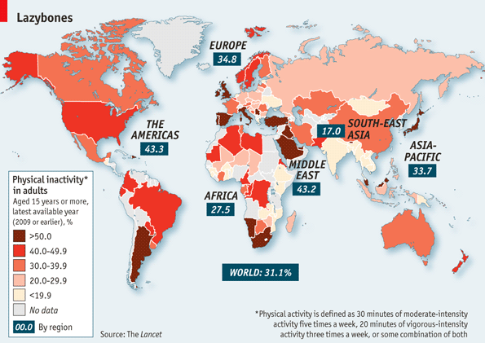
“Lazybones” – physical inactivity in adults
http://www.economist.com/node/21559319

Slide 29
TB data
source: WHO, cited in Ward et al Oxford Handbook Epidemiology for Clinicians, 2012

Slide 30
Global Data
Need data on population size
  Census
  Registration of births and deaths
  “vital statistics”
Data on health
  Registration/ reporting
  Cause of death
  Health service statistics
  Surveys

Slide 31
Global Facts
there were 139,300 measles deaths globally
  nearly 380 deaths every day = 15 deaths every hour
2010 data
But how do we know?
- discuss how you think this figure was arrived at

Slide 32
Case fatality rate
H1N1 influenza outbreak in 2009
Case fatality about 0.5%
Much higher earlier on in reports from mexico
  Why?

Slide 33
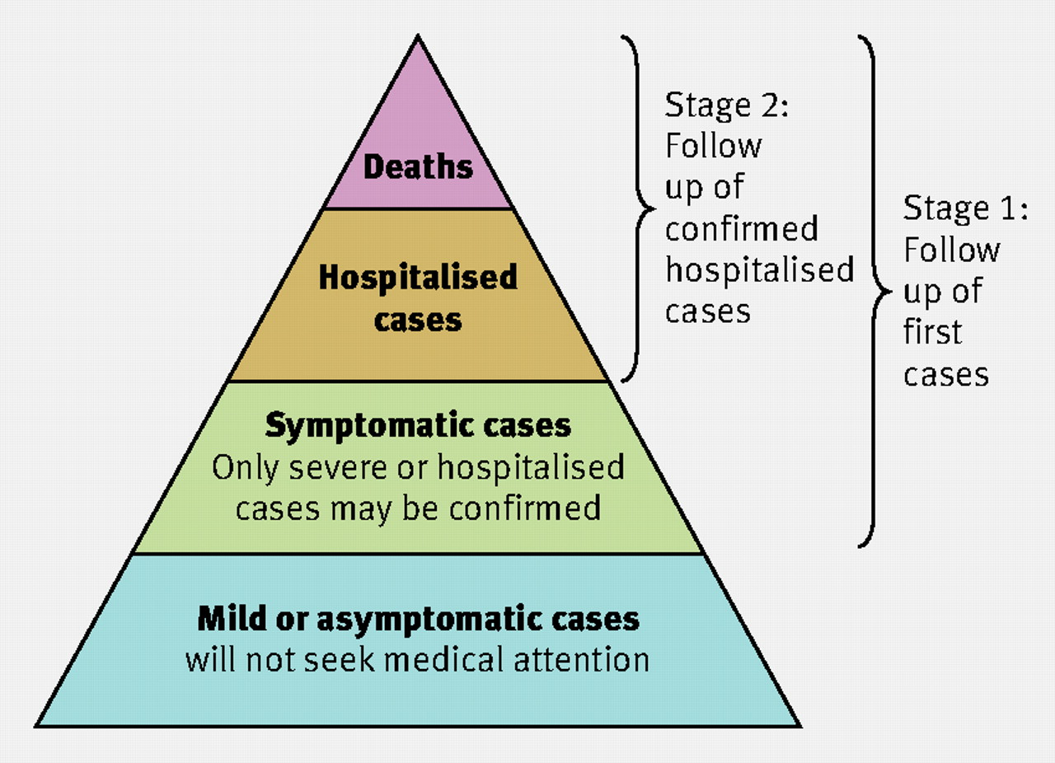

Fig 1 Spectrum of influenza cases.
Garske T et al. BMJ 2009;339:bmj.b2840
©2009 by British Medical Journal Publishing Group
Notes:
Fig 1 Spectrum of influenza cases. Infection in patients who die or are admitted to hospital will be ascertained throughout an influenza pandemic. Case fatality ratio estimates depend on how these cases change as a proportion of total case numbers as the pandemic progresses.

Slide 34
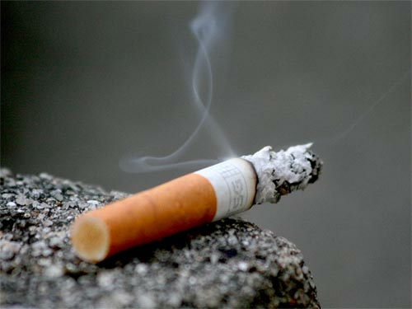
Estimated burden of disease attributable to tobacco*
Caused 100 million deaths in 20th century
One billion deaths in the 21st century
  5.4 million in 2005
  6.4 million in 2015
  8.3 million in 2030
10% of global deaths in 2015
  50% more people than HIV/AIDS
*Mathers CD, Loncar D (2006) PLoS Med 3(11): e442

Slide 35

Issues in tobacco control*
Success in many countries
  Legal and fiscal controls, health promotion
  Increased inequalities
Nearly 80% of the world's one billion smokers live in low- and middle-income countries
Tobacco companies continue to market and promote its use
WHO Framework Convention on Tobacco Control
*See special issue of Tobacco Control 2012;21

Slide 36
Measuring health
Always consider the source of data
  Was it whole population or sample?
  What was the coverage?
  Was it representative?
  Could there be bias?
  What definitions were used?
  How comparable are data?

