Slide 1
Tribology of implant materials
Philippa Cann
Tribology Group,
Department of Mechanical Engineering
Imperial College London

Slide 2
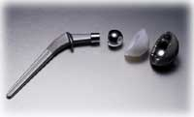
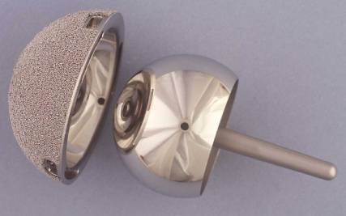
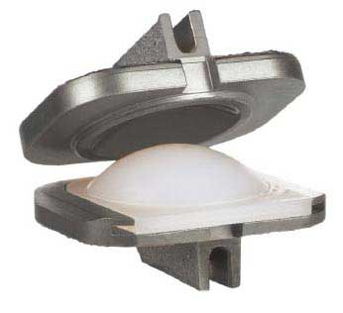
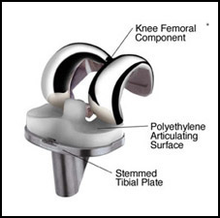
Structure of talk
Artificial joints – a tribology perspective
Implant requirements:
- Material properties
Implant tribology problems:
- Wear
- Corrosion
Measurement of wear
- Laboratory screening tests
- Explant wear measurement LIRC

Slide 3
Tribology?
Science of rubbing surfaces – friction, lubrication and wear
Load
Friction: interfacial force
Motion
SURFACE 1
F
h
Lubricant film thickness
SURFACE 2
Wear of interface - material loss or transfer
Lubrication: film separates the surfaces
Surfaces: metal, skin, wood, plastic, cartilage, ice, rock
Lubricant: water, oil, graphite, synovial fluid, skin cream, custard, gases

Slide 4
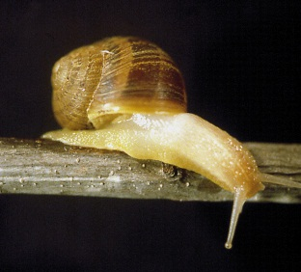
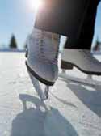

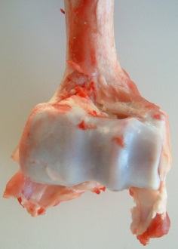
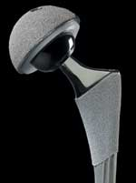
Tribology is everywhere….
Tribological ‘rules’ govern interfacial behaviour on (almost) any scale
Determine performance and component life in many systems:
- Bearings, gears, piston/cylinder
- Ice skating, curling,
- Hair conditioners, cosmetics, skin cream
- Rail/wheel adhesion ‘leaves-on-the-line’
- Earthquakes……
Bio-Tribology: contact lenses, cartilage, snail movement and synovial joints.

Slide 5
Tribology parameters – describe lubricated contact
Operating conditions
Load
Mean speed
Temperature
Geometry
Load
Pressure profile
Contact pressure
Film thickness
Surface separation
Lubricant flow
Movement
Wear
Friction
Component failure
Lubricant properties
Surface properties
Viscosity (rheology)
Chemistry
Elasticity
Mechanical properties
Surface roughness

Slide 6
Load and contact pressure
LOAD
Elastic deformation of surfaces: load supported over an area
Hertz contact pressure: force/area (Pa N/m²)
Load = Mass x g = Force (N)
Reduce contact pressure: Increase load bearing area (component size, conformity)
Softer materials (more deformation)
LOAD
Pressure profile

Slide 7
Tribological function of implant
Load bearing:
- 10x body weight (low contact pressures MPa)
- Transient loading: millions of cycles
Facilitate movement:
- Two surfaces in relative motion: sliding (fretting) or rolling
Lubrication:
- Synovial fluid - complex chemistry
- Salt solution
Fatigue and fracture
Surface damage: wear and failure
Corrosion

Slide 8

Role of a lubricant ?
Formation of an interfacial film to optimise friction & control surface damage:
Different types of film:
- Fluid film: generated by hydrodynamic action of moving surfaces
- Boundary layer: thin chemical film formed by reaction or adsorption at the implant surface
Lubricant film fails to protect surfaces:
- Wear: abrasive, adhesive
- Corrosive wear: chemical attack at the surfaces
- Fatigue fracture: due to repeated loading
- High friction: mechanical loosening

Slide 9
Lubrication regimes and friction: Stribeck curve
μ = friction force/normal load
λ<1
λ>1
λ>3
0.1
0.01
0.001
Boundary
Mixed
Fluid film
μ
λ<1
λ>1
Synovial joint μ
λ = film thickness/combined surface roughness
Increasing film thickness (speedxviscosity)
Decreasing surface wear

Slide 10
Lubrication of implants
Properties of lubricant film determine wear and failure:
- Film thickness required to separate surfaces
- Chemical and physical properties (adherence, corrosion, mechanical properties)
Film thickness factors include:
- Fluid physical properties (viscosity)
- Fluid chemistry (surface active species)
- Kinematics (speed, relative motion of surfaces)
- Loading (steady-state, transient)
Low load
Film thickness
Fluid film thickness ~ (viscosity x speed)^{n} Load
High load
Speed

Slide 11
Synovial fluid properties
Synovial fluid (SF):
- Hyaluronan (HA): linear polysaccharide
- Various proteins (18-20 mg/ml)
- Phospholipids, salts
- pH ~ 7.3-7.43 (Kitano et al 2001)
- Highly non-Newtonian ~ 0.01 PaS
Effect of disease/periprosthetic SF
- Viscosity decreases ~ 0.005 PaS
- Protein content increases (25-50 mg/ml)
- pH increases ~ 7.5-8.5 (Kitano et al 2001)
10³
10²
10¹
10⁰
10⁻¹
10⁻²
10⁻³
Newtonian fluid
Cooke et al 1978
Normal
Viscosity [PaS]
OA
RA
10⁻¹ 10⁰ 10¹ 10² 10³ 10⁴
Shear rate [s⁻¹]
Physiological shear rates

Slide 12
Hip joint gait cycle
Transient loads/speed - lubrication mechanisms and film formation vary over the gait cycle
5
4
3
2
1
0
50
40
30
20
10
0
Fluid film: high speed
Vertical force/body weight
Mean speed [mm/s]
Boundary: low speed
0.0
0.2
0.4
0.6
0.8
1.0
Time [secs]

Slide 13

Articular cartilage tribology
Low friction and wear over an extended operating life with no maintenance
- Transmit large loads
- Minimise friction and wear
- Contributes to lubrication process
Articular cartilage:
- Visco-elastic, soft
- Rough (Ra~1-2 μm)
- Biphasic porous material – active role in lubrication mechanisms
Lubricant: synovial fluid
- Film formation, surface protection
- Debris removal
Articular surface
Surface roughness ~ 1000 nm
Young’s modulus: 0.001 GPa
Water
Subchondral bone
Collagen fibrils

Slide 14
Implant material requirements
Long life - millions of loading cycles with no maintenance
Properties:
- Correct mechanical properties – strength/flexibility
- Resistant to corrosion, degradation and wear
- Biocompatibility: bulk and particles
- Cost/fabrication considerations
Materials:
- Natural: Articular cartilage:
- Artificial: Metal/polymer/ceramic
Component failure due to surface damage:
- Cartilage wear : osteoarthritis
- Prosthesis wear: polymer/metal debris – implant revision

Slide 15
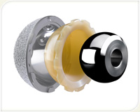
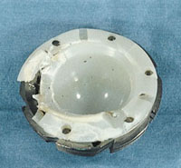
Polymers: Ultra High Molecular Weight Polyethylene (UHMWPE)
Used for:
- Acetabular cups/liners (Metal-on-Polymer)
- Knees
Advantages:
- Elastic properties mimic cartilages - low pressures
Disadvantages:
- Poor wear properties (linear wear up to 1 mm/yr)
- Fatigue/fracture – at the lip
- Limited life (~15 years) – not suited to younger patients

Slide 16
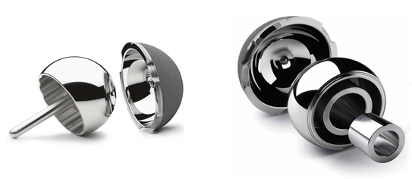
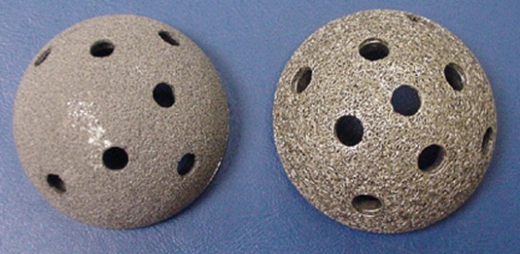
Metal alloys: Chromium Cobalt and Titanium
CrCo alloy (CrCoMo ):
- Hips and knees (femoral heads, acetabular cups)
Advantages: Disadvantages:
- Low wear (2-5 μm/year) - Nanometre wear particles
- Good corrosion resistance - MoM hips high revision rates (> 5%/5yrs)
Titanium (Ti6Al4V):
- Knees and acetabular cups (porous backing)
- Stems
Advantages: Disadvantages:
- Good corrosion resistance - Poor wear properties
- Good biocompatibility - Susceptible to fretting/corrosion
- Lower Young’s modulus

Slide 17
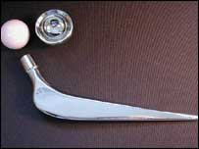
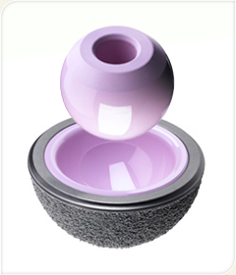
Ceramic: Alumina/zirconia
Used for:
- Hip joints (head/cup CoC, CoM)
Advantages:
- Hard, inert, good wear resistance
- Good wettability
- Very good biocompatibility: no toxicity or hypersensitivity reactions
Disadvantages:
- Fragile: susceptible to fracture (overall fracture rate 0.004%)
- Squeaking

Slide 18
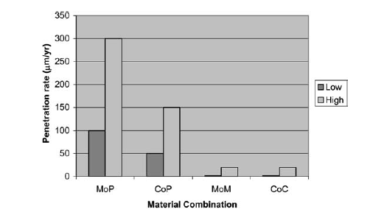
Comparative wear of materials
Review of clinical wear rates (hips) with different bearing materials (Semlitsch and Willert 1997)

Slide 19
Wear of implants
Loss or transfer of material from the surfaces
Abrasion – wear particles trapped in the contact zone
Adhesive - surfaces ‘weld’
- Particles torn from surface
Corrosive – formation of brittle reacted layer
- Abraded
Fatigue - repeated stress cycles
- Crack formation
- Breakage
Wear particles
Surface fatigue
Component fracture

Slide 20
Why do artificial joints wear?
Component factors:
- Component design, material combination (galvanic corrosion), manufacture
Clinical factors:
- Implantation: misalignment, fixation
- Patient: gait, synovial fluid properties
SF properties:
- Corrosion: pH, salt content, proteins
Surface material properties:
- Too soft: easily removed
- Abrasion due to carbides or other abrasive particles (bone cement/bone)
- Loss of surface material due to chemical reaction
CrCoMo – surface ‘rough’ ~ 20nm

Slide 21
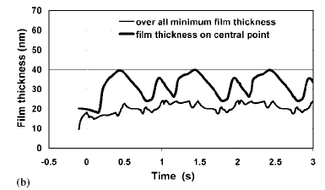
Predicted film thickness MoM hip joints
Synovial lubricant films are very thin
- Any reduction could lead to surface damage
MoM surface roughness
Jalali-Vahid, Jin and Dowson 2005

Slide 22
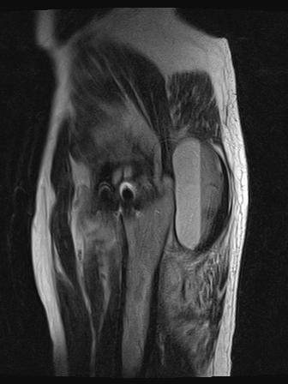
Consequences of surface damage and wear
MRI
Affect joint function
- Severe wear (polymer) impair joint function
Formation of wear particles:
- Adverse tissue reaction to wear debris
- Pain - revision of implant
Fatigue and fracture due to repeated loading/rubbing
- Cup (UHMWPE) lip fracture
- Ceramic fracture
Metal-on-metal
hip
Inflammatory mass

Slide 23
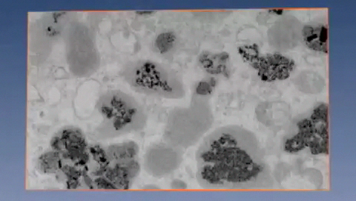
Wear particles
UHMWPE
- μm sized wear particles (<1-30 μm)
- Osteolysis – component loosening
- Limited component life
CrCoMo
- nm sized wear particles (~30nm)
- Increased Cr/Co ion levels in blood
- Pain, joint revision
Metallic debris in tissues surrounding MoM hips with unexplained failure
Hart et al Acta Biomateriala 2010

Slide 24
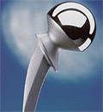
Reducing artificial joint wear
Increase component life and reduce wear - optimise tribology
Increase hip joint diameter
Decrease clearance
Increase lubricant film thickness
Improve synovial fluid properties ?
Optimise/control component position and alignment
Wear resistant surface coatings (DLC)
New materials (ceramics)
Better manufacturing methods
Improve surface finish
Improve wear properties

Slide 25
Measurement of implant wear - Why?
Improved simulation
Increasing complexity
Develop new materials
Develop new implant designs
Retrieval failure analysis
Laboratory test: material properties
Simulator test: design and material properties
In Vivo: design, material, surgeon, patient factors

Slide 26
Wear measurement – simple rubbing tests
Pin on disc
Measure surface wear:
- Material properties
- Surface texture/coating
- Lubricant properties
Advantages:
- Controlled conditions (temps,speed,load)
- Accelerated screening tests (~10⁶ cycles)
- Easy wear measurement: gravimetric or surface profilometry
Disadvantages:
- Poor simulation of joint kinematics
- Static loading
- Screening tests only
Wear track
pin
Single axis
Wear track
Dual axis – polymer wear

Slide 27
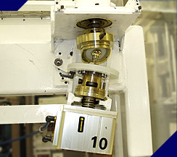
Wear measurement – joint simulator tests
Measure wear:
- Material/coating properties
- Joint design/alignment
- Lubricant properties
Advantages:
- Realistic gait simulation: transient loads/speed
- Complex wear path
- Real components
Disadvantages:
- Very expensive machines
- Long test time ~ 6 months 10⁶ cycles
- Difficult to measure wear of surfaces

Slide 28
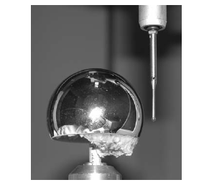
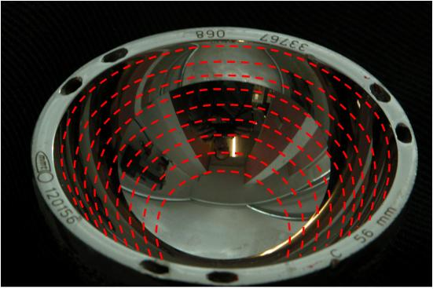
How do we quantify wear loss?
Very small amount of material lost from the surface:
- Typically very low wear rate
- MoM linear wear rate ~ 6 μm per year
In vitro simulator tests
- Gravimetric: weigh joint before/after testing
- Surface profile: form measurement before/after testing
In vivo: explanted hip joints LIRC
- Gravimetric not possible
- Form measurement CMM/out-of-roundness
- Reference measurement not available

Slide 29
Summary: Implant Tribology
Tribology is the science of friction, lubrication and wear
Requirements of implant materials: Implant materials:
- Strength - CrCoMo, titanium alloy
- Biocompatibility (bulk, particles) - UHMWPE
- Low wear - Alumina/Zirconia
- Easy to manufacture
Implant failure is often due to poor tribology and excessive surface wear or fracture

Slide 30
Summary: Implant Wear
Wear: loss or transfer of material from the surface
- Inadequate protection of the surface by a lubricant film (SF)
- Material surface properties (too soft)
- Surface embrittlement due to corrosion or oxidation (UHMWPE)
Consequences: Formation of wear debris
UHMWPE : CrCoMo
-μm sized particles - nm-sized wear particles
- Osteolysis, component loosening - High blood Cr/Co ion levels
- Reduced component life ~ 15 yrs - High revision rates

Slide 31
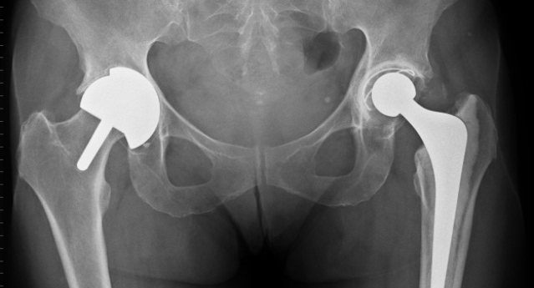
Summary: Strategies to reduce wear and failure
Implant materials:
- Improved wear properties, corrosion-resistance
- Biocompatibility (wear debris)
Implant design and manufacture;
- Surface engineering (surface roughness/coatings)
- Implant geometry and conformity
Clinical factors:
- Implant position and fixation
Patient factors:
- Lifestyle, gait
- Synovial fluid properties

Slide 32
Comparison of natural and artificial hip maximum contact pressures
Material Youngs Modulus Max. Contact pressure
Cartilage 0.001 GPa 0.3 MPa
UHMWPE 1 GPa 5 MPa
CrCoMo 230 GPa 70 MPa
Ceramic 400 GPa >100 MPa
Increasing
pressure
Rolling element bearings: 1-3 GPa (10⁹)
Page 32
© Imperial College London
Notes:
32

