Slide 1
Design of a training curriculum
Pritam Singh MA MRCS
Clinical Research Fellow
Division of Surgery
Department of Surgery & Cancer
Imperial College London

Slide 2
Learning Objectives
Definitions of terms used within the surgical education literature
Outline the difference between proficiency – versus time-based learning schedules
Defend a curricular approach to acquisition of surgical skills
Examples of surgical training curriculums
National specialty based
Technical skills

Slide 3
Definition of a curriculum
A statement of the intended
Aims and objectives
Content
Experiences
Outcomes and
Processes of a programme,
Including a description of the structure and expected methods of
Learning
Teaching
Feedback and
Supervision.
The curriculum should set out what
Knowledge
Skills and
Behaviours the trainee will achieve.
Source: ‘Standards for curricula and assessment systems’ General Medical Council

Slide 4
Definition of a syllabus
Details the content and outcomes of learning to be achieved at each stage of training:
What trainees are expected to know
What trainees are expected to be able to do
Expectations are matched to points of training
Source: ‘The Intercollegiate Surgical Curriculum – Educating the surgeons of the future’

Slide 5
Definition of an assessment
A systematic procedure for measuring a trainee’s progress or level of achievement
Measured against defined criteria to make a judgement about a trainee.
Source: ‘Standards for curricula and assessment systems’ General Medical Council

Slide 6
Definition of an assessment system
Integrated set of assessments
In place for the entire postgraduate training programme
Blueprinted against, and supports, the approved curriculum.
Can use different methods
Can be implemented as national examinations or workplace based assessments
Competence v Performance
Performance based assessment becomes more important as trainees’ experience increases
Source: ‘Standards for curricula and assessment systems’ General Medical Council

Slide 7
Definition of competence
Competence is a complex structuring of attributes needed for intelligent performance in specific situations
It incorporates the ideas of professional judgement
Source: Gonczi, A. (1994) Competence based assessment in the professions in Australia, Assessment in Education 1(1) 27–44.

Slide 8
Why do we need a competency based curriculum?
Traditionally time-based
Assumption:
After a certain number of years of training competency will be achieved
With enough time, trainees will gain enough experience to gain a broad training
Volume based
Logbook numbers
Assumption:
Volume of cases seen/performed will act as a surrogate marker of competency
Number of cases is proportional to ability
Stands to reason ‘practice makes perfect’

Slide 9
Why do we need a competency based curriculum?(2)
Time based
Problems with assumptions:
Does not account for variations in workload – numbers can still be low
Without targeted training to the trainees needs there is no guarantee that all conditions will be seen, especially rarer conditions
Volume based
Problems with assumptions:
Numbers do not inform about the quality of training received
Does not account for different rates of learning and learning curves
Time is a surrogate marker of volume and breadth of experience
Volume is a surrogate marker for competence

Slide 10
‘Tailor made’ training: Competency based
Ideal solution is to personalise training to each indvidual trainee
Difficult to deliver in the setting of a nationally standardised training curriculum
A pragmatic solution is a competency based training curriculum where progression is only possible after competency has been achieved
This is the new paradigm for all mentioned training curricula
ISCP
SCORE
CanMEDS
Assessment of competency is the new challenge

Slide 11
Competency based technical skills curriculum development
Demonstration of proficiency in technical skills is not a uniquely surgical problem
Cardiology
Anaesthetics
Gastroenterology
Respiratory
Interventional radiology
Hierarchic task-based approach to deconstruct the procedure into its constituents
Develop a systematic strategy for learning the required skills
Identify the key tasks that are integral to the procedure and form the basis of an assessment process.

Slide 12
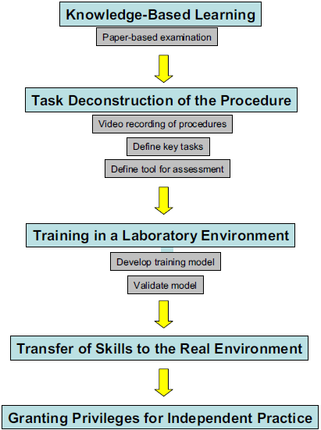

Slide 13
Validation: Some more definitions
Face validity:
Extent to which the examination resembles real life situations
Content validity:
Extent to which the domain that is being measured is being measured by the assessment tool
e.g. when attempting to assess technical skills we may in fact be testing knowledge
Construct validity:
Extent to which a test measures the trait it purports to measure
e.g. extent to which a test discriminates between various levels of expertise
Concurrent validity:
Extent to which the results of the assessment tool correlate with the gold standard for that domain
Predictive validity:
Ability of the examination to predict future performance

Slide 14
Reliability:
Test-retest: Measure of a test to generate similar results when applied at two different points
Inter-rater: Measure of the extent of agreement between two or more observers when rating the performance of an individual
Sources:
Moorthy K, Munz Y, Sarker SK, Darzi A. Objective assessment of technical skills in surgery. BMJ. 2003;327:1032–1037.
Aggarwal R, Grantcharov T, Moorthy K, Milland T, Papasavas P, Dosis A, Bello F, Darzi A. An evaluation of the feasibility, validity, and reliability of laparoscopic skills assessment in the operating room. Ann Surg. 2007 Jun;245(6):992-9.

Slide 15
Examples of surgical curricula
High profile national training curricula
Canada: CanMEDS
UK: The Intercollegiate Surgical Curriculum Programme (ISCP)
USA: Surgical Council on Resident Education (SCORE)
Technical skills curricula

Slide 16
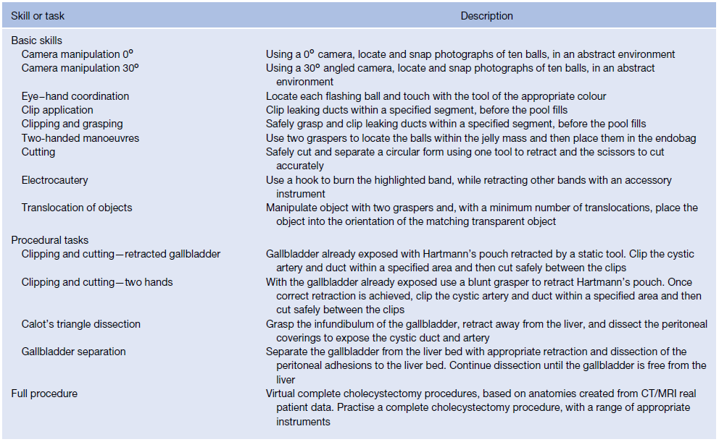
VR training curriculum development
Task deconstruction

Slide 17
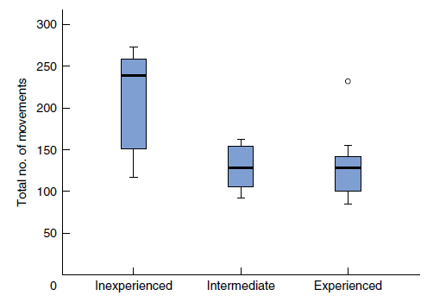
VR training curriculum development (2)
Validation of the tasks

Slide 18
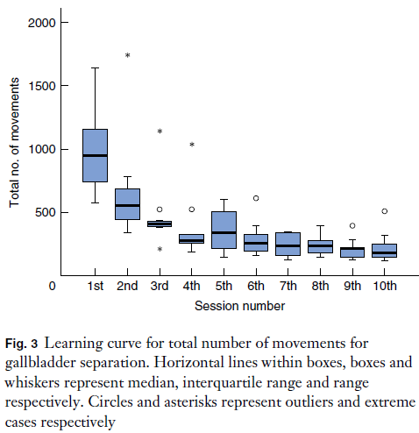
VR training curriculum development (3)
Learning curve

Slide 19
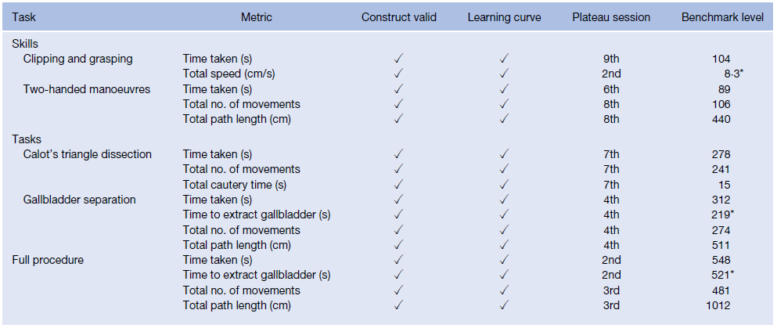
VR training curriculum development (4)
Combine construct validity and learning curve data
→ Metrics for development of the training curriculum

Slide 20
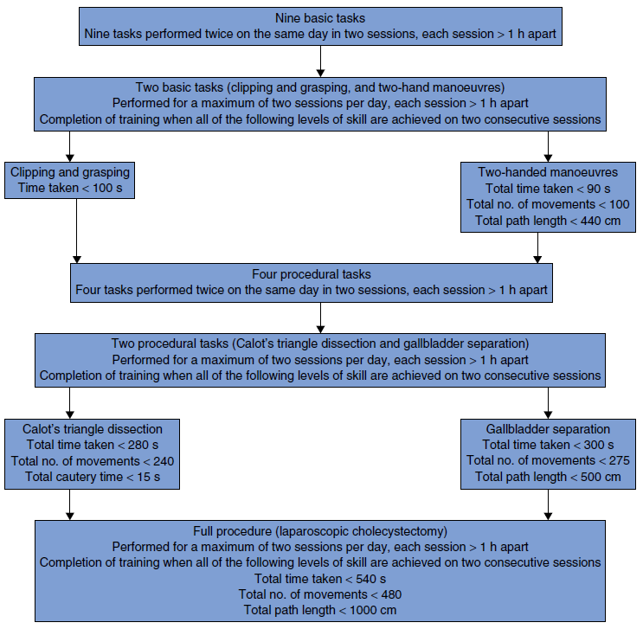
An Evidence Based Training Curriculum

Slide 21
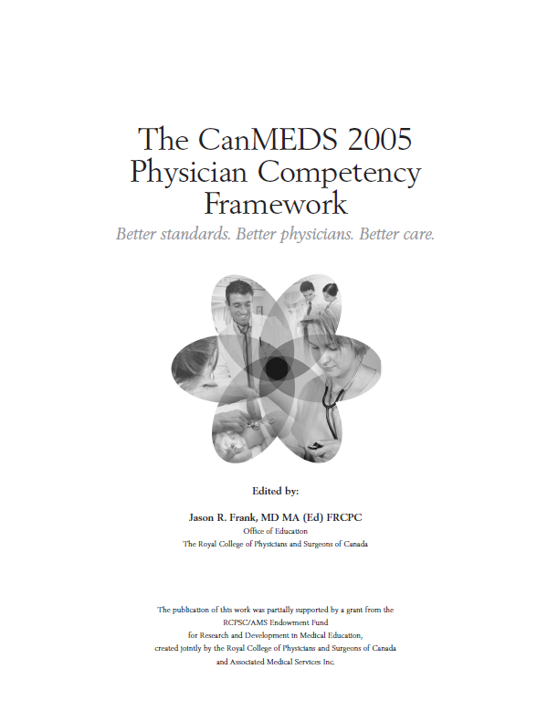
CanMEDS
Developed by the Royal College of Physicians
and Surgeons of Canada
Multiple Stakeholders
Educators
Teachers
Trainees
Practising Physicians
Researchers
Other Health Care Professionals
Public Officials
Public/Patients

Slide 22
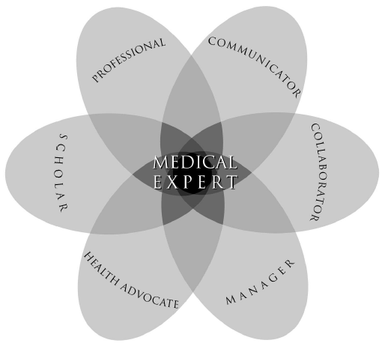
CanMEDS Physician Roles Framework
Source: Frank, JR. (Ed). 2005. The CanMEDS 2005 physician competency framework. Better standards. Better physicians. Better care. Ottawa: The Royal College of Physicians and Surgeons of Canada.

Slide 23
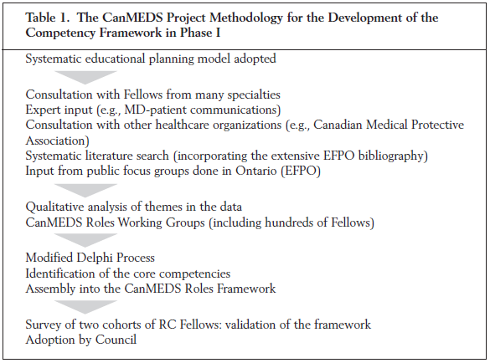
CanMEDS Development
Phase I: Framework Development (1993-1996)

Slide 24
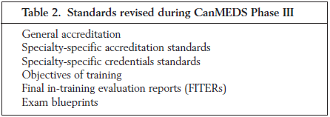
CanMEDS Development (2)
Phase II: Pilot Projects (1996-1997)
Phase III: Implementation (1997-2002)
Phase IV: Faculty Development (2002-2005)

Slide 25
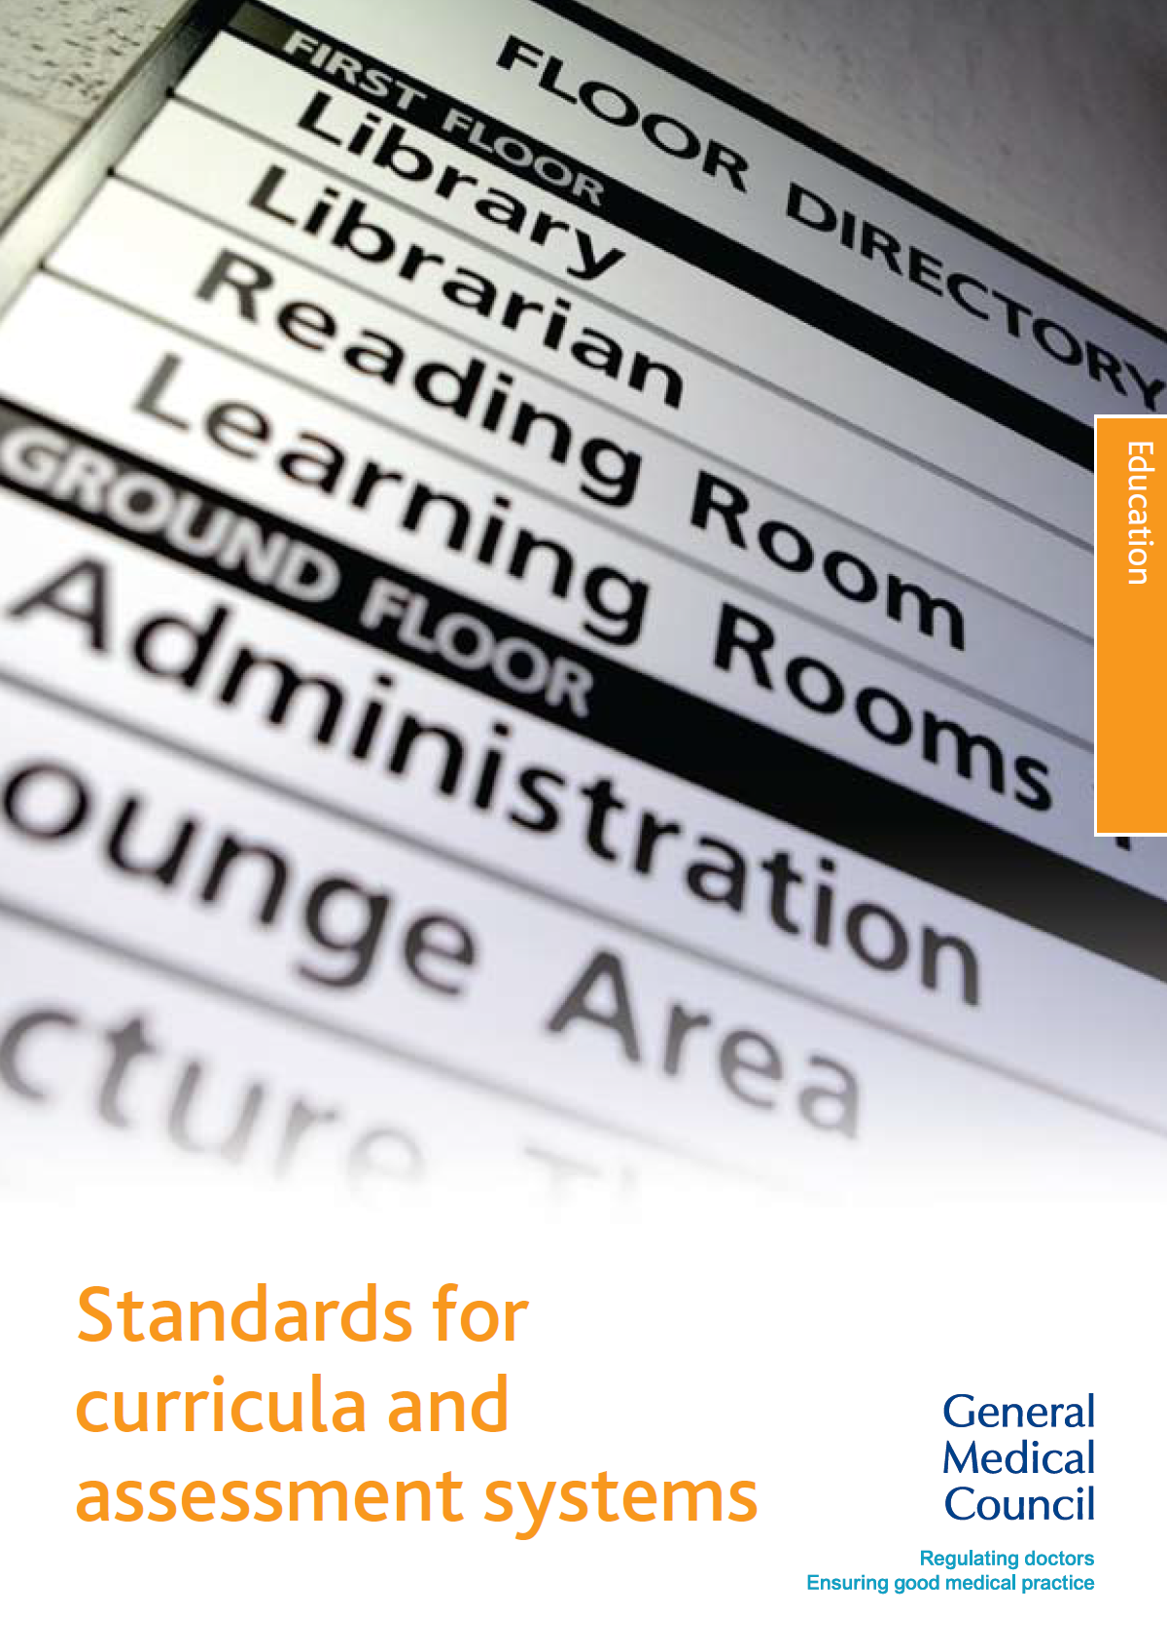
UK Standards to be met
The 1983 Medical Act
General Medical Council (GMC) to set the standards for training and the end-point to be achieved to enter GMC’s Specialist Register
to establish standards and requirements relating to postgraduate medical education and training
to maintain the standards and requirements established through quality assurance
to develop and promote postgraduate medical education and training in the UK.

Slide 26
GMC Standards for a curriculum
Planning: Standards 1 & 2
Curriculum purpose and development
The assessment system must be fit for purpose
Content: Standards 3 & 4
Content of the curriculum
Assessment and curricula referenced to all areas of Good Medical Practice
Delivery: Standards 5, 6, 7 and 8
Managing curriculum implementation
Model of learning
Learning experiences
Assessment system methods

Slide 27
GMC Standards for a curriculum (2)
Outcomes: Standards 9, 10, 11, 12, and 13
Supervision of the trainee
Role of the assessor
Assessment feedback to the trainees
Standards for classification of trainees’ performance/competence
Documentation will be standardised and accessible nationally
Review: Standards 14, 15, 16 and 17
Curriculum review and updating
Resources
Lay and patient involvement
Equality and diversity

Slide 28
Intercollegiate Surgical Curriculum Programme (ISCP)
Framework for systematic progression to consultant level
Implemented from August 1 2007
Approved by the Postgraduate Medical Education and Training Board
Syllabus provides explicit standards in specialty based:
Knowledge
Clinical judgement
Technical and operative skills
Professional skills
Aiming to go beyond technical expertise
CanMEDS
Good Medical Practice from GMC

Slide 29
ISCP: Curriculum development
Via the Intercollegiate Surgical Curriculum Project of the Joint Committee on Higher Surgical Training (JCHST)
Involving the:
Royal College of Surgeons of England
Royal College of Surgeons of Edinburgh
Royal College of Physicians and Surgeons of Glasgow
Royal College of Surgeons in Ireland
Specialty associations
Led by Chairman of the JCHST and Chairs of the Specialist Advisory Committee (SAC) and their delegated editors
Practicing surgeons
Trainees
Educationalists
Other specialists

Slide 30
ISCP: Curriculum development (2)
Managed by the Intercollegiate Surgical Curriculum Project
Phase I – Initial Development (March 2003 to September 2004)
Phase II – Pre-Pilot (December 2004 to March 2005)
Phase III – Pilot (September 2005 to July 2007)
Phase IV – Review and Evaluation (April 2007 to March 2008)
Contributing funders for Phases II and III
UK Department of Health
Irish Department of Health and Children
Royal Colleges

Slide 31
ISCP: Key Principles
Format and framework common to all surgical specialties
Systematic progression
Foundation years to exit from surgical specialist training
Competence based outcomes
Rather than time based
Progression determined by achieving competency based outcomes specified by specialty curricula
Curriculum standards underpinned by robust assessment processes which conform to PMETB standards
Delivered by appropriately qualified surgeons
MDT environment
Collaboration with health service providers and trainers at all levels

Slide 32
ISCP: Components
Syllabus content
Teaching and Learning
Assessment
Systems and Resources

Slide 33
SCORE Curriculum
SCORE developed in 2006
aim to develop a standardised national curriculum for General Surgery
Member organisations:
American Board of Surgery (ABS)
American College of Surgeons (ACS)
American Surgical Association (ASA)
Association of Program Directors in Surgery (APDS)
Association for Surgical Education (ASE)
Residency Review Committee for Surgery (RRC-Surgery)
Society of American Gastrointestinal and Endoscopic Surgeons (SAGES)
All funding provided by member organisations
Competency based:
Patient care and procedural skills Communication
Medical Knowledge Practice based learning
Professionalism Systems based practice

Slide 34
SCORE: Current state of development
Syllabus content
Started with patient care component
Surgical technical skills curriculum being developed by the ACS and APDS
Teaching and Learning
Endorsed the ACS Fundamentals of Surgery program
Examining issues related to surgical training
Assessment of technical competency
Teaching and assessment of professional behaviours
Faculty development
Assessment
Supporting an operative performance rating system in development at Southern Illinois University
Systems and Resources
SCORE Portal

Slide 35
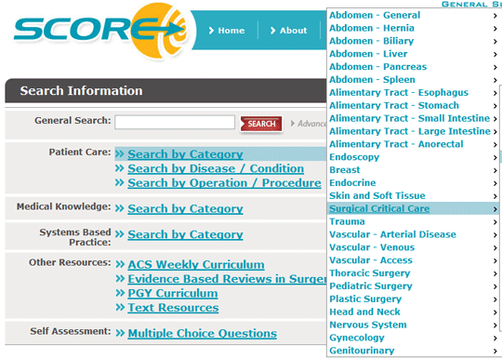
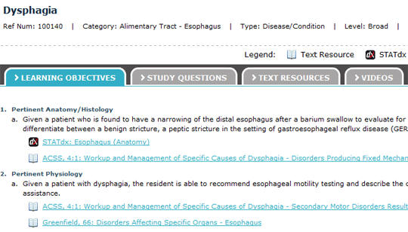
SCORE Portal
Web based learning system
Selected educational reading material
Radiology & Anatomy images
Operative videos
ABSITE practice questions
Evidence based reviews in Surgery
Ability for faculty to create and give assignments

Slide 36
ISCP v SCORE
ISCP
SCORE
Development started in 2003, in use since 2007
Full syllabus available
Web based
Faculty can use to assign learning objectives
Does not incorporate teaching material
Well developed workplace base assessments - online
Started development in 2006, still being developed
Syllabus for patient care available
Web based
Faculty can assign learning objectives
SCORE Portal has multimedia teaching material
Assessments not currently available

Slide 37
Summary
Definitions of terms used within the surgical education literature
Outline the difference between proficiency – versus time-based learning schedules
Defend a curricular approach to acquisition of surgical skills
Examples of surgical training curriculums
National specialty based
Technical skills

Slide 38
Questions & Discussion

