Slide 1
Teamwork and team performance
Dr Nick Sevdalis
Department of Surgery and Cancer
Test

Slide 2
Lecture aims
To make you familiar with issues around team performance in operating theatre teams
To introduce assessment of team skills in operating theatre teams
To allow you to experience “hands on” use of a key assessment tool and explore relevant issues

Slide 3
Lecture outline
Introduction to team performance in healthcare
Team interventions: checklists and team training
Introduction to team assessment
NOTECHS
OTAS
Video: Use of OTAS to score behaviours; discussion of ratings
Conclusions

Slide 4
Team skills and safety of care delivery
Patient safety concerns
(Preventable) Adverse events
Retrospective record reviews
USA (1991): 3.7%
Australia (1999): 16.6%
Denmark (2001): 9%
UK (2001): 10.8%-11.7%
New Zealand (2002): 12.9%
Canada (2004): 7.5%
…and more (France, Spain, Netherlands…)
Team issues
at the heart of the problem

Slide 5
Example: wrong side/site surgery
Scale of the problem
1 in 50,000 procedures in the USA
1500 to 2500 cases/year
Kwaan et al. Arch Surg. 2006;141: 353-8

Slide 6
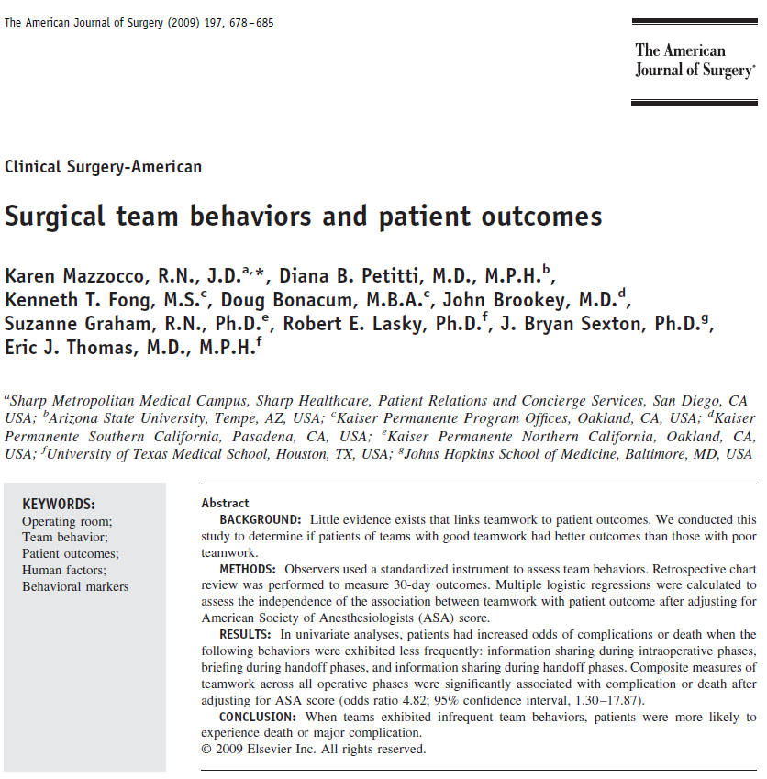
In the evidence base...

Slide 7
Team or Non-technical skills: definition
A set of
(i) behavioural and
(ii) cognitive skills
over and above technical competence
In surgery, psychomotor competence is the technical skill
How to behave and how to think whilst in theatre (in routine as well as in crises)

Slide 8
What are these skills? Yule et al (2006)

Slide 9
Systems view of surgical performance Undre, Arora, Sevdalis (2009)

Slide 10
How do we improve team performance?
Range of interventions
Often tried and tested in other industries (aviation, military operations, etc)
Two key interventions:
Checklists and team briefings
Team skills training

Slide 11
Checklists and team briefings

Slide 12
Checklists
Checklist: a list of action items arranged in a systematic manner, allowing the user to record the presence/absence of individual items to ensure that all are considered or completed Hales et al. 2006
Functions:
Reminders
Standardisation of processes
Safety checks
Redundancy to the system
Checklists and briefings slides based on lectures by K Moorthy

Slide 13
Checklists in aviation
First use possibly with US fighter Aircraft Boeing 299.
Plane crashed soon after take off on 30th Oct 1935, as the pilot forgot to release the elevator lock.
“Too much plane to fly by one man”
Boeing introduced a checklist - 1.8 million miles flight without accident
(http://www.atchistory.org/History/checklst.htm)

Slide 14
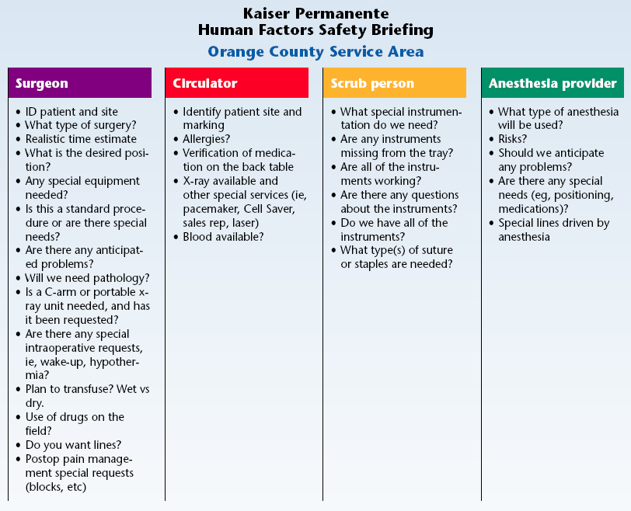

Slide 15
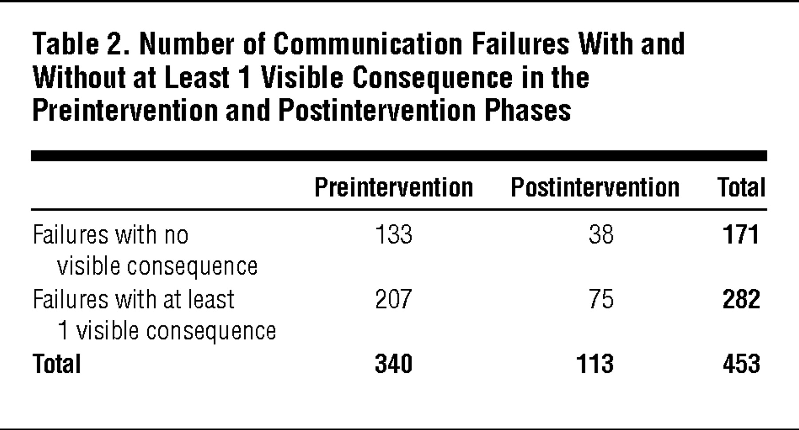
Visible consequences: inefficiency, team tension, resource waste, workaround, delay, patient inconvenience, and procedural error
Lingard et al. Arch Surg 2008;143:12-17
Notes:
15

Slide 16
WHO approach
Notes:
16

Slide 18
Eight pilot evaluation sites
PAHO I
EURO
EMRO
London, UK
Amman, Jordan
Toronto, Canada
WPRO I
Manila, Philippines
PAHO II
Seattle, USA
AFRO
WPRO II
Ifakara, Tanzania
Auckland, NZ
SEARO
New Delhi, India
Notes:
18

Slide 19
Pilot evaluation: findings

Slide 20
Reported evidence from pilot evaluation

Slide 21
Evidence from St. Mary’s hospital

Slide 23
Team/non-technical skills assessment and training

Slide 24
Simulators

Slide 25
Clinical data recorder
Trainers observe and assess via one-way mirror

Slide 26
How do we ensure robust, scientific assessment?
RELIABILITY
Do blinded expert assessors allocate similar scores?
VALIDITY
Does the assessment tool truly capture team skills?
Can the assessment tool discriminate between good and poorly performing teams?
Can the assessment tool pick up the impact of team training on team skills?
FEASIBILITY
The assessment ought to be feasible – otherwise it does not matter how robust it is

Slide 27
NOTECHS Non-Technical Skill

Slide 28
Originally developed for commercial aviation

Slide 29
Concrete, observable “Behavioural markers”

Slide 30
Modification for surgery

Slide 31
OTAS Observational Teamwork Assessment for Surgery

Slide 32
Developed specifically for use in operating theatres

Slide 33
The 5 OTAS behaviours (see handouts)
Communication: quality and quantity of information exchanged among members of the team
Coordination: management and timing of activities and tasks
Cooperation/Back-up behaviour: assistance provided among members of the team, supporting others, correcting errors
Leadership: provision of directions, assertiveness, and support among members of the team
Monitoring/Awareness: team observation and awareness of on-going processes

Slide 34
OTAS focus: separate assessments at…
3 operative phases
Pre-op
Intra-op
Post-op
3 distinct teams in the OR
Anaesthetic
Nursing
Surgical
OTAS can assess SUBTEAMS in theatre – but also INDIVIDUALS
Comprehensive assessment: 45 ratings/procedure (3x3x5)

Slide 35
Exemplar behaviours
Guide behavioural ratings
COMMUNICATION (Surgical team, Intra-operative)
Asks team if all prepared to begin the operation
Requests and instructions to team communicated clearly and effectively
Provides information to whole team on progress
Surgeon informs the team of technical difficulties and / or changes of plan

Slide 36
Empirical evidence: does OTAS work?
Feasibility: General, Urological, Vascular surgery; real and simulated procedures
Reliability: scoring is reliable between expert assessors; novice assessors can be trained to use the tool reliably
Construct Validity: demonstrated via comparison of expert and novice raters
Content Validity: demonstrated through operating theatre experts’ consensus and real-time observation

Slide 37
Video
Read ALL behaviour definitions and scoring anchors
Focus on the INTRA-OPERATIVE section, SURGICAL team: read the exemplars
Watch the video and see (i) if you can observe relevant behaviours and (ii) what score you would allocate
Group discussion

Slide 38
Conclusions
Team performance: team/non-technical skills
Role of team/non-technical skills in delivery of safe care
- Increasing care delivery by teams
Range of interventions to enhance teamwork and team performance in operating theatres:
- Checklists and team briefings
- Team skill assessment and training
Need to use robust evaluation:
- Does an intervention work?
- Is it sustainable (cost-effectiveness?)?
- How best to implement it (e.g., training may be required for faculty to assess and train, in turn, team skills in theatre personnel)

