Slide 1
Design of a Surgical Skills Centre
Philip Pucher BSc MRCS
Clinical Research Fellow
Department of Surgery and Cancer
Imperial College London

Slide 2
Learning Objectives
Understand the need for surgical skills centres (SSC)
Understand what “target audience” might be trained in a SSC
Understand the scope of the SSC curriculum
Name several methods of teaching that might be employed in a SSC
Identify advantages and disadvantages

Slide 3
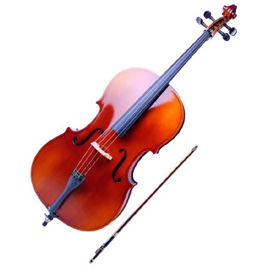
The Need for Surgical Skills Centres
The tradition of “see one, do one, teach one” is no longer an acceptable form of learning
Changes to modern practice mean less time spent training
ETWD
Work / life balance
Non-clinical commitments
Revalidation

Slide 4
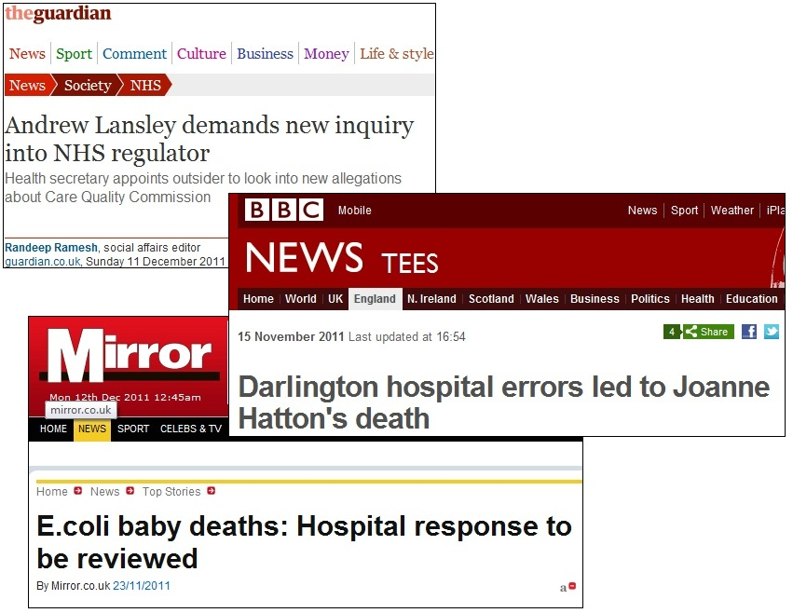
The Need for Surgical Skills Centres (2)
Increased public and political awareness of medical error and adverse events
To Err is Human (Institute of Medicine, 2000)
98,000 annual deaths in USA
Cost of training and the expense of errors
Simulation and training is believed to be cost effective vs. in situ
> £1 billion annually in UK due to errors

Slide 5
Considerations in designing a SSC
American College of Surgeons Program for Accreditation of Education Institutes
Established 2006
Now over 60 international Level I (including SMH) and Level II centres
Learners
Tech Support and Resources
Curriculum

Slide 6
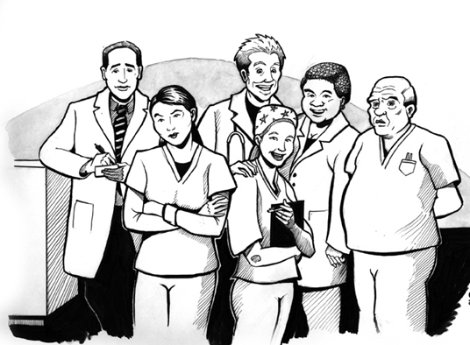
Learners
Who “needs” to be taught?
Trainees
Medical students
Who “can” be taught?
AHPs
Nurses
Senior trainees
Consultants
Other

Slide 7
Learners (2)
Why are they being taught?
Training
Revalidation
Return to practice
Retraining
Acquiring new skills
Learning new techniques / technologies
Research

Slide 8
Curriculum
What skills are to be taught?
Technical or procedural skills
Surgical techniques
Patient assessment
Basic interventions
Non-technical or cognitive skills
Teamwork
Communication
Critical thinking
Decision making
Crisis management

Slide 9
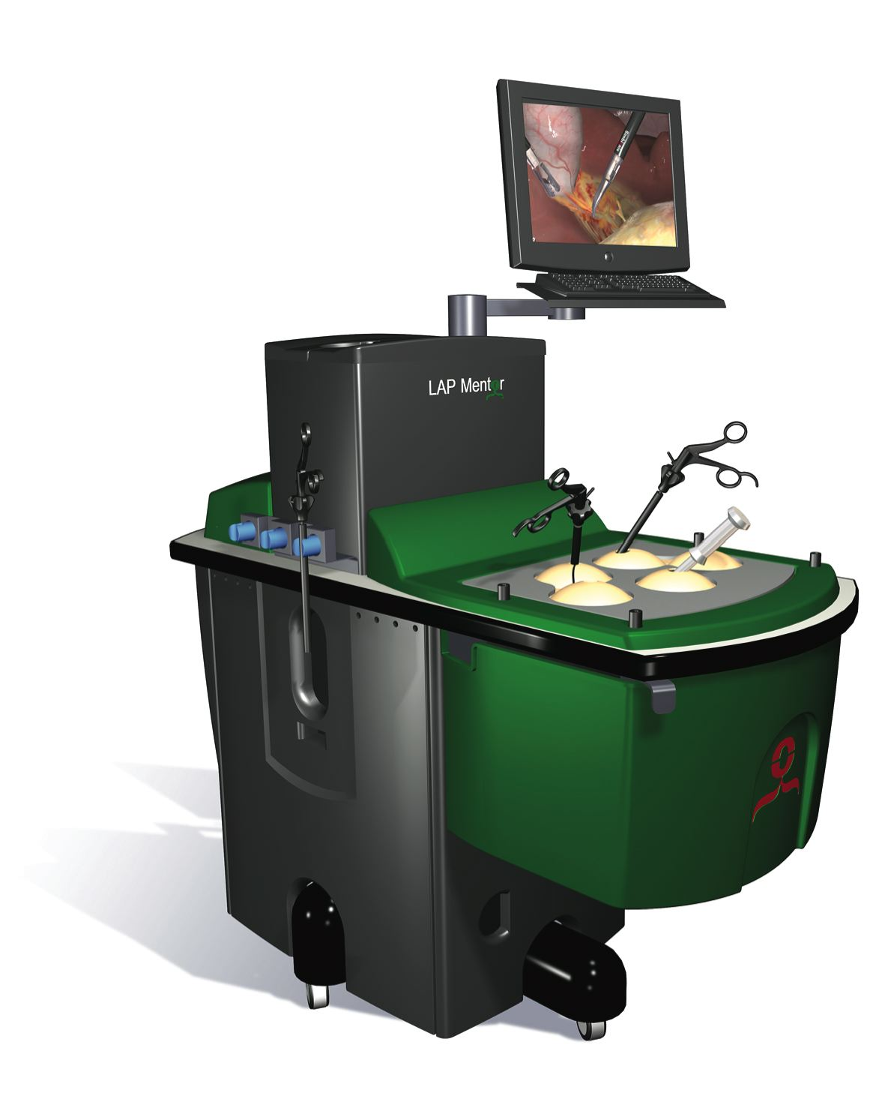
Curriculum (2)
How will teaching be delivered?
Surgical simulators
Simulated limbs or body parts
Simulated patients
Operating suite simulators
Lectures
Presentations
Wet labs

Slide 10
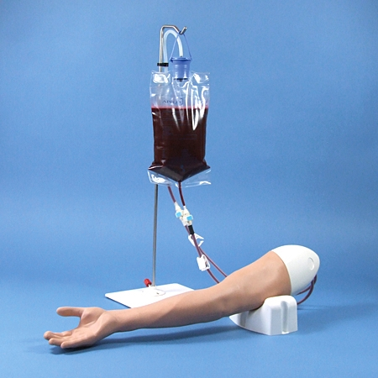
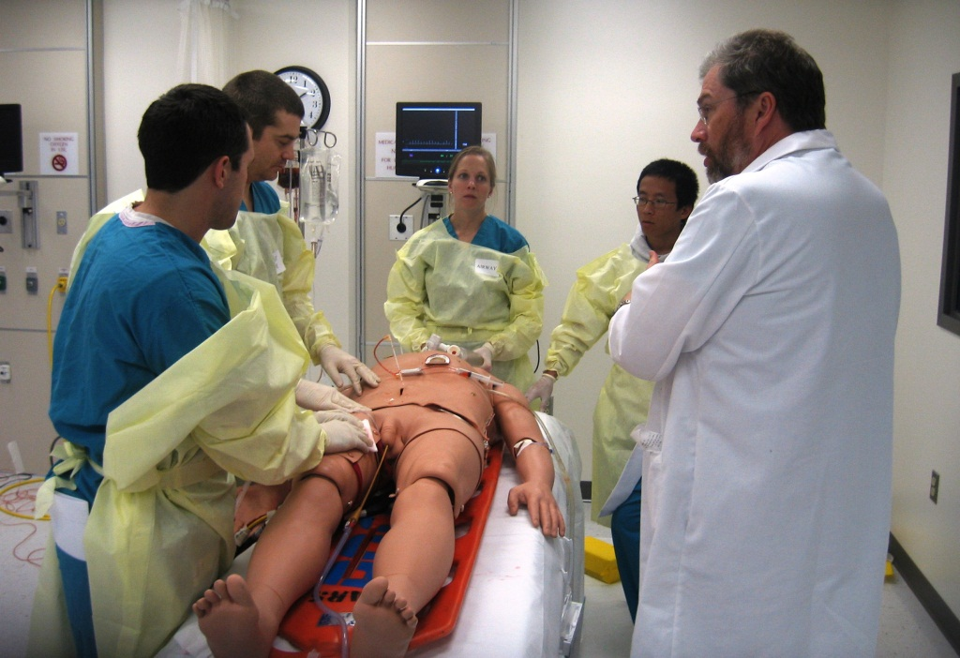
Curriculum (3)

Slide 11
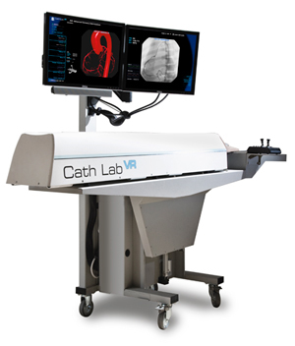
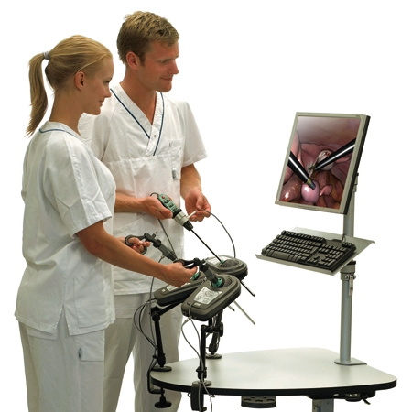
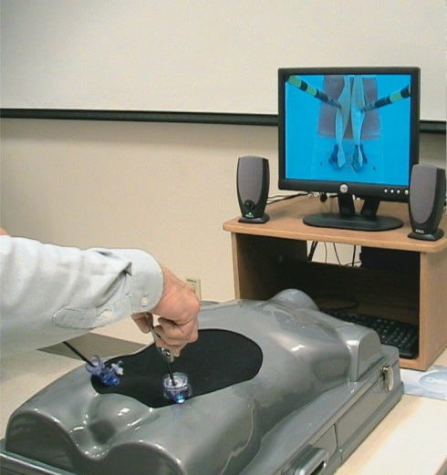
Curriculum (4)
How do you choose a simulator?
Educational goals and needs
Validity and evidence base
Fidelity
Cost

Slide 12
Technological Support & Resources
Facilities and floor space
Accreditation
Partnerships to other facilities and institutions
Financial arrangements including budget, grants, sponsorships
Teaching resources including simulators and devices
Audiovisual equipment
Faculty and remuneration
Administrative staff

Slide 13
Advantages and Disadvantages
Advantages
Centralised teaching
New training opportunities
Patient safety
Simulators and new training technologies
Simulators provide objective assessment and feedback
Cost effective training
Research
Advances further development of facilities and curriculum
Disadvantages
Initial cost
Location and space requirements
Resource intensive

