Slide 1

BSc in Surgery & Anaesthesia
Selection for surgical training
Zeshaan Maan MBBS MSc MRCS
Notes:
Introduction

Slide 2

What is Selection?
Personnel selection is a process used to determine which individuals are best suited for a particular job.¹
Notes:
[I]: What is selection?
The Society of Industrial and Organisational Psychology is a division of the American Psychological Association. They apply the scientific methods of psychology to workplace issues such as assessment, selection, training and performance.

Slide 3

Why is Selection important?
Notes:
[I]: Why is selection important?
In healthcare, the goal of selection is identifying individuals who will be able to provide a safe, competent service at the end of their training period. There are real world equivalents to Dr Nick, such as Harold Shipman. The Bristol Royal Infirmary Inquiry further highlights the need to ensure healthcare professionals are able to perform in their roles with competence and skill.
An additional consideration of selection is the emerging conflict between training and patient safety – surgical trainees need to carry out procedures in order to become the competent surgeons of the future; patients are entitled to the highest level of surgical care – which may not be provided by a new trainee. Added to this emerging issue is the new shortened training period.
The introduction of the European Working Time Directive has drastically reduced surgical training time from an estimated 30,000 hours before Calmanization to between 6-8000 hours. This has led to a drastic reduction in both the number and variety of operations undertaken during higher surgical training. It has also reduced the amount of time available to assess the progression of trainees.
The ideal surgical trainee would therefore acquire skills quickly, minimising the exposure of patients to sub-optimal surgical treatment and allowing them to gain the necessary competencies within their shortened period of training. At the end of training they would be a competent and safe provider of surgical care.

Slide 4

Selection Methodology
Notes:
The most important aspect of the process is the methodology – the same way it is the most important part of any research project.
[I]: Most of you are probably involved in some form of research. Raise your hands if you are currently involved in a project. Who can tell me what is research methodology and why is it important?
Your methodology is how your research is going to be carried out, the systematic approach you will use to answer your research question. If there is any flaw in your methodology, your entire study will be flawed.
This also holds true with a selection methodology.

Slide 5


Reliability & Validity
Notes:
Selection methodology is primarily assessed on the basis of its reliability and validity:
Reliability refers to how repeatable a measurement is - it should yield consistent results each time an individual takes it.
[I]: How might we test reliability?
This can be easily assessed using a statistical test, such as Cronbach’s alpha coefficient of reliability.
Validity is more difficult to assess. The validity of a selection methodology, according to the standards of industrial psychologists, is determined by the ‘job relatedness’ of the evidence it accumulates.
‘Job relatedness’ is the accuracy of the evidence in predicting future performance in the target position – for our purposes this would mean a selection methodology which accumulates evidence ‘related’ to the goals we discussed earlier: 1) Safe, skilful surgical practice at the end of training, 2) speedy acquisition of surgical skill during training

Slide 6





How do we select now?
Notes:
Before we get into that let’s look at how selection currently works.
Historically, in the UK, selection for surgical training has been based on:
surgical experience, demonstrated by appropriate rotations and passing examinations of the Royal College of Surgeons
academic achievement, in the form of research, publications, presentations and honours at medical school
?Knowing the right people (joke)
In 2007, MTAS and MMC were introduced. Under this system, doctors entered a two-year foundation program (F1 and F2) after qualifying from medical school.
The idea is that during this time they would develop generic skills relevant to any specialty. Upon completion, they applied for a run-through specialty training (ST) post in their area of interest. The selection process was centred on an application form that standardised the assessment of suitability for specialty training.
[I]: Does anyone here know anything about this process? What are your thoughts on it?
This system was changed within a year of introduction. This may partly be due to the lack of correlation between successful completion of the MTAS form and ownership of the skill set required to be a good doctor. This was actually demonstrated in the research the new system was based on.(2-5)
The majority of specialties have since introduced a second round of application and selection between ST2 and ST3. This divides surgical training into Core Surgical Training and Specialty Surgical Training and gives selectors another opportunity to try and figure out who will be a ‘good’ surgical trainee
6

Slide 7
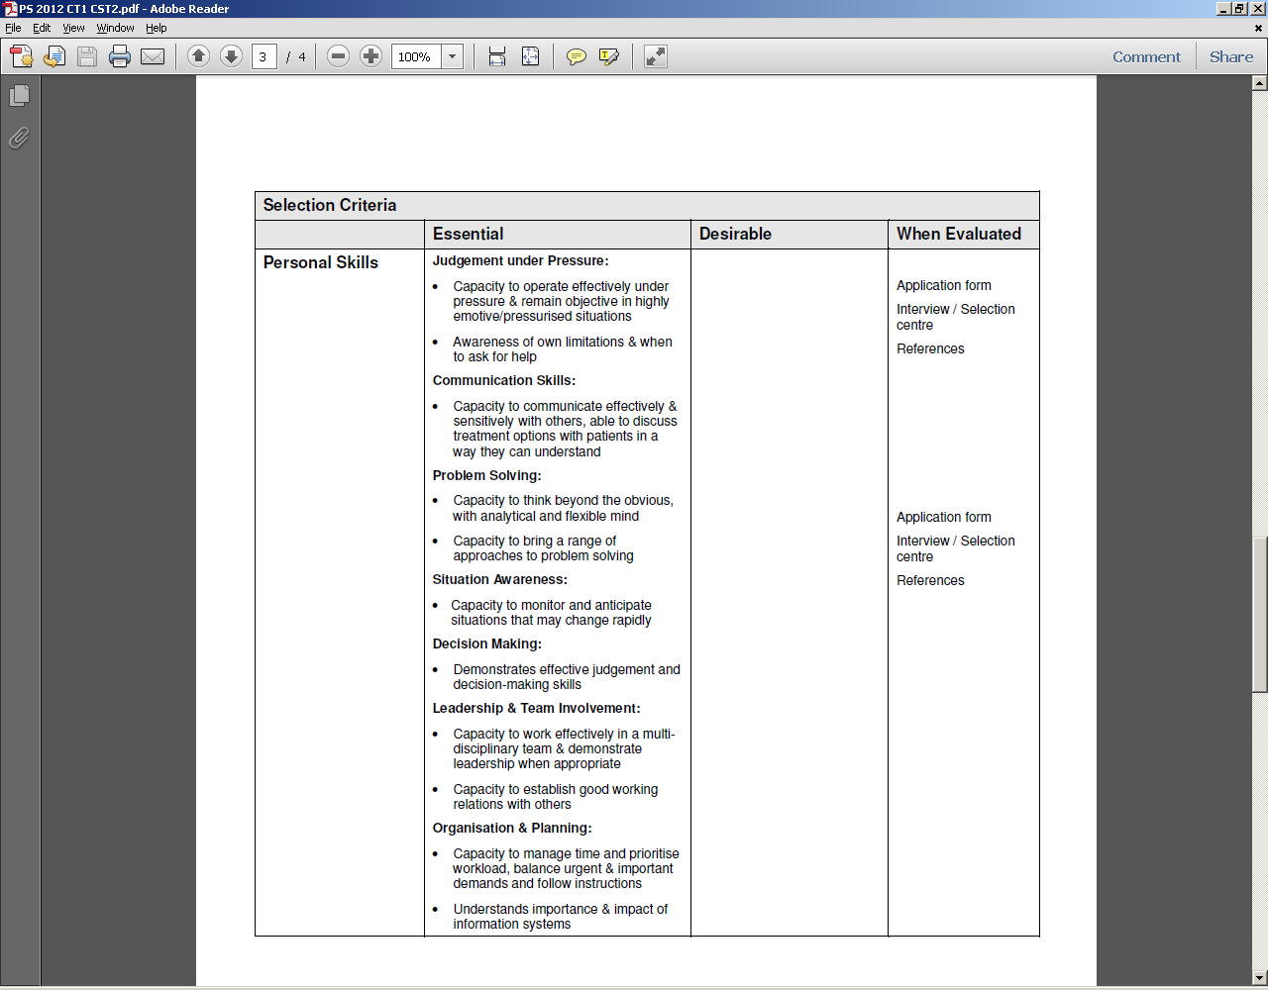
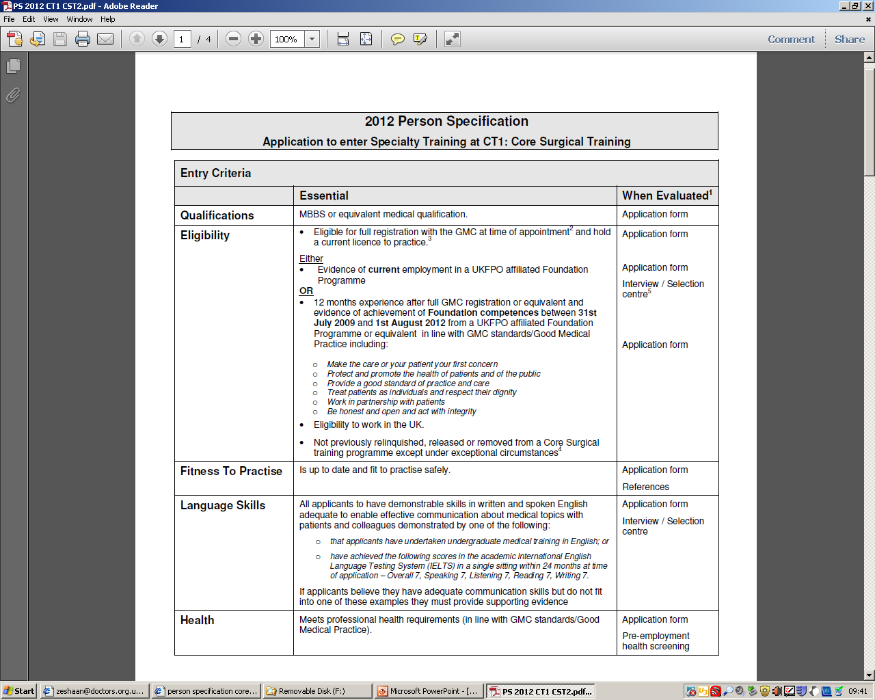
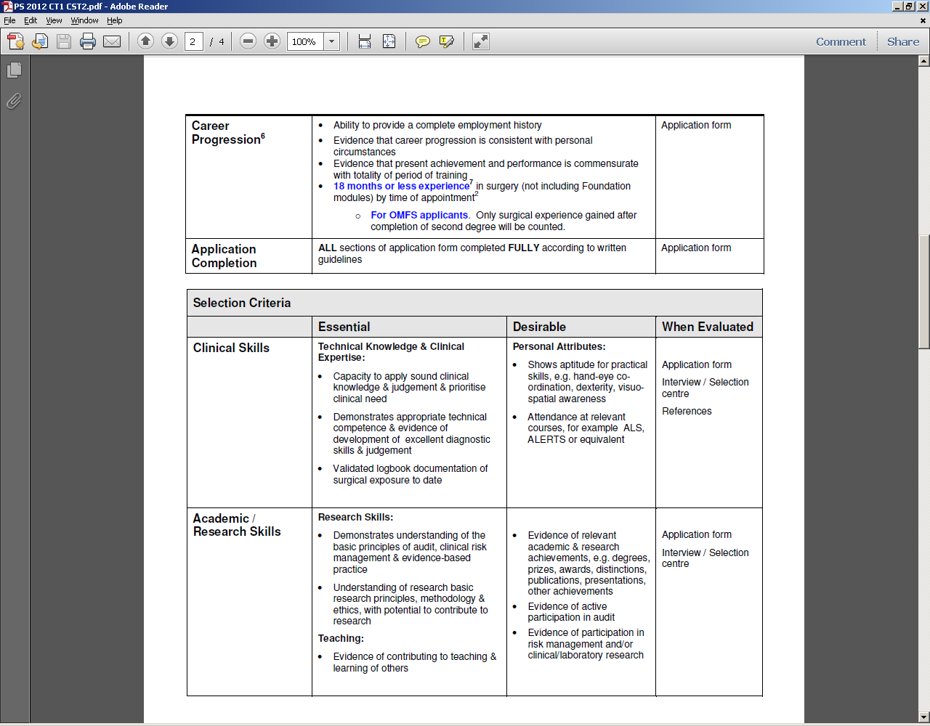
Person Specification
Notes:
Remember we were talking about accumulation of evidence by a selection methodology? In order to gather the correct evidence, we first need to know what sort of knowledge, skills and characteristics predict performance in the position.
In healthcare, we employ a person specification, which represents a summary of the ‘evidence’, including knowledge, skill and characteristics, which is believed to predict future performance.
[I]: How do we know what to include in the person specification?
There are a number of ways to determine what to include, including surveying supervisors of that position, observation of the workplace in which that role is being performed and creating focus groups to discuss the issue.
This is the most recent person specification for entry into Core Surgical Training. As you can see it addresses a wide range of predictive criteria which are believed to correlate to success in training.
[I]: What does everyone think of it? What is missing, if anything?

Slide 8
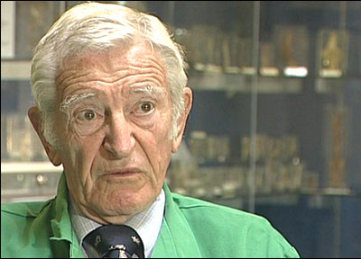

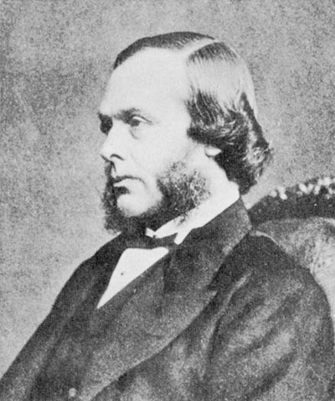

Predicting Performance
Notes:
A survey of master surgeons identified a number of attributes as key to progression through surgical training. These fell into larger categories, which included cognitive, clinical, and operative attributes. They also discussed specific personality traits, including commitment, courage, determination, and a sense of justice^{6,} ⁷.
[I]: Can you name the surgeons? A: Ara Darzi, Harold Ellis, Alfred Cuschieri, Joseph Lister – pioneered use of carbolic acid (phenol) to sterilise surgical instruments
[I]: Does the CST PS match up to what master surgeons consider to be the predictors of surgical performance?
[I]: Though the opinion of these surgeons provides a good framework for a person specification, how can we truly validate the selection methodology?
[A]: There should be a clear correlation between the chosen predictors and surgical performance, which is defined by our previously mentioned goals.
Therefore, we need to evaluate which attributes predict rapid acquisition of skills by a trainee and eventual superior performance as a surgeon.

Slide 9
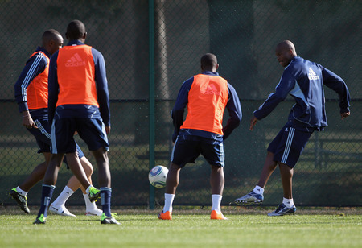
Predicting Performance
Notes:
In sports, predicting performance is also important.
[I]: What would you consider to be the predictors of performance
[A]: speed, strength, skill
AND actual performance can be assessed before selection – you can ask footballing hopefuls to play a game in front of you; this is a little more difficult in surgery, though...
[A]: tools such as a SOS are possibilities
And when a sports player ends up not living up to the expectations of selectors, the collateral damage is normally limited to a lost game – far different from what can go wrong if a selected surgical trainee is not up to scratch

Slide 10


Predicting Performance
Notes:
The Royal Air Force is more analogous to the surgery specialty, also being a High Risk Organisation.
The RAF used to have a fairly poor safety record. In light of the cost of training a pilot and an excessively high attrition rate they made an effort to improve their selection methodology. They started selecting and training individuals with attributes shown, by their research, to predict future performance⁸.
Since these changes were introduced, they have drastically improved their attrition rate and safety record.

Slide 11
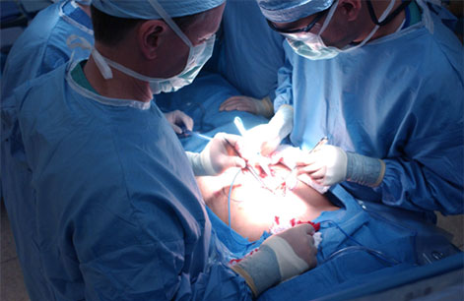
Predicting Performance
Notes:
The surgical specialty should be selecting trainees with attributes which predict rapid acquisition of skills and eventual superior performance as a surgeon.
A number of studies have sought to compare attributes in medical students and trainees to markers of surgical performance, including progression through a surgical training program. In addition to more traditional measures, such as performance in medical school, prizes and publications, these studies have evaluated the predictive power of attributes such as visual-spatial perception and psychomotor aptitude. The impact of these individual studies has been difficult to assess.
A systematic review, with well-defined inclusion and exclusion criteria, provides an unbiased summation of current evidence.

Slide 12
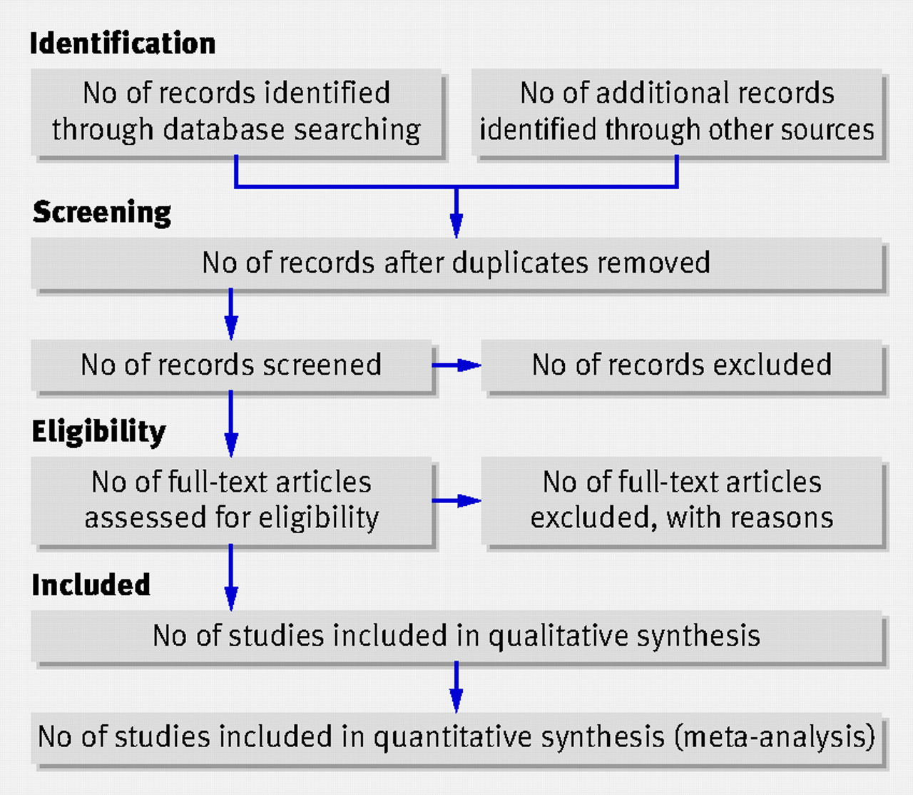
Systematic Review
Notes:
I hoped to address the conflicts in the literature by performing a methodological search of all relevant medical and educational databases for studies assessing the predictive power of measurable attributes with regards to surgical performance.
I carried out this systematic review under the supervision of Mr Rajesh Aggarwal.
The aim of my study was to examine the predictive value of current selection criteria as well as other criteria, including psychomotor aptitude and visual-spatial perception, for impact on surgical performance.

Slide 13
Systematic Review - Methods
Inclusion Criteria
Search Strategy
Assessment of Study Quality
Notes:
I looked at prospective and retrospective correlation studies and comparative studies with medical students or trainee doctors as participants. The studies had to assess the relationship between predictors such as skills, attributes, characteristics and knowledge and outcomes of surgical performance.
Primary Outcomes
Evaluation of surgical technical ability
Time taken to carry out procedures
Error score (as defined by authors)
Efficiency (path length, number of movements)
Evaluation of progression through a training curriculum (objective or subjective) (as defined by authors)
Secondary Outcomes
Other outcomes reported by individual authors
I searched Medline, Embase, CENTRAL (The Cochrane Central Register of Controlled Trials in the Cochrane Library) and ERIC (Educational Resources Information Centre). I also looked through the references of included studies.
Assessment of study quality is a key element of any systematic review. In 2006, Hayden et al⁹ identified six domains of potential study bias that should be assessed in a review of prognostic studies.
Study participation
Study attrition
Prognostic factor measurement
Outcome measurement
Confounding measurement and account
Analysis
The maximum score for each of the criteria is 2. Studies scoring 10 or more were classified as high quality.

Slide 14
Systematic Review
Database | Further information on database | Search terms | Number of articles
Medline | The National Library of Medicine’s database, providing abstracts and indexing for about 4,600 biomedical journals published in the U.S. and 70 foreign countries, and includes additional older citations and out of scope citations from Medline journals. | Personnel Selection (MeSH) Job Application (MeSH) Aptitude (MeSH) Aptitude Test (MeSH) Employee Performance Appraisal (MeSH) Select* recruit* aptitud* 1 OR 2 OR 3 OR 4 OR 5 OR 6 OR 7 OR 8 Education, Medical, Graduate (MeSH) Medical Staff, Hospital (MeSH) “Internship and Residency” (MeSH) Junior doctor Residen* Trainee 10 OR 11 OR 12 OR 13 OR 14 OR 15 Specialties, Surgical (MeSH) surg* specialt* 17 OR 18 OR 19 9 16 20 | 1942
Database | Further information on database | Search terms | Number of articles
Embase | Excerpta Medica database is a major biomedical and pharmaceutical database indexing over 3,500 international journals in the following fields: drug research, pharmacology, pharmaceutics, toxicology, clinical and experimental human medicine, health policy and management, public health, occupational health, environmental health, drug dependence and abuse, psychiatry, forensic medicine and biomedical engineering. | Personnel Selection (MeSH) Job Application (MeSH) Aptitude (MeSH) Aptitude Test (MeSH) Employee Performance Appraisal (MeSH) Select* recruit* aptitud* 1 OR 2 OR 3 OR 4 OR 5 OR 6 OR 7 OR 8 Education, Medical, Graduate (MeSH) Medical Staff, Hospital (MeSH) “Internship and Residency” (MeSH) Junior doctor Residen* Trainee 10 OR 11 OR 12 OR 13 OR 14 OR 15 Specialties, Surgical (MeSH) surg* specialt* 17 OR 18 OR 19 9 16 20 | 2689
CENTRAL | Component of Cochrane Library (high quality evidence to inform both practitioners and researchers) | (select* OR aptitud* OR recruit*) ((junior doctor) OR trainee OR residen*) (specialt* OR surg*) | 88
ERIC | Sponsored by the of the U.S. Department of Education and searches journals, reports, theses and conference papers | (select* OR aptitud* OR recruit*) ((junior doctor) OR trainee OR residen*) (specialt* OR surg*) | 0
Notes:
This is a table detailing my search strategy

Slide 15
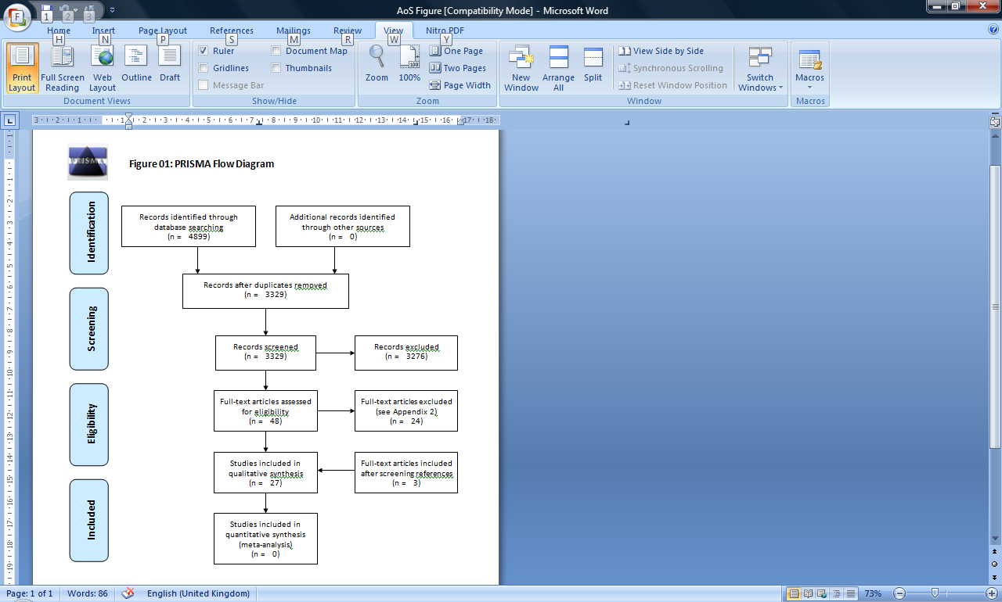
Systematic Review
Notes:
A total of 4899 references were identified from the different databases. After manually excluding duplicates and going through the titles and abstracts, full text was sought for 48 references and a total of 27 references involving 4629 participants met the eligibility criteria and were included for this review.

Slide 16
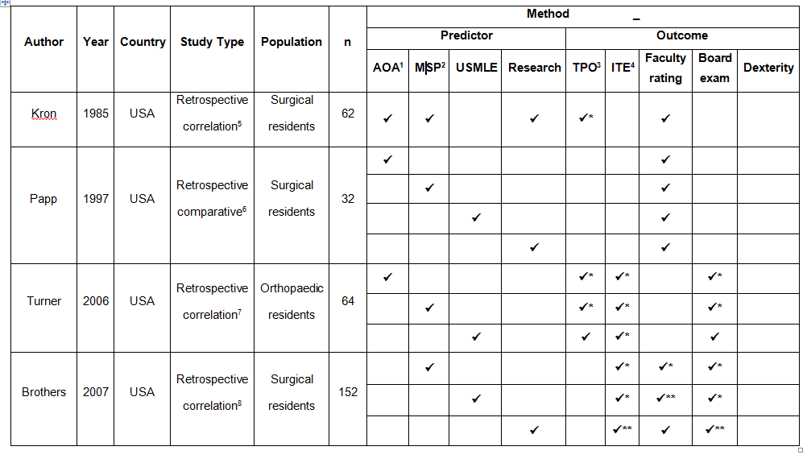

Academic Achievement
Notes:
Let’s start with more traditional methods of predicting eventual performance
Academic achievement can be measured in many ways. When it forms part of the selection criteria for surgical training, the main measures used include membership in the Alpha Omega Alpha Medical Honor Society, medical school performance in the form of grades and honours, performance on the USMLE and research experience and publications. There were no studies assessing the relationship between any aspect of academic achievement and the outcome measures of time, errors or efficiency. All studies assessing the predictive power of AA, except one, were retrospective.
One poor quality report described multiple aspects of AA as a collective measure and found it predicted successful completion of a training programme but did not correlate to faculty assessment of surgical performance. Membership in AOA was a predictor of success in progression through a training curriculum, achievement of Chief Resident Associate status and success on end of training board examinations but did not correlate to faculty assessment of surgical performance. Medical school performance predicted success in progression through a training curriculum, achievement of CRA status, success in end of training board examinations, faculty assessment of surgical performance and dexterity rating. One study found no relationship between MSP and faculty assessment of surgical performance. Though this was a high quality report, it used a comparative study design rather than correlative. The study that described a relationship between MSP and dexterity was a high quality report with a large sample size (>100).
Performance on the USMLE predicted success with in-training examinations and success on end of training board examinations. In contrast to MSP, USMLE performance did not correlate to achievement of CRA status orvfaculty assessment of surgical performance. Research experience and publications provides very little predictive power with regards to surgical performance. It actually had a negative correlation to successful progression through a training curriculum and success on board exams.

Slide 17
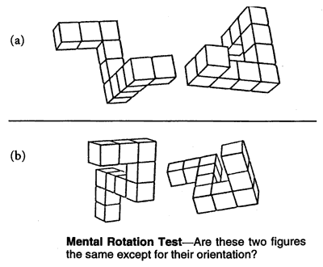

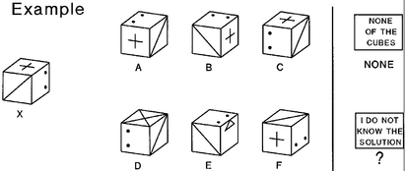
Visual-Spatial Perception
Notes:
Visual-spatial perception was evaluated using tests of low-level, intermediate-level and high-level VSP. Low-level VSP refers to edge and surface extraction and orientation, intermediate-level VSP refers to whole object recognition and mental visualization of spatial relations of object parts in 2D and high-level VSP refers to mental visualisation involving 2D and 3D spatial rotations and translation¹⁰.

Slide 18
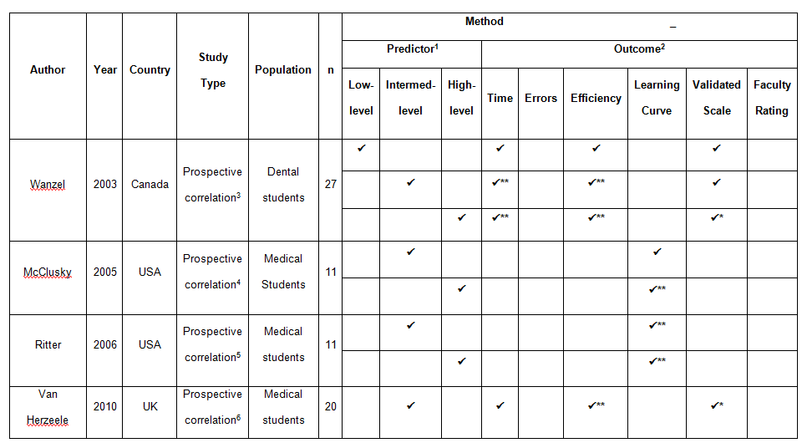



Visual-Spatial Perception
Notes:
Low-level VSP was a weak predictor of surgical performance. Edge and surface extraction and orientation may have little relevance to surgical performance.
Intermediate and high-level VSP showed congruency in terms of their predictive power, and both appear to be strong predictors of surgical performance.
Intermediate level VSP predicted improved performance in terms of time, efficiency and rate of skill acquisition but demonstrated no correlation to errors or faculty rating. Whole object recognition and mental visualization of spatial relations of object parts in 2D appear to be useful in learning tasks and performing them quickly and efficiently, but appear to have less bearing on quality of surgical performance and avoidance of mistakes.
High-level VSP predicted improved performance in terms of time, errors, efficiency, rate of skill acquisition and global assessment of surgical ability. A lack of correlation to time was reported in one study and a lack of correlation to errors and rate of skill acquisition were reported in two studies each. Two of these studies had a small sample size and their results may be due to a type 2 error. One of the studies showing no correlation between high-level VSP and rate of skill acquisition used a learning curve classification system and the validity of this system is not clearly established. Mental visualisation involving 2D and 3D spatial rotations and translation appears to have more influence on error rate and quality of surgical performance than intermediate-level VSP ability.

Slide 19
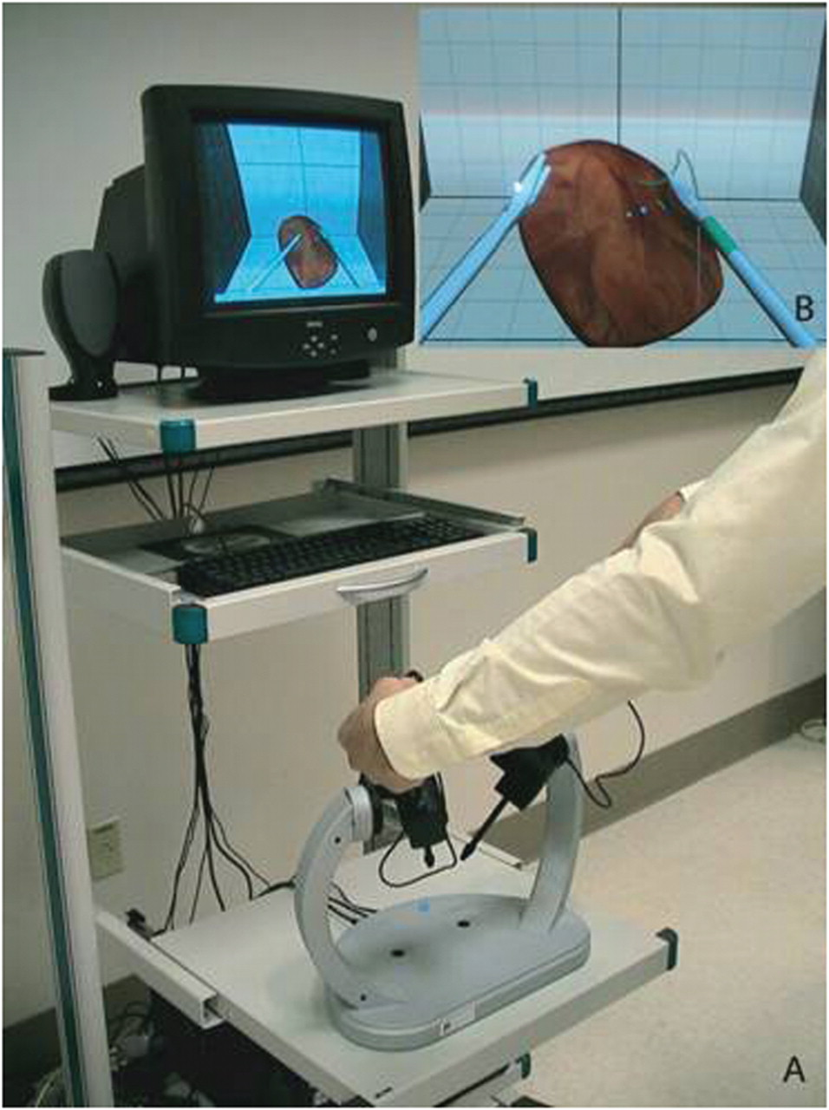


Psychomotor Aptitude
Notes:
Psycho-motor aptitude was evaluated using tests of gross motor dexterity, fine motor dexterity, reaction time and hand steadiness & coordination. Multiple aspects of psychomotor aptitude were evaluated collectively by two studies using a laparoscopic simulator.

Slide 20
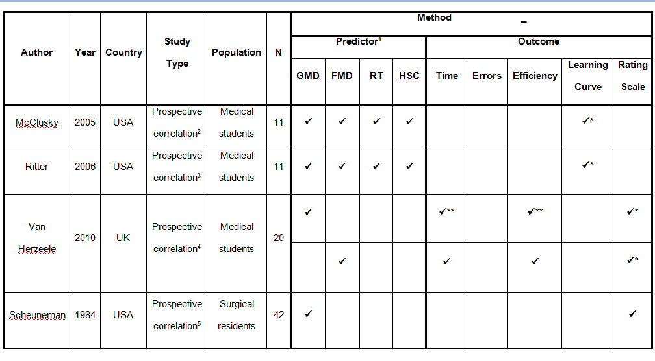

Psychomotor Aptitude
Notes:
Both studies that assessed PMA collectively had small sample sizes (n=11), but both were high quality reports and demonstrated a significant positive relationship between PMA and rate of progression through a validated curriculum on a surgical simulator.
GMD may predict efficiency, but has little relationship with other measures of surgical performance. Reports regarding the relationship between GMD and both time and global assessment of surgical ability, show conflicting results. The study assessing errors and rate of surgical skill acquisition showed no correlation. Fine motor dexterity was primarily a predictor of subjectively assessed quality of surgical performance. There was no evidence of correlation between FMD and either time or efficiency and results were conflicting regarding errors and rate of surgical skill acquisition.
Hand steadiness and coordination was primarily a predictor of subjectively assessed quality of surgical performance, though in one study HSC correlated to rating scale assessment of surgical performance by faculty.
[I]: Why might this be the case?
Like FMD, HSC is a highly visible characteristic, and may convey a sense of quality in surgical performance.
HSC showed no relationship to time or errors and showed conflicting results regarding improved rate of surgical skill acquisition. Reaction time had no correlation to time, errors or rate of skill acquisition.

Slide 21
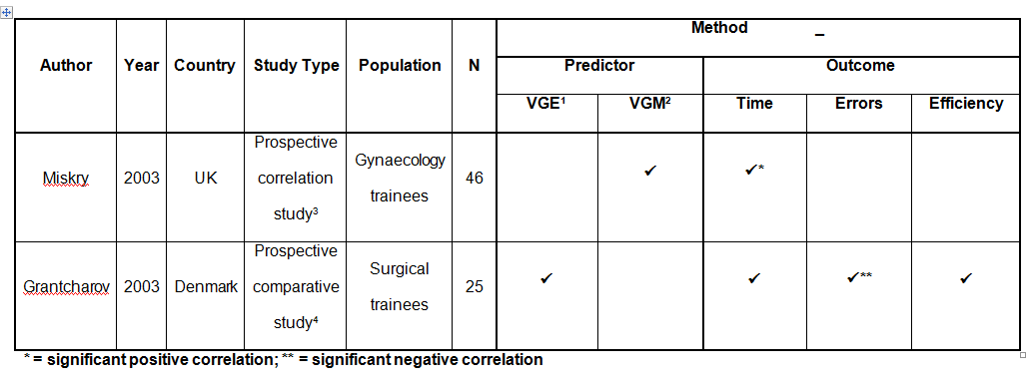
Video Games
Notes:
Video games were evaluated as a predictor in terms of both video game experience and video game metrics. Performance on a video game predicted improved surgical performance in terms of time. Participant reporting of video game experience showed no correlation to time or efficient surgical performance, but it did predict reduced errors during a surgical task.

Slide 22

Conclusion
Notes:
AA is primarily a strong predictor of successful completion of training programmes and success in end of training examinations though MSP correlates to subjective measures of surgical performance.
Collectively, intermediate and high-level visual-spatial perception are strong predictors of baseline surgical ability, rate of skill acquisition and quality of surgical performance.
Psychomotor aptitude assessed collectively provides significant predictive power regarding rate of skill acquisition.
Performance on video games may have some bearing on objective measures of surgical performance.
[I]: So what conclusions can be draw from this?
In addition to current selection criteria, based primarily on AA, surgical training program directors should consider aptitude testing, specifically of VSP and PMA, as additional measures when ranking their applicants.

Slide 23
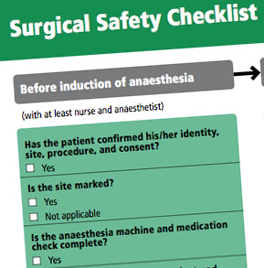
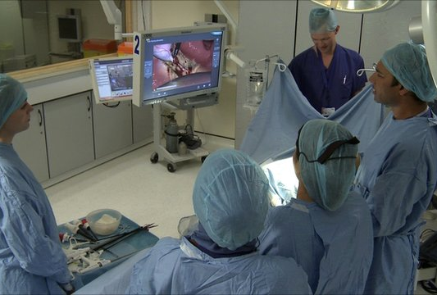
Future Research
Notes:
[I]: So how would you take this research further?
The majority of studies have relied on procedural assessments of surgical performance, and as highlighted by a number of master surgeons^{5, 6}, there are a number of non-technical factors contributing to performance. There is a need for studies assessing the relationship between aptitudes and objectively assessed performance in a simulated operating theatre³⁸; an environment that recreates the complex team based interactions of a real operating theatre.
[I]: How can we really know its beneficial?
If training program directors consider the addition of aptitude testing, the piloting of an aptitude-based selection methodology would allow for longitudinal studies, providing further validity data regarding predictors of surgical performance and the presence or lack of effect on patient safety.

Slide 24
References
Society for Industrial and Organisational Psychology, Inc. 2003. Principles for the validation and use of personnel selection procedures, Fourth Ed. Retrieved December 15, 2010, from http://www.siop.org/_Principles/principles.pdf.
Randall R, Davies H, Patterson F, Farrell K. 2006. Selecting doctors for postgraduate training in paediatrics using a competency based assessment centre. Arch Dis Child 91(5): 444–8.
Beard J, Strachan A, Davies H, Patterson F, Stark P, Ball S, Taylor P, Thomas S. 2005. Developing an education and assessment framework for the Foundation Programme. Med Educ 39 (8): 841–51.
Patterson F, Ferguson E, Norfolk T, Lane P. 2005. A new selection system to recruit general practice registrars: preliminary findings from a validation study. BMJ 330 (7493): 711-4.
Patterson F, Ferguson E, Lane P, Farrell K, Martlew J, Wells A. 2000. A competency model for general practice: implications for selection, training, and development. Br J Gen Pract 50(452): 188–93.
Baldwin PJ, Paisley AM, Paterson-Brown S. 1999. Consultant surgeons’ opinion of the skills required of basic surgical trainees. Br J Surg 86: 1078-82.
Cuschieri A, Francis N, Crosby J, Hanna GB. 2001. What do master surgeons think of surgical competence and revalidation? Am J Surg 182: 110–16.
Bailey M. 1999. Evolution of aptitude testing in the RAF. RTO MP-55 MOD report British Crown Copyright 99.
Hayden JA, Cote P, Bombardier C. 2006. Evaluation of the quality of prognosis studies in systematic reviews. Ann Int Med 144: 427-37.
Gallagher A, Cowie R, Crothers I, Jordan-Black JA, Satava RM. 2003. PicSOr – an objective test of perceptual skill that predicts laparoscopic technical skill in three initial studies of laparoscopic performance. Surg Endosc 17:1468-71.

