Slide 1
Do junior doctors reflect on patient safety?
Dr Maria Ahmed
Clinical Research Fellow
Imperial College London

Slide 2
Context
Junior doctors vital to promoting patient safety
Poor reporting due to various factors
Other methods required to identify PSIs
Reflection as fruitful way forward...
Notes:
Junior doctors are vital to promoting patient safety in the workplace. As frontline clinicians they will often be directly or indirectly involved in patient safety incidents and are well-placed to identify contributing factors and pose solutions as agents for change.
However, incident reporting amongst junior doctors is low – due to various factors: guilt; shame; lack of opportunity/ time; prevalence of a blame culture and the perceived negative impact on career progression.
So we need to think of other methods to identify incidents to which junior doctors working at the bedside are exposed to and aware of.
Reflection on clinical practice, which all doctors are strongly encouraged to perform, may be a fruitful way forward.

Slide 3
Context
Portfolios
Encourage reflection
Enhance personal responsibility for learning
Support professional development
Personal experience
Foundation training requirement
Cathartic process
Notes:
A variety of educational approaches are commonly employed to facilitate reflective learning. Portfolios in particular are being used increasingly throughout continuing medical education to encourage reflection, enhance personal responsibility for learning and support professional development
In my own experience as a recent graduate of the UK Foundation Programme (first 2 years of clinical practice following graduation), we are expected to reflect on our practice and I found reflecting on patient safety incidents very cathartic.

Slide 4
Aims
Evaluate whether Foundation trainees reflect on patient safety incidents within portfolios
Explore potential value of such reflections for quality of care
PSI = Any unintended or unexpected incident that could have or did lead to patient harm
Notes:
So I wondered whether my colleagues were equally engaged in reflective practice and set out to evaluate whether Foundation trainees reflect on patient safety incidents within their portfolios? And to explore the potential value of of such reflections for quality of care?
And PSI = Any unintended or unexpected incident that could have or did lead to patient harm

Slide 5
Methods
Cross-sectional retrospective review
All FY1s across single Trust (n=30)
All reflective entries made in first year of practice extracted from online portfolio database
Reviewed by 2 independent blinded researchers (clinical background)
Notes:
So we conducted a cross-sectional retrospective review of educational portfolios
Participants included all Foundation Year doctors in a Teaching Hospital Trust
All reflective entries (made by trainees during the preceding 12 months) were extracted from an online portfolio database by the Foundation Programme Director and issued to the reviewers in an anonymised form. Reflective practice entries are typically structured around 4 prompts: describe interesting, difficult or uncomfortable experiences. What made the experience memorable? How did it affect you? / team? What did you learn from the experience and what would you do differently next time?)
All entries were reviewed by 2 independent and blinded reviewers with a medical background.

Slide 6
NPSA-based Proforma
Presence of PSI
‘Any unintended or unexpected incident that could have or did lead to patient harm’
Emergent theme analysis: NPSA dataset domains
Incident type
Incident outcome
Contributing factors
Formally reported?
Reference within entry
Notes:
Rather than develop a bespoke coding framework, we developed a proforma based on the NPSA’s patient safety incident taxonomy from their Seven Steps to Patient Safety guide.
For all entries referring to a patient safety incident (any unintended or unexpected incident that could have or did lead to patient harm) we used an emergent theme analysis to code the PSI into incident type, contributing factors and patient outcome. We also noted whether the incident was formally reported through the Hospital Incident Reporting System.

Slide 7
Results
N=30; M:F=1; mean age 24
139 entries
68 (49%) reflected on PSI
3 (4%) formally reported
Good inter-rater reliability (0.70 to 0.83)
Notes:
So there were 30 trainees, male to female ratio was 1; mean age of 24 years
139 reflective entries were completed by the 30 trainees over the preceding 12 months
68 (49%) reflected on a PSI
Only 3 of which were formally reported
There was high interrater reliability ranging from 0.70 (patient outcome) to 0.83 (presence of PSI)

Slide 8
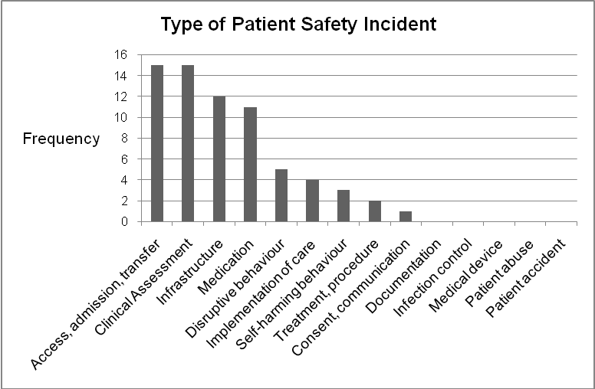
Type of incident
Notes:
The majority of incidents were assigned to errors in clinical assessment (delayed or wrong diagnosis) or delays or failure to access care – both 22%. A further 18% were assigned to infrastructure/ staffing deficiencies and 16% to medication errors.

Slide 9
Delayed diagnosis
‘A gentleman with a history of resected laryngeal cancer was admitted to the ward as ‘off legs’. On our ward round he was found to have neurological signs of acute cord compression that had not been picked up previously.’ (FY1 doctor 8)
Notes:
So this is an example of an error in clinical assessment (Delayed diagnosis)

Slide 10
Failure to access care
‘...I was shocked that despite communicating my senior-approved management plan to the nurses that it had not been carried out – the patient’s Trop T was still positive 3 days later and he had not received any further clexane since attending A&E...’ (FY1 doctor 30)

Slide 11
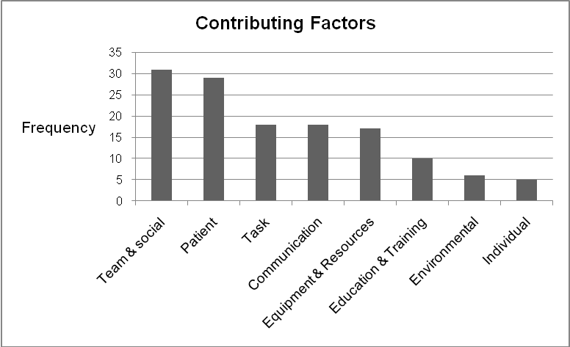
Contributing factors
Notes:
The most commonly cited contributing factors were team&social factors (23%) and patient factors (22%)

Slide 12
Patient, team & social factors
‘We commenced the patient on warfarin therapy as recommended by guidelines on the prescription sheet. The patient’s INR post loading was 8.1. The consultant in charge of the patient was extremely annoyed. I was shouted at by the consultant and the blame placed on me for the team’s mistake.’ (FY1 doctor 22)
Notes:
And this is an example– in this case the patient was frail and elderly so the higher dose of warfarin as recommended on the standard guidelines was not appropriate here – unfortunately the trainee was blamed for the team error.

Slide 13
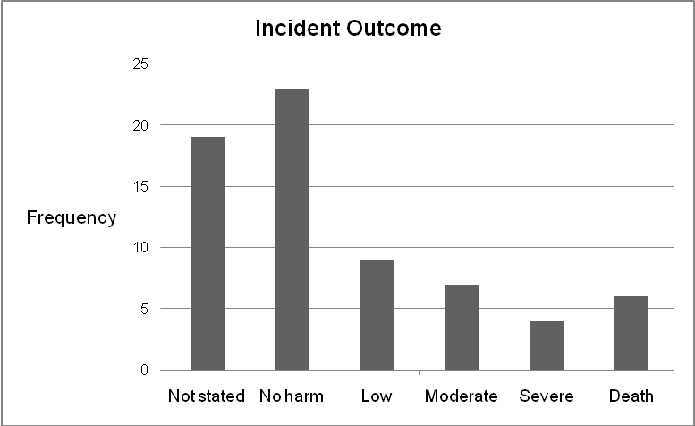
Patient outcome
Notes:
There was insufficient information to determine incident outcome in 28% of cases. Of entries where elucidation of outcome was possible, the majority (47%) led to no harm to the patient. Six reflective entries described incidents resulting in patient death

Slide 14
Deaths in detail...
Incident type | Description
Clinical assessment: missed diagnosis | Missed diagnosis of acute coronary syndrome
Clinical assessment: missed diagnosis | Missed diagnosis of spinal cord compression leading to paralysis & death
Clinical assessment: missed diagnosis | Delayed recognition and treatment of post-operative hypotension
Clinical assessment: missed diagnosis | Delayed diagnosis of ruptured abdominal aortic aneurysm
Treatment, procedure | Complication of abdominal aortic aneurysm repair (aorto-enteric fistula)
Consent, communication: failure to communicate outside of team | Antibiotic treatment for MRSA septicaemia incorrectly stopped due to failure to handover to new team
Notes:
So taking a closer look at the deaths, we can see that majority of these incident types were attributable to errors in clinical assessment: missed or delayed diagnosis. This supports existing evidence to show that diagnosis-related incidents are more likely to be associated with moderate/severe harm or death than incidents unrelated to diagnosis.

Slide 15
Summary
FY1s demonstrate awareness of patient safety
Nearly 50% of entries reflected on PSIs
Types match extant literature vs. National reports
Diagnostic errors linked to poorer outcomes
Multiple contributing factors at play
Notes:
So this study shows that foundation trainees demonstrate an awareness of patient safety and commonly reflect on patient safety incidents within their professional development portfolios.
It’s important to note that although the ‘reflective practice’ proforma does not specifically enquire into ‘patient safety incidents’, nearly half of all reflective entries made by FY1 doctors described a PSI as a memorable event.
The types of incidents reflected on broadly mirror those found in a US study which asked house officers to describe their most significant medical mistake in the last year – commonest mistakes recalled were errors in diagnosis, errors in evaluation and treatment and medication errors. However the pattern of incident type differs from that found in the data summaries from the UK’s national reporting and learning system – could reflect the different demographic of staff that report incidents through HIRs – nurses and allied health professionals tend to report more whilst doctors report less – hence diagnostic errors most commonly reflected on by doctors do not feature highly on national summaries, whereas patient accidents involving slips, trips and falls reported most commonly by nursing staff feature heavily in such reports
As discussed, we found that diagnostic errors were linked to poorer patient outcomes
And multiple factors were found to contribute to incidents reflected on – supporting existing evidence that diverse factors spanning individual clinician and healthcare systems impact on patient safety

Slide 16
Implications & Further Work
Educational strategies
Reflective portfolios as novel data source?
Does reflection translate into safer practice?
Encourage formal reporting
Promote shared learning from PSIs
Enhance organisational learning
Some evidence of ‘transformative learning’
Notes:
In terms of implications
So we know that foundation trainees commonly reflect on PSIs, and educational strategies should be employed to encourage both formal reporting and promote shared learning from PSIs
Reflective portfolios could serve as a novel data source to enhance organisational learning, particularly as contributory factors are not collated nationally
And further work is needed to explore whether reflection translates into safer practice. There is some evidence from a US team that critical reflection can lead to improvements in both individual and systems-based practice through transformative learning

Slide 17
LESSONSLEARNT
Building a Safer Foundation
Dr Maria Ahmed
Clinical Research Fellow, Clinical Safety Research Unit
Supervisors: Ms Sonal Arora, Dr Nick Sevdalis, Prof Charles Vincent
Notes:
Hi I’m Maria Ahmed, Clinical Research Fellow in the Clinical Safety Research Unit and I’m going to talk about one of my studies to implement Patient Safety training for junior doctors: Lessons Learnt Building a Safer Foundation

Slide 18
Context
Global impetus to improve Patient Safety
Education & Training for sustainable improvements
Junior Doctors as ‘Agents for Change’
Low incident reporting & peer learning
Notes:
So we know that Patient Safety has gained an increasing profile internationally.
And the recent Health Select Committee Inquiry into Patient Safety showed that although there has been significant improvements in Patient Safety over the past 10 years, sustainable improvements will be difficult to achieve without major medical education reform at both undergraduate and postgraduate levels and called for Patient Safety to be integrated into the curricular of all healthcare workers.
We also know that junior doctors are being increasingly viewed as powerful agents for change – as frontline clinicians they are well-placed to identify the contributory factors to adverse events and to pose potential solutions
However we know that in this cohort incident reporting is low due to various factors: lack of time/opportunity, fear, negative career implications, perception that HIRS enter a black hole and that nothing is done about them. We therefore need to consider ways to promote peer-learning from such events.

Slide 19
Aims
Formalise opportunity for Foundation Trainees to discuss & learn from PSIs within safe, facilitated forum
Improve safety knowledge, attitudes & skills
Foster ‘open & learning’ safety culture
Build capacity and capability for Patient Safety training
Notes:
So the aims of this study were to:
Formalise opportunity for Foundation Trainees to discuss & learn from PSIs within safe, facilitated forum
Build capacity and capability for Patient Safety training
Improve safety knowledge, attitudes & skills
Foster ‘open & learning’ safety culture

Slide 20
METHODS
METHODS
Notes:
OK so moving onto methods

Slide 21
The Setting: 16 Trusts in NW England
Notes:
The setting was 16 Trusts in North West England in collaboration with NHS North West and the Imperial CPSSQ

Slide 22
The Approach
Stakeholder engagement
Launch Event
Trainee ‘Leads’
Robust evaluation
Integrated into teaching
Attendance compulsory
Align with competencies
Build capacity & capability
‘Expert Faculty’
Consultants & SpR
Pre-post intervention
Kirkpatrick’s ‘4 Levels’
Notes:
The approach involved addressing the well-documented barriers to implementation of Patient Safety training into curricula
Starting with stakeholder engagement
Trainee Leads were appointed at each site to lead implementation locally

Slide 23
Stakeholder Engagement
Notes:
And we ran a study launch event inviting representatives from all 16 trusts with Prof Jim Reason, one of the international forerunners in the Patient Safety movement – as headline act

Slide 24
The Approach
Stakeholder engagement
Launch Event
Trainee ‘Leads’
Robust evaluation
Integrated into teaching
Attendance compulsory
Align with competencies
Build capacity & capability
‘Expert Faculty’
Consultants & SpR
Pre-post intervention
Kirkpatrick’s ‘4 Levels’
Notes:
We built capacity and capability through developing an expert faculty of consultant and senior registrar facilitators

Slide 25
Building Capacity & Capability
Notes:
We ran ‘Training the trainers’ half-day events accredited by the Royal College of Physicians with an emphasis on training senior and junior clinicians to go back to their Trusts to carry out the Lessons Learnt intervention on a monthly basis

Slide 26
The Approach
Stakeholder engagement
Launch Event
Trainee ‘Leads’
Robust evaluation
Integrated into teaching
Attendance compulsory
Align with competencies
Build capacity & capability
‘Expert Faculty’
Consultants & SpR
Pre-post intervention
Kirkpatrick’s ‘4 Levels’
Focus on sustainability:
Centrally supported - Locally led
Notes:
We conducted robust evaluation pre-post intervention aligned with Kirkpatrick’s evidence-based 4-Levels of evaluation
And integrated the training intervention into the teaching programme
And throughout all this the focus was on sustainability centrally-supported but locally led, ensuring that if successful that the intervention could continue beyond the life of the project

Slide 27
The Participants (n=1203)
Central support
FPD 20
FPA 16
Trainees
1076
Leads
34
Facilitators
57
Notes:
Participants included
20 Foundation Programme Directors
16 Foundation Programme Administrators
57 facilitators
34 Leads
Over 1000 Foundation trainees
Supported by the central project team

Slide 28
The Intervention
Safe facilitated environment
Expert-trained senior doctors
Monthly basis
60 minute sessions
Peer-group discussion of PSI
London Protocol
based analysis
Lessons Learnt
Any unintended or unexpected incident that could have or did lead to patient harm (NPSA)
Notes:
The intervention itself was based on competencies included in the World Health Organization Patient Safety Research Curriculum guide
60 minute sessions
Held on a monthly basis
Wherein Foundation trainees lead a peer-group discussion of a patient safety incident (any unintended or unexpected incident that could have or did lead to patient harm)
In a safe, facilitated environment
By expert-trained senior doctors
Using a London Protocol based analysis – root cause analysis tool developed by Charles Vincent et al.

Slide 29
Monthly Session Structure
10 mins
25 mins
Facilitated group discussion
15 mins
5 mins
Case presentation
Lessons Learnt & Action Plan
Feedback & Evaluation
5 mins
Introduction
Notes:
The monthly session structure comprised case presentation by a trainee followed by facilitated group discussion and formulation of an action plan

Slide 30
Evaluation
Completed QI projects
3. Behavioural change
Trainees: Behaviours Qr
2. Learning
Trainees, Leads & Facilitators: KSA Qr
1. Reaction
All: Satisfaction Qr
4.Org Change
Kirkpatrick DL, Kirkpatrick JL 2006
Notes:
Evaluation was aligned with Kirkpatrick’s 4 levels
Reaction was evaluated by satisfaction questionnaire of all participants
Learning was evaluated through a combination of bespoke and validated questionnaires on knowledge, skills and attitudes in trainees, Leads and facilitators
Behavioural change in trainees was assessed through questionnaire
And organisational change assessed by the quality improvement projects completed

Slide 31
METHODS
RESULTS
Notes:
Moving on to results

Slide 32
Level 1: Satisfaction (n= 498)
Notes:
Looking at satisfaction
All participants agreed or strongly agreed that Lessons Learnt promotes an open and learning safety culture, supported local continuation and integration across all Trusts

Slide 33
Level 2: Knowledge (n= 503)
All p < 0.01
Notes:
Objective scores of knowledge improved significantly post-intervention in trainees, Leads and facilitators

Slide 34
Level 2: Skills (n= 503)
All p < 0.01
Notes:
Self-report measures of skills also significantly improved in trainees, Leads and Facilitators for example in analysing patient safety incidents

Slide 35
Level 2: Attitudes (n= 503)
‘Telling others about a mistake I made would be difficult (1) to easy (5)’
Notes:
The validated attitudes questionnaire examined four domains: feelings; personal beliefs; ability to influence and intentions
And this is an example of one item in the ‘feelings domain’: ‘telling others about a mistake I made would be difficult (1) to easy (5). And we can see that feelings significantly improved post-intervention in trainees, Leads and facilitators

Slide 36
Level 3: Behavioural change (n= 420)
*p < 0.001
Notes:
Looking at behavioural change in trainees only. We can see that whilst awareness of PSIs and patient disclosure averaged the same post-intervention, reflection in portfolio, peer-group discussion and incident reporting significantly improved post-intervention (assessed at baseline and at 6 months post-intervention)

Slide 37
Level 4: Organisational Change (n=30+)
Development of clinical protocols/pathways
Insulin sliding scale
Crash protocol for Psych wards
Improved working conditions
Rota re-design
Nurse staffing ratios
User-informed teaching/ induction
NGT insertion
Hyperkalaemia management
Enhanced clinical leadership
Junior Doctors invited onto Trust Patient Safety Board
Notes:
There were over 30 quality improvement projects completed over the course of the intervention including:
Development of clinical protocols/ pathways for insulin sliding scale
Improved working conditions through rota redesign and improved staffing ratios
New teaching/induction sessions introduced informed by trainees
And enhanced clinical leadership – a number of junior doctors were invited onto the their Trust Patient Safety Board to take forward recommendations from cases discussed.

Slide 38
Summary
Largest multi-centre study of Patient Safety training intervention in the UK
Significant improvement in KSAs and behaviours
Addressed barriers to implementation
Translation & sustainability built in
Notes:
So in summary this is the largest multi-centre study of a Patient Safety training intervention in the UK
Demonstrating significant improvement in knowledge, skills, attitudes and behaviours in trainees
The approach addressed barriers to implementation of such training within curricula, with translation and sustainability built in

Slide 39
Sustainability & roll-out
Local
Next cohort training (HIEC award)
Evaluate wider impact
National
Imperial College Healthcare Trust
London Deanery
International
WHO Patient Safety Research curriculum
Notes:
In terms of next steps
Locally, the project won the Greater Manchester HIEC Innovation Award to support training for the next cohort of facilitators and Leads. We also plan to evaluate organisational impact further
Nationally we have been approached to run this across all 3 Foundation Programmes at Imperial HealthCare Trust with potential to roll-out across the London Deanery
And internationally we plan to feed back into the WHO Patient Safety Research curriculum

Slide 40
Acknowledgements
Lessons Learnt Team
Prof Paul Baker
Leads
Facilitators
Supervisors
Ms Sonal Arora
Prof Charles Vincent
Funders
NHS North West
Dr Nick Sevdalis
Notes:
Just to thank the Lessons Learnt team, my supervisors and NHS North West

Slide 41
maria.ahmed@imperial.ac.uk
Notes:
Thanks for listening. Any questions?

