Slide 1
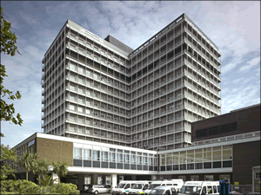
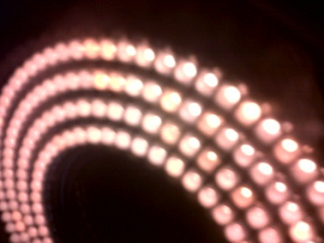
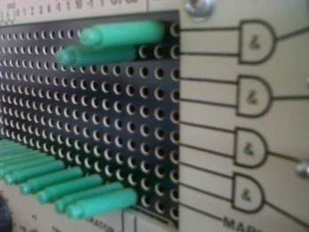
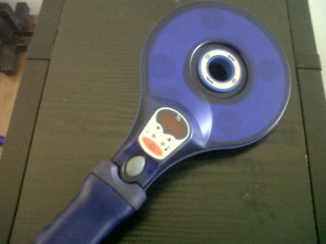
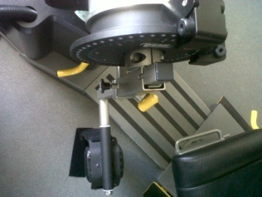
Using science to understand performance and injury and disease mechanisms
Alison H McGregor

Slide 2
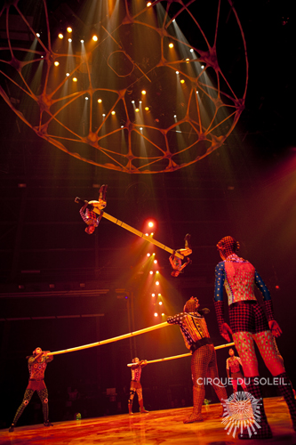
Performance
Simple or complex movement task
Sporting task
Dramatic or musical performance
Ballet
Theatre

Slide 3
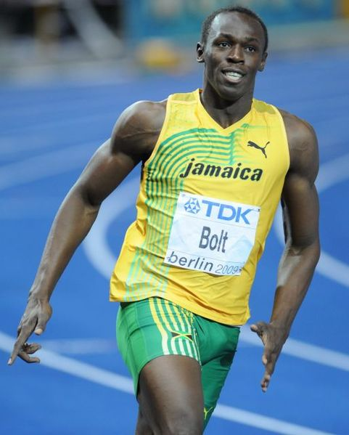
Commonality
All require the following: -
~ Muscles
~ Joints
~ Motor control
~ mental focus/ determination
Involve
High pressure/ stress
High stakes

Slide 4
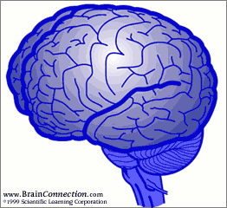
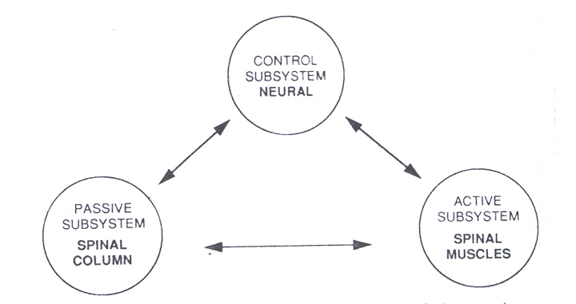
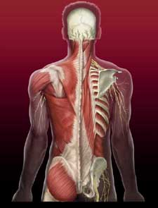
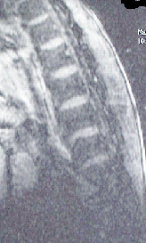
Function

Slide 5
Assessment of motion
Kinematics: description of the motion of objects
Kinetics: determination of the forces acting on the objects which are responsible for the movement of the object

Slide 6
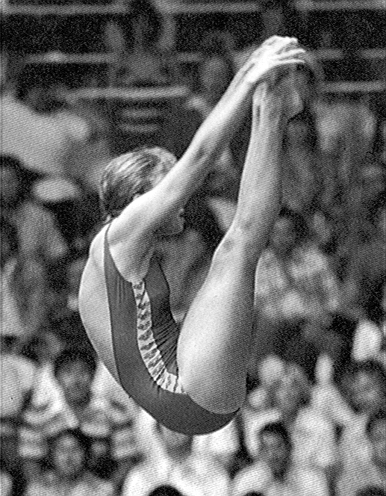
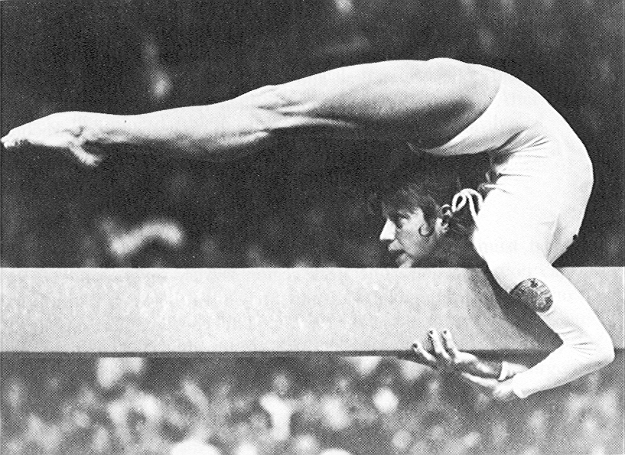
Kinematics

Slide 7
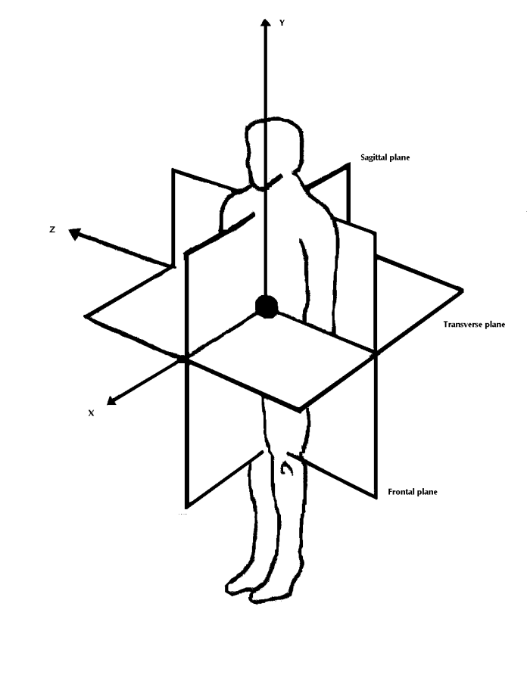
Axes of motion
Biomechanical axes
Clinical terminology
Superior/Inferior
Anterior/ Posterior
Medial/ Lateral
Proximal/ Distal
Flexion/extension
Rotation
Lateral bending

Slide 8
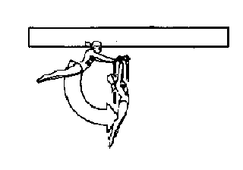
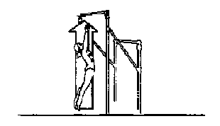
Rotation
Rotational
Linear/ translational

Slide 9
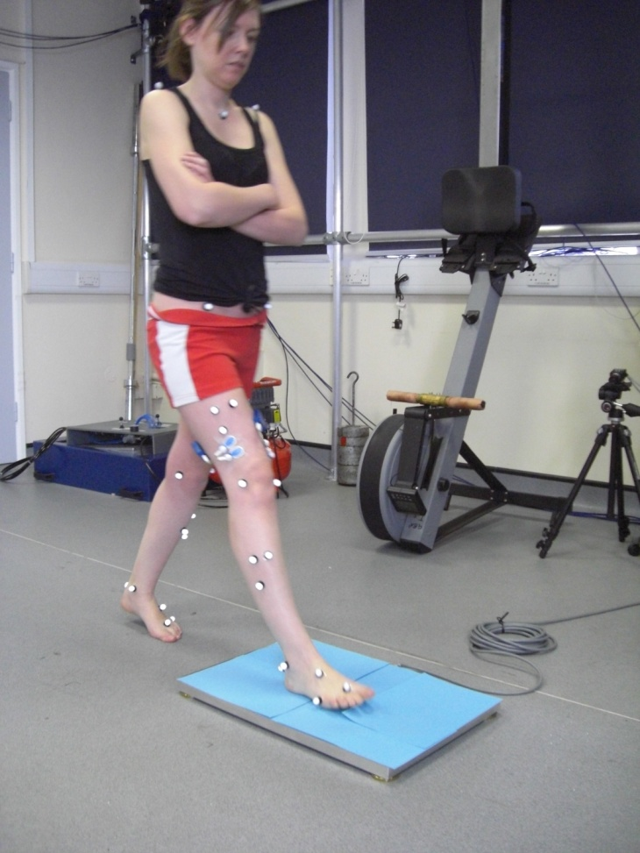
Levels of Assessment
Primary level – visual observation
2ndary level – some simple measures
Higher level assessment – complex measures with data analysis

Slide 10
Kinetics

Slide 11
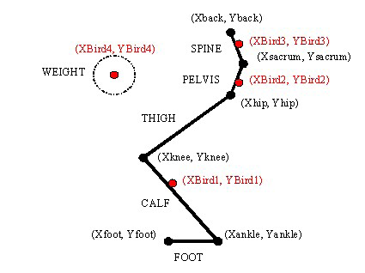
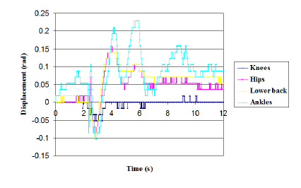
Multi-segmental

Slide 12
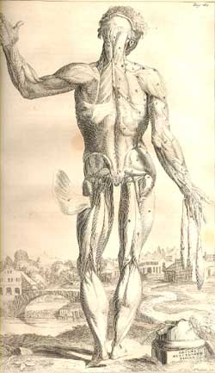
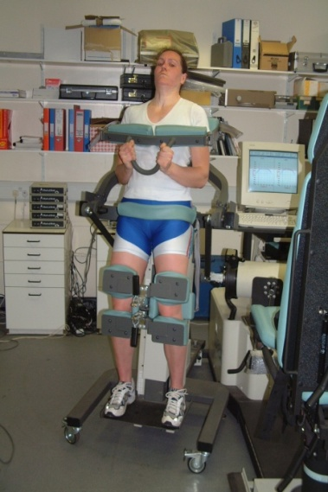
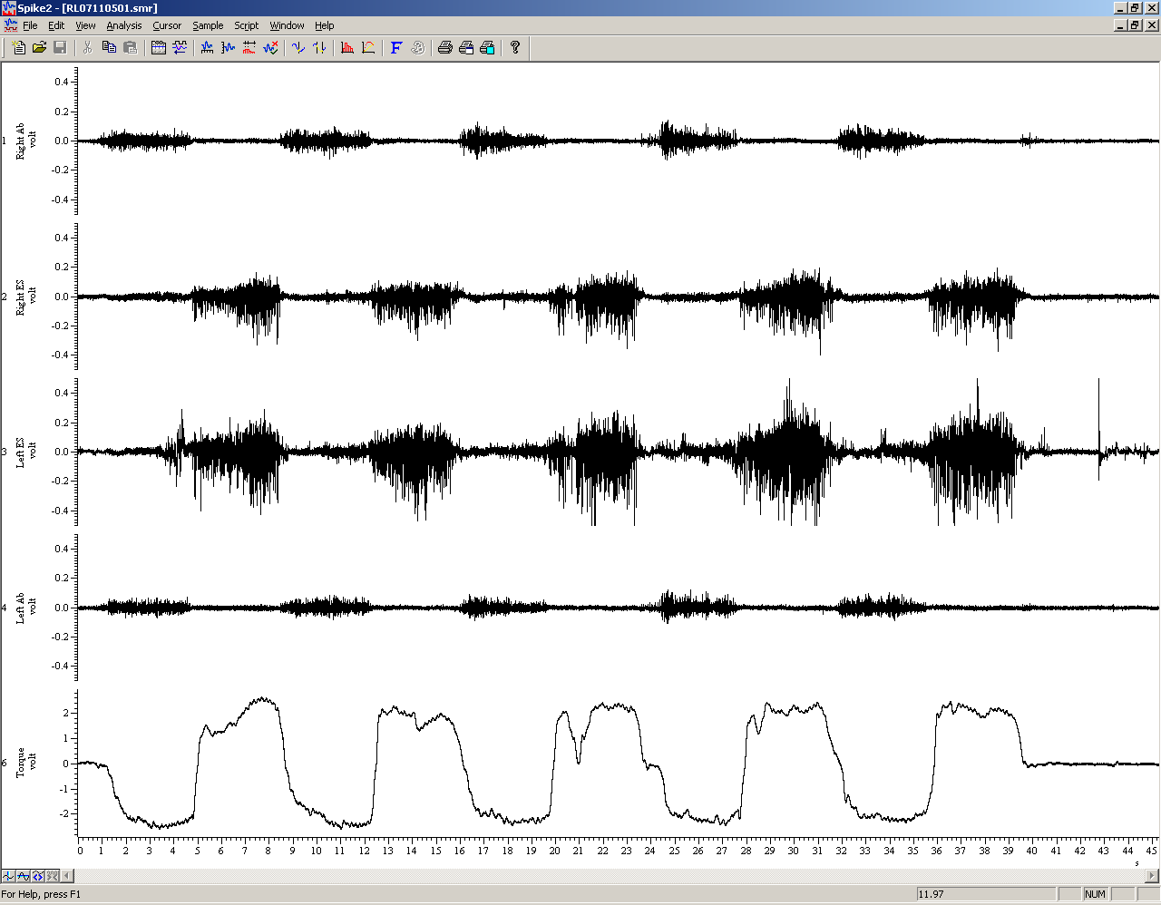
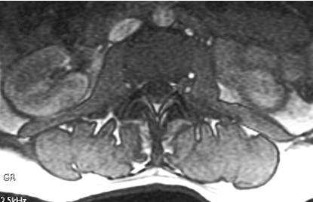
Muscle function

Slide 13
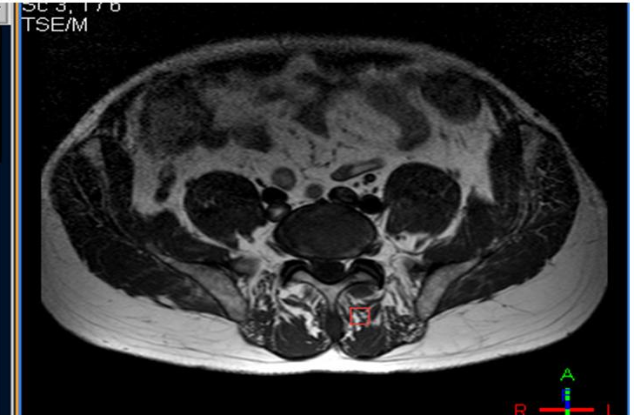
MRI imaging

Slide 14
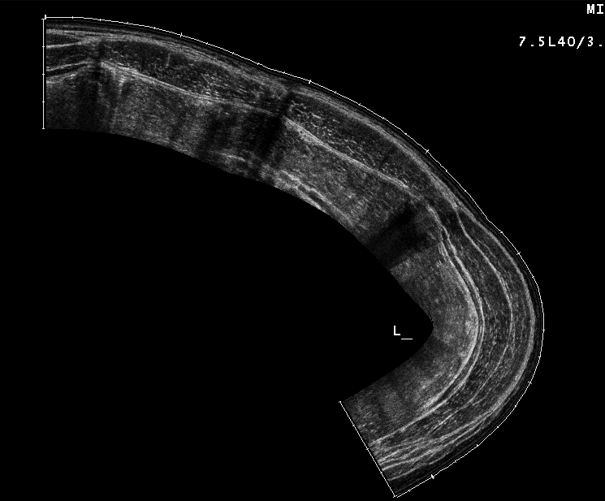
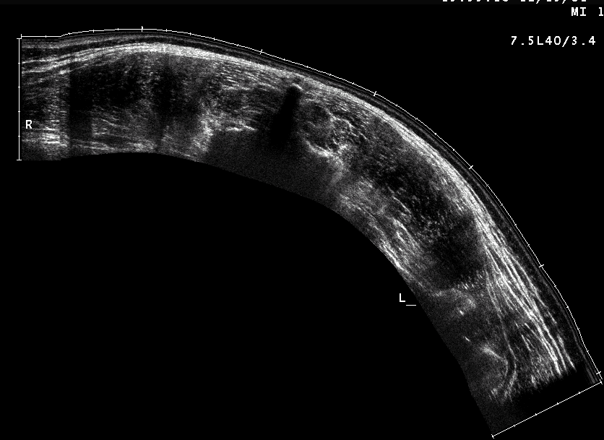
Ultrasound extended FoV

Slide 15
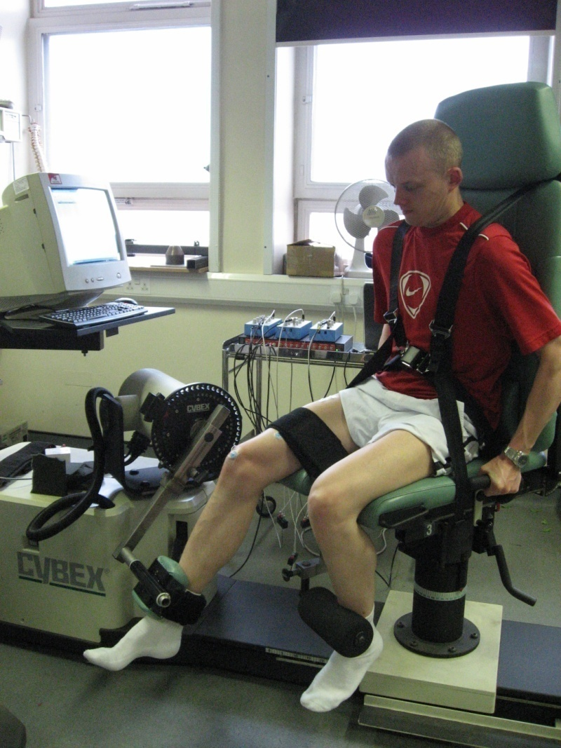
Strength testing
Isometric
Isokinetic ~ concentric ~ eccentric
Power
Peak torque
Force generated
Endurance
Fatigue

Slide 16
Isokinetic flexion / extension at 30°/s
Right RA
Right ES
Left ES
Left RA
extend
Torque
flex
Time (s)

Slide 17

Motor control
Reaction times
Balance & pertubations
Muscle timing
Corticospinal pathways
Reflex activity
FMRI

Slide 18


Slide 19
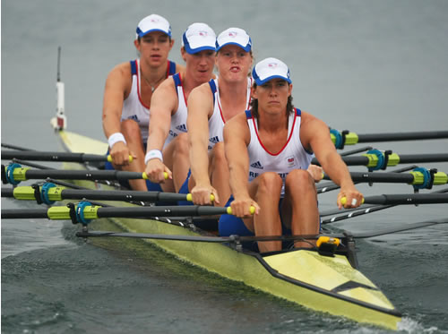
Olympic games Athens
    Gold GER 6:29.29
    Silver GB 6:31.26
World championships ‘05
    Gold GB 6:09.59
    Silver GER 6:09.93
World championships ‘06
    Gold GB 6:12.50
    Silver AUS 6:13.99
World championships ’07
    Gold GB 6:30.81
    Silver GER 6:32.02
Olympic Games Beijing
    Gold China 6:16.06
    Silver GB 6:17.37
Women’s quadruple sculls

Slide 20
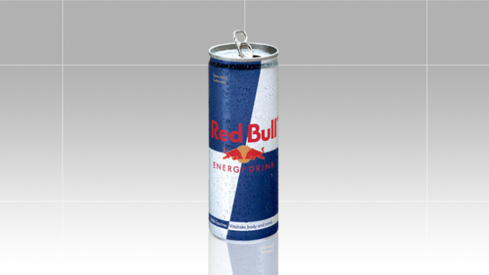
Performance Factors
Injury
Illness
Fatigue
Over-training
Physiology
Biomechanics
Mental status
Enhancing substances

Slide 21
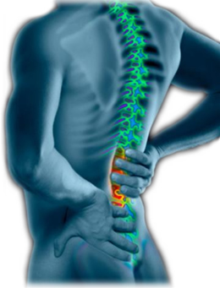
The perils of back pain
26% incidence
(Roy et al 1990)
32% intercollegiate rowers (Teitz 2002)
75% incidence in internationals (Ong et al 2003)
average 24 lost training days
crew disruption

Slide 22
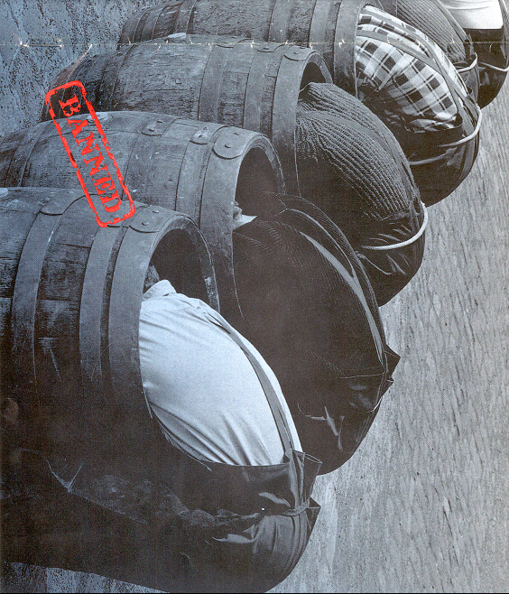
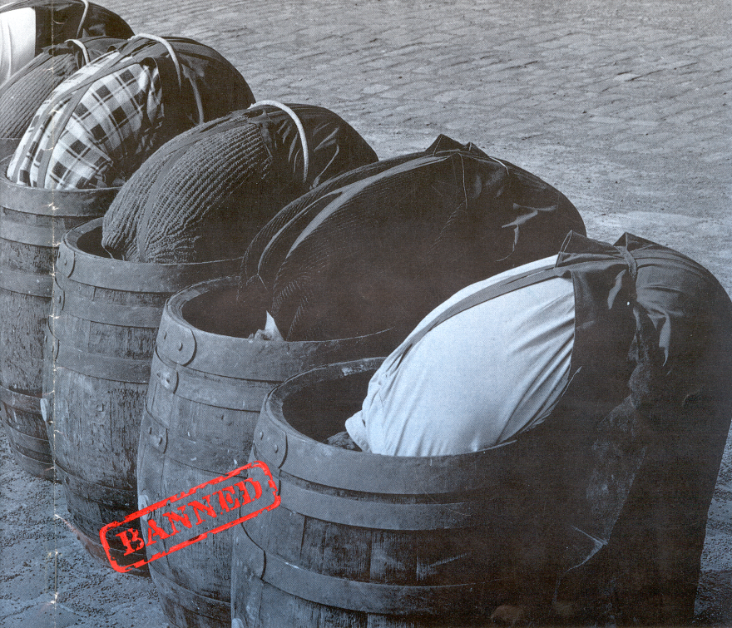
Obvious?

Slide 23
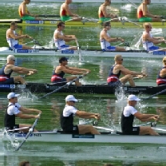

Slide 24
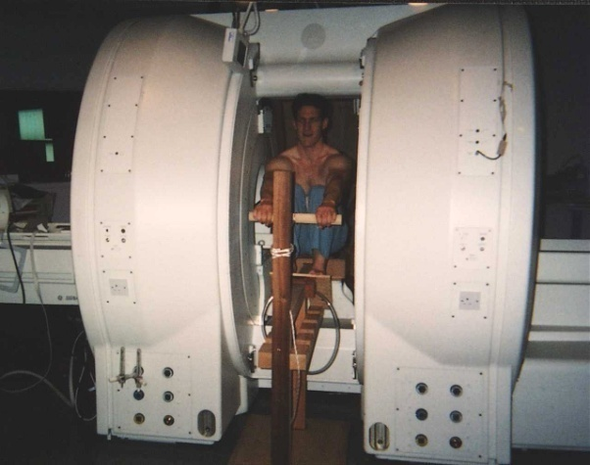
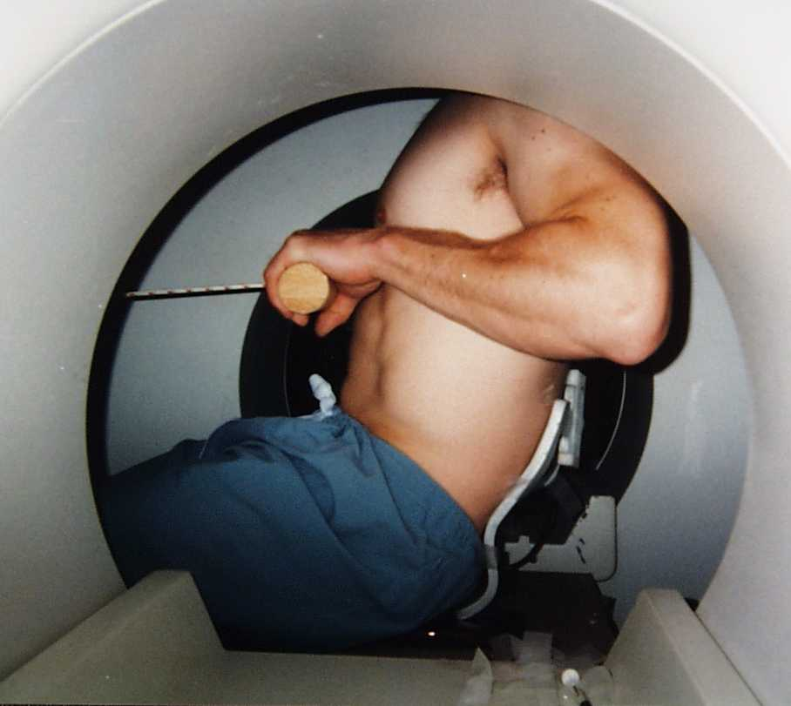
MRI Imaging
McGregor et al 2002

Slide 25

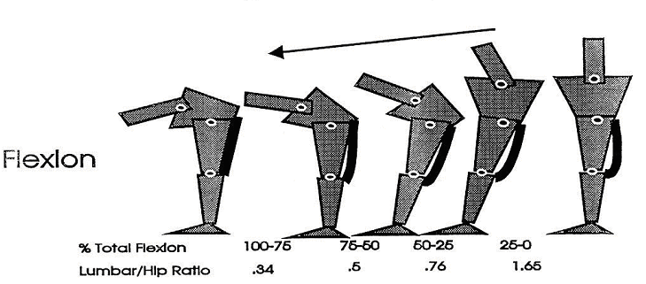
Lumbo-pelvic motion

Slide 26
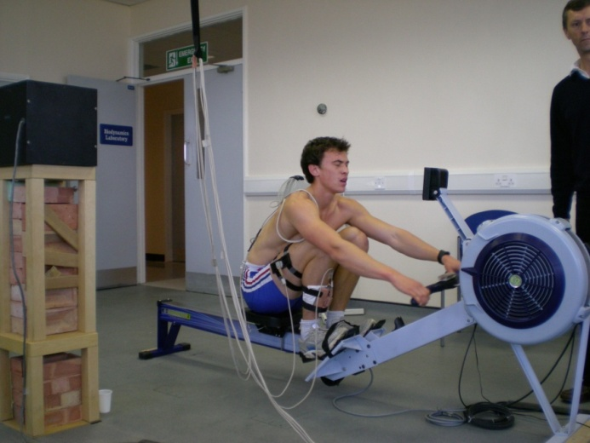
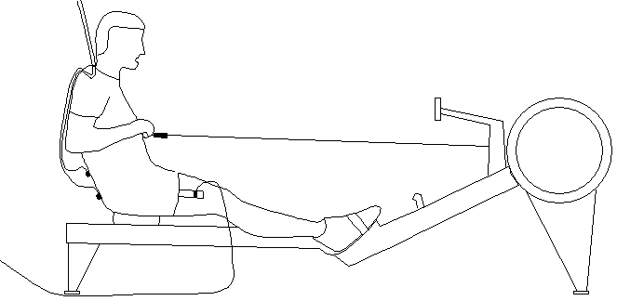
Measurement system
Electromagnetic motion tracking
Load cell for handle force

Slide 27
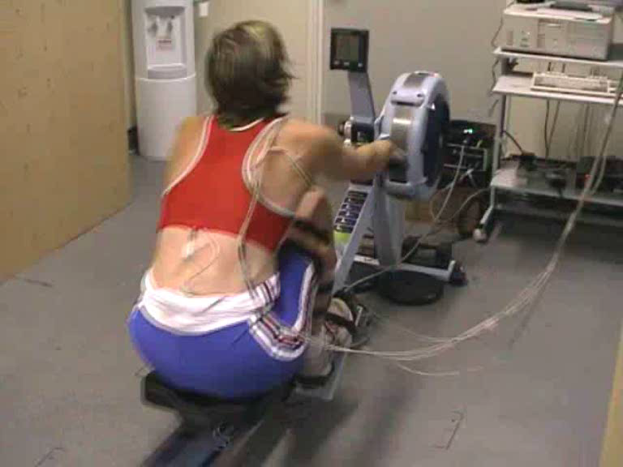
Test system

Slide 28
Data Interpretation

Slide 29
Kinematic and kinetic assessments
Fatigue
Exercise intensity
Longitudinal training
Links to performance
Links to injury

Slide 30
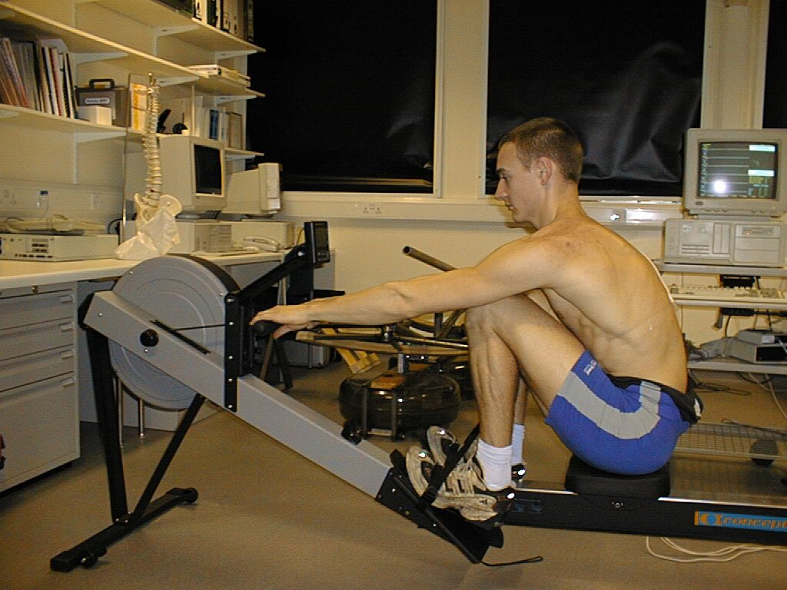
Fatigue study
Club level rowers
One hour protocol
  Decreased rate of force production
  Delay in finish position
  Increased range of lumbar flexion and extension
  Effects reduced by a 3 min half time break
Holt et al. (2003)

Slide 31
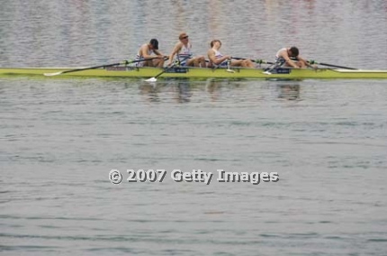
Fatigue study
One hour protocol
  No fatigue effect
  Demonstrated good consistency of rowing style
  Suggested high importance of warm up (≈ 10 min)
International rowers
MacKenzie et al. (2009)

Slide 32
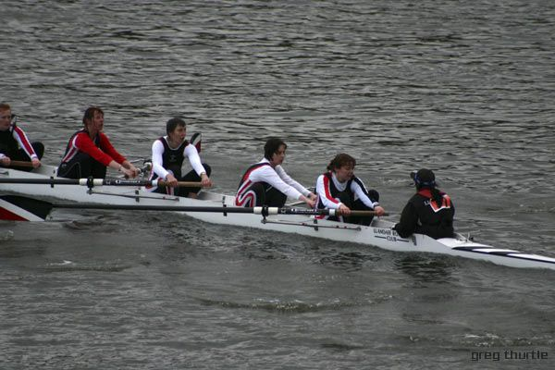
Exercise intensity study
Novice rowers
~ Sub optimal force curves observed
~ As intensity increased
  Force curve deteriorated
  “Rock over” at catch deteriorated
  “Slumping” at the finish
  Poor control of leg extension
McGregor et al. (2004)

Slide 33
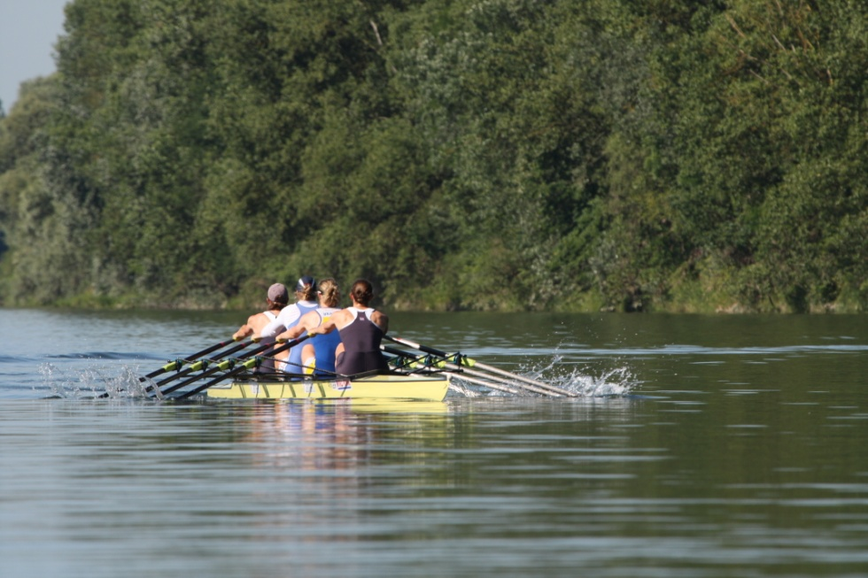
Exercise Intensity – Step testing
Elite rowers
12 elite oarswomen, National squad
Incremental Step test
5 Steps
Maximal test
McGregor et al. (2005)

Slide 34
Step testing – Force curve
Significant increases in peak force
Increase in rate of force production (/s)
Peak force occurred later in the stroke (%)
Stroke length consistent (Steps 1-5)
Stroke length shortened in maximal test
Step 6
Step 1
McGregor et al. (2005)

Slide 35
Step testing – Kinematics
Lumbopelvic ratio
At higher intensity exercise
  Reduced leg extension at the finish
  Legs not held down for as long
  Less anterior rotation of pelvis at the catch
  Greater trunk flexion at the catch
  Suggestion of poor pelvic control
Catch
Finish
McGregor et al. (2005)

Slide 36
Longitudinal training – 1
Repeated Step test protocol 2 years later
7 of the original 12 athletes
Results showed
  Increased stroke length
  Increased peak force
  Increased power output
McGregor et al. (2007)

Slide 37
Longitudinal training – 2
Results of kinematics showed
  Improved catch position
    Less femoral rotation
    Greater anterior pelvic rotation
    Improved lumbopelvic ratio
  Improved finish position
    Improved leg extension
    Good posterior pelvic rotation
    Improved lumbopelvic ratio
McGregor et al. (2007)

Slide 38
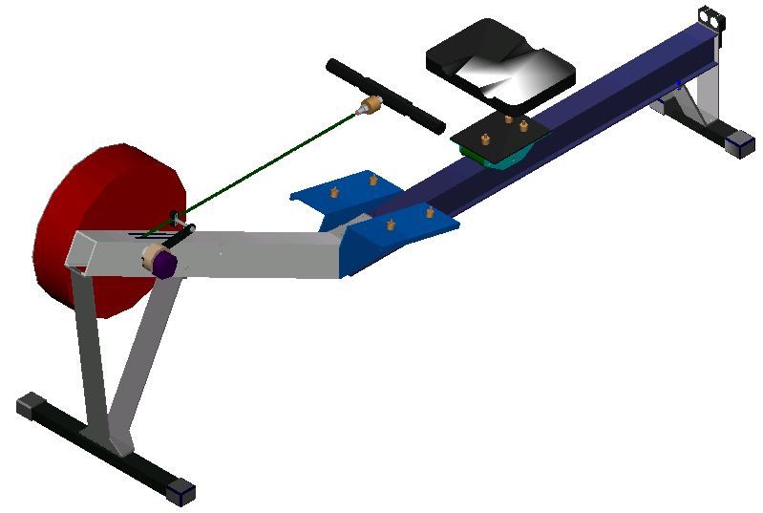
System development
Lumbar spine
Foot
6 DOF motion sensors
Joint centres
Chee et al. (2009)

Slide 39
Recent advances
Full description of 3D kinematics and kinetic profiles
Rates of change
Effect of intensity
Effect of training
Effect of technique on performance
Murphy et al. (2009)

Slide 40
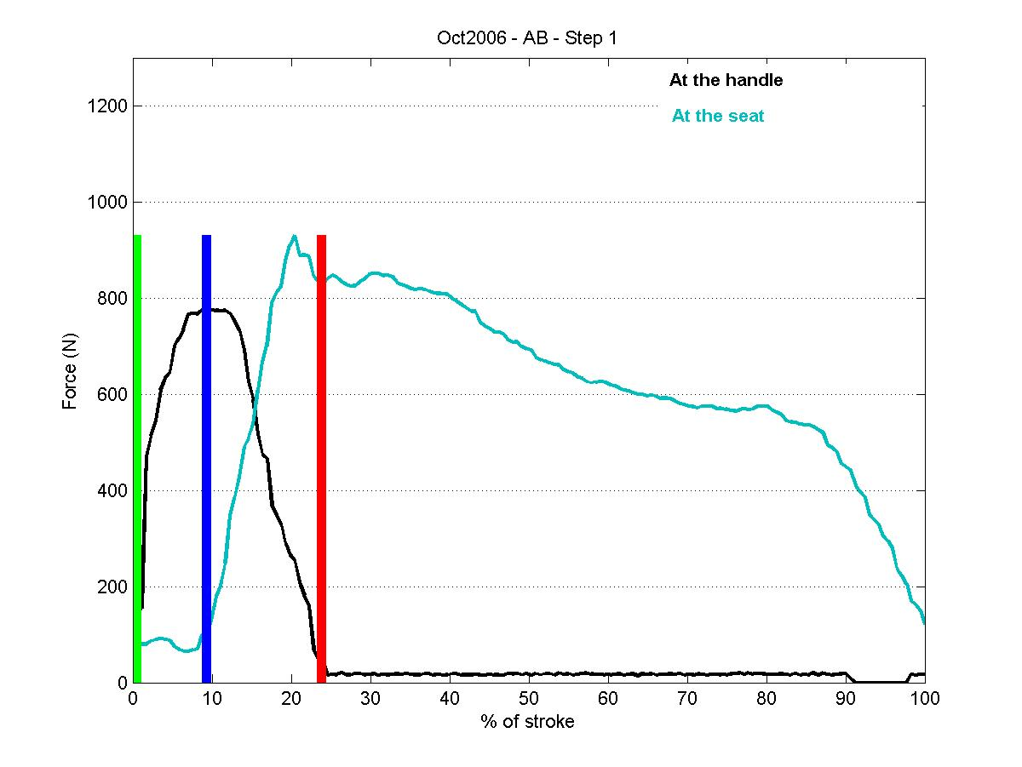
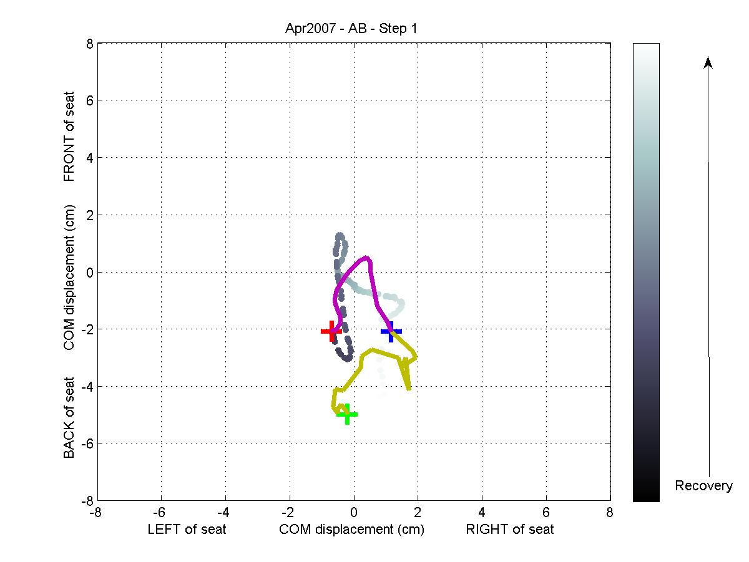
Seat data

Slide 41
Results
Some deterioration in technique with increasing intensity
Improvement in motion behaviour over months and years
Identification of technique parameters to improve performance and reduce the risk of injury
Integration into GB coaching programme
Murphy et al. (2009)

Slide 42
Instrumented foot-plates

Slide 43
Profile changes with intensity

Slide 44
Muscle function & Rowing

Slide 45
Unhealthy muscles

Slide 46
Rowers’ posterior trunk muscles

Slide 48
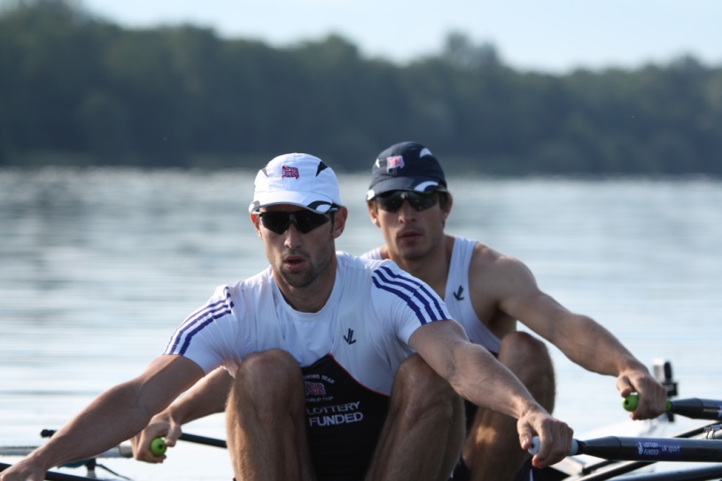
Lessons from imaging rowers
In rowers with a history of LBP
  No suggestion of unilateral or bilateral wasting
  Suggestion of well developed multifidus
  No evidence on transversus abdominus
Not in agreement with general back pain population
McGregor et al. (2002)

Slide 49
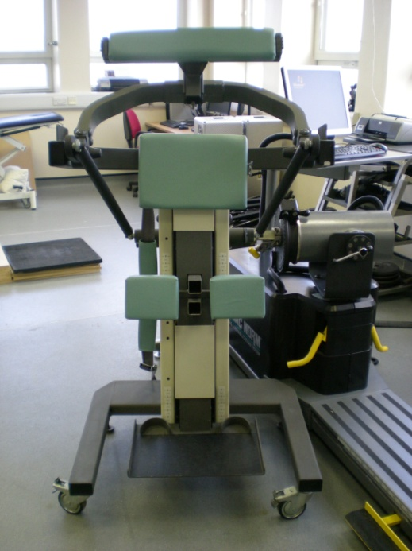
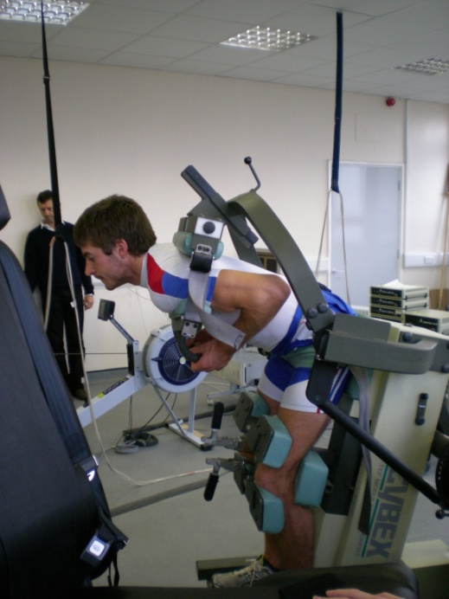
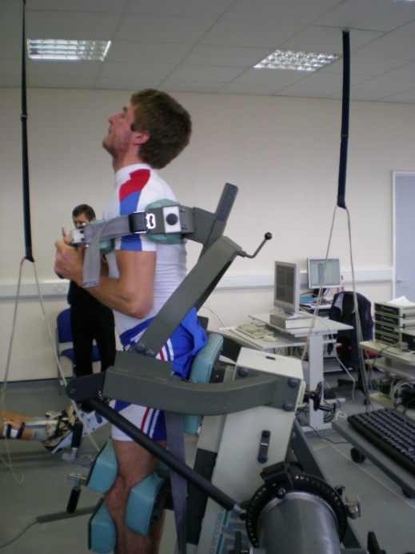
Muscle strength and power
Isokinetic and isometric dynamometry

Slide 50
Trunk torque in elite rowers
Normalised by body weight
Rowers
Non rowers
Extensors
Flexors
McGregor et al. (2004)

Slide 51
Extensor : Flexor bias
Rowers
Non rowers
Literature suggests bias should be 130-160%
Might this contribute to prevalence of LPB and injury in rowers?
Ideal
McGregor et al. (2004)

Slide 52
Static strength and endurance
Rowers
Non rowers
Rowers had greater isometric peak strength
Particularly in extension
Rowers fatigued faster over a 30s maximum hold
Surprising, as rowing is an endurance event
McGregor et al. (2004)

Slide 53
Training intervention
2002 – 2009…
Trunk strengthening programme
  Gluteal work – particularly medius and min
  Oblique work
  Lower abdominals
  Erector spinae
  Hamstring and hip flexor stretching
Use of set exercises and rowing specific exercises

Slide 54
Effects of training
y = 15.3x + 244.3
R² = 0.9029
Improved peak strength and power
Improved muscular endurance
Improved antagonistic balance
Murphy et al. (2009)

Slide 55
Symmetry of contraction

Slide 56
Isokinetic flexion / extension at 30°/s
trunk muscles are not symmetrically activated during flexion and extension
Right RA
Right ES
Left ES
Left RA
extend
Torque
flex
Time (s)

Slide 57
Rowing side influences this asymmetry
EMG activity in flexors and extensors
Left/Right EMG activity ratio

Slide 58

Summary
Biomechanically more efficient same physiological work load
Impacted on training programme
Focused technique coaching
Provided biofeedback tool
Developing tailored athlete set up
Understanding mechanical implications to body

Slide 59




Acknowledgements
Co-workers: -
  Anthony Bull
  Peter Cashman
  Finbarr &Janet O’Sullivan
  Jeremy Loh
  Bob Schroter
  Peter Holt
  Rachel Byng Maddick
  Tony Bateman
  Rebecca Steer
  Alison Saunders
  Nick Davey
  Paul Strutton
  Adam Hill
  Sarah Parkin
  Jane Grewar
  Hugh MacKenzie
  Andrew Murphy
  Samson Chee
  Simon Hislop
  Erica Buckeridge

Slide 60
Thank you for you attention
a.mcgregor@imperial.ac.uk

