Slide 1
Human error and patient safety
Dr Nick Sevdalis
Department of Surgery and Cancer
Email: n.sevdalis@imperial.ac.uk

Slide 2
By the end of the lecture you should…
Understand basic concepts relating to human error in the context of healthcare
Understand the difference between person and systems approaches to error/performance
Be able to present and discuss in some detail the systems approach to human error/performance

Slide 3
Outline
Introduction to errors and adverse events
Models of error
  Person and Systems approaches
Error analysis
  London Protocol
Conclusion and discussion

Slide 4
1. Introduction

Slide 5
Some terminology
Adverse event: injury suffered as a result of treatment or hospitalisation
Other terms:
  iatrogenic injury
  critical incident
  sentinel event
  patient safety incident

Slide 6
Types of errors
Medication errors
Prescribing/Preparation
Administration/ Adverse Drug Events
Hospital acquired infection
Indwelling devices
Pneumonia/MRSA/C. Diff
Procedural adverse events
Surgical Site Infection (SSI)
Wrong site/patient/procedure
Diagnostic errors
Documentation errors
Accuracy
Timing
Missing records
Inaccuracies
Communication errors
Poor teamwork
Lack of information

Slide 7
Incidence
“…the actual mortality in hospitals…is very much higher than the mortality of the same class of diseases treated outside hospitals”
Florence Nightingale (1820-1910)

Slide 8
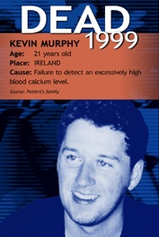
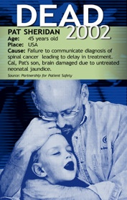


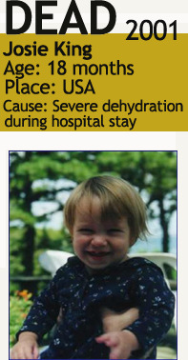

Slide 9
Incidence: early evidence
Study | Date of admissions | Number of hospital admissions | Adverse event rate (% admissions)
California Insurance Study | 1974 | 20864 | 4.65
Harvard Medical Practice Study | 1984 | 30195 | 3.7
Utah-Colorado | 1992 | 14052 | 2.9
Australian | 1992 | 14179 | 16.6
United Kingdom | 1999 | 1014 | 10.8
Denmark | 1998 | 1097 | 9.0
New Zealand | 1998 | 6579 | 11.2
France | 2002 | 778 | 14.5
Canada | 2000 | 3745 | 7.5

Slide 10
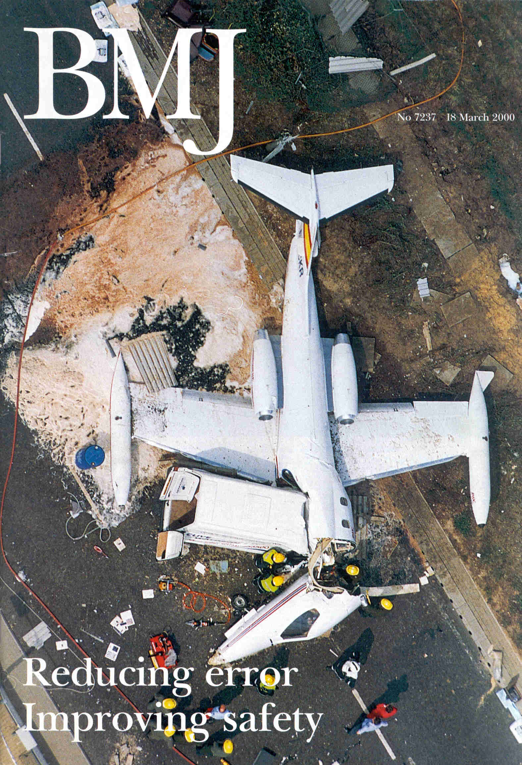

Slide 12


Slide 13
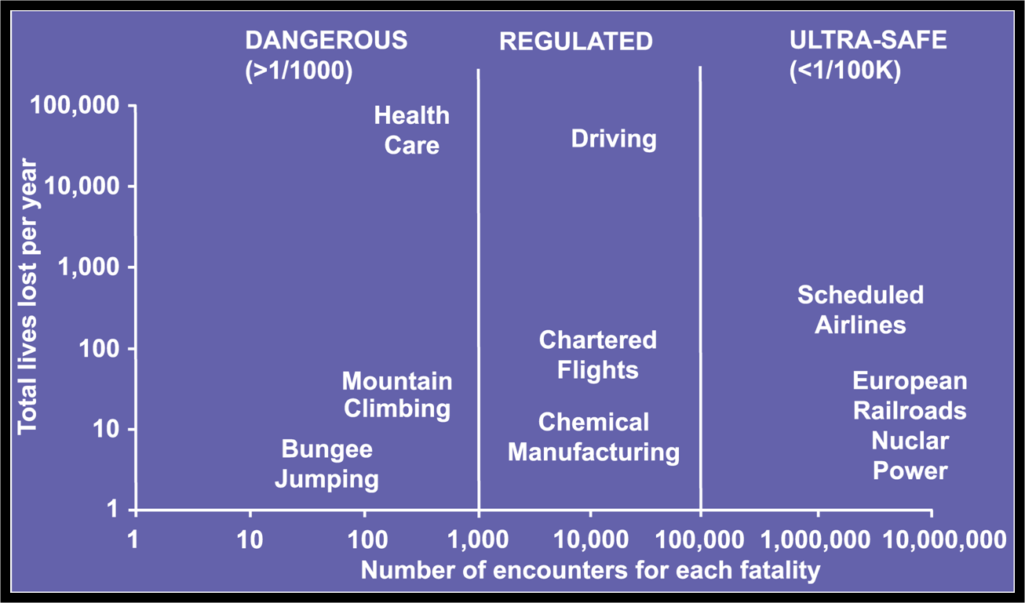
How safe is healthcare?

Slide 14
Consequences Christensen 1992; Vincent et al 1994
“A swelling on my cheek was diagnosed as a malignant tumour and part of my jaw and extensive tissue was removed without my consent. The lab test showed that it was not a tumour, malignant or benign”
“I was really shaken. My whole feeling of self worth and ability was basically profoundly shaken”
“I was appalled and devastated that I had done this to somebody”

Slide 15
Consequences: the NHS
Vincent et al 2001
  119 adverse events
  999 extra bed days
  £290,268 extra costs for the Trusts
An Organisation with a Memory 2001
  10,000 reported serious adverse drug reactions
  NHS pays £400 million in litigation
  Hospital acquired infections cost nearly £1billion and 15% are regarded as preventable

Slide 16
“It won’t affect me...”
USA-600,000 doctors
98,000 deaths annually
One error-related death every 6 years
50% unrecognised error contribution
One death per 12 years per doctor
Three per lifetime experience

Slide 17
2. Models of error

Slide 18
Human error Reason 1992
Failure of achieving the intended outcome in a planned sequence of mental or physical activities not attributable to chance
Error
Slip
correct plan, incorrect execution
Mistake
incorrect plan, correct execution

Slide 19
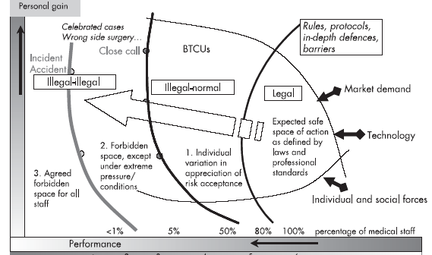
From errors to violations Amalberti et al, 2006

Slide 20
The person or the system?
The person model
The system model
Who did it?
Who is to blame?
What happened?
How do we prevent it in the future?

Slide 21
In surgery: error OF a surgeon…
Patient Risk Factors
Technical skills
Outcome

Slide 22
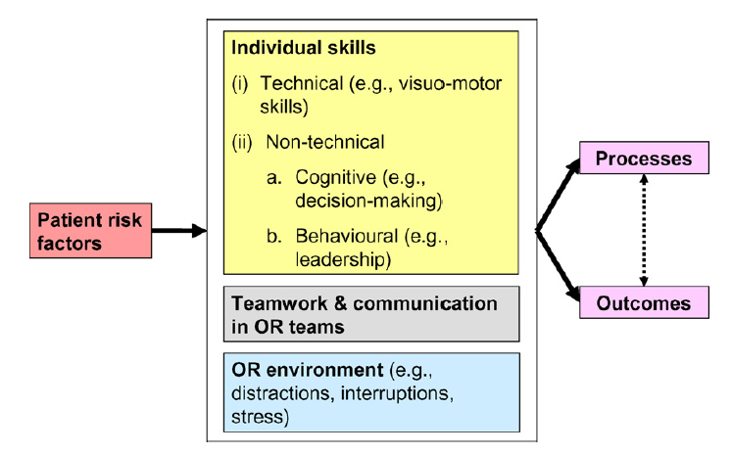
vs error IN surgery Vincent et al, 2004; Undre et al, 2009

Slide 23
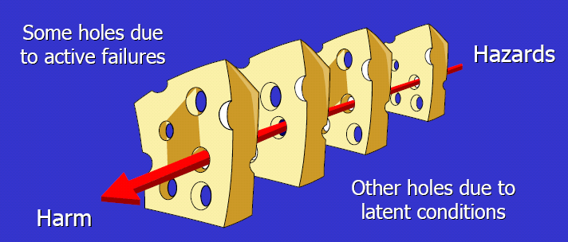
Error in the system: James Reason’s ‘Swiss Cheese’ model
© J. Reason

Slide 24
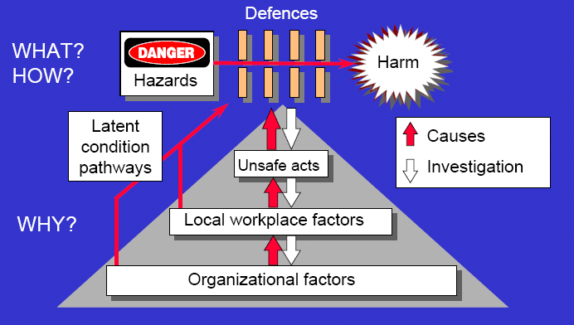
More on Reason’s view of errors
© J. Reason

Slide 25
3. Error analysis

Slide 26
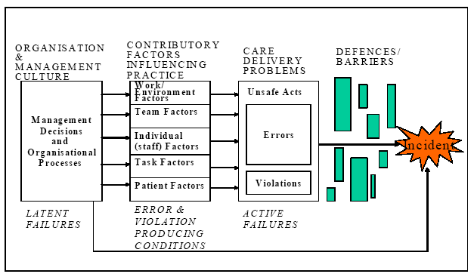
Charles Vincent’s ‘London Protocol’

Slide 27
Key concepts
Care delivery problem (CDP)
Contributing factors

Slide 28
Care Delivery Problems
CDPs are problems that arise in the process of care
Actions or omissions by staff
  Failure to monitor, observe or act
  Incorrect (with hindsight) decision
  Not seeking help when necessary
Two key features:
  Care deviated beyond safe limits of practice
  The deviation contributed to adverse outcome for the patient
Several CDPs may be involved in one incident

Slide 29
Contributing Factors
Patient factors
  Condition (complexity and seriousness)
  Language and communication
  Personality and social factors
Task factors
  Task design and clarity of process
  Availability & use of protocols,
  Availability & use of test results
Individual staff factors
  Knowledge and skills
  Motivation, physical and mental health
Team Factors
  Verbal and written communication
  Supervision and seeking help
  Leadership
Work environment
  Staffing levels and skill mix
  Workload and shift patterns
  Design, availability and maintenance of equipment
Organisation and management
  Financial resources & constraints
  Organisational structure
  Policy standards & goals
  Safety culture & priorities
Institutional context
  Economic & regulatory context
  Social attitudes to risk
  National Health Service Executive
  Clinical negligence schemes
Notes:
Explain how factors open out into:
Themes
Specific questions … in incident analysis.
Make 24/7 remark. See original paper, 24 sub-categories
I only thought of 7 levels recently
Could have called the paper Safety 24/7
But that might have been a bit too cute…

Slide 30
The analysis seeks to establish:
What happened?
How did it happen?
Why did it happen?
What can we learn from this and what changes should we make, if any?

Slide 31
How is it done?
Establish the chronology of events
Identify Care Delivery Problems (CDPs)
Determine contributing factors
Establish implications for action
Use: inspection of patient records and interviews with staff involved

Slide 32
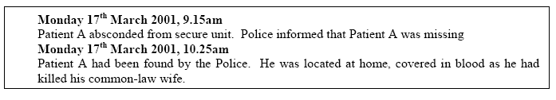

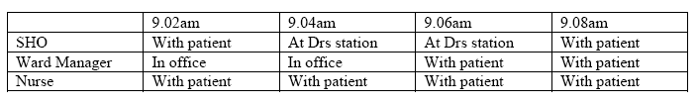
Chronology

Slide 33
Chronology + others aspects
X
X
X
X
X
X
xxxxx
x
xxx
X
XX

Slide 34
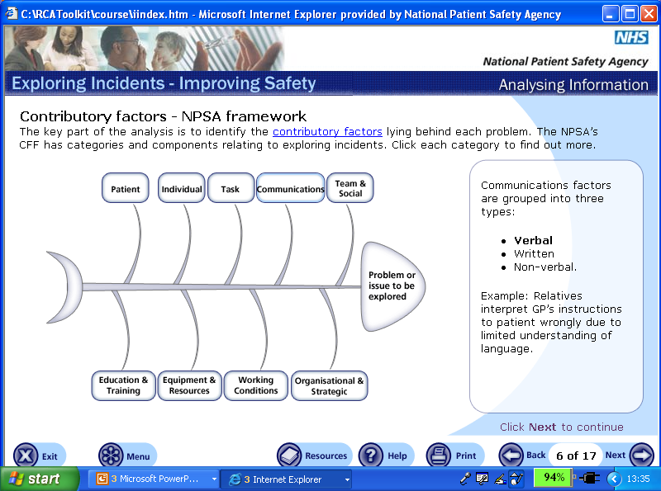
Fishbone diagrams

Slide 35
Action plan/s
Contri-butory Factors | Actions to Address Factors | Level of Recommendation (Individual Team, Directorate, Organisation) | By Whom | By When | Resource Required | Evidence of Completion | Completion Sign-off

Slide 36
How to use the London Protocol
Flexible approach: “Use in 10mins or 10 days” (Prof C Vincent)
Brief application for immediate reflection
Brief interviews or structured discussion in the time available
  Determine what happened and who involved
  Impact on patient and staff
  Most important CDPs
  Most important contributory factors
  How those involved think future similar incidents might be prevented
Full investigation if incident is serious or carried significant learning potential

Slide 37
Key idea: A ‘window’ on the system
Error analysis allows understanding of a complex system
  Complexity of events
  Complexity of contributory factors
    It’s not just about “whose fault it is”
The analysis identifies weaknesses in the system
  Looking to the future
  Prioritising contributory factors to address
  Generating plans for action
Notes:
Stress a few things about the value of case analysis, sometimes lost when you have to do it because its demanded of you, or when its done in a top heavy way, bureaucratic way.
Analyses bring rich detail on evolution of incidents and contributory factors
Greatest potential in close analysis of small numbers
Ensure comprehensive approach without `premature closure’
To me it’s a structured way of reflecting on the system in which you work. What you’re doing is not looking back to what happened, at least only in part. Really, you’re looking to the future. What’s this case tell us about our system. A route to the broader system and to interventions
Two really important uses:
1. To bring the systems view to life. People often say, how to persuade people. I think this is a great way for a team to think about.
2. To identify the persistent themes and consider priorities for interventions, at whichever level they seem to be showing.
However, while I think this is a great help, I don’t think we should rely on analysis of incidents etc entirely for improving safety. …. And this is subject of Part II.
PART II ...

Slide 38
Conclusion and discussion
Errors occur and have potentially catastrophic consequences
Person vs Systems approaches to error
  Analysis and learning from errors
  London Protocol

Slide 39
Conclusion and discussion
Multiple contributors
  Operators’ limitations
    Inevitability of error?
  Complex operations
Teams: triggering errors or contributing to reliable care delivery?
  Team lecture

