Slide 1
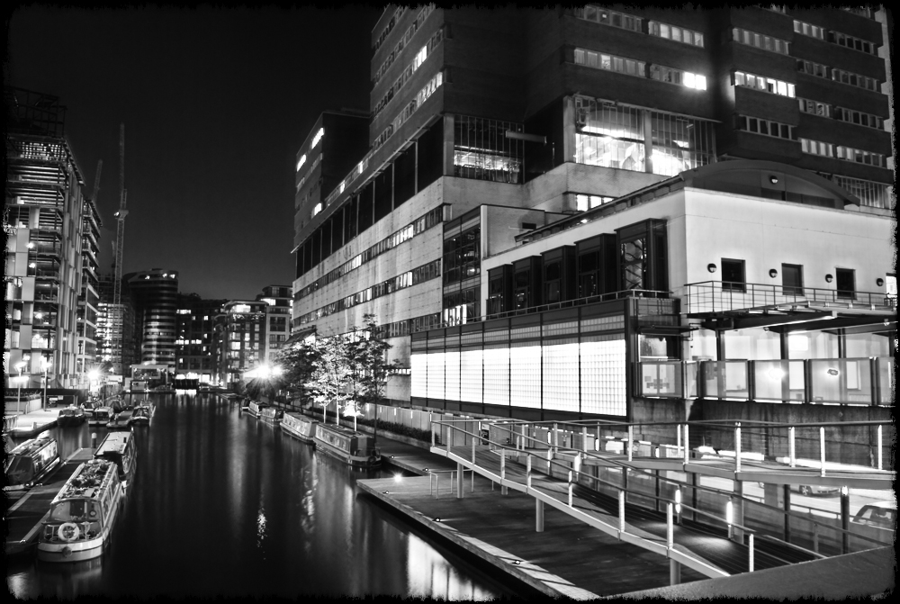
Fracture management
Chinmay M Gupte, PhD, FRCS (Tr &Orth), MA, BM BCh
Consultant Orthopaedic Surgeon St John St Elizabeth’s, St Mary’s and Charing Cross Hospitals
Senior Lecturer
Imperial College London
c.gupte@imperial.ac.uk

Slide 2
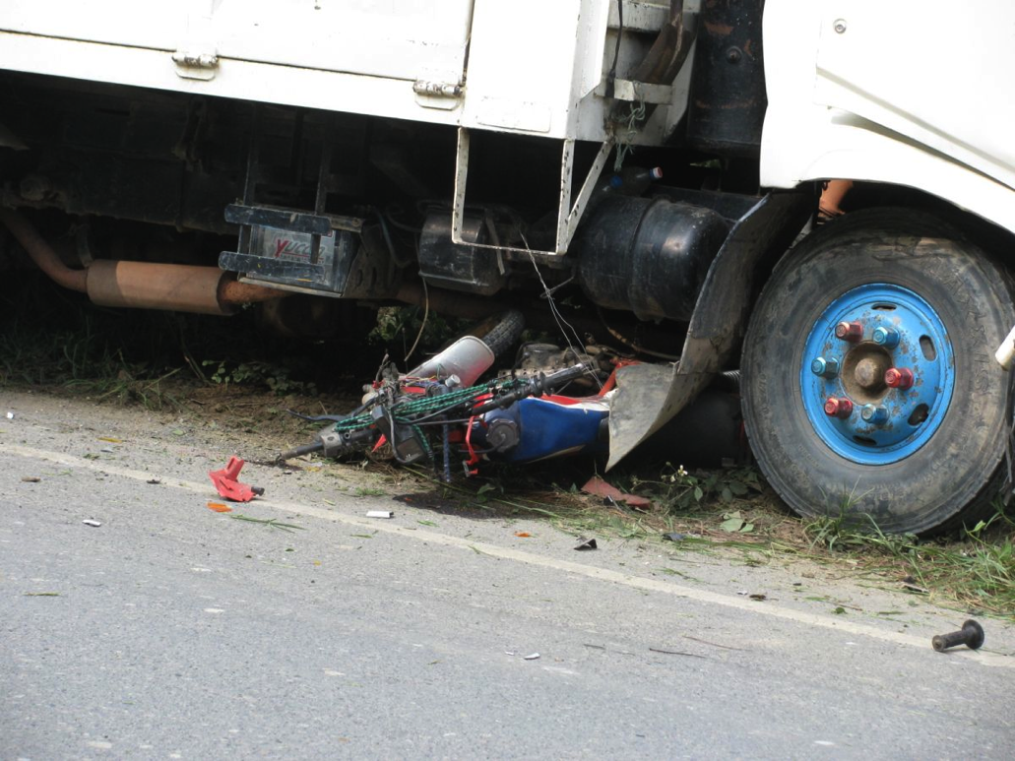
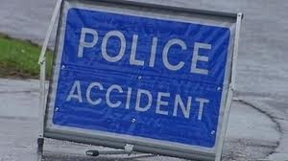

Slide 3
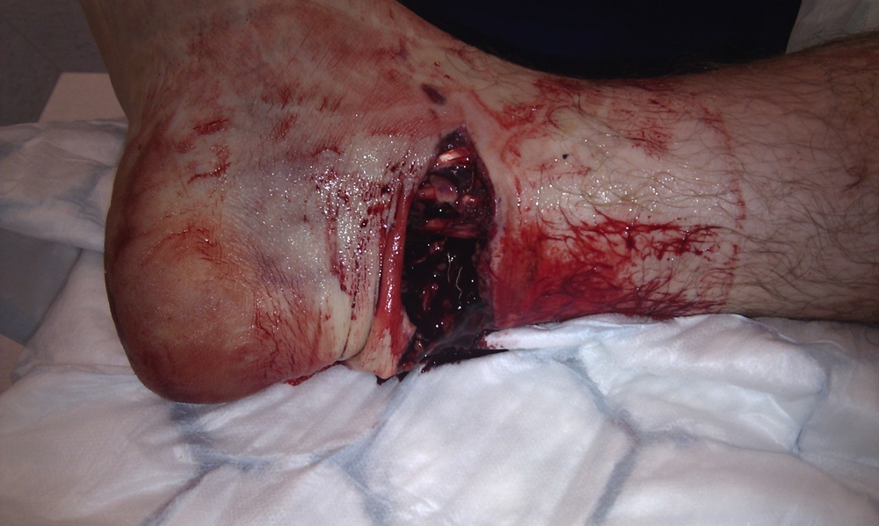
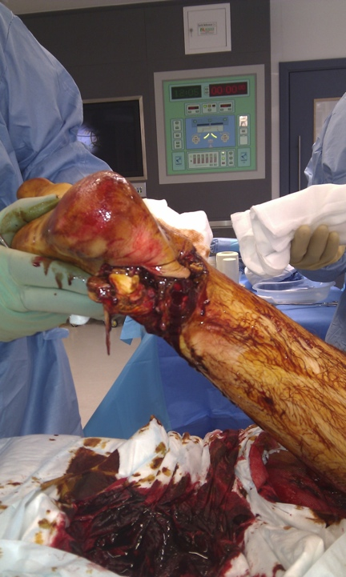
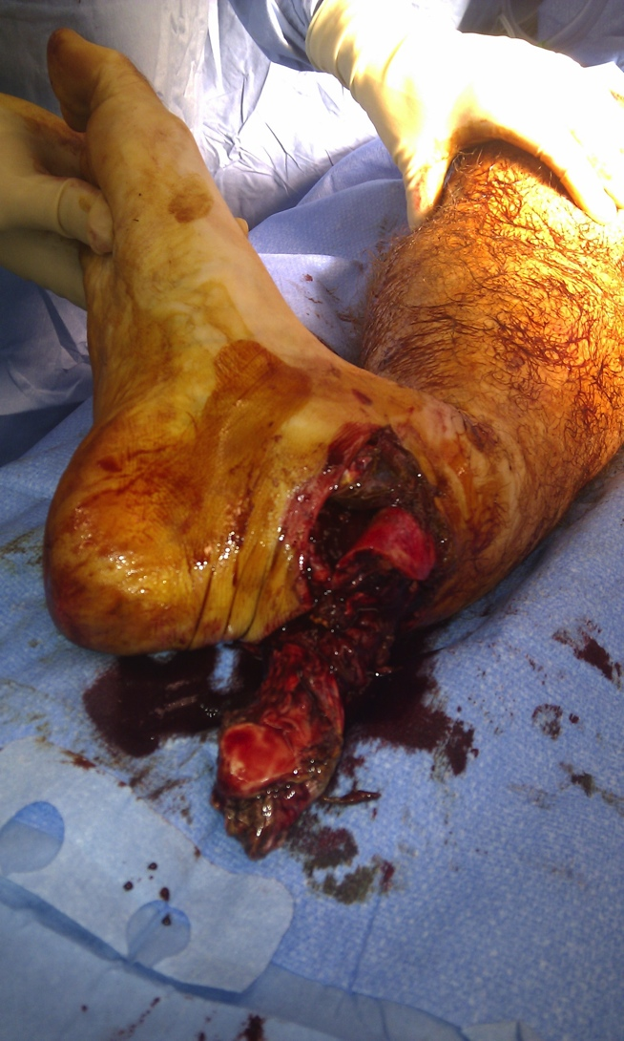
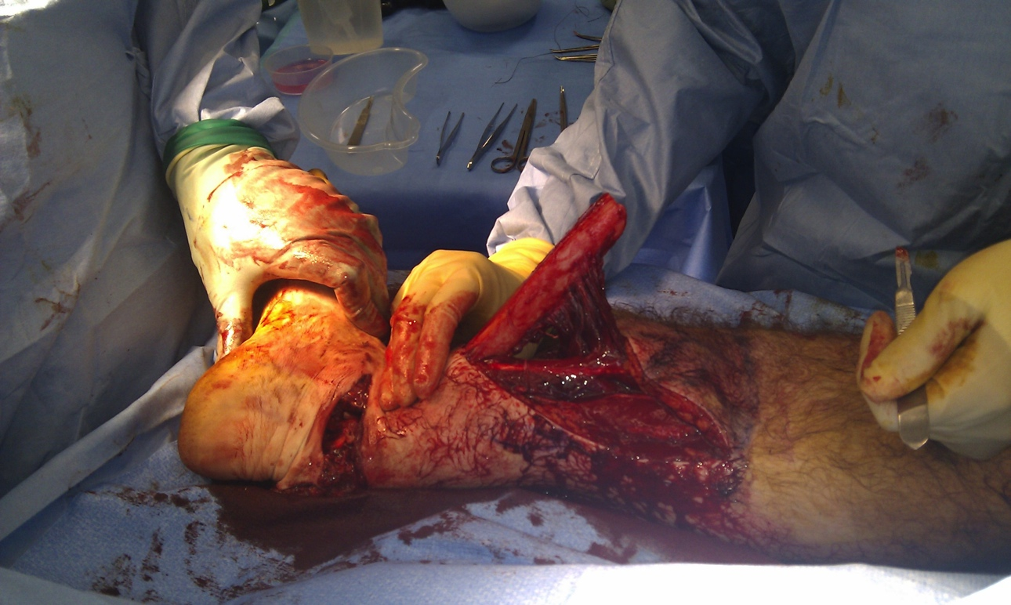

Slide 4
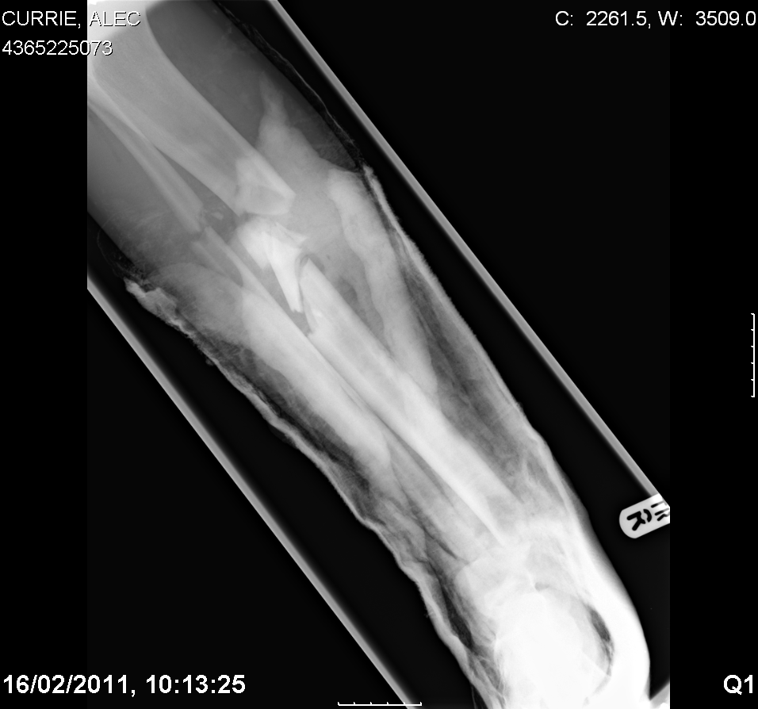

Slide 5
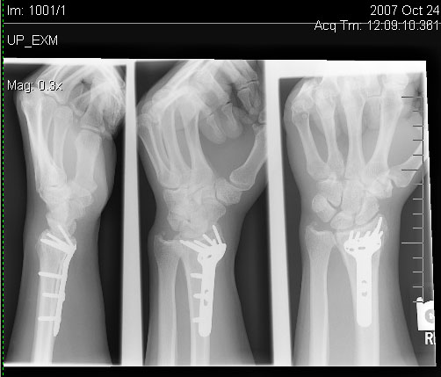
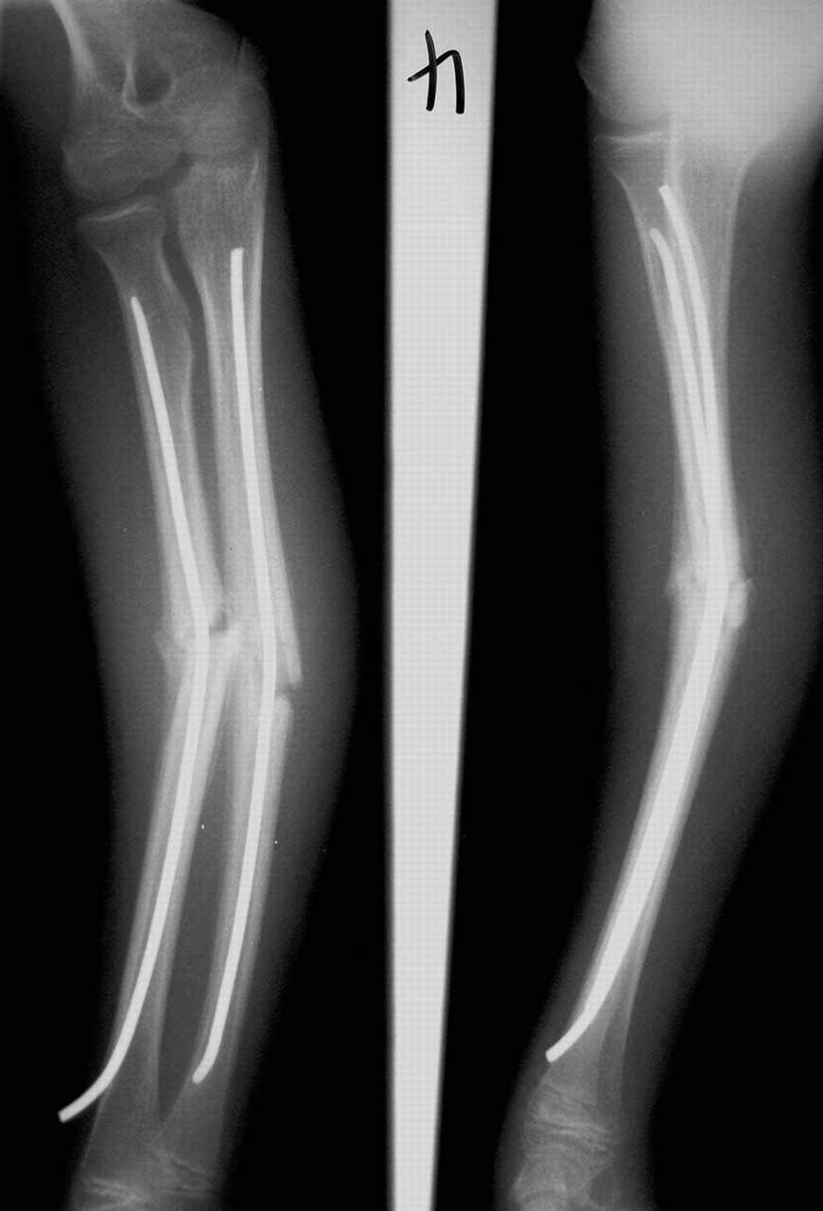
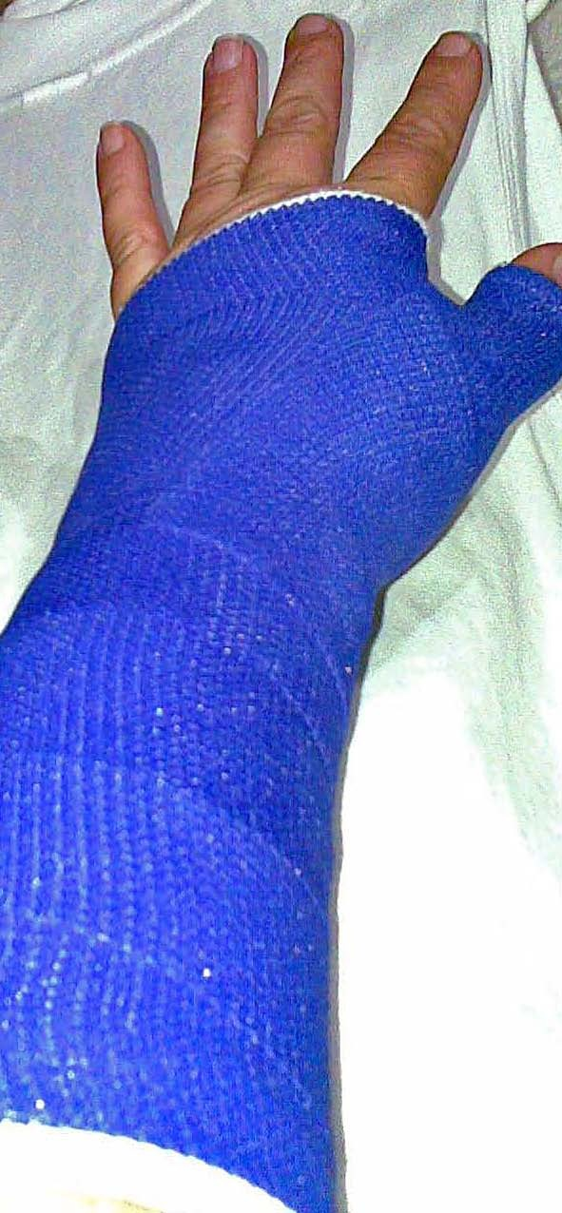
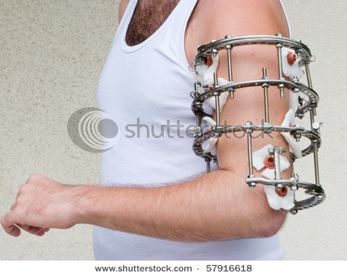
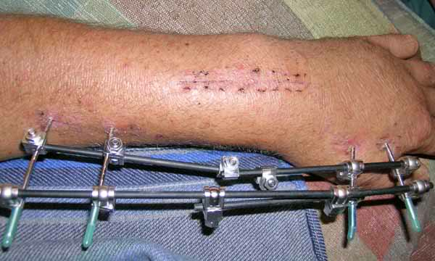

Slide 6
General principles
Reduce
Closed
open
Hold
No metal
Metal
Rehabiliate
Move
Physiotherapy
Use

Slide 7
Reduction
Reduction
Closed
Manipulation
Traction
Open
Mini-incision
Skin
Skeletal (pins in bone)
Full exposure

Slide 8
Hold
Hold
Closed
Plaster
Traction
Fixation
Skin
Skeletal

Slide 9
Fixation
Fixation
Internal
Intramedullary
Extramedullary
External
Monoplanar
Pins
Nails
Plate/screws
Pins
Multiplanar

Slide 10
Rehabilitate
Rehabiliate
Use
Pain relief
Retrain
Weight bear
Move
Strengthen

Slide 11
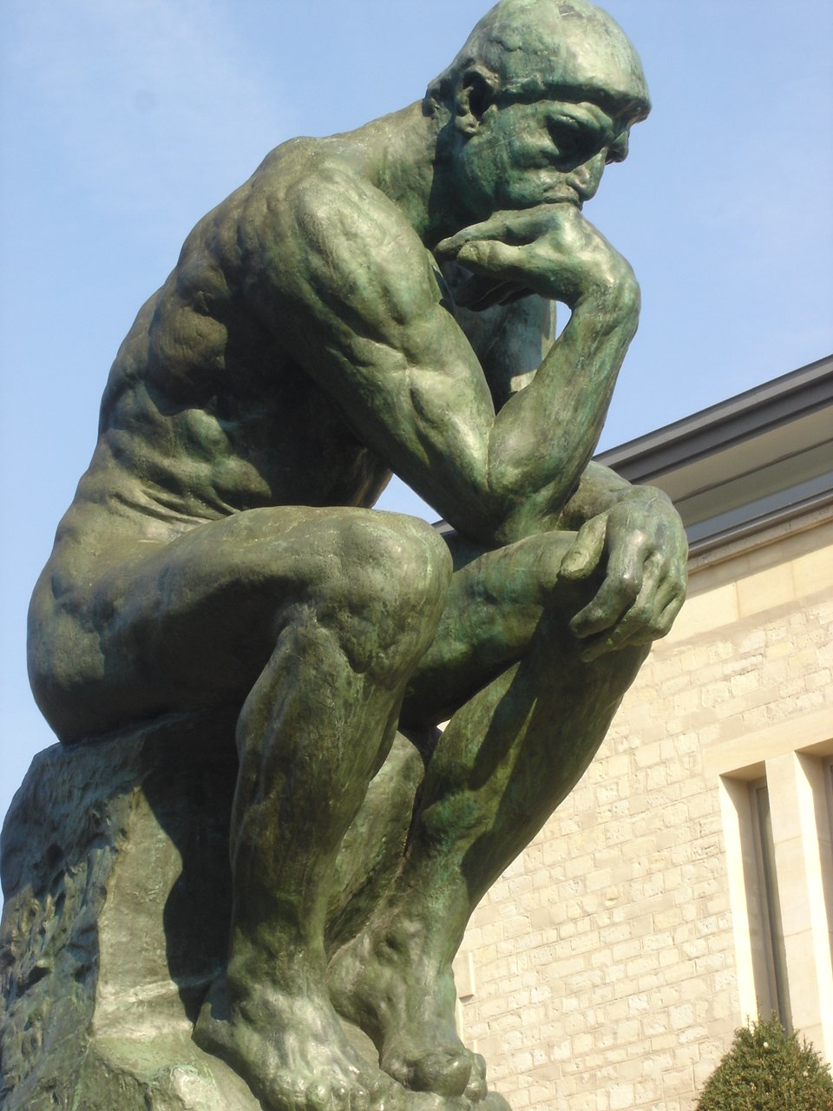
How do you decide which?

Slide 12
Is fracture displaced?
Is it stable
Are soft tissues OK?
What other illnesses?
Is it at a joint surface
What does the patient think?

