Slide 1
Fluids and application of fluid mechanics to medical implants
Hayley Moore
Clinical Research Fellow
Imperial College London

Slide 2

Overview
Fluids
Fluid Mechanics
Fluid mechanics and industry
Medical implants
Application of fluid mechanics to medical implants

Slide 3
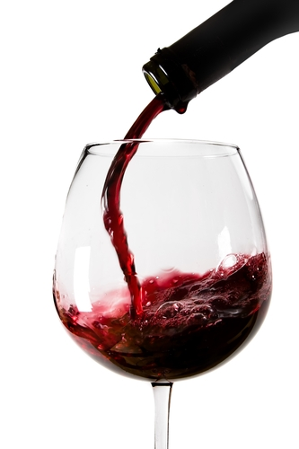
Fluids - definitions
“A fluid is a substance that continually deforms under an applied shear stress”
Ability to flow
Adopts the shape of the container that it is in and has a definite volume

Slide 4
Real fluids
Viscosity
Can be subjected to small amounts of shear stress before deformation
Resistance to flow
Change with temperature, stress, flow rate

Slide 5
Fluid Mechanics
The study of fluids and forces on them
Fluid kinematics – fluid motion
Fluid dynamics – forces on fluid motion
  Fluid statics – at rest
  Fluid kinetics – in motion

Slide 6
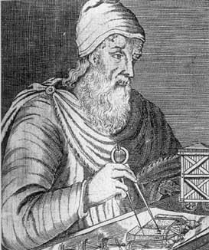
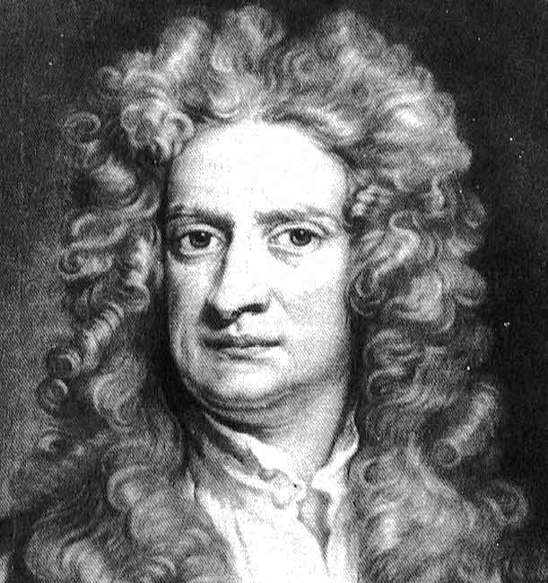
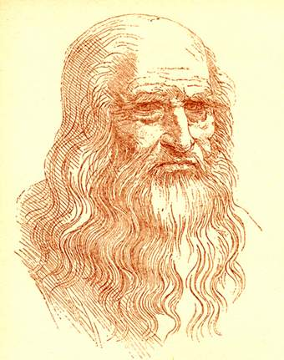
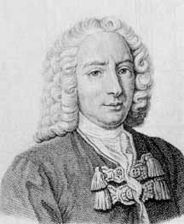

Fluid dynamics - History
Archimedes
Da Vinci
Newton
Pascal
Bernoulli
Poiseuille
Mathematicians and Engineers

Slide 7
Fluid Dynamics
Many equations used to define fluid mechanics
Important points
  Conservation mass
  Conservation momentum
  Conservation energy
  Often assume viscosity zero
In this house, we obey the laws of thermodynamics!

Slide 8
Fluid Mechanics and Industry
Modelling tool
Industries:-
  Automotive
  Chemical
  Aeronautical
  Manufacturing
  Medical

Slide 9
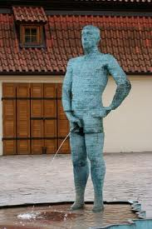
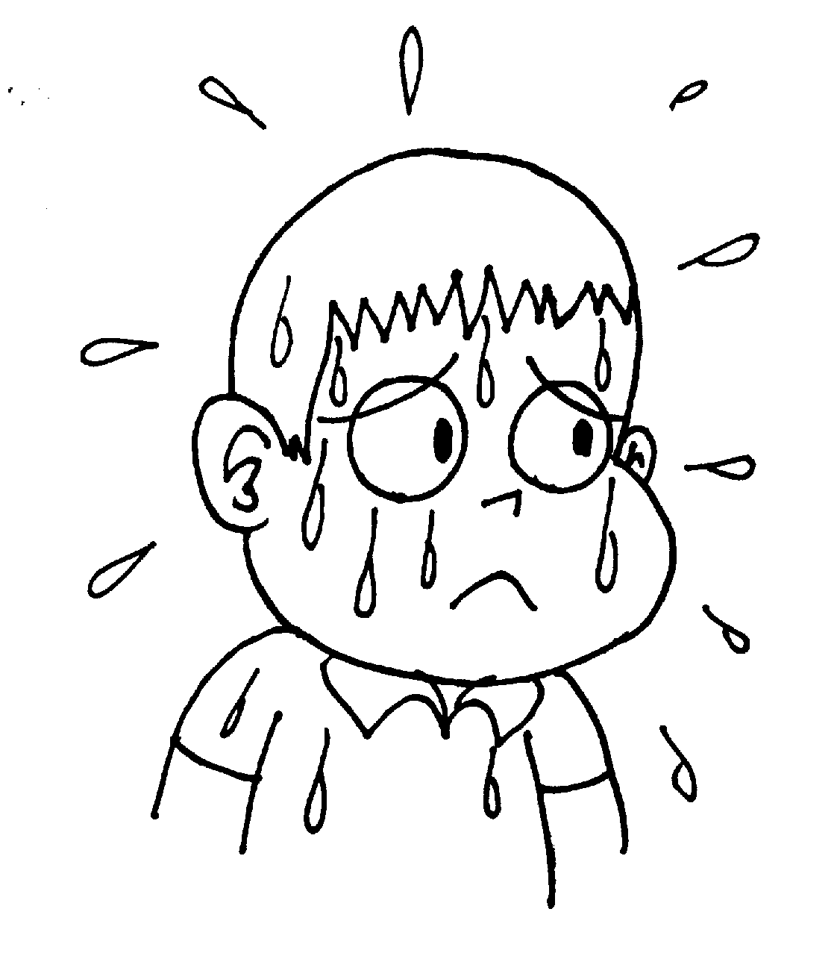
Fluids in the body
Urine
Sweat
Cerebrospinal fluid
Blood
Gastric secretions
Mucus

Slide 10
Application of Fluid Mechanics
Mathematically complex
Computers used – CFD
Huge in field of research
Used for modelling

Slide 11
Application to industry
Using these models to study
  Physiological transport modelling
    Drug delivery
    Disease process modelling
  Optimisation of medical device performance
  Surgical method modelling

Slide 12
Modelling the Vascular System
Obtain information
Imaging – Dynamic MRI, Ultrasound
Catheters
Make assumptions
Account for interactions blood, vessel wall, valve
Translate to mathematical equations
Solve these for finite volume or element
Fluid structure interaction simulations

Slide 13
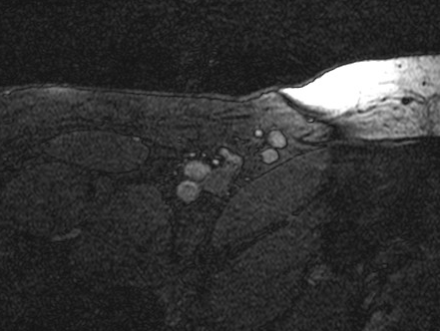
MRI

Slide 14
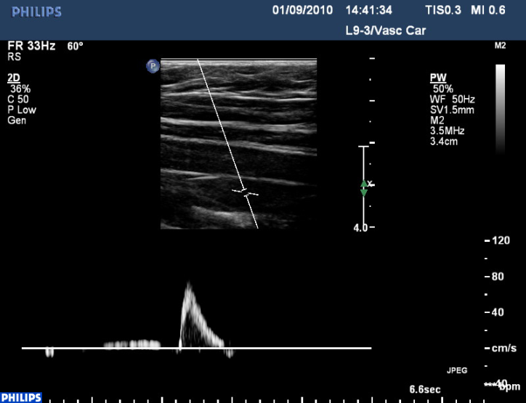
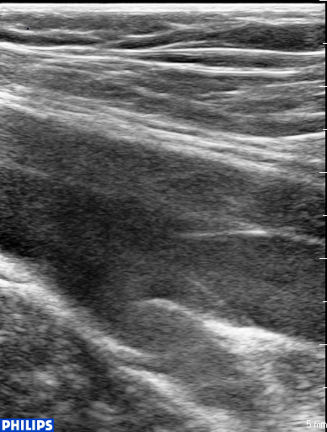
Ultrasound

Slide 15
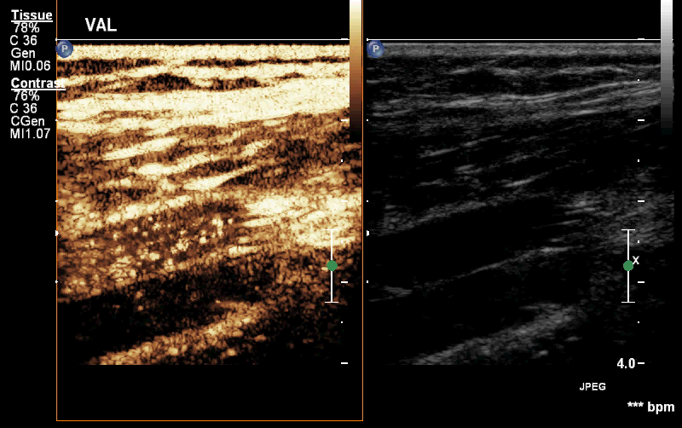
Contrast Ultrasound

Slide 16
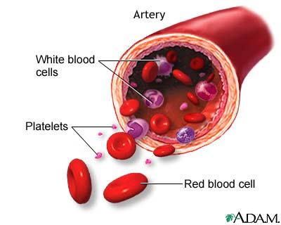
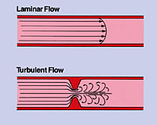
Blood
Cells, platelets plasma
Non-Newtonian behaviour
Viscous
Flow turbulent

Slide 17
Vessel
Wall dynamic
Valves
Varying diameter
Pulse, respiration
Position changes

Slide 18
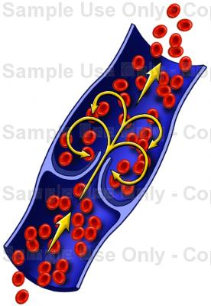
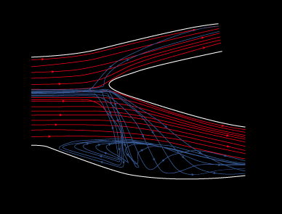
Special areas
Areas where atherosclerosis or thrombi form
Bifurcations
Valve pockets

Slide 19
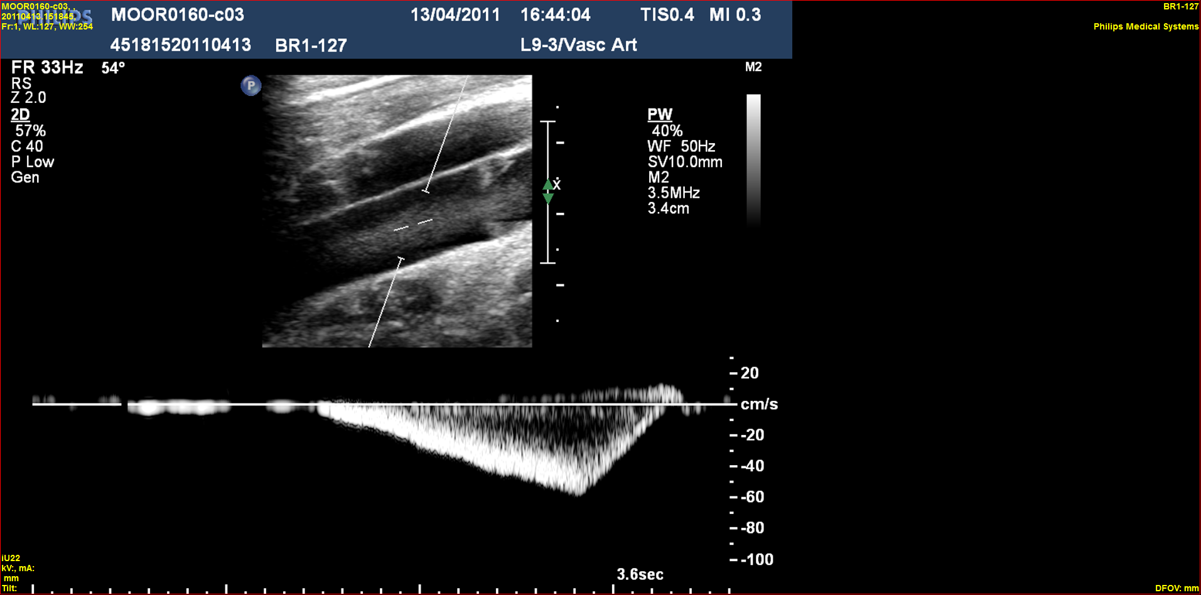
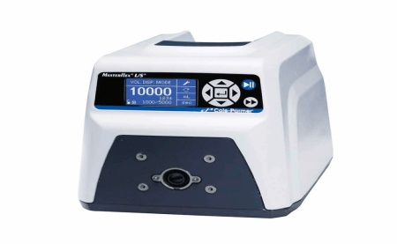
Laboratory Flow Model
Flow Meter
Display
Pressure Gauge
20mA to PC
Reservoir
PC

Slide 20
Medical Implants
Vascular Implants
  Vascular Grafts
  Stents
  Valve-stent devices

Slide 21
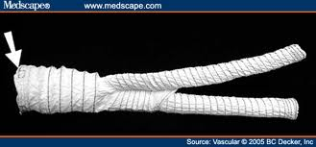
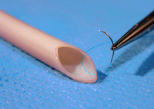
Vascular Grafts
Dacron
PTFE
Tissue engineered
Polymer

Slide 22
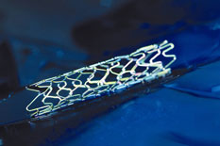
Stents
Artificial tube implanted to open stenosis
Arterial and venous
Multiple areas in the body, not just vascular
Combined with grafts to make stent-grafts

Slide 23
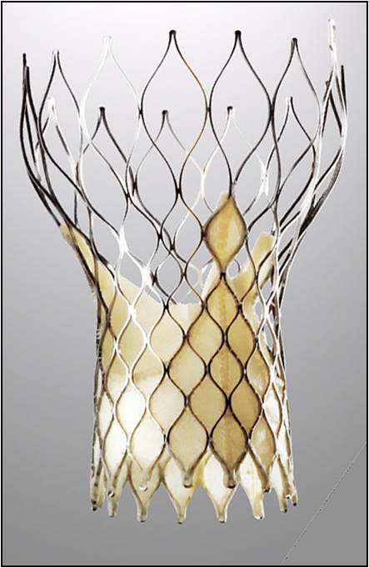
Valve stent devices
Cardiac
Venous

Slide 24
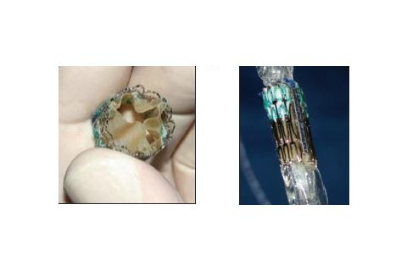
Valve stent devices - Cardiac
Percutaneous implantation
2 currently available
Bovine or porcine pericardium on metal stent

Slide 25
Valve stent devices - Venous
Current research being undertaken
Some phase 1 clinical trials previously – abandoned
Novel materials
Valve design
Method of implantation

Slide 26
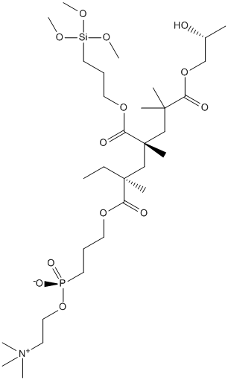
What can be varied
Material
  Stent
  Coating
  Valve leaflets
Size
  Diameter
  Length
  Leaflet size
Shape
Method of implantation
(open surgery, endovascular)

Slide 27
Further modelling
Vary all of these with knowledge of properties and develop computational model thus deciding what can be varied and what will produce the best results
All before in vitro, animal models and clinical trials!!

Slide 28
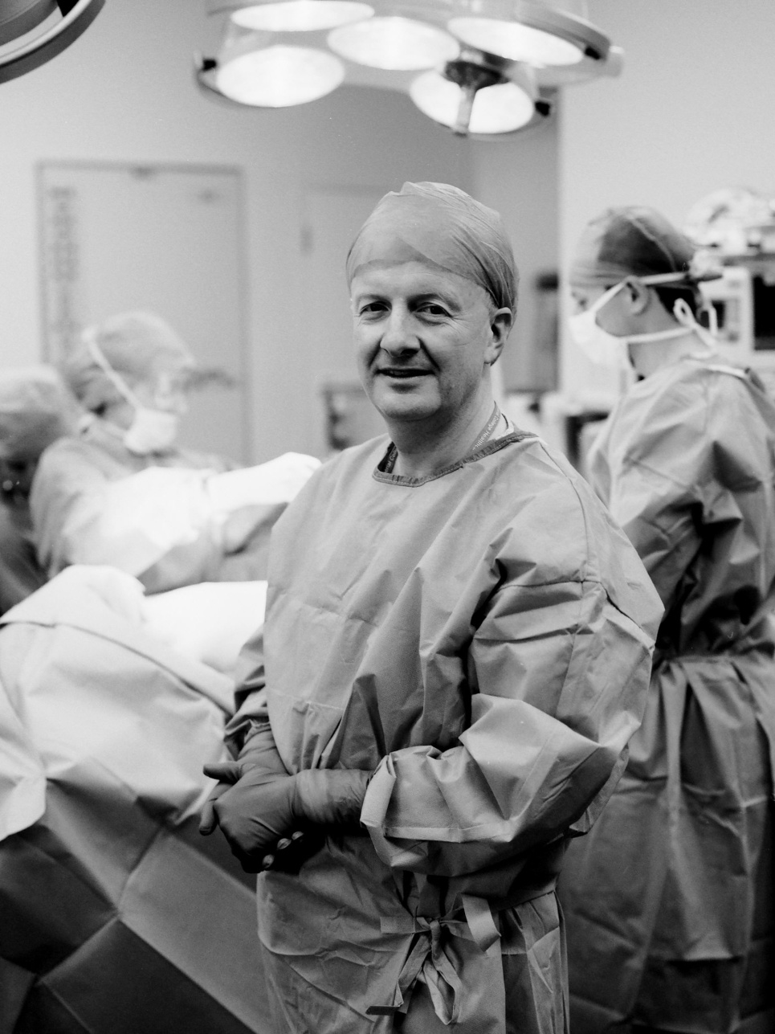
With thanks
Professor Alun H Davies
Professor Yun Xu
Professor Molly Stevens
You all

Slide 29

Any Questions?
Hayley.moore03@ic.ac.uk

