Slide 1
Error analysis workshop
Dr Nick Sevdalis
Imperial College London

Slide 2
Workshop aims
To give you hands on experience of analysing incidents using a validated tool
London Protocol
To show you how the London Protocol is being embedded into junior doctors’ training

Slide 3
Workshop structure
You split into 4-5 groups
Each group receives one incident to analyse
You analyse the incident using the London Protocol 30mins
Each group feeds back to the entire group 30-40mins
You see an application of this process into FYs’ training 30mins

Slide 4
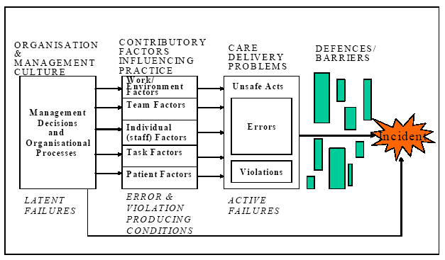
London Protocol

Slide 5
The analysis seeks to establish:
What happened?
Why did it happen?
What can we learn from this and what changes should we make, if any?

Slide 6
Key concepts
Care delivery problems
Contributing factors

Slide 7
Care Delivery Problems
CDPs are problems that arise in the process of care
Actions or omissions by staff
Failure to monitor, observe or act
Not seeking help when necessary
Two key features:
Care deviated beyond safety
The deviation contributed to adverse outcome for the patient
Several CDPs may be involved in one incident

Slide 8
Contributing Factors
Patient factors
Condition (complexity and seriousness)
Language and communication
Personality and social factors
Task factors
Task design and clarity of process
Availability & use of protocols,
Availability & use of test results
Individual staff factors
Knowledge and skills
Motivation, physical and mental health
Team Factors
Verbal and written communication
Supervision and seeking help
Leadership
Work environment
Staffing levels and skill mix
Workload and shift patterns
Design, availability and maintenance of equipment
Organisation and management
Financial resources & constraints
Organisational structure
Policy standards & goals
Safety culture & priorities
Institutional context
Economic & regulatory context
Social attitudes to risk
National Health Service Executive
Clinical negligence schemes

Slide 11
Small group work
Split into 4-5 groups
Each group will receive a short description of an incident
Apply the Protocol principles:
Identify what happened
Identify care delivery problems
Identify contributory factors
Identify benefits and challenges in using the Protocol
One person from each group to report back
Discussion

Slide 12
Contributing Factors
Patient factors
Condition (complexity and seriousness)
Language and communication
Personality and social factors
Task factors
Task design and clarity of process
Availability & use of protocols,
Availability & use of test results
Individual staff factors
Knowledge and skills
Motivation, physical and mental health
Team Factors
Verbal and written communication
Supervision and seeking help
Leadership
Work environment
Staffing levels and skill mix
Workload and shift patterns
Design, availability and maintenance of equipment
Organisation and management
Financial resources & constraints
Organisational structure
Policy standards & goals
Safety culture & priorities
Institutional context
Economic & regulatory context
Social attitudes to risk
National Health Service Executive
Clinical negligence schemes

Slide 13
Embedding error awareness into clinical practice Dr Maria Ahmed

