Slide 1
Environment & Ergonomics
Morkos Fakhry Gamil
Academic Clinical Fellow
Registrar – General Surgery
m.fakhry@imperial.ac.uk

Slide 2
Agenda
Agenda
Background
Non Clinical Settings
Clinical Settings
Operating Room
Equipment Design
Equipment Setup
Summary
Objectives, definitions and background
Ergonomics in non clinical applications
Ergonomics in surgery
Operating room environment
Equipment design
Equipment setup
Summary

Slide 3
Objectives
Agenda
Background
Non Clinical Settings
Clinical Settings
Operating Room
Equipment Design
Equipment Setup
Summary
Eye opener to the field of ergonomics
Appreciating its importance in today’s surgical practice
Stimulating critical appraisal of surgical ergonomics

Slide 4
Definition
Agenda
Background
Non Clinical Settings
Clinical Settings
Operating Room
Equipment Design
Equipment Setup
Summary
Ergonomics: from the Greek
ergon = work
nomos = natural laws
“Ergonomics is the application of scientific information concerning humans to the design of objects, systems and environment for human use.”
The International Ergonomics Association, 2007

Slide 5
Definition
Agenda
Background
Non Clinical Settings
Clinical Settings
Operating Room
Equipment Design
Equipment Setup
Summary
Ergonomics is the science of adapting the job and the human being to each other in harmony for optimal safety and productivity
Job: Equipment, environment, process
Human: Anatomy, physiology, psychology
Safety (including physical and psychological comfort)
Productivity (quality and quantity)

Slide 6
Background
20th Century:Polish biologist, author Ergonomics
Taylor pioneered the “Scientific Management" method: shovelling rate.
Agenda
Background
Non Clinical Settings
Clinical Settings
Operating Room
Equipment Design
Equipment Setup
Summary
20th Century: Frank and Lillian Gilbreth "Time and Motion Studies“ for number of motions in bricklaying.
World War II: Complex machines and weaponry: "pilot error" could be greatly reduced when more logical and differentiable controls replaced confusing designs in airplane cockpits.
Space age (Outer space effect), Information age (HCI), Consumer goods, Electronics, and finally Medicine and Surgery

Slide 7
Principle considerations in equipment design
Body size (anthropometry), motion, and strength capabilities (biomechanics)
Sensory-motor capabilities—vision, hearing, haptics (force and touch), dexterity
Cognitive processes and memory (including situational awareness)
Training and current knowledge relating to equipment, systems, and practices
Training and current knowledge of medical conditions (including emergency conditions)
Expectations and cultural stereotypes relating to the operation of equipment
General health, age, motivation, stress levels, mental fatigue, performance under drug treatment or the effects of alcohol
Robert Stone and Rory McCloy Ergonomics in medicine and surgery BMJ VOLUME 328 8 MAY 2004
Agenda
Background
Non Clinical Settings
Clinical Settings
Operating Room
Equipment Design
Equipment Setup
Summary

Slide 8
Areas of application
Agenda
Background
Non Clinical Settings
Clinical Settings
Operating Room
Equipment Design
Equipment Setup
Summary
Computers
Automobiles
Cockpits
Factories machinery
?? Surgery

Slide 9
Comparison!
Agenda
Background
Non Clinical Settings
Clinical Settings
Operating Room
Equipment Design
Equipment Setup
Summary
Automotive industry:
Almost everything seems to be adjustable, heated, ventilated, tweakable and tunable
For the safety and comfort of the driver

Slide 10
Comparison!
Steering wheel controls
Climate control
Air bags & PRE-SAFE system
NECK-PRO head restraints
Heated/cool seats that massage your lower back to keep your spine supple
Antilock brakes (ABS)
Brake assist
Traction control
Safety-belt features
LATCH (Lower Anchors and Tethers for Children)
Electronic stability control (ESC)
Tire-pressure monitor
Telematics
Agenda
Background
Non Clinical Settings
Clinical Settings
Operating Room
Equipment Design
Equipment Setup
Summary

Slide 11
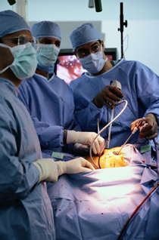
Comparison!
Surgery!
Agenda
Background
Non Clinical Settings
Clinical Settings
Operating Room
Equipment Design
Equipment Setup
Summary
Tight working space
Hand-Eye Coordination
Awkward positions
Coordination between different operators
Long rigid instruments
Drains, cables and other objects
Saving patient’s life

Slide 12
Laparoscopic Surgery
Questionnaire - 149 surgeons
Agenda
Background
Non Clinical Settings
Clinical Settings
Operating Room
Equipment Design
Equipment Setup
Summary
Table 2. Results of SAGES ergonomics questionnaire
 | Never (%) | Occasionally (%) | Frequent (%)
Neck pain | 41 | 43 | 9
Neck stiffness | 33 | 44 | 18
Shoulder/arm pain | 39 | 43 | 12
Shoulder/arm stiffness | 40 | 39 | 11
Hand and wrist pain | 45 | 36 | 11
Hand and wrist stiffness | 43 | 40 | 9
Hand and wrist numbness | 59 | 26 | 8
Berguer R, Forkey DL, Smith WD. Ergonomic problems associated with laparoscopic surgery. Surg Endosc 1999; 13(5):466-8.

Slide 13
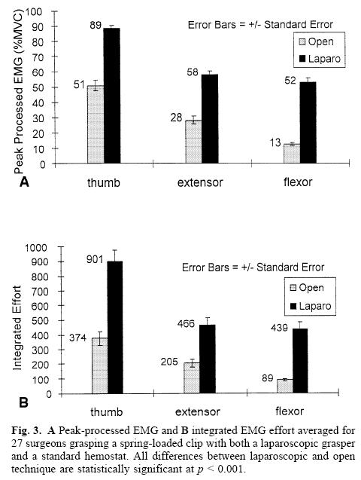
Laparoscopic Surgery
Agenda
Background
Non Clinical Settings
Clinical Settings
Operating Room
Equipment Design
Equipment Setup
Summary
Berguer R, Forkey DL, Smith WD. Ergonomic problems associated with laparoscopic surgery. Surg Endosc 1999; 13(5):466-8.

Slide 14
Other Ergonomic Problems
Agenda
Background
Non Clinical Settings
Clinical Settings
Operating Room
Equipment Design
Equipment Setup
Summary
Horgan LF, O’Riordan DC, Doctor N (1997) Neuropraxia following laparoscopic procedures: an occupational injury. Minim Invasive Ther Allied Technol 6: 33–35
Majeed AW, Jacob G, Reed MW, Johnson AG (1993) Laparoscopist’s thumb: an occupational hazard. Arch Surg 128: 357 [letter; see comments]

Slide 15
Operating Table
Ergonomically optimal operating surface height 0.7 and 0.8 of the elbow height of the operator.
Reduces discomfort in the shoulders, back, and wrists during laparoscopic surgery.
Influences the upper joint excursions of the surgeon.
This optimal table height range for laparoscopic surgery is lower than those currently available.
van Veelen MA, Kazemier G, Koopman J, et al. Assessment of the Ergonomically Optimal Operating Surface Height for Laparoscopic Surgery. Journal of Laparoendoscopic & Advanced Surgical Techniques 2002; 12(1):47-52.
Agenda
Background
Non Clinical Settings
Clinical Settings
Operating Room
Equipment Design
Equipment Setup
Summary

Slide 16
Operating Table
The optimum table height for laparoscopic surgery should:
Position the laparoscopic instrument handles close to surgeons' elbow level.
This corresponds to an approximate table height of 64 to 77 cm above floor level.
A redesign of current operating room tables may be required to meet these ergonomic guidelines.
Berquer RR. An ergonomic study of the optimum operating table height for laparoscopic surgery. Surgical endoscopy 2002; 16(Volume 16, Number 3 / March, 2002):416-421.
Agenda
Background
Non Clinical Settings
Clinical Settings
Operating Room
Equipment Design
Equipment Setup
Summary

Slide 17
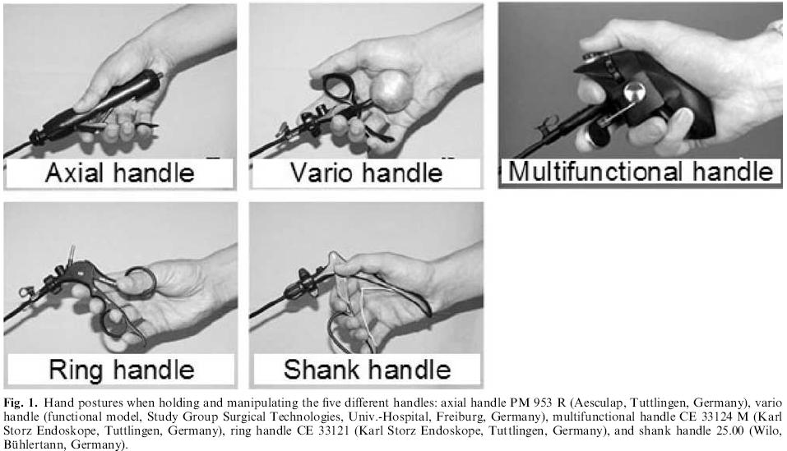
Handle Design
Agenda
Background
Non Clinical Settings
Clinical Settings
Operating Room
Equipment Design
Equipment Setup
Summary
Matern UU. Ergonomic aspects of five different types of laparoscopic instrument handles under dynamic conditions with respect to specific laparoscopic tasks: An electromyographic-based study. Surgical endoscopy 2002; 18(Volume 18, Number 8 / August, 2004):1231-1241.

Slide 18
Handle Design
Agenda
Background
Non Clinical Settings
Clinical Settings
Operating Room
Equipment Design
Equipment Setup
Summary
Summarized scores for three test courses
 | Handle
 | A | V | M | R | S
Curved | -10 | -2 | 6 | 4 | 1
Helix | -8 | 1 | -1 | 4 | 1
Straddle | -3 | 5 | -1 | -4 | 3
Total | -21 | 4 | 4 | 4 | 5
Matern UU. Ergonomic aspects of five different types of laparoscopic instrument handles under dynamic conditions with respect to specific laparoscopic tasks: An electromyographic-based study. Surgical endoscopy 2002; 18(Volume 18, Number 8 / August, 2004):1231-1241.

Slide 19
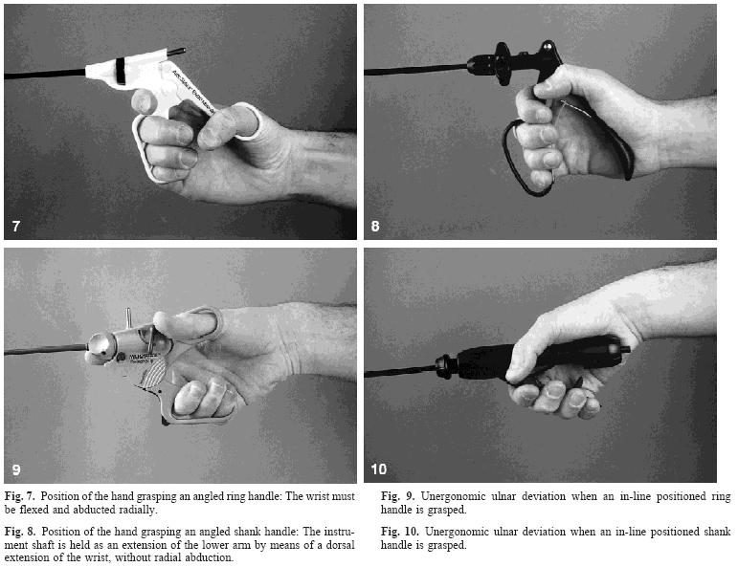
Handle Design
Agenda
Background
Non Clinical Settings
Clinical Settings
Operating Room
Equipment Design
Equipment Setup
Summary
Instruments for minimally invasive surgery Principles of ergonomic handles. Surgical endoscopy 2002; 13(Volume 13, Number 2 / February, 1999):174-182.

Slide 20
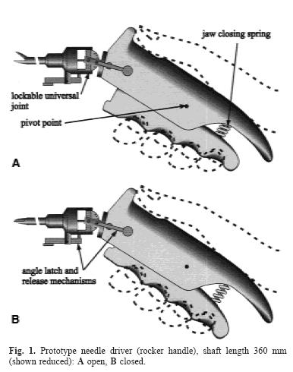
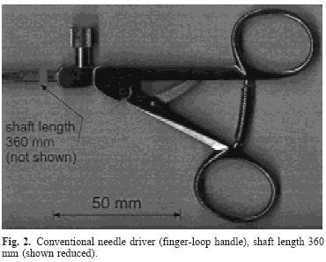
New Handle Design
Agenda
Background
Non Clinical Settings
Clinical Settings
Operating Room
Equipment Design
Equipment Setup
Summary
Emam TA, Frank TG, Hanna GB, et al. Rocker handle for endoscopic needle drivers. Technical and ergonomic evaluation by infrared motion analysis system. Surg Endosc 1999; 13(7):658-61.

Slide 21
Handle Design
conventional finger loop, rocker, and ball handle prototype
motion analysis, muscle work, and fatigue of the surgeon's dominant upper limb
Task quality and efficiency during endoscopic suturing, were significantly better with the ball and rocker handle.
The integrated muscle work was much lower for both the rocker and the ball handles.
Significant muscle fatigue, especially of the arm flexors and deltoid, was observed only with finger loop instruments. Comfort and maneuverability rating scores were higher with both handles than with the conventional finger loop. The ball handle was easier to maneuver, but less comfortable than the rocker system.
Agenda
Background
Non Clinical Settings
Clinical Settings
Operating Room
Equipment Design
Equipment Setup
Summary
Emam TA, Frank TG, Hanna GB, Cuschieri A. Influence of handle design on the surgeon's upper limb movements, muscle recruitment, and fatigue during endoscopic suturing. Surg Endosc 2001; 15(7):667-72.

Slide 22
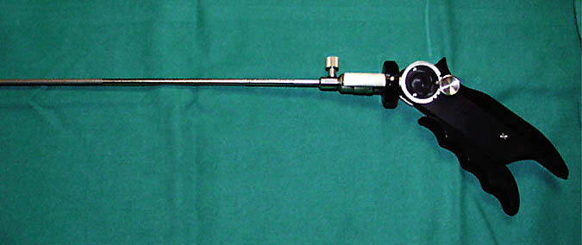
Handle/Shaft Optimal Angle
Agenda
Background
Non Clinical Settings
Clinical Settings
Operating Room
Equipment Design
Equipment Setup
Summary
The 40° -> significantly highest leakage pressure + lowest suture error placement score. compared with the 0° and 80° angles (P<.001).
No significant difference between the 0° and 80° angles (P>.20).
Ahmed S, Hanna GB, Cuschieri A. Optimal Angle Between Instrument Shaft and Handle for Laparoscopic Bowel Suturing. Arch Surg 2004; 139(1):89-92.

Slide 23
Hand Size & Handle Design
Correlation between surgical glove size, preexisting musculoskeletal problems, and difficulty using laparoscopic instruments (159 women and 567 men )
Hand size is a significant determinant of difficulty using laparoscopic surgical instruments.
Individuals using glove sizes 6.5 or smaller experience significantly more difficulty using common laparoscopic instruments, and in particular laparoscopic staplers.
Manufacturers of surgical hand tools should consider hand size when designing future surgical instruments.
Agenda
Background
Non Clinical Settings
Clinical Settings
Operating Room
Equipment Design
Equipment Setup
Summary
Berguer RR. The relationship between hand size and difficulty using surgical instruments: A survey of 726 laparoscopic surgeons. Surgical endoscopy 2002; 18(Volume 18, Number 3 / March, 2004):508-512.

Slide 24
Patient Size & Handle Design
Endoscopic knot tying was performed faster in the neonatal simulator box using pediatric needle-holders while maintaining knot quality. Upper limb muscular recruitment was reduced resulting in less discomfort for the surgeon.
Agenda
Background
Non Clinical Settings
Clinical Settings
Operating Room
Equipment Design
Equipment Setup
Summary
A. Lee, M. Haddad, and G. Hanna, "Influence of instrument size on endoscopic task performance in pediatric intracorporeal knot tying," Surgical Endoscopy, vol. 21, pp. 2086-2090, 2007.

Slide 25
Hand assisted surgery
The pressure in the hand access device up to 16 mmHg does not affect the hand cutaneous microcirculation.
The best ergonomic setup in hand-assisted laparoscopic surgery entails a manipulation angle of 45° to 60° and use of an instrument with a shorter shaft than standard laparoscopic length.
The optimum table height for hand-assisted laparoscopic surgery allows the working surface of the extracorporal instrument handle to be at or 5 cm above the elbow level.
Agenda
Background
Non Clinical Settings
Clinical Settings
Operating Room
Equipment Design
Equipment Setup
Summary
S. Manasnayakorn, A. Cuschieri, and G. Hanna, "Ergonomic assessment of optimum operating table height for hand-assisted laparoscopic surgery," Surgical Endoscopy.
S. Manasnayakorn, F. Khan, R. Levison, A. Cuschieri, and G. Hanna, "Influence of compression pressure from the hand access device on hand microcirculation during hand-assisted laparoscopic surgery," Surgical Endoscopy.
S. Manasnayakorn, A. Cuschieri, and G. Hanna, "Ideal manipulation angle and instrument length in hand-assisted laparoscopic surgery," Surgical Endoscopy, vol. 22, pp. 924-929, 2008.

Slide 26
Shadow depth cues
Endoscopic task performance significantly improves with a system that provides illumination and shadows in the operative field.
Optimum endoscopic task performance is obtained with overhead shadow-casting illumination and a balanced degree of illumination and shadow contrast.
Agenda
Background
Non Clinical Settings
Clinical Settings
Operating Room
Equipment Design
Equipment Setup
Summary
G. B. Hanna, A. B Cresswell, and A. Cuschieri, "Shadow Depth Cues and Endoscopic Task Performance," Arch Surg, vol. 137, pp. 1166-1169, 2002.
R. K. Mishra, G. B. Hanna, S. I. Brown, and A. Cuschieri, "Optimum Shadow-Casting Illumination for Endoscopic Task Performance," Arch Surg, vol. 139, pp. 889-892, 2004.

Slide 27
Light source
Halogen
LED
LASER
Agenda
Background
Non Clinical Settings
Clinical Settings
Operating Room
Equipment Design
Equipment Setup
Summary
Hanna GB, Shimi S, Cuschieri A. Influence of direction of view, target-to-endoscope distance and manipulation angle on endoscopic knot tying. Br J Surg 1997; 84(10):1460-4.

Slide 28
3D Vs 2D vision
Surgeons experienced visual strain with the three systems, but it was rated higher with 3-D imaging. With the current technology, we have not documented any significant difference in task efficiency and quality of endoscopic bowel suturing by trained surgeons between 2-D and 3-D imaging systems.
Agenda
Background
Non Clinical Settings
Clinical Settings
Operating Room
Equipment Design
Equipment Setup
Summary
Hanna GB, Cuschieri A. Influence of two-dimensional and three-dimensional imaging on endoscopic bowel suturing. World J Surg. 2000 Apr;24(4):444-8; discussion 448-9

Slide 29
Intra-abdominal magnet camera
The use of the magnetic wireless camera setup with a single external handle is feasible and has demonstrated a wider visual exposure than the 30 degrees endoscope.
Agenda
Background
Non Clinical Settings
Clinical Settings
Operating Room
Equipment Design
Equipment Setup
Summary
Fakhry M, Gallagher B, Bello F, Hanna GB. Visual exposure using magnet driven, intra-abdominal wireless camera in minimal access surgery. Surg Endosc. 2008 March 18 (PMID: 18347855)

Slide 30
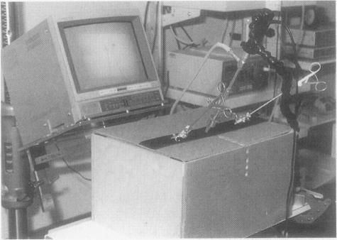
Location of the Image Display
Agenda
Background
Non Clinical Settings
Clinical Settings
Operating Room
Equipment Design
Equipment Setup
Summary
Task performance improves when the image display is placed in front of the operator, at a level below the head and close to the hands.
Hanna GB, Shimi SM, Cuschieri A. Task performance in endoscopic surgery is influenced by location of the image display. Ann Surg 1998; 227(4):481-4.

Slide 31
Manipulation angle
The direction of view of the endoscope had no significant effect on intracorporeal knotting if the optical axis subtended the same angle with the task surface.
The optimal ergonomic conditions include an endoscope-to-target distance of 75-150 mm and a manipulation angle of 60 degrees.
Agenda
Background
Non Clinical Settings
Clinical Settings
Operating Room
Equipment Design
Equipment Setup
Summary
Hanna GB, Shimi S, Cuschieri A. Influence of direction of view, target-to-endoscope distance and manipulation angle on endoscopic knot tying. Br J Surg 1997; 84(10):1460-4.

Slide 32
Da Vinci Robot
Separate consol
3D vision
More ergonomic handles
Reduced hand tremors
Pelvic operations: prostatectomy
Agenda
Background
Non Clinical Settings
Clinical Settings
Operating Room
Equipment Design
Equipment Setup
Summary
Hanna GB, Shimi S, Cuschieri A. Influence of direction of view, target-to-endoscope distance and manipulation angle on endoscopic knot tying. Br J Surg 1997; 84(10):1460-4.

Slide 33
Methods of assessment
Survey/questionnaires
Electromyogram measurements
Performance parameters
Force measurements
Direct observation
Motion analysis
Agenda
Background
Non Clinical Settings
Clinical Settings
Operating Room
Equipment Design
Equipment Setup
Summary

Slide 34
Summary
History of Ergonomics
Ergonomics in non-clinical vs clinical domains.
Table height
Handle designs
Handle/Shaft angle
Optimum location of display
Manipulation angle
Agenda
Background
Non Clinical Settings
Clinical Settings
Operating Room
Equipment Design
Equipment Setup
Summary

Slide 35
Thank you
Questions?

