Slide 1
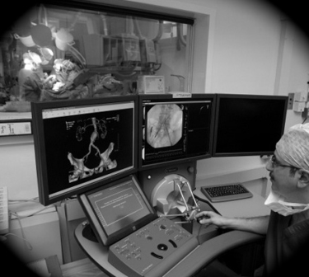
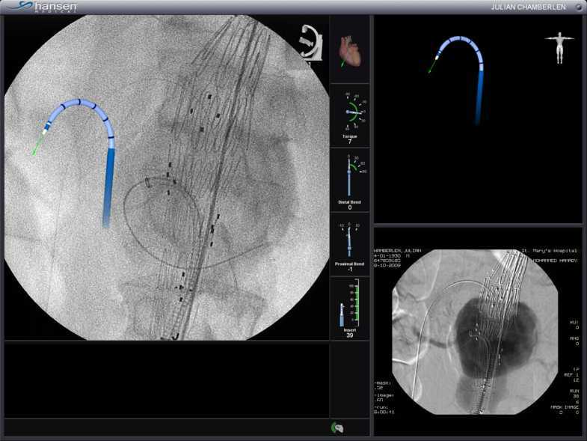
Endovascular robotics
Imperial College
London
Celia Riga
Clinical Lecturer in Surgery
Academic Division of Surgery
Imperial Vascular Unit
Hamlyn Centre for Robotic Surgery, Institute of Global Health Innovation
Imperial College London

Slide 2
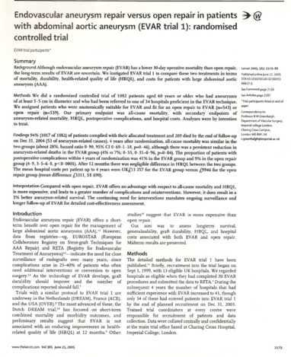
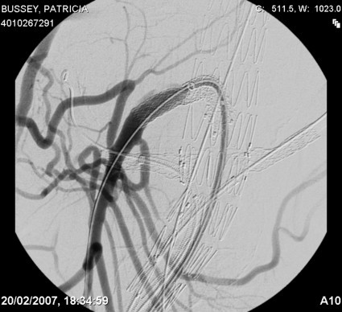
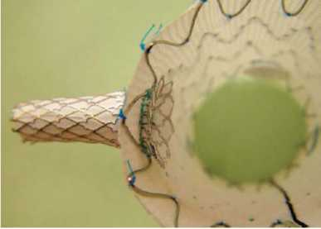
ENDOVASCULAR THERAPY
Rapidly evolving
Technology driven
Improving patient outcomes
Imperial College
London

Slide 3
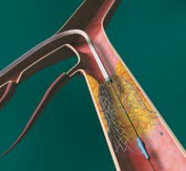
Imperial College
London

Slide 4
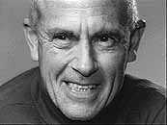
Evolution of endovascular intervention
1964 - Charles T Dotter
Presented in US first case of SFA angioplasty
Patient with critical ischaemia of foot
Idea from urethral dilatation
Ideas largely rejected by US
Imperial College
London

Slide 5
Andreas Grüntzig
Developed a balloon catheter capable of dilating peripheral arteries.
Grüntzig described the first 5 cases of percutaneous transluminal coronary angioplasty in Lancet 1978
Subsequent embracing of percutaneous, minimally invasive techniques
Imperial College
London

Slide 6

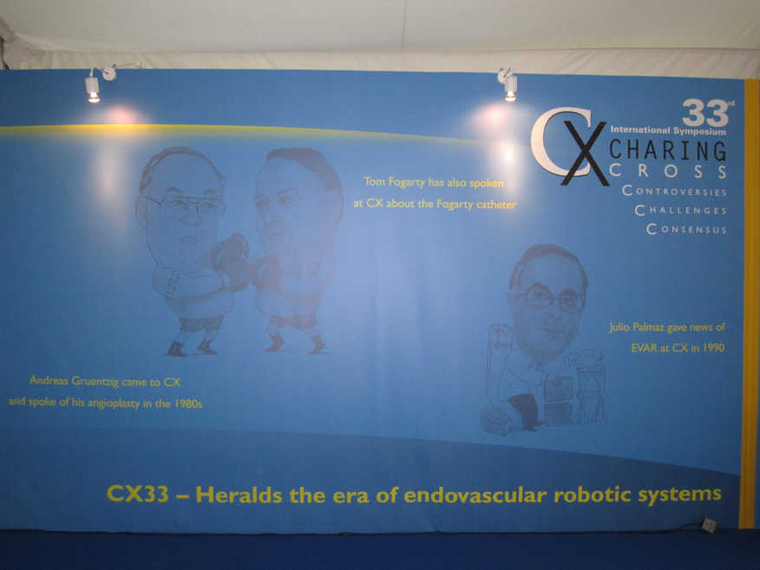
Imperial College
London

Slide 7

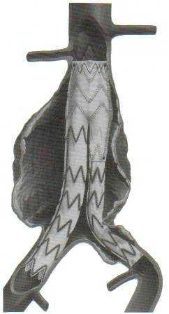
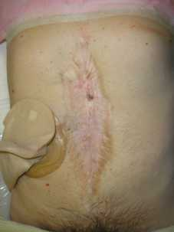
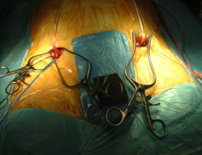
versus
Imperial College
London

Slide 8
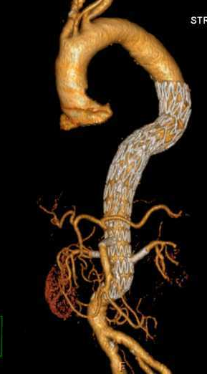
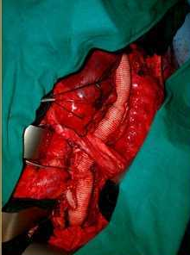
versus
Imperial College
London

Slide 9
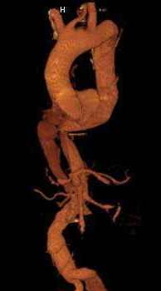
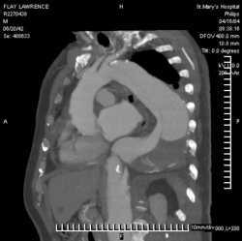
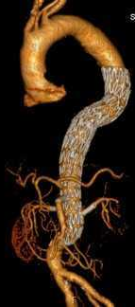
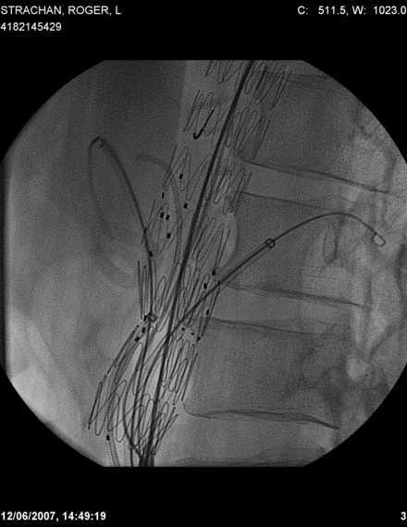
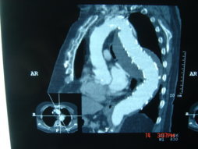
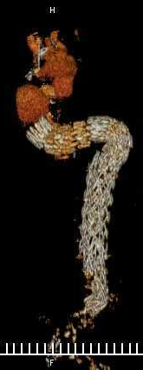
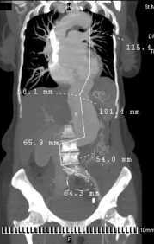
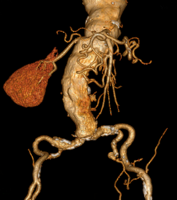
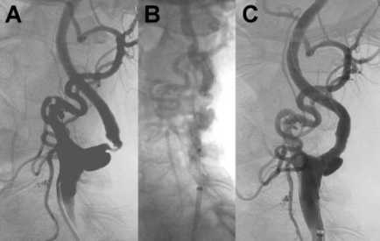
HANSEN SENSEI SYSTEM
ENDOVASCULAR INTERVENTION: CHALLENGES
105˚
Imperial College
London
Imperial College
London

Slide 10
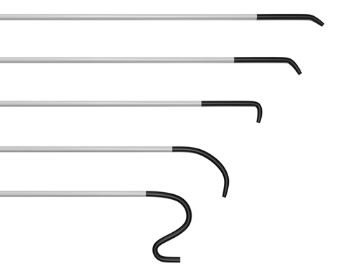
HANSEN SENSEI SYSTEM
ENDOVASCULAR INTERVENTION: CHALLENGES
105˚
Imperial College
London
Imperial College
London

Slide 11
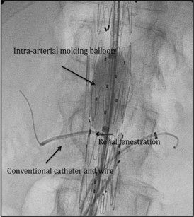
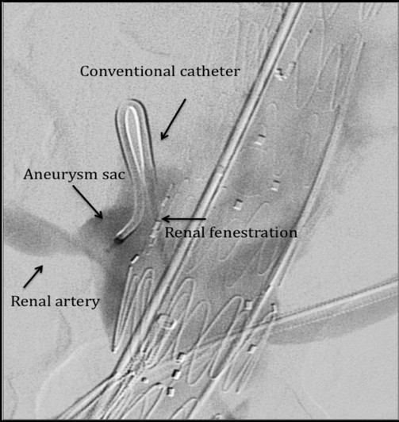
ENDOVASCULAR INTERVENTION: CHALLENGES
Bicknell CD, Riga CV et al
The J Endovasc Ther (JVET)
2008 Oct;15(5):514-7
Proc Inst Mech Eng H. 2010;224(6):743-9.
The requirement for smart catheters for advanced endovascular applications.
Nordon IM, Hinchliffe RJ, Holt PJ, Loftus IM, Thompson MM.
St George's Vascular Institute, St James' Wing, St George's Hospital, London, UK.
Imperial College
London

Slide 12
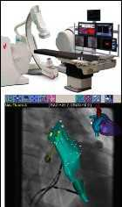
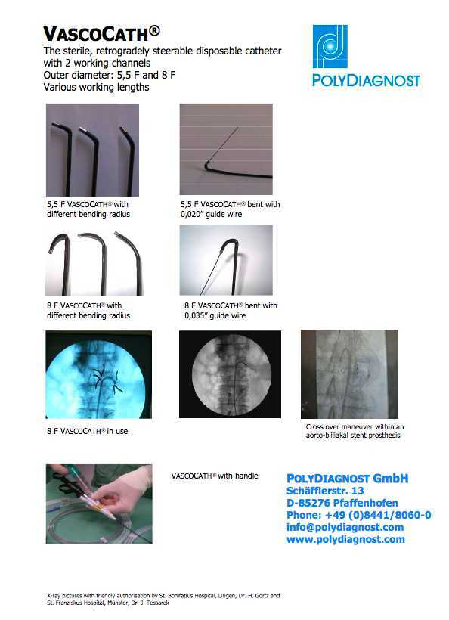
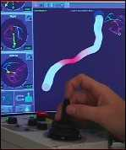

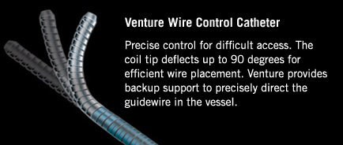
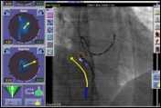
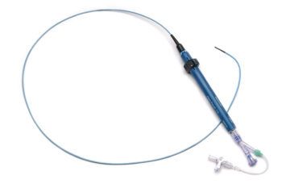
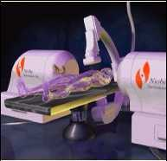
CATHETER TECHNOLOGY
Imperial College
London
Imperial College
London

Slide 13
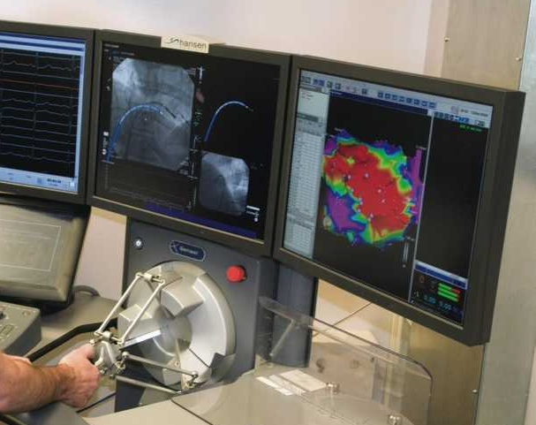
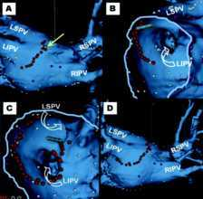
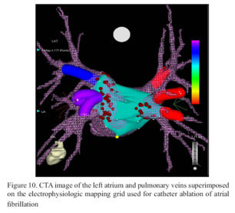
HANSEN SENSEI SYSTEM
Imperial College
London

Slide 14
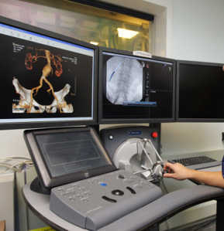
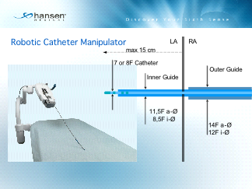
HANSEN SENSEI SYSTEM
Workstation
Instinctive Motion Controller (IMC); 3D hand-operated joystick
Remote Catheter Manipulator (RCM)
Artisan Catheter
Full rotational ability, 270° bend radius
Endovascular Robotics Program
Innovative research theme
First to install system for aortic use
RCM
IMC
Imperial College
London

Slide 15
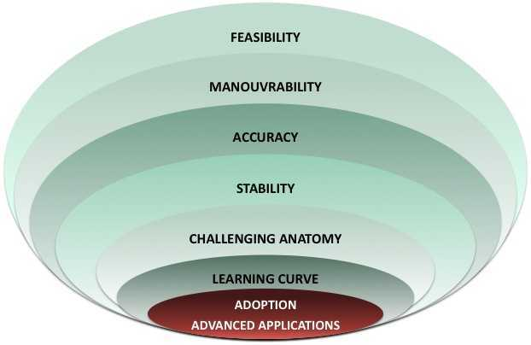
ENDOVASCULAR ROBOTICS
Imperial College
London
Notes:
The operating room environment is a complex system

Slide 16
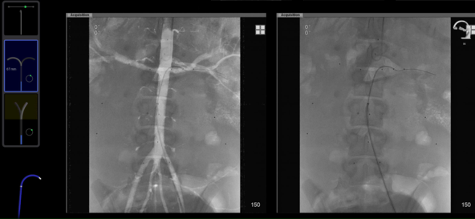
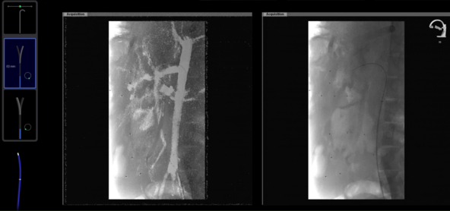
RENOVISCERAL SEGMENT
* P< .001
Riga et al, BJS 2009, Feb;V96:S1
Riga et al, J Cardiovasc Surg 2011, Jun;52(3):353-62,
Imperial College
London
Notes:
To establish some of the factors that may lead to any increased failures in this specialty.

Slide 17
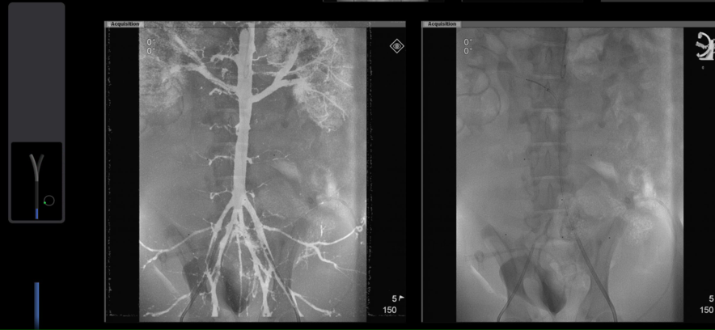

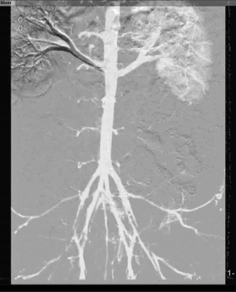
RENAL STENTING & FENESTRATED STENT GRAFTING
*
* p<0.001
Riga et al JVS 2010, Apr;51(4):810-9
Notes:
To establish some of the factors that may lead to any increased failures in this specialty.

Slide 18
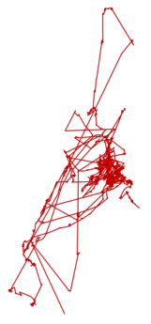
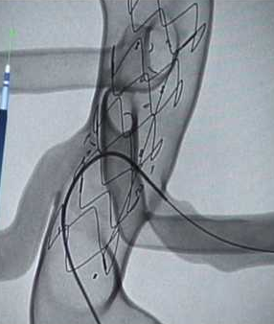
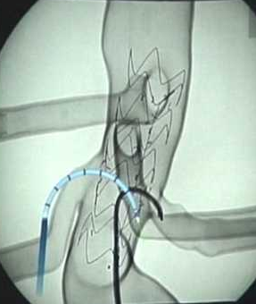

RENAL STENTING & FENESTRATED STENT GRAFTING
* P< .001
Riga et al JVS 2010, Apr;51(4):810-9
Shah C et al, BJS 2012
Notes:
To establish some of the factors that may lead to any increased failures in this specialty.

Slide 20
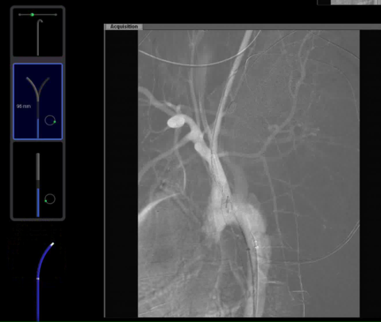
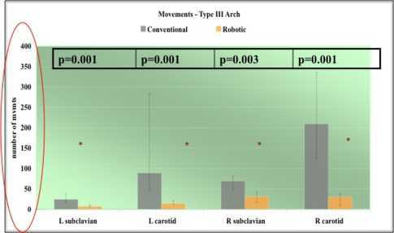
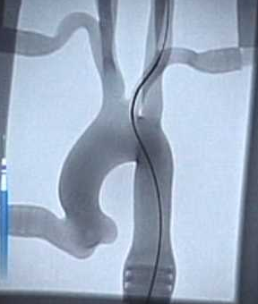
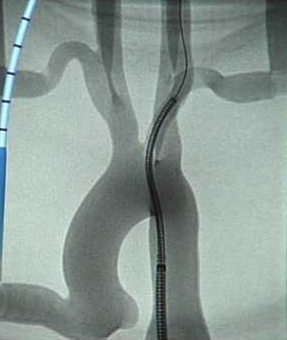
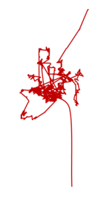

AORTIC ARCH
Riga CV et al, JVS 2011
Sep;54(3):799-809
Imperial College
London
Conventional
Robotic
Notes:
The operating room environment is a complex system

Slide 21

OPERATOR PERFORMANCE
100-200
200-300
> 300
Riga et al JVS 2010, Apr;51(4):810-9
Notes:
The aims of this study were two-fold:
To identify the type and rate of failures in vascular and endovascular surgery.
To establish some of the factors that may lead to any increased failures in this specialty.

Slide 22

LEARNING CURVES
CONVENTIONAL versus ROBOT
p=0.005
p=0005
p=0.008
p=0.005
p=0.007
Learning Curves
Riga CV et al, EJVES 2011
Notes:
The aims of this study were two-fold:
To identify the type and rate of failures in vascular and endovascular surgery.
To establish some of the factors that may lead to any increased failures in this specialty.

Slide 24














Stiff guidewire exchanges n=216
Catheter Stability
A
B
C
Imperial College
London
Notes:
The aims of this study were two-fold:
To identify the type and rate of failures in vascular and endovascular surgery.
To establish some of the factors that may lead to any increased failures in this specialty.

Slide 25

ILIAC TORTUOSITY
Imperial College
London
Notes:
The aims of this study were two-fold:
To identify the type and rate of failures in vascular and endovascular surgery.
To establish some of the factors that may lead to any increased failures in this specialty.

Slide 26











MILESTONES
The St Mary’s Experience
2007
EARLY BENCHTOP / PORCINE STUDIES OF ROBOTIC CARDIAC (SENSEI) SYSTEM
INSTALLATION OF WORLDS FIRST ENDOVASCULAR ROBOT SYSTEM FOR ARTERIAL USE AT IMPERIAL AND MHRA APPROVAL
2008
PROOF OF CONCEPT:
WORLD’S FIRST ROBOT-ASSISTED ANEURYSM REPAIR
2009
EXTENSIVE PRE-CLINICAL IN VITRO AND IN VIVO STUDIES DEMONSTRATE THE ADVANTAGES OF ROBOTIC SYSTEMS IN ARTERIAL INTERVENTION
2010
INDUSTRY COLLABORATION & DEVELOPMEMT OF THE VASCULAR ROBOTIC (MAGELLAN) SYSTEM-CE MARKED FOR AORTIC USE
2011
FIRST PATIENTS TREATED WITH CE MARKED MAGELLAN SYSTEM AT IMPERIAL
2012
INTERGRATION OF COMPLEMENTARY 3D IMAGING AND NAVIGATION TECHNOLOGY

Slide 27

CLINICAL APPLICATIONS
J Endovasc Ther. 2009 Apr;16(2):149-53.
Initial clinical application of a robotically steerable catheter system in endovascular aneurysm repair
Riga C, Bicknell C, Cheshire N, Hamady M.
First Patient Application
Imperial College
London

Slide 28


CLINICAL APPLICATIONS
Imperial College
London

Slide 29



CLINICAL APPLICATIONS
J Endovasc Ther. 2010 Oct;17(5):612-6.
Robot-assisted stenting of a high-grade anastomotic pulmonary artery stenosis following single lung transplantation.
Lumsden AB, Anaya-Ayala JE, Birnbaum I, Davies MG, Bismuth J, Cheema ZF, El Sayed HF, Seethamraju H, Loebe M, Valderrabano M.
Methodist DeBakey Heart & Vascular Center, Department of Cardiovascular Surgery, The Methodist Hospital, Houston, Texas 77030, USA.
Imperial College
London

Slide 30

THE VASCULAR ROBOTIC CATHETER SYSTEM
6 Fr Leader catheter OD
9.5 Fr Sheath OD
Compatible with 0.018 to 0.035 wires
4 way bending sections, 6 degrees of freedom
Imperial College
London
Notes:
To establish some of the factors that may lead to any increased failures in this specialty.

Slide 31

THE VASCULAR ROBOTIC CATHETER SYSTEM
Imperial College
London
Notes:
To establish some of the factors that may lead to any increased failures in this specialty.

Slide 32

THE VASCULAR ROBOTIC CATHETER SYSTEM
2D and 3D Image Integration
Robotic Control of:
Sheath
Leader catheter
Guidewire
Navigation Modes
Pendant Driving
Instinctive Driving
Imperial College
London
Notes:
To establish some of the factors that may lead to any increased failures in this specialty.

Slide 33





THE VASCULAR ROBOTIC CATHETER SYSTEM
British surgeons pioneer surgery with robotic arm
British doctors have performed a world-first operation using a robot that could save hundreds of lives a year.
Imperial College
London
Notes:
To establish some of the factors that may lead to any increased failures in this specialty.

Slide 34




Imperial College
London
Questions ?
Thank you
Notes:
Making the leap from…. May seem ambitious. Intergration of 3D realtime imaging with robotic technology, focus of our current research

Slide 35




PROcedure Rehearsal

Slide 36







I. CTA Aortic Arch and Carotids
IV. 3D Segmentation
VI. 2D Virtual Angiography
II. DICOM on PACS
V. 3D Upload in Simulator
VII. Simulated CAS
III. Upload into Software
Willaert W. et al Int J Med Robot. 2010 Jun;6(2):202-10.
Strong influence on tool selection and fluoroscopy

Slide 37





1. Dicom
2. 3D recon
3. VR Sim
4. Real case
Simulated Case in SOS
Real Case in Angiosuite
Significant improvement in endovascular performance

Slide 38






VR
Real
Willaert W. et al. J Vasc Surg. 2010 Dec;52(6):1700-5

Slide 39


Limitations
Filling Defects
DICOM data
Influence of CT/MRA artefact(s)
Static Imagery
  Biomechanical properties not simulated
    Vessel reaction tot dilatation/stenting
    Difficulty in crossing lesions
Time consuming in daily practice
Cost

Slide 40

Hybrid Endovascular Suite
Non Technical Skills
  Situation awareness
  Decision making
  Communication and teamwork
  Leadership

Slide 41




‘Whole’ Simulation
Cognition
Perception
Communication
Compassion
Dexterity
Role of Practice

