Slide 1
Economics of technologies
BSc Surgery and Anaesthesia
13 January 2012

Slide 2
Outline
Health economics: a primer
Trends: Looking ahead, understand operating environment
Spend to save
Where things go wrong
Further Reading/References

Slide 3
Why think about these issues?
No money
Increased consumer and societal demands and expectations
The changing role of clinicians

Slide 4
What is health economics?
Health economics is a branch of economics concerned with issues related to efficiency, effectiveness, value and behaviour in the production and consumption of health and health care.
Health economists study the functioning of the health care systems as well as health-affecting behaviours, for example alcohol consumption, smoking.
Economists plan for uncertainty – health no exception eg patient outcomes or finance.
Asymmetric information
Dealing with externalities

Slide 5
Health economics:the science of optimism?
Health economics: “the cheerful face of the dismal science”
Two certainties in life: death and taxes
Health economics is concerned with
postponing death with efficient health care
reducing taxes by using good measurement and management of costs and outcomes data
Health economists should be creative agents concerned with improving population health at least cost
Notes:
Williams described health economics “as the cheerful face of the dismal science”
Economics is about death and taxes
Health economics is about postponing death with efficient health care and reducing taxes by using good measurement and management of costs and outcomes data
Let’s not be pessimistic, but creative agents concerned with improving population health at least cost

Slide 6
An approach– Alan Williams - 1987
Significant intellectual achievements in terms of conceptual innovation
Considerable success in influencing policy
still along way to go, especially in shifting performance management from its focus on inputs, processes and activities to outcomes
Williams’ “plumbing” diagram shows the essence of health economics and the links between its component parts
Notes:
Significant intellectual achievements in terms of conceptual innovation
Considerable success in influencing policy
but still along way to go, especially in shifting performance management from its focus on inputs, processes and activities to outcomes
Williams’ “plumbing” diagram showing the essence of health economics and the links between its component parts

Slide 7
A
B
WHAT INFLUENCES HEALTH? (OTHER THAN HEALTH CARE) Occupational hazards; consumption patterns; Education; Income etc
WHAT IS HEALTH? WHAT IS ITS VALUE? Perceived attributes of health;
health status indexes; value of
life; utility scaling of health
E
C
F
MICRO-ECONOMIC EVALUATION AT TREATMENT LEVEL Cost effectiveness & cost benefit analysis of alternative ways of delivering care (e.g. choice of mode, place, timing or amount) at all phases (detection, diagnosis,treatment, after care etc.)
DEMAND FOR HEALTH CARE Influences of A + B on health care seeking behaviour; barriers to access (price, time, psychological,
formal); agency relationship; need
MARKET EQUILIBRIUM Money prices, time prices,
waiting lists & non-price rationing systems
as equilibrating mechanisms and their differential effects
D
SUPPLY OF HEALTH CARE Costs of production; alternative production techniques; input substitution; markets
for inputs (workforce, equipment, drugs etc.); remuneration methods and incentives
H
G
PLANNING, BUDGETING & MONITORING MECHANISMS Evaluation of effectiveness of instruments available for optimising the system; including the interplay of budgeting, workforce allocations; norms; regulation etc. and the incentive structures they generate.
EVALUATION AT WHOLE SYSTEM LEVEL Equity & allocative efficiency criteria brought to bear on E + F; inter-regional & international comparisons of performance

Slide 8
Outline
Health economics: a primer
Trends: Looking ahead, understand operating environment
Spend to save
Where things go wrong
Further Reading/References

Slide 13
Outline
Health economics: a primer
Trends: Looking ahead, understand operating environment
Spend to save
Where things go wrong
Further Reading/References

Slide 14
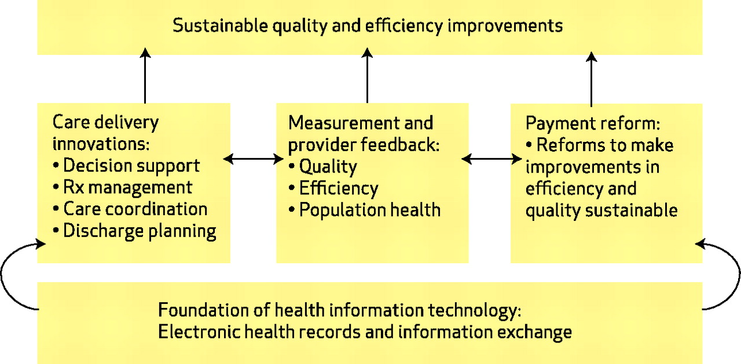
Productivity model
Buntin M B et al. Health Aff 2010;29:1214-1219

Slide 15
Outline
Health economics: a primer
Trends: Looking ahead, understand operating environment
Spend to save
Where things go wrong
Further Reading/References

Slide 16
Outline
Health economics: a primer
Trends: Looking ahead, understand operating environment
Spend to save
Where things go wrong
Further Reading/References

