Slide 1

An introduction to biomechanics
Dr Dominic Southgate
Research Associate in Musculoskeletal Mechanics
Department of Bioengineering
January 2012
a.bull@imperial.ac.uk
www.bg.imperial.ac.uk/staff/abull

Slide 2
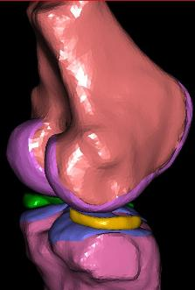
What is Biomechanics?
"The study of forces acting on and generated within the body and of the effects of these forces on the tissues, fluids or materials used for diagnosis, treatment or research purposes."

Slide 3
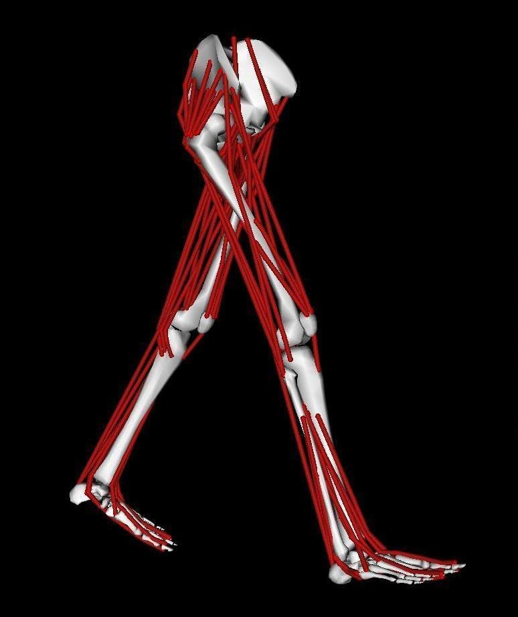
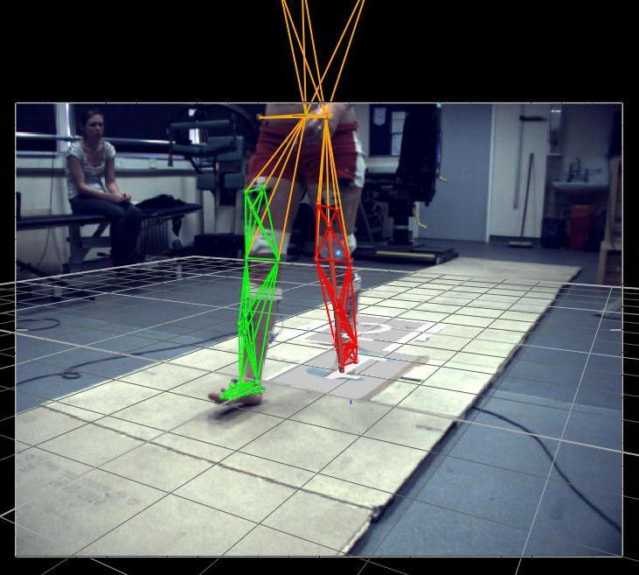
Applications
Research e.g.
Osteoarthritis Centre

Slide 4
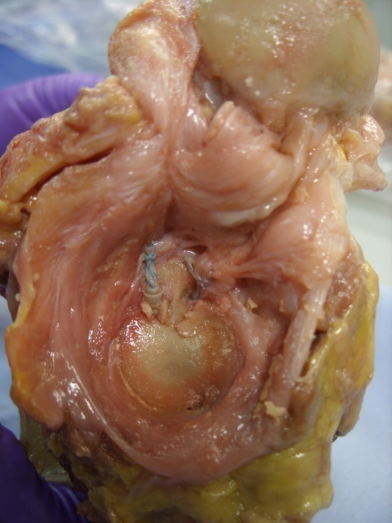
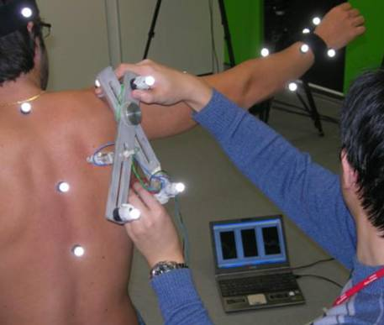
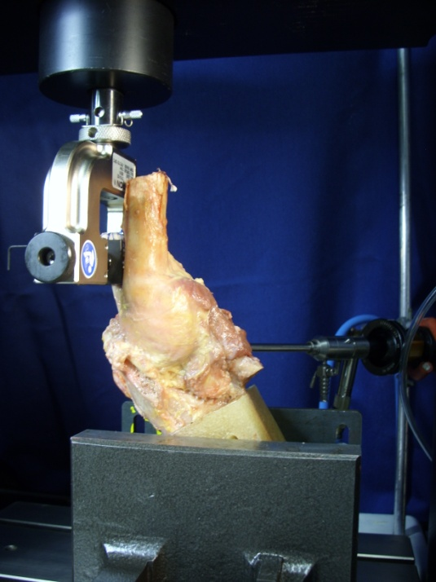
Applications
Research e.g. shoulder

Slide 5
Part 1 – General Mechanics
Forces and Moments
Equilibrium
Free Body Diagrams
Bending, Torsion, Shear
Stress and Strain
Young’s Modulus
Basic Concepts Combining&Calculating Stress&Strain

Slide 6
Sources of Force
External
Internal
Friction
Acceleration
Weight (Weight = mass × g ; g is a type of acceleration)
Basic Concepts Combining&Calculating Stress&Strain

Slide 7
Force
…is a vector
…is measured in Newtons (N)
Basic Concepts Combining&Calculating Stress&Strain

Slide 8
Combining Forces
“Resultant”
=
Basic Concepts Combining&Calculating Stress&Strain

Slide 9
Polygon of forces
=
Basic Concepts Combining&Calculating Stress&Strain

Slide 10
Combining Forces
“Components”
F_{y}
F_{x}
Basic Concepts Combining&Calculating Stress&Strain

Slide 11
Resolving Forces
Summation: Σ
ΣF_{x}, ΣF_{y}
In equilibrium:
ΣF_{x} = 0
ΣF_{y} = 0
Basic Concepts Combining&Calculating Stress&Strain

Slide 12
Equilibrium
µ = coefficient of friction
R = reaction force
R
Maximum frictional force = µR
Basic Concepts Combining&Calculating Stress&Strain

Slide 13
Equilibrium
F = resultant force
m = mass
a = acceleration
F = m x a
a = F / m
Basic Concepts Combining&Calculating Stress&Strain

Slide 14
Moments
“Moment of a force”
Levers
Measured in Nm
d
F
Moment = F × d
Basic Concepts Combining&Calculating Stress&Strain

Slide 15
Moments
Direct moments
In equilibrium:
ΣM = 0
Moment = M
M
Basic Concepts Combining&Calculating Stress&Strain

Slide 16
Free Body Diagrams
A way of calculating unknown forces and moments
Example
Basic Concepts Combining&Calculating Stress&Strain

Slide 17
Free Body Diagrams
Basic Concepts Combining&Calculating Stress&Strain

Slide 18
Free Body Diagrams
F
W
R
1 unit
10 units
Basic Concepts Combining&Calculating Stress&Strain

Slide 19
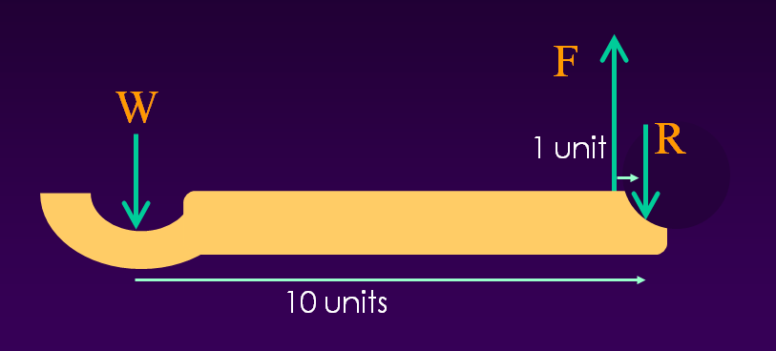
Free Body Diagrams
Resolve Forces:
ΣF_{y} = 0
F – W – R = 0
Resolve Moments:
ΣM_{Joint} = 0
(F x 1unit) – (W x 10units) = 0
F = W x (10/1) R = …
Basic Concepts Combining&Calculating Stress&Strain

Slide 20
Modes of loading
Tie (tension)
Strut (compression)
Axial
Basic Concepts Combining&Calculating Stress&Strain

Slide 21
Examples – Tension/Compression
Ligaments
Tendons
Bone
Articular cartilage
Basic Concepts Combining&Calculating Stress&Strain

Slide 22
Modes of loading
Shear
Basic Concepts Combining&Calculating Stress&Strain

Slide 23
Examples – Shear
Tendons
Bone
Articular cartilage
Basic Concepts Combining&Calculating Stress&Strain

Slide 24
Modes of Loading
Bending
Beam
Basic Concepts Combining&Calculating Stress&Strain

Slide 25
Examples - Bending
Fracture plates
Fracture fixation pins
Bones
Basic Concepts Combining&Calculating Stress&Strain

Slide 26
Modes of Loading
Shaft/axle
Torsion
Basic Concepts Combining&Calculating Stress&Strain

Slide 27
Examples - Torsion
Fracture plates
Bones
Basic Concepts Combining&Calculating Stress&Strain

Slide 28
Bending
Compression
y
−σ
+σ
Tension
Basic Concepts Combining&Calculating Stress&Strain

Slide 29
Combined Loading
Compression
Tension
y
y
y
+
=
−σ
+σ
−σ
+σ
−σ
+σ
Basic Concepts Combining&Calculating Stress&Strain

Slide 30
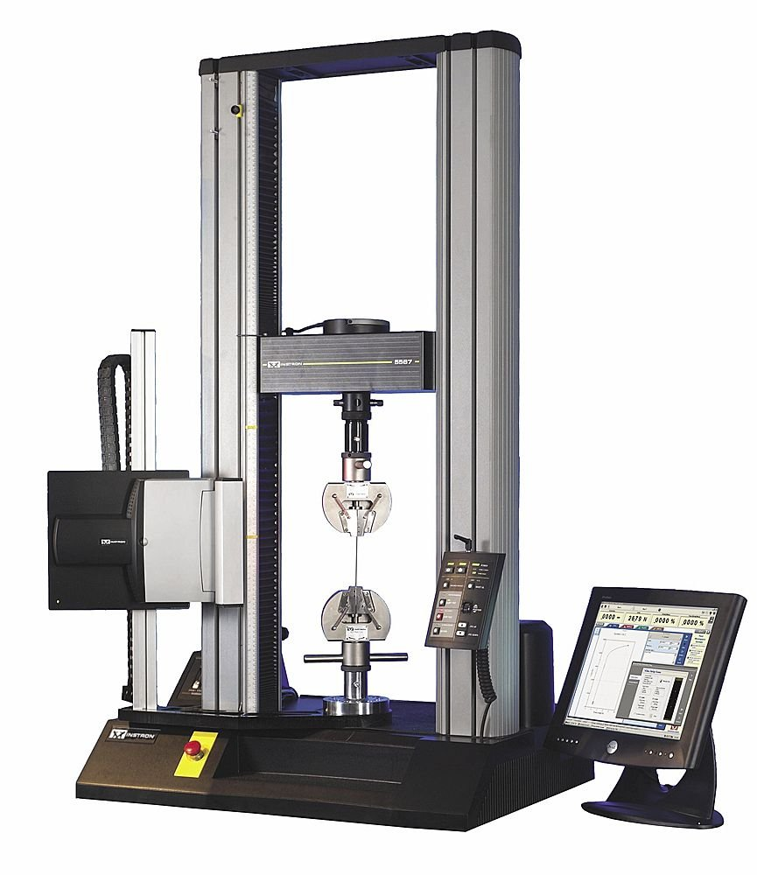
Materials Testing
Basic Concepts Combining&Calculating Stress&Strain

Slide 31
Materials Testing
Measure force
Measure extension
Basic Concepts Combining&Calculating Stress&Strain

Slide 32
Distribution of load/force
F
F
F
F
Basic Concepts Combining&Calculating Stress&Strain

Slide 33
Stress
Stress (normalised Force)
Pressure (acting equally in all directions)
Stress or Pressure = Force/Area
Area
Basic Concepts Combining&Calculating Stress&Strain

Slide 34
Normalisation of extension
F
F
F
F
Basic Concepts Combining&Calculating Stress&Strain

Slide 35
Strain
Normalised Extension
Strain = Extension/Original Length
L
F
F
x
Basic Concepts Combining&Calculating Stress&Strain

Slide 36
Stiffness
Extension per unit force
“Young’s Modulus”
  Normalised stiffness
= Stress/Strain
Basic Concepts Combining&Calculating Stress&Strain

Slide 37
Normalising Stiffness
σ = F / A
ε = ΔL / L
Basic Concepts Combining&Calculating Stress&Strain

Slide 38
Young’s Modulus
Units: Pa (N/m²) x10⁹ or GPa
Steel
Aluminium
Bone
Ligaments
Cartilage
Basic Concepts Combining&Calculating Stress&Strain

Slide 39
Summary
Forces and Moments
Equilibrium
Free Body Diagrams
Bending, Torsion, Shear
Stress and Strain
Young’s Modulus

Slide 40
Part 2 – Mechanics in the Body
Cadaveric Testing e.g. ligaments
Intersegmental models
Finite Element models
Intersegmental Finite Element Cadaveric Testing

Slide 41
Cadaveric Testing
Uses
Establishing material properties
Investigating joint laxity and restraints
Simulating pathology and surgical intervention
Intersegmental Finite Element Cadaveric Testing

Slide 42
Ligament/Tendon
‘Viscoelastic’
Load-extension response is time dependent
Intersegmental Finite Element Cadaveric Testing

Slide 43
Ligament/Tendon
Multiple failure region
Fibres fail sequentially
Linear region
Straight fibres
Full fibre recruitment
Rupture
Toe region
Uncrimping of fibres
Gradual fibre recruitment
Intersegmental Finite Element Cadaveric Testing

Slide 44
Cadaveric Testing
Long head of biceps tendon
Tensile test to failure
Intersegmental Finite Element Cadaveric Testing

Slide 45
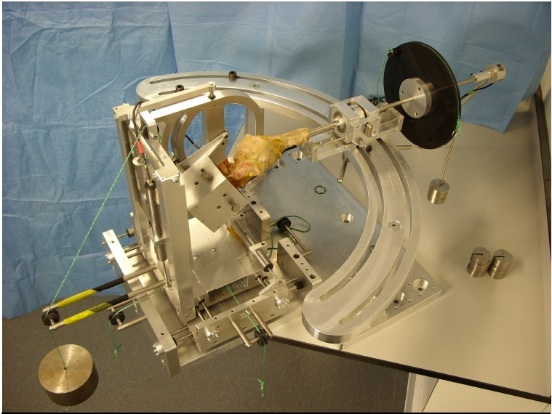
Cadaveric Testing
Intersegmental Finite Element Cadaveric Testing

Slide 46
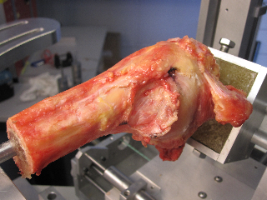
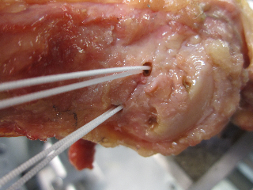
Cadaveric Testing
Intersegmental Finite Element Cadaveric Testing

Slide 47
Cadaveric Testing
Intersegmental Finite Element Cadaveric Testing

Slide 48
Types of Biomechanical Model
Intersegmental models
Each bone/muscle/ligament treated as a single element
Calculates joint reaction forces and predicts muscle tension
Finite Element models
Each bone/muscle/ligament divided into many small elements
Calculates distribution of stress/strain within the tissues
Intersegmental Finite Element Cadaveric Testing

Slide 49
Intersegmental Modelling
Kinematics
Movements (position, velocity, acceleration, joint angles)
Kinetics
Forces during movements (joint torque, GRF)
Forward Dynamics
How forces cause movements. Estimate the movement resulting from forces and moments
Inverse Dynamics
How movements require forces. Estimate the forces that cause the motions we measure
Intersegmental Finite Element Cadaveric Testing

Slide 50
Intersegmental Modelling
F
W
R
1 unit
10 units
Intersegmental Finite Element Cadaveric Testing

Slide 51
Intersegmental Moments
M = 50(0.3cos(θ-90))
θ
0.3m
50 N
Intersegmental Finite Element Cadaveric Testing

Slide 52
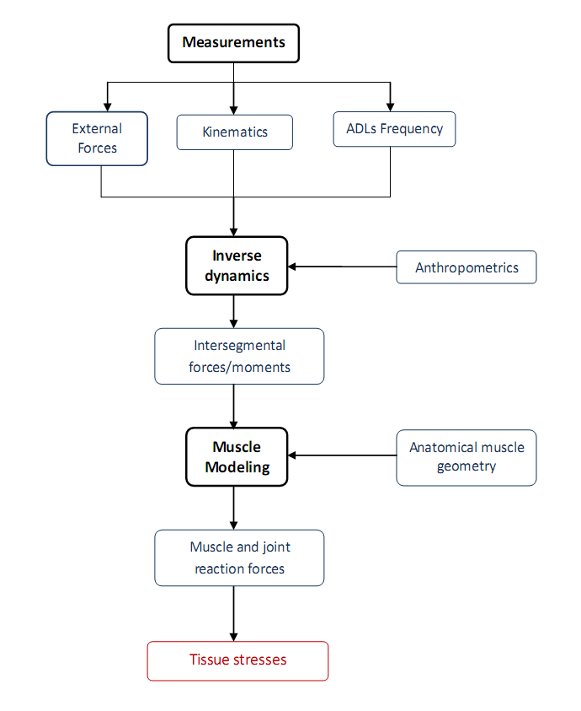
Intersegmental Modelling
Intersegmental Finite Element Cadaveric Testing

Slide 53
Intersegmental Modelling
Motion Capture
Kinematic analysis
Intersegmental Finite Element Cadaveric Testing

Slide 54
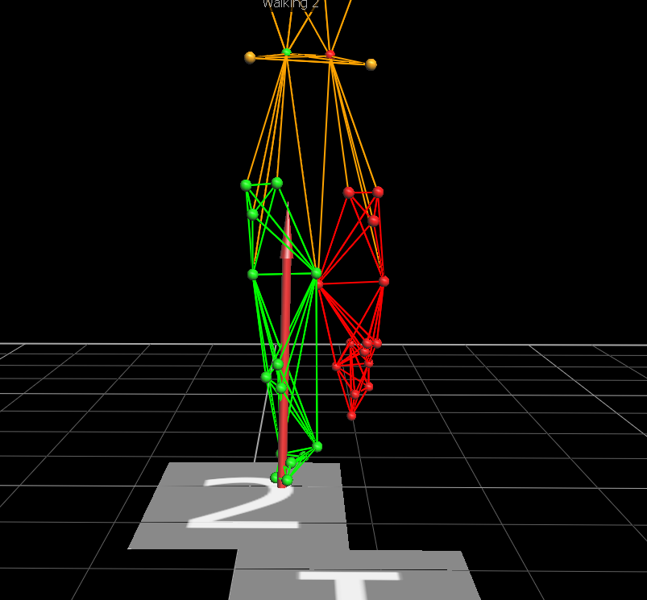
Intersegmental Modelling
Motion Capture
Kinematic analysis can be used directly…
Intersegmental Finite Element Cadaveric Testing

Slide 55
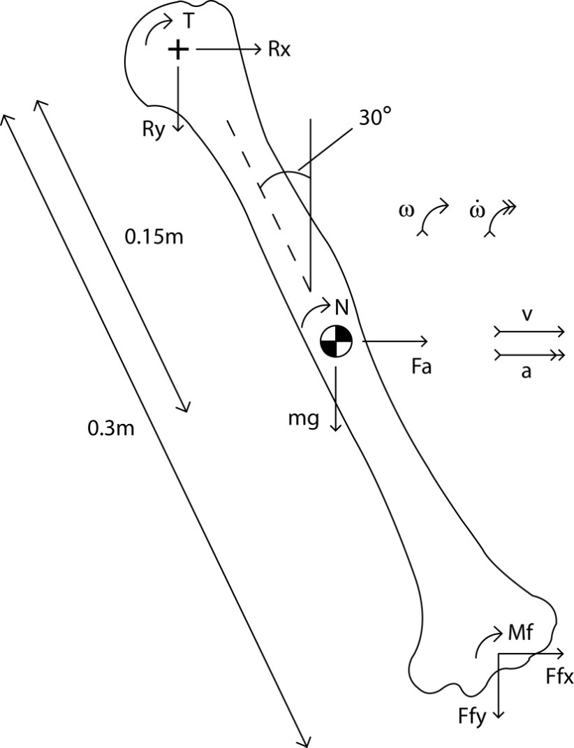
Intersegmental Modelling
Inverse Dynamics
Joint force and torque calculation
Intersegmental Finite Element Cadaveric Testing

Slide 56
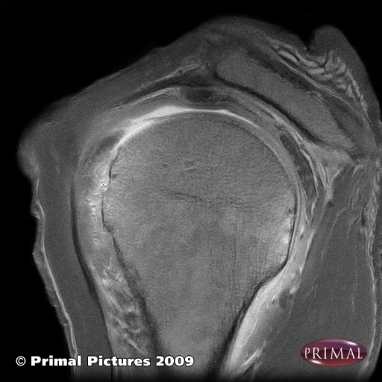
Intersegmental Modelling
Anatomical geometry
Segmentation
MRI/CT etc.
Intersegmental Finite Element Cadaveric Testing

Slide 57
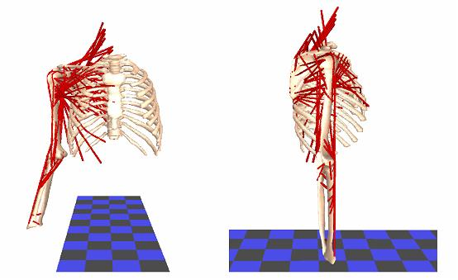
Intersegmental Modelling
Optimisation Algorithms
Cost function to minimise muscle stress
Newcastle Shoulder Model
Intersegmental Finite Element Cadaveric Testing

Slide 58
Intersegmental Modelling
Output Muscle Forces
Intersegmental Finite Element Cadaveric Testing

Slide 59
Intersegmental Modelling
Uses
Estimating muscle and joint forces
  Improving implant design etc.
Analysing joint motions
  Diagnosing abnormal patterns
Effects on muscle moment arms
  Changes following surgery
Intersegmental Finite Element Cadaveric Testing

Slide 60
Finite Element Modelling
Anatomical geometry
Segmentation
MRI/CT etc.
Intersegmental Finite Element Cadaveric Testing

Slide 61
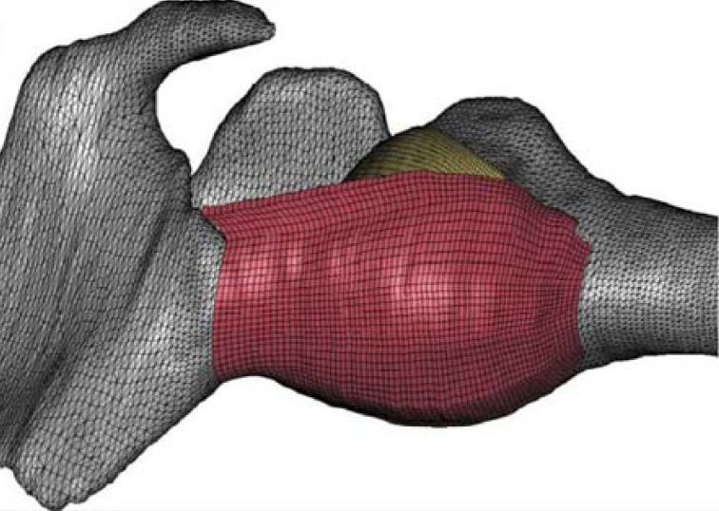
Finite Element Modelling
Mesh Generation
Element type
No. of elements
Inferior Glenohumeral Ligament Model – Weiss Group
Intersegmental Finite Element Cadaveric Testing

Slide 62
Finite Element Modelling
Inputs
Material Properties
Loading Conditions
Knee Model - Masouros 2008
Intersegmental Finite Element Cadaveric Testing

Slide 63

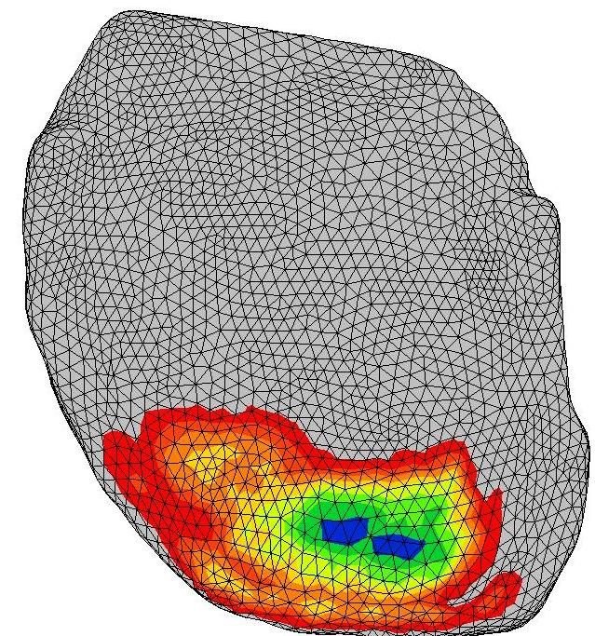
Finite Element Modelling
Outputs
Stress/Strain patterns
Glenoid cartilage
Intersegmental Finite Element Cadaveric Testing

Slide 64
Finite Element Modelling
Uses
Estimating joint contact stress
  Improving implant design etc.
Simulating surgery
  Effects of meniscectomy, for example
Intersegmental Finite Element Cadaveric Testing

Slide 65
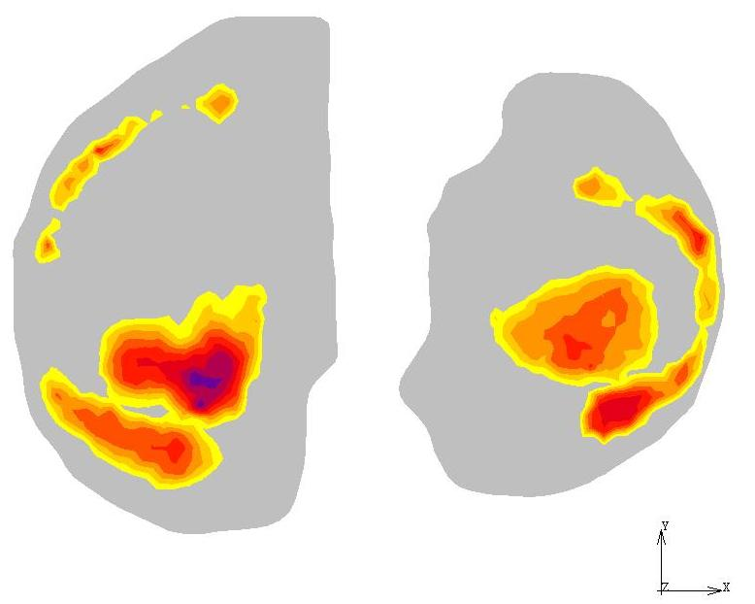
Finite Element Modelling
30° flexion
Normal stresses
in articular cartilage
Max. principal stresses
in menisci
Knee Model - Masouros 2008
Intersegmental Finite Element Cadaveric Testing

Slide 66
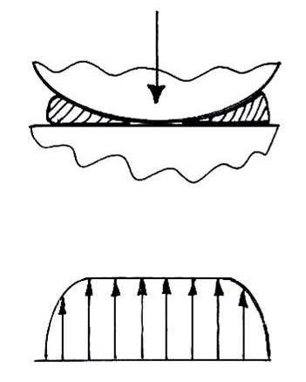
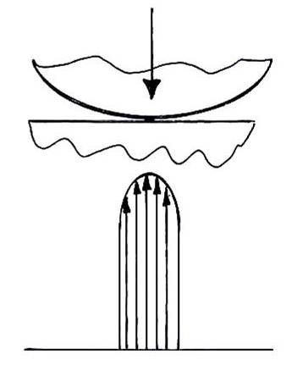
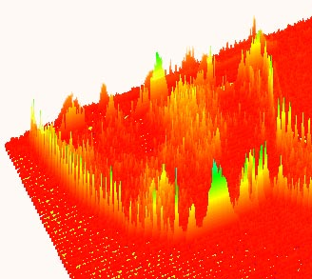
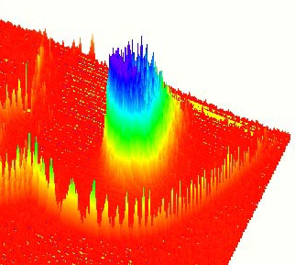
Finite Element Modelling
Meniscectomy results in:¹⁻³
Cartilage to cartilage contact
Less conformity
Decreased contact area
Increased contact stresses (up to 200%)¹
Increased shear stresses
¹Baratz et al, 1986, AJSM
²Seedhom & Hargreaves, 1979, Eng Med
³McDermott et al, 2008, KSSTA
Intact
Meniscectomised
Intersegmental Finite Element Cadaveric Testing

Slide 67
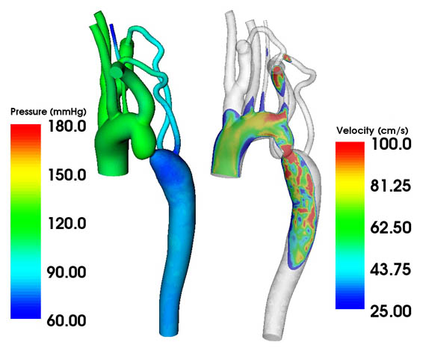
Computational Fluid Dynamics
Analysing fluid flow in the body, for example:
Vascular
Gastrointestinal
Ocular
SimTK
Intersegmental Finite Element Cadaveric Testing

Slide 68
Modelling Summary
Experimental Data
Input
Modelling
Validation
Output
Mechanical Behaviour
Clinical application
Intersegmental Finite Element Cadaveric Testing

