Slide 1


Functional MRI of eating behaviour
Dr Alexander Miras
MRC Clinical Research Fellow
Imperial Weight Centre - Charing Cross Hospital
Metabolic Imaging Group - Hammersmith Hospital

Slide 2
WHY DO WE EAT
Hunger
  Physiological (internal) drive to eat
  The feeling that prompts thought of food and motivates food consumption
  Influenced by nutrients in the bloodstream, eating patterns, climate, etc
  Controlled internally

Slide 3
WHY WE EAT
SATIETY
If the quest for food is successful the brain signals the body to stop eating (hunger is suppressed).

Slide 4
WHY DO WE EAT
Appetite
  Psychological (external) drive to eat
  Often in the absence of hunger
  Often of particular type of food
  Combination of internal and external signals drive us to eat
  Appetite is affected by a variety of external forces
  Not a perfect system; desire to eat can be overwhelming

Slide 5
SATIETY REGULATOR
The hypothalamus
  When feeding cells are stimulated, they signal us to eat
  When satiety cells are stimulated, they signal us to stop eating

Slide 6
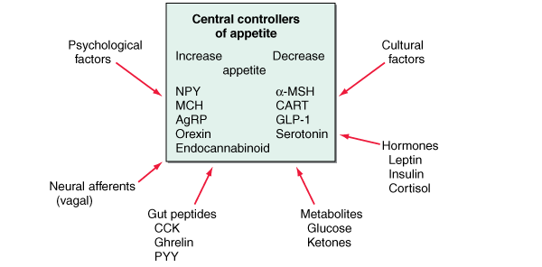
THE FACTORS THAT REGULATE APPETITE
PSYCHOLOGICAL
Factors
CULTURAL
Factors
HORMONES
Leptin
Insulin
Cortisol
NEURAL AFFERENTS
( Vagal )
GUT PEPTIDE
CCK
Ghrelin
PYY
METABOLITES
Glucose
Ketones

Slide 7
FACTORS THAT REGULATE QUANTITY OF FOOD INTAKE
Short term regulation
Concerned primarily with preventing over eating at each meal
Long term regulation
Concerned primarily with maintenance of normal quantities of energy stores in the body

Slide 8
Afferent factors in appetite regulation
Food Intake
Energy Expenditure
Leptin
GO
Vagus
CCK
Ghrelin
Insulin
PYY
GLP-1
OXM
Notes:
Hormones that control eating. Leptin and insulin (lower part of the figure) circulate in the blood at concentrations proportionate to body-fat mass. They decrease appetite by inhibiting neurons (centre) that produce the molecules NPY and AgRP, while stimulating melanocortin-producing
neurons in the arcuate-nucleus region of the hypothalamus, near the third ventricle of the brain. NPYand AgRP stimulate eating, and melanocortins inhibit eating, via other neurons (top). Activation of NPY/AgRP-expressing neurons inhibits melanocortin-producing neurons. The gastric hormone ghrelin stimulates appetite by activating the NPY/AgRP-expressing neurons. Batterham et al.1 have now shown that PYY3-36, released from the colon, inhibits these neurons and thereby decreases appetite for up to 12 hours. PYY3-36 works in part through the autoinhibitory NPY receptor Y2R.

Slide 9
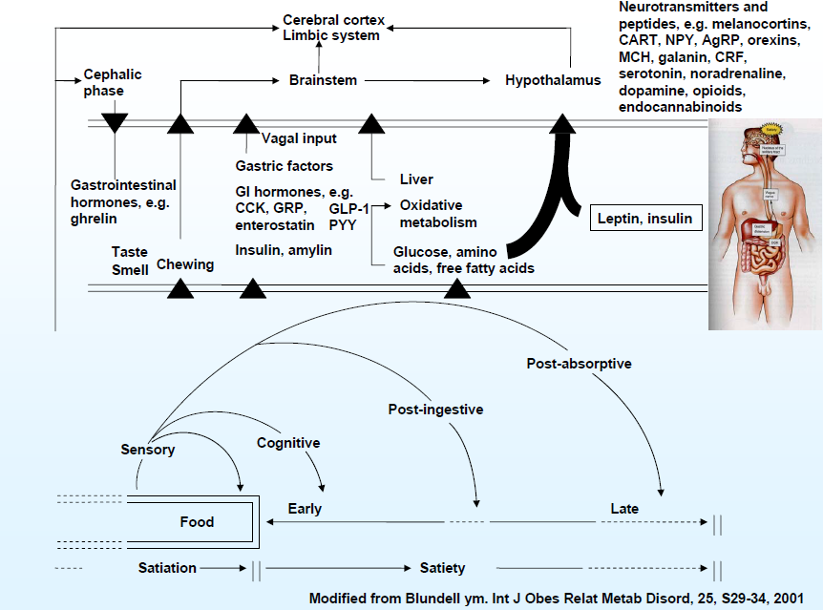
Factors operating during a meal

Slide 10
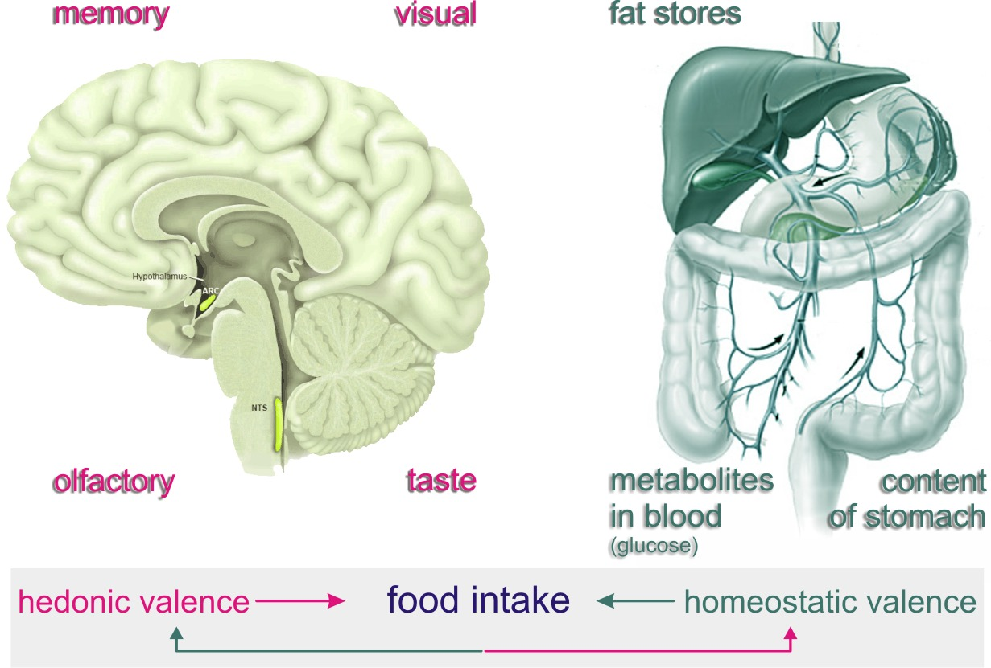
Homeostatic and reward signals
Ijsbrand Kramer www.cellbiol.net

Slide 11
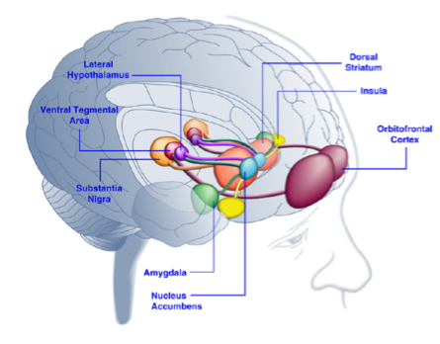
Brain Regions Activated in Response to
Palatable Food or Food-Associated Cues
Kenny et al. Neuron 69:664-679, 2011
Notes:
Caudate: learning and memory, responses to visual beauty
Amygdala: formation and storage of memories associated with emotional events, appetitive conditioning: more emotionally-arousing information increases amygdalar activity, and that activity correlates with memory retention
OFC: reward value, the expected reward value, and subjective pleasantness of foods
Anterior cingulate: ventral ACC is connected with amygdala, nucleus accumbens, hypothalamus, and anterior insula, and is involved in assessing the salience of emotion and motivational information
Nucleus accumbens: inputs from OFC, amygdala, and dopaminergic in the ventral tegmental area (VTA). Associated with addiction, reward motivation, drive, expectancy.

Slide 12
Recidivism after volitional weight loss
Set point
BMI
Volitional / pharmacological weight loss
Reduced-obese state
40
Homeostatic response promotes weight regain
30
20
Time
Bray GA,JCEM, 2008; 93:S81-8.

Slide 13
Calorie Intake vs PYY dose response
*
*
*
*
PYY
(pmol/L)
*
*
500 mL
900 mL
Test meal (kcal)
le Roux et al Endocrinology 2006

Slide 14
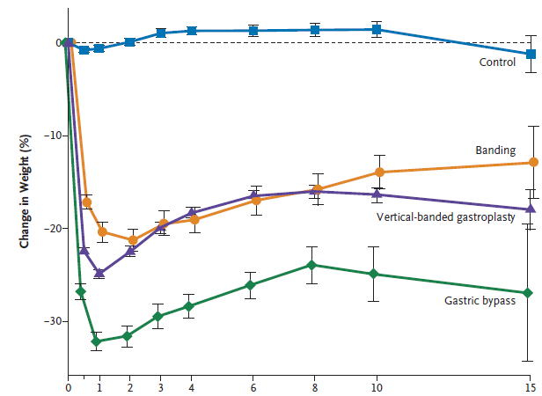
Long term weight loss maintenance
Sjöström, L. et al. N Engl J Med 2007

Slide 15
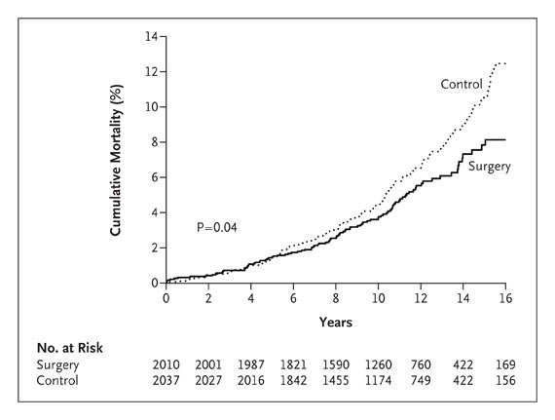
Mortality benefit
Diet/Drug induced weight loss NO mortality benefit (yet)
Sjostrom NEJM 2007

Slide 16
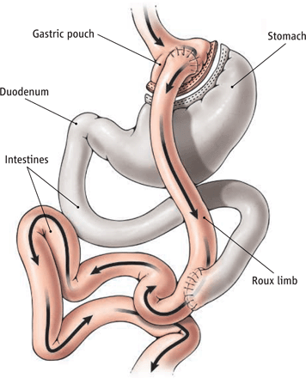
Gastric bypass - It’s five operations in one!
Small pouch
Bypassed stomach and duodenum
Altered bile flow
Distal jejunum in contact with food earlier
Vagal manipulation

Slide 17
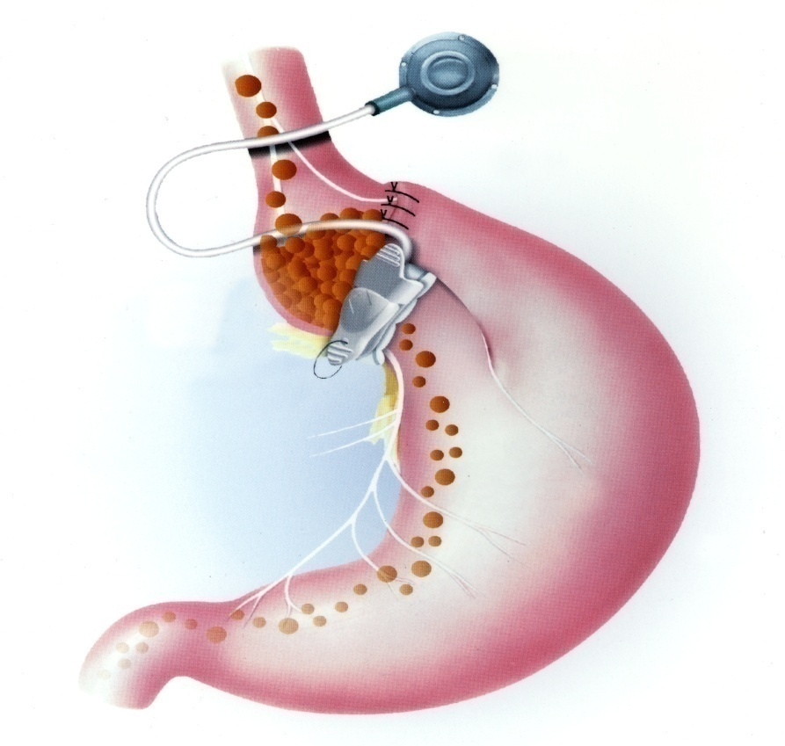
Adjustable Silastic Gastric Banding
Adjustable Lap Band
  <1 hr procedure
  1 day in-patient
  20% weight loss
  1:1000 Risk of Death
  High risk of re-operation
  Self-sabotage easier
  Reversible

Slide 18
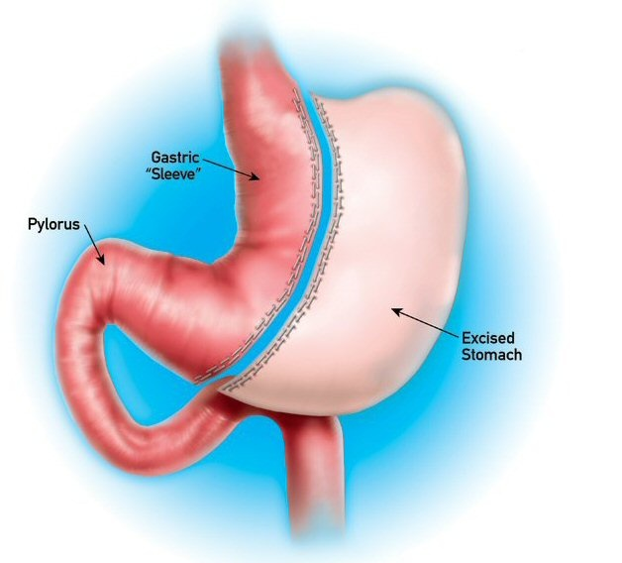
Sleeve gastrectomy
Laparoscopic
  1-2 hour procedure
  2-3 days in-patient
  25% weight loss
  1:300 Risk of Death
  1:10 complications
  1st choice for very obese

Slide 19
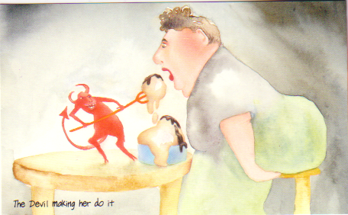
Physiology?

Slide 20
Decreasing adipocyte mass
Progressive weight loss
Decreased fasting leptin
Decreased fasting insulin

Slide 21
Visual analogue scores
le Roux, Borg et al 2006 Brit J Surg

Slide 22
PYY response after bariatric surgery
MEAL
PYY
pmol/L
Time point (min)
le Roux et al Ann Surg 2006

Slide 23
PYY response pre & post RYGB
***
***
PYY AUC
pmol/l/min
12
24
Months post-op
le Roux et al Ann Surg 2009

Slide 24
Good and poor weight loss after RYGB
Weight loss
PYY
le Roux, Olbers et al Ann of Surg 2007

Slide 25
Blocking gut hormones with octreotide
Gastric banding
Gastric bypass
le Roux, Kokkinos et al Ann of Surg 2007

Slide 26
Postprandial and fasting GLP-1
le Roux, Pournaras et al Ann of Surg 2010

Slide 27
Ghrelin post meal
Cummings et al N Engl J Med. 2002

Slide 28
Dose response curve
LEAN
OBESE
Satiety
Physiological range
Bypass surgery
Meal Size

Slide 29
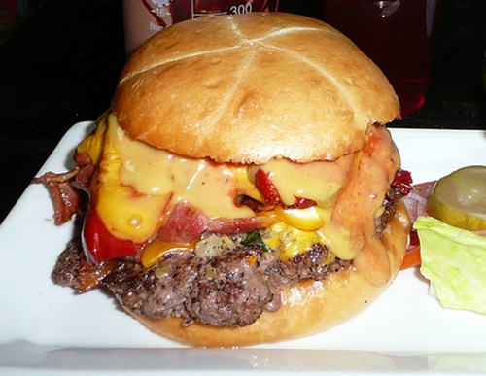
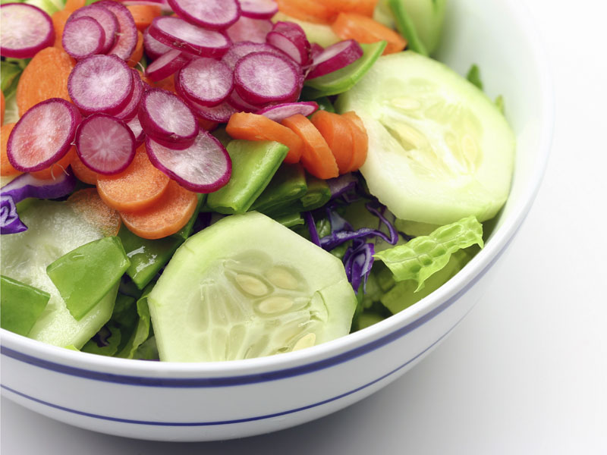
Clinic – Dietary Change
preoperative
postoperative
“I Don’t Enjoy Burgers Anymore” Syndrome
Paradoxical – as dietary weight loss increases preference for fatty food and sugars
Olbers Ann Surg 2006

Slide 30
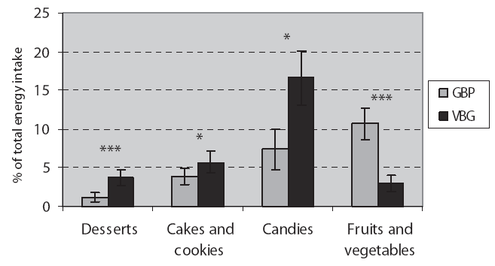
“Behaviour surgery”
Olbers T et al, Ann Surg 2006
Notes:
Why is this important?

Slide 31
Brain Regions Activated in Response to
Palatable Food or Food-Associated Cues
Kenny et al. Neuron 69:664-679, 2011
Notes:
Caudate: learning and memory, responses to visual beauty
Amygdala: formation and storage of memories associated with emotional events, appetitive conditioning: more emotionally-arousing information increases amygdalar activity, and that activity correlates with memory retention
OFC: reward value, the expected reward value, and subjective pleasantness of foods
Anterior cingulate: ventral ACC is connected with amygdala, nucleus accumbens, hypothalamus, and anterior insula, and is involved in assessing the salience of emotion and motivational information
Nucleus accumbens: inputs from OFC, amygdala, and dopaminergic in the ventral tegmental area (VTA). Associated with addiction, reward motivation, drive, expectancy.

Slide 32
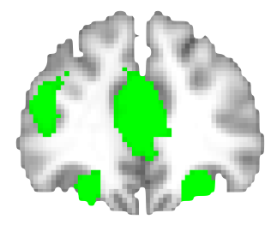
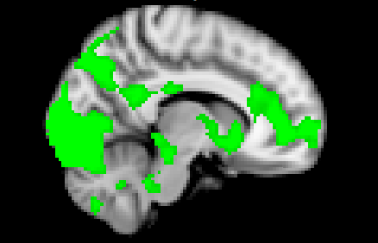
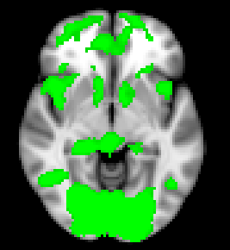
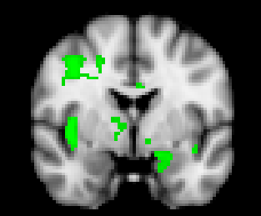
Reward System Activation to High-Calorie Food Pictures
R
x 10
y 36
vACC
IFG
ventral
ACC
OFC
Caudate
Medial frontal cortex
Ventral striatum
Ventral striatum
y -2
Insula
cortex
Amygdala
z -6
n=59, High-calorie foods > Objects, cluster threshold Z>2.6, P<0.05

Slide 33
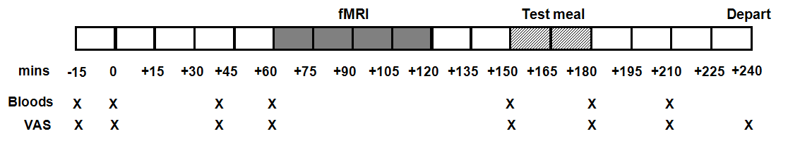
Study 2 - Functional MRI
Gastric bypass vs. Gastric banding vs. unoperated controls (n=20 each)
Fasted overnight
Follicular phase of menstrual cycle (females)
fMRI viewing high-calorie & low-calorie food pictures (11am)
Ad libitum test meal (ice cream) 90 mins later
Visual analogue scales: hunger
Rating ‘appeal’ and ‘liking to eat’ of identical foods
Notes:
33

Slide 34
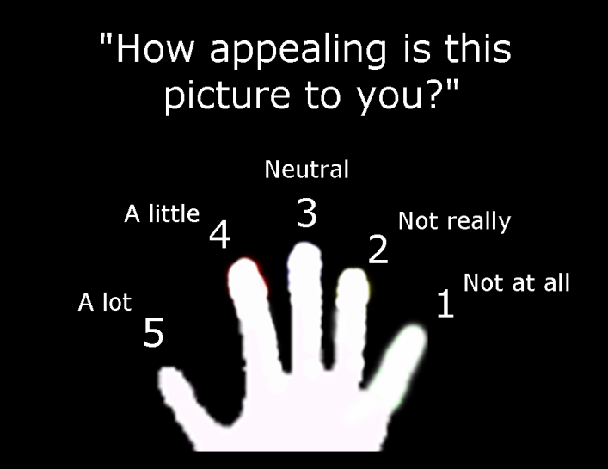

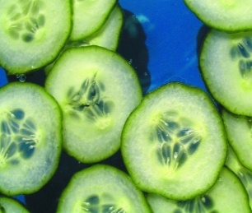

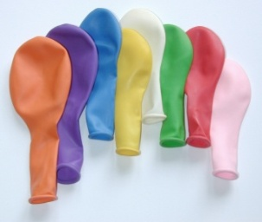

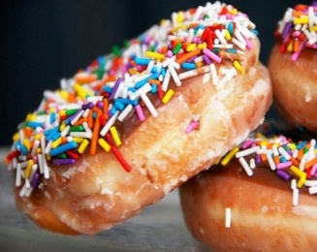
fMRI Study Design
Pseudo-randomized block design
Low-calorie
18 sec
Blurred
Echo-gradient EPI
2 x 2 x 3.25 mm, 44 slices
TR 3 sec, TE 30 msec
SENSE factor 2
-30˚AC-PC slice acquisition with z-shim and field map B0 correction for OFC optimisation
x 60
Objects
18 sec
Blurred
18 sec
High-calorie (x6)
2.5 sec / picture
0.5 sec inter stimulus interval
6 pictures / block
10 blocks / category
2 runs
18 sec
Notes:
Viewing high or low calorie foods, non-food related household objects and blurred pictures in pseudo-randomised block design (6 pictures per block, 2.5sec per picture, 0.5sec ISI)
Rating of how appealing each picture is during fMRI (scale 1-5)
4Hz flashing checkerboard as a control visual stimulus (5 x 24sec blocks)
analyses of functional connectivity can provide
insight into how neural networks interact with each other to carry out cognitive and behavioral
functions (28) although conclusions about exact circuitry and causal mechanisms are limited by
spatiotemporal resolution and most importantly by the cross-sectional, descriptive nature of the
data generated (26, 29)

Slide 35

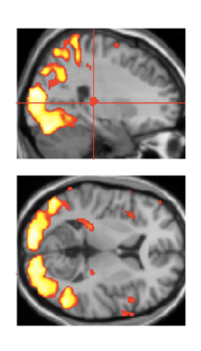
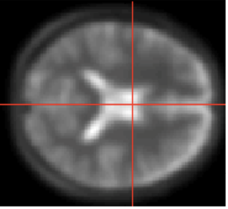
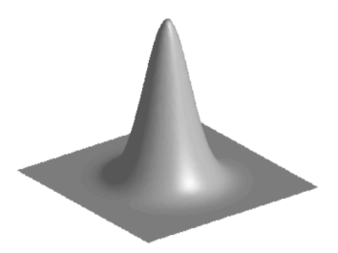
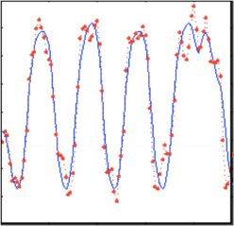
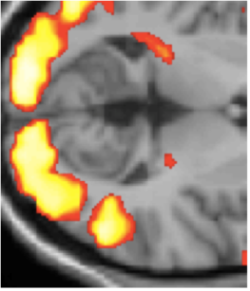
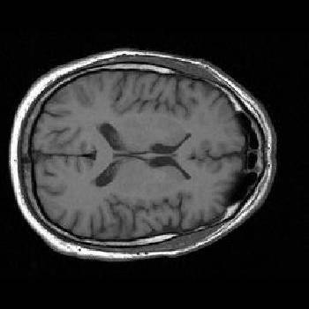
fMRI Pre-Processing & Analysis: FSL
Statistical parametric
map (SPM) at Individual
Level for each Contrast
Design matrix
Magnitude of activation in significantly different voxels within anatomical ROIs for HiCal>Obj
in Bypass, Banding and Unoperated
Image time-series
Kernel
General linear model:
HiCal, LoCal, Objects
Motion regressors
Temporal derivative
Motion Correction
Smoothing
6mm FWHM
Cluster threshold
whole brain
Z>2.1, P<0.05
HiCal > Obj
LoCal > Obj
Statistical
Inference at
Group Level
Non-linear
Registration
Random
effects
analysis
Unpaired t-test between Bypass and Banding
including age, gender, BMI as covariates
Parameter estimates
T1 Template
MNI Space
Modified from www.fil.ion.ucl.ac.uk/spm

Slide 36
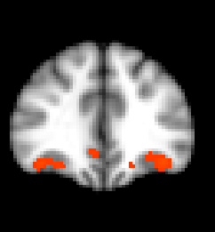
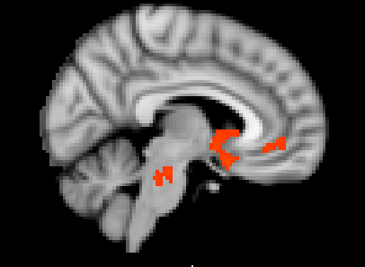
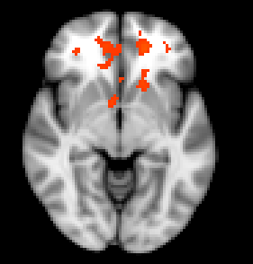
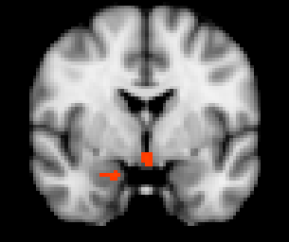
Less Activation to High-Calorie Foods in Gastric Bypass
R
y 36
x 6
Caudate
vACC
vACC
OFC
Ventral striatum
Medial frontal cortex
z -6
y -2
Ventral striatum
Amygdala
High-calorie food > Objects, Banding > Bypass, Bypass > Banding, adjusting age, gender, BMI
n=19-20, cluster threshold Z>2.1 , P<0.05

Slide 37
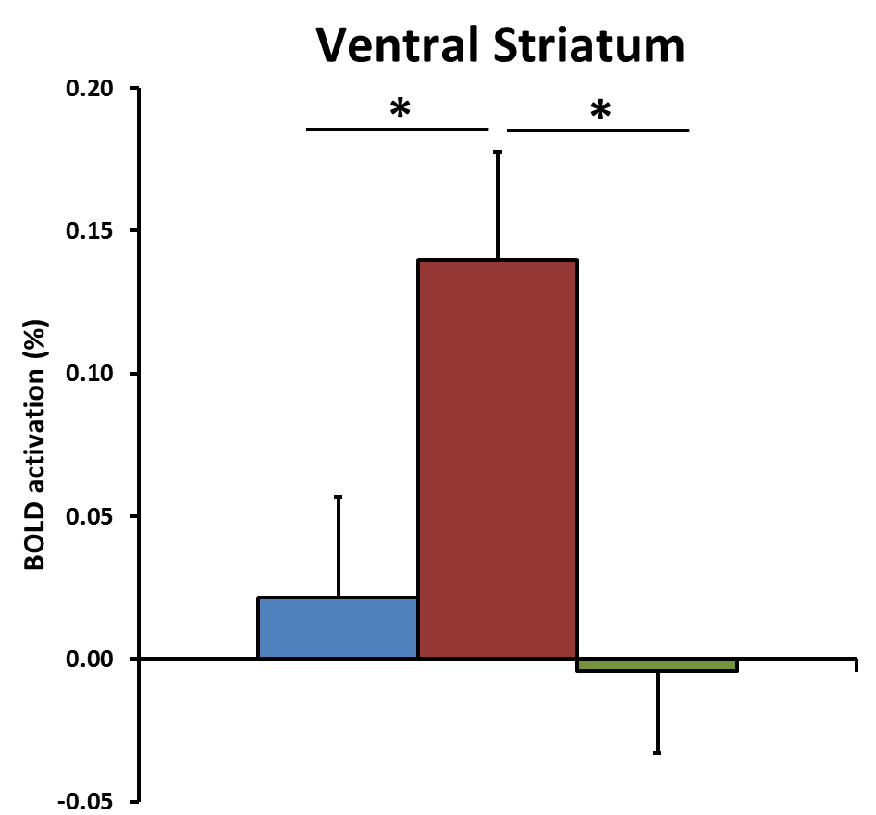
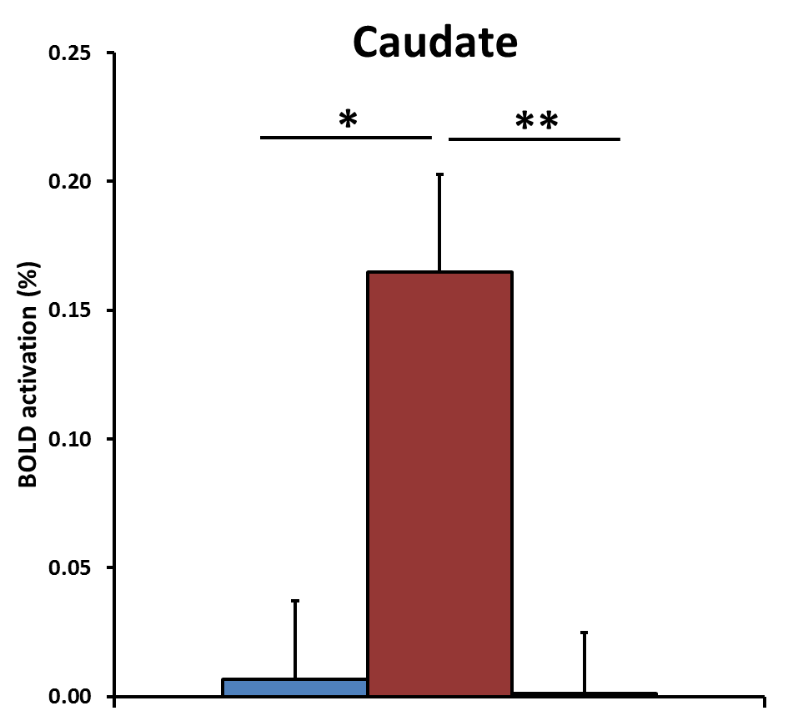
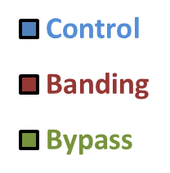
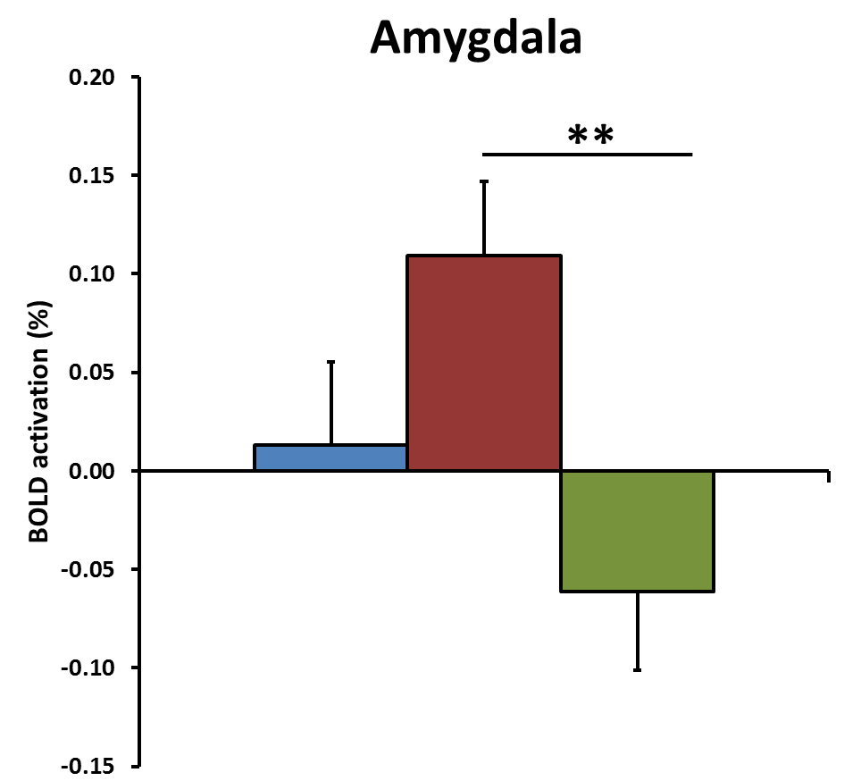
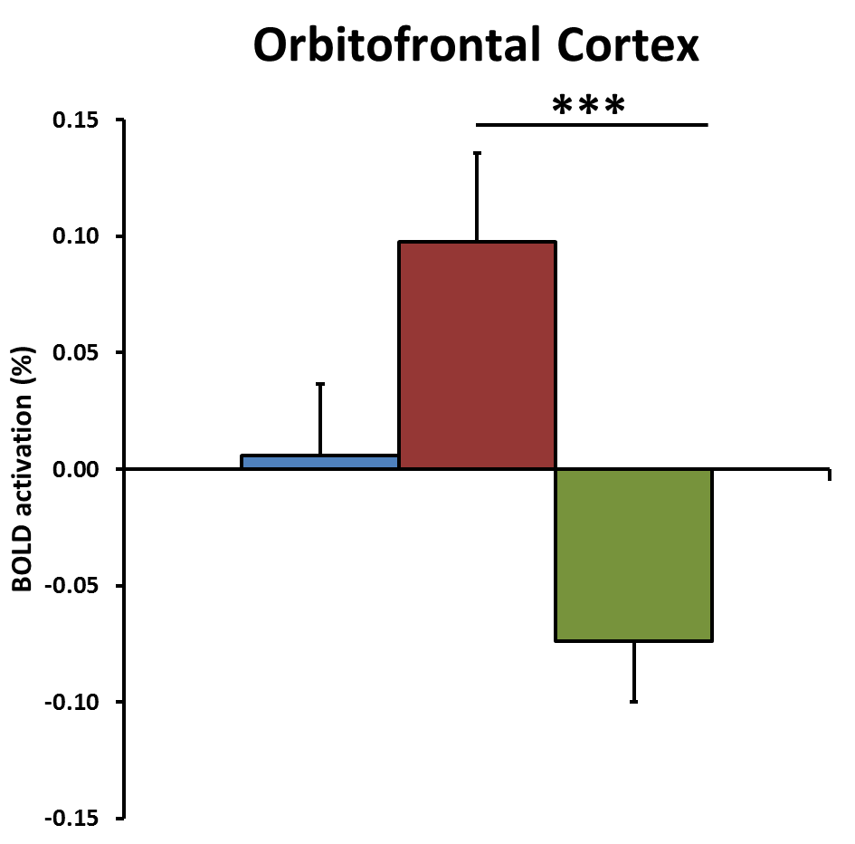
Less Activation to High-Calorie Foods in Gastric Bypass
*P<0.05, **P<0.01, ***P<0.005
ANOVA with post-hoc Tukey test, n=19-20

Slide 38
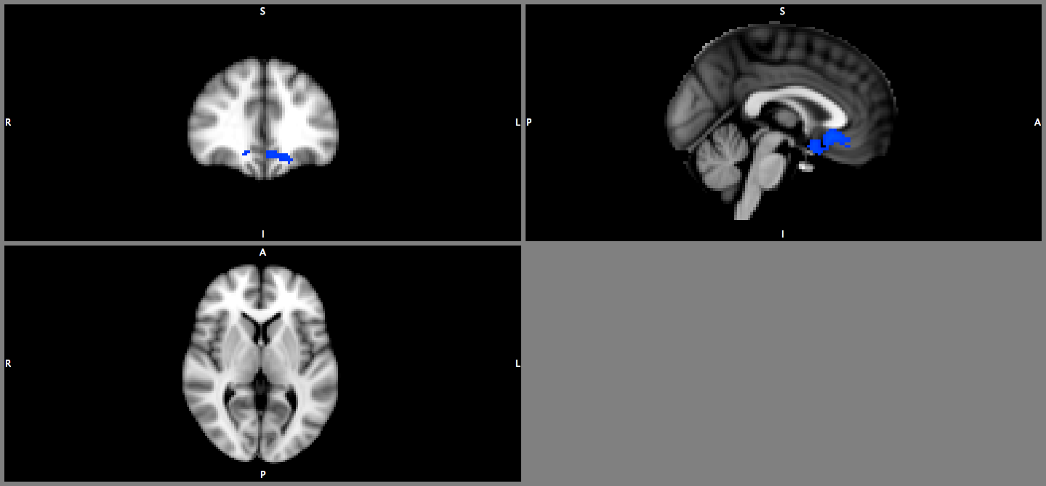
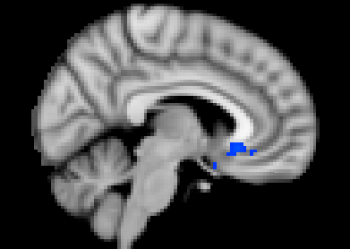
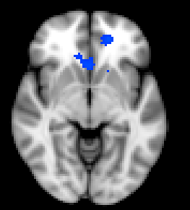
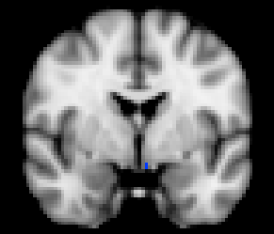
Less Activation to Low-Calorie Foods in Gastric Bypass
R
y 36
x 6
Medial frontal
cortex
Ventral
striatum / subcallosal
cortex
z -6
Medial frontal
cortex
y -2
Low-calorie food > Objects, Banding > Bypass, Bypass > Banding, adjusting age, gender, BMI
n=19-20, cluster threshold Z>2.1 , P<0.05

Slide 39
PYY and Reward System
iv PYY – resting BOLD signal
Batterham et al. Nature 2007

Slide 40
Summary
Gastric bypass patients had:
Less activation to high-calorie foods in ventral striatum, caudate, amygdala, ventral anterior cingulate, medial frontal and orbitofrontal cortex than gastric banding
Less activation to low-calorie foods in ventral striatum and medial frontal cortex than gastric banding (but not apparent in caudate, amygdala, ventral anterior cingulate and orbitofrontal cortex)

Slide 41
Mechanism facilitating weight maintenance
BMI
Leptin
Insulin
40
30
RYGB
20
↑ Gut hormones, ↑ energy expenditure, food choices
Time

Slide 42
Metabolic surgery will:
make you healthier
make you more functional
Allow us to understand (patho) physiology
Engage in Translational research
Optimise/personalise surgical treatments
Develop effective obesity pharmacotherapy
Optimise health before and after surgery

Slide 43


Acknowledgements
Imperial College London
  Dr Carel le Roux
  Mr Torsten Olbers
  Mr Ahmed R Ahmed
  Mr Krishna Moorthy
  Mr Florian Seyfried
Medical Research Council/CSC
  Prof Jimmy Bell
  Dr Tony Goldstone
  Dr. Samantha Scholtz
  Dr. Christina Prechtl
  Dr Navpreet Chhina
  Dr Mohammed Hankir

