Slide 1
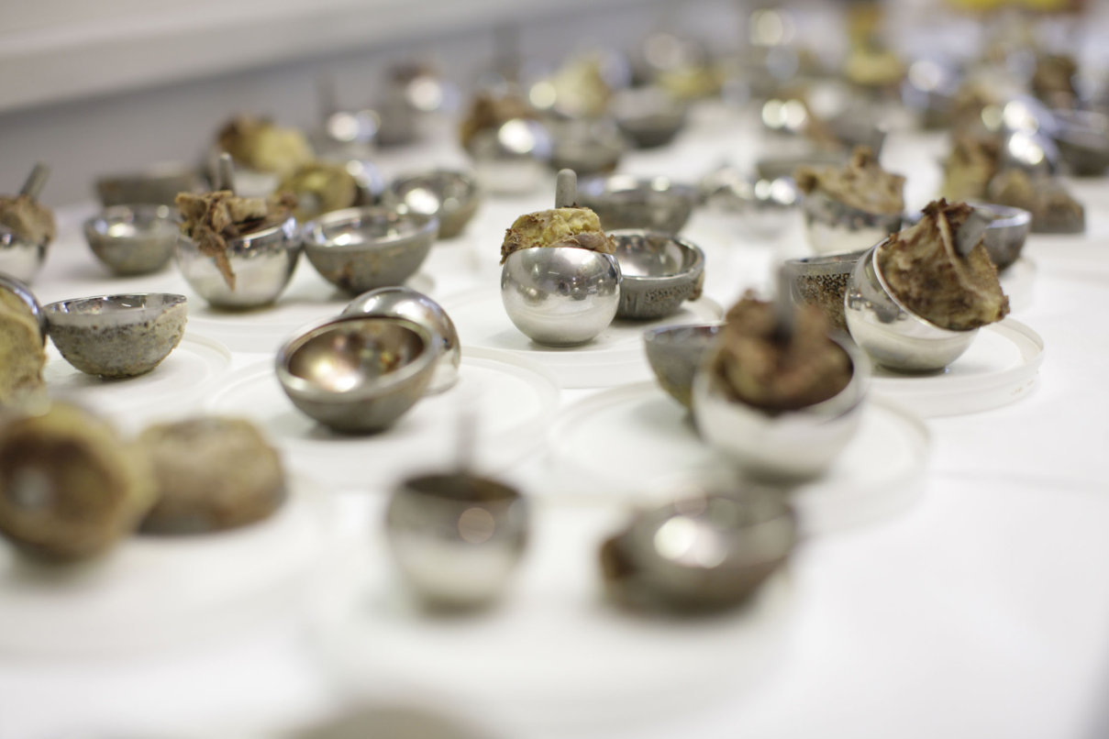
BSc Course 2012
Hip Implant Retrieval Centre
Alister Hart
Consultant Orthopaedic Surgeon & Senior Lecturer
Imperial College Healthcare NHS Trust
Charing Cross Hospital
An Imperial / UCL collaboration with John Skinner, RNOH

Slide 2
Talk structure
Hip implants in general
The current clinical problem
What can be done about it
Why is a retrieval centre needed?

Slide 3

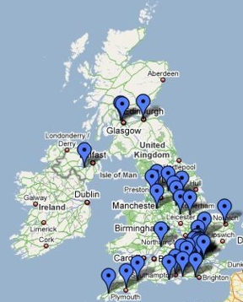
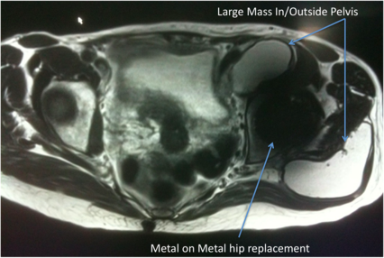






Our experience with failed MOM hips
The London Implant Retrieval Centre
>850 components
Painful MOM hip clinic
>200 MARS MRI scans; >100 lesions found
Hart, Skinner et al JBJS Br. 2009 Jun;91-B(6):738-44;
Sabah, Skinner, Hart et al Epub J Athroplasty 2010
Notes:
We have collected 280 MOM retrievals
Last week we received 6. We are now receinving hips from the US
We are funded by the British Orthopaedic Association with a contract that involves 8 Orthopaedic companies to allow them to use the data for regulatory obligations
The Imperial College standard academic contract includes protection of our statements, ie the companies are prevented from manipulating our conclusions

Slide 4
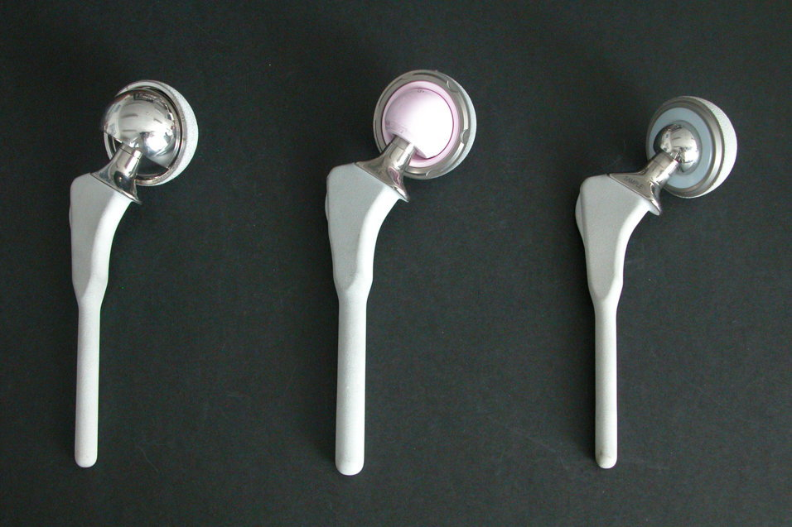
3 types of hip replacement

Slide 5
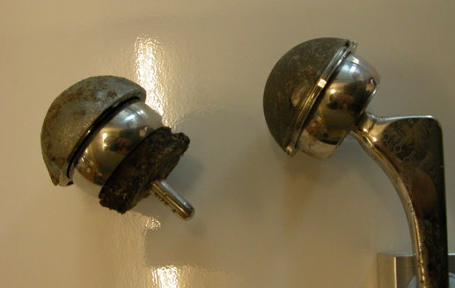
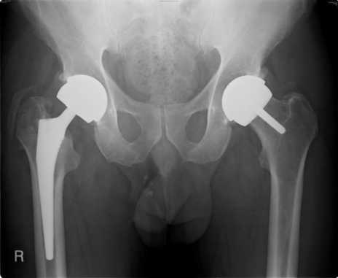
Metal-on-metal hip

Slide 6
History of metal-on-metal hip arthroplasty: 1
Early designs of hip arthroplasty used MOM bearings
1938, Phillip Wiles, Middlesex Hospital
Many different designs followed
Not used in large numbers

Slide 7
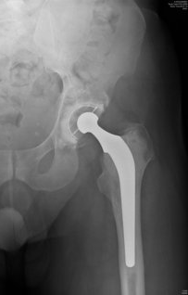
1960s: MOM and MOP were used
Mckee & Farrar
and others
Charnley’s MOP LFA
Charnley’s device won

Slide 8
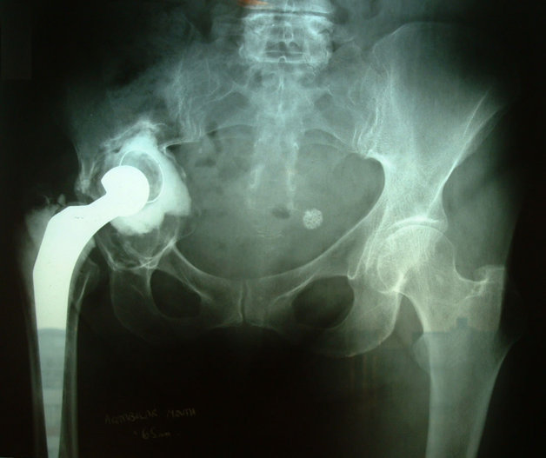
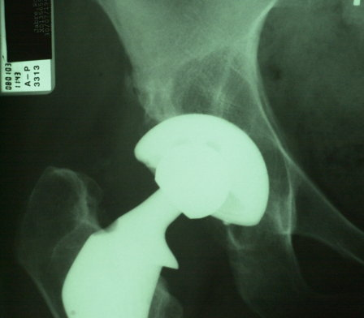
However:
Polyethylene debris causes osteolysis

Slide 9

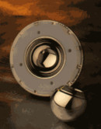
1996 to now
MOM hips an alternative to MOP to minimise osteolysis
Also allows large diameter hips
  reduces dislocation due to an increased jump distance
  enables resurfacing
Notes:
Last month, the Medicines and Health Regulatory Agency in the UK issued a medical device alert concerning the safety of metal on metal hips. This is a reflection of the high reported failure rates of MOM hip resurfacing and the growing concern over the incidence of painful periprosthetic lesions. These are shown in the MRI scan, and have been associated with increased wear and raised metal ions.
We know that there is a problem with metal on metal hip resurfacings.
But do these problems also exist in modular MOM total hip replacements?
When you consider that over 10’000 MOM hips are implanted annually in the UK, it is important to investigate why these hips are failing and if all types of hip are failing in the same way. One way in which we can investigate failure is by analysing failed hip joints.

Slide 10
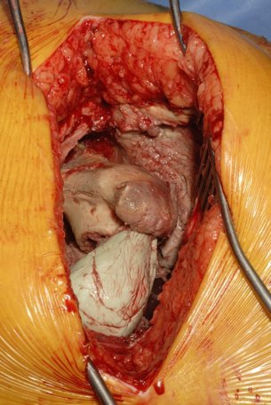
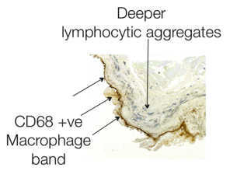
2008:
MOM Soft Tissue Inflammatory Reaction
MRI
At Operation
Histopathology
Inflammatory mass
15 cm of dead bone
& muscles dead
Metal-on-metal hip
Reported by:
Willert 1996
And then Campbell 2006
Pandit 2008, Toms 2008,
Hart2009, Sabah 2010
1 million MOM hips worldwide

Slide 11
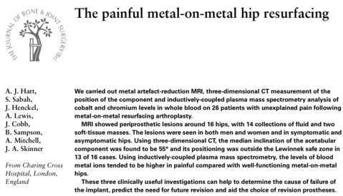
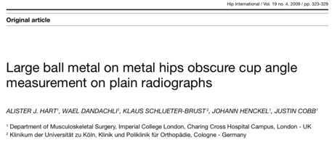
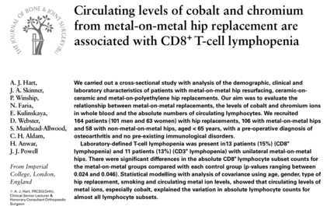
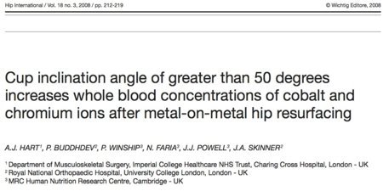
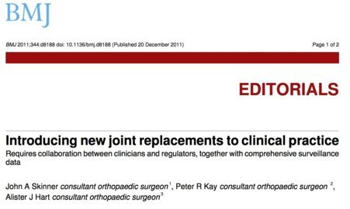
Some of our relevant papers for this talk

Slide 12
Why Do MOM Hips Fail?
Talk Plan
Joint registry data
Mechanistic studies
Factors
    Patient
    Implant
    Surgical

Slide 13
MOM hips: is it a big problem?
Not really if:
  most were not resurfacings
  We know how to avoid failure of resurfacings: good surgery
  Small diameter metasuls commonly used with good results
  Problems such as ALVAL are v rare
  Problems can be picked up through a blood test for high metal ion levels

Slide 14
Joint Registry Data
Do MOM Hips Have A High Failure Rate?
Need:
  Large dataset
  Longitudinal
  Numerator and Denominator known
  Considers confounders: age, implant type
Ie. A Joint Registry. UK NJR & Aus JR report from data from 2003.

Slide 15
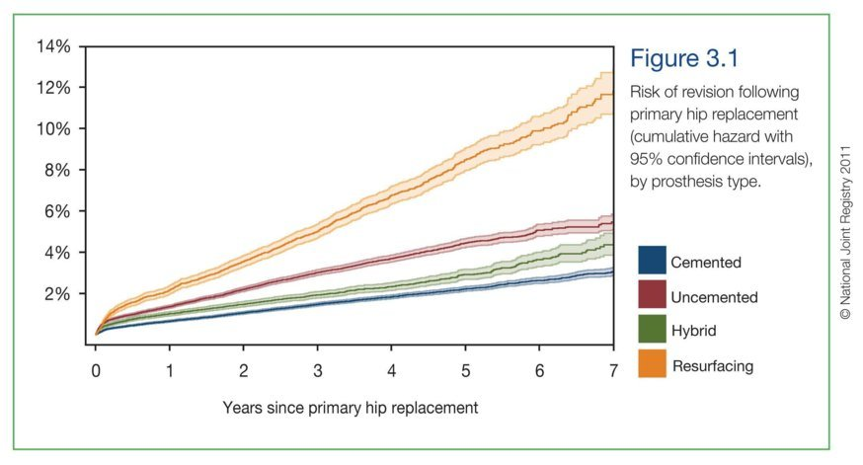
Resurfacing has a high failure rate

Slide 16
Old news
Learning curve:
  Femoral neck fracture
  Cup malalignment / poor seating due to difficult exposure
High risk patients and femoral failure:
  AVN
  Poor bone stock
Other:
  Neck thinning
  Effects of metal ions

Slide 17
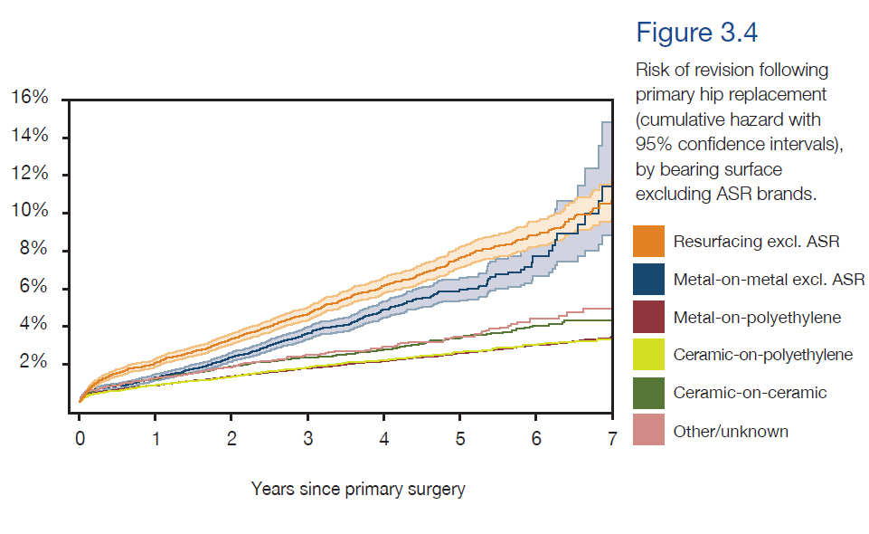
UK Joint Registry:
All MOM Hips Have A High Failure Rate

Slide 18
And, cause of failure is not properly understood

Slide 19
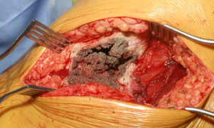
We need to know why they fail
1 million patients worldwide
100,000 have ASR (70,000 XL)
Failure rates of ASR XL by 6 years:
  50% Newcastle
  30% Belfast
  25% Cardiff
Failure rates of Stemmed BHR by 5 years:
  15% Southampton
Mode of failure can involve muscle destruction, not visible on radiograph

Slide 20
Literature supports a simple explanation:
High cup inclination, high wear, high metal ions
High cup
inclination
angle
Edge
loading
High
Wear
High
metal ions
ALVAL /
Pseudotumour
Failure
Morlock 2008
Kwon 2010
Langton 2010
Hart 2008
Langton 2008
De Haan 2008

Slide 21
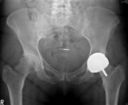
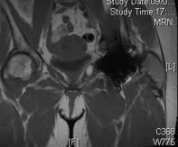
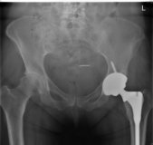
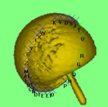
An example
52 yrs, female,
ASR, Over-reamed
High blood
metal ions
MARS MRI
Large mass
3 years
post revision
 | Patient | Median 88 well functioning MOM hips
Co (ppb) | 328 | 1.7
Cr (ppb) | 136 | 2.3
3D CT
Inc 70, ver 43
OHS 14/48
OHS 47/48

Slide 22
Do metal ions return to normal after revision?

Slide 23
Painful hips had double that of well functioning
& well functioning outliers were >7ppb

Slide 24
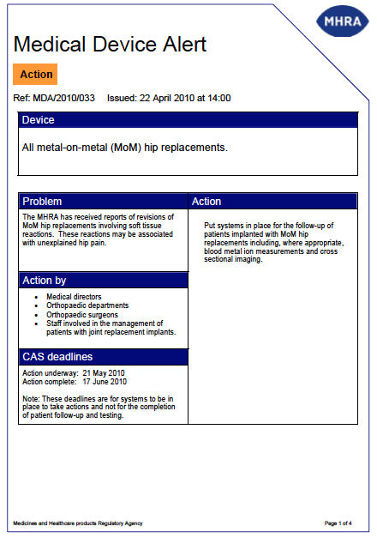
Hence, UK MHRA recommends measuring metal ions

Slide 25
7ppb cut-off level:
90% specificity but only 50% sensitivity
176 patients with a unilateral MOM hip
88 Cases
unexplained failures
88 Controls
well functioning
 | Failed | Well Functioning | Total
Co <=7 ppb | 45 | 79 | 125
Co >7 ppb | 43 | 9 | 51
Total | 88 | 88 | 176

Slide 26
If 7ppb cut-off level only detects 50% of failures, then lower the cut-off:
Cut-off (ppb) | Sensitivity (95% CI) | Specificity (95% CI)
4.83 | 63% (51-72%) | 85% (76-92%)
7.20 | 52% (41-63%) | 91% (82-96%)
9.58 | 44% (34-55%) | 95% (88-99%)
A lower cut-off results in more falsely positive diagnoses:
unecessary revisions will result

Slide 27
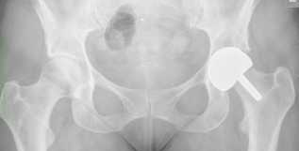
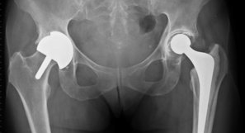
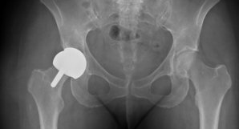
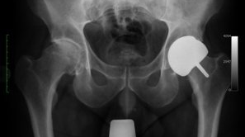
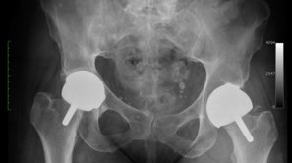
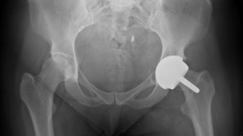
But, we do not need metal ions, we can just look at radiograph
70 deg
80 deg
73 deg
75 deg
80 deg
78 deg

Slide 28
And metal ions are related to cup position

Slide 29
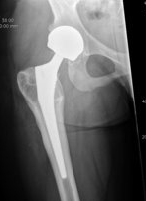
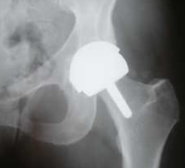
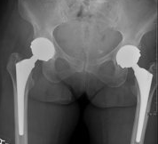
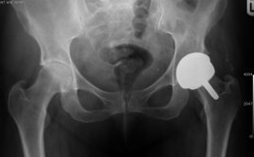
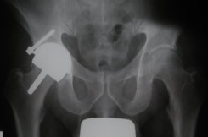
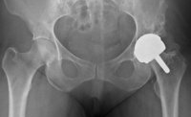
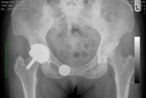
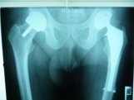
The most common findings:
Well positioned cups, non-infected & well fixed

Slide 30
But, the retrievals are highly worn?
Metal ions concordant with wear rate data:
50% are low wearing
50% have metal ions <7ppb

Slide 31
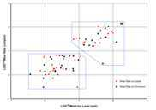
Evidence for susceptibility:
BHR failures: low & high material loss
In press for JBJS Am

Slide 32
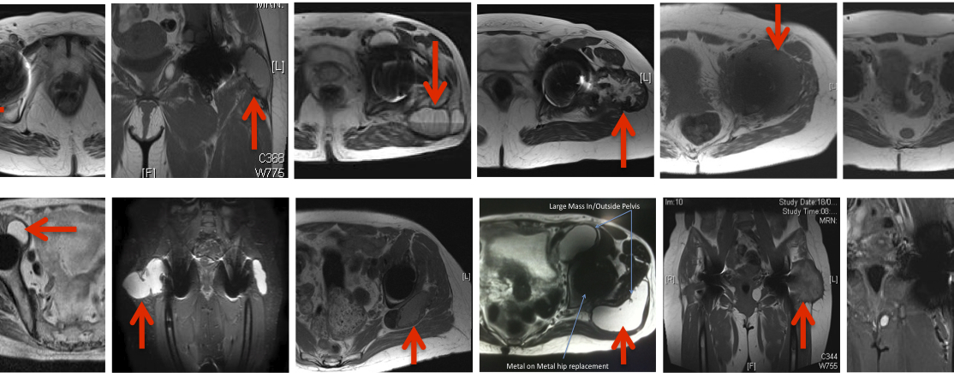
But, at least we can detect the tissue response even if metal ions low: can’t we?
And we know how to interpret them: don’t we?

Slide 33
MRI & CT study of unilateral MOM hips
Cases (n=30)
Painful and Revised
Or OHS < 30
Controls (n=28)
Well-functioning
Oxford hip score | 20 (10-31) | 46 (42 to 48)
Inclination angle (degrees) | 44 (36-52) | 45 (38-51)
Version angle (degrees) | 15 (8-21) | 20 (12-26)
In press for JBJSAm
Both groups had pseudotumours in 60% of patients
Notes:
The study was ethically approved
The design was case

Slide 34
Literature supports a simple explanation:
High cup inclination, high wear, high metal ions
But 50% have
low inclination
50% have
low wear
50% have low
metal ion levels
Pseudotumours are found in
60% of well functioning hips
High cup
inclination
angle
Edge
loading
High
Wear
High
metal ions
ALVAL /
Pseudotumour
Failure
Morlock 2008
Kwon 2010
Langton 2010
Hart 2008
Langton 2008
De Haan 2008
Can be correct for only a maximum
of 50% of patients

Slide 35
So why do MOM hips fail?
3 groups of factors
  Surgical posiitoning
  Implant
  Patient

Slide 36
Conclusions
Metal ions are a useful diagnostic test but not a screening test because of low sensitivity.
50% of failures may have been susceptible
Future:
  What proportion of patients are susceptible?
  How can we detect them?

