Slide 1
Pre-operative surgical planning of hip replacement: the 5 Ps
Alister Hart
Imperial College London

Slide 2
Surgical planning and positioning
Planning
Understanding the anatomy: the map
Which place do you want to put them
Achieving
Arriving at where you wanted to be

Slide 3
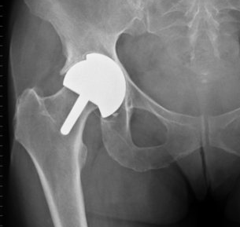
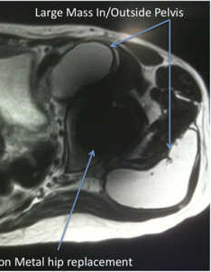
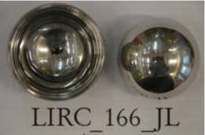
What determines how long a hip replacement will last
Surgeon related
Implant related
Patient related
Needs clinical and retrieval analysis

Slide 4
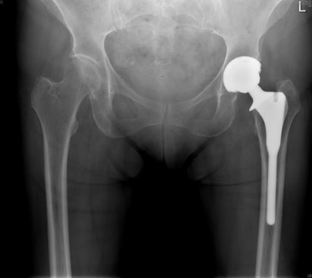
Component Orientation
What assessed?
  Cup: Inclination, Version
  Femur: Version, Neck-shaft angle, HFO, Length
What is optimal?
  One size fits all (Lewinnek’s box) vs custom fit
How assessed?
  Xr vs CT
  Standing / lying
  Pelvic position (tilt / roll)

Slide 5
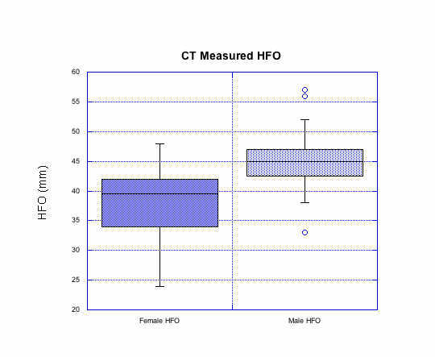
Offset: what is optimal?

Slide 6
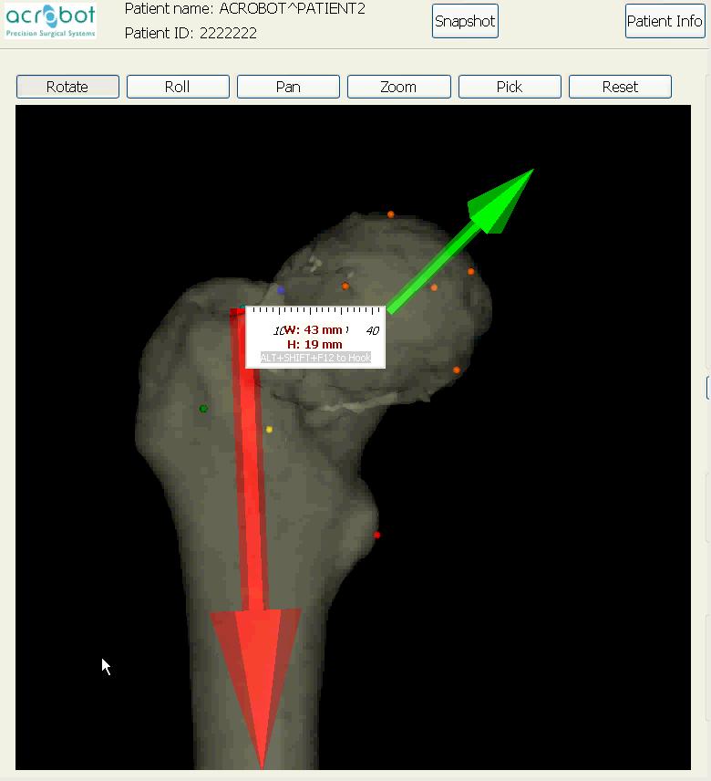
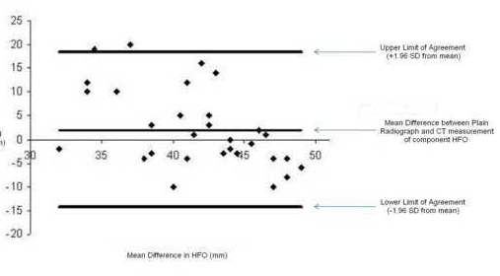
How do you measure offset?
3D CT vs Xray

Slide 7
What is the optimal Cup Version & Inclination?
One position fits all: 40 & 15
What is the normal anatomy?
4 x 3D CT studies
Lewinnek chose:
  40 deg inclination
  15 deg version
  10 deg error around each
 | Inc | Ver
Murtha | 48 – 67 | 8.5 - 33
Dandachli | 37 – 63 | 1 - 31
Vanden- bussche | 27 – 48 | 6 - 34
Humza | 34 - 62 | 5 - 40

Slide 8
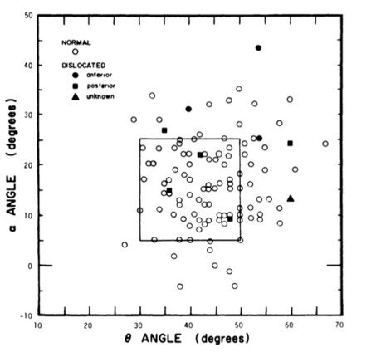
Cup angles: Lewinnek vs normal hips

Slide 9
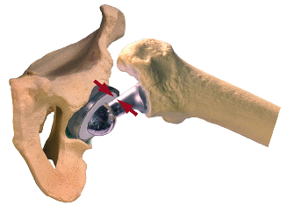
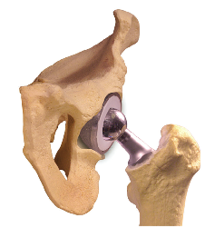
What is the optimal cup inclination and version
For Wear
For Range of Motion
30 deg of inclination
But …
Cup and femur relevant
50 deg inclination
Combined version

Slide 10
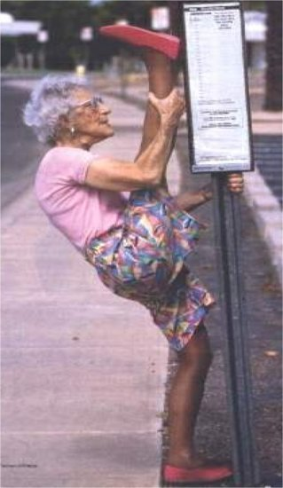
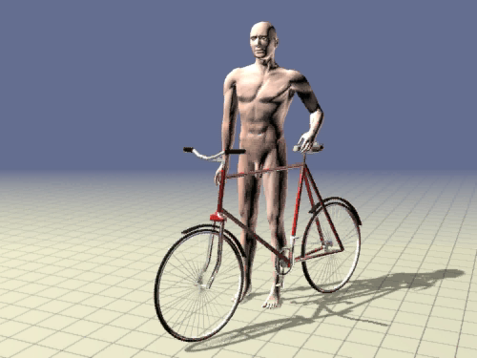
Impingement

Slide 11
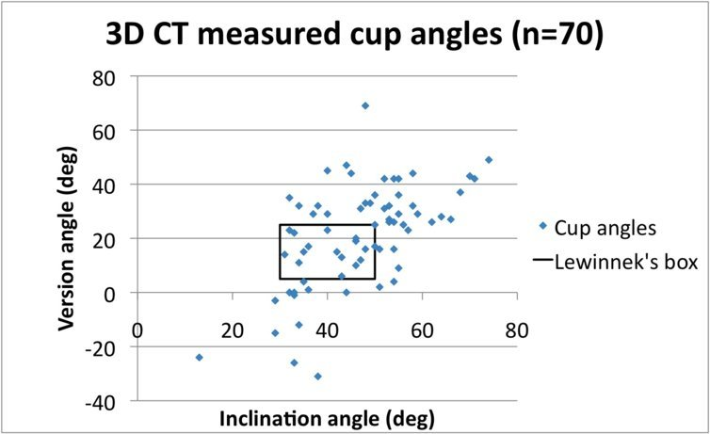




Spread of cup angles
69
degrees
-33
degrees

Slide 12
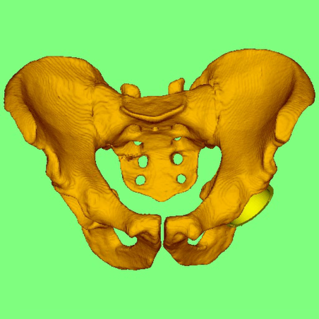
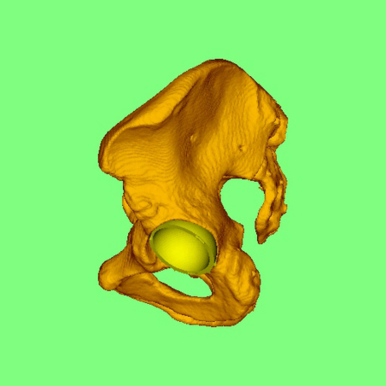
Tilting the pelvis alters the inclination and version angles

Slide 13
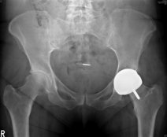
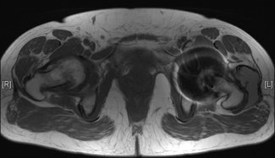
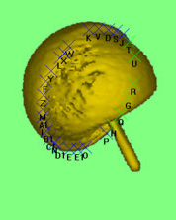
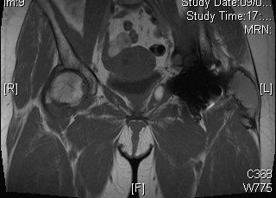
The painful triad:
Pain, high metal ions, mass on MRI
High blood
metal ions
MARS MRI
Large mass
3D CT
 | MMZ | Median 88 well functioning MOM hips
Co (ppb) | 328 | 1.7
Cr (ppb) | 136 | 2.3
3D CT
Inclination 70,
version 43
52 yrs, female
ASR june 2005
Jan 2009
Oxford hip score= 40/60

Slide 14
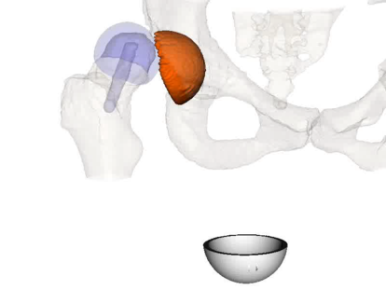
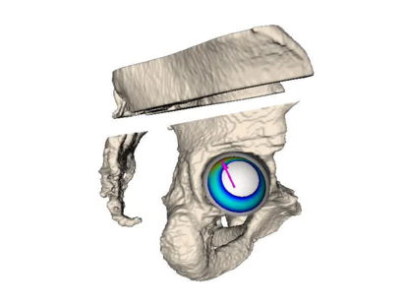
In vivo hip biomechanics

Slide 15
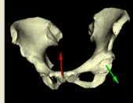

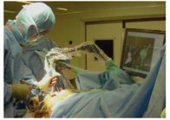
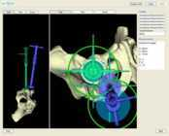

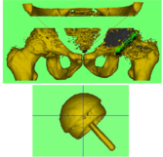
CT is the workhorse
3D CT planning of hip replacements (scanning takes 90 seconds). Low dose.
3D CT Computer “checkers” during the operation to confirm the implants are in the correct position
CT scanning with 3D computer analysis of the achieved result

Slide 16
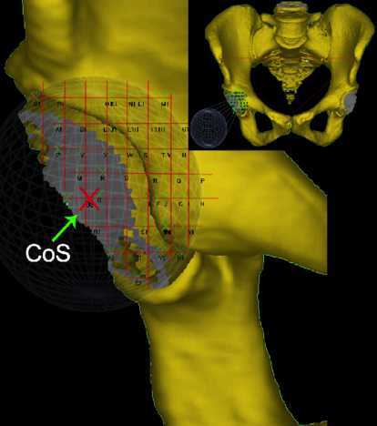
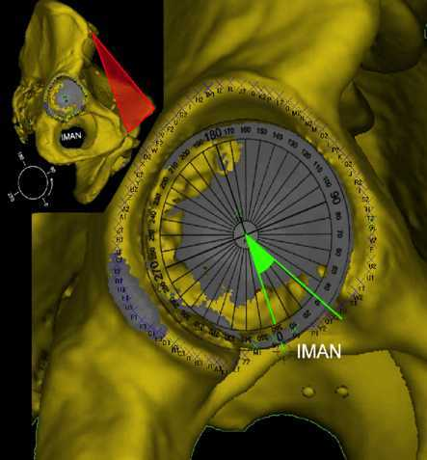
Mapping the acetabular margin
Centre of acetabular sphere
Points every 2° around the rim, 6pm on clock the named by the IMAN
(Vandenbussche et al 2008)
12
3
9
6

Slide 17
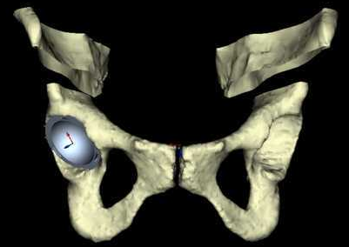
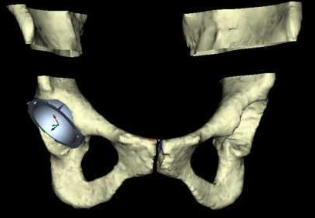
Using the map: where do you want to go?
Cup flush with psoas valley
Cup proud of psoas valley

Slide 18
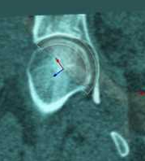
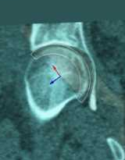
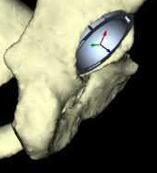
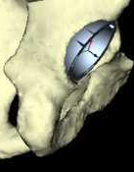
Effect of failure to bottom out
Bottomed out
Bottomed out
More posterior cup visible
Despite same orientation

Slide 19
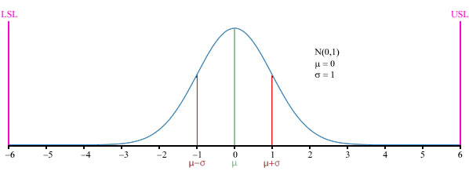
Manufacturing industry has quality control
Surgeons are semi-skilled fitters

Slide 20
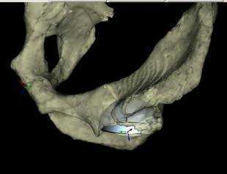
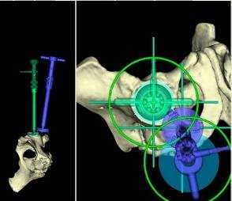
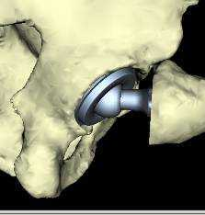
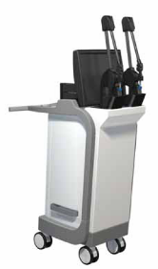
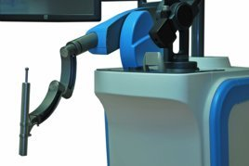
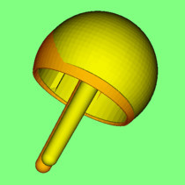
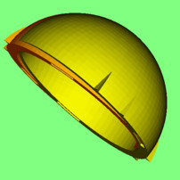
Imperial College Technology base
Virtual surgery
    For every high value arthroplasty
Computerised assistants
  active robots
    for complex tasks
  passive navigators
    for simpler ones
Validation
    Co-registered ct
    Discriminant function scores
    Metal ion levels

Slide 21
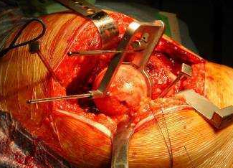
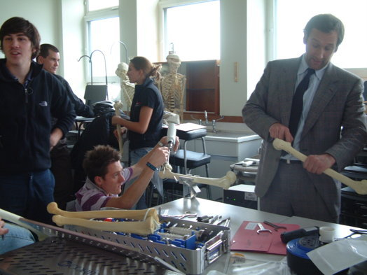
Conventional Station
Apply the jig (neck based in this study)
  Insert the guide wire
    down the planned trajectory
Guide wire entry point

Slide 22
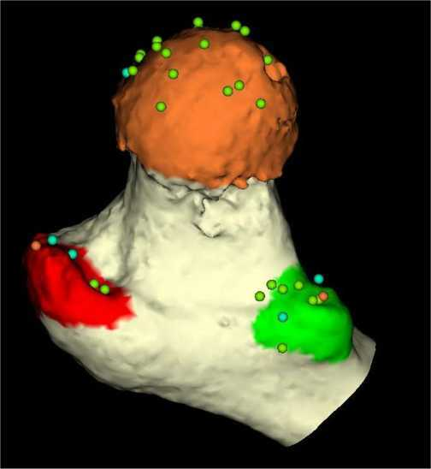
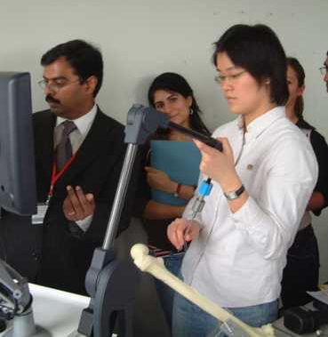
Planned Navigation
Task1 30 points
3 zones

Slide 23
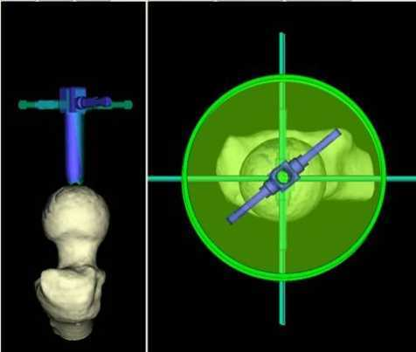
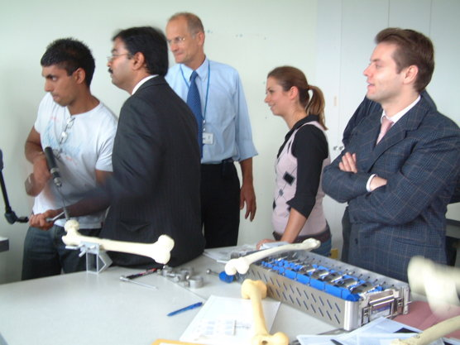
Planned navigation
Task 2 Navigation of wire
  according to plan

Slide 24
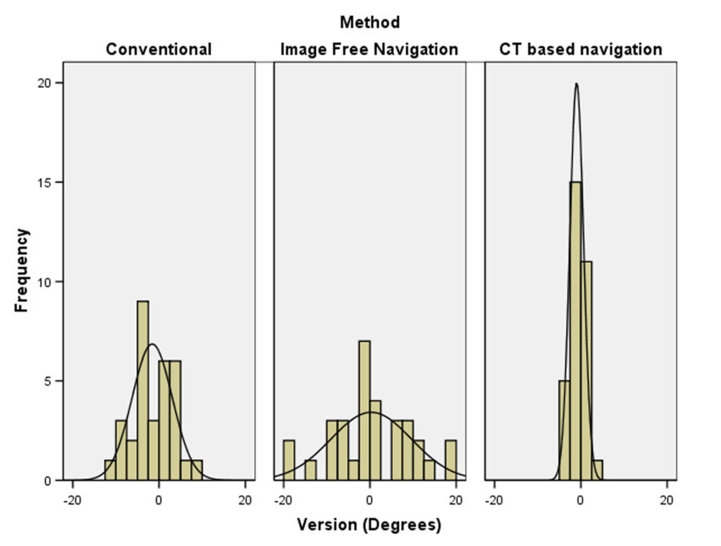
Angular error
conventional: 1 sd = 5 °
Image free: 9 °
CTbased: 2 °

Slide 25
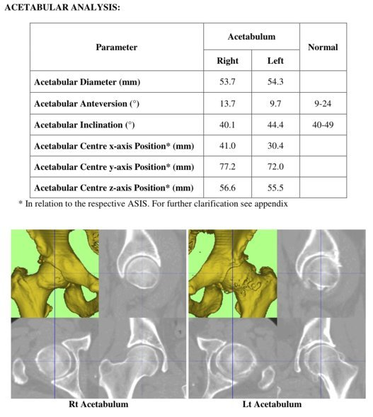
The map

Slide 26
What I do: the plan
Cup flush with psoas valley
Cup proud of psoas valley

Slide 27
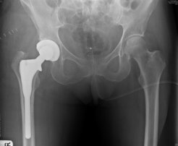





Achieving: CT based nagivation

Slide 28
Conclusions
Perfect Planning …
Requires understanding:
  The map (anatomy)
  The implant
  The plan
  Its execution

